Slide 1
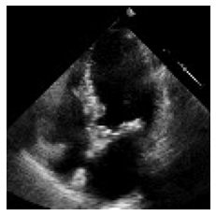
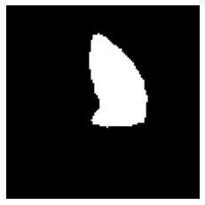
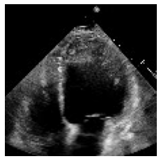
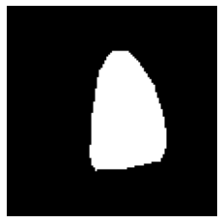
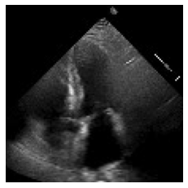

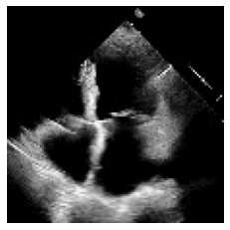

Design
Weakly supervision
Temporal subsampling
Two Layers Bi-directional LSTM
Estimated EFi
.
.
.
ESVi
EDVi.
.
.
U-Net
ResNet-18
BCE Loss
Smooth L1 Loss

