Slide 1

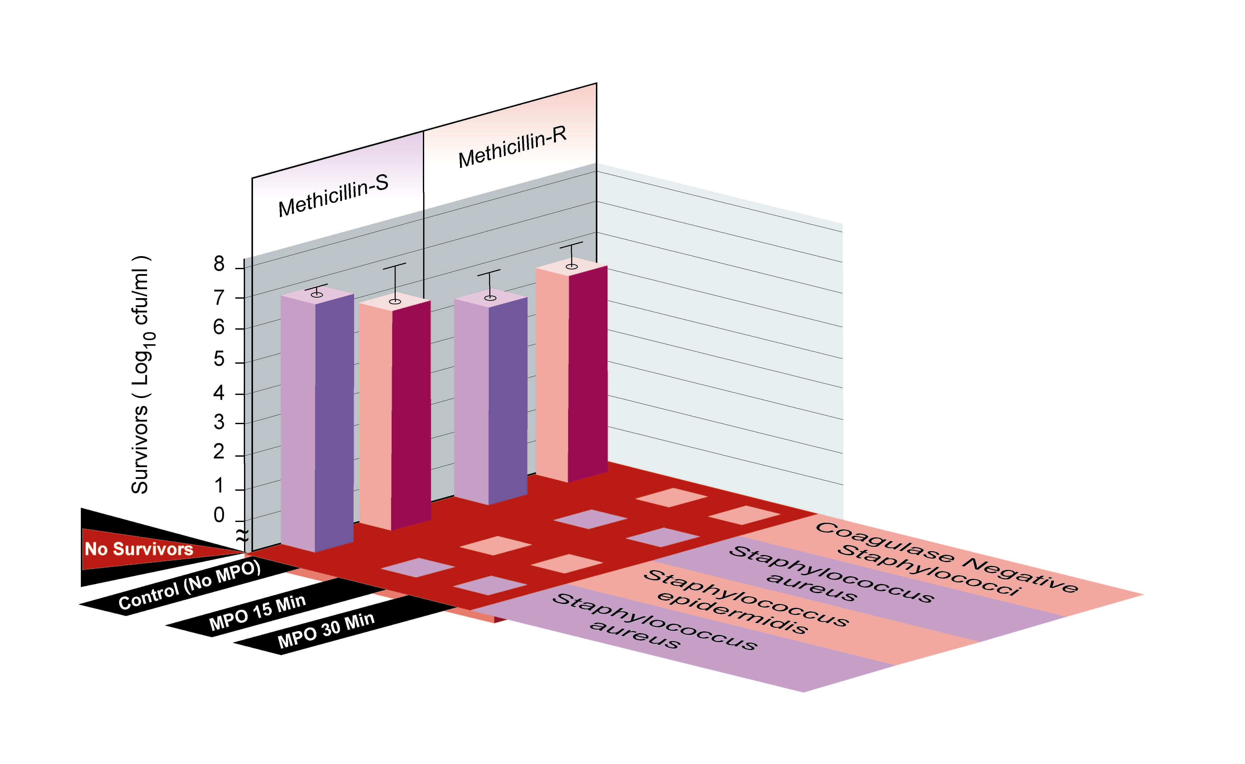
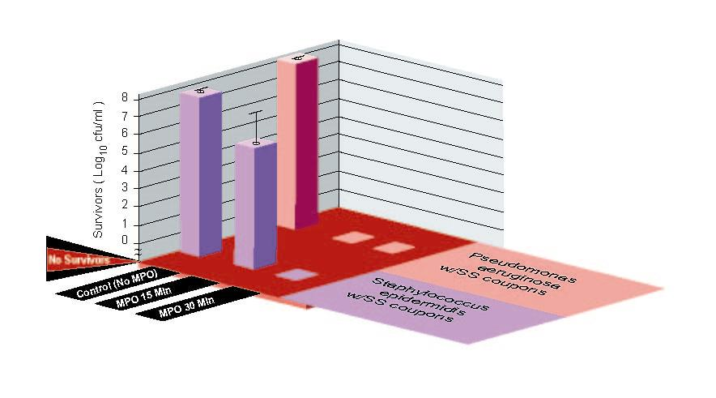
A New Approach For The Prevention And Treatment Of Staphylococcal Musculoskeletal Infection
Orthopaedic Research Society
49th Annual Meeting, February 2-5, 2003
New Orleans, LA USA
Poster #1062
+*Robins, A; **Woodhead, S
+University of Washington, Seattle, WA **Ricerca Biosciences, Concord, OH
Contact Information
www.exoxemis.com
Objectives
Staphylococcus aureus (SA) and the coagulase-negative staphylococci (CNS) are the most frequent cause of musculoskeletal infections. The clinical presentation can range from a fulminate infection with a virulent strain of SA to an indolent course with a relatively avirulent CNS. Staphylococcus epidermidis, a major biofilm former, can produce devastating results when associated with synthetic medical implants. A new formulated enzyme system using myeloperoxidase (MPO) has been developed (ExOxEmis, Inc., Little Rock, AR) in which the selective binding properties of MPO to pathogenic organisms are exploited. The objectives of this study were to determine (1) the in vitro efficacy of the MPO enzyme system against clinical strains of staphylococci, (2) the in vitro efficacy of the MPO enzyme system against biofilm producing S. epidermidis and Pseudomonas aeruginosa in the presence of surgical stainless steel (SS) material, and (3) in vivo safety of the MPO enzyme formulation in multiple animal species.
Results
The challenge control cultures of staphylococci ranged from 10⁶ to 10⁷ cfu/ml. Because of the short duration of testing, the 30-minute no MPO control reading was used as the challenge concentration. No survivors of both SA and CNS after 15 minutes of treatment were observed, demonstrating 100% kill with the MPO enzyme system regardless of the presence of resistance to methicillin (Figure 2).
The challenge control cultures in the presence of SS ranged from 10⁷ to 10⁸ cfu/ml. Complete kill of P. aeruginosa with the MPO enzyme system occurred within 15 minutes. A one to two log reduction of S. epidermidis was achieved at 15 minutes and complete kill within 30 minutes. When tested with a 25 μg/ml MPO formulation, complete kill of S. epidermidis was achieved within 15 minutes. The presence of SS did not interfere with the performance of the MPO enzyme system (Figure 3).
No lethality was seen in mice injected IP with the MPO enzyme system at 1000 mcg MPO/ml (Table 1). Single dose animal safety studies conducted to date with pure enzyme solution demonstrate no toxicity by oral route in rats, dermal route in rabbits, or pulmonary route in rats. MPO enzyme solutions were found to be non-irritating after ocular or dermal administration to rabbits, non-sensitizing in guinea pigs, non-genotoxic in mice.
Methods
Organisms. A total of 46 unique strains (43 clinical and 3 control strains) were tested for microbicidal activity including 12 methicillin susceptible SA (MSSA); 10 methicillin resistant SA (MRSA); 12 methicillin susceptible S. epidermidis, (MSSE); and 12 methicillin resistant, coagulase negative staphylococci, MRCNS (9 S. epidermidis, 2 S. haemolyticus, and 1 S. lugdunensis). Control strains included S. aureus ATCC 6538, S. aureus ATCC 33591, and S. epidermidis ATCC 12228. Two biofilm producing strains (S. epidermidis ATCC 35984 and P. aeruginosa ATCC 15442) were used for microbicidal testing in the presence of SS.
In vitro test design. The experimental design for microbicidal testing is shown in Figure 1. Bacterial suspensions were prepared from late log to early stationary phase growth to yield approximately 10⁶ to 10⁷ cfu/ml. Three tubes, each containing 1 ml of bacterial suspension were used to test each isolate. A challenge control culture with no MPO formulation was incubated for 30 minutes at 37C and quantitative cultures performed. Treatment cultures with MPO formulation were incubated for 15 and 30 minutes each at 37C, and the entire 1 ml, respectively, were plated onto isolation media. In the treated cultures, the concentration of MPO enzyme in the system was 6 mcg/ml. Excess catalase was added to each tube, including control, after each exposure time to stop further microbicidal activity. Log kill was measured by determining the number of survivors in the entire reaction mixture after treatment compared to the challenge control cultures (cfu/ml).
In vitro test with stainless steel coupons. Stainless steel type 316L, cut into 9.53 by 4.5 mm disks and buff polished (DePuy Orthopaedics, Inc., Warsaw, IN) and SS type 316L washers, 13.0 mm (Synthes, Monument, CO) were cleaned and sterilized by autoclaving prior to use. Sterile SS coupons were immersed in a direct colony suspension of approximately 10⁹ cfu/ml for 15 min. The inoculated SS coupons were then placed into the test vial and processed as described above. After treatment, the vials were vortexed for 10 sec and the entire 1 ml sample was plated for quantitative culture. An additional 4ml of Trypticase Soy Broth was added back to the reaction vials and incubated for residual growth at 24 and 48h.
In vivo safety studies. The safety of a more concentrated form of the MPO enzyme system used for the in vitro studies above was determined by intraperitoneally (IP) injecting a group of ten mice with 0.5 ml each of the MPO enzyme system at 1000 mcg/ml. Mice were observed for five days for gross changes and survival. Additionally, single dose safety studies with pure MPO enzyme solutions in several animal species by different administration routes were performed.
Table 1. Safety testing of the MPO enzyme formulation in mice
Animals
Test
MPO
Dose
Survivors
Tested
Article
Concentration
Volume
(No.)
(No.)
(
mcg/ml)
(ml)
10
Buffer
0
0.5
10
10
MPO
1000
0.5
10
Conclusions
The MPO enzyme system demonstrated both rapid action (less than or equal to 15 minutes) and complete microbicidal activity in vitro at a very low concentration of MPO in the formulation system.
Stainless steel did not interfere with the performance of the MPO enzyme system. Both biofilm producing strains of S. epidermidis and P. aeruginosa were killed within 30 minutes with no residual growth after 48 hours.
The mechanism of action of the MPO enzyme system and microbicidal activity is similar to that of the natural neutrophil host defense system which makes emergence of resistance, as seen with traditional synthetic antimicrobials, theoretically unlikely.
The MPO enzyme system is not only effective in vitro, but evidence indicates safety in animals tested to date for potential prophylactic and therapeutic applications against problematic microorganisms associated with musculoskeletal infections. The selectivity of MPO to bind to and kill pathogens suggests potentially minimal collateral damage to host cells.
www.exoxemis.com
Figure 1. Workflow Schematics for Microbicidal Testing
Isolate
pure
culture
Inoculate
Shake Flask
(50 ml tryptic soy)
Incubate
Shaker/Incubator
(5C 35C, 200 rpm)
Late log/early-
stationary phase
Aliquot 1 ml
microcentrifuge, resuspend
and dilute in buffer 1:10
Control: No MPO
(buffer + glucose + organism)
1ml
Treatment: MPO (6μg/ml)
(MPO formulation + organism)
30
min
15
min
30
min
Incubate 37°C Dry bath
10⁴
^{(100 mcl}
Stop treatment (add 100 mcg catalase)
10⁵
^{(100 mcl}
1 ml
1 ml
Perform quantitative cultures and determine Log kill
Figure 2. Microbicidal activity of MPO enzyme
system vs. staphylococci
Figure 3. Microbicidal activity of MPO enzyme
system vs. biofilm forming bacteria

