Slide 1
SKY130 77 K: card refit with the bias-only correction g v2, compared with the published 77 K card
Published 77 K card: all-device RRMS 0.2751, combined 0.2595
Method (starting card, held-out refit with g v2, LODO): all-device RRMS 0.0739, combined 0.0700
18 measured devices (8 nMOS, 10 pMOS); ngspice-41; BSIM4 state C; all rows DEV, method draft not frozen; 2026-10-27
RRMS: relative RMS current error of the paper (slide 2). Combined: mean of the nMOS and pMOS family means. LODO: leave-one-device-out. State C: BSIM4 A2 clamp written into the card (slide 2). g v2: learned bias-dependent current correction (slide 5). C0_refit: card refit without g (slide 4).

Slide 2
Data and metric: 18 devices, 11 curves each, strict paper RRMS
nMOS L x W (um) | scored curves | pMOS L x W (um) | scored curves
0.15 x 1.6 | 10 | 0.35 x 0.55 | 11
0.19 x 7 | 10 | 0.35 x 1.6 | 10
0.25 x 1.6 | 10 | 0.35 x 5 | 10
100 x 100 | 10 | 0.5 x 0.42 | 9
1 x 1.6 | 10 | 0.5 x 0.64 | 10
1 x 3 | 10 | 2 x 5 | 9
20 x 0.64 | 10 | 4 x 7 | 9
8 x 1.6 | 10 | 8 x 0.84 | 9
 |  | 8 x 1.6 | 9
 |  | 8 x 5 | 9
Devices: SkyWater SKY130 nfet_01v8_lvt and pfet_01v8_lvt, measured at 77 K (data of the paper).
Curves per device: Id-Vg at |Vds| = 0.01, 0.37, 0.74, 1.11, 1.48, 1.85 V; Id-Vd at |Vgs| = 0.37, 0.74, 1.11, 1.48, 1.85 V.
Scored curves: frozen to the published card's inclusion set (9-11 per device); 25,086 scored points in total.
All-device RRMS: mean over the 18 devices. Combined RRMS: (nMOS mean + pMOS mean) / 2.
Published card: all-device 0.2751, combined 0.2595 (nMOS 0.1198, pMOS 0.3992).
Simulator: ngspice-41, arm64 build. State C: a2 > 1 written as a2 = 1, a1 = 0; a2 < 0.01 as 0.01 (ngspice-41 clamps A2 only in the first analysis per model).
n_c: points of curve c after the trim (points below the device current floor at the start of the sweep removed); den_c: mean |I_meas| of those points.

Slide 3
Pipeline: published card to deployed element (one LODO fold k)
C0_refit (control)
TRF refit of device k, g = 0
max_nfev 400
RRMS 0.1051 / 0.0984
Published 77 K card
(paper)
RRMS 0.2751 / 0.2595
Starting card, device k
43 parameters, direct NGSpice fit
CMA-ES + TRF, 3 rounds + FD
44,219 calls / device
RRMS 0.1109 / 0.1049
Method: refit with g v2
TRF refit of device k,
I_card x exp(g) in residuals, g frozen
RRMS 0.0739 / 0.0700
Deployed element
card + channel replica
+ OSDI module (Verilog-A)
element deck RRMS
0.0739 / 0.0700
g v2, fold k
trained on the starting-card records
of the 17 other devices;
penalty weight lambda by nested
inner CV (slide 6)
RRMS values: all-device / combined, held-out device k, 18 folds. Starting cards were fitted per device before the LODO folds (device k's own measured curves).
Starting-card calls: rounds 1-3 and FD polish (44,219, I22-1 cost.json); the 7-parameter stage that initializes round 1 adds 3,283 calls / device.
TRF: scipy least_squares(method='trf'), bounded local coordinates. FD: forward-difference Jacobian.

Slide 4
Starting cards and C0_refit: stages, budget, RRMS
Stage | Parameters | Optimizer | NGSpice calls / device | All-device | Combined
Published 77 K card | - | - | - | 0.2751 | 0.2595
7 parameters | 7 | CMA-ES 3000 evals, then TRF max_nfev 400 | 3,283 | 0.1676 | 0.1575
43 p., round 1 | 43 | CMA-ES 8000 evals, then TRF max_nfev 600 | 21,213 | 0.1201 | 0.1126
43 p., round 2 | 43 | CMA-ES 8000 evals, then TRF max_nfev 600 | 14,287 | 0.1094 | 0.1024
43 p., round 3 | 43 | CMA-ES 8000 evals, then TRF max_nfev 600 | 8,405 | 0.1049 | 0.0981
round 3 + FD = starting card | 43 | TRF max_nfev 400, IRLS 2, diff_step 0.01 | 314 | 0.1109 | 0.1049
C0_refit (held-out, LODO) | 37-40 active of 43 | TRF max_nfev 400, IRLS 2, diff_step 0.01 | 315.7 (166-404) | 0.1051 | 0.0984
Method refit (g v2 in loop) | 37-40 active of 43 | same as C0_refit | 310.7 | 0.0739 | 0.0700
43 parameters (115 candidates, one-at-a-time sensitivity screen): vsat, ua, ub, rdsw, prwg, wr, u0, a0, a2, ags, b0, b1, pclm, pdiblc2, drout, delta, alpha0, beta0, toxe, toxm, xj, ndep, nsd, dwg, rsh, voff, nfactor, cit, cdscd, eta0, dsub, vth0, k1, k2, k3, dvt0, dvt1, dvt1w, w0, k3b, vfb, lpe0, lpeb.
Box: local coordinates u in [-1, 1]; parameters with value 0 or below the box activity test are held fixed, so 37-40 are active per device.
Starting-card stages are CMA-ES (sigma0 0.3, seed 20261015) then TRF on the NGSpice RRMS objective; the round-3 + FD card is the starting card of every later arm.

Slide 5
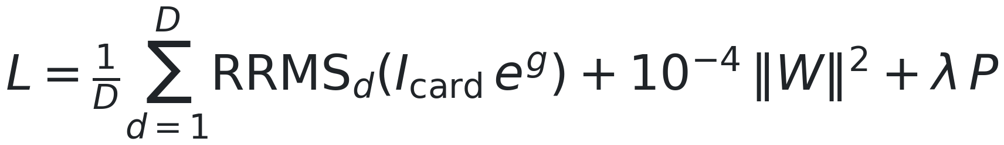
Correction g v2: inputs, network, loss
Item | Value
I_ch | channel current of a replica of the card instance
EPS | 0.01 V (smooth |Vds|)
VDD (input scale) | 1.85 V
s, a, b, m | polarity sign; s Vgs; s Vgd; smooth |Vds|
x1, x2 | unchanged when drain and source are exchanged
h_j network | 3-16-16-1, tanh, last layer zero-initialized
ensemble | 5 members, seeds 0-4; g = member mean
optimizer | Adam, lr 3e-3, 2000 full-batch steps
training data | starting-card records of the 17 training devices (cards fixed)
P grid | 25 mV, 75 x 75, 0-1.85 V, forward quadrant, I_card > 1e-9 A
u_g, u_d | s Vgs, s Vds; gm, gds of the card by central differences
lambda | penalty weight (V); grid {0, 1, 2, 5, 10} V, slide 6
D, W | number of training devices; weight matrices
P | mean hinge on negative gm / I and gds / I of I_card exp(g) (1/V)

Slide 6
Penalty weight lambda: nested inner cross-validation per fold
lambda (V) | 0 | 1 | 2 | 5 | 10 | selected
folds with lambda* = value | 1 | 10 | 6 | 0 | 1 | 18
full-data inner score (mean ln RRMS) | -2.8607 | -2.8915 | -2.8829 | -2.8608 | -2.8739 | lambda* 1 V
LODO all-device RRMS, fixed lambda (post hoc) | 0.0736 | 0.0731 | 0.0726 | 0.0734 | 0.0772 | 0.0739
LODO combined RRMS, fixed lambda (post hoc) | 0.0696 | 0.0692 | 0.0687 | 0.0696 | 0.0732 | 0.0700
Per outer fold k: the 17 training devices are sorted (nMOS first, then tag) and split into 3 inner folds (device i -> inner fold i mod 3).
Per inner fold and lambda: one member (seed 0) trained on the other 2 inner folds; inner held-out devices refit with g frozen (outer refit settings).
Inner score: mean ln RRMS over the inner held-out devices. lambda* = argmin; ties within 1e-12 go to the larger lambda. Device k is not used.
Full-data lambda* = 1 V: the same selection over all 18 devices; it defines the module of the deployment checks (slide 17), not the LODO rows.
Fixed-lambda rows are reported after the fact; they did not enter the selection.

Slide 7
Evaluation protocol: leave-one-device-out (LODO), 18 folds
Stage | Uses data of held-out device k | Detail
Starting card of k | yes | direct NGSpice fit to k's measured curves, before the folds
g v2 training (fold k) | no | starting-card records of the 17 training devices
Input standardization, penalty grid | no | training devices only
lambda selection (fold k) | no | inner CV over the 17 training devices
Held-out refit of k | yes | k's measured curves, g frozen; max_nfev 400
Score of k | yes | fresh NGSpice run of the kept card x exp(g); frozen inclusion set
Full-data lambda* and module | yes | deployment checks only (slide 17)
Dataset gate S3_D (apply g or not) | yes | uses all DEV records incl. k (I19-1); sky130: apply
Method design (inputs, EPS, penalty, grid) | yes | chosen on these 18 devices since I3-2 (DEV)
Held-out device k contributes: its own starting card, its measured curves to its refit, and its score.
Held-out device k does not contribute: g, its input scaling, its penalty, or the lambda of fold k.
The 6 former REAL_TEST sky130 devices were opened on 2026-10-21 by user decision; no locked sky130 TEST exists.

Slide 8
Results: all 18 devices, LODO, state C
Card / arm | Circuit element | All-device RRMS | Combined RRMS | GMR(g v2, row) [95% CI] | NGSpice calls / device
Published 77 K card (paper) | card | 0.2751 | 0.2595 | 0.249 [0.205, 0.305] | -
Paper per-device cards, 7 parameters | card | 0.2284 | 0.2135 | 0.332 [0.273, 0.406] | -
Paper per-device cards, 43 parameters | card | 0.2038 | 0.1905 | 0.373 [0.307, 0.453] | -
Starting card (43 parameters) | card | 0.1109 | 0.1049 | 0.645 [0.536, 0.770] | 44,219
C0_refit (refit, g = 0) | card | 0.1051 | 0.0984 | 0.743 [0.654, 0.855] | +315.7
T1_inloop (refit, one gain per curve) | no: defined only at measured biases | 0.0753 | 0.0713 | 0.957 [0.906, 1.006] | +321.5
M_bias v1 (refit, g v1) | no: not deployable (I15-1) | 0.0735 | 0.0695 | 0.997 [0.962, 1.027] | +325.7
Selected g v2 (method), Python rows | deployable with restrictions (I17-1) | 0.0739 | 0.0700 | 1 | +310.7 (+27,880 selection, estimate)
Selected g v2, NGSpice element deck | same element | 0.0739 | 0.0700 | 0.9997 | as above
M_bias v1 has a lower RRMS than selected g v2 (0.0735 vs 0.0739; GMR(g v2, v1) 0.997 [0.962, 1.027]), but v1 is not deployable as a circuit element: Verilog-A g not d/s symmetric; terminal-exchange asymmetry > 1e-3; Q2 derivative agreement; Q2 gm sign change in strong inversion (I15-1 core failures).
GMR(g v2, row): paired geometric-mean ratio of g v2 to the row over the 18 devices (slide 9); 95% percentile bootstrap CI, 10,000 resamples, seed 0. Below 1: g v2 has the lower RRMS.
Paper per-device cards: reference_scores.json paper_seven / paper_full43, scored with the same metric.

Slide 9
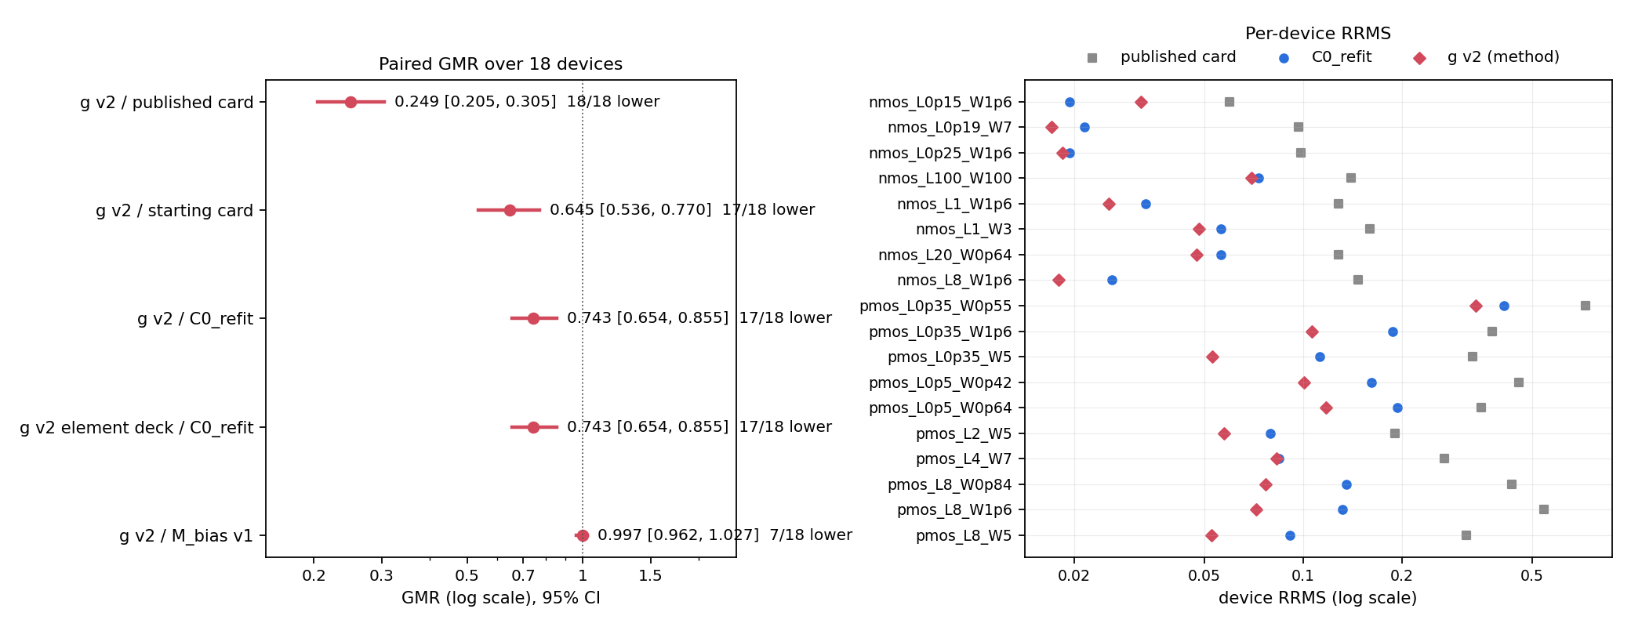
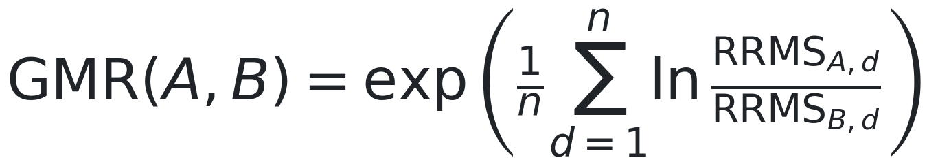
Paired comparison: GMR of g v2 against the published card and controls
g v2 vs published card: GMR 0.249 [0.205, 0.305], 18/18 devices lower (computed here from the stored rows). g v2 vs C0_refit: stored in I15-2.

Slide 10
Per-device RRMS: published card, starting card, C0_refit, g v2
Device | Curves | lambda* (V) | Published card | Starting card | C0_refit | g v2 (Python) | g v2 (element deck) | g v2 / C0_refit | g v2 / published
nmos_L0p15_W1p6 | 10 | 1 | 0.0595 | 0.0193 | 0.0193 | 0.0320 | 0.0320 | 1.654 | 0.538
nmos_L0p19_W7 | 10 | 1 | 0.0967 | 0.0699 | 0.0215 | 0.0170 | 0.0170 | 0.791 | 0.176
nmos_L0p25_W1p6 | 10 | 1 | 0.0983 | 0.0301 | 0.0194 | 0.0184 | 0.0184 | 0.950 | 0.187
nmos_L100_W100 | 10 | 1 | 0.1403 | 0.0732 | 0.0731 | 0.0697 | 0.0695 | 0.954 | 0.497
nmos_L1_W1p6 | 10 | 1 | 0.1283 | 0.0331 | 0.0331 | 0.0256 | 0.0256 | 0.773 | 0.199
nmos_L1_W3 | 10 | 2 | 0.1599 | 0.0561 | 0.0561 | 0.0481 | 0.0481 | 0.857 | 0.301
nmos_L20_W0p64 | 10 | 1 | 0.1283 | 0.0797 | 0.0561 | 0.0473 | 0.0471 | 0.843 | 0.369
nmos_L8_W1p6 | 10 | 1 | 0.1474 | 0.0463 | 0.0260 | 0.0180 | 0.0180 | 0.691 | 0.122
pmos_L0p35_W0p55 | 11 | 1 | 0.7270 | 0.4090 | 0.4089 | 0.3356 | 0.3356 | 0.821 | 0.462
pmos_L0p35_W1p6 | 10 | 1 | 0.3776 | 0.1876 | 0.1876 | 0.1062 | 0.1063 | 0.566 | 0.281
pmos_L0p35_W5 | 10 | 1 | 0.3291 | 0.1122 | 0.1122 | 0.0527 | 0.0527 | 0.470 | 0.160
pmos_L0p5_W0p42 | 9 | 2 | 0.4560 | 0.1617 | 0.1615 | 0.1004 | 0.1004 | 0.622 | 0.220
pmos_L0p5_W0p64 | 10 | 2 | 0.3498 | 0.1943 | 0.1942 | 0.1176 | 0.1176 | 0.605 | 0.336
pmos_L2_W5 | 9 | 2 | 0.1907 | 0.0796 | 0.0796 | 0.0574 | 0.0574 | 0.721 | 0.301
pmos_L4_W7 | 9 | 0 | 0.2702 | 0.0849 | 0.0844 | 0.0832 | 0.0832 | 0.985 | 0.308
pmos_L8_W0p84 | 9 | 2 | 0.4340 | 0.1352 | 0.1352 | 0.0767 | 0.0767 | 0.568 | 0.177
pmos_L8_W1p6 | 9 | 2 | 0.5433 | 0.1322 | 0.1321 | 0.0721 | 0.0721 | 0.545 | 0.133
pmos_L8_W5 | 9 | 10 | 0.3146 | 0.0914 | 0.0914 | 0.0526 | 0.0526 | 0.575 | 0.167
All-device mean |  |  | 0.2751 | 0.1109 | 0.1051 | 0.0739 | 0.0739
Combined |  |  | 0.2595 | 0.1049 | 0.0984 | 0.0700 | 0.0700

Slide 11
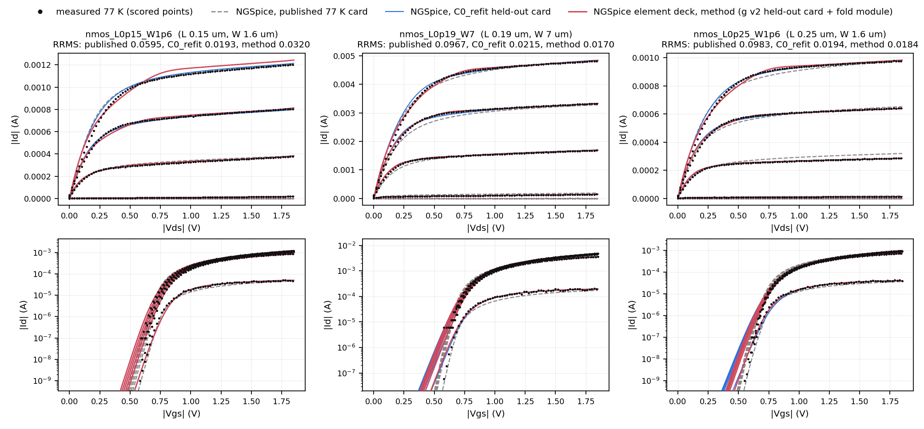
I-V, held-out devices 1-3 of 18: nmos_L0p15_W1p6, nmos_L0p19_W7, nmos_L0p25_W1p6
All curves are NGSpice runs (ngspice-41 OSDI build, state C), re-simulated by this script. Method: g v2 held-out card + fold OSDI module in the element deck; RRMS equal to the stored I17-1 element-deck rows (difference 0) and within 2.0e-04 of the I15-2 Python rows. Faded: curves outside the scored set. Top: Id-Vd; bottom: Id-Vg, log scale.

Slide 12
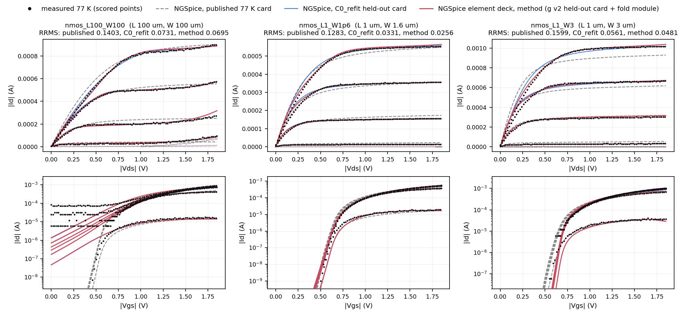
I-V, held-out devices 4-6 of 18: nmos_L100_W100, nmos_L1_W1p6, nmos_L1_W3
All curves are NGSpice runs (ngspice-41 OSDI build, state C), re-simulated by this script. Method: g v2 held-out card + fold OSDI module in the element deck; RRMS equal to the stored I17-1 element-deck rows (difference 0) and within 2.0e-04 of the I15-2 Python rows. Faded: curves outside the scored set. Top: Id-Vd; bottom: Id-Vg, log scale.

Slide 13
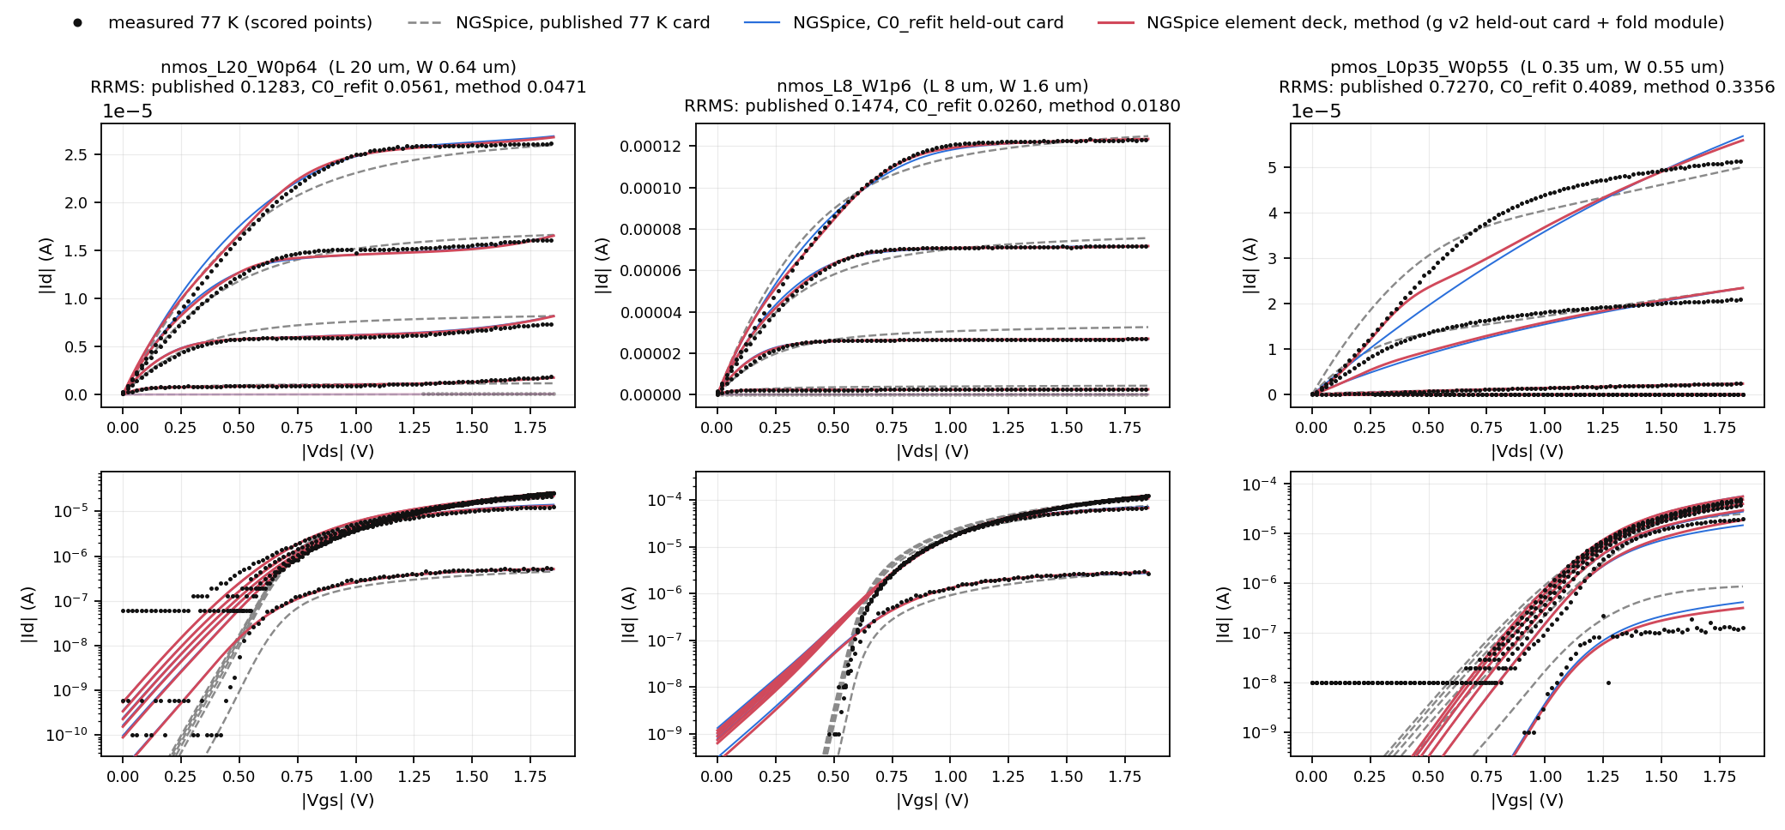
I-V, held-out devices 7-9 of 18: nmos_L20_W0p64, nmos_L8_W1p6, pmos_L0p35_W0p55
All curves are NGSpice runs (ngspice-41 OSDI build, state C), re-simulated by this script. Method: g v2 held-out card + fold OSDI module in the element deck; RRMS equal to the stored I17-1 element-deck rows (difference 0) and within 2.0e-04 of the I15-2 Python rows. Faded: curves outside the scored set. Top: Id-Vd; bottom: Id-Vg, log scale.

Slide 14
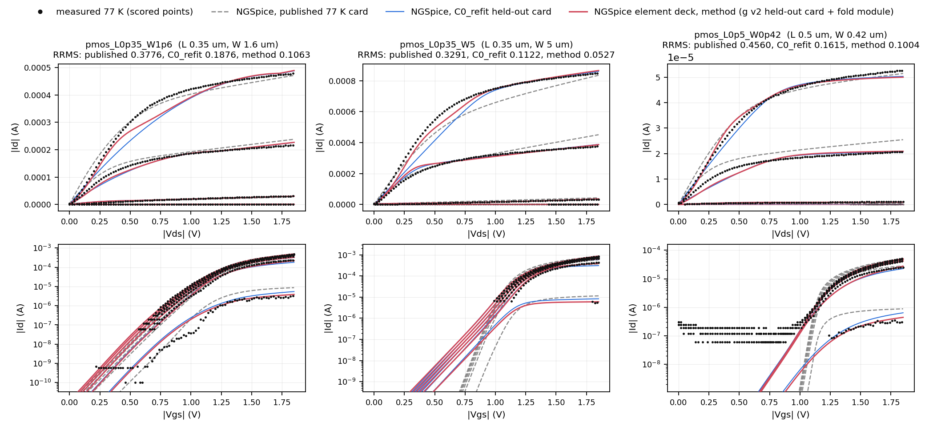
I-V, held-out devices 10-12 of 18: pmos_L0p35_W1p6, pmos_L0p35_W5, pmos_L0p5_W0p42
All curves are NGSpice runs (ngspice-41 OSDI build, state C), re-simulated by this script. Method: g v2 held-out card + fold OSDI module in the element deck; RRMS equal to the stored I17-1 element-deck rows (difference 0) and within 2.0e-04 of the I15-2 Python rows. Faded: curves outside the scored set. Top: Id-Vd; bottom: Id-Vg, log scale.

Slide 15
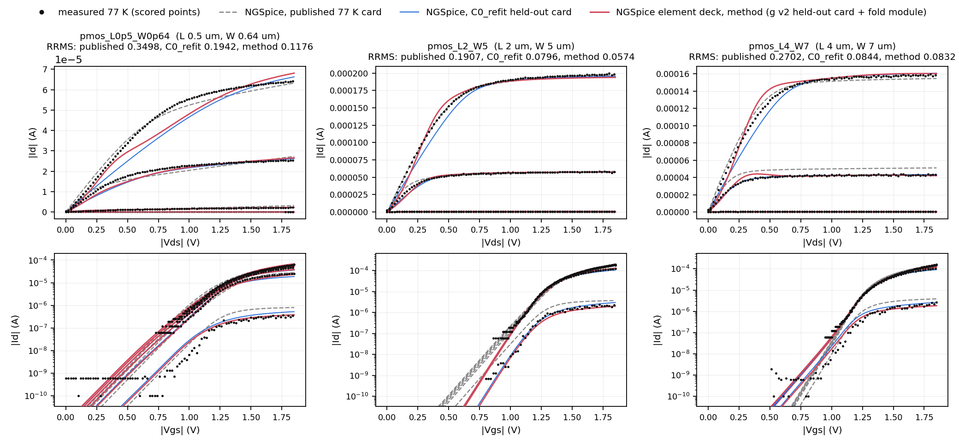
I-V, held-out devices 13-15 of 18: pmos_L0p5_W0p64, pmos_L2_W5, pmos_L4_W7
All curves are NGSpice runs (ngspice-41 OSDI build, state C), re-simulated by this script. Method: g v2 held-out card + fold OSDI module in the element deck; RRMS equal to the stored I17-1 element-deck rows (difference 0) and within 2.0e-04 of the I15-2 Python rows. Faded: curves outside the scored set. Top: Id-Vd; bottom: Id-Vg, log scale.

Slide 16
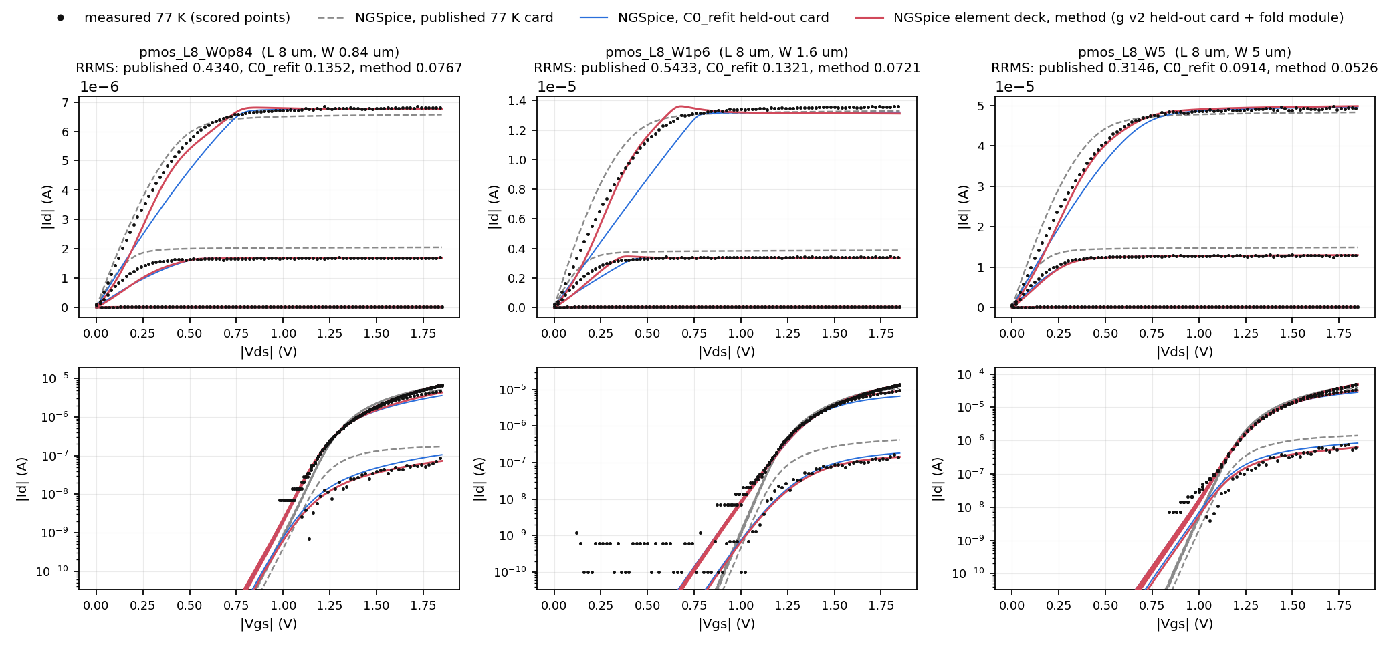
I-V, held-out devices 16-18 of 18: pmos_L8_W0p84, pmos_L8_W1p6, pmos_L8_W5
All curves are NGSpice runs (ngspice-41 OSDI build, state C), re-simulated by this script. Method: g v2 held-out card + fold OSDI module in the element deck; RRMS equal to the stored I17-1 element-deck rows (difference 0) and within 2.0e-04 of the I15-2 Python rows. Faded: curves outside the scored set. Top: Id-Vd; bottom: Id-Vg, log scale.

Slide 17
Deployment checks of the g v2 element (I17-1, full-data lambda* 1 V)
Check | Type | Value | Threshold | Result
Q1 equivalence, tight tolerance (points violating) | core | 0 | 0 | pass
Q1 convergence messages / non-finite / failed runs | core | 0 | 0 | pass
Q1 |I(Vds = 0)|, tight tolerance (A) | core | 4.87e-17 | <= 1e-12 | pass
Verilog-A g vs Python g | core | 2.8e-16 | <= 1e-09 | pass
Verilog-A g, exchanged vs forward terminals | core | 1.7e-16 | <= 1e-12 | pass
terminal-exchange asymmetry |d ln I| | core | 2.2e-05 | <= 1e-03 | pass
Q2 gm / gds vs element identity (AC, tight) | core | 1.1e-05 | <= 1e-03 | pass
Q2 capacitances vs card | core | 3.3e-14 | <= 1e-03 | pass
gm sign change in strong inversion (curves) | core | 0 of 54 | 0 | pass
Q3 circuits failing only with the element | core | 0 | 0 | pass
default-tolerance relative difference, |I| > 1 nA | restriction | 1.84e-03 | restriction if > 1e-03 | restriction
gds sign change introduced (curves) | restriction | 6 of 90 | restriction if > 0 | restriction
runtime ratio element / card (max) | restriction | 4.60 | restriction if > 2 | restriction
Label: deployable with restrictions. Q1 grid: Vgs 0-1.85 V x Vds -1.85..1.85 V, 25 mV. Q3: inverters, 5-stage ring oscillators, current mirrors.
gds sign changes on pmos_L2_W5, pmos_L8_W0p84, pmos_L8_W1p6, pmos_L8_W5 (long-channel pMOS); the same points appear in I_card x exp(g), so they come from g. Max runtime ratio on ro5_A.
The Vds = 0 check was re-registered at tight tolerance after an observed failure at default tolerance (I16-1: 1.0006e-12 A, 1 point); I16-1 stays 'not deployable'.

Slide 18
Cost: NGSpice calls per held-out device, sky130 (I22-1, I23-1)
Arm | Refit calls / device | Other calls / device | Total / device | x C0_refit | g trainings | Training CPU s
Starting card (once per device) | - | 44,219 | 44,219 | - | - | -
C0_refit | 315.7 | 0 | 315.7 | 1.00 | 0 | 0
M_bias v1 | 325.7 | 0 | 325.7 | 1.03 | 90 | -
Selected g v2 (nested lambda selection) | 310.7 | 27,880 (estimate) | 28,191 | 89.3 | 360 | 28,110
g v2, fixed lambda 1 V (I23-1) | 317.3 | 0 | 317.3 | 1.01 | 90 | 11,390
Selection calls: 1,530 inner refits over 18 folds, estimated as inner refits x median held-out calls (cost.json); 98.9% of the g v2 total. Full-data lambda*: 90 refits, 29,520 calls, once.
Fixed lambda 1 V vs selected g v2: sky130 GMR 0.988 [0.962, 1.014]; NIST lvt 1.018 [0.991, 1.044]; NIST RT card 1.030 [1.002, 1.058].
I23-1 outcome: 'fixed lambda 1 V not shown non-inferior' (fails on NIST RT card, where the selection chose 0 V for all 87 devices); the nested selection stays in the draft method.
One NGSpice call: one simulation of a device's measured bias set.

Slide 19
Baselines at matched protocol, sky130 (I22-1)
Correction-stage arm | All-device | Combined | GMR vs C0_refit | GMR(arm, g v2) | Calls x C0_refit
Selected g v2 | 0.0739 | 0.0700 | 0.743 [0.654, 0.855] | 1 | 89.3
B1 wider card set (+19 BSIM4 parameters) | 0.1054 | 0.0988 | 1.020 [0.999, 1.056] | 1.373 [1.191, 1.556] | 2.08
B2 extrinsic resistance + self-heating | 0.1049 | 0.0983 | 1.013 [0.994, 1.045] | 1.363 [1.182, 1.547] | 1.06
B3 cubic polynomial g | 0.0900 | 0.0847 | 0.912 [0.852, 0.977] | 1.227 [1.125, 1.331] | 1.06
B4 Gaussian-process discrepancy | 0.1330 | 0.1246 | 1.171 [1.009, 1.368] | 1.576 [1.355, 1.867] | 1.06
Parameter-extraction arm (from the starting card, budget = C0_refit calls) | GMR(arm, TRF refit) | Label
CMA-ES, sigma0 0.1 | 1.048 [1.000, 1.117] | LS better
CMA-ES, sigma0 0.03 | 1.021 [0.999, 1.055] | inconclusive
TuRBO-1 (BoTorch), L_init 0.1 | 1.002 [0.994, 1.011] | inconclusive
TuRBO-1 (BoTorch), L_init 0.03 | 1.007 [0.997, 1.019] | inconclusive
I22-1 outcome: 'selected g v2 not matched by a correction-stage baseline'. Same protocol for all arms: state C, g v2 folds and training order, held-out refit max_nfev 400; B1 / B2 matched per TRF iteration.
Part C budget per device: 165-403 NGSpice calls (the C0_refit calls of that device); TRF refit = C0_refit card. GMR > 1: the arm has the higher RRMS.

Slide 20
Other datasets (DEV): same g v2 recipe, GMR vs C0_refit
Dataset | n | C0_refit RRMS | g v2 RRMS | GMR(g v2, C0_refit) [95% CI] | Statement
NIST sky130 4 K, lvt (77 K card) | 53 | 0.0399 / 0.0427 | 0.0318 / 0.0340 | 0.803 [0.757, 0.857] 50/53 | gain; element not deployable (I21-1)
NIST sky130 4 K, RT card | 87 | 0.0567 / 0.0593 | 0.0466 / 0.0491 | 0.811 [0.761, 0.871] 77/87 | gain; element not deployable (I21-1)
IHP SG13G2 300 K | 18 | 0.0191 / 0.0191 | 0.0205 / 0.0205 | 1.255 [1.026, 1.600] 9/18 | worse; B1 vs C0_refit 0.775
IHP SG13G2 233 K | 18 | 0.0273 / 0.0273 | 0.0279 / 0.0279 | 1.084 [0.898, 1.371] 11/18 | inconclusive; B1 vs C0_refit 0.794
IHP SG13G2 343 K | 18 | 0.0190 / 0.0190 | 0.0194 / 0.0194 | 1.188 [0.990, 1.503] 10/18 | inconclusive; B1 vs C0_refit 0.695
IHP SG13G2 398 K | 18 | 0.0197 / 0.0197 | 0.0202 / 0.0202 | 1.260 [1.026, 1.607] 11/18 | worse; B1 vs C0_refit 0.809
TU Delft 40 nm, 4.13 K | 45 (7 groups) | 0.0602 / 0.0532 | 0.0484 / 0.0449 | 0.826 [0.669, 1.014] 30/45 | inconclusive (cluster CI includes 1)
TU Delft 40 nm, 295.0 K | 45 (7 groups) | 0.0265 / 0.0251 | 0.0215 / 0.0218 | 0.829 [0.523, 1.247] 29/45 | inconclusive (cluster CI includes 1)
IHP: PSP103 cards, 12-parameter refit; the dataset gate keeps C0_refit at all 4 temperatures; no element exists for PSP103. B1 (wider PSP103 card set) gains over C0_refit at all 4 temperatures (I22-1, I23-1).
TU Delft: generic CMOSedu BSIM4 example card, not a foundry PDK; CI by 7 geometry groups.
NIST: devices of the NIST sky130 4 K data set; RT card = room-temperature sky130 card. Element checks (I21-1) fail core checks on both.

Slide 21
Limitations
- No locked TEST result: every number in this deck is DEV. The method draft is not frozen (planned about 2026-12-10).
- sky130 77 K: method choices (inputs, EPS, penalty, lambda grid) were made on these 18 devices; the 6 former TEST devices were opened on 2026-10-21.
- IHP SG13G2: no gain; 300 K GMR 1.255 [1.026, 1.600]; B1 (wider card set) is better than g v2 at all 4 temperatures; no PSP103 element.
- NIST (lvt, RT card): RRMS gain, but the element is not deployable on either dataset (I21-1 core failures).
- sky130 element restrictions: default-tolerance difference 1.84e-03, gds sign changes 6 of 90 curves, runtime ratio up to 4.60.
- Cost: nested lambda selection is 89x the C0_refit NGSpice calls (28,191 per device); fixed lambda 1 V costs 1.01x but is not shown non-inferior on NIST RT card (1.030 [1.002, 1.058]).
- Starting cards: 44,219 NGSpice calls per device; no matched-budget comparison of this stage (NPE and neural-operator baselines not run).
- TU Delft: generic example card; result inconclusive with the 7-group cluster CI.
- M_bias v1 has a lower sky130 RRMS (0.0735) than g v2 (0.0739) but is not deployable as a circuit element.

