Slide 1
SKY130 at 77 K: 43-parameter card refit with a shared bias-only correction
Measured I-V of 18 transistors; held-out device RRMS from NGSpice (leave-one-device-out)
All-device RRMS: released card 0.2751, paper 43 parameters 0.2038, M_bias 0.0732
2026-10-21

Slide 2
Data and metric
Devices: SkyWater SKY130 130 nm, measured at 77 K (Beall et al.); 18 transistors, 8 nMOS (nfet_01v8_lvt) and 10 pMOS (pfet_01v8_lvt), L 0.15-100 um, W 0.42-100 um.
Curves per device: 11. Id-Vg at |Vds| = 0.01, 0.37, 0.74, 1.11, 1.48, 1.85 V; Id-Vd at |Vgs| = 0.37, 0.74, 1.11, 1.48, 1.85 V.
Curve RRMS = RMS(I_sim - I_meas) / mean|I_meas| over the trimmed sweep points (paper rrmsCalc.py). Device RRMS = mean over included curves.
Curve inclusion is frozen to the set the released card includes (9-11 curves per device). The upstream dynamic inclusion is not used here.
All-device = mean of the 18 device values. Combined = (mean nMOS + mean pMOS) / 2. Paper numbers below are all-device.
Simulator: ngspice-41 (arm64 build; reproduces the reference scores exactly). Every RRMS on these slides is from an NGSpice simulation.
Reference, 18 devices: released card 0.2751 (combined 0.2595); paper, 7 parameters 0.2284 (0.2135); paper, 43 parameters 0.2038 (0.1905).
Device split: the 18 devices are the 12 former DEV and 6 former TEST devices. The TEST devices were opened on 2026-10-21 by user decision.

Slide 3
Method: card refit with a shared correction g, leave-one-device-out
Starting card
43 BSIM4 parameters per device
(direct NGSpice fit, round 3 + FD)
Train g
on the 17 other devices'
starting-card records
Refit held-out card
43 parameters, TRF in NGSpice
with g fixed in the residual
Score held-out device
strict paper RRMS,
NGSpice x exp(g)
Model: I_D = I_card(V; theta) x exp(g), g = mean over 5 seeds of tanh(MLP 3-16-16-1(is_pmos, |Vgs|/VDD, |Vds|/VDD)), VDD = 1.85 V
g inputs carry no geometry. One g is shared by all devices of both polarities. 353 weights per seed, 1765 in total.
Training of g: loss = mean strict paper RRMS of I_card x exp(g) over the training records, + 1e-4 L2; Adam, learning rate 3e-3, 2000 steps; seeds 0-4. Cards fixed during training.
Held-out refit: start from the device's starting card; bounded TRF on the 43 parameters, max_nfev 400, 2 IRLS rounds, diff_step 0.01; residual = I_card x exp(g) - I_meas.
Folds: 18. In each fold the held-out device enters neither the training of g nor any other fitted quantity.
Controls with the same refit: C0_refit, g = 0. T1_inloop, g replaced by one constant per (polarity, curve tag), e.g. pMOS idvg@0.37, 21 values fitted on the training devices; defined only at the measured bias settings.
Recipe: pre-registered for the 12-device run (I3-2, 2026-10-20); applied unchanged to all 18 devices.

Slide 4
Performance across methods, sky130 77 K measured data
Method | Fitted parameters | n | All-device | Combined | Median | NGSpice cost | Source
References (18 devices)
Published 77 K card (Beall et al.), strict scorer | published | 18 | 0.2751 | 0.2595 | 0.2304 | - | reference_scores.json
Paper, 7 parameters | 7 | 18 | 0.2284 | 0.2135 | 0.2027 | - | reference_scores.json
Paper, 43 parameters | 43 | 18 | 0.2038 | 0.1905 | 0.1763 | - | reference_scores.json
Fixed ML series, July setup (18 devices)
direct MLP forward pass | 7 | 18 | 0.2723 | 0.2579 | 0.2363 | 1 forward pass | out/pdk_direct_mlp
emu_search | 7 | 18 | 0.2357 | 0.2204 | 0.2072 | 10k-card bank/device | out/pdk_ml_emu_raw
emu_search+fd | 7 | 18 | 0.2290 | 0.2140 | 0.2066 | bank + FD; 2420 s run | out/pdk_ml_emu
Cold-start loop, October (18 devices)
Cold paper pipeline, round 4 | 7 | 18 | 0.1697 | 0.1602 | 0.1585 | 40k bank sims/device | polished/pipe_r4_fd (before)
Cold paper pipeline, round 4 (a) | 43 | 18 | 0.1522 | 0.1437 | 0.1173 | 40k bank sims/device | pipe_fixed/full_r4
Direct NGSpice (CMA-ES + TRF) | 7 | 18 | 0.1676 | 0.1575 | 0.1460 | 3283 calls/device | ngspice_direct/seven_r1_direct
Direct NGSpice, round 1 | 43 | 18 | 0.1201 | 0.1126 | 0.1071 | 21213 calls/device | ngspice_direct/full_r1_direct_seeded
Direct NGSpice, round 2 | 43 | 18 | 0.1094 | 0.1024 | 0.0890 | 14287 calls/device | ngspice_direct/full_r2_direct
Direct NGSpice, round 3 | 43 | 18 | 0.1049 | 0.0981 | 0.0853 | 8405 calls/device | ngspice_direct/full_r3_direct
Direct NGSpice, round 3 + FD (starting card) | 43 | 18 | 0.1044 | 0.0976 | 0.0823 | +314 calls/device | polished/direct43_r3_fd
This deck: leave-one-device-out, all 18 devices
C0_refit (refit, g = 0) | 43 | 18 | 0.1043 | 0.0975 | 0.0820 | +315 calls/device | I3_2/all18
T1_inloop (refit, per-curve gain table) (b) | 43 + table | 18 | 0.0744 | 0.0703 | 0.0672 | +317 calls/device | I3_2/all18
M_bias (refit with shared g) | 43 + 1765 shared (c) | 18 | 0.0732 | 0.0691 | 0.0643 | +317 calls/device | I3_2/all18
Pre-registered I3-2 run, 12 devices, training on 11 (d)
Published 77 K card, same 12 devices | published | 12 | 0.2848 | 0.2608 | 0.2304 | - | reference_scores.json
C0_refit | 43 | 12 | 0.1072 | 0.0981 | 0.0820 | +300 calls/device | I3_2/real_dev
T1_inloop (b) | 43 + table | 12 | 0.0820 | 0.0760 | 0.0650 | +330 calls/device | I3_2/real_dev
M_bias | 43 + 1765 shared | 12 | 0.0806 | 0.0749 | 0.0605 | +326 calls/device | I3_2/real_dev
Fixed procedures applied to every device; no per-device choice between methods. Rows with n = 12 compare only with each other. (a) Re-scored with failed-curve rejection (stored before the fix: 0.1513). (b) One constant g per (polarity, curve tag), 21 values; defined only at the measured biases. (c) 43 card parameters per device plus 5 x 353 network weights shared by all devices. (d) Pre-registered I3-2 run on the 12 former DEV devices. Cost: NGSpice simulations; '+' = on top of the starting card; direct NGSpice rounds: calls in that round.

Slide 5
Per-device held-out RRMS, 18 devices
Device | Published card | Starting card | C0_refit | T1_inloop | M_bias
nmos_L0p15_W1p6 | 0.0595 | 0.0193 | 0.0193 | 0.0214 | 0.0226
nmos_L0p19_W7 * | 0.0967 | 0.0155 | 0.0153 | 0.0183 | 0.0193
nmos_L0p25_W1p6 | 0.0983 | 0.0188 | 0.0188 | 0.0176 | 0.0171
nmos_L100_W100 | 0.1403 | 0.0732 | 0.0731 | 0.0678 | 0.0681
nmos_L1_W1p6 * | 0.1283 | 0.0331 | 0.0331 | 0.0269 | 0.0251
nmos_L1_W3 | 0.1599 | 0.0561 | 0.0561 | 0.0506 | 0.0487
nmos_L20_W0p64 | 0.1283 | 0.0491 | 0.0489 | 0.0420 | 0.0415
nmos_L8_W1p6 * | 0.1474 | 0.0257 | 0.0255 | 0.0194 | 0.0187
pmos_L0p35_W0p55 | 0.7270 | 0.4090 | 0.4089 | 0.3255 | 0.3315
pmos_L0p35_W1p6 * | 0.3776 | 0.1876 | 0.1876 | 0.1043 | 0.1049
pmos_L0p35_W5 | 0.3291 | 0.1122 | 0.1122 | 0.0666 | 0.0605
pmos_L0p5_W0p42 | 0.4560 | 0.1617 | 0.1615 | 0.0919 | 0.0966
pmos_L0p5_W0p64 * | 0.3498 | 0.1943 | 0.1942 | 0.1091 | 0.1136
pmos_L2_W5 | 0.1907 | 0.0796 | 0.0796 | 0.0732 | 0.0707
pmos_L4_W7 | 0.2702 | 0.0849 | 0.0844 | 0.0763 | 0.0744
pmos_L8_W0p84 * | 0.4340 | 0.1352 | 0.1352 | 0.0752 | 0.0721
pmos_L8_W1p6 | 0.5433 | 0.1322 | 0.1321 | 0.0881 | 0.0778
pmos_L8_W5 | 0.3146 | 0.0914 | 0.0914 | 0.0651 | 0.0537
All-device | 0.2751 | 0.1044 | 0.1043 | 0.0744 | 0.0732
Combined | 0.2595 | 0.0976 | 0.0975 | 0.0703 | 0.0691
Median | 0.2304 | 0.0823 | 0.0820 | 0.0672 | 0.0643
* former TEST device (opened 2026-10-21).
Starting card: direct NGSpice 43-parameter fit (round 3 + FD); every refit starts from it.
C0_refit, T1_inloop, M_bias: held-out refit, leave-one-device-out.
M_bias below C0_refit on 16 of 18 devices.
Published-card RRMS: reference_scores.json; reproduced by the deck re-simulation.

Slide 6
Earlier pre-registered run: 12 devices, training on 11
Same 12 devices | Published card | C0_refit | T1_inloop | M_bias
I3-2 run (2026-10-20), g trained on 11 devices, all-device | 0.2848 | 0.1072 | 0.0820 | 0.0806
I3-2 run (2026-10-20), g trained on 11 devices, combined | 0.2608 | 0.0981 | 0.0760 | 0.0749
All-18 run, g trained on 17 devices, all-device | 0.2848 | 0.1072 | 0.0822 | 0.0803
All-18 run, g trained on 17 devices, combined | 0.2608 | 0.0981 | 0.0761 | 0.0745
The I3-2 run was pre-registered on the 12 former DEV devices; the 6 TEST devices were not loaded then.
On 2026-10-21 the user opened the 6 TEST devices. The all-18 run uses the same recipe with 17 training devices per fold.
C0_refit does not depend on the training devices: on the 12 devices the two runs give the same values (max |difference| 0.0e+00).

Slide 7
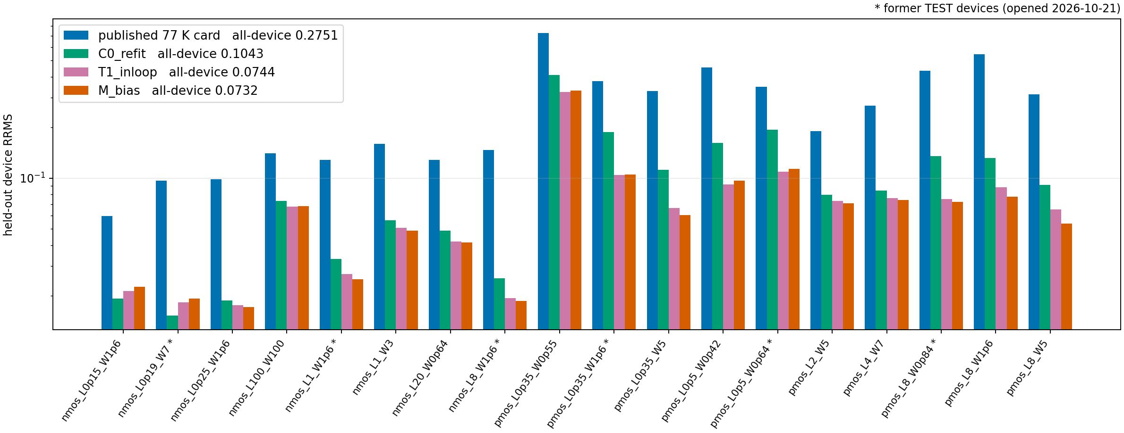
Per-device RRMS, 18 devices (log scale)

Slide 8
Deployment: g as a Verilog-A element in NGSpice
Export: g written as Verilog-A (module i3_2_bias_corr, explicit tanh layers, 5-seed mean). Element between the external drain d and the transistor drain di: I(d, s) += (exp(g) - 1) x I(d -> di).
Compile: OpenVAF 23.5.0 -> OSDI 0.3. Simulator: ngspice-41 built with --enable-osdi (same source and flags as the canonical build; uncorrected currents bit-identical).
Netlist: M1 di g s b <card>; NCORR d g s di corrmodel; pre_osdi <file>.osdi in .control.
Run | Devices | SPICE-native (Verilog-A) | NGSpice card x exp(g), Python | Max per-device |difference|
All-18 run, 18 fold models | 18 | 0.073171 (0.069117) | 0.073163 (0.069110) | 1.7e-05
I3-2 run, 12 fold models (F1c) | 12 | 0.080555 (0.074863) | 0.080550 (0.074858) | 1.2e-05
Values: all-device RRMS (combined). Python value on the deck re-simulation vs stored all-18 value: max per-device |difference| 0.0e+00.
I3-2 F1c: SPICE-native and Python currents differ by up to 2.45e-3 relative, at a 2.0e-12 A point (pmos_L0p5_W0p42, Id-Vg at |Vds| = 1.85 V); 0 convergence messages, 0 non-finite currents.
All-18 SPICE-native runs: 0 devices with convergence messages, 0 non-finite scored values.

Slide 9
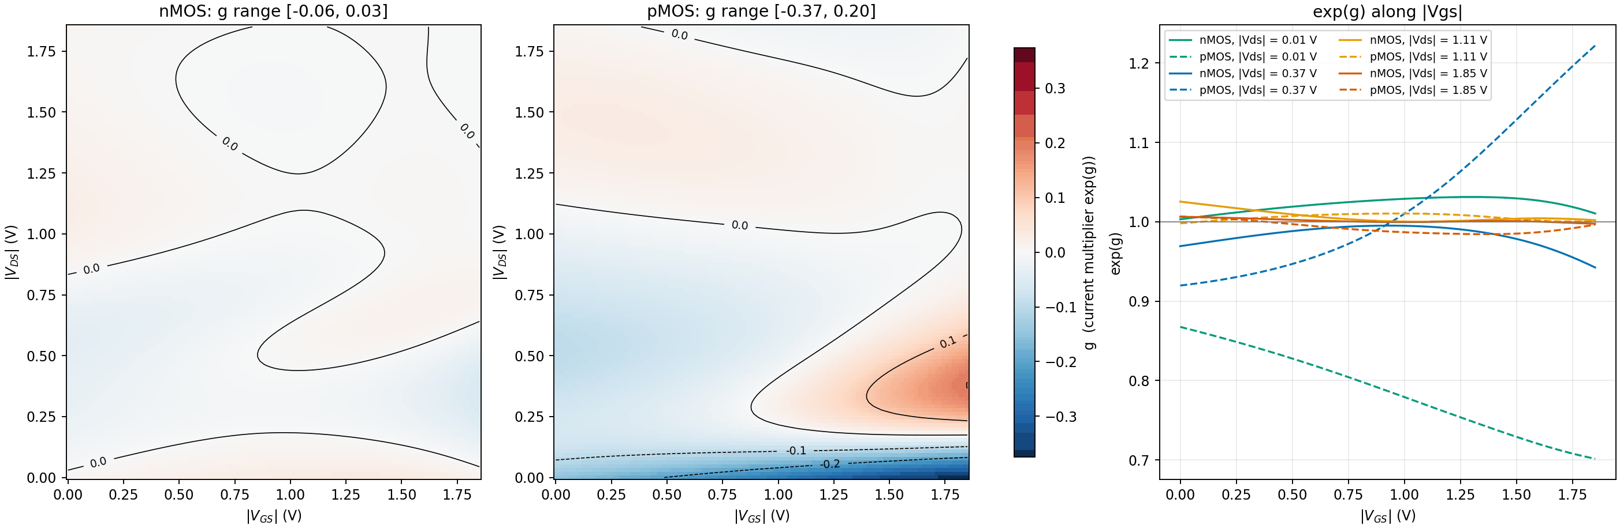
Learned g, full model trained on all 18 devices
The full model is the one written for deployment; held-out scores use the 18 fold models (each without its device). exp(g) is the factor applied to the card current.

Slide 10
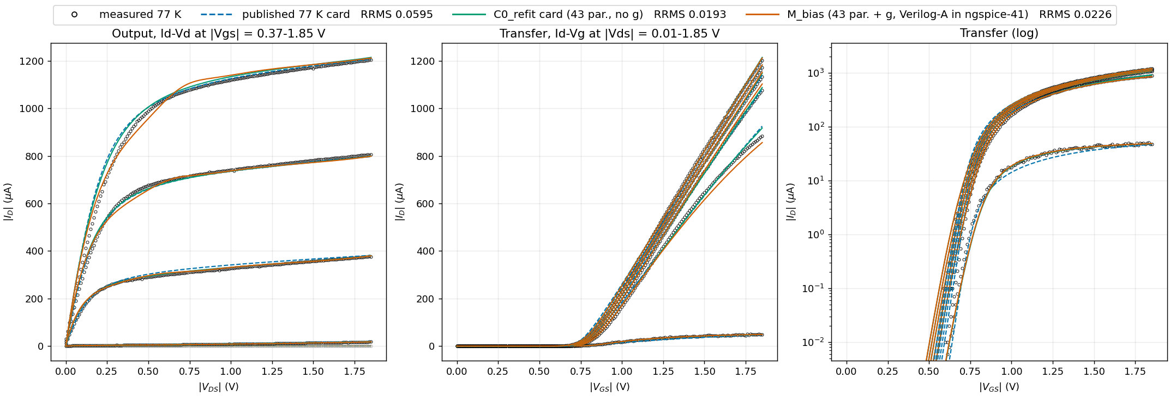
nmos_L0p15_W1p6: NMOS, L = 0.15 um, W = 1.6 um
Points: measured. Lines: NGSpice (ngspice-41). M_bias line: refit card with the fold Verilog-A g in the netlist (OSDI), g trained without this device. Faded: curves outside the frozen inclusion set (not scored). RRMS: strict paper metric for this device.

Slide 11
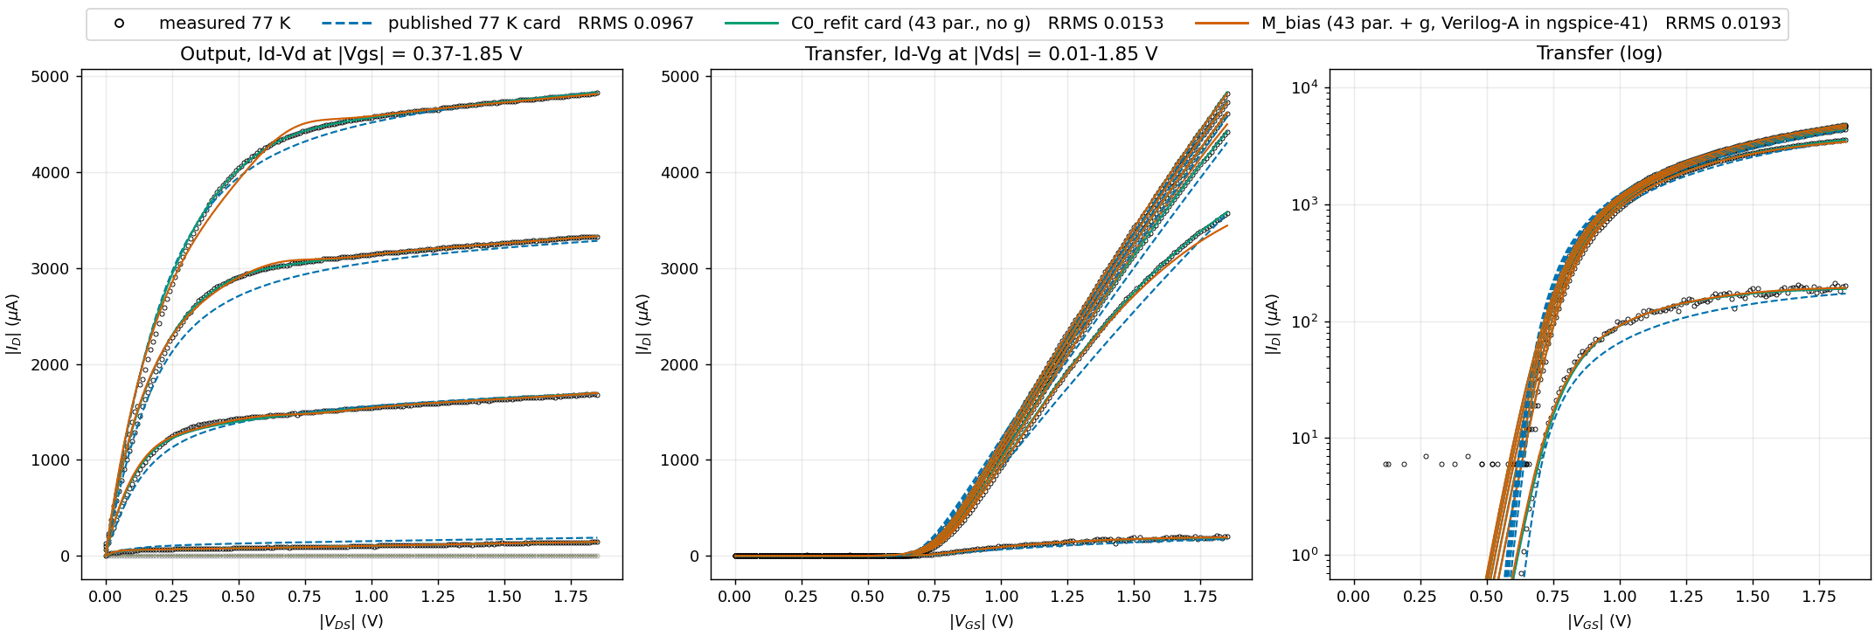
nmos_L0p19_W7: NMOS, L = 0.19 um, W = 7 um (former TEST device)
Points: measured. Lines: NGSpice (ngspice-41). M_bias line: refit card with the fold Verilog-A g in the netlist (OSDI), g trained without this device. Faded: curves outside the frozen inclusion set (not scored). RRMS: strict paper metric for this device.

Slide 12
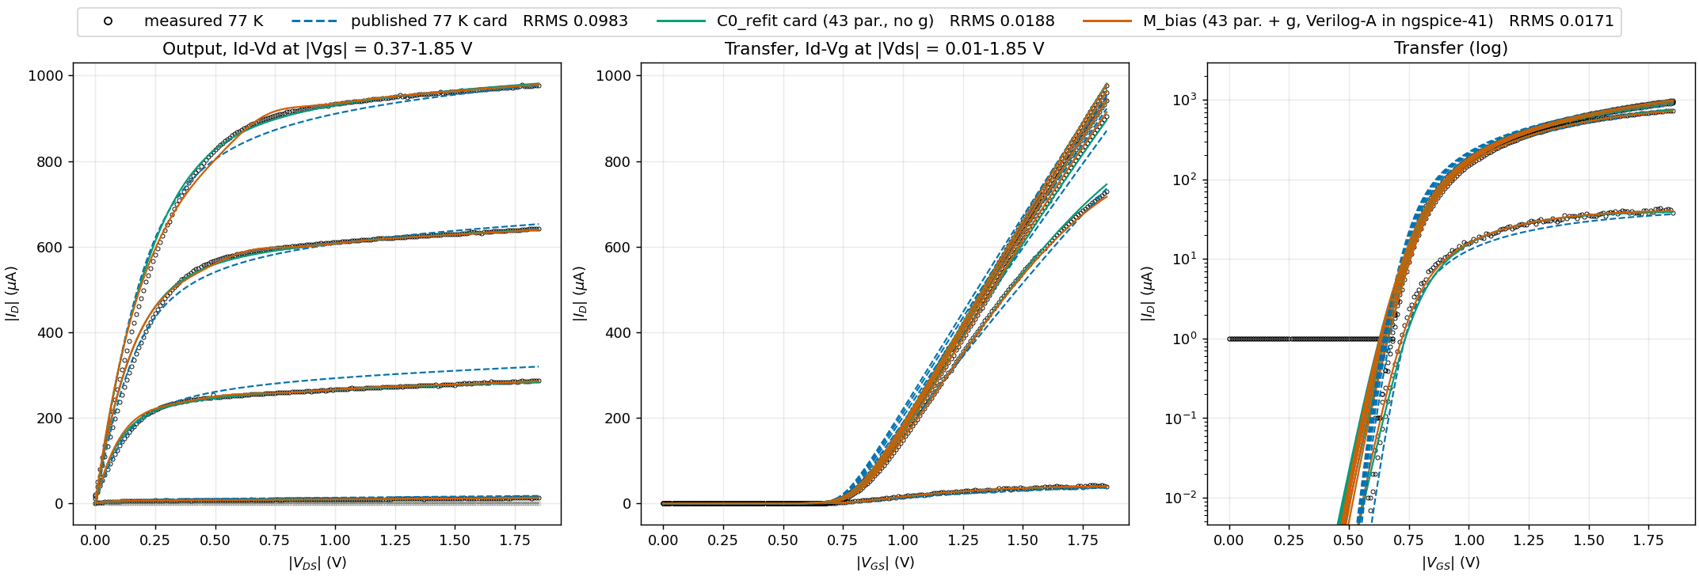
nmos_L0p25_W1p6: NMOS, L = 0.25 um, W = 1.6 um
Points: measured. Lines: NGSpice (ngspice-41). M_bias line: refit card with the fold Verilog-A g in the netlist (OSDI), g trained without this device. Faded: curves outside the frozen inclusion set (not scored). RRMS: strict paper metric for this device.

Slide 13
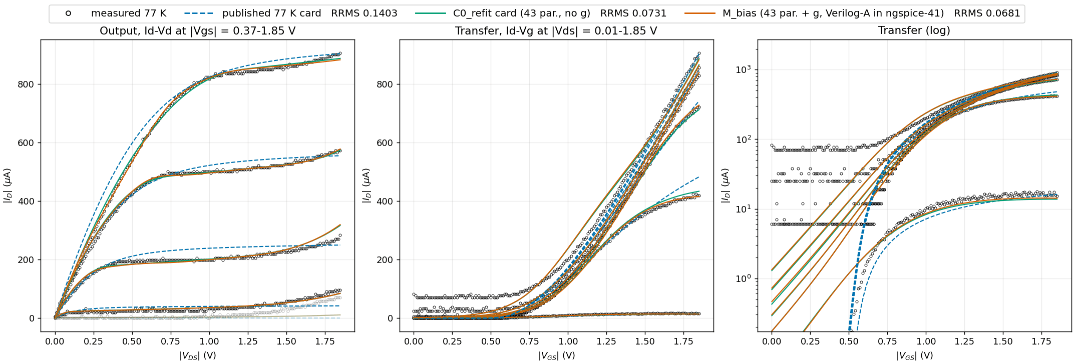
nmos_L100_W100: NMOS, L = 100 um, W = 100 um
Points: measured. Lines: NGSpice (ngspice-41). M_bias line: refit card with the fold Verilog-A g in the netlist (OSDI), g trained without this device. Faded: curves outside the frozen inclusion set (not scored). RRMS: strict paper metric for this device.

Slide 14
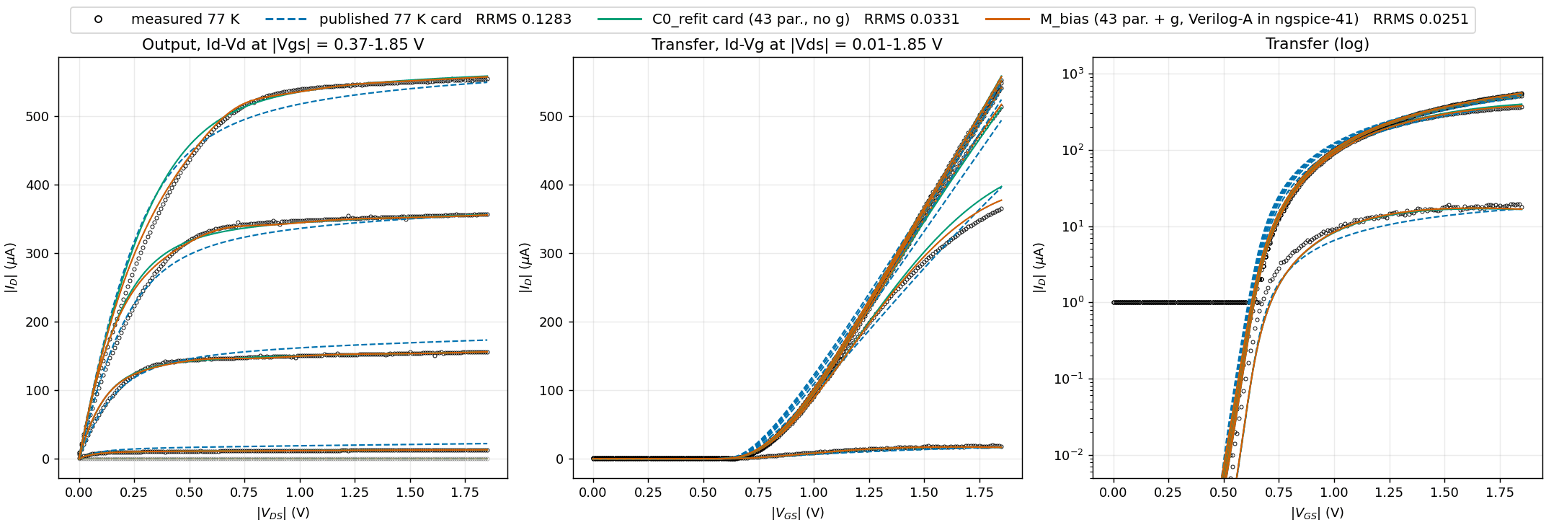
nmos_L1_W1p6: NMOS, L = 1 um, W = 1.6 um (former TEST device)
Points: measured. Lines: NGSpice (ngspice-41). M_bias line: refit card with the fold Verilog-A g in the netlist (OSDI), g trained without this device. Faded: curves outside the frozen inclusion set (not scored). RRMS: strict paper metric for this device.

Slide 15
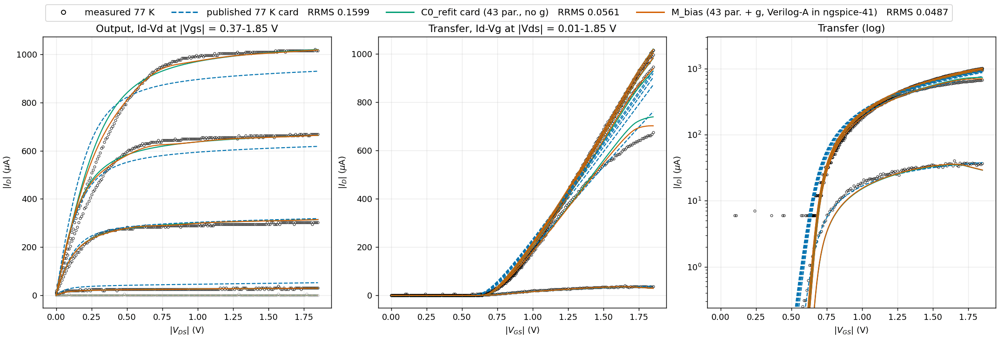
nmos_L1_W3: NMOS, L = 1 um, W = 3 um
Points: measured. Lines: NGSpice (ngspice-41). M_bias line: refit card with the fold Verilog-A g in the netlist (OSDI), g trained without this device. Faded: curves outside the frozen inclusion set (not scored). RRMS: strict paper metric for this device.

Slide 16
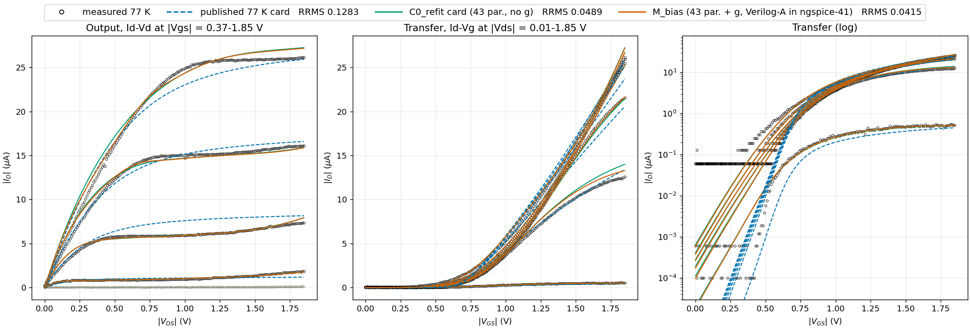
nmos_L20_W0p64: NMOS, L = 20 um, W = 0.64 um
Points: measured. Lines: NGSpice (ngspice-41). M_bias line: refit card with the fold Verilog-A g in the netlist (OSDI), g trained without this device. Faded: curves outside the frozen inclusion set (not scored). RRMS: strict paper metric for this device.

Slide 17
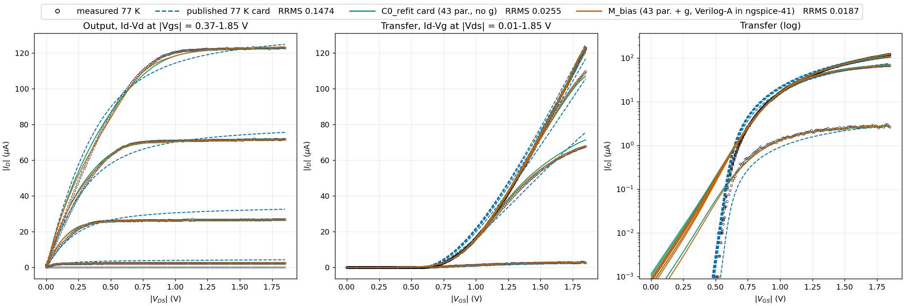
nmos_L8_W1p6: NMOS, L = 8 um, W = 1.6 um (former TEST device)
Points: measured. Lines: NGSpice (ngspice-41). M_bias line: refit card with the fold Verilog-A g in the netlist (OSDI), g trained without this device. Faded: curves outside the frozen inclusion set (not scored). RRMS: strict paper metric for this device.

Slide 18
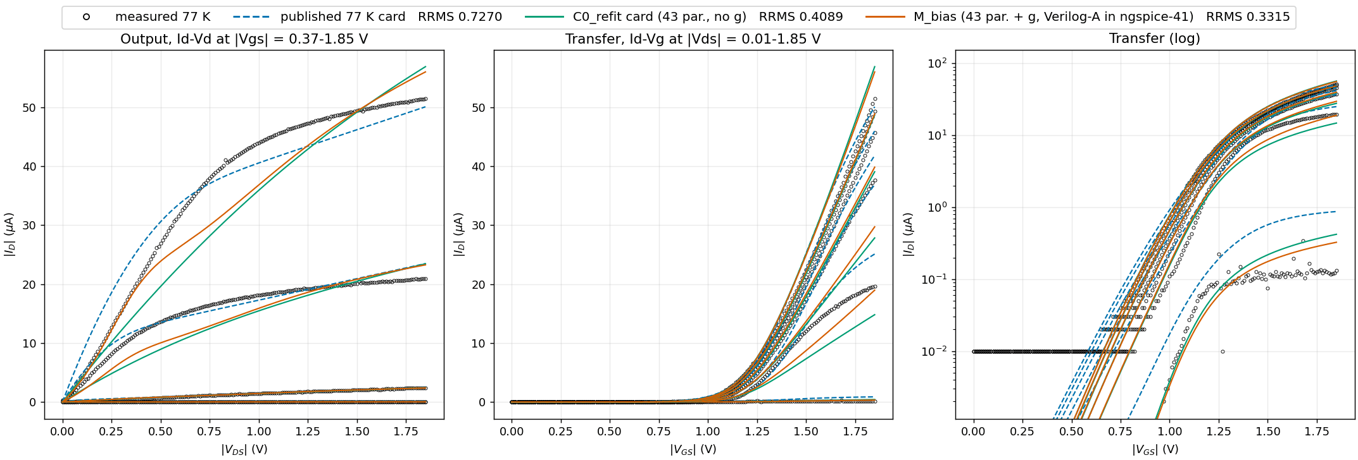
pmos_L0p35_W0p55: PMOS, L = 0.35 um, W = 0.55 um
Points: measured. Lines: NGSpice (ngspice-41). M_bias line: refit card with the fold Verilog-A g in the netlist (OSDI), g trained without this device. Faded: curves outside the frozen inclusion set (not scored). RRMS: strict paper metric for this device.

Slide 19
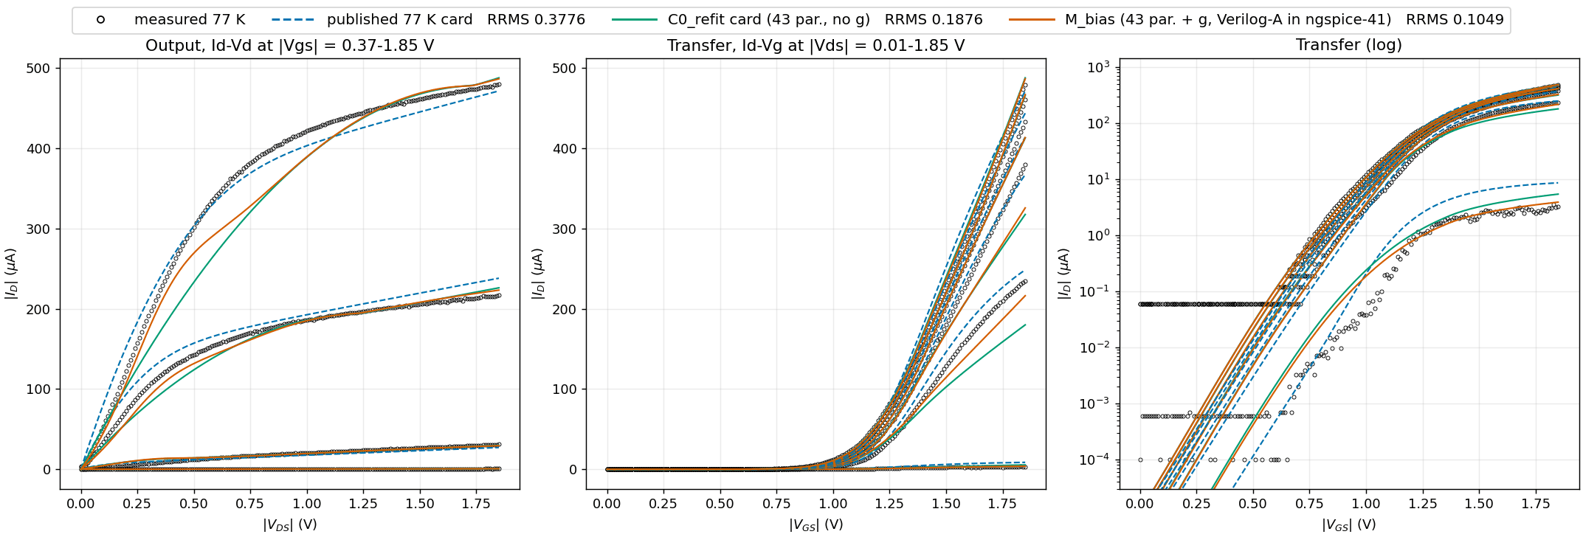
pmos_L0p35_W1p6: PMOS, L = 0.35 um, W = 1.6 um (former TEST device)
Points: measured. Lines: NGSpice (ngspice-41). M_bias line: refit card with the fold Verilog-A g in the netlist (OSDI), g trained without this device. Faded: curves outside the frozen inclusion set (not scored). RRMS: strict paper metric for this device.

Slide 20
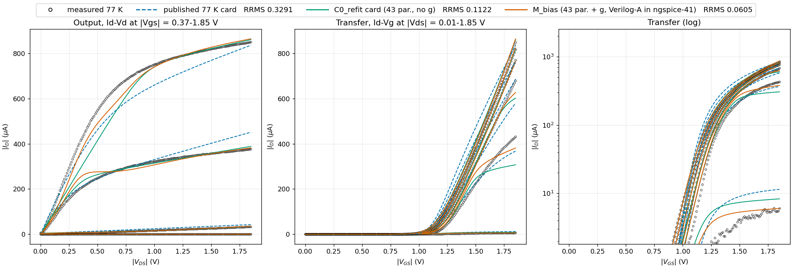
pmos_L0p35_W5: PMOS, L = 0.35 um, W = 5 um
Points: measured. Lines: NGSpice (ngspice-41). M_bias line: refit card with the fold Verilog-A g in the netlist (OSDI), g trained without this device. Faded: curves outside the frozen inclusion set (not scored). RRMS: strict paper metric for this device.

Slide 21
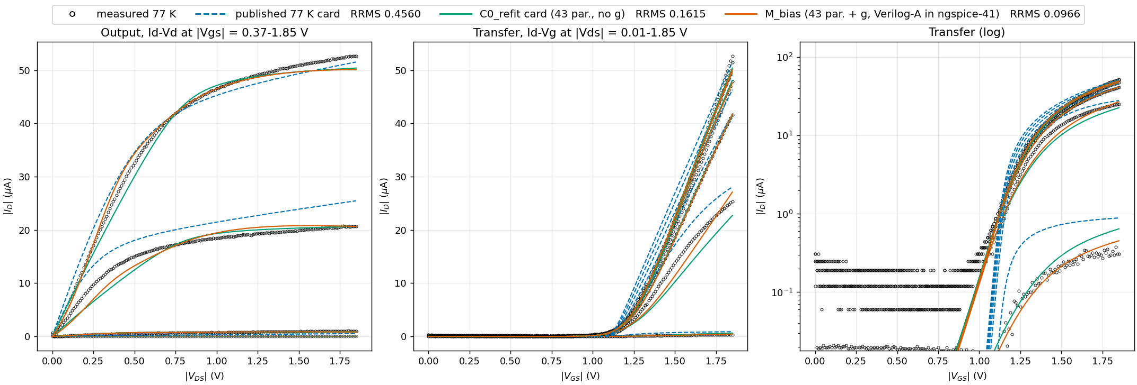
pmos_L0p5_W0p42: PMOS, L = 0.5 um, W = 0.42 um
Points: measured. Lines: NGSpice (ngspice-41). M_bias line: refit card with the fold Verilog-A g in the netlist (OSDI), g trained without this device. Faded: curves outside the frozen inclusion set (not scored). RRMS: strict paper metric for this device.

Slide 22
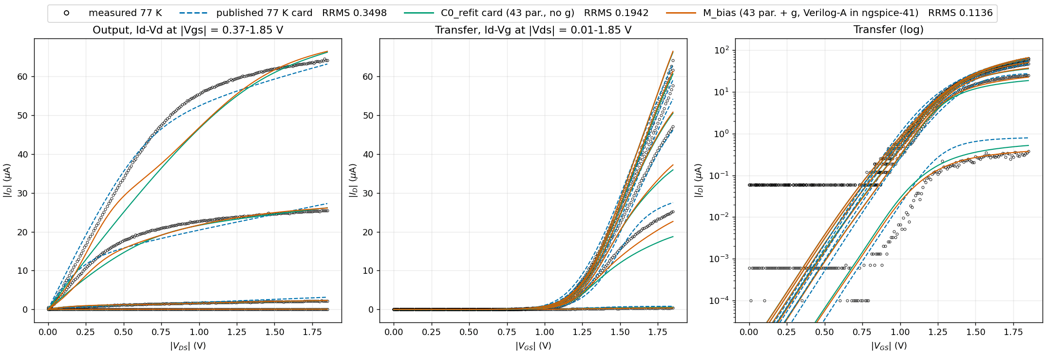
pmos_L0p5_W0p64: PMOS, L = 0.5 um, W = 0.64 um (former TEST device)
Points: measured. Lines: NGSpice (ngspice-41). M_bias line: refit card with the fold Verilog-A g in the netlist (OSDI), g trained without this device. Faded: curves outside the frozen inclusion set (not scored). RRMS: strict paper metric for this device.

Slide 23
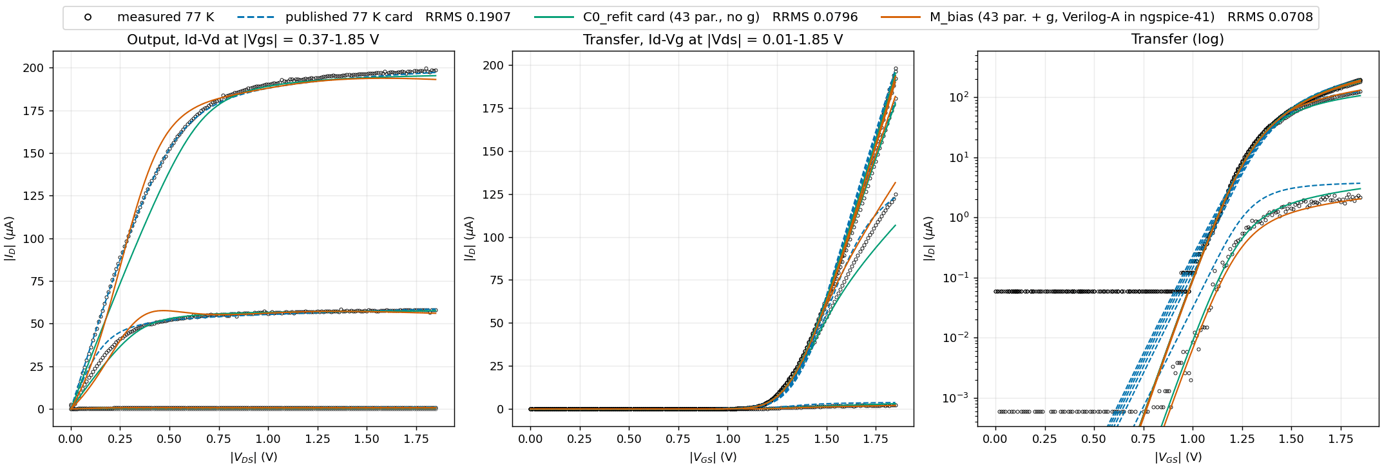
pmos_L2_W5: PMOS, L = 2 um, W = 5 um
Points: measured. Lines: NGSpice (ngspice-41). M_bias line: refit card with the fold Verilog-A g in the netlist (OSDI), g trained without this device. Faded: curves outside the frozen inclusion set (not scored). RRMS: strict paper metric for this device.

Slide 24
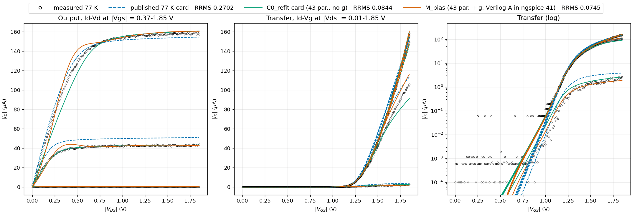
pmos_L4_W7: PMOS, L = 4 um, W = 7 um
Points: measured. Lines: NGSpice (ngspice-41). M_bias line: refit card with the fold Verilog-A g in the netlist (OSDI), g trained without this device. Faded: curves outside the frozen inclusion set (not scored). RRMS: strict paper metric for this device.

Slide 25
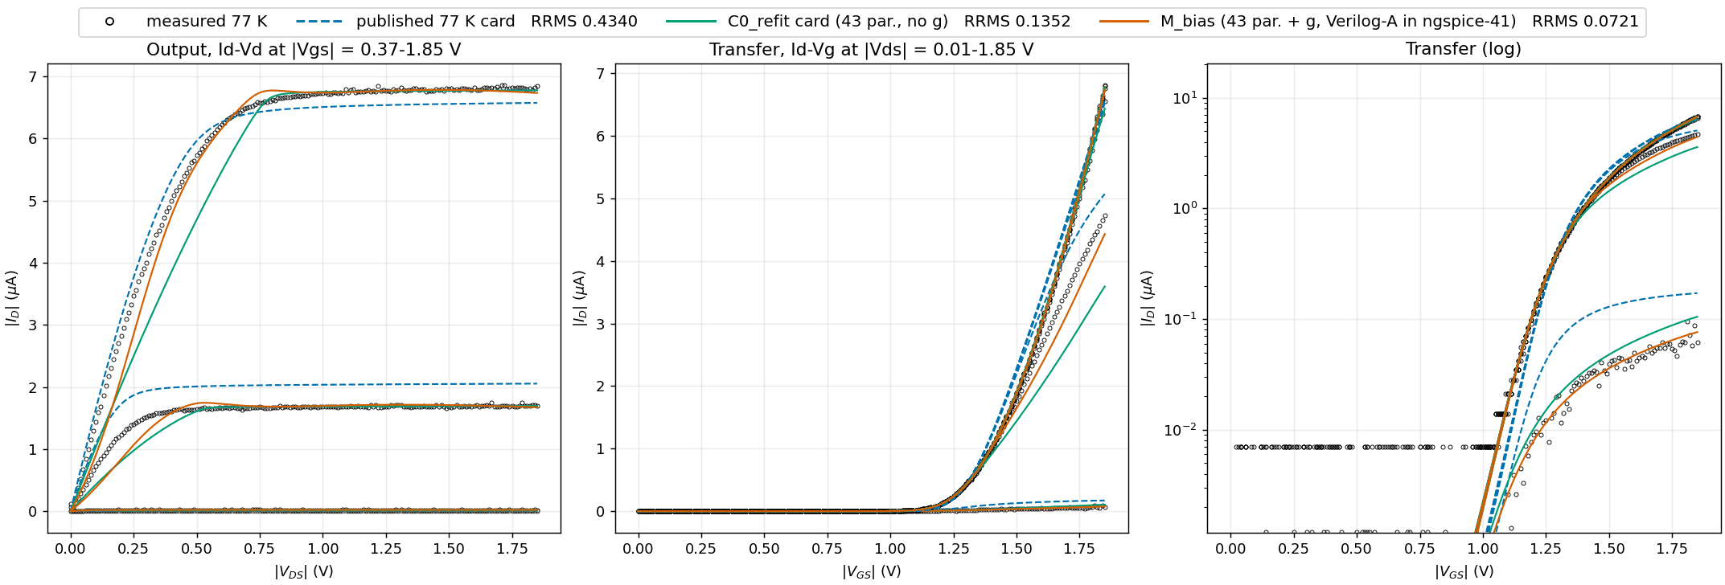
pmos_L8_W0p84: PMOS, L = 8 um, W = 0.84 um (former TEST device)
Points: measured. Lines: NGSpice (ngspice-41). M_bias line: refit card with the fold Verilog-A g in the netlist (OSDI), g trained without this device. Faded: curves outside the frozen inclusion set (not scored). RRMS: strict paper metric for this device.

Slide 26
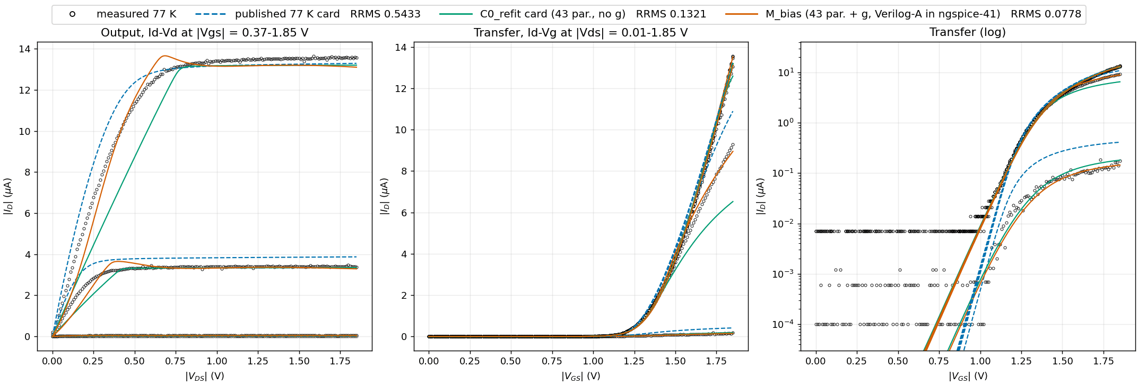
pmos_L8_W1p6: PMOS, L = 8 um, W = 1.6 um
Points: measured. Lines: NGSpice (ngspice-41). M_bias line: refit card with the fold Verilog-A g in the netlist (OSDI), g trained without this device. Faded: curves outside the frozen inclusion set (not scored). RRMS: strict paper metric for this device.

Slide 27
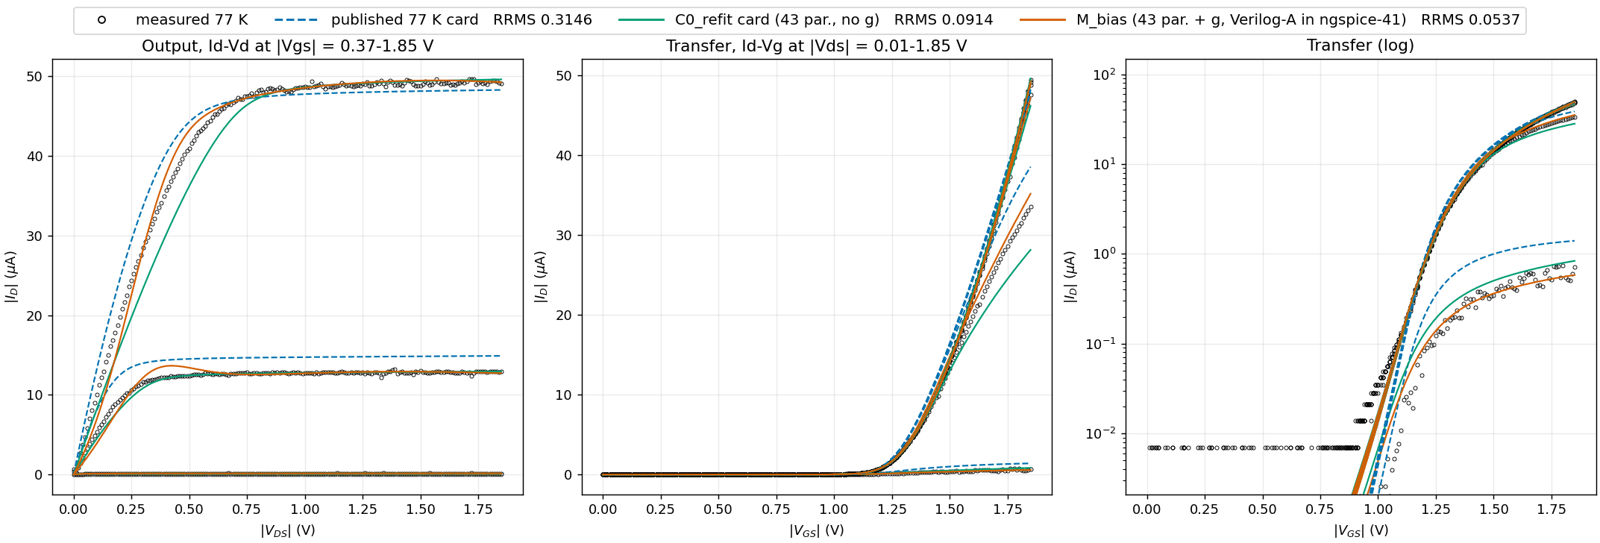
pmos_L8_W5: PMOS, L = 8 um, W = 5 um
Points: measured. Lines: NGSpice (ngspice-41). M_bias line: refit card with the fold Verilog-A g in the netlist (OSDI), g trained without this device. Faded: curves outside the frozen inclusion set (not scored). RRMS: strict paper metric for this device.

