Slide 1
STREAM WATER QUALITY SAMPLING NETN
Monthly samples May – Oct
Samples taken regardless of baseflow
Some ACAD sites only sampled on odd and even years, few (3?) sampled every year. Why?
Why were more than one sample taken per month? Because early and late month sample?

Slide 2
Monthly temperature

Slide 3
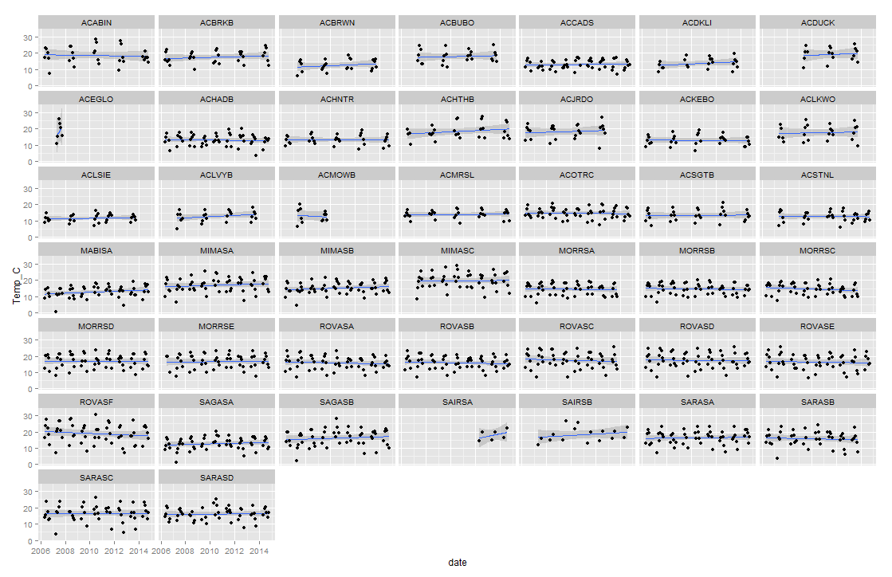
Temperature- trend

Slide 4
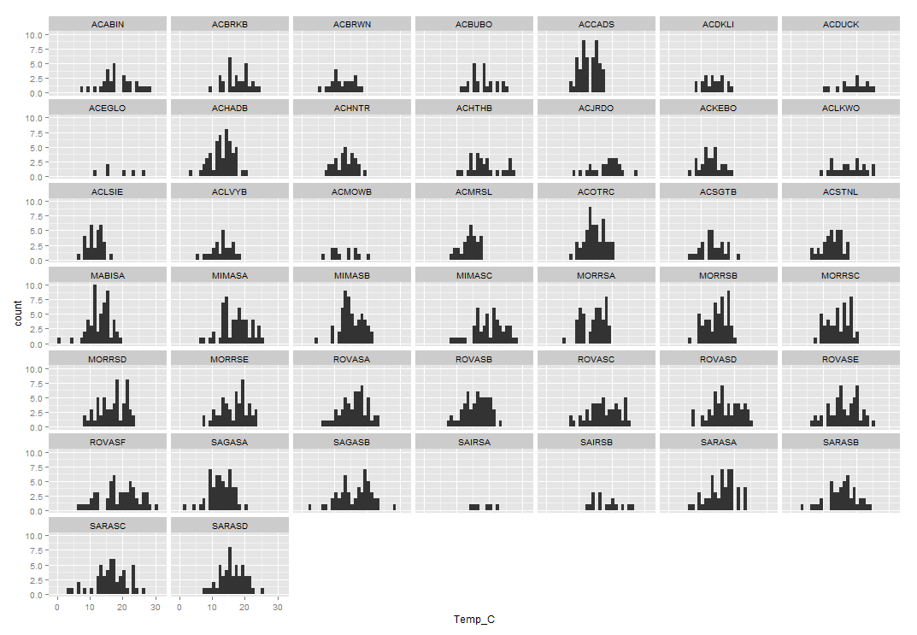
Temperature- Variability in temperatures May-Oct

Slide 5
Minimum annual temperature

Slide 6
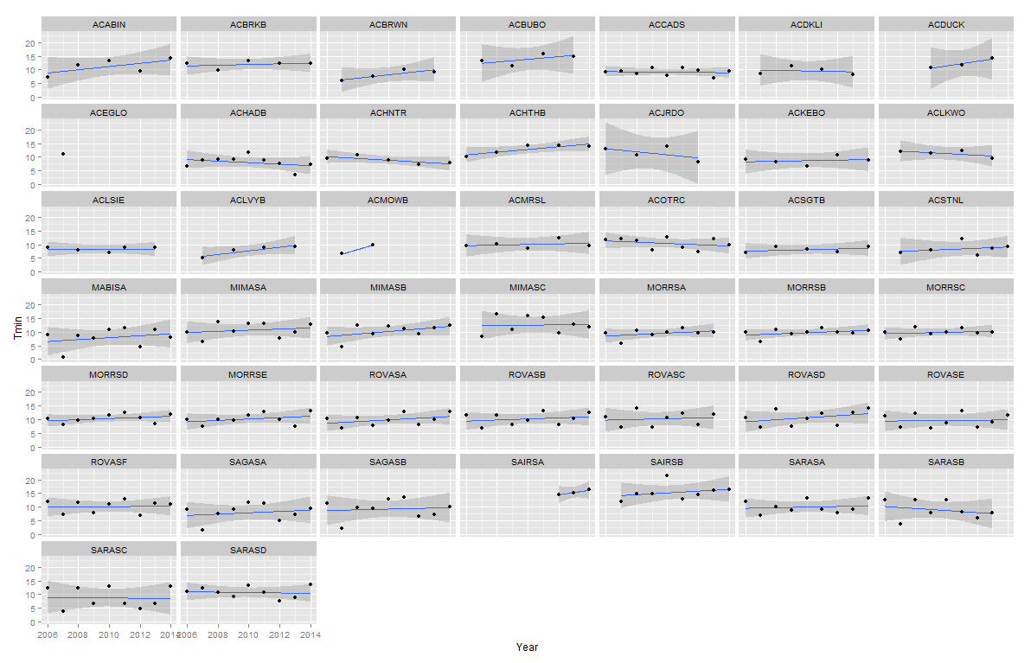
Temperature- Minimum annual temperature

Slide 7
Maximum annual temperature

Slide 8
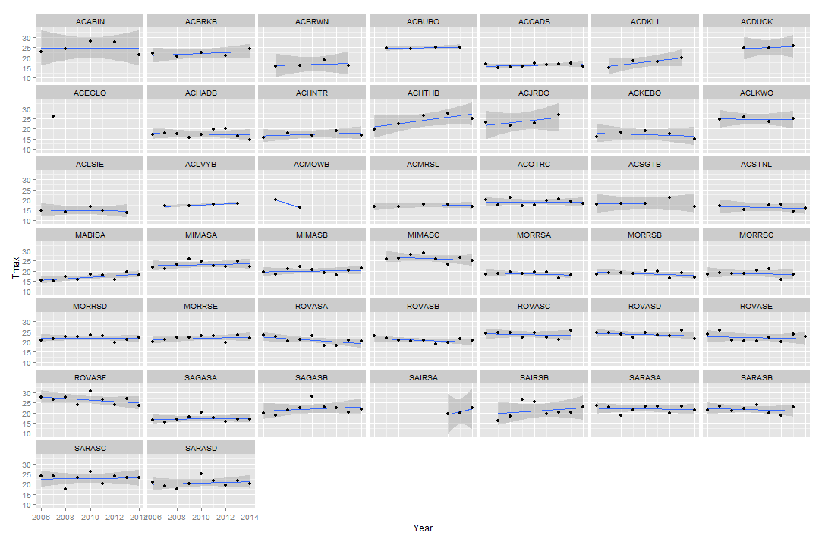
Temperature- Maximum annual temperature

Slide 9
Modeling temporal variation
What is the estimated long-term trend and associated uncertainty?

Slide 10
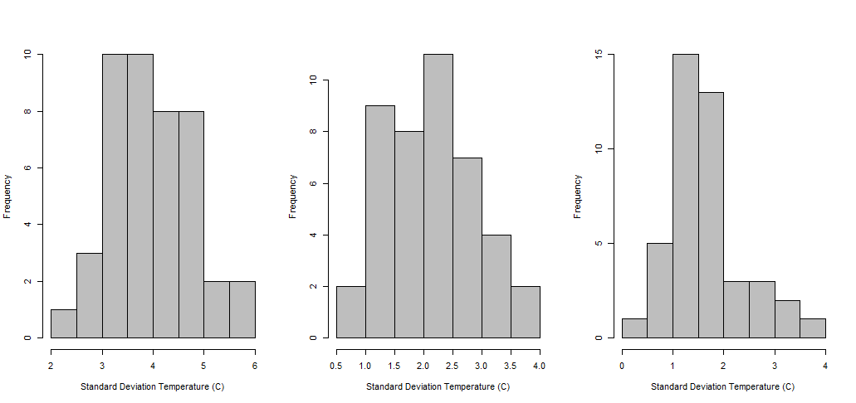
Temperature- Standard deviation in site-level data across NETN
All data
Annual minimums
Annual maximums

Slide 11
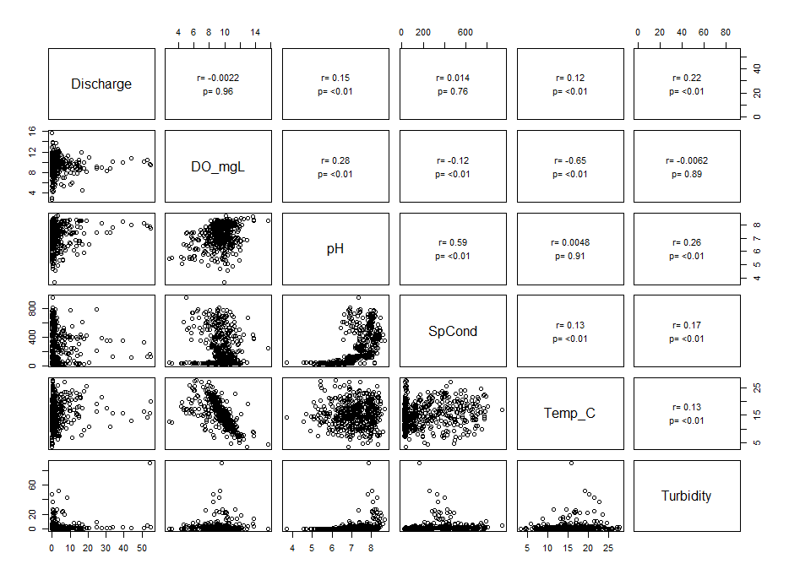
Correlation among parms

Slide 12
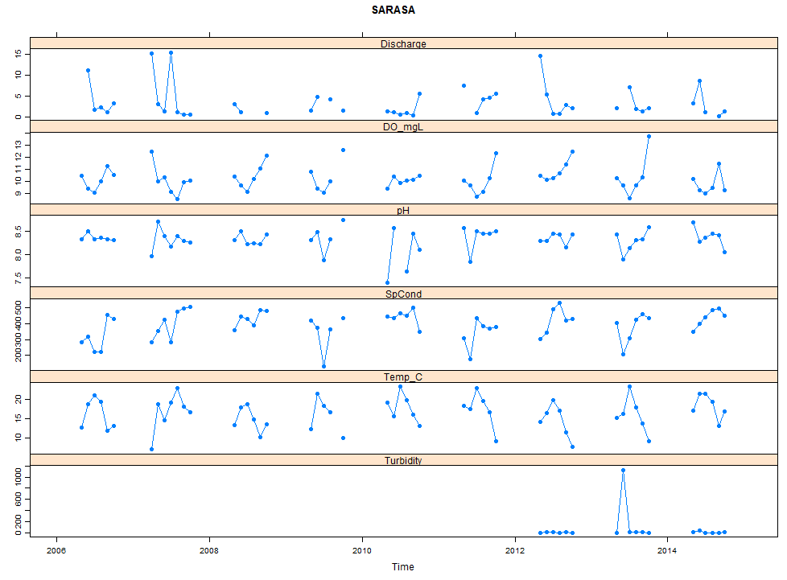
Data from one LNETN site

Slide 13
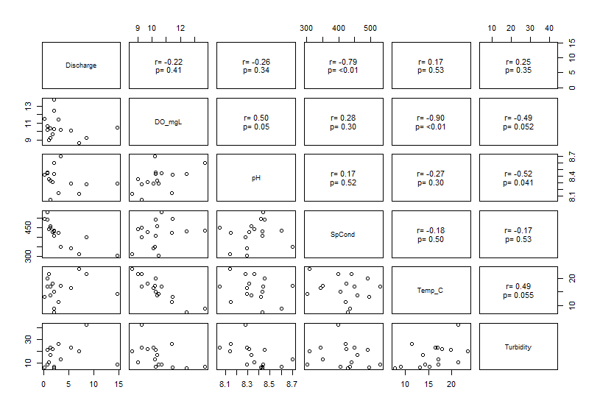
Data from one LNETN site

