Slide 1

Handling Indeterminate Predictions of Vascular Access Dysfunction in Chronic Hemodialysis Patients through Tree-Based Approaches
For Oral Defense
Reporter：陳政霖
Advisor: 馬清文教授
Date: 1/7
Notes:
Handling Indeterminate Predictions of Vascular Access Dysfunction in Chronic Hemodialysis Patients through Tree-Based Approaches
Indeterminate-Aware Tree-Based Approaches for Predicting Vascular Access Dysfunction in Chronic Hemodialysis Patients
透過基於樹的方法處理慢性血液透析患者血管通路功能障礙的不確定預測

Slide 2
Research Flow Chart
Start
Research Purpose
Design feature engineering variables
Is the model’s predictive capability sufficient?
yes
Multipass Indeterminacy Estimation Algorithm
no
Literature review
Tree-based Model Building
Redesigning feature engineering variables
Adjust model parameters
Indeterminate-Aware Data Classification Algorithm
Obtain patient test records
Model Validation
Analyze
prediction results
Discuss the significance of the variables with doctor
Result Analysis
Plot extended confusion matrix
Conclusions
Analyze data
End

Slide 3
Prediction of vascular access dysfunction
Notes:
血管通路功能障礙的預測

Slide 4
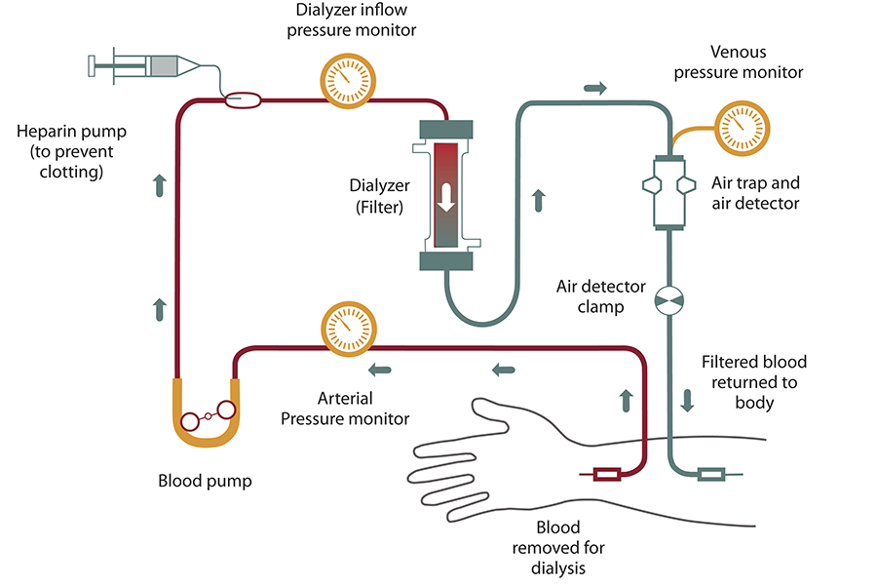
Prediction of vascular access dysfunction
Taiwan has the highest proportion of dialysis patients in the world, and vascular access dysfunction is a common and severe complication among dialysis patients, increasing their health risks. To reduce such risks, patients need regular monitoring of vascular access flow to ensure patency. However, the heavy workload of healthcare professionals poses a challenge, making it essential to reduce physician workload while improving diagnostic efficiency.
Traditionally, physicians determine the need for surgery based on fixed blood flow rate thresholds and a 25% decrease in flow.
Image from the National Institute of Diabetes and Digestive and Kidney Diseases (NIDDK)
Notes:
台灣以洗腎人口占比全球第一而聞名，並且因為血管通路失能導致透析相關併發症產生。為了改善血管通路失能的狀況，病患會定期追蹤血管通路流量來改善血管通路通暢和減少併發症。
在傳統判斷方法是使用固定的血液流速閾值以及流速是否下降來評估病患是否要執行手術

Slide 5
Abstract
This study applies tree-based machine learning models to classify real hospital structured data, focusing on Indeterminacy analysis for Indeterminate samples. By introducing an extended confusion matrix and new Indeterminacy metrics such as Error, Leakage, Overkill, Indeterminate, and Imperfection, the accuracy of Indeterminacy evaluation is enhanced, improving traditional diagnostic methods.
Through simulations and validation using clinical data, the results show that this approach effectively predicts the risk of vascular access dysfunction, helping to reduce the incidence of complications and improve patient's quality of life.
Notes:
而此研究主要是透過數模型來將醫院的真實資料進行分析，並且藉由我們實驗室提出的判斷方法extended confusion matrix 以及其他判斷指標來評估結果
最後透過我們的不確定性判斷方式成功改進傳統的診斷方法

Slide 6
Goal
Our goal is to find out the possibility of vascular access dysfunction from the patient's regular testing data and provide a highly reliable prediction.
Notes:
但由於每個患者的理想的血管通路流量值可能會不同，所以我們需要藉由機器學習的方式來找出通用於各病患的血管通路流量閾值，並且給予不確定意識的高可信度輸出來判斷病患是需要執行手術還是不執行手術，又或是對於此次檢次結果提出不確定讓病患再進行檢測。

Slide 7
Research Flow Chart
Start
Research Purpose
Design feature engineering variables
Is the model’s predictive capability sufficient?
yes
Multipass Indeterminacy Estimation Algorithm
no
Literature review
Tree-based Model Building
Redesigning feature engineering variables
Adjust model parameters
Indeterminate-Aware Data Classification Algorithm
Obtain patient test records
Model Validation
Analyze
prediction results
Discuss the significance of the variables with doctor
Result Analysis
Plot extended confusion matrix
Conclusions
Analyze data
End

Slide 8
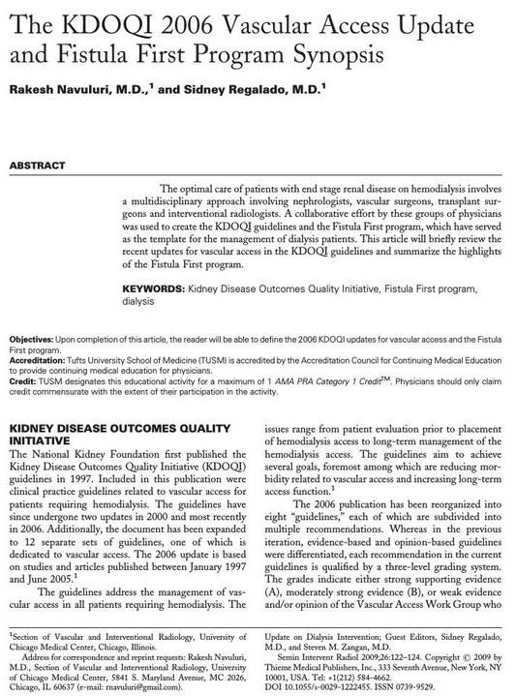
KDOQI Guidelines
Notes:
我們參考的文獻最重要的是KDOQI guidelines，那什麼是KDOQI guidelines?

Slide 9
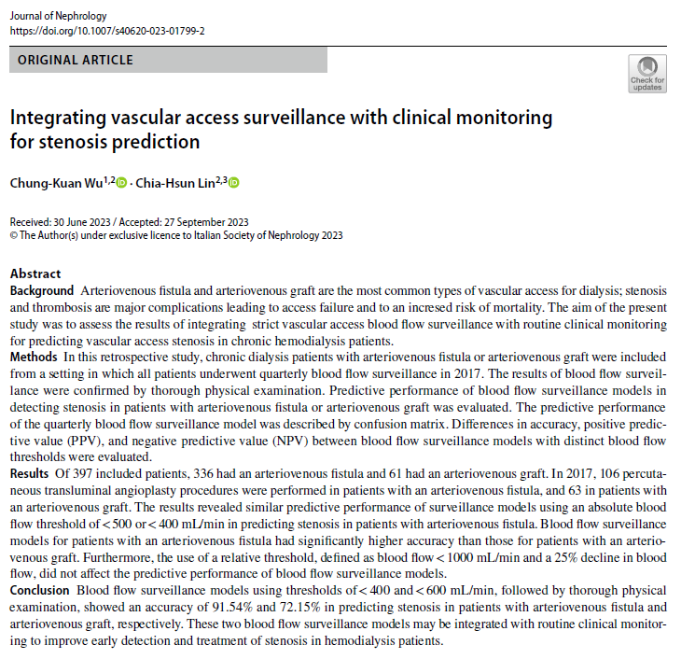
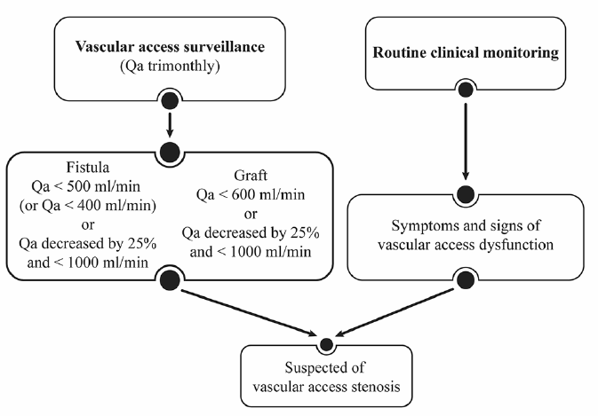
KDOQI Guidelines
The KDOQI 2006 Vascular Access Update and Fistula First Program Synopsis
Notes:
KDOQI guidelines是在2006年提出用來判斷血管通路流量閾值是否需要介入治療的方式，從紅色框起來的地方可以看到他針對不同瘻管提出不同的判斷方法，而目前這種方式也是醫院來評估的方法，並且我們在後續特徵工程的地方也有將此方法當作特徵使用以及我們的資料集也是使用兩種瘻管種類AVF以及AVG的資料集 https://www.ncbi.nlm.nih.gov/pmc/articles/PMC3036429/

Slide 10
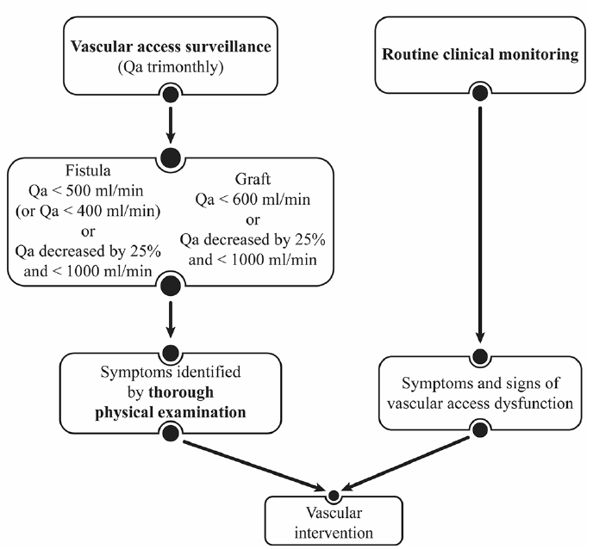
KDOQI Guidelines
2023 CK Wu Integrating VA surveillance with clinical monitoring for stenosis prediction
Notes:
再來是基於KDOQI guidelines，再提出定期3個月至醫院檢測的方法，但是這種方式長期下來越來越多病患進行檢測會消耗大量的人力資源
所以我們提出一種方式讓病患可以在進行血管通路流量檢測後就可以知道自己是否需要進行手術或是還需要進行後續檢測，可以節省醫師寶貴的人力資源

Slide 11
Research Flow Chart
Start
Research Purpose
Design feature engineering variables
Is the model’s predictive capability sufficient?
yes
Multipass Indeterminacy Estimation Algorithm
no
Literature review
Tree-based Model Building
Redesigning feature engineering variables
Adjust model parameters
Indeterminate-Aware Data Classification Algorithm
Obtain patient test records
Model Validation
Analyze
prediction results
Discuss the significance of the variables with doctor
Result Analysis
Plot extended confusion matrix
Conclusions
Analyze data
End
Notes:
再來介紹我們的資料，以及我們怎麼將病患檢測資料視覺化來與醫師進行討論

Slide 12

Tabular Dataset
Constant data (input)
Diabetes mellitus (DM)
Hypertension patients (HTN)
Dyslipidemia(Dyslipid)
Coronary artery disease(CAD)
Acute myocardial infarction (AMI)
Cerebral Vascular Accident(CVA)
Peripheral artery occlusive disease (PAOD)
Heart failure (HF)
Age
Gender
Surveillance part
Serial data (input)
Vascular access blood flow (Qa)
02
869
(14.9%)
651 (74.9%)
218 (25.1%)
Surgery record (output)
Percutaneous transluminal angioplasty (PTA)
4991
(85.1%)
4445 (89.1%)
546 (10.9%)
03
01
Notes:
我們所拿到的是病患定期檢測的結構化表格資料，以及病患過去執行手術的紀錄
那這邊是我對這些資料整理的結果，左圖為兩種資料集所佔的人數比例，大部分的人都是自體瘻管，再來右圖為兩種資料集分別是否需要執行PTA手術的分布狀況(2~3倍、8倍)，而這也是我們所要預測的y

Slide 13
Tabular Dataset
869
(14.9%)
Constant data (input)
Serial data (input)
Diabetes mellitus (DM)
Hypertension patients (HTN)
Dyslipidemia(Dyslipid)
Coronary artery disease(CAD)
Acute myocardial infarction (AMI)
Cerebral Vascular Accident(CVA)
Peripheral artery occlusive disease (PAOD)
Heart failure (HF)
Age
Gender
Surveillance part
Vascular access blood flow (Qa)
02
Surgery record (output)
Percutaneous transluminal angioplasty (PTA)
4991
(85.1%)
03
01
Notes:
在來是輸入的資料的其他特徵，有靜態資料以及序列資料，其中序列資料為最主要用來判斷的血液流速值 我們的輸出是這個病人是否需要執行手術

Slide 14
Visualization of Qa and PTA
Raw Data
Days Difference From Previous Surveillance Record | Days Since Surgery To Surveillance Record | Surveillance QA Value
0 | N/A | 540
5 | N/A | N/A
91 | 86 | 1430
91 | 86+91 | 1380
Surgery
No
Yes
No
No
86+91 days
86 days
Surveillance Record
Surgery Record
Number of days after
surgery to the next surveillance
In our data, there is no Qa value for the day of surgery, only the difference in the number of days from the previous record.
Aligned Raw Data
Days Difference From Previous Surveillance Record | Days Since Surgery To Surveillance Record | Surveillance QA Value
0 | N/A | 540
91 | 86 | 1430
91 | 86+91 | 1380
Surgery
Yes
No
No
2018-02
2018-05
2018-07
Date
Notes:
再來是我們怎麼進行視覺化，我們一開始拿到的RAW data因為手術當天不會進行檢測，所以當天不會有資料，只會有手術紀錄
所以我們將這樣的資料對齊，(說明左圖)這筆檢測資料後有執行手術，就將這筆檢測資料的y當作有執行手術

Slide 15
Visualization of Qa and PTA
Raw Data
Days Difference From Previous Surveillance Record | Days Since Surgery To Surveillance Record | Surveillance QA Value
0 | N/A | 540
5 | N/A | N/A
91 | 86 | 1430
91 | 86+91 | 1380
Surgery
No
Yes
No
No
86+91 days
86 days
Surveillance Record
Surgery Record
Number of days after
surgery to the next surveillance
Aligned Raw Data
Days Difference From Previous Surveillance Record | Days Since Surgery To Surveillance Record | Surveillance QA Value
0 | N/A | 540
91 | 86 | 1430
91 | 86+91 | 1380
Surgery
Yes
No
No
2018-02
2018-05
2018-07
Date

Slide 16
Constant Data
Age | Gender | 檢測部位 | 廔管種類
63 | M | 左前臂 | AVG
45 | F | 右上臂 | AVG
24 | M | 左上臂 | AVF
82 | F | 右前臂 | AVF
DM | HTN | Dyslipid | CAD | AMI | CVA | PAOD | HF
0 | 1 | 0 | 0 | 1 | 0 | 0 | 0
0 | 0 | 1 | 0 | 1 | 0 | 1 | 0
1 | 0 | 0 | 0 | 1 | 1 | 1 | 0
0 | 1 | 1 | 0 | 0 | 1 | 0 | 1
Essential Information of the patients
Past medical histories of the patients
Notes:
再來是其他特徵的呈現展示，左邊是病患一定會有的資料，右邊是病人過去有的病史

Slide 17
Data Splitting
K-fold Cross-Validation
Training / Validation
AVF: 3327 / 1664
AVG: 579 / 290
Notes:
我們使用K-fold的方式來進行資料分割，並且使用3次步驟，每次拿取2/3的資料進行訓練1/3的資料進行驗證

Slide 18
Research Flow Chart
Start
Research Purpose
Design feature engineering variables
Is the model’s predictive capability sufficient?
yes
Multipass Indeterminacy Estimation Algorithm
no
Literature review
Tree-based Model Building
Redesigning feature engineering variables
Adjust model parameters
Indeterminate-Aware Data Classification Algorithm
Obtain patient test records
Model Validation
Analyze
prediction results
Discuss the significance of the variables with doctor
Result Analysis
Plot extended confusion matrix
Conclusions
Analyze data
End
Notes:
再來說明我們怎麼進行特徵工程

Slide 19
Feature Engineering

Slide 20
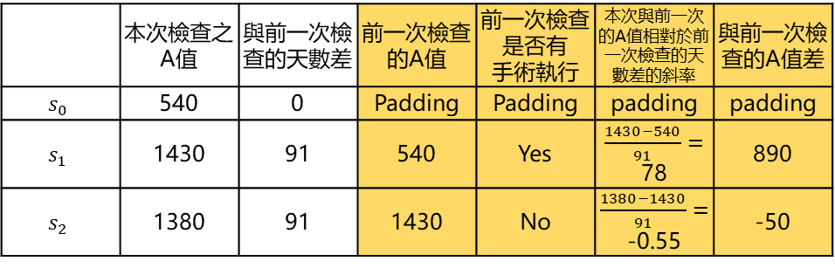

Feature Engineering
A sample has historical information Features have independent meaning Features improve interpretability
Aligned raw data
Feature data from Qa
姓名 | 本次檢查之 A值 | 與前一次檢查的天數差 | y
丁坤佳 | 540 | 0 | Yes
丁坤佳 | 1430 | 91 | No
丁坤佳 | 1380 | 91 | No
 | 本次檢查之 A值 | 與前一次檢查的天數差 | 前一次檢查的A值 | 前一次檢查 是否有 手術執行 | 本次與前一次的A值相對於前一次檢查的天數差的斜率 | 與前一次檢查的A值差
$$s_{0}$$ | 540 | 0 | Padding | Padding | padding | padding
$$s_{1}$$ | 1430 | 91 | 540 | Yes | $\frac{1430−540}{91}=$ 78 | 890
$$s_{2}$$ | 1380 | 91 | 1430 | No | $\frac{1380−1430}{91}=$ -0.55 | -50
$$y$$
Yes
No
No
Notes:
我們會將對齊好的資料藉由觀察來進行特徵的創建，像是我們希望一筆樣本存在過去的血液流速資料，就會創建前一筆的值，以及是否有手術執行，並且參考KDOQI guidelines的方法我們也創建了斜率、差值當作特徵

Slide 21
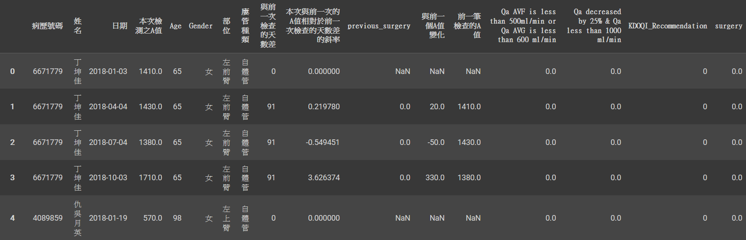

Feature Engineering
Feature Creation
$$\frac{ΔQ_{a}}{Δd}=\frac{330}{91}≈3.63$$
Surveillance Record
Qa value difference
Day difference
+330
91 days
2018-01
2018-04
2018-07
2018-10
Date
Notes:
這邊展示我們怎麼讓一筆樣本獲得更多的資訊

Slide 22
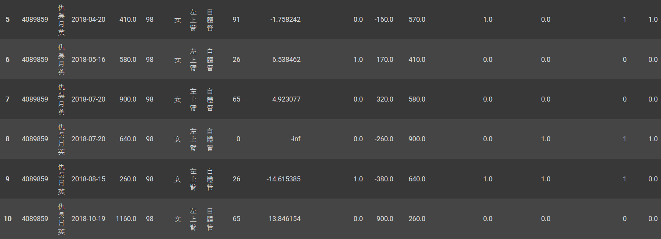
Feature Engineering
Feature Creation, case KDOQI guidelines
Surveillance Record
AVF and Qa value is less than 500
AVG and Qa value is less than 600
Qa value is less than 1000 and
dropped by 25%
2018-01
2018-04
2018-07
2018-10
Date
Notes:
再來是KDOQI guidelines的判斷方式，在條件下規定，會直接判斷此樣本可能需要執行手術

Slide 23
Research Flow Chart
Start
Research Purpose
Design feature engineering variables
Is the model’s predictive capability sufficient?
yes
Multipass Indeterminacy Estimation Algorithm
no
Literature review
Tree-based Model Building
Redesigning feature engineering variables
Adjust model parameters
Indeterminate-Aware Data Classification Algorithm
Obtain patient test records
Model Validation
Analyze
prediction results
Discuss the significance of the variables with doctor
Result Analysis
Plot extended confusion matrix
Conclusions
Analyze data
End
Notes:
前處理的部分完成後，我們開始進行模型說明

Slide 24
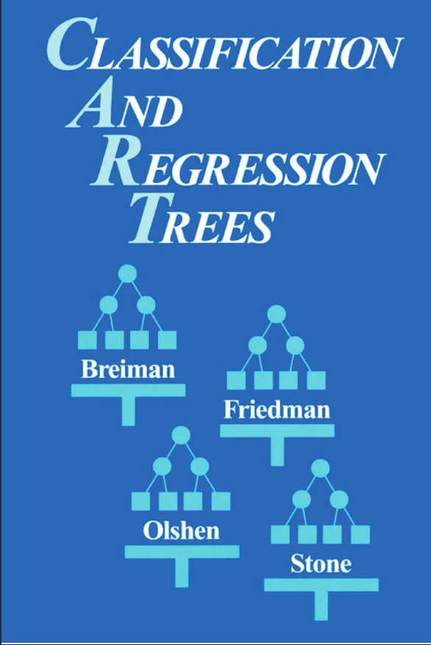
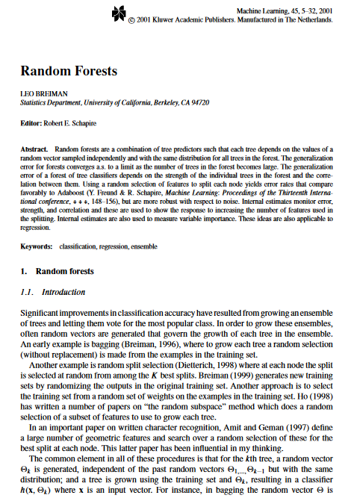
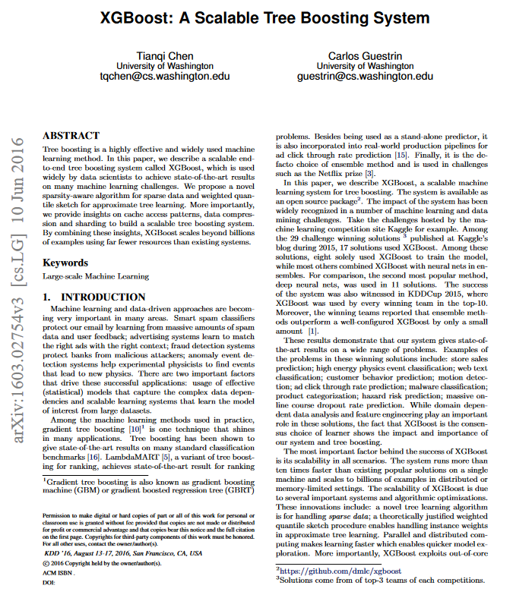
Tree Based Approaches
Notes:
我們這份研究最重要的是樹模型

Slide 25
Tree Based Approaches
Notes:
我們使用了3種樹模型，分別是decision tree、random forest、xgboost，稍後會對為什麼使用這3種模型進行補充
https://www.taylorfrancis.com/books/mono/10.1201/9781315139470/classification-regression-trees-leo-breiman-jerome-friedman-olshen-charles-stone https://link.springer.com/article/10.1023/A:1010933404324 https://arxiv.org/pdf/1603.02754

Slide 26
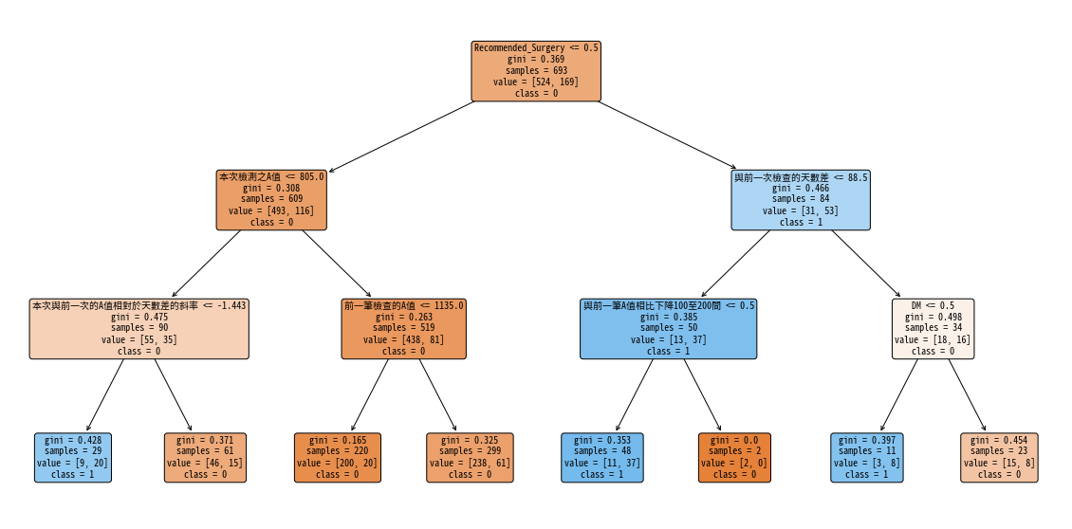
Decision Tree
Easy to interpret
Handles a wide range of data types
Handles non-linear data
Breiman, L., Friedman, J., Olshen, R., & Stone, C. (1984). Classification and Regression Trees. Wadsworth.
Notes:
決策樹具有清晰的可解釋性，可以視覺化，容易解釋每個決策點的邏輯
能夠同時處理數值型和分類型特徵，而不需要進行特徵標準化或正則化
決策樹能夠很好地捕捉數據中的非線性關係
Partition the dataset recursively based on features, creating a tree-like structure where each node represents a decision on a feature.

Slide 27
Random Forest
Training Data
Data 1
Data 2
Data N
Tree 1
Tree 2
Tree N
Soft voting
Reduces overfitting
Increases accuracy and stability
Handles high-dimensional data
Breiman, L. (2001). Random forests. Machine Learning, 45(1), 5-32.
Notes:
通過集成多棵隨機選擇數據和特徵的決策樹，降低了單一決策樹容易過擬合的風險
相比單一決策樹，隨機森林的預測更準確且穩定，因為集成多個樹的結果能有效抵消單棵樹的誤差 可以很好地處理大量特徵（高維數據），並且內建了特徵重要性排序，能有效識別重要特徵
Build multiple decision trees and enhance prediction accuracy through averaging (regression) or majority voting (classification).

Slide 28
XGBoost
Tree 1
Errors
Tree 2
Score 1
Score 2
Tree N
Errors
Score N
Boosting
High accuracy
Fast computation
Regularization
Chen, T., & Guestrin, C. (2016). XGBoost: A scalable tree boosting system. In Proceedings of the 22nd ACM SIGKDD International Conference on Knowledge Discovery and Data Mining (pp. 785-794).
Notes:
梯度提升（Gradient Boosting）有效減少了過擬合問題
會使用XGBoost 是因為他引入了 L1 和 L2 正則化，可以控制模型的複雜度，減少過擬合，從而提升泛化能力(說明圖)，稍後會說明xgboost是怎麼讓多棵樹學習的
Construct a series of decision trees sequentially through gradient boosting, emphasizing correcting errors made by previous trees at each iteration to improve model performance.

Slide 29
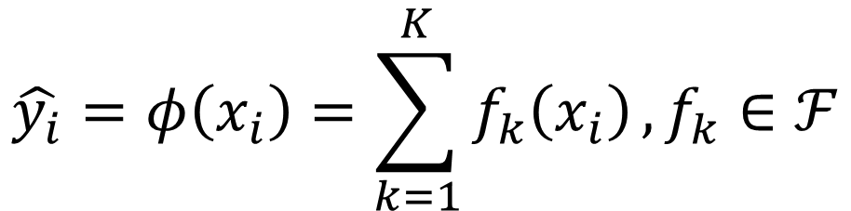
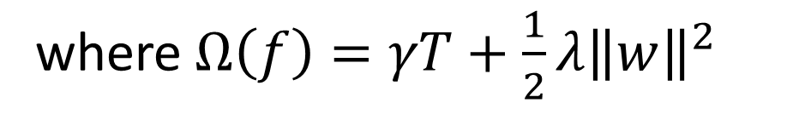
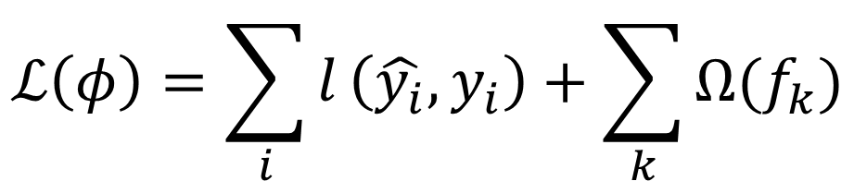
XGBoost
$$𝒟=\left\{\left(x_{i},y_{i}\right)\right\} (\left|𝒟\right|=n, x_{i}∈ℝ^{m},y_{i}∈ℝ)$$
$$\hat{y_{i}}=φ\left(x_{i}\right)=\sum_{k=1}^{K}{f_{k}\left(x_{i}\right)}, f_{k}∈ℱ$$
$$ℒ\left(φ\right)=\sum_{i}{l}\left(\hat{y_{i}},y_{i}\right)+\sum_{k}{Ω(f_{k})}$$
When the regularization parameter is set to zero, the objective falls back to the traditional gradient tree boosting.
where $Ω\left(f\right)=γT+\frac{1}{2}λ{\left\|w\right\|}^{2}$
Notes:
這邊補充XGBoost的相較於一般的Gradient Boost差別，XGBoost多了紅框的正則化項來防止過擬和
https://medium.com/@jimmywu0621/%E6%B1%BA%E7%AD%96%E6%A8%B9%E7%B3%BB%E5%88%97-xgboost%E6%A8%A1%E5%9E%8B%E7%90%86%E8%AB%96-16d450ebf377
https://medium.com/chung-yi/xgboost%E4%BB%8B%E7%B4%B9-b31f7ec8295e

Slide 30

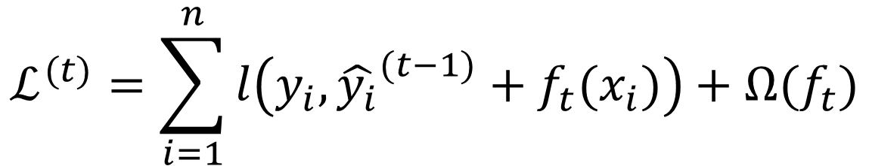
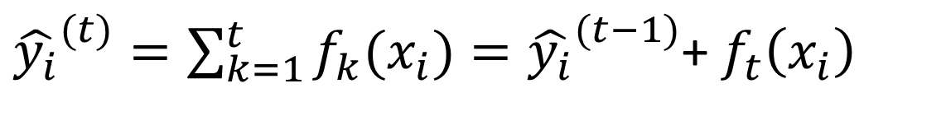
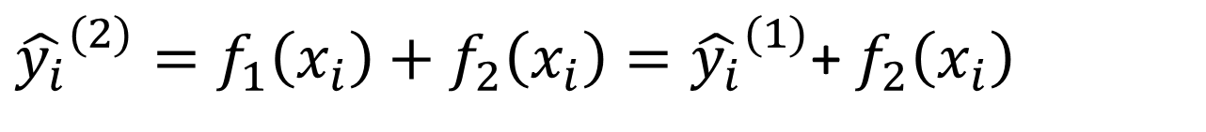
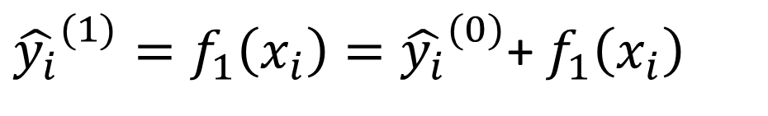

XGBoost
additive training
$$ℒ^{(t)}=\sum_{i=1}^{n}{l\left(y_{i},{\hat{y_{i}}}^{(t−1)}+f_{t}(x_{i})\right)+Ω(f_{t})}$$
$${\hat{y_{i}}}^{(0)}=0$$
${\hat{y_{i}}}^{(1)}=f_{1}\left(x_{i}\right)={\hat{y_{i}}}^{(0)}$+ $f_{1}\left(x_{i}\right)$
${\hat{y_{i}}}^{(2)}=f_{1}\left(x_{i}\right)+f_{2}\left(x_{i}\right)={\hat{y_{i}}}^{(1)}$+ $f_{2}\left(x_{i}\right)$
$$……$$
${\hat{y_{i}}}^{(t)}=\sum_{k=1}^{t}{f_{k}(x_{i})}={\hat{y_{i}}}^{(t−1)}$+ $f_{t}\left(x_{i}\right)$
Notes:
這是用來補充剛剛樹的串聯方法，每棵樹的結果都是建立在前一個樹的預測上，並且每棵樹都會預測出一個結果
----
因為無法在一次訓練所有的樹，因此會透過增量訓練 (additive training) 的方式，每一步都是在前一步的基礎上增加一棵樹來做修正。

Slide 31
Why use Tree-based models?

Slide 32
Why use Tree-based models?
Surveillance Record
Surgery Record
Tree-based models can capture complex non-linear relationships in data.
Tree-based models handle mixed data types, including both categorical and continuous features.
The decision-making process involves a series of if-else conditions, leading to a clear and interpretable structure.
The circles below represent True predictions.
Decision Tree Prediction
Random Forest Prediction
XGBoost Prediction
Notes:
從剛剛說明的樹模型中
Decision Tree 作為基礎模型，易於解釋，但容易過度擬合
Random Forest 是一種 Bagging 方法，通過多棵樹的集成來減少過擬合，並提高穩定性
XGBoost 則是一種 Boosting 方法，通過逐步修正錯誤提升預測準確性

Slide 33
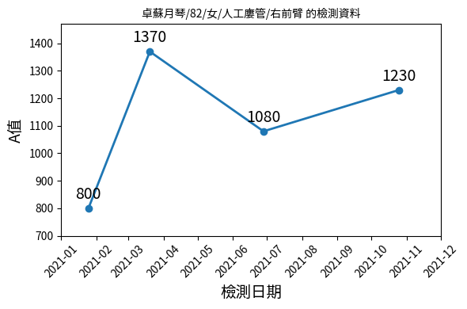
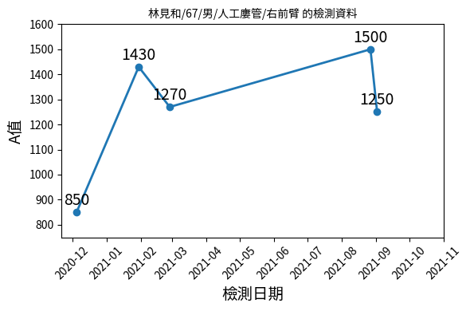
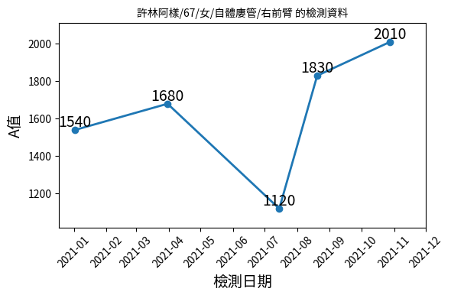
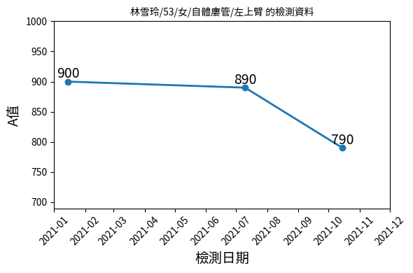
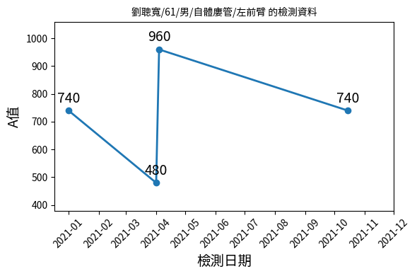
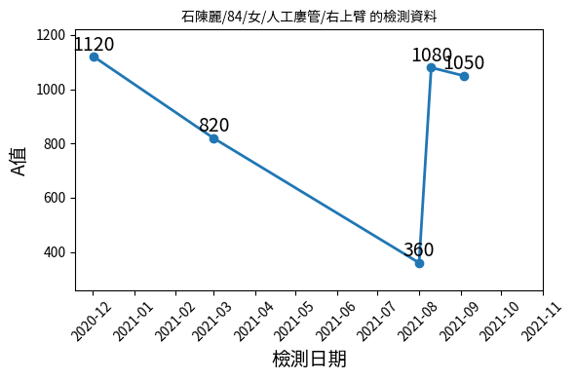
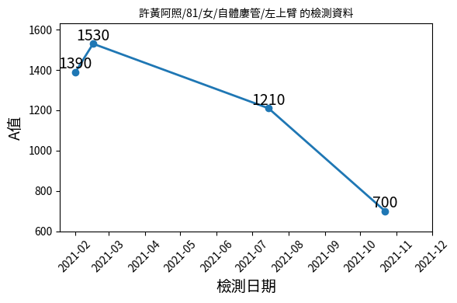
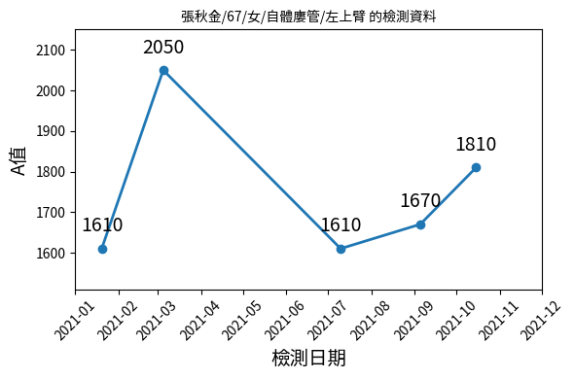
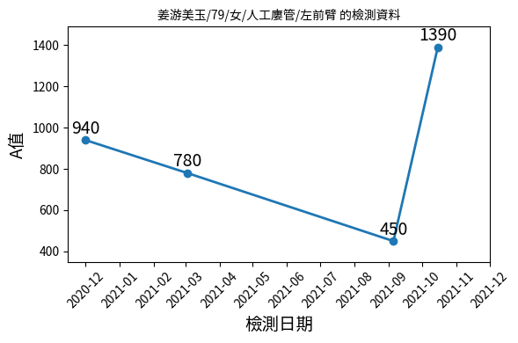
Analysis of Results from Tree-Based Models
Surveillance Record
Surgery Record
The circles below represent True predictions.
Decision Tree Prediction
Random Forest Prediction
XGBoost Prediction
Notes:
接下來是這三個模型在病人血液流速變化的預測狀況，然後對照實際執行手術的結果，(說明圈圈)
對於變化的A值，這三種模型都有優缺點，Decision tree比較簡單，所以會有機會預測錯誤(很容易像KDOQI guideline一樣找出特定流量範圍的執行手術預測)
相較於decision tree，random forest和xgboost能夠分析流量變化給予預測，甚至較難預測的第一筆資料也能依照內部多棵樹的決策判斷到

Slide 34
Decision
Tree
Random
Forest
XGBoost
Ensemble Learning
Notes:
再來由於這三種模型都各有優點，所以我們打算將他們合併，並使用集成學習的方式來提出預測結果
-- 結合成 Voting 模型，是為了利用它們各自的優點。Voting 模型通過綜合這些模型的預測結果，可以減少單一模型的偏差或方差問題，從而提升整體預測性能。這種策略可以在不同場景下捕捉數據的多樣性和複雜性，使模型更加穩健且泛化能力更強，最終有助於提高我們的研究在實際應用中的預測準確度和可靠性

Slide 35
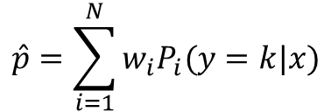
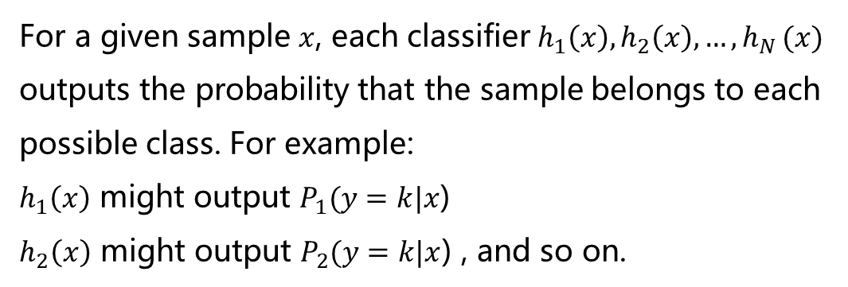
Ensemble Learning
Soft voting model
Decision
Tree
Random
Forest
XGBoost
For a given sample $x$, each classifier $h_{1}\left(x\right),h_{2}\left(x\right),{…,h}_{N}(x)$ outputs the probability that the sample belongs to each possible class. For example:
$h_{1}\left(x\right)$ might output $P_{1}(y=k|x$)
$h_{2}\left(x\right)$ might output $P_{2}(y=k|x$) , and so on.
$$\hat{p}=\sum_{i=1}^{N}{w_{i}P_{i}(y=k|x)}$$
Notes:
我們使用soft voting投票的方法將這三個模型各自輸出的結果取加權平均，再來輸出各類別預測的機率
$$\hat{y_{i}}=arg\max_{k}{(\sum_{i=1}^{N}{w_{i}P_{i}(y=k|x)})}$$

Slide 36






Ensemble Learning Block Diagram
Soft voting model
Decision
Tree
Random
Forest
XGBoost
$$x_{i}$$
$$\left(p_{i,T},p_{i,F}\right)$$
$$\left(p_{i,T},p_{i,F}\right)$$
$$\left(p_{i,T},p_{i,F}\right)$$
Weighted Average
$$[w_{1},w_{2},w_{3}]$$
$$\hat{p_{i}}$$
Notes:
就像這張方塊圖所展示的，我們的soft voting模型透過加權平均，輸出各類別預測的機率

Slide 37
Research Flow Chart
Start
Research Purpose
Design feature engineering variables
Is the model’s predictive capability sufficient?
yes
Multipass Indeterminacy Estimation Algorithm
no
Literature review
Tree-based Model Building
Redesigning feature engineering variables
Adjust model parameters
Indeterminate-Aware Data Classification Algorithm
Obtain patient test records
Model Validation
Analyze
prediction results
Discuss the significance of the variables with doctor
Result Analysis
Plot extended confusion matrix
Conclusions
Analyze data
End
Notes:
樹模型訓練好後，再來將這個樹模型加入我們提出的不確定性方法

Slide 38
Multipass Indeterminacy Estimation Algorithm
Notes:
首先我們介紹Multipass Indeterminacy Estimation 演算法

Slide 39
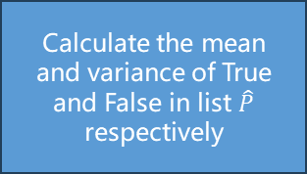
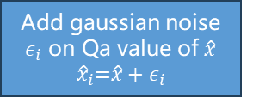


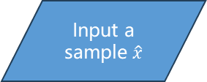
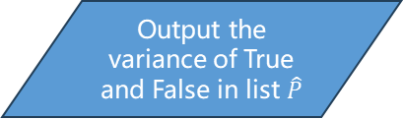

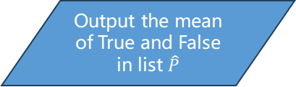
Multipass Indeterminacy Estimation Algorithm
Flow Chart
Start algorithm
Input a sample $\hat{x}$
Output the mean of True and False in list $\hat{P}$
yes
Calculate the mean and variance of True and False in list $\hat{P}$ respectively
Is it estimated 𝑛 times
Add gaussian noise $ε_{i}$ on Qa value of $\hat{x}$
$${\hat{x}}_{i}\text{=}\hat{x}+ε_{i}$$
Output the variance of True and False in list $\hat{P}$
no
Input ${\hat{x}}_{i}$ to
voting model
Resample Noise in ${\hat{x}}_{i}$
End
algorithm
Append model output $\hat{p_{i}}$ to list $\hat{P}$
Notes:
這個演算法會先將輸入的樣本加入高斯雜訊，再輸入至訓練好的soft voting model中，完成預測後將各類別的預測機率存起來，再來重複相同的步驟執行加入不同雜訊，直到達到我們設定好的目標數n
最後會計算所有相同類別預測機率的mean與variance來完成此演算法，這邊的類別是True以及False代表是否執行手術
0.6,0.4
0.63,0.37
0.5 0.5

Slide 40
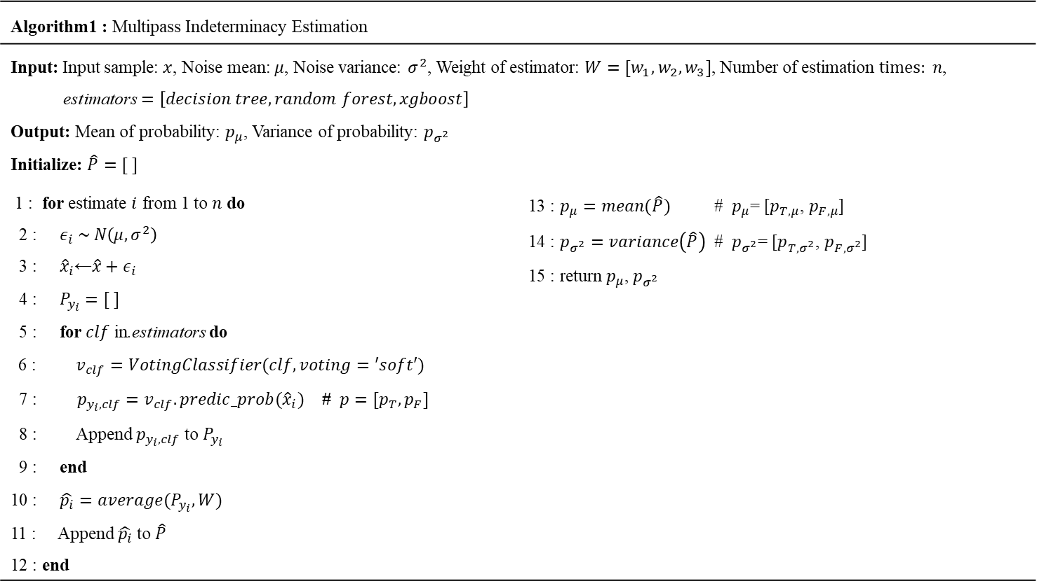
Multipass Indeterminacy Estimation Algorithm
Algorithm1 : Multipass Indeterminacy Estimation
Input: Input sample: $x$, Noise mean: $μ$, Noise variance: $σ^{2}$, Weight of estimator: $W=[w_{1},w_{2},w_{3}]$, Number of estimation $times: n$, $\text{estimators}=\left[decision tree,random forest,xgboost\right]$ Output: Mean of probability: $p_{μ}$, Variance of probability: $p_{σ^{2}}$ Initialize: $\hat{P}=[ ]$
1 : for estimate $i$ from 1 to $n$ do 2 : $ε_{i} \sim N\left(μ,σ^{2}\right)$ 3 : ${\hat{x}}_{i}\text{←}\hat{x}+ε_{i}$ 4 : $P_{y_{i}}=[ ]$ 5 : for $clf$ in$\text{.}\text{estimators}$ do 6 : $v_{clf}=VotingClassifier(clf, voting=′soft′)$ 7 : $p_{y_{i},clf}=v_{clf}.predic_prob({\hat{x}}_{i})$ # $p=[p_{T}, p_{F}]$ 8 : Append $p_{y_{i},clf}$ to $P_{y_{i}}$ 9 : end 10 : $\hat{p_{i}}=average(P_{y_{i}},W)$ 11 : Append $\hat{p_{i}}$ to $\hat{P}$ 12 : end | 13 : $p_{μ}=mean(\hat{P})$ # $p_{μ}$= [$p_{T,μ}$, $p_{F,μ}$] 14 : $p_{σ^{2}}=variance\left(\hat{P}\right)$ # $p_{σ^{2}}$= [$p_{T,σ^{2}}$, $p_{F,σ^{2}}$] 15 : return $p_{μ}$, $p_{σ^{2}}$
Notes:
完整的演算法可以參考這，輸入是一個樣本、高斯雜訊的mean與variance，以及voting model的各自權重，執行加入雜訊的次數
輸出是所有相同類別預測機率的mean與variance

Slide 41
Indeterminate-Aware Data Classification Algorithm
Notes:
再來我們要使用剛剛輸出的mean與variance在Indeterminate-Aware Data Classification 演算法中

Slide 42
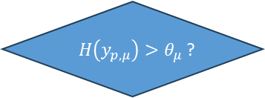

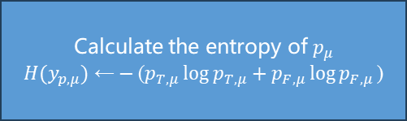

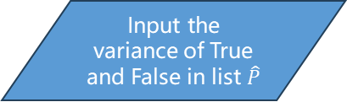
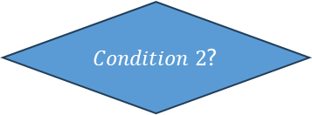
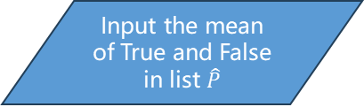
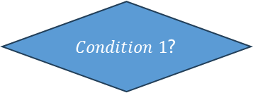
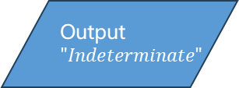
Indeterminate-Aware Data Classification Algorithm
Flow Chart
Start algorithm
$H\left(y_{p,μ}\right)>θ_{μ}$?
yes
Output$"Indeterminate"$
End
algorithm
Input the mean of True and False in list $\hat{P}$
no
$Condition 1$?
yes
Output$"True"$
End
algorithm
Input the variance of True and False in list $\hat{P}$
no
$Condition 2$?
yes
Output$"False"$
End
algorithm
Calculate the entropy of $p_{μ}$
$$H(y_{p,μ}) \text{←}−\text{(}p_{T,μ}\log{p_{T,μ}}+p_{F,μ}\log{p_{F,μ}}\text{)}$$
no
Output$"Indeterminate"$
End
algorithm
${Condition 1 :p}_{T,μ}>p_{F,μ}$ and $p_{T,μ}$- $\sqrt{p_{{T,σ}^{2}}}$ > $p_{F,μ}+\sqrt{p_{F,σ^{2}}}$
${Condition 2 :p}_{F,μ}>p_{T,μ}$ and $p_{F,μ}$ - $\sqrt{p_{F,σ^{2}}}$ > $p_{T,μ}+\sqrt{p_{T,σ^{2}}}$
Notes:
這個步驟會先用剛剛的mean來計算hypothesis，再來判斷時使用設定的不確定性閾值、以及下方兩個條件來控制輸出為True還是False又或是Indeterminate
下方兩個條件分別是用前一個演算法得到的mean與variance來判斷為True或為False的情況
Classification Result: True/False/Indeterminate

Slide 43
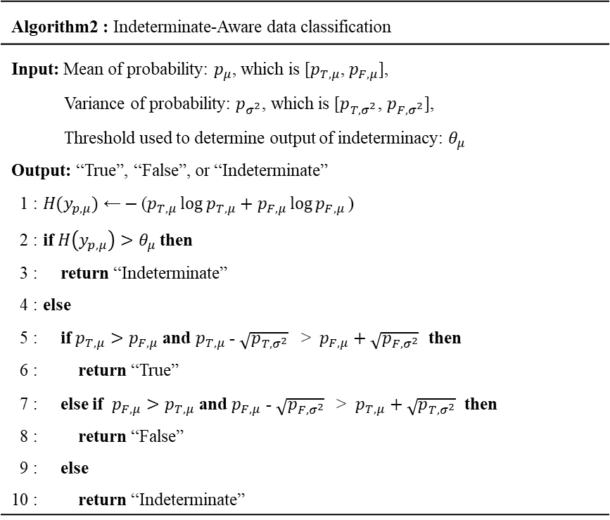
Indeterminate-Aware Data Classification Algorithm
Algorithm2 : Indeterminate-Aware data classification
Input: Mean of probability: $p_{μ}$, which is [$p_{T,μ}$, $p_{F,μ}$], Variance of probability: $p_{σ^{2}}$, which is [$p_{T,σ^{2}}$, $p_{F,σ^{2}}$], Threshold used to determine output of indeterminacy: $θ_{μ}$ Output: “True”, “False”, or “Indeterminate” 1 : $H(y_{p,μ}) \text{←}−\text{(}p_{T,μ}\log{p_{T,μ}}+p_{F,μ}\log{p_{F,μ}}\text{)}$ 2 : if $H\left(y_{p,μ}\right)>θ_{μ}$ then 3 : return “Indeterminate” 4 : else 5 : if $p_{T,μ}>p_{F,μ}$ and $p_{T,μ}$- $\sqrt{p_{{T,σ}^{2}}}$ > $p_{F,μ}+\sqrt{p_{F,σ^{2}}}$ then 6 : return “True” 7 : else if $p_{F,μ}>p_{T,μ}$ and $p_{F,μ}$ - $\sqrt{p_{F,σ^{2}}}$ > $p_{T,μ}+\sqrt{p_{T,σ^{2}}}$ then 8 : return “False” 9 : else 10 : return “Indeterminate”
Notes:
完整的演算法可以參考這，輸入是前一步的mean與variance，以及不確定性的閾值，輸出為True、False、Indeterminate

Slide 44
Research Flow Chart
Start
Research Purpose
Design feature engineering variables
Is the model’s predictive capability sufficient?
yes
Multipass Indeterminacy Estimation Algorithm
no
Literature review
Tree-based Model Building
Redesigning feature engineering variables
Adjust model parameters
Indeterminate-Aware Data Classification Algorithm
Obtain patient test records
Model Validation
Analyze
prediction results
Discuss the significance of the variables with doctor
Result Analysis
Plot extended confusion matrix
Conclusions
Analyze data
End
Notes:
最後是我們的實驗結果

Slide 45
Evaluation Metrics
Notes:
首先我們先來看指標的部分

Slide 46
Evaluation Metrics
Extended Confusion Matrix
 | Predicted Positive | Predicted Negative | Predicted Indeterminate
Actually Positive | a | b | e
Actually Negative | c | d | f
a : True positive (TP)
b : False negative (FN)
c : False positive (FP)
d : True negative (TN)
e : Actual positive cases predicted as indeterminate (IP)
f : Actual negative cases predicted as indeterminate (IF)
Notes:
我們實驗室提出了Extended Confusion Matrix，用在不確定性樣本的分類上

Slide 47
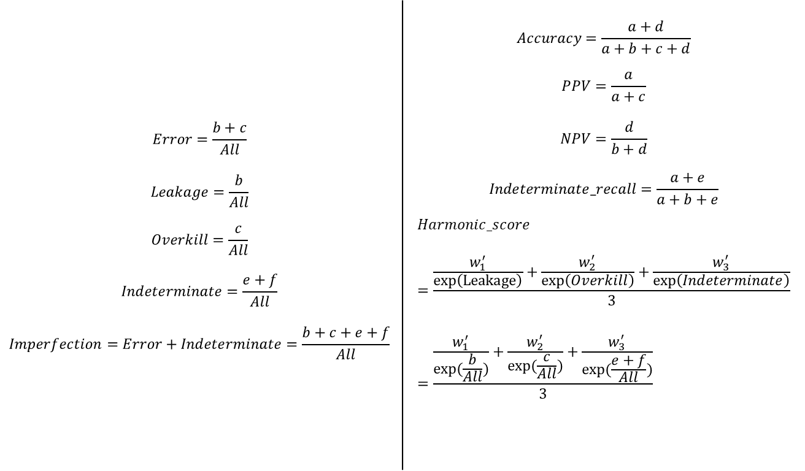
Evaluation Metrics
$$All=a+b+c+d+e+f$$
 | Predicted Positive | Predicted Negative | Predicted Indeterminate
Actually Positive | a | b | e
Actually Negative | c | d | f
$$Error=\frac{b+c}{All}$$ $$Leakage=\frac{b}{All}$$ $$Overkill=\frac{c}{All}$$ $$Indeterminate=\frac{e+f}{All}$$ $$Imperfection=Error+Indeterminate=\frac{b+c+e+f}{All}$$ | $$Accuracy=\frac{a+d}{a+b+c+d}$$ $$PPV=\frac{a}{a+c}$$ $$NPV=\frac{d}{b+d}$$ $$Indeterminate_recall=\frac{a+e}{a+b+e}$$ $$Harmonic_score=\frac{\frac{w_{1}^{′}}{\exp\left(Leakage\right)}+\frac{w_{2}^{′}}{\exp\left(Overkill\right)}+\frac{w_{3}^{′}}{\exp\left(Indeterminate\right)}}{3}=\frac{\frac{w_{1}^{′}}{exp⁡(\frac{b}{All})}+\frac{w_{2}^{′}}{exp(\frac{c}{All})}+\frac{w_{3}^{′}}{exp⁡(\frac{e+f}{All})}}{3}$$
a : True positive (TP)
b : False negative (FN)
c : False positive (FP)
d : True negative (TN)
e : Actual positive cases predicted as indeterminate (IP)
f : Actual negative cases predicted as indeterminate (IF)
Notes:
並且提出以下指標來評估不確定性(指標說明)

Slide 48
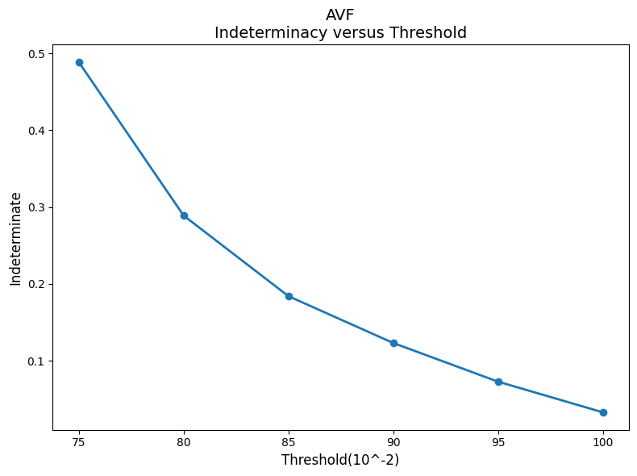
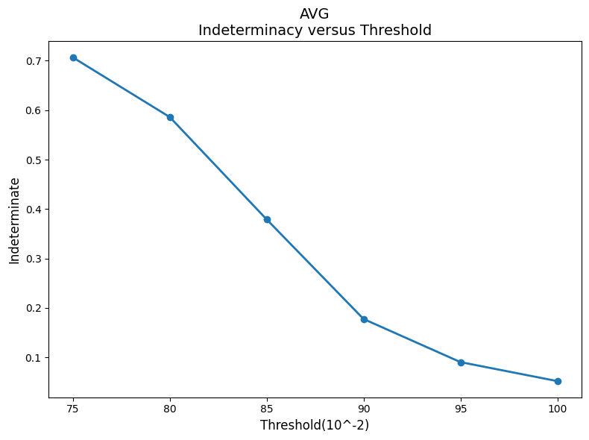

Threshold changes used to determine output of indeterminacy
 | Predicted Positive | Predicted Negative | Predicted Indeterminate
Actually Positive | a | b | e
Actually Negative | c | d | f
$$Indeterminate=\frac{e+f}{All}$$
$$All=a+b+c+d+e+f$$
Notes:
X軸是剛剛演算法提到用來控制不確定性的閾值Y軸是不確定性，這次的研究主要控制不確定性盡量在0.1以下，所以選擇0.95當作threshold
AVF
75 : 0.488474
80 : 0.288929
85 : 0.184126
90 : 0.123218
95 : 0.072928
100 : 0.033056
AVG
75 : 0.706737
80 : 0.586071
85 : 0.378972
90 : 0.177441
95 : 0.090207
100 : 0.051760

Slide 49
Arteriovenous Fistula (AVF) Dataset
Notes:
再來我們開始介紹在AVF資料集的狀況

Slide 50
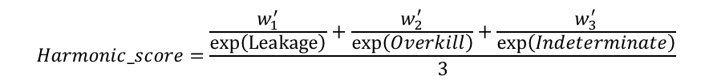
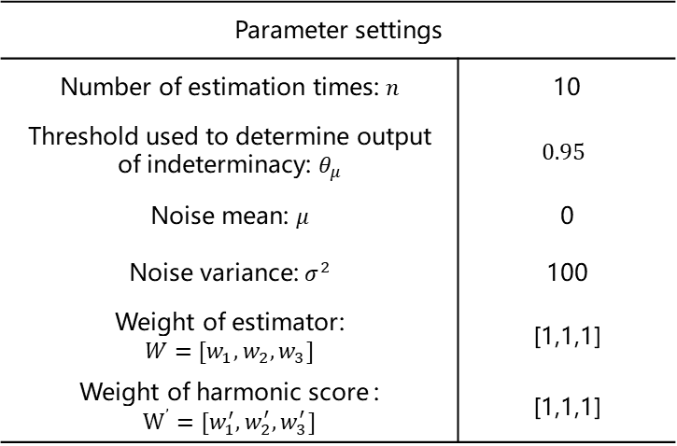
Arteriovenous Fistula (AVF) Dataset
Parameter settings
Number of estimation times: $n$ | 10
Threshold used to determine output of indeterminacy: $θ_{μ}$ | $$0.95$$
Noise mean: 𝜇 | 0
Noise variance: $σ^{2}$ | 100
Weight of estimator: $$W=[w_{1},w_{2},w_{3}]$$ | [1,1,1]
Weight of harmonic score : $$W^{’}=[w_{1}^{′},w_{2}^{′},w_{3}^{′}]$$ | [1,1,1]
546
(10.9%)
4445
(89.1%)
Find the parameters by bayesian optimization
$$Harmonic_score=\frac{\frac{w_{1}^{′}}{\exp\left(Leakage\right)}+\frac{w_{2}^{′}}{\exp\left(Overkill\right)}+\frac{w_{3}^{′}}{\exp\left(Indeterminate\right)}}{3}$$
Notes:
我們的參數設定如右表所示

Slide 51
Arteriovenous Fistula (AVF) Dataset
Evaluation Metrics
 | Accuracy | PPV | NPV | Error | Leakage | Overkill | Indeterminate | Imperfection
AVF (baseline) | 0.8722 ± 0.0012 | 0.3940 ± 0.0109 | 0.9177 ± 0.0026 | 0.1292 ± 0.0100 | 0.0781 ± 0.0120 | 0.0511 ± 0.0310 | 0.0000 ± 0.0000 | 0.1292 ± 0.0100
AVF (Without indeterminate) | 0.8952 ± 0.0035 | 0.5886 ± 0.0283 | 0.9040 ± 0.0015 | 0.1048 ± 0.0035 | 0.0934 ± 0.0010 | 0.0114 ± 0.0025 | 0.0000 ± 0.0000 | 0.1048 ± 0.0035
AVF (indeterminate) | 0.9131 ± 0.0029 | 0.8412 ± 0.0427 | 0.9136 ± 0.0011 | 0.0805 ± 0.0015 | 0.0785 ± 0.0020 | 0.0020 ± 0.0017 | 0.0729 ± 0.0265 | 0.1535 ± 0.0213
 | Indeterminate recall | Harmonic score
AVF (baseline) | 0.2610 ± 0.0391 | 0.9583 ± 0.0020
AVF (Without indeterminate) | 0.1461 ± 0.0144 | 0.9665 ± 0.0011
AVF (indeterminate) | 0.2922 ± 0.0298 | 0.9508 ± 0.0078
Notes:
第一列是KDOQI guidelines的判斷結果，再來依序是我們的模型，但是關閉不確定性，然後第三列是開啟不確定性的結果 在自體瘻管資料集中我們的準確度、與預測手術率有明顯提升並且error、leakage、overkill都有明顯降低

Slide 52



Arteriovenous Fistula (AVF) Dataset
Extended Confusion Matrix
KDOQI guidelines
(Baseline)
Our approach
(Without indeterminate)
Our approach
(indeterminate)
Notes:
再來是Extended Confusion Matrix結果，從右邊的圖可以看到，我們成功將較難判斷的資料排除來改善我們的結果

Slide 53



Arteriovenous Fistula (AVF) Dataset
ROC Curve
KDOQI guidelines
(Baseline)
Our approach
(Without Indeterminate)
Our approach
(Indeterminate)
Notes:
接著是ROC curve，使用不確定性的方式也可以改善模型的可信度

Slide 54
Arteriovenous Graft (AVG) Dataset
Notes:
接著是在AVG資料集的狀況

Slide 55

Arteriovenous Graft (AVG) Dataset
Parameter settings
Number of estimation times: $n$ | 10
Threshold used to determine output of indeterminacy: $θ_{μ}$ | $$0.95$$
Noise mean: 𝜇 | 0
Noise variance: $σ^{2}$ | 80
Weight of estimator: $$W=[w_{1},w_{2},w_{3}]$$ | [1,1,1]
Weight of harmonic score : $$W^{’}=[w_{1}^{′},w_{2}^{′},w_{3}^{′}]$$ | [1,1,1]
218
(25.1%)
651
(74.9%)
Find the parameters by bayesian optimization
$$Harmonic_score=\frac{\frac{w_{1}^{′}}{\exp\left(Leakage\right)}+\frac{w_{2}^{′}}{\exp\left(Overkill\right)}+\frac{w_{3}^{′}}{\exp\left(Indeterminate\right)}}{3}$$
Notes:
我們的參數設定如右表所示

Slide 56
Arteriovenous Graft (AVG) Dataset
Evaluation Metrics
 | Accuracy | PPV | NPV | Error | Leakage | Overkill | Indeterminate | Imperfection
AVG (Baseline) | 0.7906 ± 0.0183 | 0.6849 ± 0.0440 | 0.8091 ± 0.0258 | 0.2080 ± 0.0318 | 0.1861 ± 0.0107 | 0.0480 ± 0.0164 | 0.0000 ± 0.0000 | 0.2080 ± 0.0318
AVG (Without indeterminate) | 0.7652 ± 0.0225 | 0.6950 ± 0.0446 | 0.7879 ± 0.0279 | 0.2348 ± 0.0225 | 0.1899 ± 0.0274 | 0.0319 ± 0.0171 | 0.0000 ± 0.0000 | 0.2348 ± 0.0225
AVG (indeterminate) | 0.8178 ± 0.0192 | 0.7397 ± 0.1369 | 0.8280 ± 0.0309 | 0.1473 ± 0.0166 | 0.1278 ± 0.0252 | 0.0195 ± 0.0117 | 0.1922 ± 0.0071 | 0.3395 ± 0.0110
 | Indeterminate recall | Harmonic score
AVG (Baseline) | 0.2616 ± 0.0697 | 0.9077 ± 0.0184
AVG (Without indeterminate) | 0.2467 ± 0.0586 | 0.9279 ± 0.013
AVG (indeterminate) | 0.4957 ± 0.0586 | 0.8954 ± 0.0132
Notes:
在人工瘻管資料集中我們的準確度、與預測手術率、預測不手術率有明顯提升，並且error、leakage、overkill都有明顯降低

Slide 57



Arteriovenous Graft (AVG) Dataset
Extended Confusion Matrix
KDOQI guidelines
(Baseline)
Our approach
(Without indeterminate)
Our approach
(indeterminate)
Notes:
再來是Extended Confusion Matrix結果，也成功地將較難判斷的資料排除來改善我們的結果

Slide 58



Arteriovenous Graft (AVG) Dataset
ROC Curve
KDOQI guidelines
(Baseline)
Our approach
(Without Indeterminate)
Our approach
(Indeterminate)
Notes:
接著是ROC curve，在AVG資料集上使用不確定性的方式模型的可信度提升比較明顯

Slide 59
Research Flow Chart
Start
Research Purpose
Design feature engineering variables
Is the model’s predictive capability sufficient?
yes
Multipass Indeterminacy Estimation Algorithm
no
Literature review
Tree-based Model Building
Redesigning feature engineering variables
Adjust model parameters
Indeterminate-Aware Data Classification Algorithm
Obtain patient test records
Model Validation
Analyze
prediction results
Discuss the significance of the variables with doctor
Result Analysis
Plot extended confusion matrix
Conclusions
Analyze data
End
Notes:
最後是我的結論

Slide 60
Conclusion
Taiwan has the highest proportion of dialysis patients globally, with vascular access dysfunction being a common complication. This study uses tree-based machine learning models for data classification and Indeterminacy analysis. By introducing new metrics and an extended confusion matrix, diagnostic accuracy is improved, leading to better patient outcomes.
Compared to the KDOQI guidelines and 2023 CK Wu's methodology, our methodology has better prediction results.
Notes:
我們提出了以樹狀結構為基礎的學習模型來進行資料分類與不確定性分析。並透過引入新的指標和extended confusion matrix，提高了診斷的準確性，從而改善了患者的治療效果。

Slide 61
Thanks for Your Attention
Q&A

Slide 62
Types of uncertainty
Our Method→
Aleatoric Uncertainty (Data Uncertainty)
Represents uncertainty inherent in the data due to randomness or noise. It is irreducible, meaning it cannot be eliminated even with infinite data.
Epistemic Uncertainty (Model Uncertainty)
Arises from lack of knowledge or insufficient training data. It is reducible and can be minimized by gathering more or better data.
Other Specialized Types of Uncertainty
Ontological Uncertainty
Distributional Shift Uncertainty
Quantization Uncertainty
Subjective Uncertainty
Total Uncertainty
The combined effect of aleatoric and epistemic uncertainty
Can be modeled directly from data (e.g., using probabilistic models).
Highlights the dependence on noise in the input.
Notes:
it reflects the intrinsic unpredictability due to noisy inputs.

Slide 63
Comparison of tree based model and deep learning model on tabular data
 | Tree based model | Deep learning model
Performance | Models like Gradient Boosted Trees excel in handling tabular data with structured features (categorical, numerical). They often outperform deep learning on small-to-medium-sized tabular datasets due to their ability to capture non-linear relationships and feature importance effectively. | Deep learning models like fully connected neural networks often require large amounts of data to generalize well. They can underperform on tabular data because they struggle to effectively leverage structured relationships without extensive feature engineering.
Application Scenarios | Small-to-medium-sized tabular datasets. Problems requiring interpretability. Domains like finance, healthcare, and e-commerce. | Very large datasets with high-dimensional categorical features. Scenarios where embeddings or end-to-end deep learning (e.g., multi-modal data) are advantageous. Tasks with a mix of tabular and unstructured data (e.g., text, images).

Slide 64
References for comparison between tree models and deep learning models
"Why do tree-based models still outperform deep learning on tabular data?" by Léo Grinsztajn, Edouard Oyallon, and Gaël Varoquaux (2022):
This paper presents extensive benchmarks across 45 datasets, demonstrating that tree-based models, such as XGBoost and Random Forests, often outperform deep learning models on medium-sized tabular datasets (~10,000 samples).
The authors attribute this performance gap to differences in inductive biases, noting that neural networks may struggle with uninformative features and irregular functions common in tabular data.
"When Do Neural Nets Outperform Boosted Trees on Tabular Data? " by Duncan McElfresh, Sujay Khandagale(2023):
This study covers 19 algorithms and 176 datasets.
GBDTs outperform NNs on average, but the emphasis on algorithm choice may be overstated. On many datasets, simple baseline models or light hyperparameter tuning, such as using CatBoost in GBDTs, often achieves performance comparable to selecting between NNs and GBDTs.
GBDTs excel particularly in handling data irregularities, such as skewed or heavy-tailed distributions. Additionally, dataset-specific properties significantly influence algorithm performance.
"A Closer Look at Deep Learning on Tabular Data" by Han-Jia Ye et al. (2024)
This study evaluates deep learning methods on 300 tabular datasets, covering various task types and domains.
The findings indicate that while deep learning models have made progress, tree-based models remain competitive, especially in scenarios with limited data or resources.

