Slide 1
Capstone Option 2:
Biodiversity for the National Parks

Slide 2
Data 1:
category,scientific_name,common_names,conservation_status
Data2:
Vascular Plant,Pyrrocoma integrifolia,"Entireleaf Goldenweed, Manysted Goldenweed, Many-Stemmed Goldenweed",
Data 3:
Vascular Plant,Erysimum asperum,Western Wallflower,
Data 4:
Vascular Plant,Silene vulgaris,"Bladder Campion, Bladder Silene, Cowbell, Maiden's Tears, Maidenstears, Maiden's-Tears, Rattleweed",

Slide 3
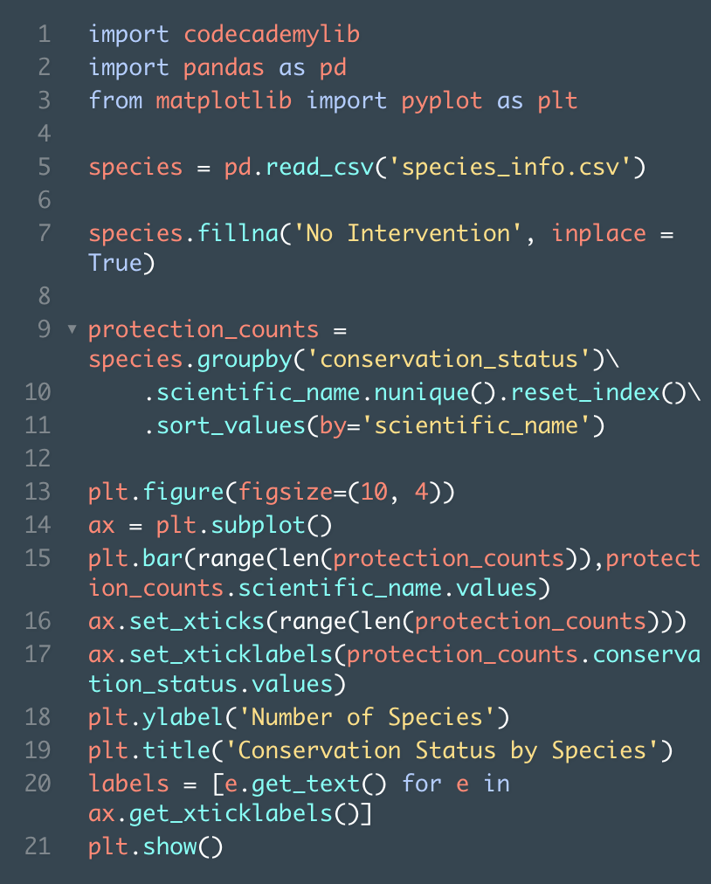
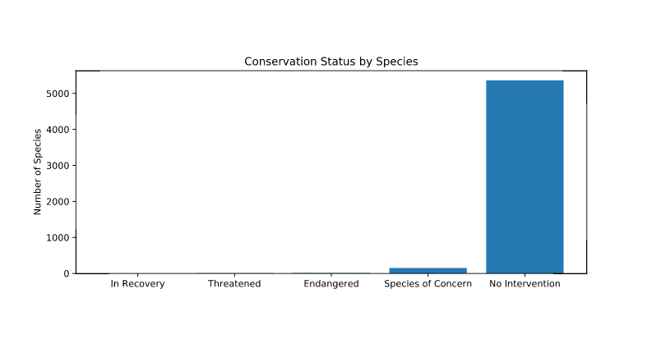
Plotting Conservation Status by Species

Slide 4
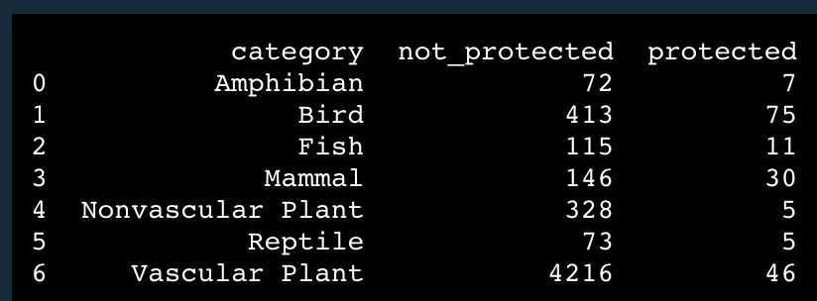
Recommendation
Choose:
Vascular Plant and Nonvascular Plant
Fish

Slide 5
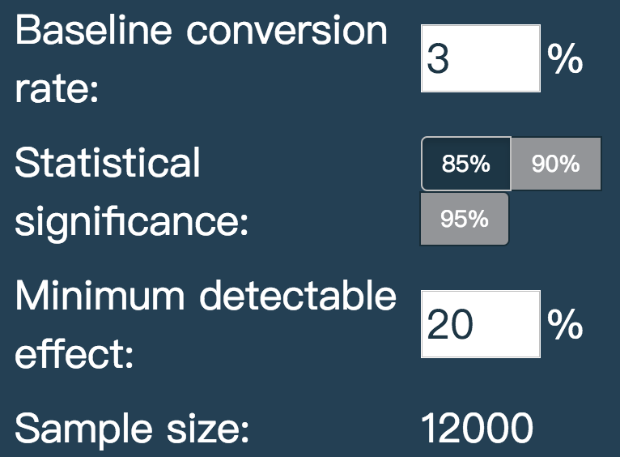
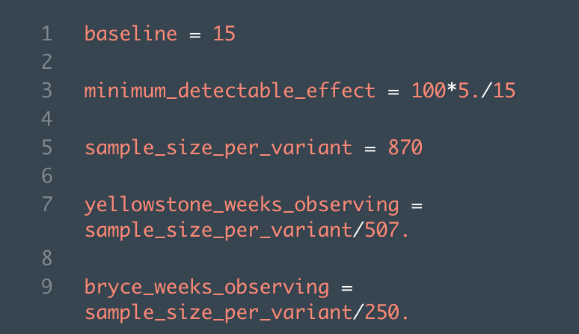
Capstone Option 2:
Biodiversity for the National Parks

Slide 6
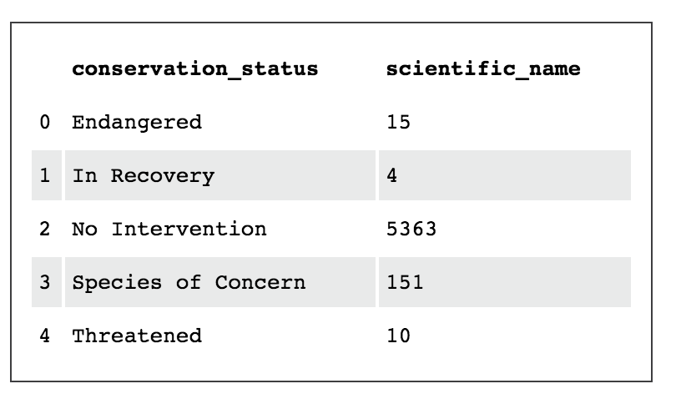

Slide 8

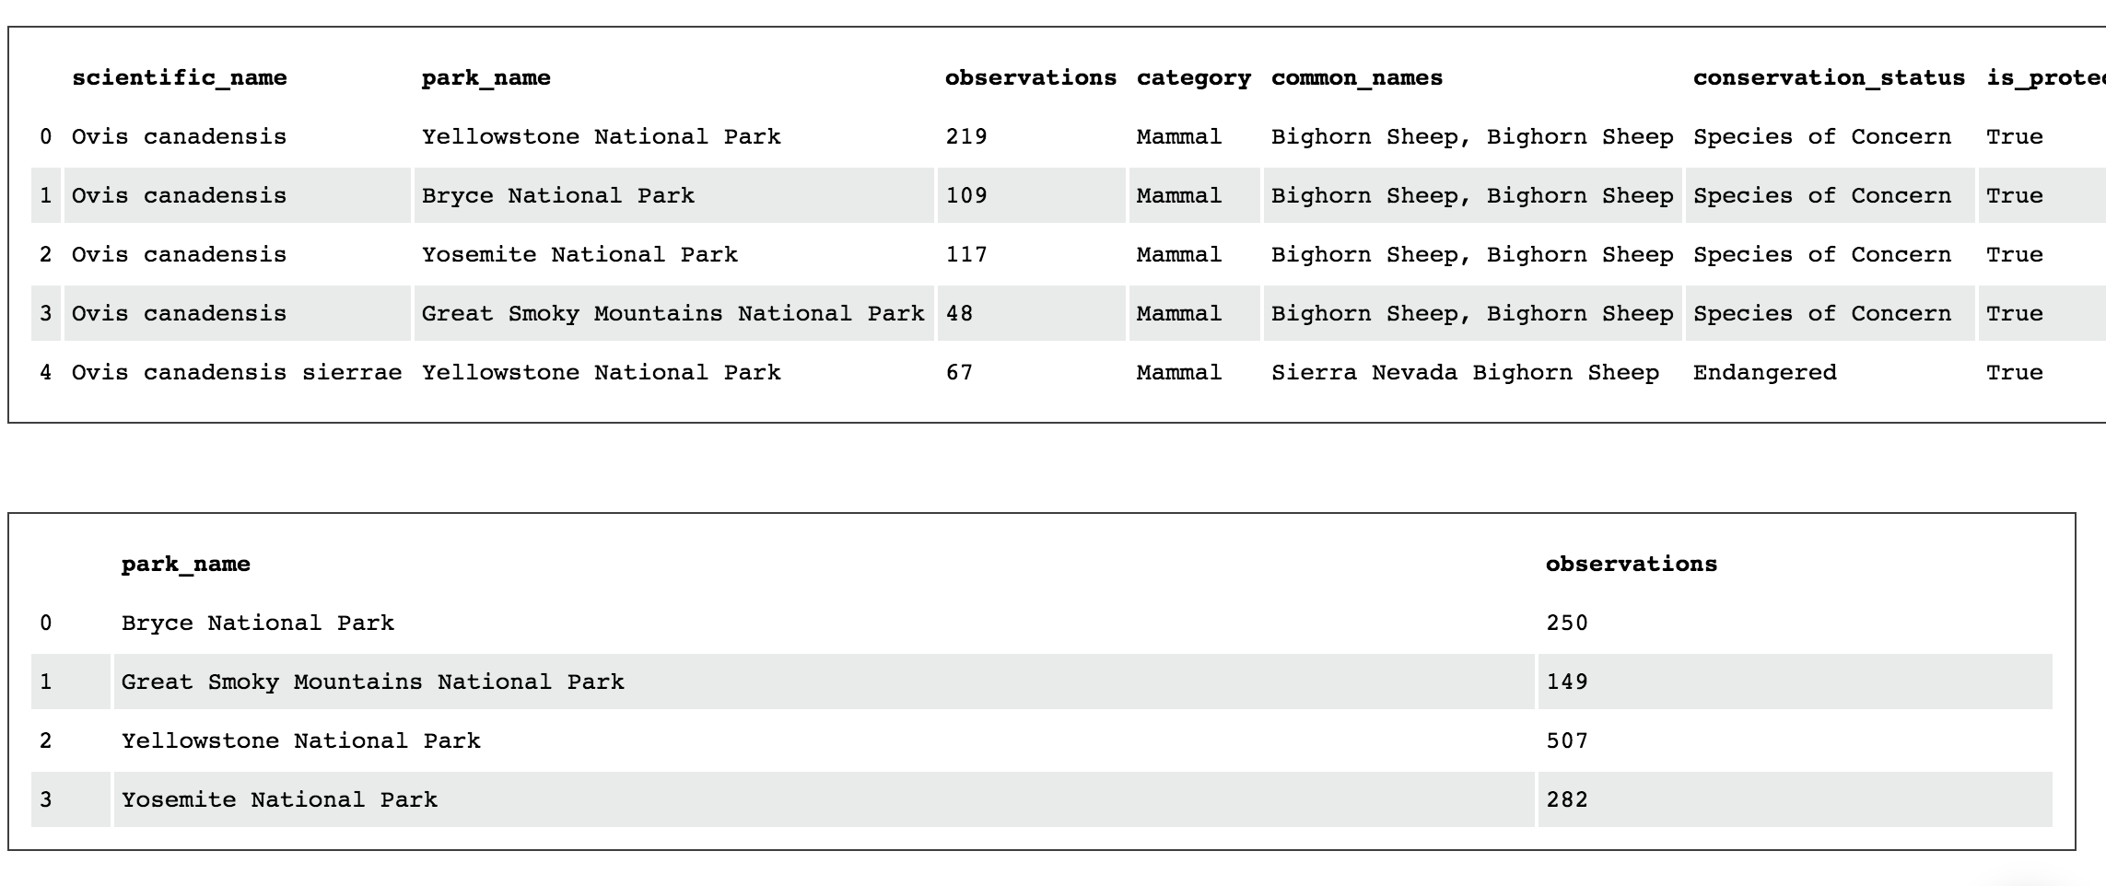

Slide 9
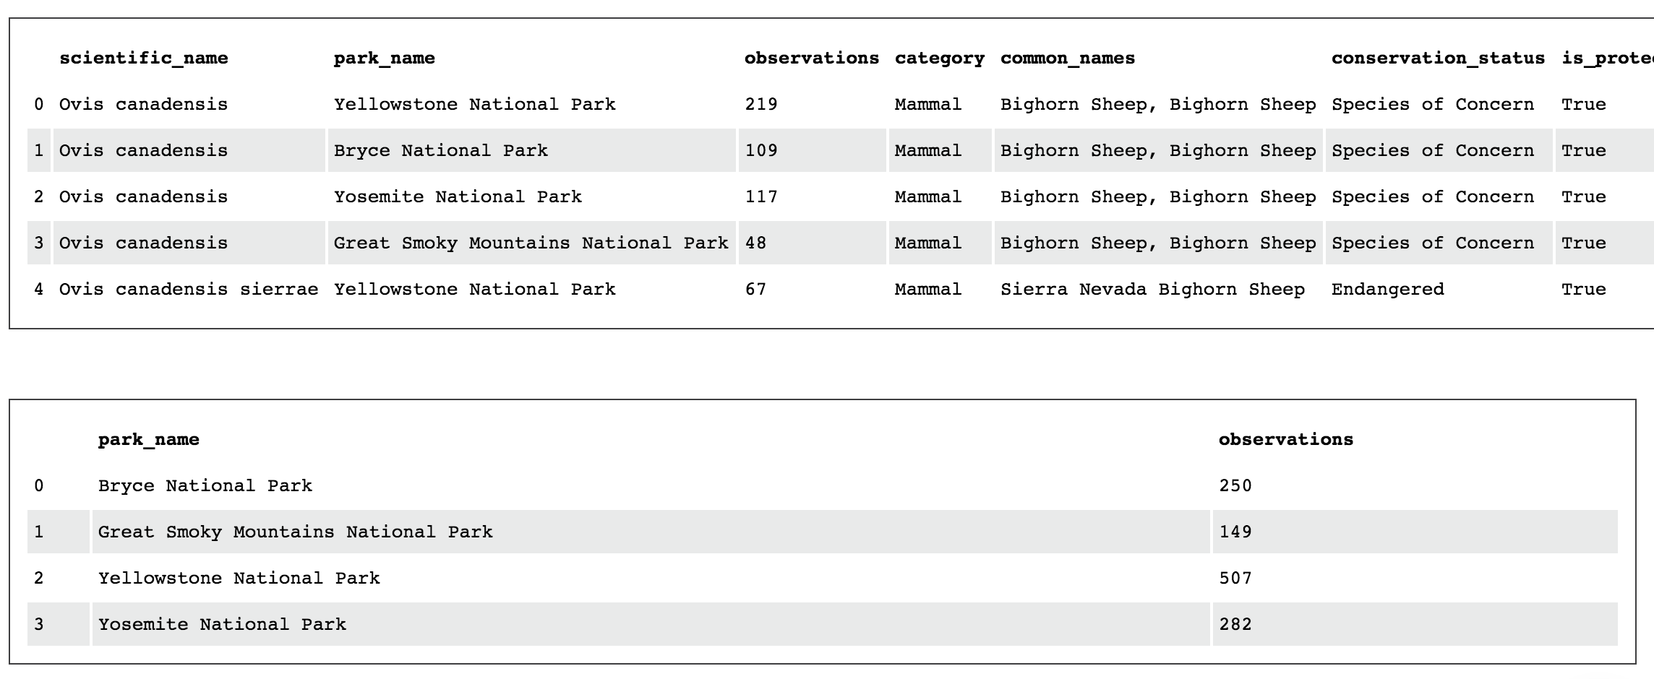


Slide 10
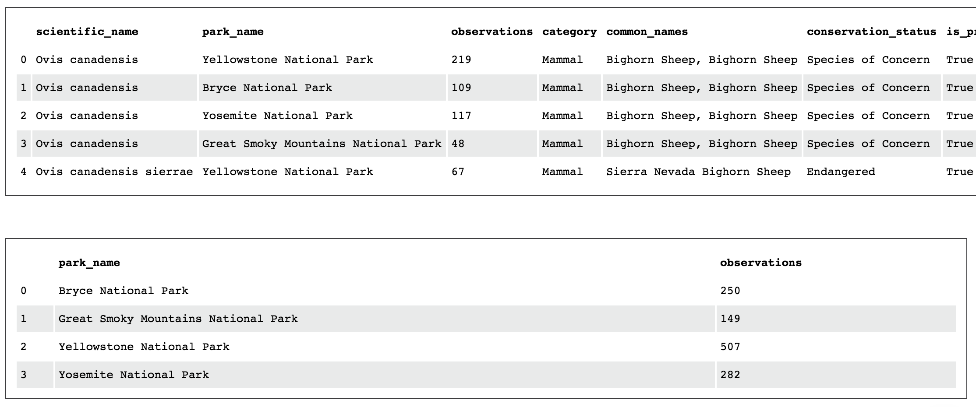
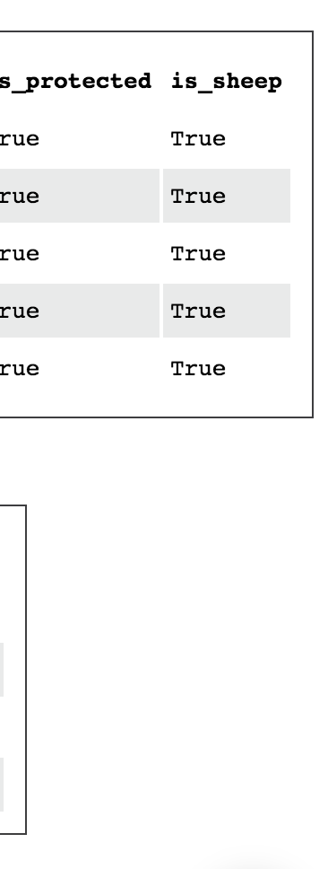

Slide 11
