Slide 1


HOW TO MAKE FRIENDS
DR. SHELDON COOPER Ph.D
GET STARTED! ->

Slide 2
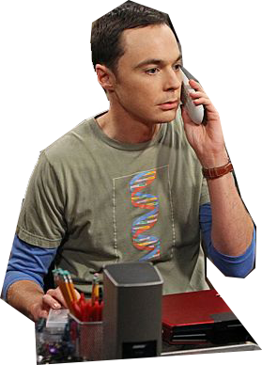


Step 1.
Place phone call
BRRRING BRRRRRRING…

Slide 3

Step 1.
DID HE/SHE PICK UP?
NEXT ->

Slide 4
Step 1.
NO.
LEAVE MESSAGE…
Wait for call back
NEXT ->

Slide 5
Step 1.
yes.
“WOULD YOU LIKE TO SHARE A MEAL?”
What is the response?
NEXT ->

Slide 6
SHARE MEAL?
no.
“DO YOU ENJOY A HOT BEVERAGE?”
What is the response?
NEXT ->

Slide 7
SHARE MEAL?
YES.
dine together
NEXT ->

Slide 8

Begin
friendship!

