Slide 1
Data Science and R
Summer 2018
By: Amit Arora

Slide 2
Before we begin
This presentation and everything we need is available on https://github.com/aarora79/DS_For_HighSchoolers-Summer-2018-/
This presentation:
https://github.com/aarora79/DS_For_HighSchoolers-Summer-2018-/raw/master/class1/Class1.pptx
Please copy code from the github repo (you could clone the repo) to your PC in a folder where you plan to keep all the material for this class, typically c:\users\<your username>\Documents\R_and_DataScience.

Slide 3
What, why and how
What this class is about: Using data we are familiar with to create practical examples of analytics workflows using R.
Why this class: all of us work with data in some capacity, why not use the latest tools and technologies to make this work easier and do so much more.
How we would be going about this class: We would be using RStudio and various packages from the R ecosystem.
If at the end of three classes you see a CSV file and your first thought is “I can do so much with this data using R” then we have scored a win.

Slide 4
Agenda
Class 1 & 2 : Get the basics of R. Run through a typical workflow for exploring a dataset.
Setting up R Studio
Data Types
Loops and Conditional Statements
Functions, vectorized version of functions
Functional Programming
Commonly used Packages and tasks: dplyr, purr, ggplot2, lubridate, tidyr,
All through we will be working with publically available data i.e. data we understand to make this all relevant.

Slide 5
Class 1
Basics of R

Slide 6
All material available at
We would approach learning R from the perspective of already knowing some programming language(s).
To be able to program in any programming language we need to know some basic constructs:
Data types supported by the language
How to write loops, conditional statements
How to write functions
There is one more thing though…
Programming Idioms (which may be) unique to the language
Stack overflow is your friend, but not to be kept on speed dial !

Slide 7
RSTudio
RStudio is the Integrated Development Environment (IDE) for R.
It is possible to do development in R without RStudio as well but it is the defacto standard.
We would be using RStudio throughout and for the most part stick to the default layout and options, and explore the simplest workflow i.e. open a file, write some code, run the code, see the results on the console and charts on the Plots or Viewer tab.
A cheatsheet for RStudio is available here https://www.rstudio.com/wp-content/uploads/2016/01/rstudio-IDE-cheatsheet.pdf.

Slide 8
Data Types in r
R is a high-level, interpreted computer language. Everything in R is an object (and a vector).
Basic data types
logical (TRUE/FALSE)
integer (2, 3L etc.)
numeric (real or decimal, for e.g. 3.4)
complex (1+2i)
character (“b”, “abc”)
Data structures
vector (of any basic data type, e.g. c(1, 5, 7), c(T,F,F))
matrix (vector represented in 2d, e.g. matrix(c(1,5,6),3,1))
data frame (a table, different columns could be of different data types, e.g. data.frame(x=c(1,2), y=('a', ‘b'))
list (ordered collection of objects, could have lists of lists, for e.g. list(x1=1, y1='a', z1=list(x2=2, y2='b'))
Use functions as.integer, as.numeric etc for data type conversion
Use functions “str” ,“class”, “names”, “length” to understand the details of a variable

Slide 9
There is one more data type to know
Factor: used for representing nominal or ordinal data. Represented as strings but internally stored as integers. Think of it as enum in C.
Nominal: the assigned integer value does not matter.
ipgw_types = factor(c("E-IPGW", "MGW", "WGW", "VPN", "N-IPGW", "T-IPGW"))
>ipgw_types[2]
[1] MGW
Levels: E-IPGW MGW WGW VPN N-IPGW T-IPGW
Ordinal: the assigned integer values matter
state = ordered(c(“disabled“, “enabled”))
>str(state)
Ord.factor w/ 2 levels “disabled”<“enabled”: 1 2
When reading data from a CSV file, by default R treats strings as factors (which could be problematic)!

Slide 10
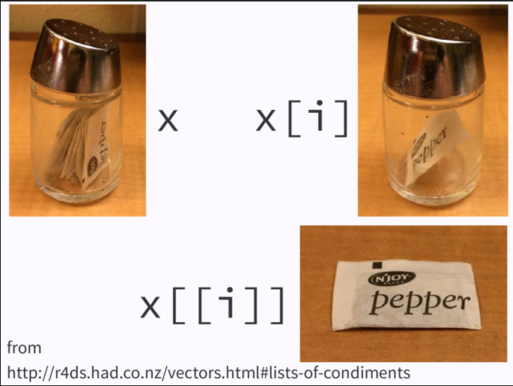

one more thing before we move on from data types
R uses [ ] as well as [[ ]] for accessing elements of a vector, when to use [and when to use [[ ?
The [[ is also used when accessing columns of a dataframe by column name or index.

Slide 11

Loops
R supports the usual for and while loops (I don’t actually recall using a while loop in R!)
ipgw_list = c("GW101IGW11V1A001", "GW101IGW11V1A002")
for(ipgw in ipgw_list) {
print(ipgw)
}
Iterating some sort of list or collection is one of the most common tasks, what if we do not have to write the for loop ourselves?
map(ipgw_list, print) #function from the purrr package, general format is map (<list>, <function to be applied to each element of the list>)

Slide 12
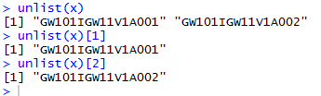
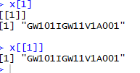
Map and friends
The output of map is a list and usually we have to simplify it to get a vector.
x=map(ipgw_list, print)
x[1]
x[[1]]
Often the output of map is fed to a reduce function. The reduce function combines the map output to produce a single result.
For more details refer to http://purrr.tidyverse.org/reference/map2.html

Slide 13
Conditional statements
The if statement, if-else statement or the if - else if – else combination available in R is similar to what is usually available in any programming language.
The ifelse statement: this is a vectorized version of the if-else statement.
x = c(1,2,3,4,5)
ifelse(x > 2, T, F) # iterate over the vector x and return T (for TRUE) if an element is greater than 2, return F (for FALSE) otherwise
We can use the TRUE/FALSE values provided by ifelse as indices to find out the actual entries of the vector that satisfied the condition.
x[ifelse(x > 2, T, F)]

Slide 14
Functions
R supports functions just like any other programming language.
Implicit Returns: it is not mandatory to write an explicit return statement
Can specify default value for arguments.
Can have functions defined within functions.
Anonymous functions
get_half_normal_mean <- function(n=10) {
x = rnorm(n)
mean(x[x>0])
}
get_half_normal_mean()
get_half_normal_mean(100)

Slide 15
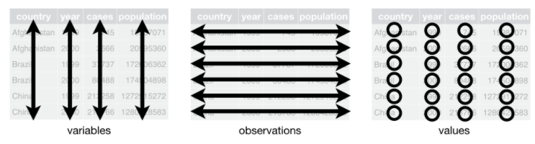
One more thing before we get to labs…
The concept of tidy data: makes data analysis tasks much simpler and once we get the hang of it we would always want to get the data into a tidy format before starting with analysis.
Each variable must have its own column.
Each observation must have its own row.
Each value must have its own cell
Contrast this representation with a different one where year+cases was a column of its own, for e.g. 1999_cases, 2000_cases.
Tidy format allows use of dplyr verbs (e.g. filter out all entries except the ones from the year 2000 and then summarize) and ggplot2 visualization (use the year values to color observations differently).

