Slide 1
Data Science and R
Summer 2018
By: Amit Arora

Slide 2
What we will be covering
The idea of distributions (continuous and discrete), why do we need models.
Expected Value.
Sampling, bootstrap and confidence intervals.
The idea of statistical significance and associated tools and test like t test, Zscore,
p-value etc
Basic review of matrices, derivatives and related concepts to introduce the
idea of optimization.
Eigen values and Eigen vectors (time permitting).

Slide 3
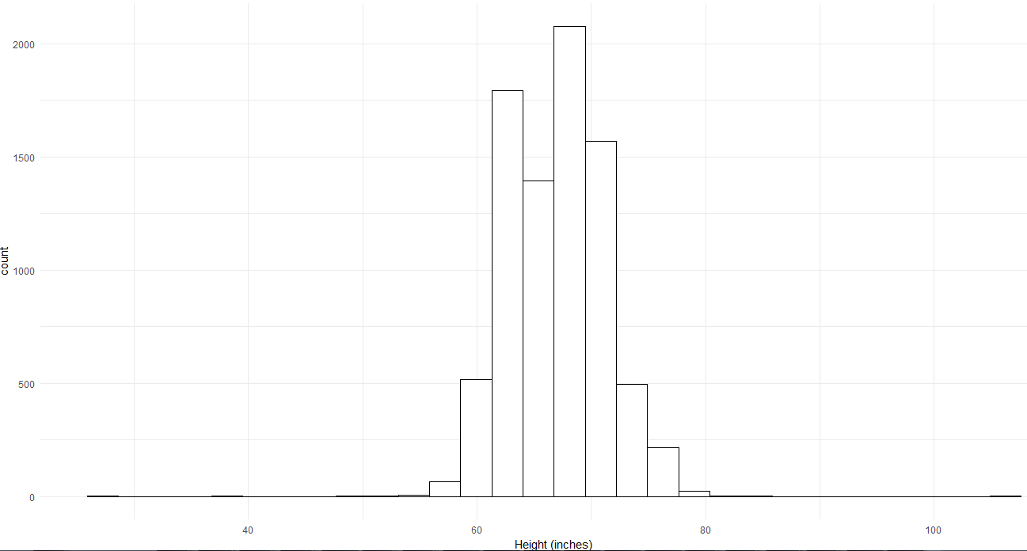
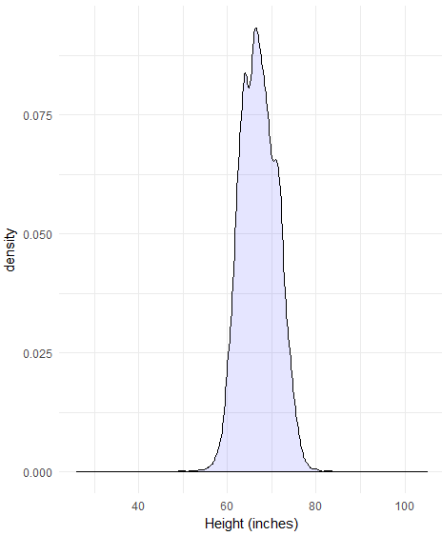
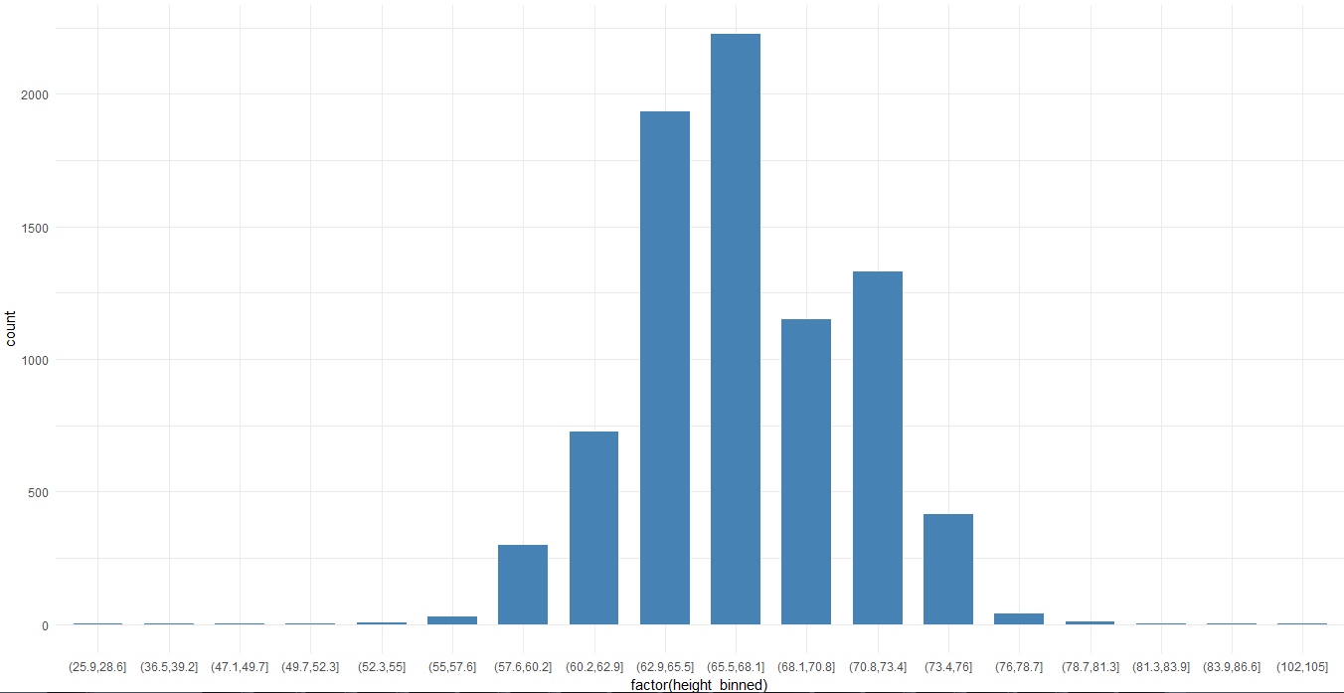
Statistical distributions
The simplest way is to understand a distribution is a frequency table and then visualize it as a bar graph. Lets take an example:
Let us consider data from a youth survey (see https://www.statcrunch.com/app/index.php?dataid=2433114) and plot a distribution of the Height of the participants.

Slide 4
Statistical distributions
Discrete distributions
When we binned the data for example. The quantity being plotted is discrete or countable like a category (days of week) or an integer quantity (such as minutes to next goal in a soccer match).
Each quantity could potentially have a non-zero frequency/probability of occurrence.
Continuous Distributions
- We can still bin the data but the quantity being plotted is continuous or infinite like numbers on the real number line. There could be infinitely many numbers between any two points on the real number line.
- The probability of occurrence of a single quantity in a continuous distribution is zero.
- We are instead interested in probability of a range, for example in the Youth dataset, if the height was not represented inches but inches and centimeters like 56.4, so between 56 and 57 we could have an infinite number of heights: 56.5, 56.55, 56.5555 and so on. The individual probability of a specific height value say 56.4 is 0 but the probability of height being between 56 and 57 is non-zero,

Slide 5
Statistical distributions
Essential Reading
http://onlinestatbook.com/2/introduction/distributions.html

Slide 6
Expected value
Essential Reading
From Wikipedia
In probability theory, the expected value of a random variable, intuitively, is the long-run average value of repetitions of the experiment it represents. For example, the expected value in rolling a six-sided die is 3.5, because the average of all the numbers that come up in an extremely large number of rolls is close to 3.5. Less roughly, the law of large numbers states that the arithmetic mean of the values almost surely converges to the expected value as the number of repetitions approaches infinity. The expected value is also known as the expectation, mathematical expectation, EV, average, mean value, mean, or first moment.

Slide 7



Expected value
.
.
Discrete distributions
Countable finite case: for example fair six sided die
Infinite case
Continuous distributions

Slide 8
Sampling, bootstrap and confidence intervals
.
.
Sampling
taking random draws from the dataset (which itself could be a sample)
Bootstrapping
Taking random draws from a dataset with REPLACEMENT.
We do this when we don’t have enough data but want to generate statistical summaries.
Confidence intervals
First understand percentiles/quantiles.
Confidence interval does not mean “probably” what you think it means i.e. it is not a probability measure.

