Slide 1

CIS 7000
The Mathematical Foundations of AI Alignment
Instructor: Aaron Roth

Slide 2
Welcome! (Organizational Basics)
Instructor: Aaron Roth
Website: https://aaroth.github.io/cis-7000-ai-alignment/
Communication: Slack. (Invite link on course website)
Goal: To bring all of us up to (and beyond) the research frontier of an under-developed but important area.
No problem sets, exams.
Attendance is important --- we’re all learning together.
Evaluation is based on a (hopefully ambitious) research project.

Slide 3
Welcome! (Organizational Basics)
What are the foundations of AI alignment?
??
We are in the exciting position of being able to help develop/define them.
I have some topics in mind, and will tell you about them.
But you likely have other/better ideas.
If there is a paper or topic you think we should be learning about with foundations that are already developed, volunteer by email or on slack to claim a lecture time.
Could be either a formal lecture or more of a group discussion you lead.
If there are important topics that are not yet developed, that’s a great project topic.

Slide 4
Welcome! (Organizational Basics)
Grading
20% Participation (we’ll learn better with everyone’s active engagement)
Bonus points if you take a lecture!
80% Final project
15% project proposal (due mid-semester, 1-2 pages written)
15% project presentation (in class, last few weeks of the semester)
50% project writeup (in the style of a research paper)
Goal: Discover something new and important.
Working in groups of ~ 3-4 is encouraged.
Use of AI tools is fine/good; be ambitious.
But don’t produce slop! Exposition and clarity are important.

Slide 5
The Division of the Semester
Preferences
What should we ”align” to?
How can we represent preferences and what can we learn about them from elicited comparisons?
Information
Suppose we learn user preferences. Then what?
How can we make predictions that are aligned with a user’s decision making problem? How can we combine information we and the user have to advance their goals?
Mechanisms
Suppose we fail to align models or institutions. Can we design mechanisms and marketplaces for them to interact in so that our interests are advanced anyhow?

Slide 6
Preferences

Slide 7
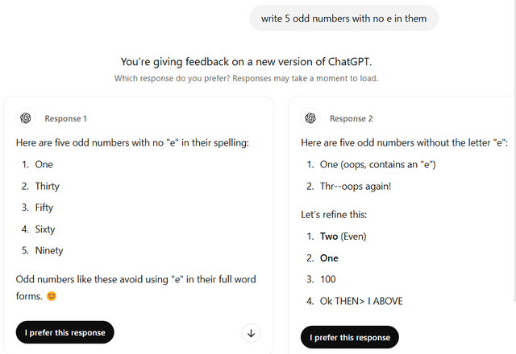
Pairwise Comparisons
An easy kind of preference to elicit: “Which response do you prefer”?
How much can we learn about your preferences from such comparisons?
How should we aggregate different people’s different preferences in one model?

Slide 8
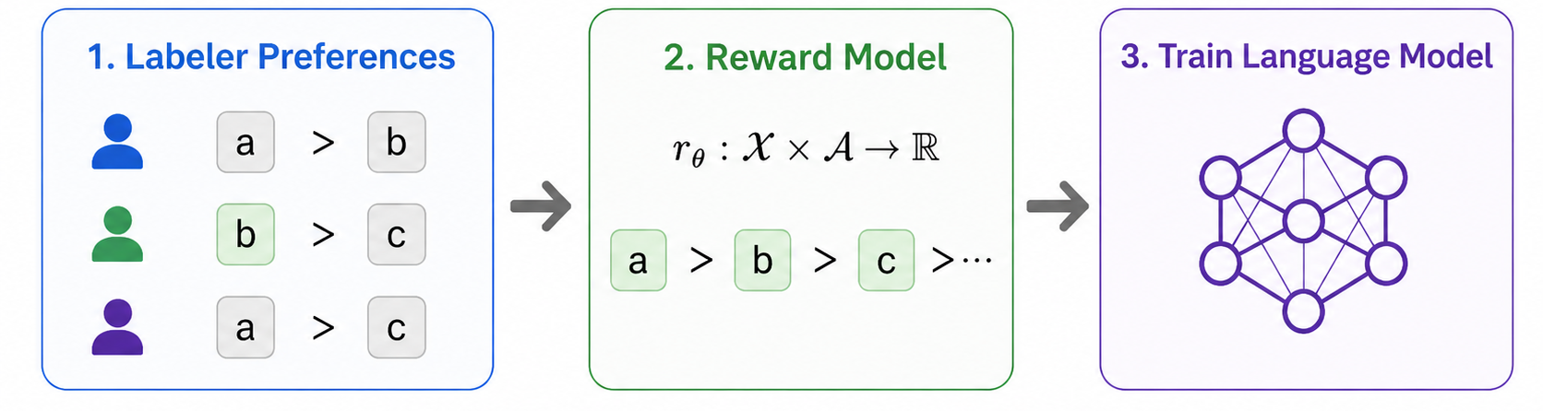
The RLHF Pipeline
A common alignment pipeline (RLHF):
Gathers pairwise preferences over prompt/completion pairs from a collection of human labelers
Trains a reward model to predict those preferences
Uses the reward model to refine a language model to produce higher reward completions.

Slide 9


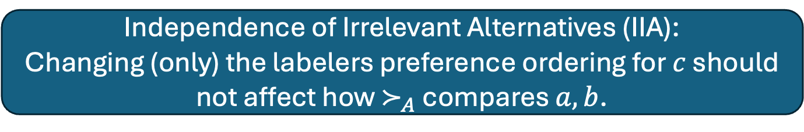
Basic Impossibility [Arrow]
Given: $n$ transitive preference orderings $≻_{i}$ over $m$ alternatives.
Output: An aggregate preference ordering $≻_{A}$.
Question: What properties should a good $≻_{A}$ satisfy?
Pareto Efficiency (PE):
If $a≻_{i}b$ for all $i$, then $a≻_{A}b$.
Independence of Irrelevant Alternatives (IIA):
Changing (only) the labelers preference ordering for $c$ should not affect how $≻_{A}$ compares $a, b$.
Arrow: Any aggregation rule satisfying PE and IIA must be a dictatorship:
$≻_{A}= ≻_{i}$ for some $i$.

Slide 10
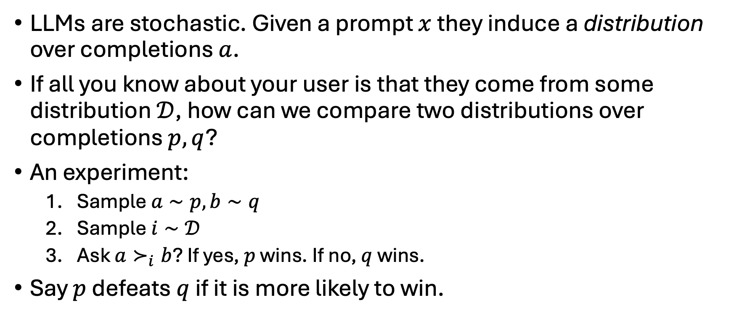
Alternatives to Learning a Reward Model
LLMs are stochastic. Given a prompt $x$ they induce a distribution over completions $a$.
If all you know about your user is that they come from some distribution $𝒟$, how can we compare two distributions over completions $p, q$?
An experiment:
Sample $a∼p, b∼q$
Sample $i∼𝒟$
Ask $a≻_{i}b$? If yes, $p$ wins. If no, $q$ wins.
Say $p$ defeats $q$ if it is more likely to win.

Slide 11
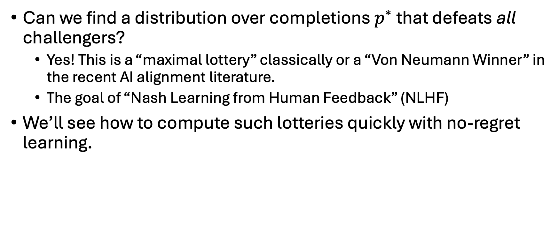
Alternatives to Learning a Reward Model
Can we find a distribution over completions $p^{∗}$ that defeats all challengers?
Yes! This is a “maximal lottery” classically or a “Von Neumann Winner” in the recent AI alignment literature.
The goal of “Nash Learning from Human Feedback” (NLHF)
We’ll see how to compute such lotteries quickly with no-regret learning.

Slide 12
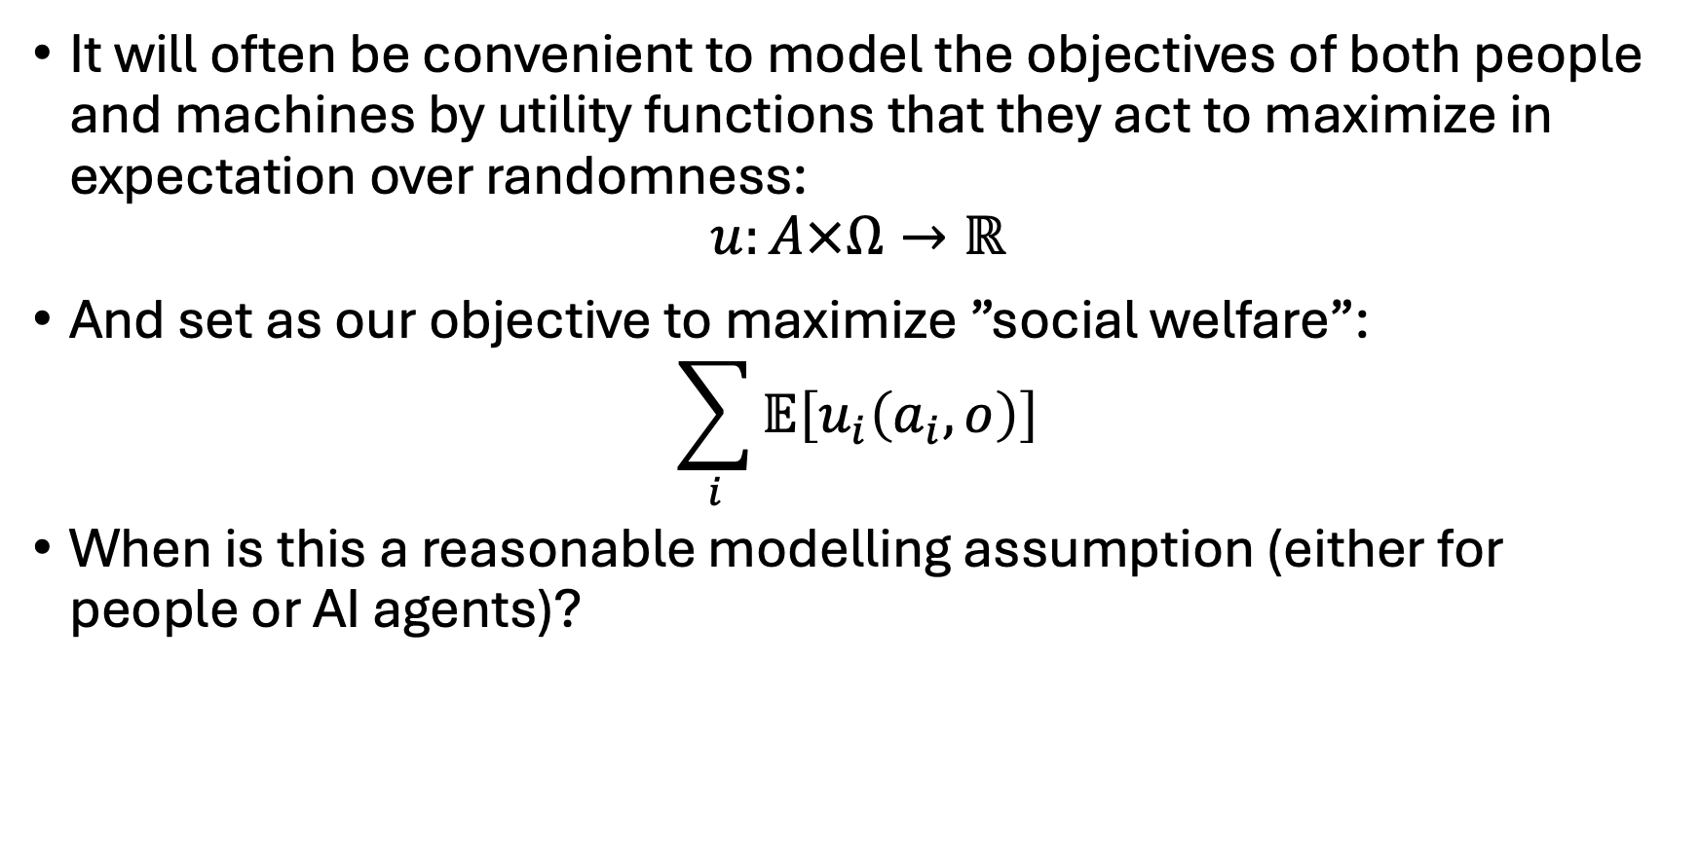
Utility Functions
It will often be convenient to model the objectives of both people and machines by utility functions that they act to maximize in expectation over randomness:
$$u:A×Ω→ℝ$$
And set as our objective to maximize ”social welfare”:
$$\sum_{i}{𝔼\left[u_{i}\left(a_{i},o\right)\right]}$$
When is this a reasonable modelling assumption (either for people or AI agents)?

Slide 13
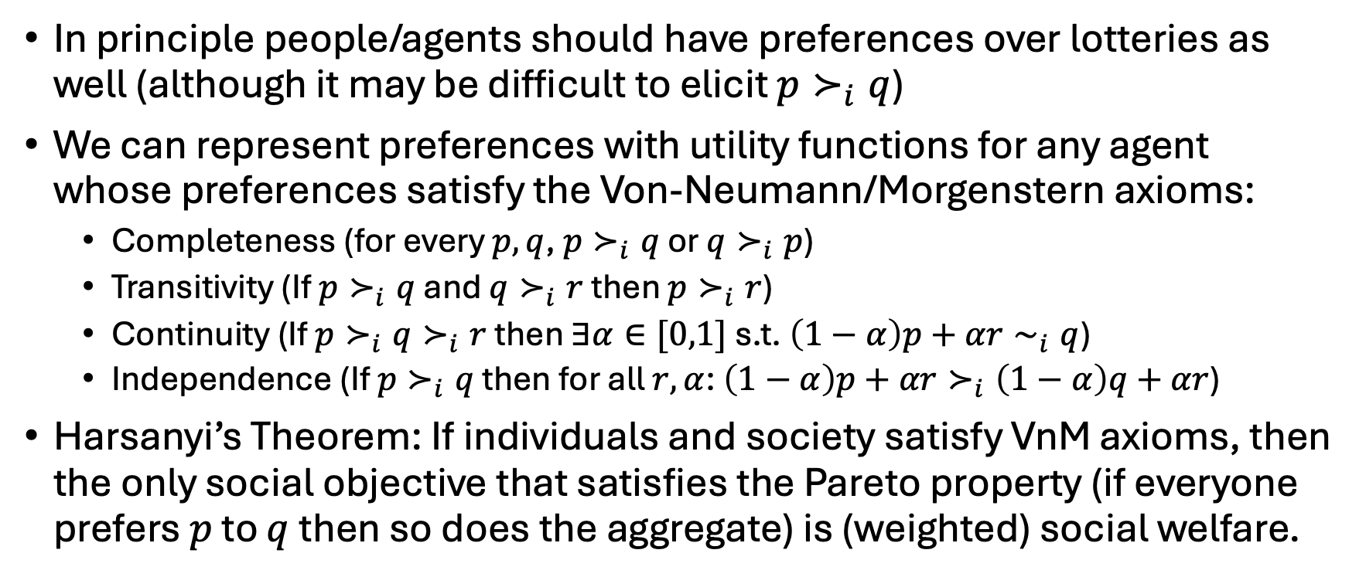
Social Welfare Aggregation
In principle people/agents should have preferences over lotteries as well (although it may be difficult to elicit $p≻_{i}q$)
We can represent preferences with utility functions for any agent whose preferences satisfy the Von-Neumann/Morgenstern axioms:
Completeness (for every $p, q$, $p≻_{i}q$ or $q≻_{i}p$)
Transitivity (If $p≻_{i}q$ and $q≻_{i}r$ then $p≻_{i}r$)
Continuity (If $p≻_{i}q≻_{i}r$ then $∃α∈[0,1]$ s.t. $\left(1−α\right)p+αr∼_{i}q$)
Independence (If $p≻_{i}q$ then for all $r, α$: $\left(1−α\right)p+αr≻_{i}\left(1−α\right)q+αr$)
Harsanyi’s Theorem: If individuals and society satisfy VnM axioms, then the only social objective that satisfies the Pareto property (if everyone prefers $p$ to $q$ then so does the aggregate) is (weighted) social welfare.

Slide 14
Back to the RLHF/NLHF pipeline
Suppose we only elicit comparison data
But we care about maximizing social welfare.
How should we choose completions to minimize the worst-case distortion:
Worst case over preferences consistent with the elicited comparisons, of the ratio of the welfare of the optimal lottery for those preferences to the welfare of the lottery we find.
This is optimized by finding a maximal lottery/NLHF!

Slide 15
Information

Slide 16
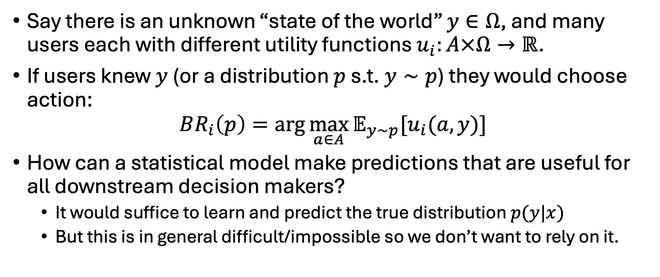
Suppose we can learn user utility functions. Then what?
Say there is an unknown “state of the world” $y∈Ω$, and many users each with different utility functions $u_{i}:A×Ω→ℝ$.
If users knew $y$ (or a distribution $p$ s.t. $y∼p$) they would choose action:
$$BR_{i}\left(p\right)=\arg{\max_{a∈A}{𝔼_{y∼p}[u_{i}(a,y)}]}$$
How can a statistical model make predictions that are useful for all downstream decision makers?
It would suffice to learn and predict the true distribution $p(y|x)$
But this is in general difficult/impossible so we don’t want to rely on it.

Slide 17
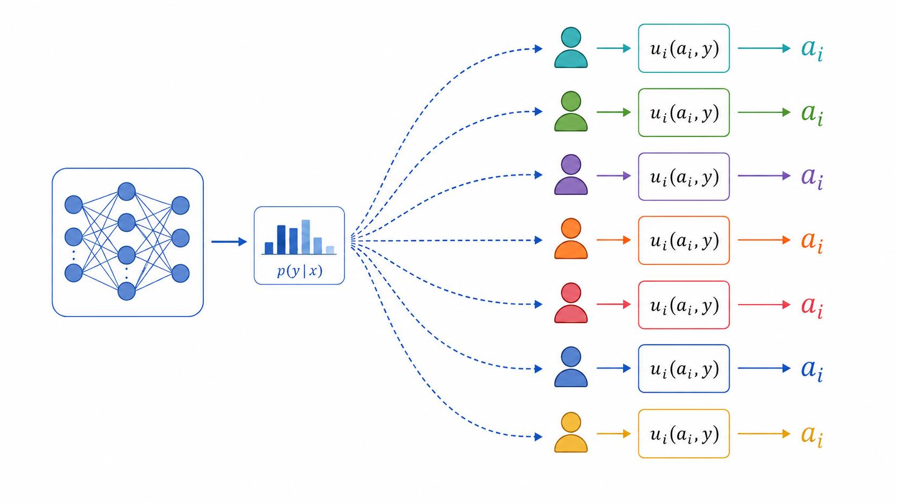
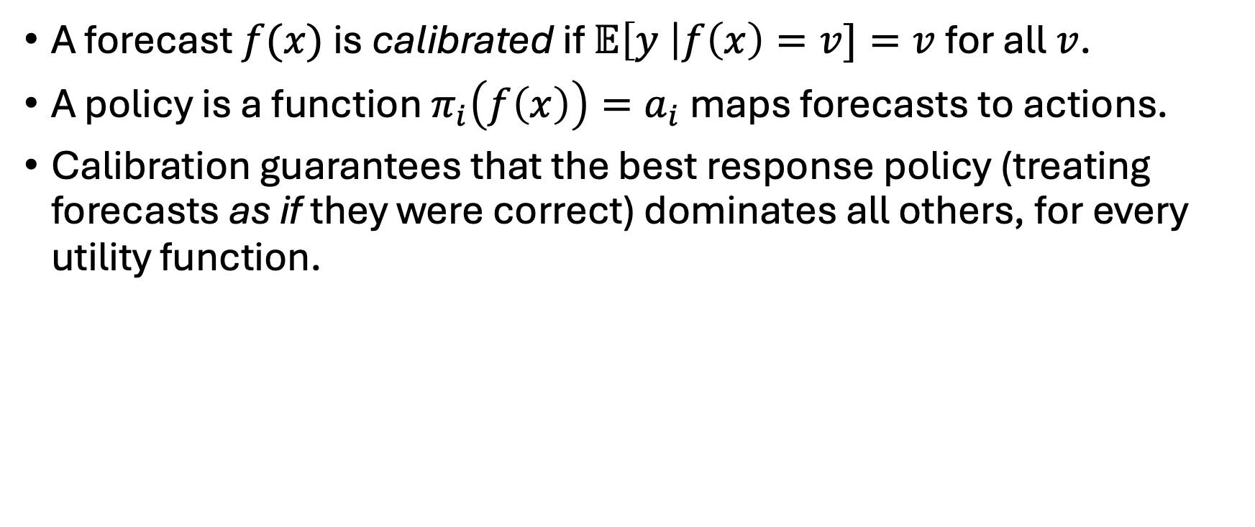
Calibration
A forecast $f(x)$ is calibrated if $𝔼\left[y \right|f\left(x\right)=v]=v$ for all $v$.
A policy is a function $π_{i}\left(f\left(x\right)\right)=a_{i}$ maps forecasts to actions.
Calibration guarantees that the best response policy (treating forecasts as if they were correct) dominates all others, for every utility function.

Slide 18
Calibration
It is possible to produce calibrated forecasts even in settings with arbitrary distribution shift, using Blackwell Approachability (a generalization of no regret learning)
“Decision calibration” gives efficient generalizations in high dimensional settings)

Slide 19
Collaboration
For the foreseeable future, people will continue to have value-added to AI systems and vice versa
People have broader contextual knowledge, qualitative observations that are hard to communicate to AI, etc.
AI systems are trained on much more data than a person can internalize.
How can we make decisions that integrate expertise of both parties and improve on either’s performance alone?
Without communicating everything you know to the other party…

Slide 20
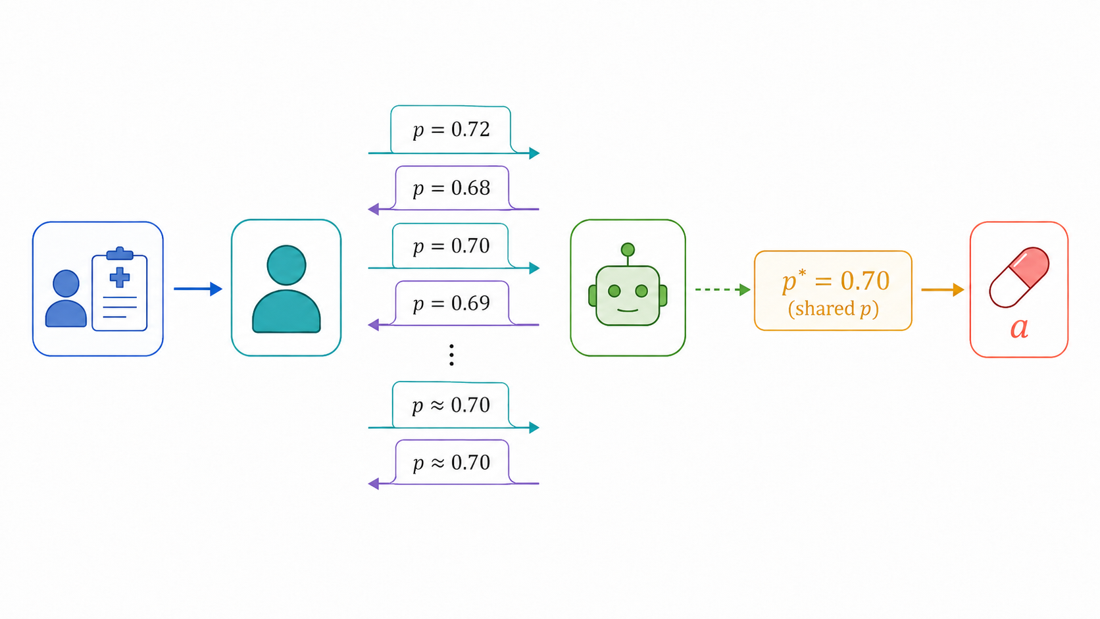
Collaboration
A related question is studied by “Aumann’s Agreement Theorem”
Two Bayesians, with a common prior but different observations, have “conversations”
Each communicates their current posterior belief to the other.
This must converge to (accuracy-improving) agreement.

Slide 21
Collaboration
It turns out we can get the same behavior efficiently without any Bayesian assumptions.
It is enough that each round of conversation be calibrated to the outcome, conditional on what was said at the previous round.
This can be done efficiently, even in high dimensional settings, when the user’s utility function is known.

Slide 22
Mechanisms

Slide 23
How can we design institutions to mitigate misalignment?
Maybe alignment is hard.
It might be hard to elicit/discover user utilities.
It might be hard to embed those elicited utilities into models in ways that cause them to pursue the same goals.
Maybe organizations can align their models with their own goals, but those goals might differ from yours.
How can we set up structures that result in safe/beneficial behavior despite individual agent misalignment?

Slide 24
AI Debate
Idea: A human being (or trusted but weak model) may be able to adjudicate local claims for correctness without being able to solve (or even verify the solution to) large problems of interest.
Use two AI models as prosecutor/defense attorney.
One tries to establish a claim.
The other attempts to poke holes in the argument.
The AI models may be arbitrarily powerful but the adjudicator is computationally bounded.
Goal: if the claim is false, the adjudicator should be able to isolate an easily verifiable inconsistency.

Slide 25
AI Debate
Suppose two models are tasked with proving vs. falsifying a claim, and rewarded for convincing a sound/complete poly-time judge.
The models can perform arbitrary computations and can interact for polynomially many rounds.
Then at minimax equilibrium, the process is sound/complete for every problem in PSPACE.
These problems do not in general have poly-time verifiers, so the debate is increasing the power of the adjudicator.

Slide 26

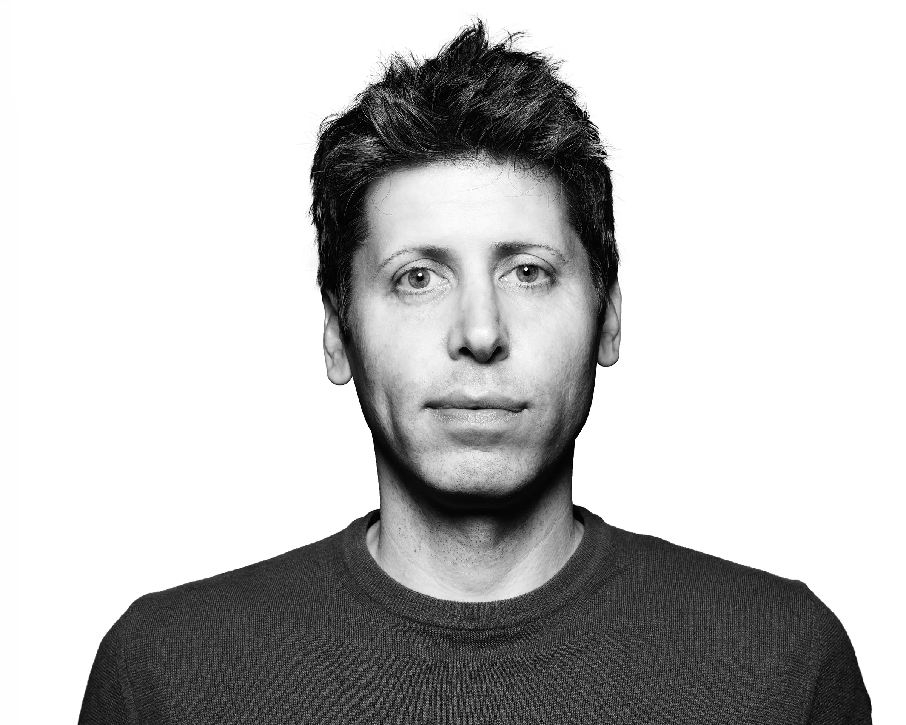

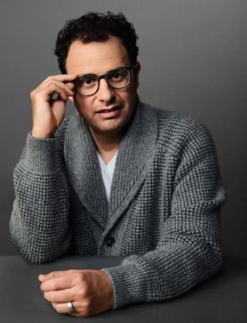
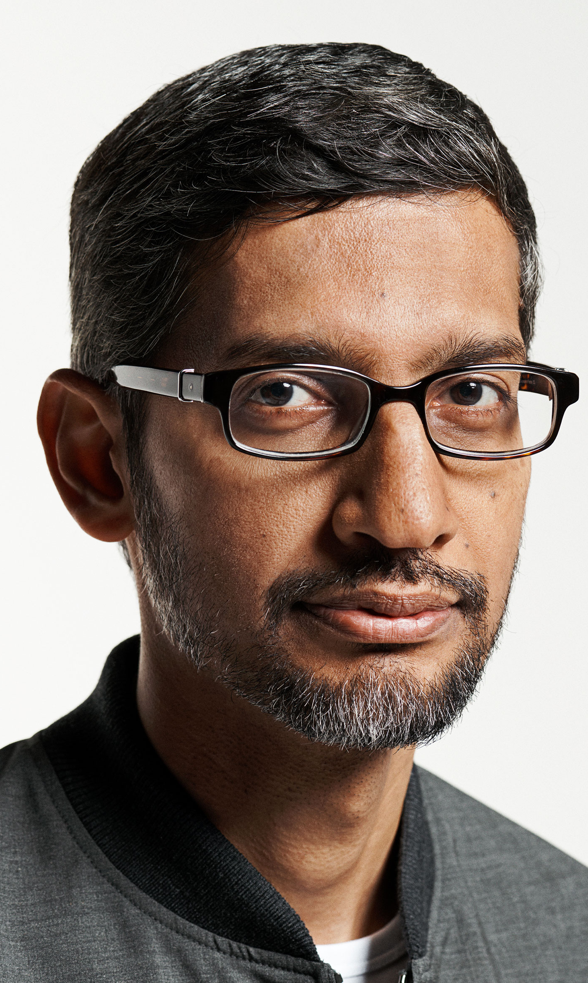


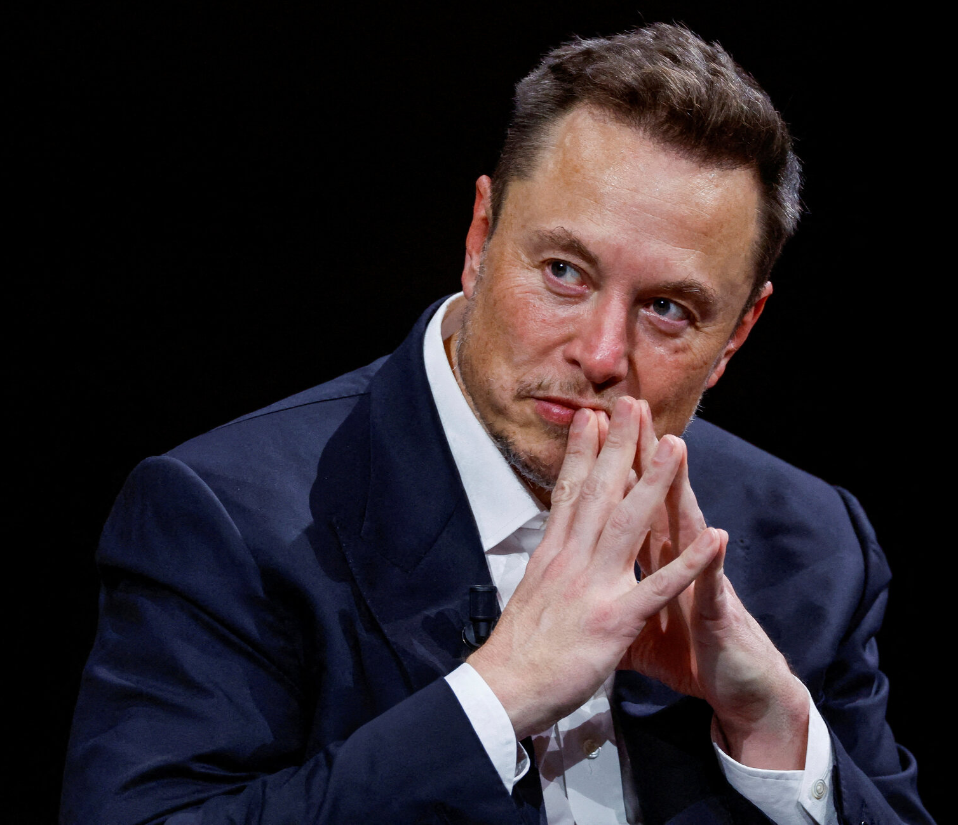
Alignment Through Competition
Suppose AI models are aligned with their creators.
Your goals may be different than those of AI CEOs. They may want to influence your behavior (e.g. votes, purchase decisions, etc).
But you have a choice of which AI model to use
And a model cannot affect your behavior unless you use it.

Slide 27
Alignment Through Competition
The organizations are misaligned with you.
But they may be differently misaligned --- i.e. also misaligned with each other.
Thus in choosing which models to deploy they are engaged in a strategic game with each other.
Maybe in the equilibria of this game we get the benefits of full alignment even without any aligned provider?

Slide 28
Alignment Through Competition
We can! If collectively the providers satisfy “market alignment”
User utility function lies in the non-negative linear combination of provider utility functions
A substantially weaker condition than individual alignment.

Slide 29
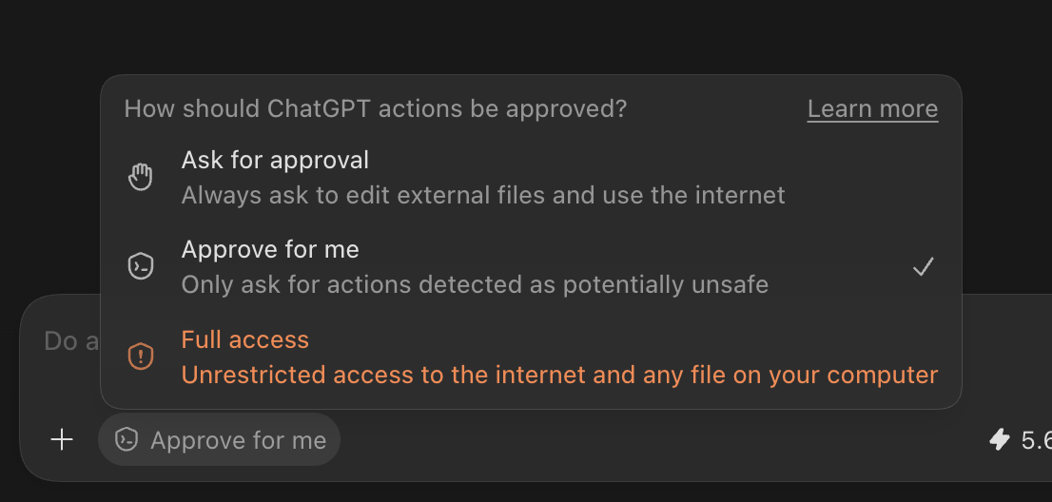
Delegated Approval
Long running agents can automate complex tasks but create a safety/control problem.
We could be conservative and require human approval before every action.
But this removes a lot of the benefit of automation…
Or, we could delegate approval to another agent!
Is this circular?
If the main agent is misaligned, the approval agent probably is too…

Slide 30
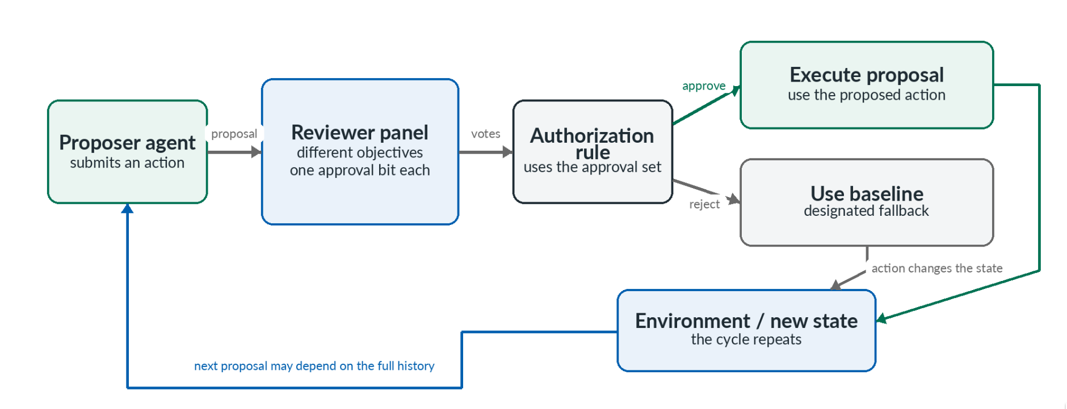
Delegated Approval
What if we have a panel of differently misaligned reviewers? Can we characterize a weaker condition necessary and sufficient for safety?

Slide 31
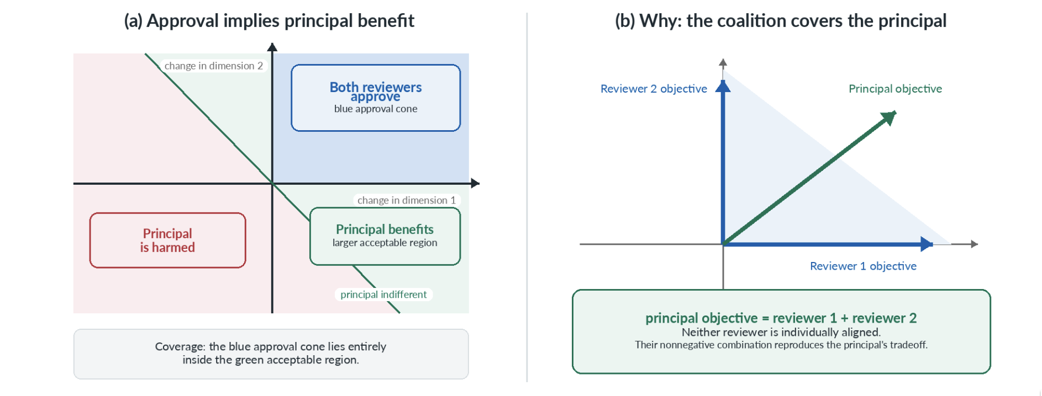
Delegated Approval
Yes! Closely related to market alignment.
We are guaranteed safety (relative to a baseline policy) iff the user’s utility is in the non-negative span of the reviewer agents.
Can generalize this to trade off safety with completeness, to handle strategic agents in long-running interactions, etc.

Slide 32
More?
This is just a selection of topics on which formal work has been done. Lots of important topics that this doesn’t cover.
There is surely lots of work that has been done that isn’t on my list
Claim a lecture and tell us about it/lead a discussion!
There are many important topics for which no foundations have been formalized.
Do it for your project!
This is an important but nascent field, which is a great opportunity to make an impact.

