Slide 1
CS50P: IKEA Payslip
Name: Aaron Tran
City: Melbourne
Country: Australia

Slide 2
Description
- Involves using a simplified Google Calendar API
- Serves to obtain shifts, pay, tax and hours worked from each payslip

Slide 3

How to Use
1. Use the relevant arguments:
‘--shifts’ – displays the shifts for the payslip
‘--pay’ – displays the tax withheld and gross income for the payslip
‘--hour’ – displays the types of hour worked for the payslip
‘--add’ – adds shifts to the Google Calendar
‘--payslip_date’ – displays the possible payslip dates
2. Input the desired payslip date (leave empty for current payslip)

Slide 4
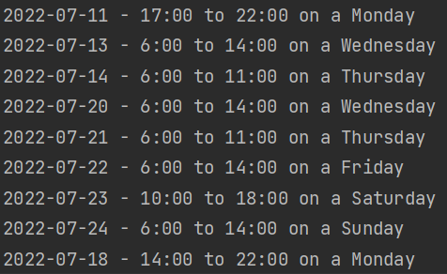
Feature 1: Obtains Shifts for a Given Payslip
Use argument ‘--shifts’ e.g. “python project –-pay”

Slide 5
Feature 2: Obtains Pay for a Given Payslip
Use argument ‘--pay’ e.g. “python project --pay”

Slide 6
Feature 3: Obtain Hours for a Payslip
Use argument ‘--hours’ e.g. “python project --hours”

Slide 7
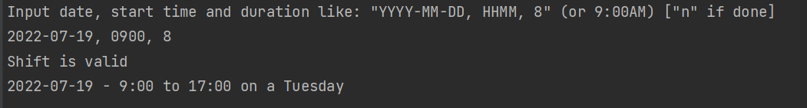
Feature 4: Add Shifts to the Google Calendar
Use argument ‘--add’ e.g. “python project --add”

Slide 8
Feature 5: Obtain Hours for a Payslip
Use argument ‘—payslip_date’ e.g. “python project –payslip_date”

