Slide 2









E
ELDA
Dashboard
View
New
Search
Subjects

Slide 3







HECTRE
Cases
Dashboard
View
New
Search
My cases – 13 cases
Add new
Sort: Last edited
Search cases
Title 15 charac…
OTHER
Add new
Details
02/20
1
Watched cases – 13 cases
Sort: Last edited
Search cases

Slide 4
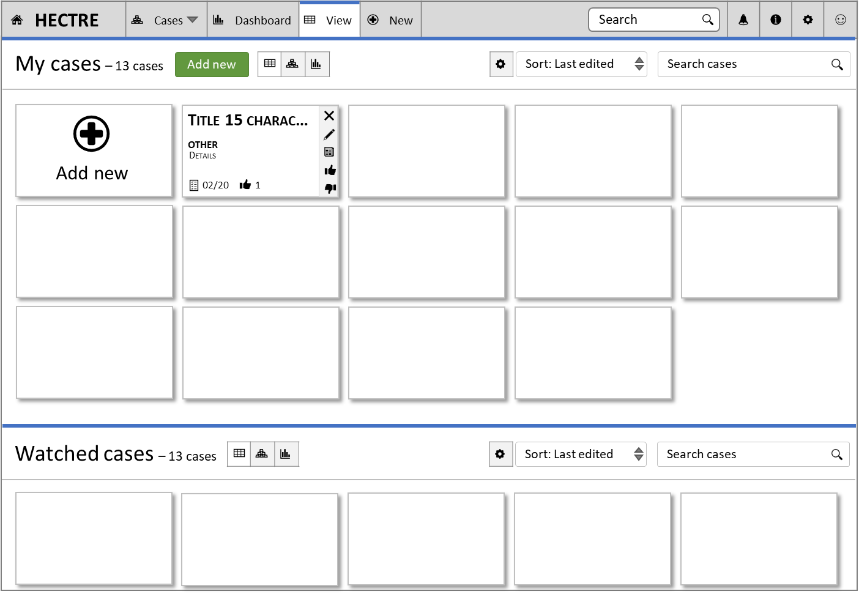




Details
HC005-007 – Arthur Anderson
First Name:
Middle Initial:
Last Name:
Current Ge…:
DOB:
MRN:
Status:
Priority:
Labels:
Add labels

Slide 5
Details
HC005-007 – Arthur Anderson
First Name
Middle Initial
Last Name
Current Gender
DOB
MRN
Status
Priority
Labels

Slide 6
Issues
HC005-007 – Arthur Anderson

Slide 7
Audit
HC005-007 – Arthur Anderson
Last updated:
Updated:
Updated:
Created:

Slide 8
Attachments
HC005-007 – Arthur Anderson

Slide 9
Notes
HC005-007 – Arthur Anderson

Slide 10
Pair
Cases
Dashboard
View
New
Search
Home-Dashboard
Profile completeness
Skill stats & recommend..
Job stats
Goals
Skill center
Jobs
Dash
Bespoke Profiles
My applications
Profile-Resume
Experience - Skills
Education
Testimonials
My cases – 13 cases
Add new
Sort: Last edited
Search cases
Title 15 charac…
OTHER
Add new
Details
02/20
1
Watched cases – 13 cases
Sort: Last edited
Search cases

Slide 11
First Name
MI
Last Name

