Slide 2










HECTRE
Cases
Dashboard
View
New
Search

Slide 3

EDAC
Cases
Dashboard
View
New
Search
My cases – 13 cases
Add new
Sort: Last edited
Search cases
Portfolio IT Strat…
TCV
Customer
$15M
National Cancer Institute
Add new
RFP Date
Owner
10/20
RG
Hot
Dormant

Slide 4
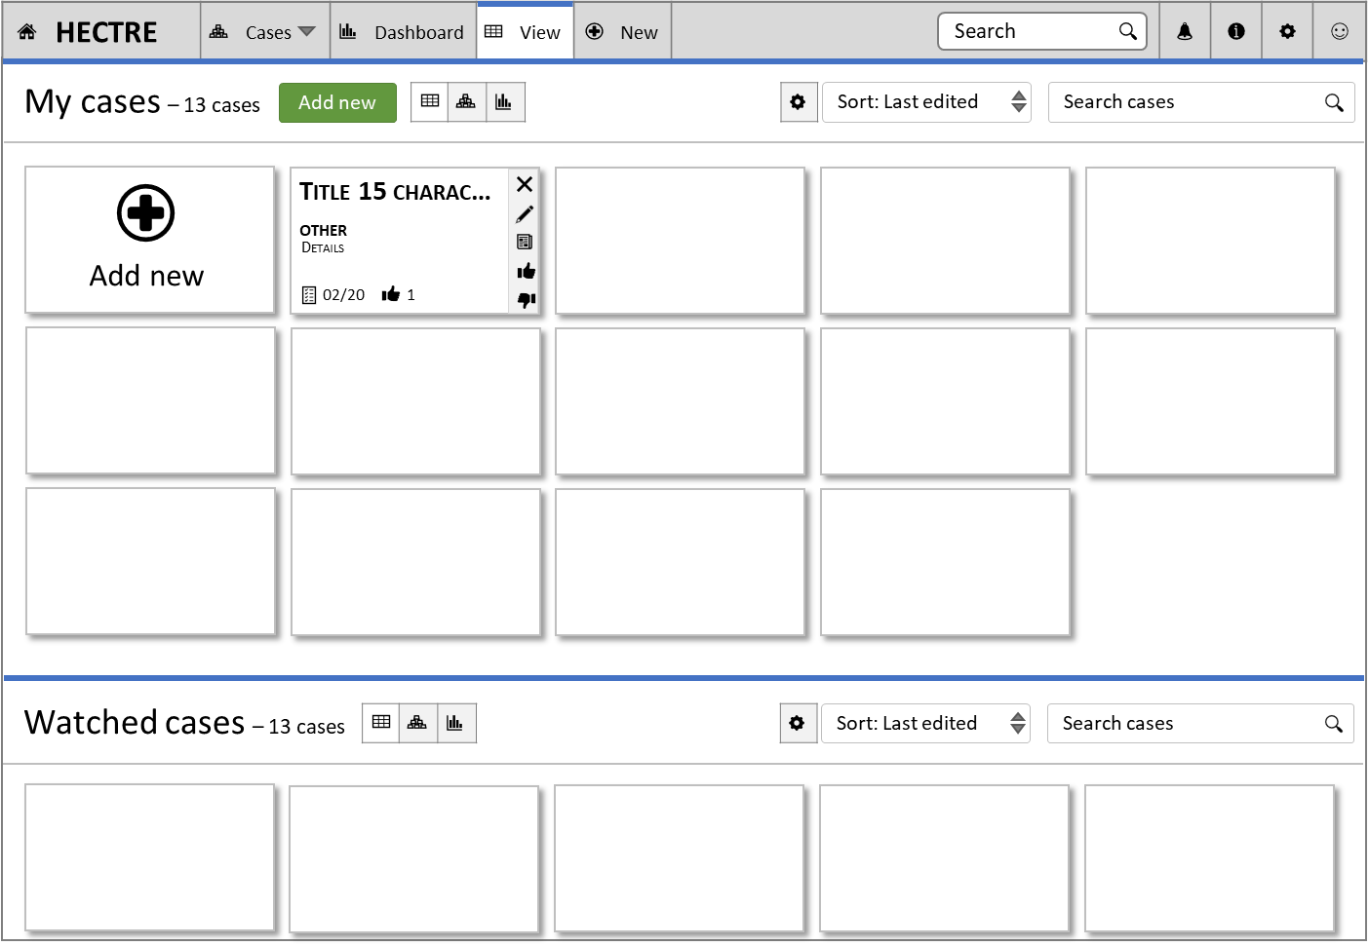




Details
Portfolio IT Strategy and Architecture
Contact:
Account:
Response Due Date:
Period of Performance:
Place of Performance:
Solicitation Number:
Status:
Priority:
Labels:
Add labels

Slide 5
Details
HC005-007 – Arthur Anderson
First Name
Middle Initial
Last Name
Current Gender
DOB
MRN
Status
Priority
Labels

Slide 6
Issues
HC005-007 – Arthur Anderson

Slide 7
Audit
HC005-007 – Arthur Anderson
Last updated:
Updated:
Updated:
Created:

Slide 8
Attachments
HC005-007 – Arthur Anderson

Slide 9
Notes
HC005-007 – Arthur Anderson

Slide 10





Pair
Cases
Dashboard
View
New
Search
Home-Dashboard
Profile completeness
Skill stats & recommend..
Job stats
Goals
Skill center
Jobs
Dash
Bespoke Profiles
My applications
Profile-Resume
Experience - Skills
Education
Testimonials
My cases – 13 cases
Add new
Sort: Last edited
Search cases
Title 15 charac…
OTHER
Add new
Details
02/20
1
Watched cases – 13 cases
Sort: Last edited
Search cases

Slide 11
First Name
MI
Last Name

