Slide 1
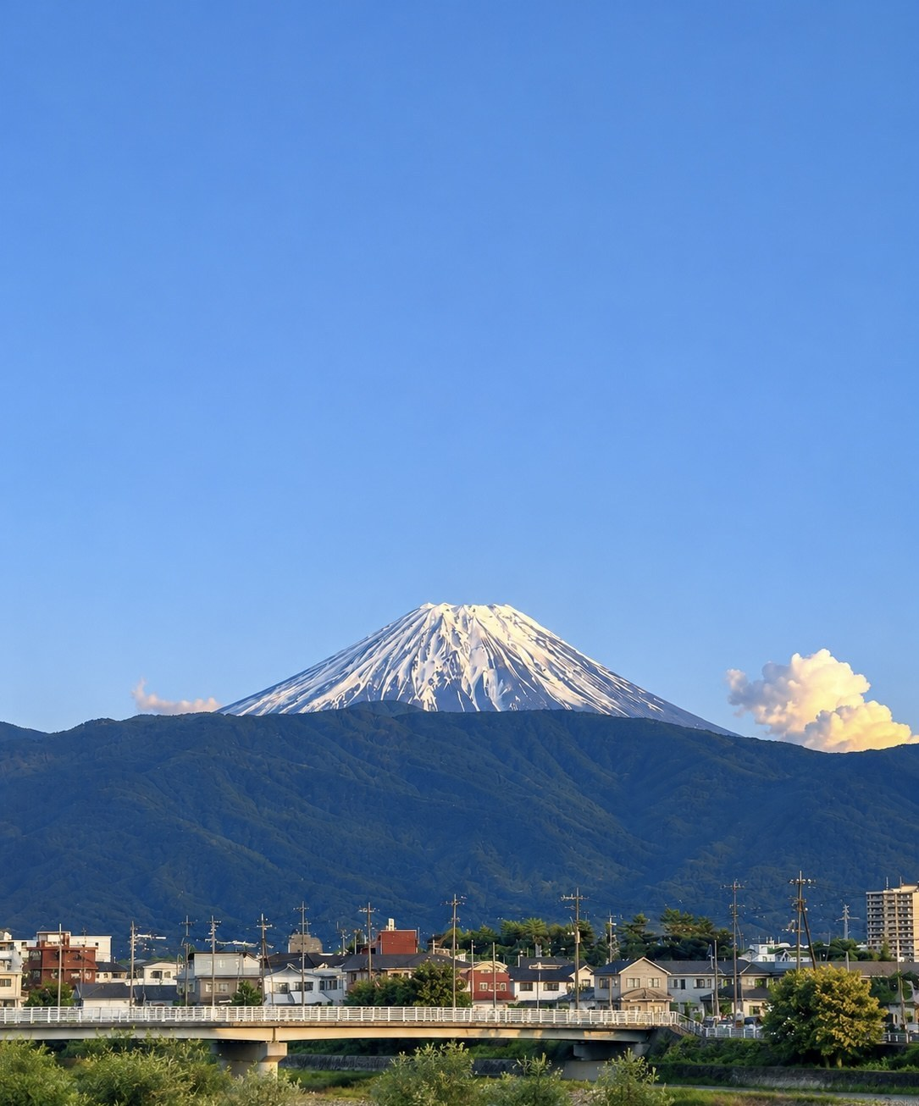

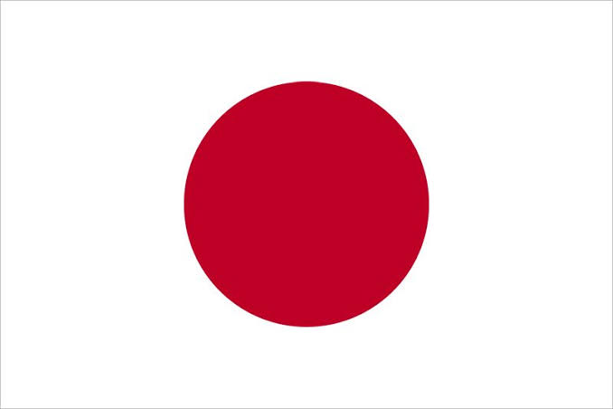






Building Bridges That Last
橋
MIRAI-SETU 2026 · KYUSHU A
Group Action Plan
Our journey in Japan may be ending, but the connections we have built should continue.
INDIA × JAPAN · NOVEMBER 2026
Notes:
30 seconds. Opening: "We arrived in Japan as students seeking new experiences. We leave with new perspectives, professional connections and friendships. Today, we would like to share how these experiences can become the foundation for stronger India–Japan relationships."

Slide 2
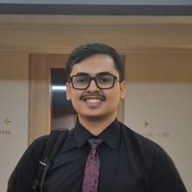
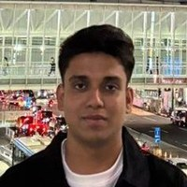
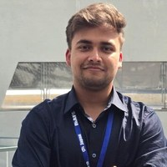
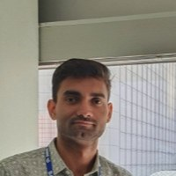
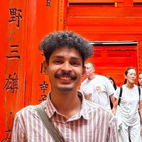
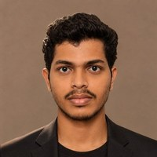
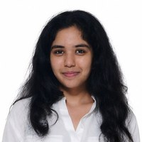
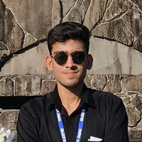
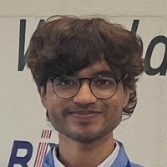
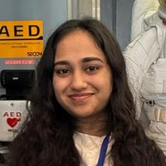
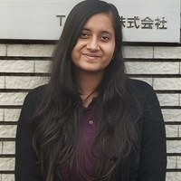
Meet the Team
Eleven students from IIT Guwahati, IIT Madras and IIITDM Jabalpur · Kyushu A group
Aarsh Jain
Anmol Singhal
Siddhant Chauhan
Sparsh Shukla
Aabhas Malpani
Meghraj Shinde
IIT Guwahati
IIITDM Jabalpur
IIITDM Jabalpur
IIITDM Jabalpur
IIITDM Jabalpur
IIITDM Jabalpur
Yaskawa, Seiko
Yaskawa, Seiko
Saga Toyopet
BPLUST
Hubest, ASO Group
MIZ
Aarya Shisode
Adarsh Gyan Priyadarshi
Aryan Pansare
Nandini Maheshwari
Divya Gupta
IIT Guwahati
IIITDM Jabalpur
IIITDM Jabalpur
IIT Madras
IIT Madras
Nakayama Iron Works
Nakayama Iron Works
Renesas, RIX
Saga Toyopet
TOTO, Matsumoto
Notes:
Introduce the team: eleven participants from three institutes, each placed with one or two host companies. Names, institutes and host companies are shown under each photo.

Slide 3
Our Journey at a Glance
Tokyo → Kyushu → Kansai → Hamamatsu → Yamanashi → Tokyo
I
旅
Our Journey
One month in Japan, the places we visited and the programs that impressed us most
4 – 7
II
文
Cultural Exchange
Heritage and peace, everyday life, language, and feeling at home
8 – 13
III
業
Corporate Internship
Who went where, internship moments, skills and host feedback
14 – 18
IV
道
Action Plan
Recommendations, our website, the best month to run the program
19 – 23
Notes:
Overview of the presentation: four acts. Act I, our journey. Act II, cultural exchange. Act III, the corporate internships. Act IV, our action plan for future editions, including our website. The page numbers on the right show where each act begins and ends.

Slide 4
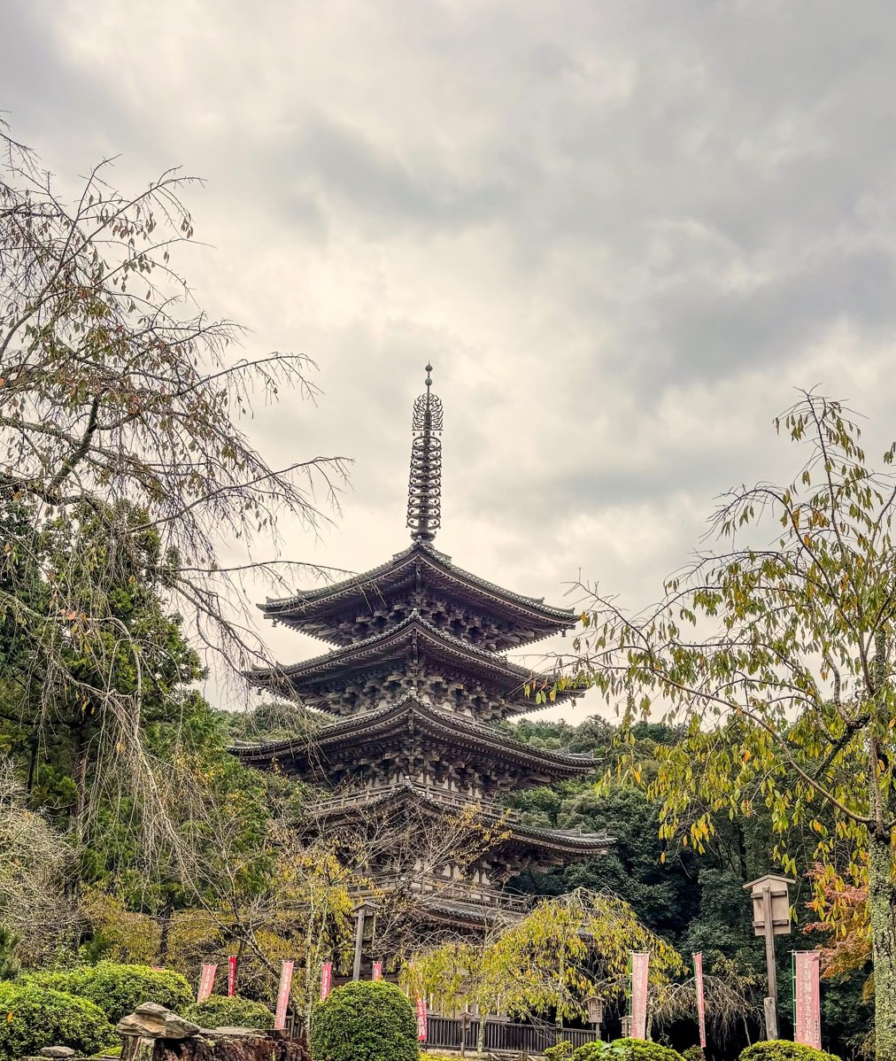
Our Journey
旅
ACT I
Where we went, and the programs that made the biggest difference.
Notes:
Act I title page.

Slide 5
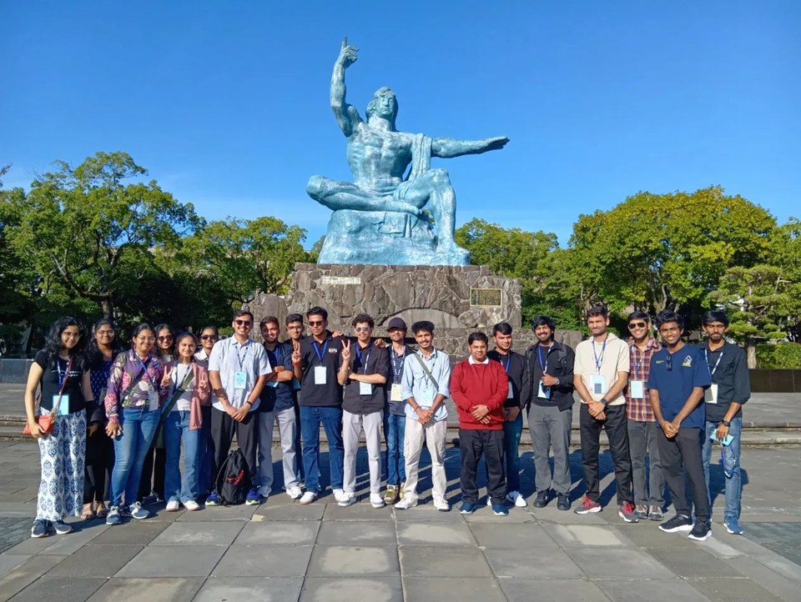





One Month, Many Perspectives
A journey of learning, discovery and meaningful connections in Japan.
Tokyo
Kyushu
Kansai
Hamamatsu
Yamanashi
Tokyo
Cultural immersion
Traditions, food and daily life: the APU festival, Beppu, Dazaifu Shrine and the Nagasaki peace study.
University visits
Six universities: research, laboratories and career pathways.
Corporate visits
TCS Japan, JAXA, VeBuIn, Suzuki, Alfred and the Yonekurayama site.
Eight-day internships
Host companies in Fukuoka, Oita and Saga.
Workshops and networking
Keynote, TCS Ideathon, Indian professionals in Japan, the Consulate General of India and the Mayor of Hamamatsu.
Nagasaki Peace Park · MIRAI-Setu participants
Notes:
1 minute. A visual timeline of our journey: Tokyo, Kyushu, Kansai, Hamamatsu, Yamanashi and back to Tokyo. Photo: our group at the Peace Statue, Nagasaki Peace Park (17 Oct). 1. Cultural immersion: Japanese traditions, food, language and everyday life (APU festival); Beppu (Umi Jigoku and Chinoike Jigoku); Dazaifu and shrines; peace study at the Nagasaki museum, park and hypocentre. 2. University and institutional visits: University of Tokyo, Kyushu University, Ritsumeikan APU, Kyoto University, Shizuoka University and University of Yamanashi. 3. Corporate visits: TCS Japan, JAXA, VeBuIn, Suzuki Motor Corporation, Alfred and the Yonekurayama Electric Power Storage Technology Research Site. 4. Eight-day corporate internships in Fukuoka, Oita and Saga. 5. Workshops and networking: keynote by Associate Professor Aashlesha Marathe (University of Tsukuba), arrival orientation and TCS Ideathon; session with Indian business professionals in Japan (Rajan Nandha, Santosh Maurya, Bhavesh, Vaibhav); Consulate General of India in Fukuoka; Mayor of Hamamatsu; atomic bomb survivor Mr. Shigemitsu Tanaka in Nagasaki. Key message: the value was not limited to the places we visited, but also the people we met and the perspectives we gained.

Slide 6







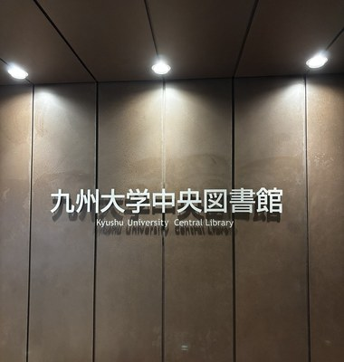
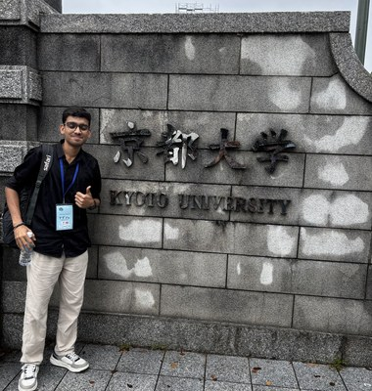
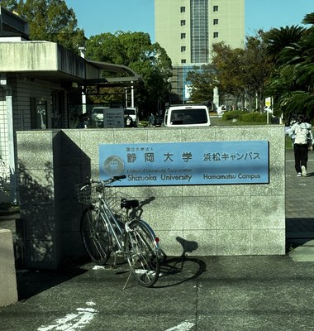
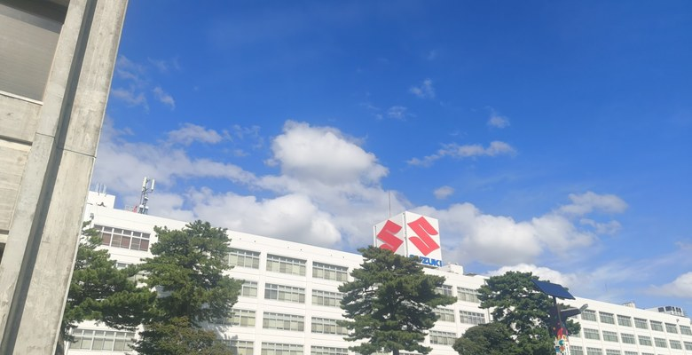
Universities and Companies We Visited
Six universities and a range of companies, from space agencies to automakers.
UNIVERSITIES
COMPANIES AND SITES
Ritsumeikan APU
JAXA
Beppu
Space agency
Shizuoka University
Suzuki
Yonekurayama
Hamamatsu
Automotive
Site visit
Company visits felt personal: we already use their products.
Kyushu University
Kyoto University
Shizuoka University
Suzuki Motor, Hamamatsu
Notes:
Where we visited. Universities: University of Tokyo, Kyushu University, Ritsumeikan APU, Kyoto University, Shizuoka University and University of Yamanashi. Companies and sites: TCS Japan, JAXA, VeBuIn, Suzuki, Alfred and the Yonekurayama site. University visits were very technical for such short visits; company visits felt more personal because we already use products from companies such as Suzuki.

Slide 7
Programs That Impressed Us Most
As we consider future careers in Japan: internships, university and industry visits, JAXA and Japanese work culture.
Aabhas Malpani
Aarsh Jain
Meghraj Shinde
Sparsh Shukla
“University visits inspired me to pursue research.”
“The JAXA control room was truly unforgettable.”
“The internship let me apply my skills to real challenges.”
“The eight-day internship built my skills and industry exposure.”
Aarya Shisode
Divya Gupta
Aryan Pansare
Nandini Maheshwari
“The corporate internship gave me practical industry exposure.”
“I valued the exposure to Japanese work culture and corporate etiquette.”
“The internship clarified Japanese business culture and career paths.”
“I learned a great deal about Japanese work culture and networking.”
Siddhant Chauhan
Adarsh Gyan Priyadarshi
Anmol Singhal
KEY TAKEAWAY
Internships, industry, academia and culture together shaped our career goals in Japan.
“Visiting Suzuki Motor made me want to become an automotive engineer.”
“Japan’s countryside and its warm people became a second home.”
“The Yaskawa robots deepened my passion for automation.”
Notes:
Which program impressed you most, as you consider future career options in Japan? Programs that stood out: corporate internships, university visits, industry visits (Suzuki, Yaskawa), the JAXA experience, and Japanese work culture. Participant reflections: Aabhas Malpani: university visits inspired me to pursue future research opportunities. Meghraj Shinde: the two-week internship helped me apply skills to real-world challenges. Aarya Shisode: the corporate internship, for its practical industry exposure. Aryan Pansare: corporate internships clarified Japanese business culture and career paths. Siddhant Chauhan: the visit to Suzuki Motor Co. made me want to pursue a career as an automotive engineer. Anmol Singhal: Yaskawa robots deeply inspired my passion for automation. Aarsh Jain: my JAXA control room experience was truly unforgettable. Sparsh Shukla: the two-week internship strengthened my skills and industry exposure. Divya Gupta: exposure to Japanese work culture and corporate etiquette. Nandini Maheshwari: understanding Japanese work culture and networking skills. Adarsh Gyan Priyadarshi: Japan's countryside and warm people created a second home. Key takeaway: a blend of internships, industry exposure, academic interaction and cultural learning strongly influenced our future career aspirations in Japan.

Slide 8
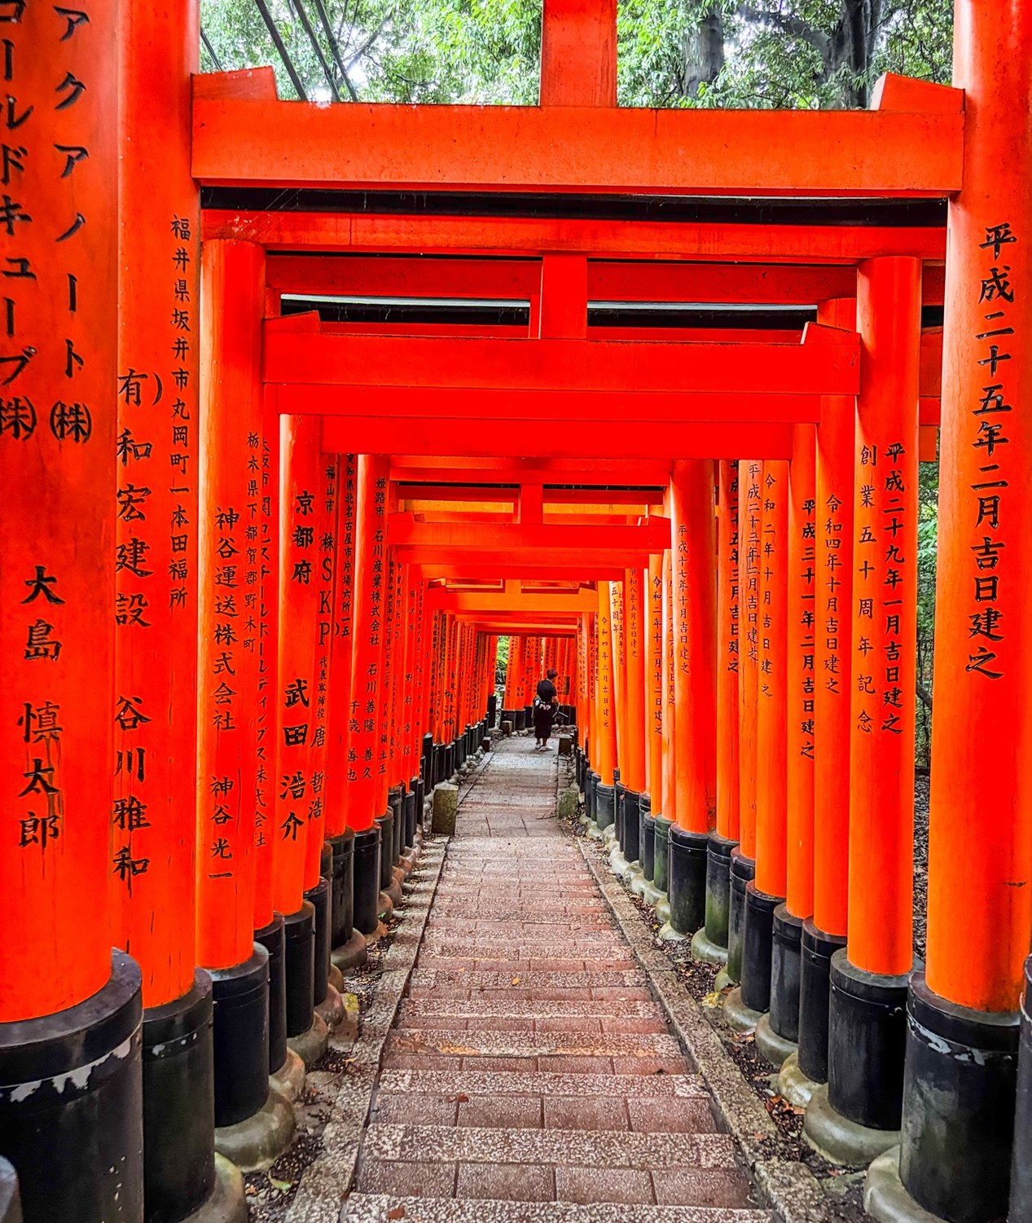
Cultural Exchange
文
ACT II
The places we visited, the life we lived, and how language shaped our experience.
Notes:
Act II title page.

Slide 9
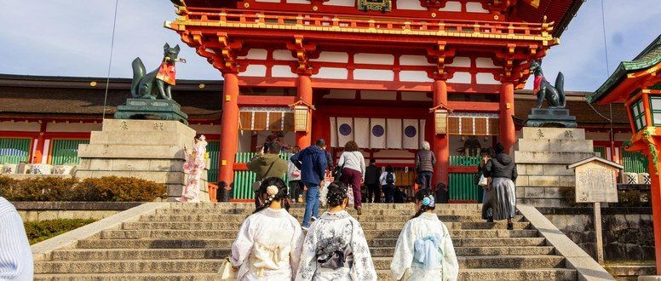
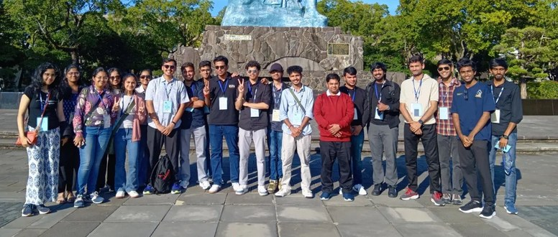
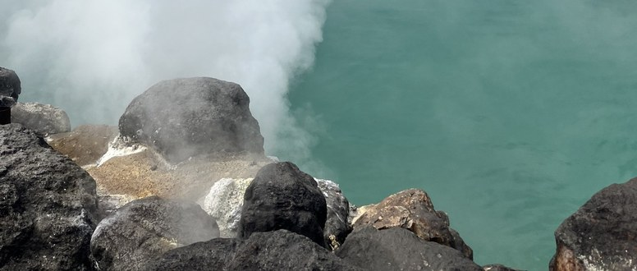
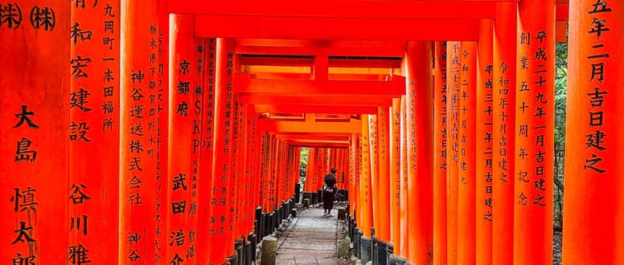
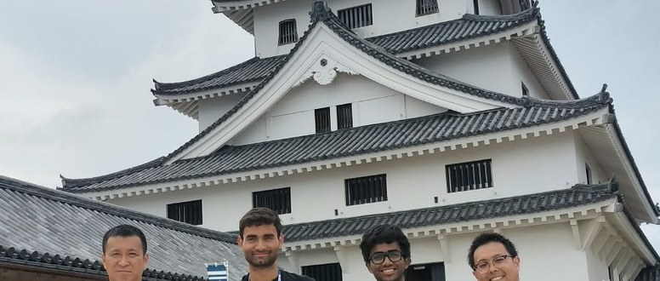
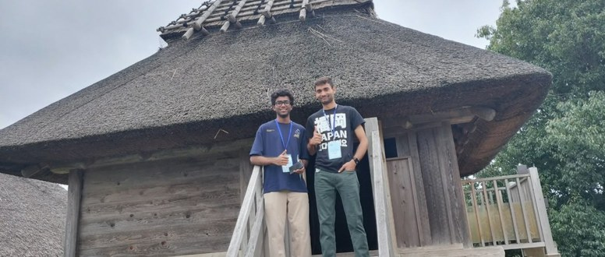
Heritage, Peace and Nature
Places across Japan that showed us where the country comes from.
Dazaifu Tenmangu
Nagasaki Peace Park
Beppu Jigoku
A shrine to the deity of learning. We took part in the purification ritual.
Bombed on 9 August 1945. The city says: “Let Nagasaki be the last.”
Volcanic hot springs, including the blue Umi Jigoku.
Fushimi Inari, Kyoto
Karatsu Castle
Yoshinogari
Thousands of torii gates along the mountain path.
A castle town in Saga, visited with our hosts.
An ancient Yayoi-period village site in Saga.
Notes:
Heritage, peace and nature. At Dazaifu Tenmangu, dedicated to the deity of learning, we rinsed our hands, bowed and made an offering. As students, that felt personal. In Nagasaki, bombed on 9 August 1945, we saw the Peace Park, the museum and the hypocenter, and understood why the city says 'let Nagasaki be the last'. In Beppu we saw the blue Umi Jigoku and how Japan turns volcanic land into culture and wellbeing. Fushimi Inari, Karatsu Castle and Yoshinogari showed us different layers of Japanese history. India links (spoken only): respect for education and teachers, a shared belief in peace, living with nature.

Slide 10
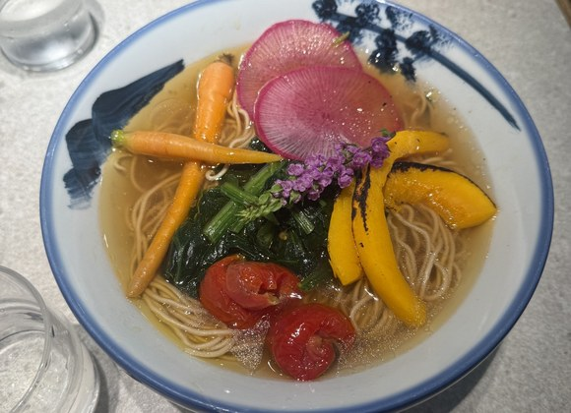
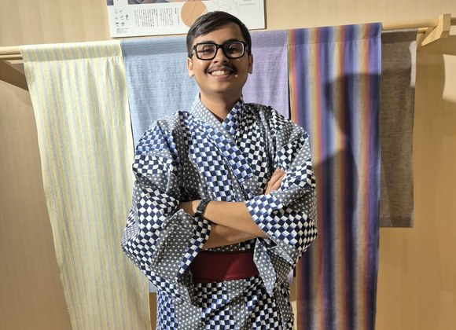


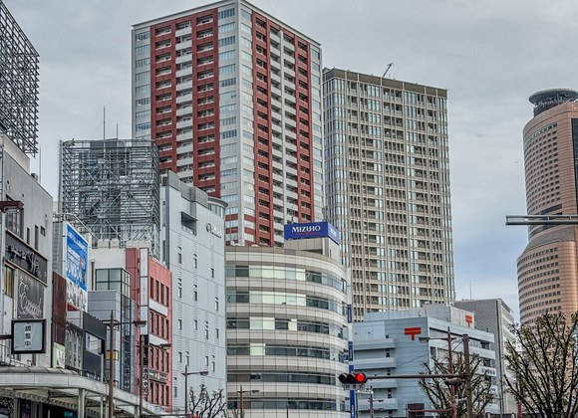
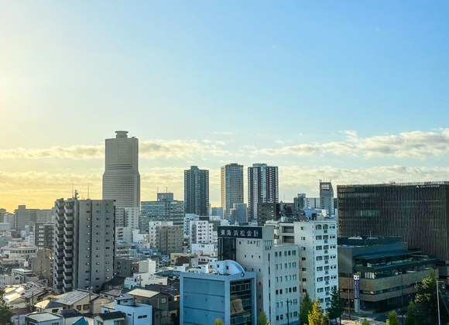


Everyday Life in Japan
A few highlights from living in Japan for a month.
Konbini
7-Eleven
Fresh food, ATMs and services, open 24 hours.
Konbini
Buses and trains
On time to the minute, quiet and orderly.
A Japanese meal
Trying a yukata
Punctuality
Being on time shows respect for other people’s time.
Hospitality
Sincere care for guests, with nothing expected in return.
Main street in Hamamatsu
City skyline at dusk
Notes:
Day to day, a few things stood out: konbini such as 7-Eleven open 24 hours, buses and trains running on the minute, punctuality as a form of respect, and omotenashi, sincere hospitality, which India knows as Atithi Devo Bhava. The photos show food, clothing and the streets and skylines we saw.

Slide 11
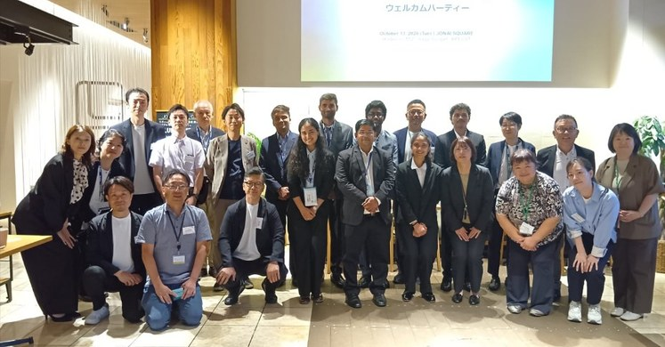
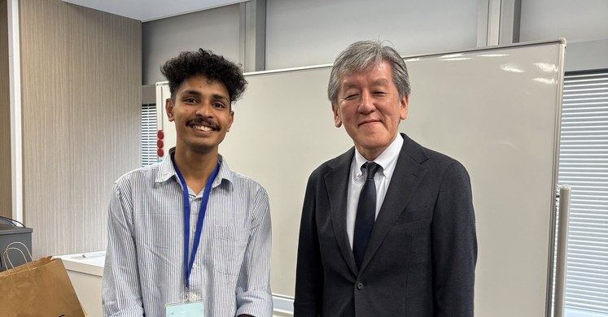
Language Barriers
It never stopped the work. It limited the bonds.
WHAT WORKED
WHAT GOT LOST
Interpreters and translators
Casual conversation
Arranged by AFS throughout our visits.
Small talk with hosts and colleagues.
English at stations
Deeper understanding
Signs and announcements helped us travel.
Of the people and the culture around us.
Gestures and simple English
Food
Enough for everyday needs.
Finding suitable meals was a daily challenge.
AFS Japan staff
Lab explanations
Unofficial interpreters who helped us find beef-free and meat-free food in konbini.
Details at the labs we visited.
Welcome party in Saga, and time with our hosts
A translator carries information, not rapport.
Notes:
Language never stopped the program from working; it limited the part where relationships form. What worked: AFS arranged interpreters and translators throughout our visits; there was some English at stations; gestures and simple English covered the rest; and AFS Japan staff acted as unofficial interpreters, helping us find beef-free and meat-free food in konbini. What got lost: casual conversation, deeper understanding, food (finding suitable meals) and explanations at the labs we visited. A translator carries information, not rapport.

Slide 12



Bridging the Language Gap
Practical steps before, during and after the program.
BEFORE
DURING
AFTER
Select 2–3 months earlier, so there is time to learn Japanese (for example with the Busuu app)
Attend regular Japanese lessons in India
A student buddy for informal conversation beyond AFS staff
Host companies could extend internships, so interns keep learning Japanese
Keep in touch through online language exchange
Build a stronger alumni network
TWO SOLUTIONS
A trusted course list
A weekly language hour
AFS India shares reliable online Japanese courses and tutors, so students do not have to guess.
A short Japanese session during the program, led by AFS staff or local volunteers.
Notes:
Overcoming the language gap. Before: select students 2–3 months earlier so there is time to learn Japanese, for example with Busuu; attend regular Japanese lessons in India. During: a student buddy for informal conversation apart from AFS staff; host companies could extend internships so interns can learn Japanese during their stay. After: online language exchange and a stronger alumni network. Two solutions: first, a trusted course list, because the problem we faced in India was not knowing which online Japanese courses and tutors to trust; second, a short weekly language hour during the program.

Slide 13



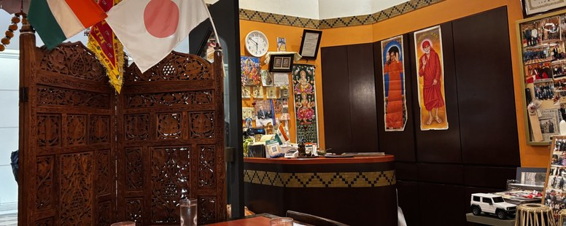
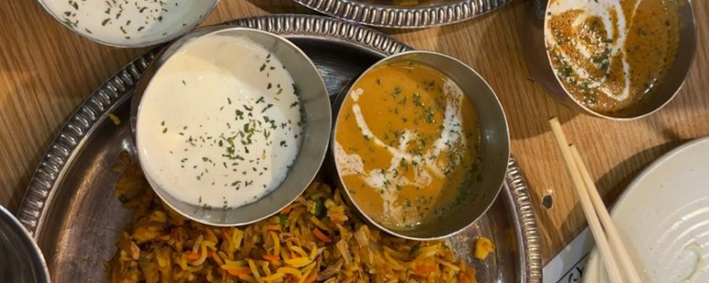
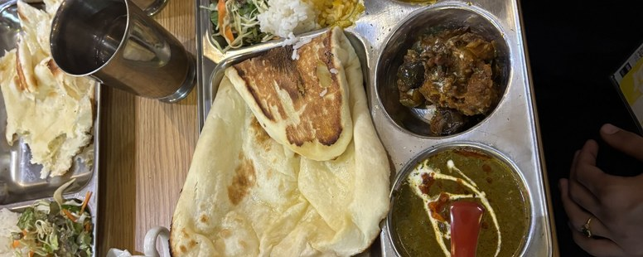
Food and Comfort
Small changes that help participants feel at home in Japan.
FOOD
COMMUNICATION
COMMUNITY
More Indian meals near host companies and hotels
Vegan and vegetarian options at konbini
Dietary needs shared with hosts and restaurants before arrival
English labels and menus that show meat, fish and dairy clearly
A short phrase card for dietary needs
Basic English support for hosts
Indian festivals celebrated together in Japan
More cross-cultural events and joint activities
Meals and visits with local families
Notes:
Making both sides feel at home. Food: more Indian meals near host companies and hotels, vegan and vegetarian options at konbini, and dietary needs shared with hosts and restaurants before arrival. Communication: clear English labels and menus, a phrase card, and basic English for hosts. Community: Indian festivals celebrated together in Japan, more cross-cultural events, and meals or visits with local families. These are our suggestions.

Slide 14
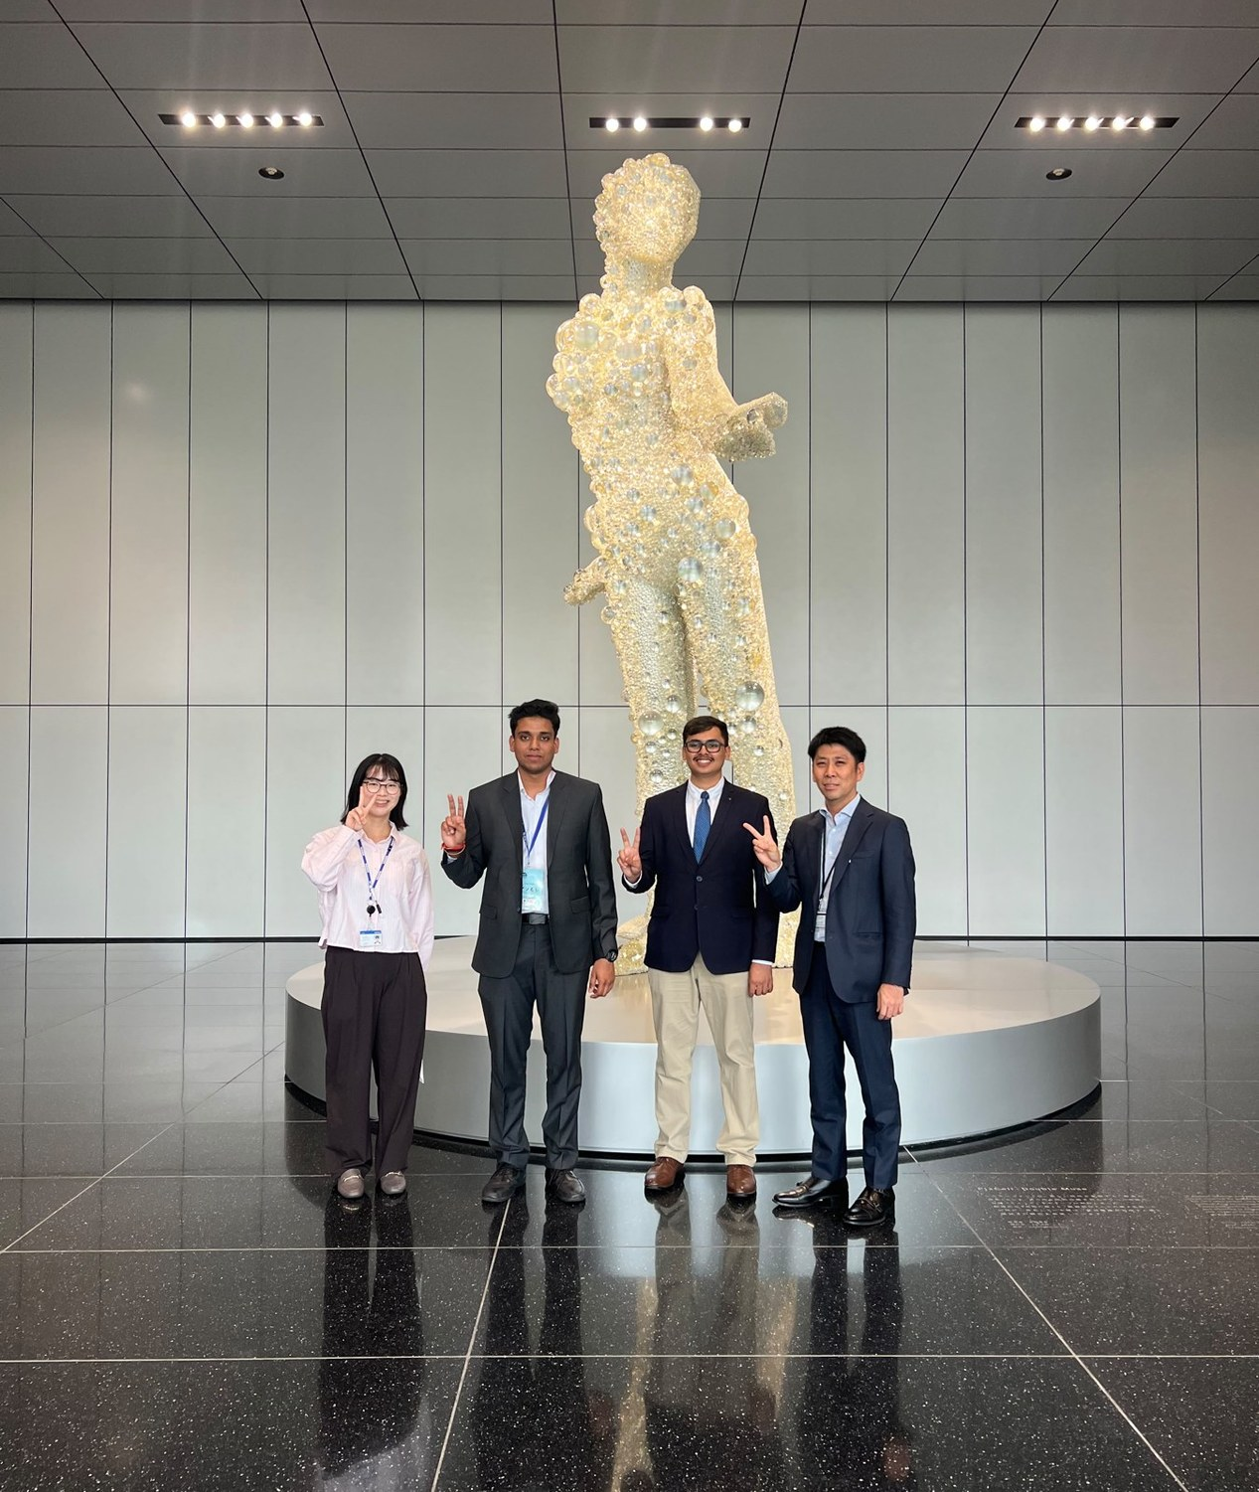
Corporate Internship
業
ACT III
Eight days inside Japanese companies: where we went, what we built and what we learned.
Notes:
Act III title page.

Slide 15







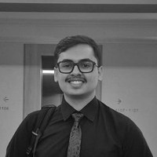
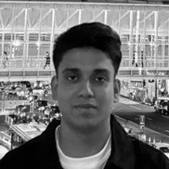
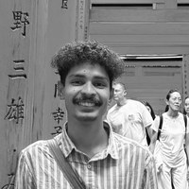
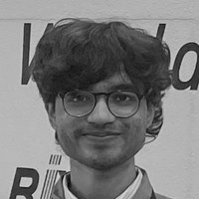
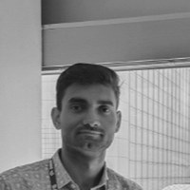





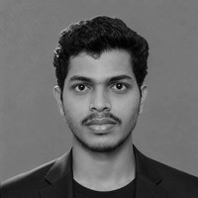
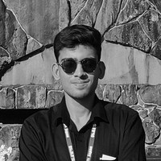
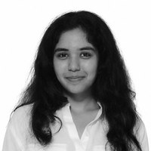
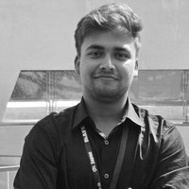
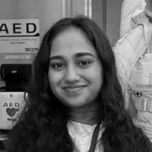
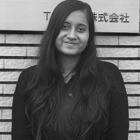
Who Went Where
12 host companies · 11 interns · Week 1 (13–16 Oct) → Week 2 (19–22 Oct)
→
→
→
Aarsh Jain
Anmol Singhal
Aabhas Malpani
Aryan Pansare
Sparsh Shukla
IIT Guwahati
IIITDM Jabalpur
IIITDM Jabalpur
IIITDM Jabalpur
IIITDM Jabalpur
→
Meghraj Shinde
Adarsh Priyadarshi
Aarya Shisode
Siddhant Chauhan
Nandini Maheshwari
Divya Gupta
IIITDM Jabalpur
IIITDM Jabalpur
IIT Guwahati
IIITDM Jabalpur
IIT Madras
IIT Madras
Notes:
Act III · Who went where. Each card starts from the host company logo (week 1, then week 2 where the intern moved) and shows the interns who worked there, with their institute. Yaskawa Electric then Seiko Electric: Aarsh Jain (IIT Guwahati), Anmol Singhal (IIITDM Jabalpur). Hubest Holding then ASO Group: Aabhas Malpani. Renesas Electronics then RIX Corporation: Aryan Pansare. BPLUST: Sparsh Shukla. MIZ Co., Ltd.: Meghraj Shinde. Nakayama Iron Works: Adarsh Gyan Priyadarshi (IIITDM Jabalpur), Aarya Shisode (IIT Guwahati). Saga Toyopet: Siddhant Chauhan (IIITDM Jabalpur), Nandini Maheshwari (IIT Madras). TOTO then Matsumoto Industry: Divya Gupta (IIT Madras).

Slide 16
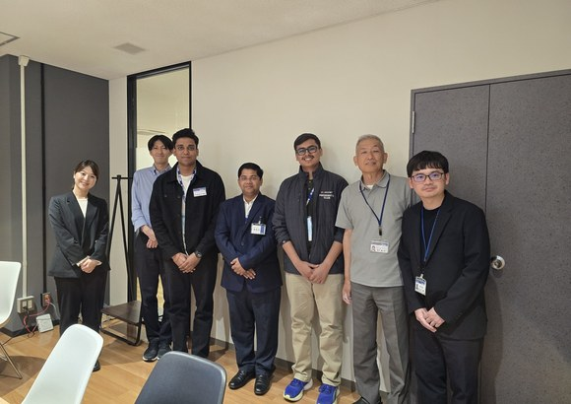
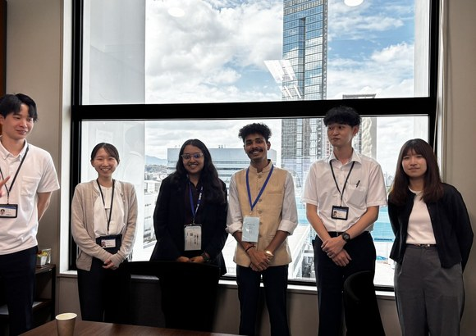
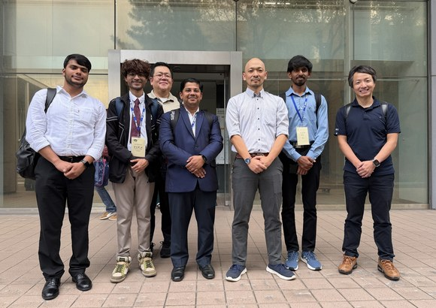





Internship Moments
Eight days of real projects, hosted by people who made us feel welcome.
Yaskawa Electric and Seiko Electric
ASO Group
Renesas Electronics and RIX
BPLUST
MIZ
Nakayama Iron Works
Saga Toyopet
TOTO and Matsumoto Industry
Notes:
A few moments from the internships: with our hosts at each company, at project presentations, and at the Saga welcome and farewell events.

Slide 17
Skills Across Our Hosts
Skills each host company’s work called for, from our project reports.
Simulation
Vision and 3D sensing
Data analytics
IoT and monitoring
Anomaly detection
Service and product design
Software and platforms
Site observation
Yaskawa Electric Robotics
Seiko Electric Port systems
Hubest Holding
—
ASO Group Consulting
Renesas Electronics Semiconductors
—
RIX Corporation Services
BPLUST Media and IT services
—
MIZ Healthcare
Nakayama Iron Works Crushers, micro-hydro
Saga Toyopet Automotive, mobility
TOTO Bathware
—
Matsumoto Industry
—
hands-on work
studied or observed
Notes:
Skills each host company's work called for. Filled dot: we did hands-on work in that skill; ring: we studied or observed it. Yaskawa: physics simulation (thermal model) and computer vision (strawberry grasping). Seiko: anomaly-detection design (PlantGuard), plus monitoring studied. RIX: service and product design (CareLoop), plus monitoring and anomaly detection studied. MIZ: the S.V.A.S.T.H.A. healthcare platform. Nakayama: data analytics (rock and crusher evidence base) and industrial monitoring (micro-hydro dashboard), anomaly detection studied. Saga Toyopet: data analytics and service design (tuk-tuk app, paperless platform). ASO: site observation. Skills for Hubest, Renesas, BPLUST, TOTO and Matsumoto are still to be confirmed by the interns.

Slide 18
What Our Hosts Said
Feedback from our host companies after the internships.
To Anmol Singhal and Aarsh Jain
To Aabhas Malpani
“When I listened to your presentations today, I could see that you had a wonderful four days, and that made me very happy.”
“It was a pleasure to meet such promising young people who will help shape the future of our world.”
Kana Hayashi
Teppei Uchimura
Yaskawa Electric Corporation
ASO Group
To Meghraj Shinde
To Aarya Shisode and Adarsh Gyan Priyadarshi
“Your engineering skills, problem-solving mindset, and passion for technology have inspired our entire company.”
“Demonstrated commendable commitment, professionalism and enthusiasm for learning. Conduct, dedication and overall performance were highly appreciated.”
Yamamoto Takao
Kenichiro Dan
Deputy General Manager, Community Relations and Engagement Division, MIZ Co.
Director, Product Development Section, Nakayama Holdings Ltd.
Notes:
What our hosts said, quoted from emails and written feedback the interns received. Yaskawa Electric, Kana Hayashi, to Anmol Singhal (16 Oct): "Thank you for joining our internship. When I listened to your presentations today, I could see that you had a wonderful four days, and that made me very happy." ASO Group, Teppei Uchimura, to Aabhas Malpani (23 Oct): "I also enjoyed spending time with you all and having such a fruitful discussion. It was a pleasure to meet such promising young people who will help shape the future of our world." MIZ Co., Ltd., Yamamoto Takao, Deputy General Manager, Community Relations and Engagement Division, to Meghraj Shinde (and Akshita): thanks for "hard work, dedication, and technical excellence" during the 8-day internship; contributions to the S.V.A.S.T.H.A. healthcare platform "have been remarkable"; "Your engineering skills, problem-solving mindset, and passion for technology have inspired our entire company." MIZ plans an online meeting to continue the project. Nakayama Holdings Ltd., Kenichiro Dan, Director, Product Development Section, to Aarya Shisode and Adarsh Gyan Priyadarshi: each "demonstrated commendable commitment, professionalism and enthusiasm for learning", and their "conduct, dedication and overall performance were highly appreciated." (The same words were given to each; shown once.)

Slide 19

Action Plan
道
ACT IV
How we turn this experience into something that lasts.
Notes:
Act IV title page. Opening line: 'This last part is about how we make it happen.'

Slide 20


Recommendations for Future Editions
From exposure to meaningful participation.
2–3
MONTHS EARLIER
01
02
03
More company visits
Earlier selection
An Even Saturday
University visits were highly technical, and in a short time it was hard to understand what each university does. Company visits felt more personal, because we already use products from companies like Suzuki. More of them would help us feel connected.
Select participants 2–3 months before departure, so that everyone has enough time to learn Japanese, for example with the Busuu app.
Keep Saturdays light and evenly paced, so the week is less hectic and there is time to rest. We believe exploring alone helps us understand the country better.
Notes:
Recommendations for future editions. 1. More company visits: university visits were very technical and it was hard to learn what each university does in such a short time. Company visits make us feel connected because we already use their products, for example Suzuki. 2. Earlier selection: select participants 2–3 months beforehand so they have enough time to learn Japanese, for example with the Busuu app. 3. An even Saturday: a lighter, evenly paced day, less hectic, with rest and time to explore alone, which helps us understand the country. Key message: move from exposure to meaningful participation.

Slide 21

We Recommend October
June or October? Three reasons favor October.
1
No clash with internships
May to July is summer internship season for the students this program is designed for.
2
Better weather for travel
June is the rainy season: about 269 mm of rain in Fukuoka, compared with about 93 mm in October.
3
Already proven
The 2025 and 2026 groups both ran in October.
Our recommendation: October, after consulting universities, host companies and students.
Notes:
Say the recommendation first: October. Reason 1, students are available: May to July is summer internship time for exactly these students, so a June program would force them to choose. Reason 2, weather and travel: June is the rainy season (tsuyu) in every region the program visits; Fukuoka gets about 269 mm of rain in June against about 93 mm in October. Be honest that early October can still bring a typhoon, so say 'much better', not 'perfect'. Reason 3, it already works: the 2025 group (1–29 Oct) and our 2026 group (6 Oct – 4 Nov) both ran in October. Also worth keeping in any month: the whole group stayed in the same hotels, which built real friendships.

Slide 22

Our Journey, Online
A website where every participant shares their own views, journey and learning.
1
Individual views
Each of us shares our own perspective, which is hard to present in a single session.
2
Our journey
Where we travelled, what we learned, and our personal challenges.
3
A portal for the future
Future participants can use it to prepare for Japan.
11
participants today
40
participants next
Our Kyushu A group
All MIRAI-Setu 2026 groups
Scan to read our stories
Student-created resource, not an official AFS or MOFA website.
Notes:
It is difficult to present the views of all eleven of us in one session, so we have built a website where each participant shares their own views, the places we traveled, what we learned, and our personal learning and challenges. It can also act as a portal for future participants. Today it covers our group of 11; it can be extended to all 40 participants. Scan the QR code to visit. The site is a student-created resource and not an official AFS or Ministry website.

Slide 23




Thank you
ありがとうございました
Learn
Keep learning each other’s languages and cultures.
Connect
Keep the friendships and work relationships.
Collaborate
Turn connections into academic, professional and cultural opportunities.
With sincere thanks to the Ministry of Foreign Affairs of Japan, AFS, our host companies, the universities and our interpreters, who made every conversation possible.
Kyushu A, together throughout the month
Our website
Notes:
Our commitment is to keep learning, keep connecting and, where there is shared interest, to collaborate. MIRAI-Setu is not only a month we experienced; it is a bridge we can keep building. We sincerely thank the Ministry of Foreign Affairs of Japan, AFS, our host companies, the universities and our interpreters, who made every conversation possible. All members: step forward, say arigatō gozaimashita together, then bow.

