Slide 1

Impact of Absent Father on Child’s Education
Aarshay, Bindia, Keerti

Slide 2
What is The “Fragile” Families & Wellbeing Study?
Birth cohort study of ~5000 American families in urban areas over 15 years
Collected in 5 waves [1998-2015]
As per child’s age - birth, 1st year, 3rd year, 5th year and 9th year
Addresses 3 areas of great interest to policy makers and community leaders
Nonmarital childbearing, welfare reform, and the role of fathers
Data on unwed fathers is more complete than those from previous surveys
Interviewed at least 75% of the unwed fathers
Data on the missing fathers completed from mother’s file
Notes:
Why fragile - 75% unwed parents, these homes, low income, high alcohol, more poverty
Scale - nationalized data (from 15 years)
Aim - Better policies

Slide 3
Why did we pick this data?

Slide 4


Lets Not Go There!!
12943 survey questions over 15 years
4242 children tracked
Cryptic feature codings
~25 files with documentation!
~80% of the time
on knowing data!
Notes:
Cumbersome data

Slide 5
Children born to unmarried parents have been shown to be more vulnerable to adverse outcomes
Nearly a third of all children born in the United States today are born to unmarried parents with higher among poor and minority populations
Some of the existing research is around the effect of:
Father involvement on child’s behavior
Parents’ On/Off Relationship on father’s involvement
Upbringing in disadvantaged families leading to low college performance
The link between father involvement and child’s school education outcomes is not common; thus our primary focus
Notes:
Adverse outcomes
⅓ to unmarried to poor and minority pop
Existing research around behaviour | college performance

Slide 6
Our aim is to assess the impact of biological father’s involvement upto 9 years on GPA of child at the age of 15
Interviews questions covered the following variables:
Relationships, Parenting behaviour, Employment status, Neighbourhood Characteristics, Home Environment, Incarceration Histories, Race/Religion etc.
~600 constructed variables
Created a data dictionary for these variables (66 cells)
Can be used to map the variable meaning in the future research

Slide 7
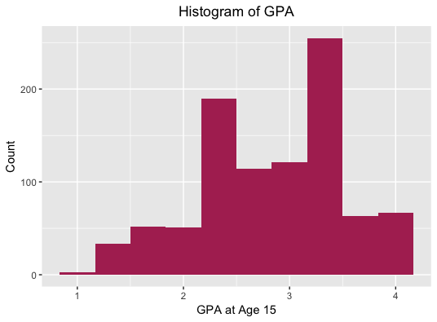
We chose GPA as a measure of educational attainment at the age of 15
Available Outcomes:
GPA
Grit
Material Hardship
Eviction
Being laid off
We picked GPA!

Slide 8
FEATURE ENGINEERING

Slide 9
We started with some primary data cleaning
Considering Ids where GPA is present (~54%)
Considered only the mothers present in all waves (~82%)
Drop children under father’s custody (~0.2%)
Missing value imputation

Slide 10
We have engineered 5 features to access the impact of biological father’s involvement upto 9 years on GPA of child at the age of 15
Father’s Involvement
Father’s Presence
Cohabiting with biological father
Cohabiting with any partner
Number of partner’s changed
Notes:
Clg data
Father presence more on school performance as more father involvement during this time
Easily influenced kids

Slide 11
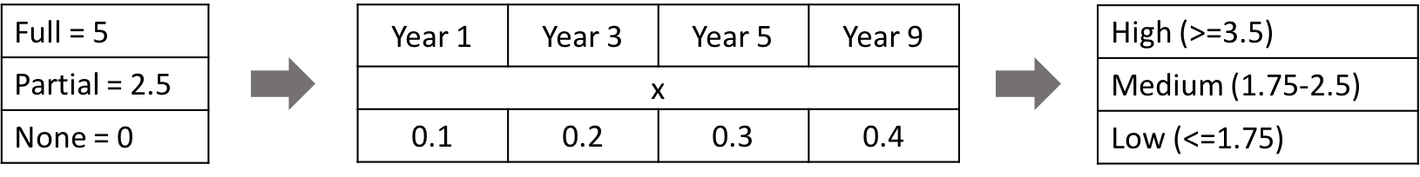
Presence of biological father was determined based on the time lived in the same house.
Full presence - father lives in the same house
Partial presence - father has seen the child in the last 2 years
No presence or None - father has not seen the child in the last 2 years
Categories
Interview years
Conclusion

Slide 12
Father’s involvement with child was determined based on frequency of spending time with the child.
Full involvement - 1+ hour everyday.
Partial involvement - a few times a week or a few times a month
No involvement or None - very little time or not at all
Categories
Interview years
Conclusion

Slide 13
Presence of a fatherly figure is based on the mother living with any partner
Cohabiting with biological father
Number of times mother answered “yes” to living with the biological father
Cohabiting with any partner
Number of times mother answered “yes” to living with the father or any other partner

Slide 14
The number of romantic partners of the mother, apart from biological father, were also captured.
Number of romantic partners the mother had
Expected to have a negative connotation to the child’s academic performance
Data only available for the last two interviews (span of 6 years)

Slide 15
We had some control variables to account for other factors/confounders.
Parent’s education (Integer)
Both father’s and mother’s education
CIDI (Integer)
Cases of depression, anxiety, alcohol and drug abuse involving mothers
Household Income (log scale)
Average of the income throughout the interview years
Cases of Spanking (Integer)
Taken from the child’s interview at age 9

Slide 16
EXPLORATORY ANALYSIS
Univariate Analysis
Interaction Modeling Using OLS

Slide 17
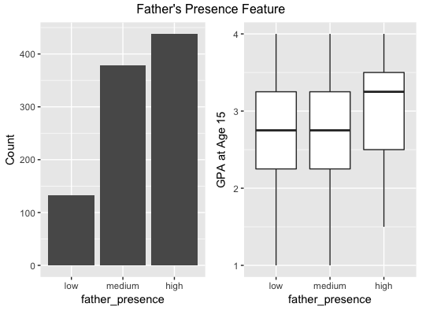
Children who experience high presence of biological father have higher GPA on average
3-way ANOVA also shows significant results

Slide 18
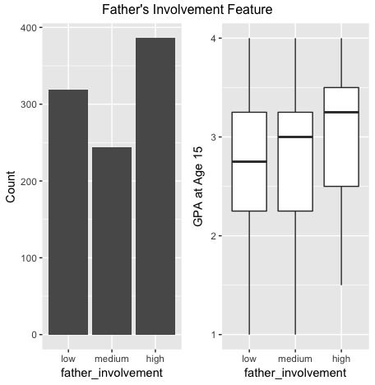
But children whose fathers were even mildly involved have higher GPA on average
3-way ANOVA also shows significant results

Slide 19
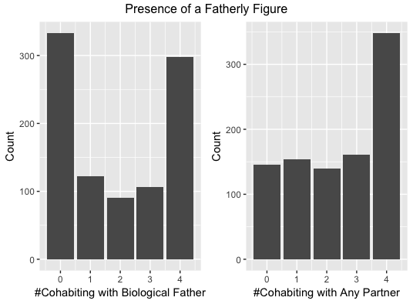
Cohabitation with biological or even other partners show positive correlations with GPA
Correlation Coeff: 0.24 0.22
Notes:
many women living with biological father; both cases have positive correlation

Slide 20
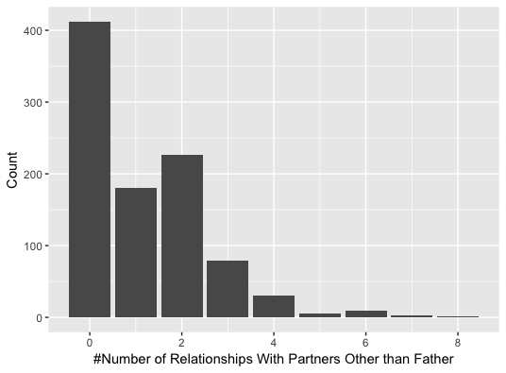
More than half of mothers had non-marital relationships, which are negative correlated with GPA
Corr = -0.18

Slide 21
REGRESSION AS AN
EXPLORATORY TOOL

Slide 22
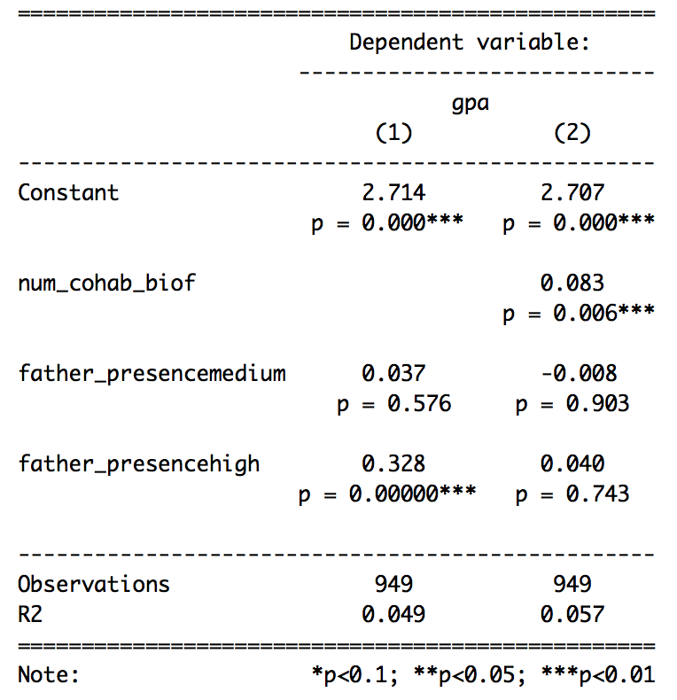
Cohabiting biological fathers seem to have a significant impact on GPA

Slide 23
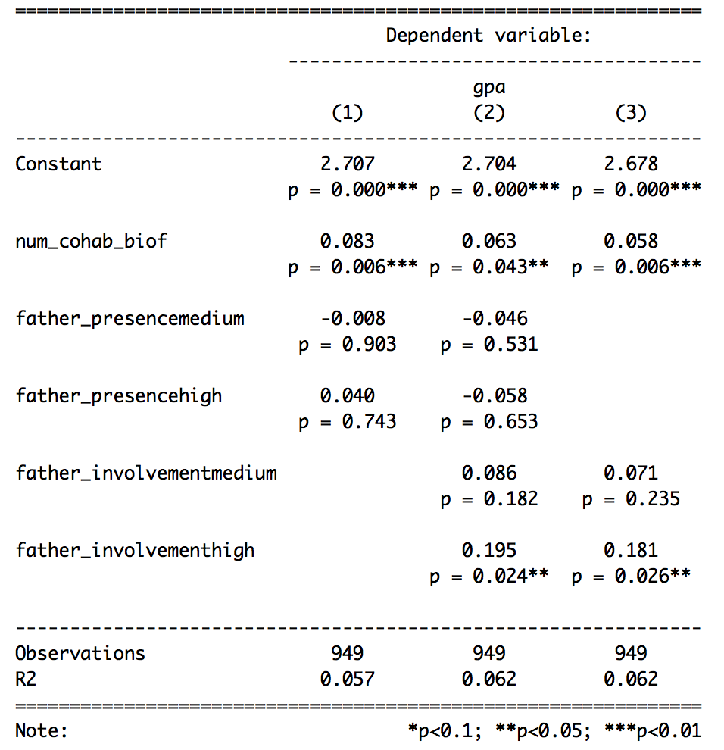
But biological father’s high involvement with the child is more important even if not living together.

Slide 24
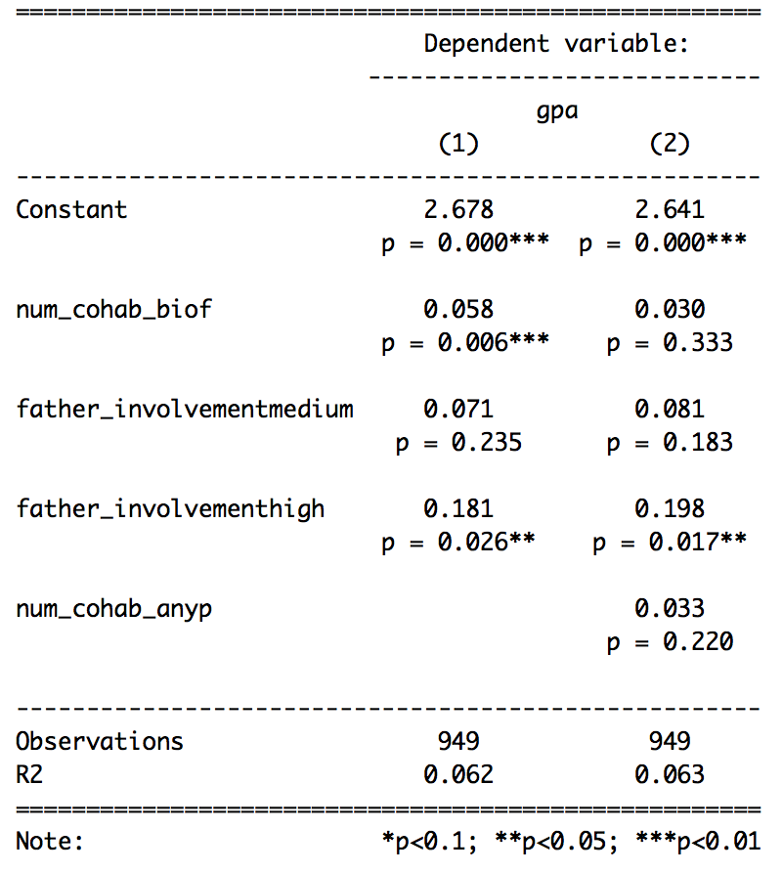
Non-biological fathers don’t appear to have a significant impact on child’s GPA

Slide 25
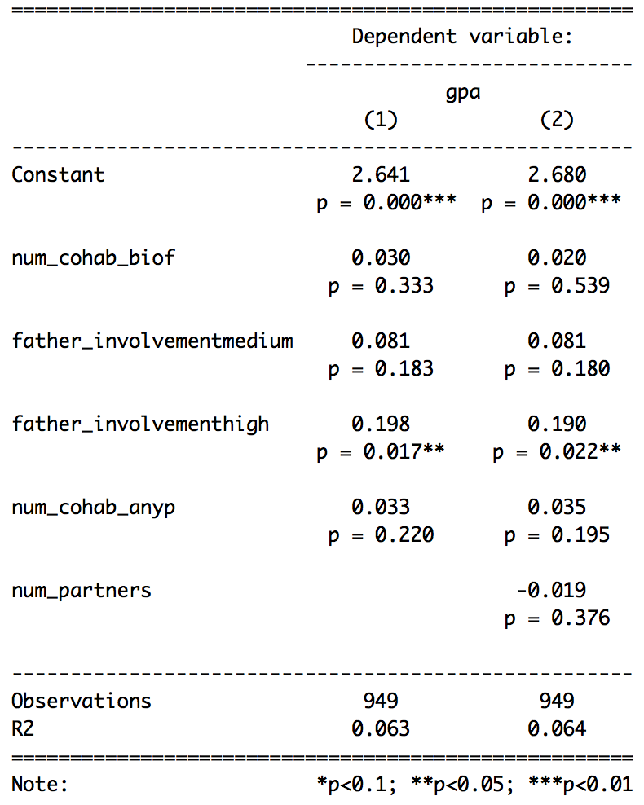
The number of non-marital relationships of mother has a slight negative impact

Slide 26
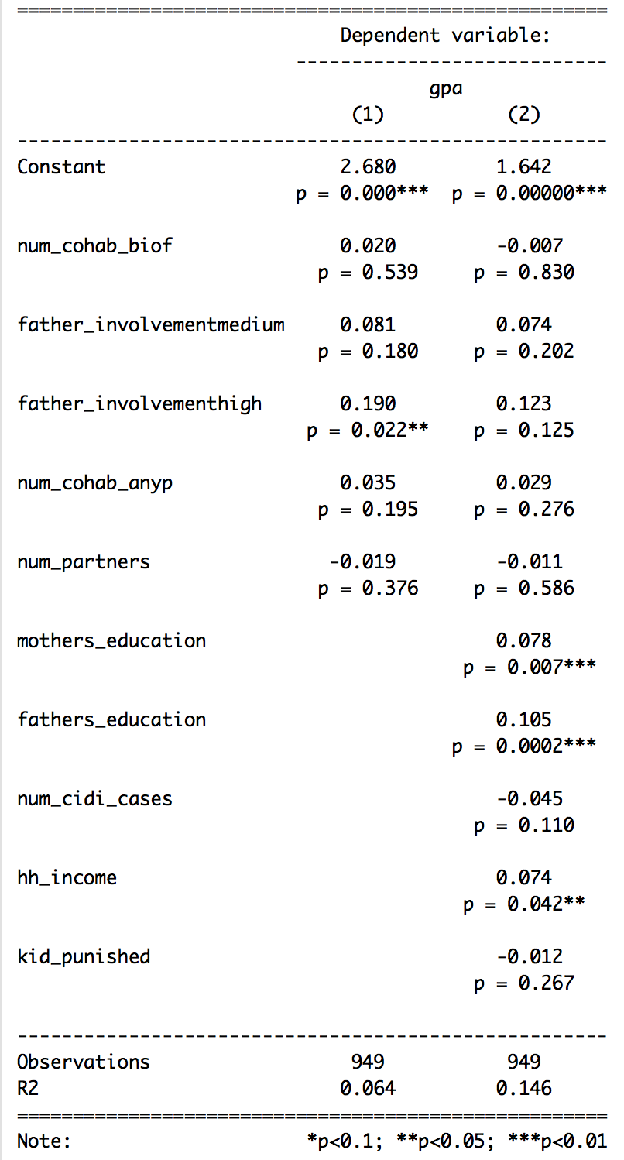
Control Variables seem to overpower the explanatory variables, but the interpretation is still the same

Slide 27
In conclusion, we found 3 factors to correlate* well with high GPA outcomes
In order of priority:
Biological father’s high involvement (~95% conf)
Biological father’s mild involvement (~80% conf)
Presence of a fatherly figure (~80% conf)
* No causal claims!!
Notes:
Not strong enough for a policy recommendation though

Slide 28
Challenges/Shortcomings
80% of the time spent on:
Understanding the questionnaire hierarchy
Data understanding and cleaning
Tracking the changes in question and response codes in-between waves
We used information up to 9 years of age to predict outcomes at 15 yrs, missing out crucial
Assumptions and proxy measures used to account for the factors taken in consideration

Slide 29
Future work
Analyze the data geographically - get contract data (secured)
Understanding the effect of social desirability bias and response bias
Find natural experiments in the data and make causal claims
Attempt fancy imputation techniques instead of dropping (though not sure if that would really help)
Incorporate more factors and try to get more significant results

Slide 30
THANK YOU!!

