Slide 1
IoT streaming & analytics dashboard
November 2017

Slide 2
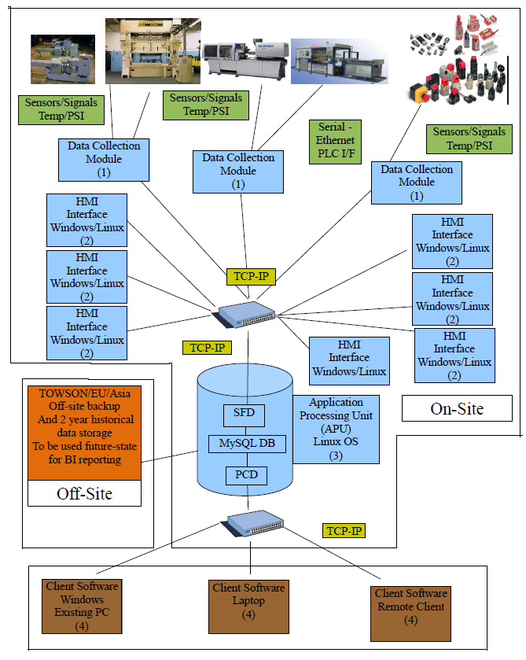
Process

Slide 3


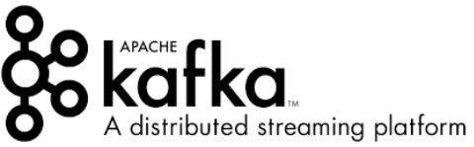










IoT Architecture Building Blocks
Device Management, Data Analysis, and Applications
IoT Data Sources
Connected Factory
Warehouse Management Systems
Vehicles
Connected Tools
Stream Processing Platform for real time data feeds
Enterprise Dashboard, Search & Insights
Data Stream Collection, Ingestion, Filter & Dispatch
Nifi
Nifi
Spark Streaming
Kafka Connect,
Kafka Streams
Topic Streams
Raw Data Streams
Spark SQL
Mlib
Machine Learning
Spark Cassandra Connector
Enterprise Search
IoT Gateway
Raw to Aggregate Data Streams
Splunk
Apache Flume
Cluster
Data Analysis & Visualization, Applications & Dashboards (Chart.js, D3, …)
Apache Zookeeper
Mesos Cluster Management
Data Categories
Streaming Data
Transactions
Historic Logs
Customer Feedback
End User Information
Alerts & Messaging
Structured & Unstructured Data
Hadoop YARN
HDFS

Slide 4
Dashboard
Build a stream processing app to stream IoT data.
Identify and alert potential anomalies using machine learning algorithms.
Build a dashboard to display alerts and display relevant IoT data (students have the option of using interactive queries feature of Apache Kafka).
Students are encouraged to use as much open source as possible like Apache, D3.JS and Spark.

