Slide 1
Modeling path dependent financial products using monte carlo approach
By – Aarsh Sachdeva (A# 20595501)
Instructor – Prof. Fred Hickernell

Slide 2
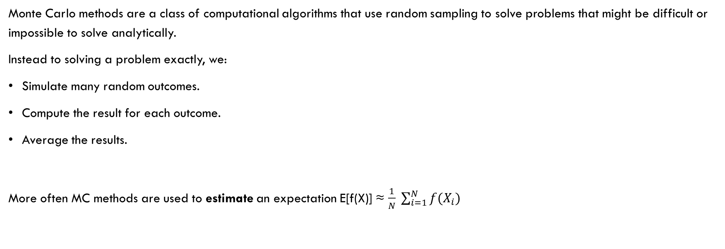
What is Monte carlo?
Monte Carlo methods are a class of computational algorithms that use random sampling to solve problems that might be difficult or impossible to solve analytically.
Instead to solving a problem exactly, we:
Simulate many random outcomes.
Compute the result for each outcome.
Average the results.
More often MC methods are used to estimate an expectation E[f(X)] ≈ $\frac{1}{N} \sum_{i=1}^{N}{f(X_{i})}$

Slide 3
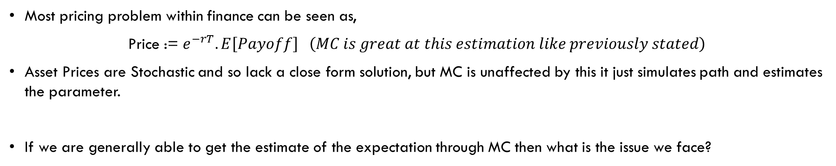
Why is it very popular In finance
Most pricing problem within finance can be seen as,
Price := $e^{−rT}.E\left[Payoff\right] \left(MC is great at this estimation like previously stated\right)$
Asset Prices are Stochastic and so lack a close form solution, but MC is unaffected by this it just simulates path and estimates the parameter.
If we are generally able to get the estimate of the expectation through MC then what is the issue we face?

Slide 4
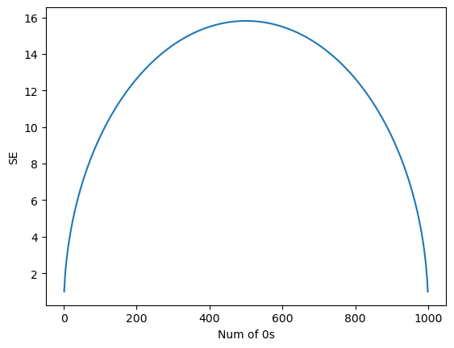
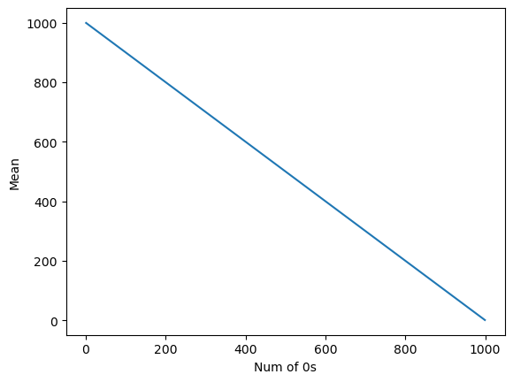

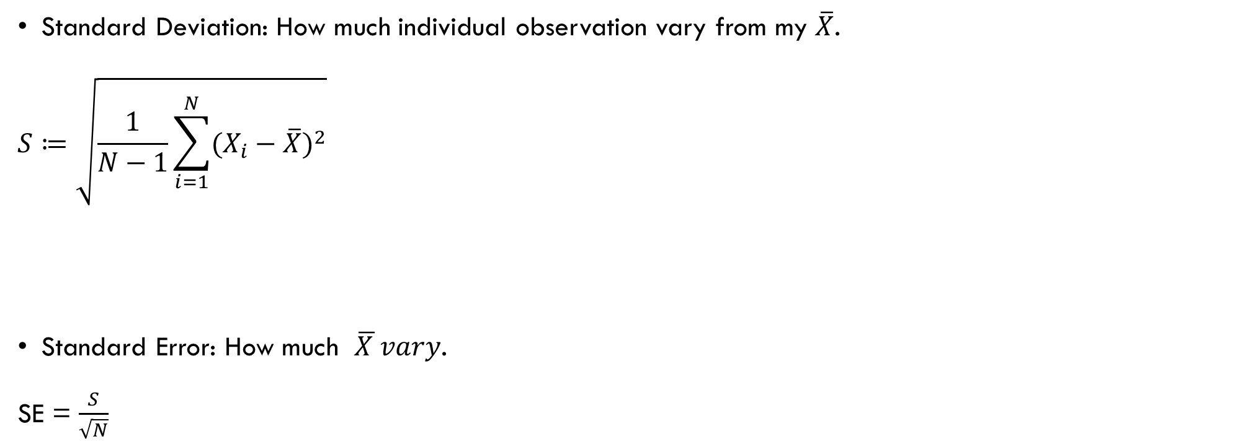


Standard error v/s standard deviation
Standard Deviation: How much individual observation vary from my $\overline{X}$.
$$S≔\sqrt{\frac{1}{N−1}{\sum_{i=1}^{N}{(X_{i}−\overline{X}})}^{2}}$$
Standard Error: How much $\overline{X }vary$.
SE = $\frac{S}{\sqrt{N}}$
$x_{1}$,…., $x_{1000}$=1000
$x_{1}$,…., $x_{999}$=1000 ,$x_{1000}$=0
$x_{1}$,…., $x_{998}$=1000 ${,x}_{999},x_{1000}$=0
SE
Mean

Slide 5
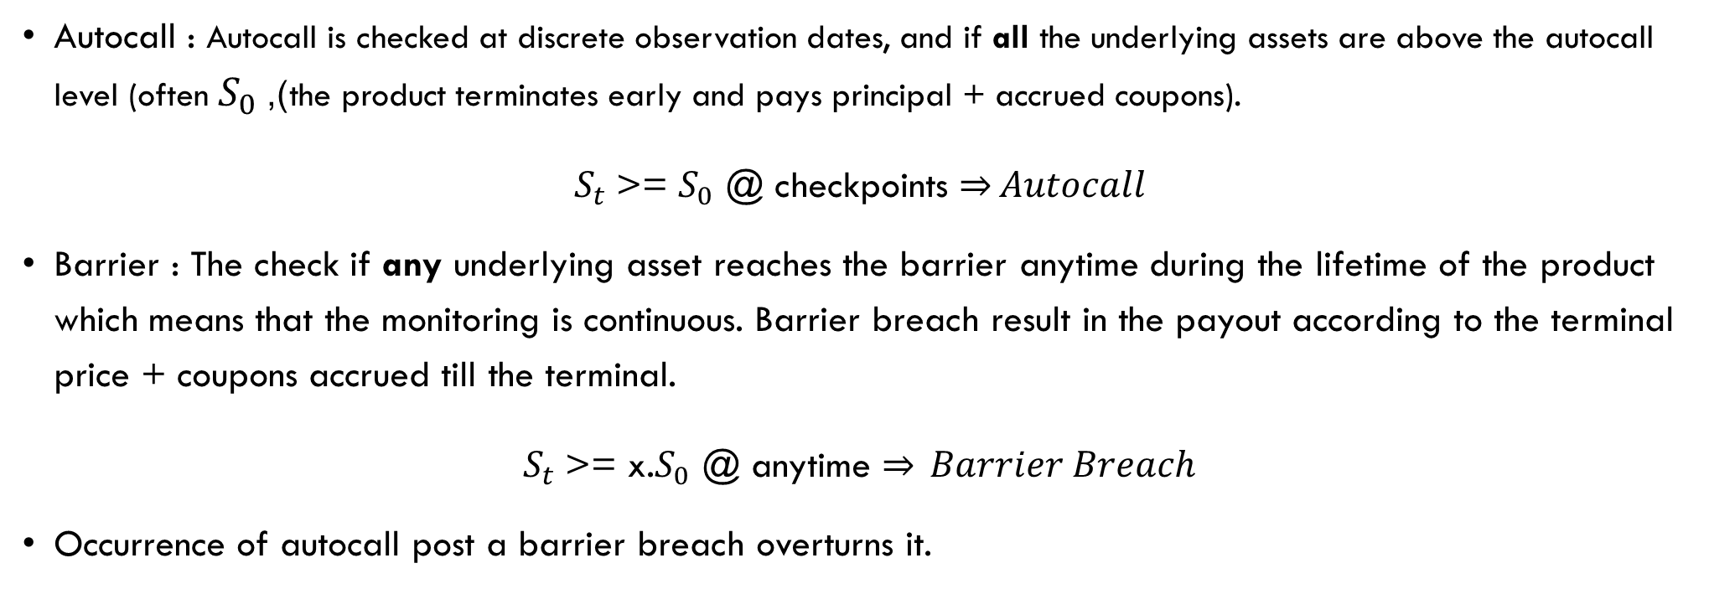
ACBRC (Autocall barrier reverse convertible)
Autocall : Autocall is checked at discrete observation dates, and if all the underlying assets are above the autocall level (often $S_{0}$), the product terminates early and pays principal + accrued coupons).
$S_{t}$>= $S_{0}$ @ checkpoints $\underset{⇒}{}Autocall$
Barrier : The check if any underlying asset reaches the barrier anytime during the lifetime of the product which means that the monitoring is continuous. Barrier breach result in the payout according to the terminal price + coupons accrued till the terminal.
$S_{t}$>= x.$S_{0}$ @ anytime $\underset{⇒}{} Barrier Breach$
Occurrence of autocall post a barrier breach overturns it.

Slide 6
Generating the data to get the mean payout
What are the parameters we are using:
No. of stocks = 3 (This leads us to work with 3D tensors)
Investment = SG$ 1000
Dividend are pay annually and vary for each stock
Contract tenure is 1.25 years
The underlying assets are chosen which are correlated to each other
Coupons payout is 8% of the investment/ annum payed quarterly (i.e. 2% every quarter).
Autocall Checkpoints are [0.5,0.75,1] (in yrs)
Trading days in year = 252

Slide 7
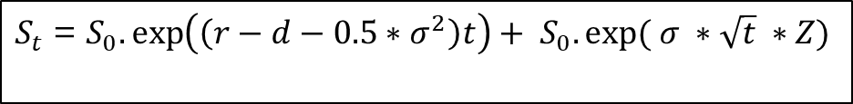
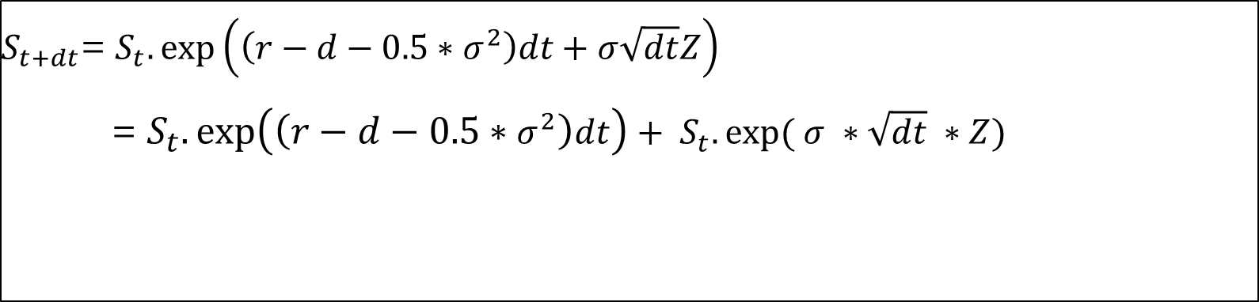
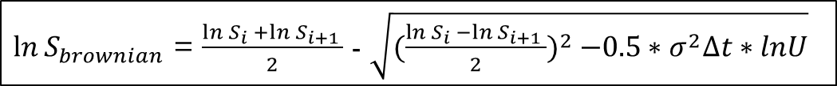
Generating simulations and getting the payout
$S_{t+dt}$= $S_{t}.\exp\left(\left(r−d−0.5∗σ^{2}\right)dt+σ\sqrt{dt}Z\right)$
= $S_{t}.\exp\left(\left(r−d−0.5∗σ^{2}\right)dt\right)+ S_{t}.exp⁡( σ ∗\sqrt{dt} ∗Z)$
Z ~ N(0,1)
Drift Term
Diffusion Term
$S_{t}$ = $S_{0}.\exp\left(\left(r−d−0.5∗σ^{2}\right)t\right)+ S_{0}.exp⁡( σ ∗\sqrt{t} ∗Z)$
$\ln{S_{brownian}}$ = $\frac{\ln{S_{i} }+\ln{S_{i+1} }}{2}$ - $\sqrt{{(\frac{\ln{S_{i} }−\ln{S_{i+1} }}{2})}^{2} −0.5∗σ^{2}∆t∗lnU}$
U ~ U[0,1] : Introduces randomness
Exp($\ln{S_{brownian}}$ ) would give us the minimum price between 2-time stamps
Midpoint term where the path roughly lies
Difference term larger distance between the end points higher variability

Slide 8
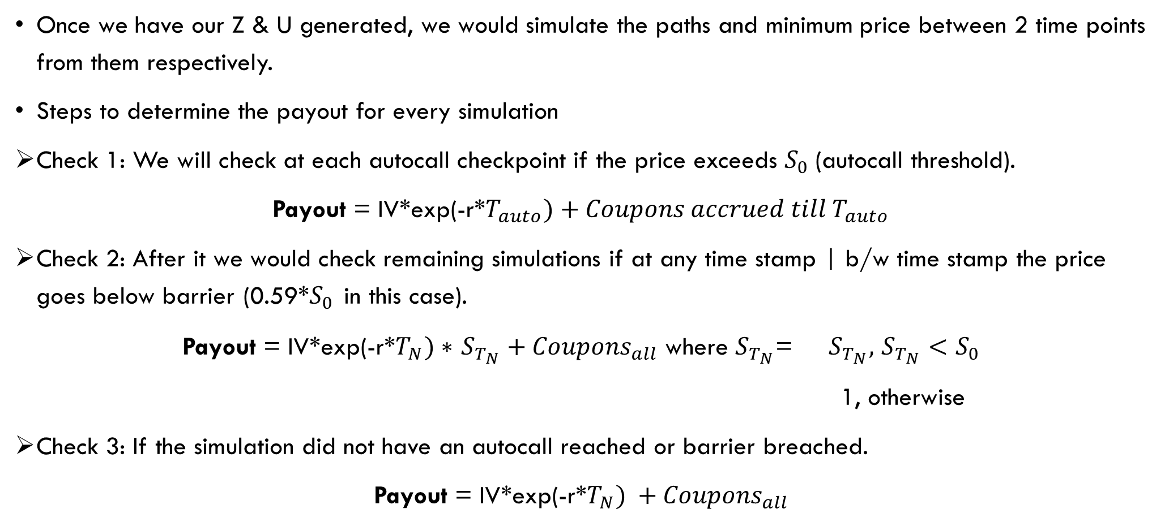
Average Payout computation
Once we have our Z & U generated, we would simulate the paths and minimum price between 2 time points from them respectively.
Steps to determine the payout for every simulation
Check 1: We will check at each autocall checkpoint if the price exceeds $S_{0}$(autocall threshold).
Payout = IV*exp(-r*$T_{auto})+Coupons accrued till{ T}_{auto}$
Check 2: After it we would check remaining simulations if at any time stamp | b/w time stamp the price goes below barrier (0.59*$S_{0 }$in this case).
Payout = IV*exp(-r*$T_{N})∗$ $S_{T_{N}}+{Coupons}_{all}$ where $S_{T_{N}}$= $S_{T_{N}},$ $S_{T_{N}}<S_{0}$
1, otherwise
Check 3: If the simulation did not have an autocall reached or barrier breached.
Payout = IV*exp(-r*$T_{N}) +{Coupons}_{all}$

Slide 9
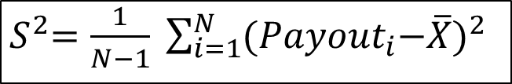
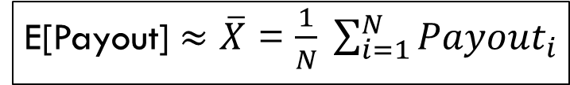
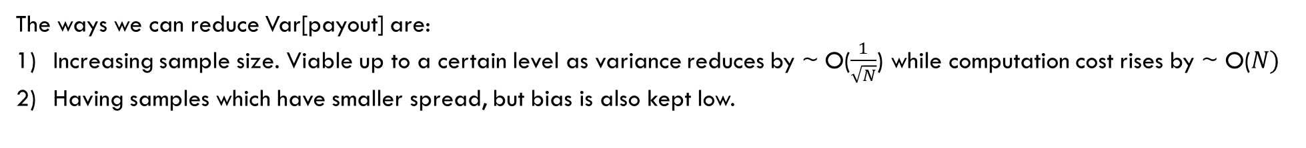
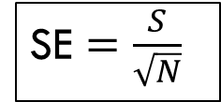
E[Payout] $≈$ $\overline{X}$ = $\frac{1}{N} \sum_{i=1}^{N}{{Payout}_{i}}$
S = np.std(payout,ddof=1) will give us the sample sd
${ S}^{2}=$ $\frac{1}{N−1} \sum_{i=1}^{N}{{{(Payout}_{i}−\overline{X})}^{2}}$
SE $=$ $\frac{S}{\sqrt{N}}$
The ways we can reduce Var[payout] are:
Increasing sample size. Viable up to a certain level as variance reduces by ~ O($\frac{1}{\sqrt{N}}$) while computation cost rises by ~ O($N)$
Having samples which have smaller spread, but bias is also kept low.
Can work on this

Slide 10
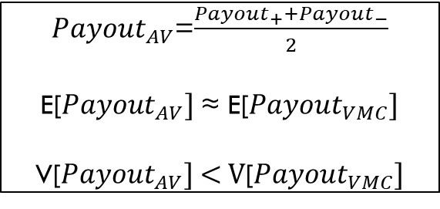
Antithetic Variates
Antithetic Variates is one of the simplest and most effective variance reduction techniques. It basically forces symmetry in randomness to cancel noise.
In this technique we use negatively correlated random variables of the current random variables.
Instead of simulating a Z or U with N simulations (Used in Vanilla Monte Carlo), we use N/2 simulations and simulate Z and U.
The combination of random variable gives N number of simulations and performance comparison of Antithetic Variates with Vanilla Monte Carlo becomes feasible.
Given Z~N(0,1) then –Z~N(0,1) & U~U[0,1] then (1-U)~U[0,1]
${Payout}_{AV}$=$\frac{{Payout}_{+}+{Payout}_{−}}{2}$
E[${Payout}_{AV}] \text{≈} \text{E}\text{[}{Payout}_{VMC}]$
V[${Payout}_{AV}] \text{< }\text{V}\text{[}{Payout}_{VMC}]$
To produce a smallest possible variance, we need to have chosen random variable as negatively correlated as possible
¼(V[${Payout}_{+}]+$ V[${Payout}_{−}]$ + 2Cov(${Payout}_{+},{Payout}_{−}$))

Slide 11
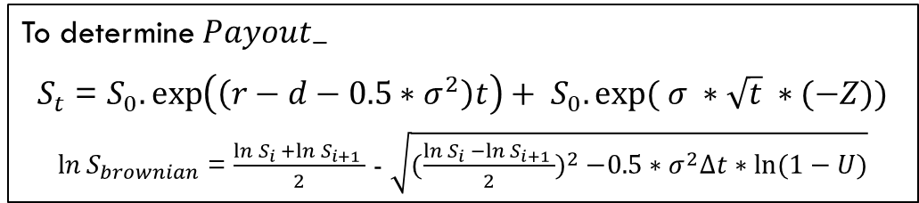
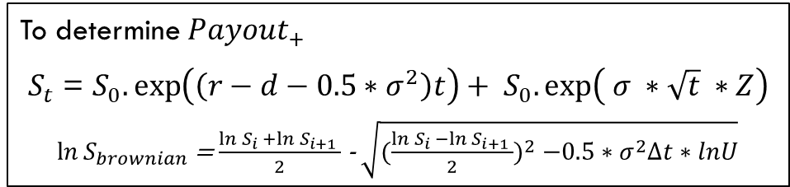
To determine ${Payout}_{+}$
$S_{t}$ = $S_{0}.\exp\left(\left(r−d−0.5∗σ^{2}\right)t\right)+ S_{0}.\exp\left( σ ∗\sqrt{t} ∗Z\right)$
$\ln{S_{brownian}}$ = $\frac{\ln{S_{i} }+\ln{S_{i+1} }}{2}$ - $\sqrt{{(\frac{\ln{S_{i} }−\ln{S_{i+1} }}{2})}^{2} −0.5∗σ^{2}∆t∗lnU}$
To determine ${Payout}_{−}$
$S_{t}$ = $S_{0}.\exp\left(\left(r−d−0.5∗σ^{2}\right)t\right)+ S_{0}.exp⁡( σ ∗\sqrt{t} ∗(−Z))$
$\ln{S_{brownian}}$ = $\frac{\ln{S_{i} }+\ln{S_{i+1} }}{2}$ - $\sqrt{{(\frac{\ln{S_{i} }−\ln{S_{i+1} }}{2})}^{2} −0.5∗σ^{2}∆t∗ln⁡(1−U)}$
Advantages (Other than Variance reduction):
The computational advantage provided by AV broadens as N increases.
Complexity almost like VMC just requires an arithmetic operation per sample.
Disadvantages
Lower N values generally are computationally expensive as the additional arithmetic operation requires time which may exceed the time to generate the additional N/2 simulations.
For multidimensional problems the symmetry effect dilutes.
Relies on Cov(f(Z),f(-Z)) having large negative magnitude which may not be considerably large in some cases.
Furthermore, as the payout is completely different for near barrier or near autocall threshold point so the symmetry may not perfectly align in few cases which means that this use case may not be able to fully explore the benefits of Antithetic Variates as effectively in comparison to the financial products which have sort of linear or monotonous payouts like the European options
Given all the above discussion AV performs better almost every time when compared to VMC just the amount of performance increase may vary depending on the above stated factors.
Although AV gives variance reduction when compared to VMC but the benefit is limited and very often not enough to be considered as a technique which would have considerably large advantage over VMC (in this case) .

Slide 12

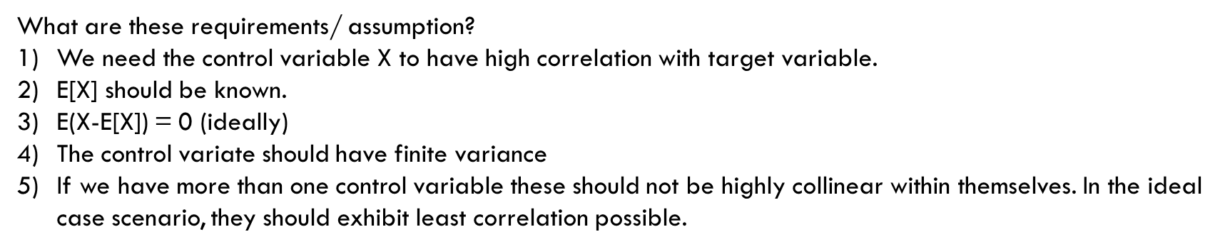
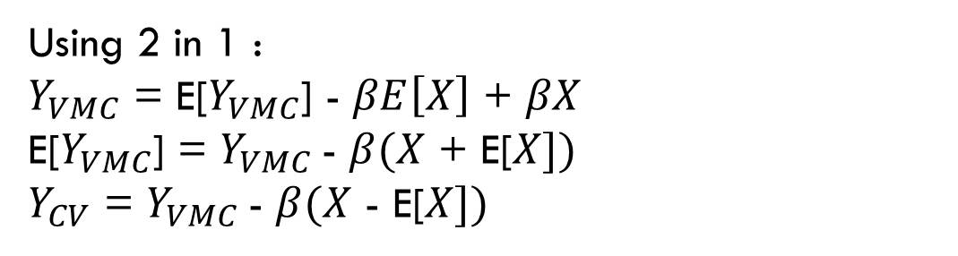
Control Variates
Control Variates is a Monte Carlo Technique for variance reduction by using another random variable which is highly correlated to the random variable of interest.
In most cases it performs better than VMC given that certain requirements and assumptions are met.
What are these requirements/ assumption?
We need the control variable X to have high correlation with target variable.
E[X] should be known.
E(X-E[X]) = 0 (ideally)
The control variate should have finite variance
If we have more than one control variable these should not be highly collinear within themselves. In the ideal case scenario, they should exhibit least correlation possible.
Reminds me something like linear regression
CV uses concept of linear regression and has assumptions similar to it.
$Y_{VMC}$ = $α$ + $βX$+ $ε$
$ε$ = $Y_{VMC}$ - $α$ - $βX$
E[$ε$] = E[$Y_{VMC}$] - $α$ - $βE[X]$
$α$= E[$Y_{VMC}$] - $βE\left[X\right]$
Using 2 in 1 :
$Y_{VMC}$ = E[$Y_{VMC}$] - $βE\left[X\right]$ + $βX$
E[$Y_{VMC}$] = $Y_{VMC}$- $β(X$ + E[$X])$
$Y_{CV}$ = $Y_{VMC}$- $β(X$ - E[$X])$
1
2

Slide 13
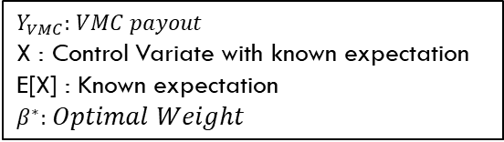

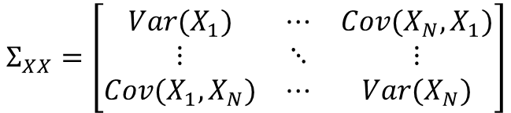





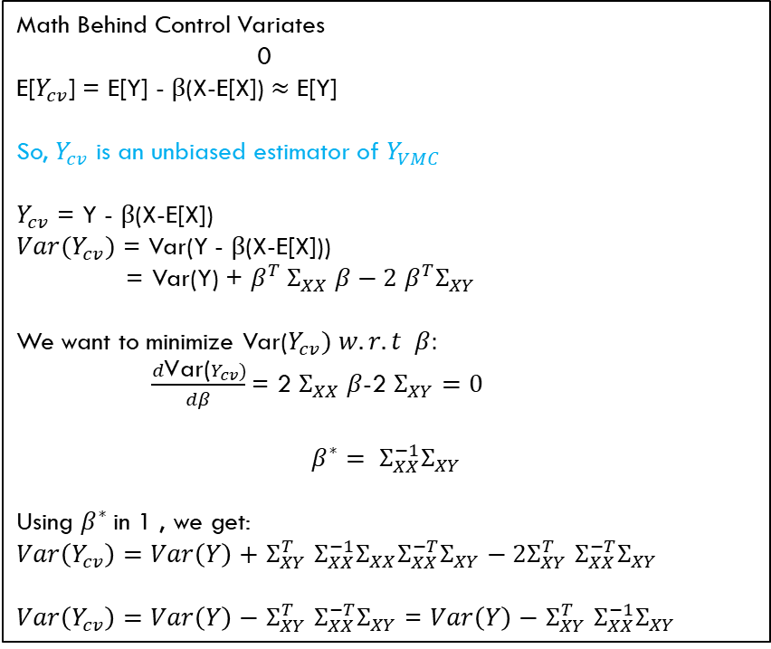
$Y_{VMC}:$ $VMC payout$
X : Control Variate with known expectation
E[X] : Known expectation
$β^{∗}:$ $Optimal Weight$
$Y_{cv}$= $Y_{VMC}$-$β^{∗}(X−E\left[X\right])$
Math Behind Control Variates
0
E[$Y_{cv}$] = E[Y] - $β$(X-E[X]) $≈\text{E}\text{[}\text{Y}\text{]}$
So, $Y_{cv}$ is an unbiased estimator of $Y_{VMC}$
$Y_{cv}$ = Y - $β$(X-E[X])
$Var(Y_{cv})$ = Var(Y - $β$(X-E[X]))
= Var(Y) + $β^{T} Σ_{XX} β−2$ $β^{T}Σ_{XY}$
We want to minimize Var($Y_{cv}) w.r.t β:$
$\frac{d\text{Var}\text{(}Y_{cv})}{dβ}$= 2 $Σ_{XX} β$-2 $Σ_{XY}=0$
$$β^{∗}= Σ_{XX}^{−1}Σ_{XY}$$
Using $β^{∗}$in 1 , we get:
$Var\left(Y_{cv}\right)=Var\left(Y\right)+$ $Σ_{XY}^{T}$ $Σ_{XX}^{−1}Σ_{XX}Σ_{XX}^{−T}Σ_{XY}−2Σ_{XY}^{T} Σ_{XX}^{−T}Σ_{XY}$
$Var\left(Y_{cv}\right)=Var\left(Y\right)−$ $Σ_{XY}^{T}$ $Σ_{XX}^{−T}Σ_{XY}$ = $Var\left(Y\right)−$ $Σ_{XY}^{T}$ $Σ_{XX}^{−1}Σ_{XY}$
$$Σ_{XY}=\left[\begin{matrix}Cov(X_{1},Y) \\ ⋮ \\ Cov(X_{N},Y)\end{matrix}\right]$$
$$β^{∗}=Σ_{XX}^{−1}Σ_{XY}$$
$$Σ_{XX}=\left[\begin{matrix}Var(X_{1}) & ⋯ & Cov(X_{N},X_{1}) \\ ⋮ & ⋱ & ⋮ \\ Cov(X_{1},X_{N}) & ⋯ & Var(X_{N})\end{matrix}\right]$$
$Y_{cv}$= $Y_{VMC}$-$β^{T}(X−E\left[X\right])$
$$β^{∗}=\frac{Cov(X,Y_{VMC})}{Var(X)}$$
I
1 CV case
Non-negative
$Σ_{XX }$is positive semi-definite

Slide 14
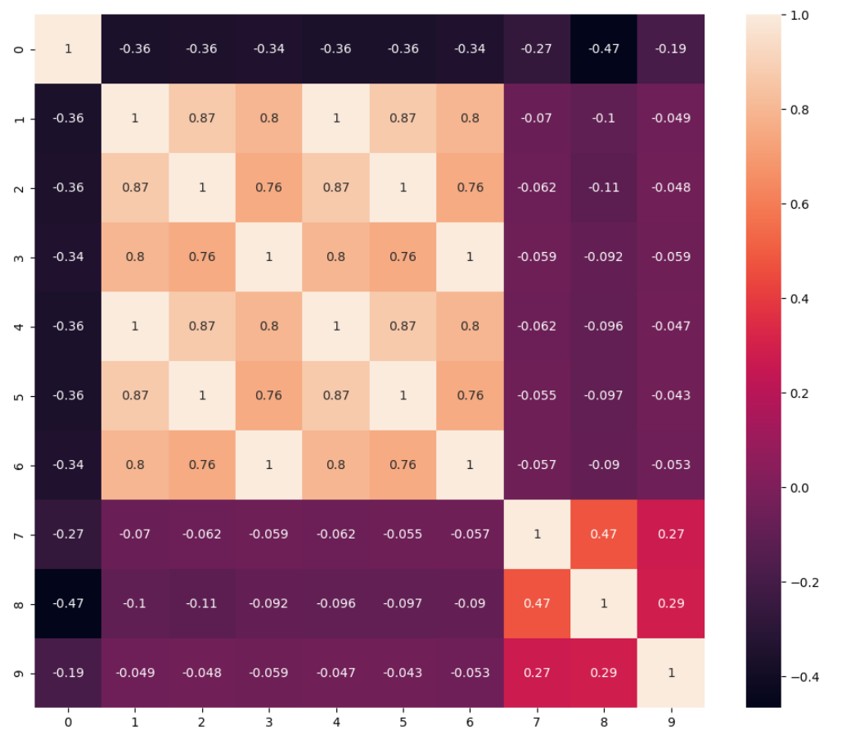
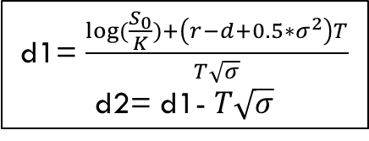
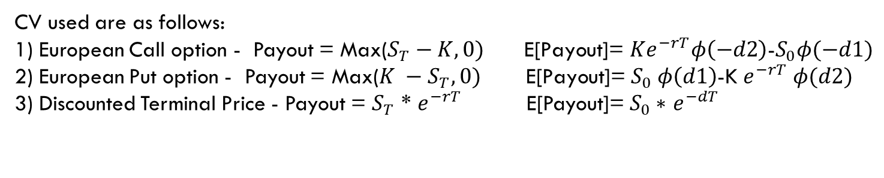
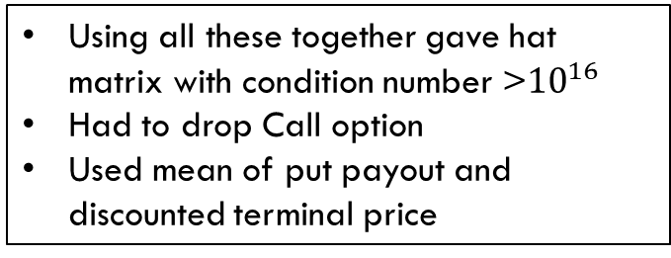
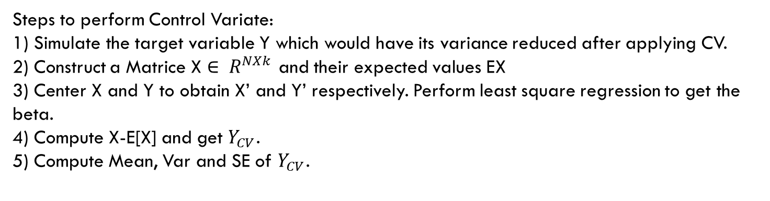
Steps to perform Control Variate:
1) Simulate the target variable Y which would have its variance reduced after applying CV.
2) Construct a Matrice X $∈ R^{NXk}$ and their expected values EX
3) Center X and Y to obtain X’ and Y’ respectively. Perform least square regression to get the beta.
4) Compute X-E[X] and get $Y_{CV}$.
5) Compute Mean, Var and SE of $Y_{CV}$.
CV used are as follows:
1) European Call option - Payout = Max($S_{T}−K,0) \text{E}\text{[}\text{Payout}\text{]= }Ke^{−rT}φ\left(−d2\right)\text{−}S_{0}φ(−d1)$
2) European Put option - Payout = Max($K −S_{T},0) \text{E}\text{[}\text{Payout}\text{]=}$ $S_{0} φ\left(d1\right)$-K $e^{−rT} φ(d2)$
3) Discounted Terminal Price - Payout = $S_{T}$ * $e^{−rT}$ E[Payout]= $S_{0}∗$ $e^{−dT}$
d1= $\frac{\log{(\frac{S_{0}}{K})}+\left(r−d+0.5∗σ^{2}\right)T}{T\sqrt{σ}}$
d2= d1- $T\sqrt{σ}$
VMC payout
Call payout
Using all these together gave hat matrix with condition number >${10}^{16}$
Had to drop Call option
Used mean of put payout and discounted terminal price
Put payout
Discounted Terminal price payout

Slide 15
Advantages:
If the CV are fairly correlated with target variable the variance reduction can be significant.
Works on regression principle. So, performance can be tuned in similar manner being easier to decipher and debug.
Disadvantages:
Finding control variates which are not only correlated to target but also have a known expected value. (A CV like number of barrier breach has a very high correlation and could have easily performed very well but the expectation computation was very complex).
Can be computationally expensive.
Correlation within CVs can make the problem ill-conditioned.
Why do we center X and Y for determining the beta?
Centering is performed to remove the effect of mean of X and Y and determine the actual true relationship between X and Y.

Slide 16
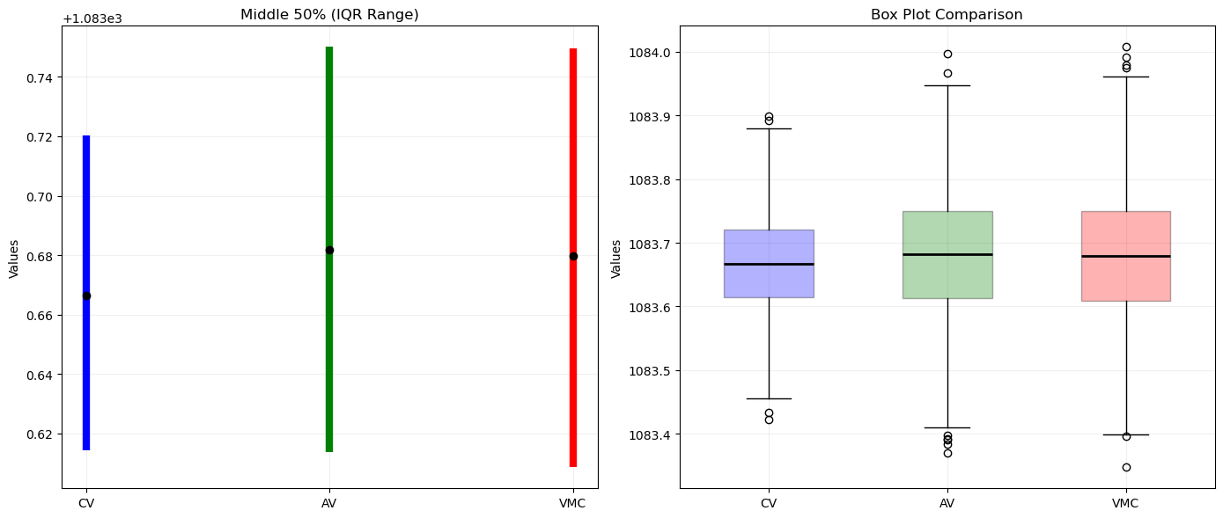
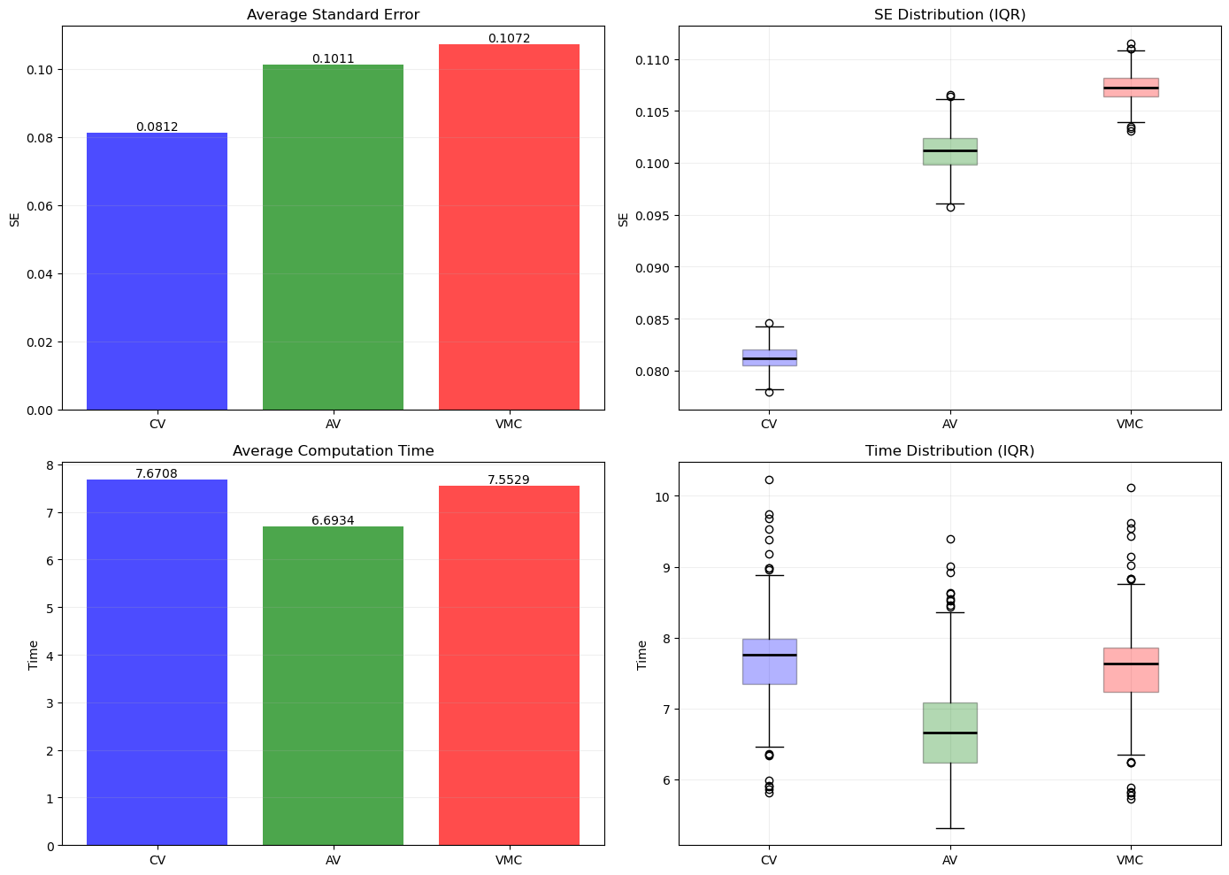
100 K Simulations X 100 iterations

Slide 17
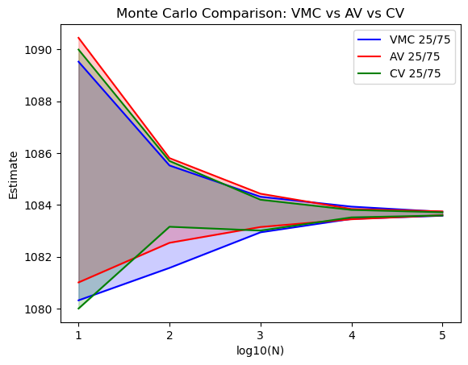
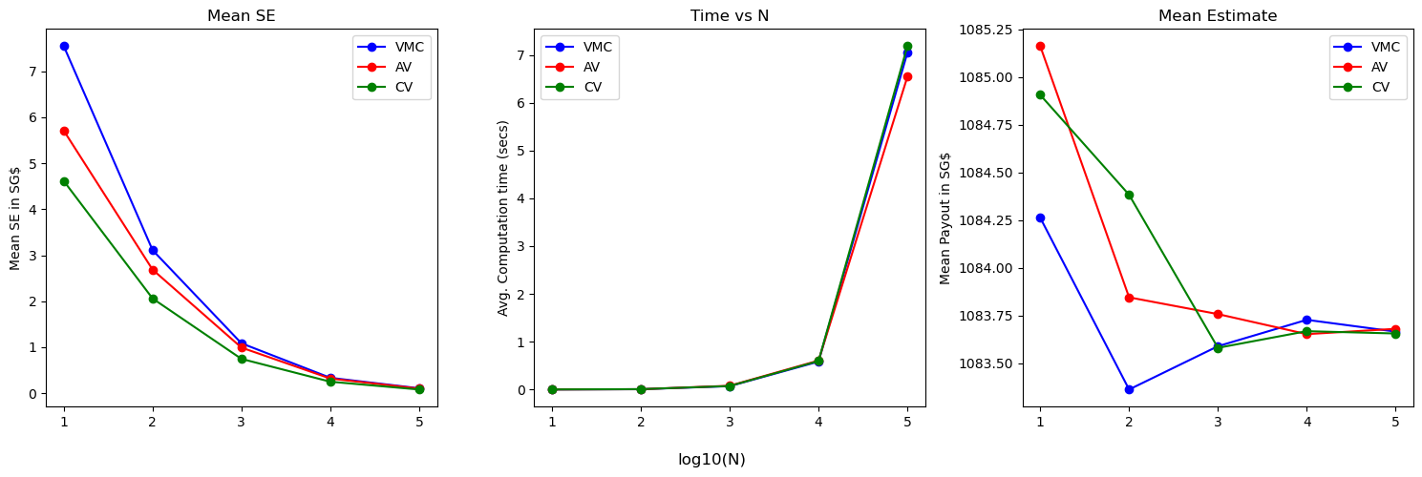
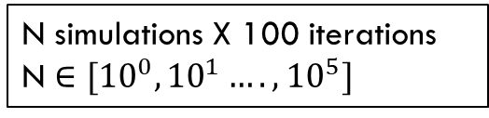
N simulations X 100 iterations
N $∈[{10}^{0},{10}^{1}….,{10}^{5}]$

Slide 18
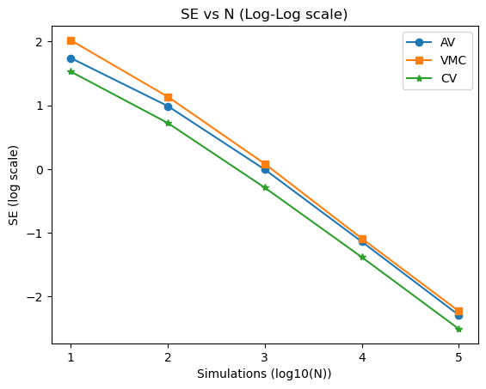
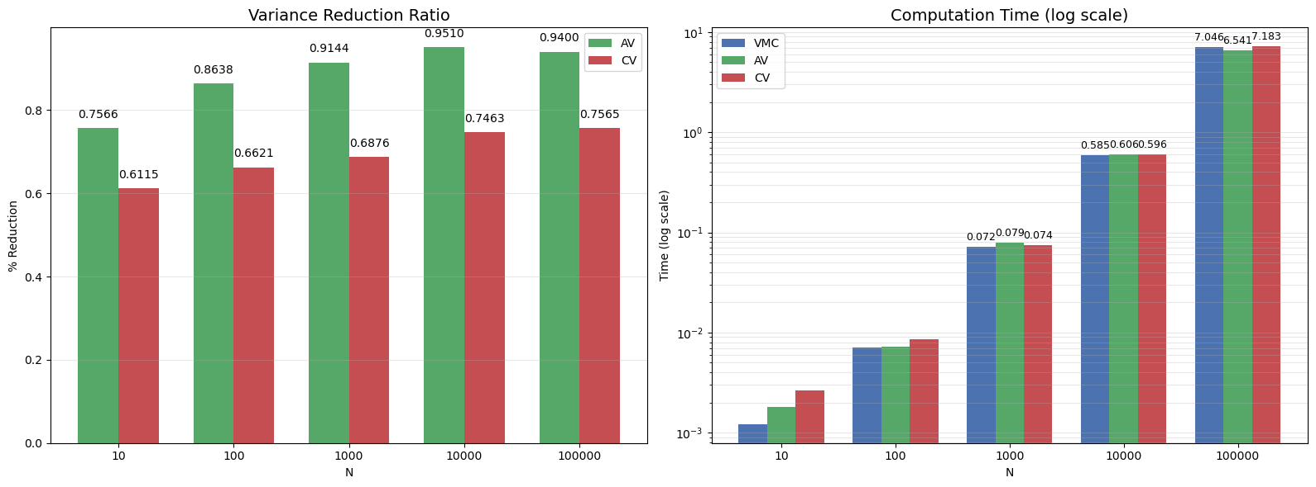
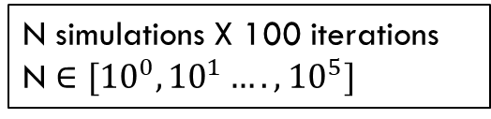
N simulations X 100 iterations
N $∈[{10}^{0},{10}^{1}….,{10}^{5}]$

Slide 19
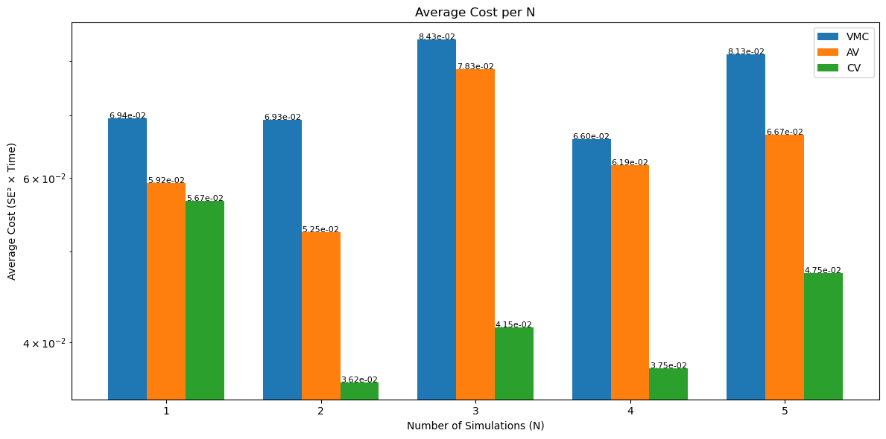
Cost effectiveness

Slide 20
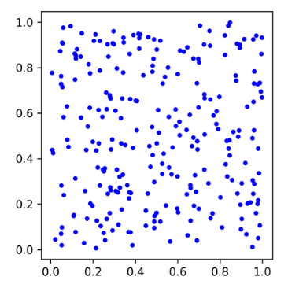
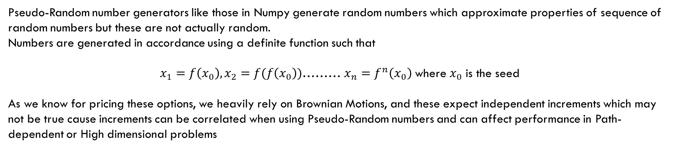
“Pseudo”-Random Numbers
Pseudo-Random number generators like those in Numpy generate random numbers which approximate properties of sequence of random numbers but these are not actually random.
Numbers are generated in accordance using a definite function such that
$x_{1}=f\left(x_{0}\right),x_{2}=f(f\left(x_{0}\right))$……… $x_{n}=f^{n}\left(x_{0}\right)$where $x_{0}$ is the seed
As we know for pricing these options, we heavily rely on Brownian Motions, and these expect independent increments which may not be true cause increments can be correlated when using Pseudo-Random numbers and can affect performance in Path-dependent or High dimensional problems
Pseudo-random sampling leads to uneven coverage of the sample space, resulting in clusters and gaps.

Slide 21
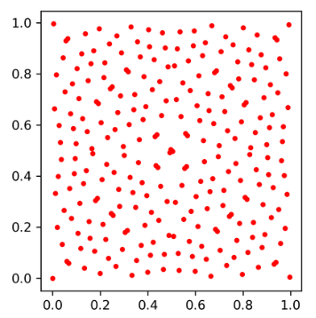
“Quasi”-Random Numbers
Unlike pseudo-random numbers, quasi-random numbers are not random at all. They are constructed to fill the sample space as evenly as possible, reducing clustering and gaps.
The sampling is called low-discrepancy means the sample points have minimal deviation from a perfectly uniform distribution over the space.
Quasi-random sampling leads to even coverage of the sample space.

Slide 22
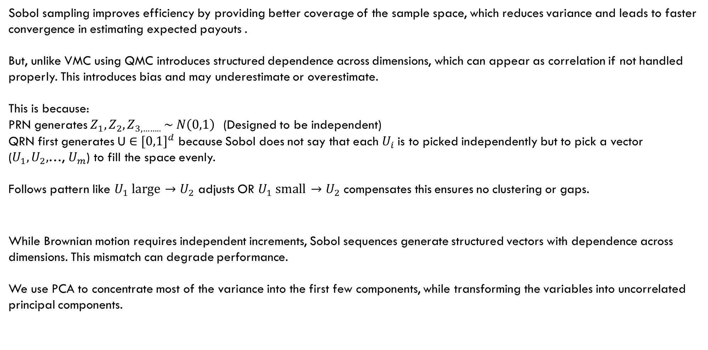
Sobol Sampling
Sobol sampling improves efficiency by providing better coverage of the sample space, which reduces variance and leads to faster convergence in estimating expected payouts .
But, unlike VMC using QMC introduces structured dependence across dimensions, which can appear as correlation if not handled properly. This introduces bias and may underestimate or overestimate.
This is because:
PRN generates $Z_{1},Z_{2},Z_{3,…….. }\sim N\left(0,1\right)$(Designed to be independent)
QRN first generates U $∈$ ${[0,1]}^{d}$ because Sobol does not say that each $U_{i}$is to picked independently but to pick a vector ($U_{1},U_{2},$…, $U_{m}$) to fill the space evenly.
Follows pattern like $U_{1} large \overset{→}{}$ $U_{2}$ adjusts OR $U_{1} small \overset{→}{}$ $U_{2}$ compensates this ensures no clustering or gaps.
While Brownian motion requires independent increments, Sobol sequences generate structured vectors with dependence across dimensions. This mismatch can degrade performance.
We use PCA to concentrate most of the variance into the first few components, while transforming the variables into uncorrelated principal components.

Slide 23
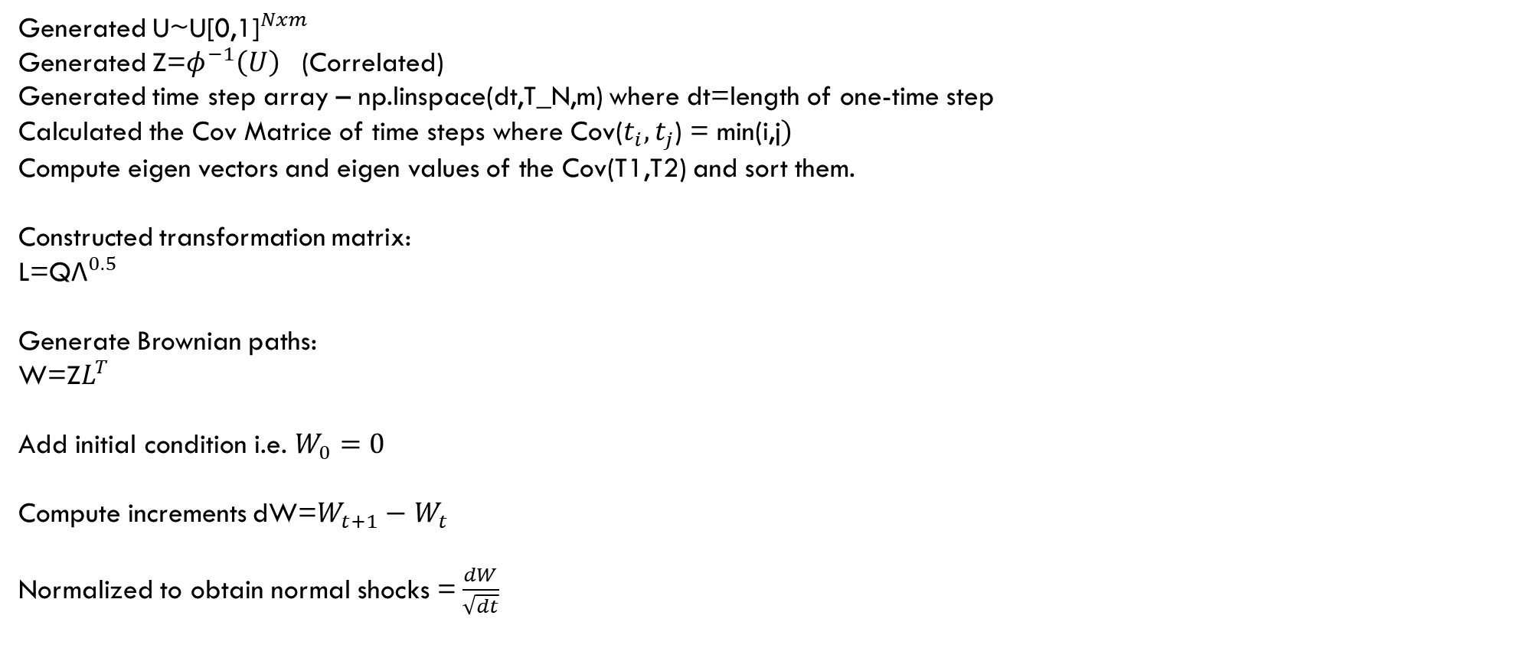
Mathematics review
Generated U~${\text{U}\text{[0,1]}}^{Nxm}$
Generated Z=$φ^{−1}\left(U\right)$ (Correlated)
Generated time step array – np.linspace(dt,T_N,m) where dt=length of one-time step
Calculated the Cov Matrice of time steps where Cov($t_{i},t_{j}$) = min(i,j$)$
Compute eigen vectors and eigen values of the Cov(T1,T2) and sort them.
Constructed transformation matrix:
L=Q${\text{Λ}}^{0.5}$
Generate Brownian paths:
W=Z$L^{T}$
Add initial condition i.e. $W_{0}=0$
Compute increments dW=$W_{t+1}−$ $W_{t}$
Normalized to obtain normal shocks = $\frac{dW}{\sqrt{dt}}$

Slide 24
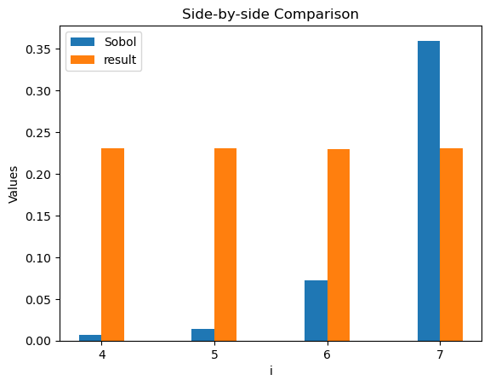
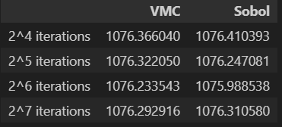
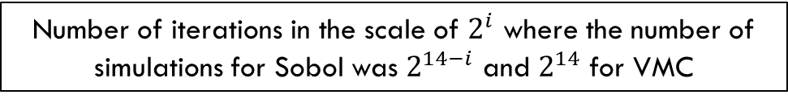
Results
SE Comparison
Mean Estimate
SE
Number of iterations in the scale of $2^{i}$ where the number of simulations for Sobol was $2^{14−i}$ and $2^{14}$ for VMC

Slide 25
THANK YOU

