Slide 1
SMART SHOPPING CART
AARSH SACHDEVA (1709131002)

Slide 2
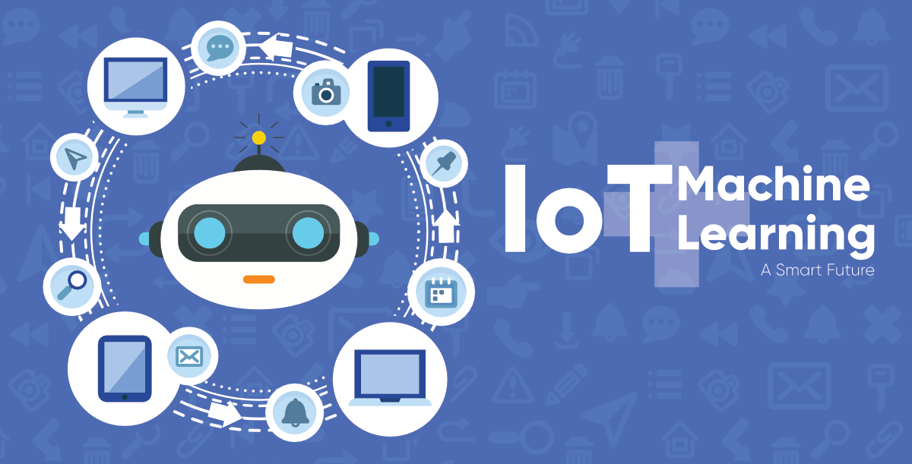
SMART SHOPPING CART
OBJECTIVE-
To develop a system using IOT and ML techniques which can help in detecting and recommending the products by monitoring their past experiences.

Slide 3

WHY IS IT REQUIRED ?
In India there are about 700 supermarkets and 1.5 lakh customers daily visits these supermarkets.
Most them are middle class people which makes 1-2 visits/week.
Report shows that they buy day-to-day cooking needs, quick meals and utility products and the prominent product categories for which a consumer shops from a supermarket.
An intelligent system which can recommend the items and also shows where they are located can help them to save alot of time.

Slide 4
PROJECT STRUCTURE:
Camera Integration with Shopping cart which works on Computer Vision and Scan Barcodes of Products
Working of Machine Learning Algorithm on Decoded Image and shopping data set
Data output , which is the recommended items from trained model get saved in cloud.
In cloud (AWS) the Node.js script is running, which fetches the data from the trained model and create server over it.
Android app which is in hand of customer get the recommended items an he/she can shop accordingly.

Slide 5
EXISTING SYSTEM VS OUR SYSTEM
In the current system the item is identified by the help of RFID.
The items are detected through only bar codes.
Our system will detect a wider range of products by the help of camera(open CV).
Our System uses cloud for proper user handling
The system will also detect fruits and vegetables and the items that are associated to them for making some dish.
The algorithm used for image classification is Naïve Bayes with Logistic Regression

Slide 6
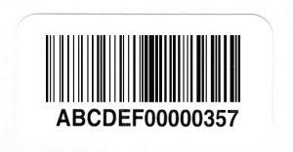
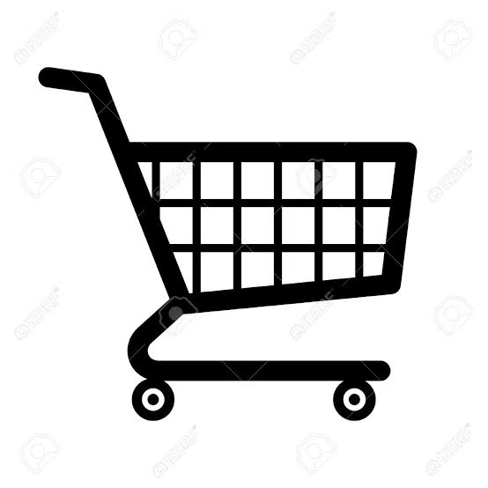



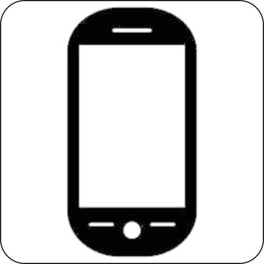
THE IMPLEMENTATION
Product barcode
.
Machine Learning
Shopping cart
Cloud
Andorid app

Slide 7
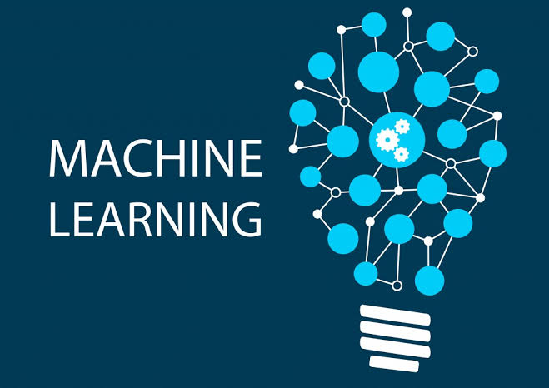
MACHINE LEARNING
Machine Learning is a technique of parsing data, learn from that data and then apply what they have learned to make an informed decision.
In the proposed system ML techniques are used to decide which item should be suggested next based on the item the customer choose at that time .
Algorithms that can be used-
Naïve Bayes Clasification with Logistic Regression
Other software requirements-
Python ,Anakonda ,OpenCV, Numpy, Pandas, Metaplotlib.

Slide 8
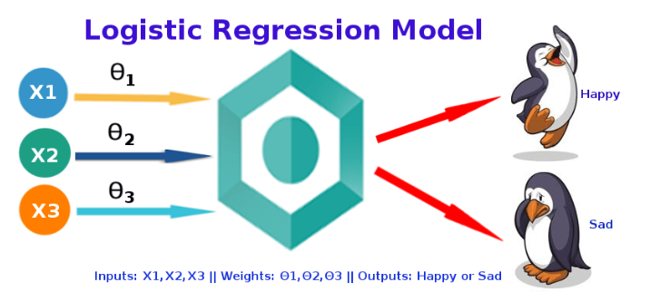
LOGISTIC REGRESSION:
In statistics, the logistic model is used to model the probability of a certain class or event existing such as pass/fail, win/lose, alive/dead or healthy/sick. This can be extended to model several classes of events such as determining whether an image contains a cat, dog, lion, etc.

Slide 9
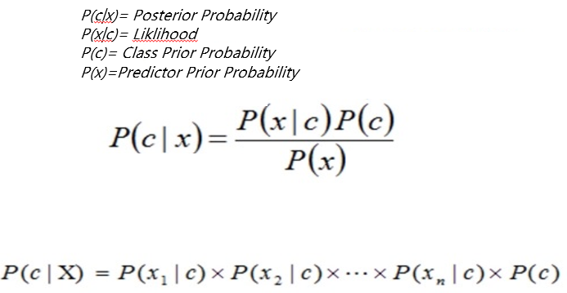
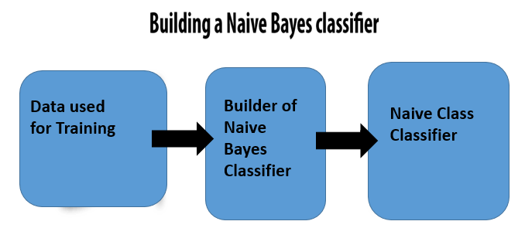
NAIVE BAYES CLASSIFICATION
It is a classification technique based on Bayes' Theorem with an assumption of independence among predictors. In simple terms, a Naive Bayes classifier assumes that the presence of a particular feature in a class is unrelated to the presence of any other feature

Slide 10
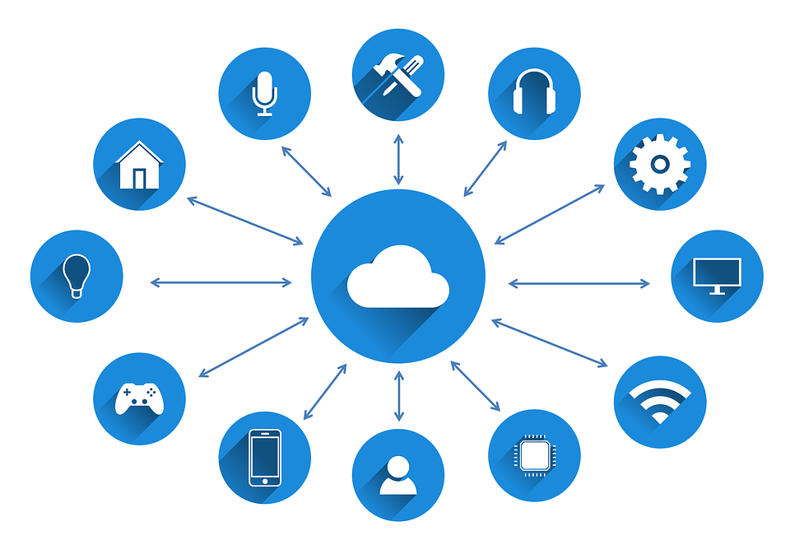
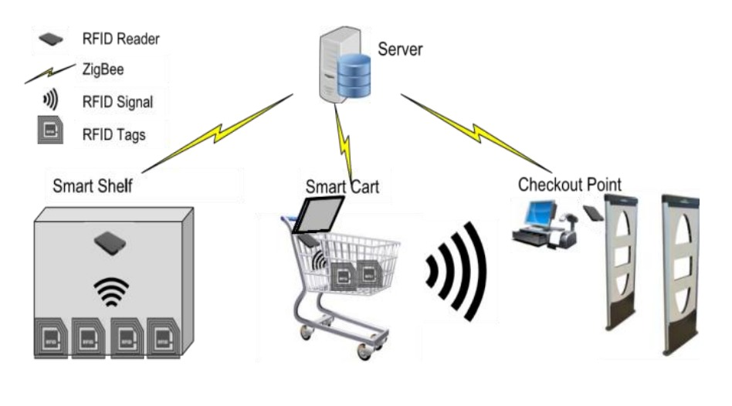
INTERNET OF THINGS
The internet of things (IoT) is a computing concept that describes the idea of everyday physical objects being connected to the internet and being able to identify themselves to other devices.
In the proposed system, LCD and the camera will capture the present time data and will send it to the server.
Components Used:-
Camera
Integrated with OpenCV through Laptop

Slide 11
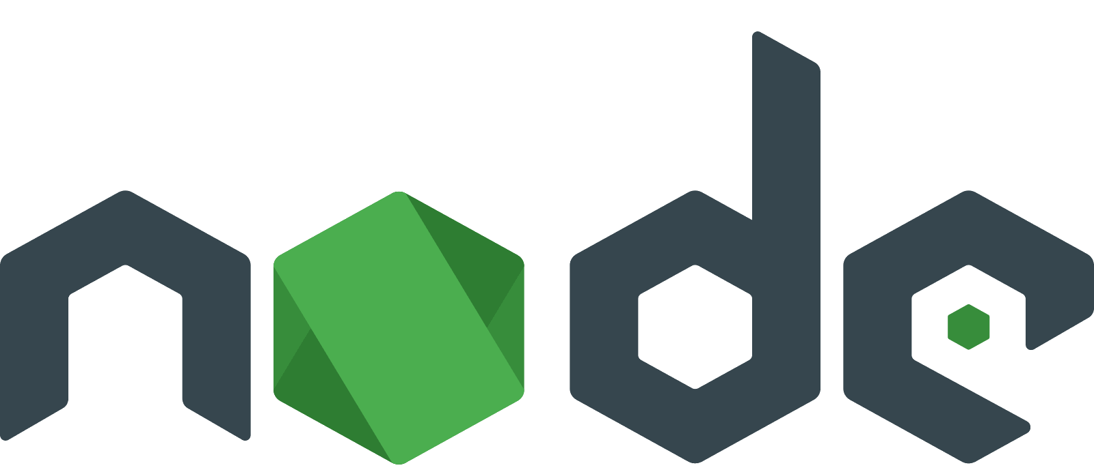
ANDROID APP AND NODE.JS
We have used Android app for user interaction and provide the user accurate information about recommended items.
In cloud (AWS) the Node.js script is running, which fetches the data from the trained model and create server over it.
Node.js is a platform built on Chrome's JavaScript runtime for easily building fast and scalable network applications. Node.js uses an event-driven, non-blocking I/O model that makes it lightweight and efficient, perfect for data-intensive real-time applications that run across distributed devices.

Slide 12
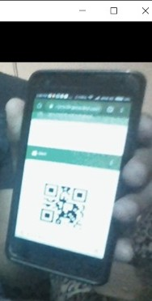
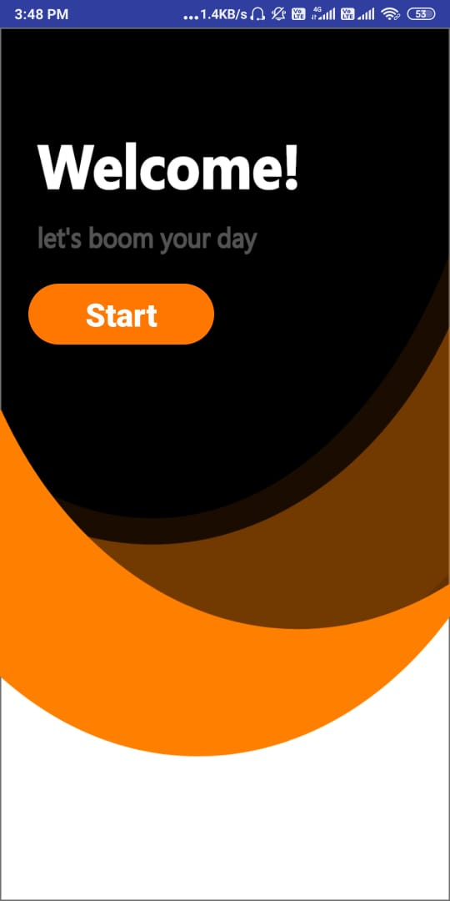
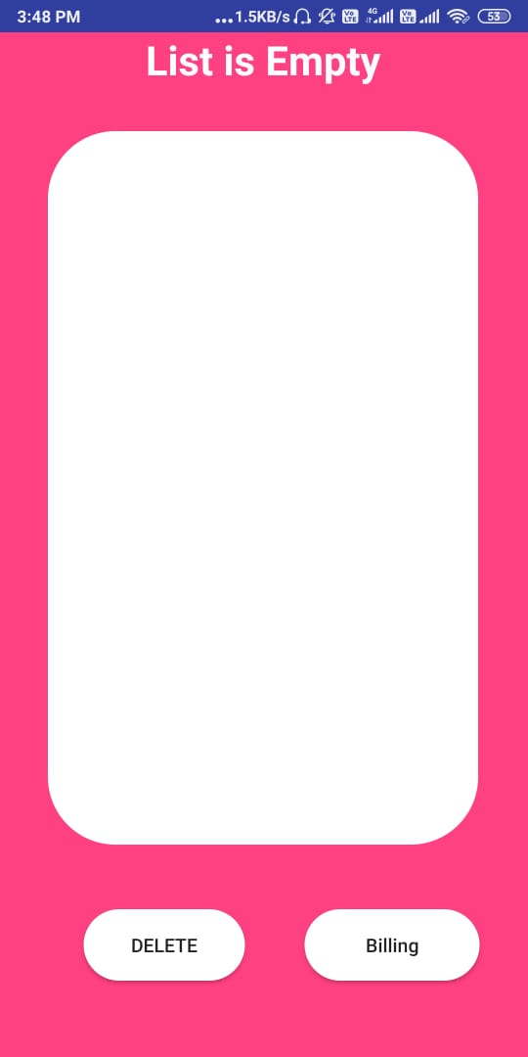
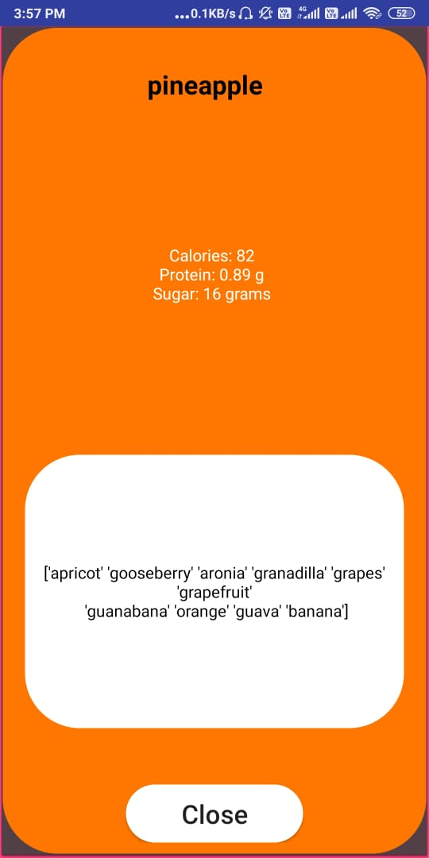
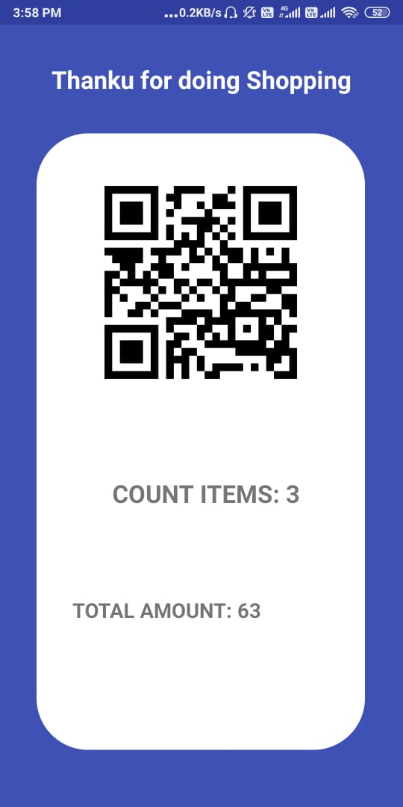
RESULTS SNAPSHOTS:
Scanning of item Intro Activity Shopping List Recommended list Billing System

Slide 13
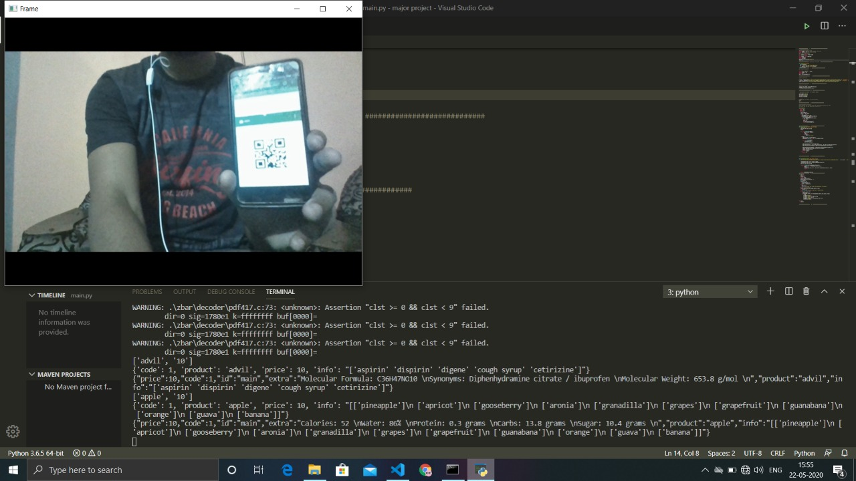
PROJECT WORK:

Slide 14
THANK YOU

