Slide 1

Meet
Slidekick
Turn a brief and your brand kit into a PowerPoint deck you can actually edit.
Notes:
Slidekick is a Claude Code skill. You type /slidekick, give it a brief and your brand kit, and get back a real .pptx.

Slide 2
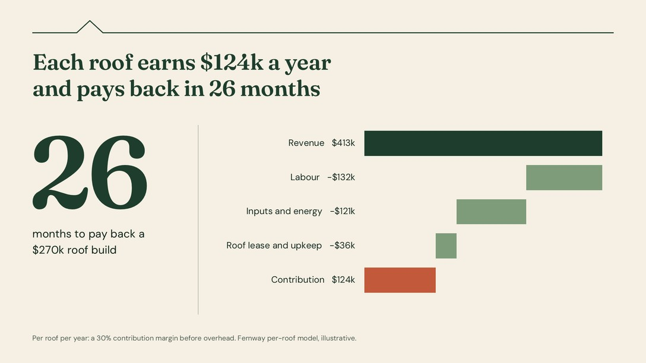
Decks still take
a day, and most
AI tools hand back
pictures of slides
Picture 1 · 1 object
Click any word and you select the whole slide.
Notes:
Click into most AI-made slides and the whole slide is one picture. Change a word and you are back to rebuilding it.

Slide 3
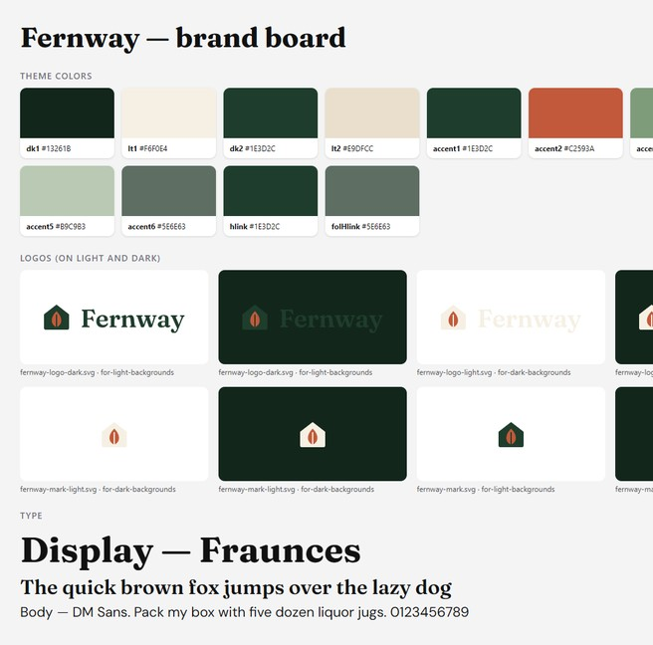
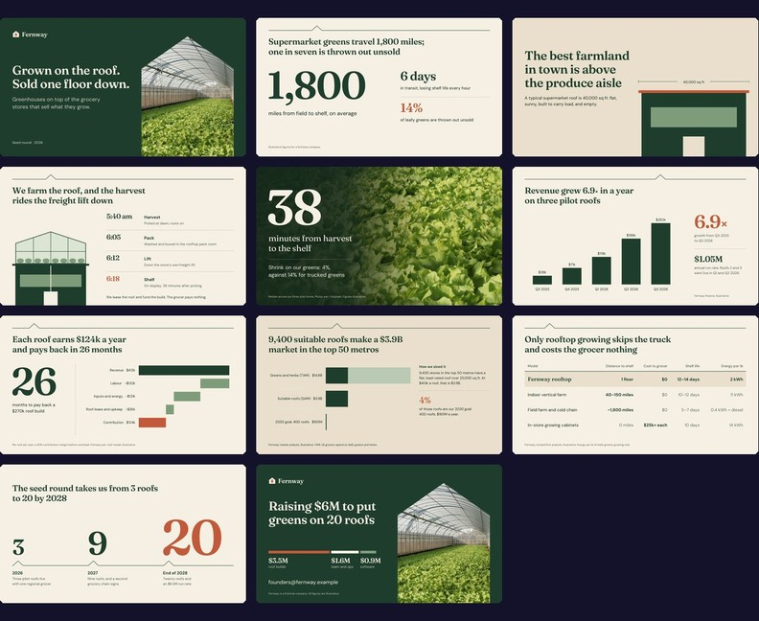
Your brief and brand kit in, an editable deck out
An 11-slide seed pitch for Fernway, a fictional startup that grows produce on grocery-store roofs. For seed investors, first meeting. Show the unit economics.
brief.md
Brand kit
deck.pptx · 11 native slides
Notes:
This is a real run: the Fernway example in this repo. The brief and brand kit on the left produced the deck on the right.

Slide 4

Every word, chart and table is native PowerPoint
124
Text box
Chart · data in Excel
native objects in the 11-slide
Fernway deck, including
69 text boxes, 3 charts
and 1 table
Text box
0
slides flattened into pictures
Notes:
The same slide as before, as it really is: a text box you can retype, a chart whose data opens in Excel, numerals you can edit. Counts from deck.py inspect.

Slide 5
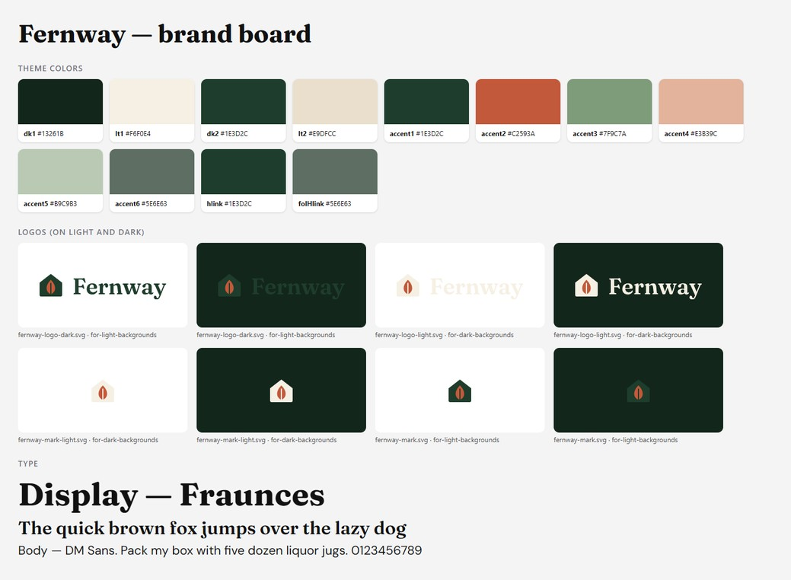
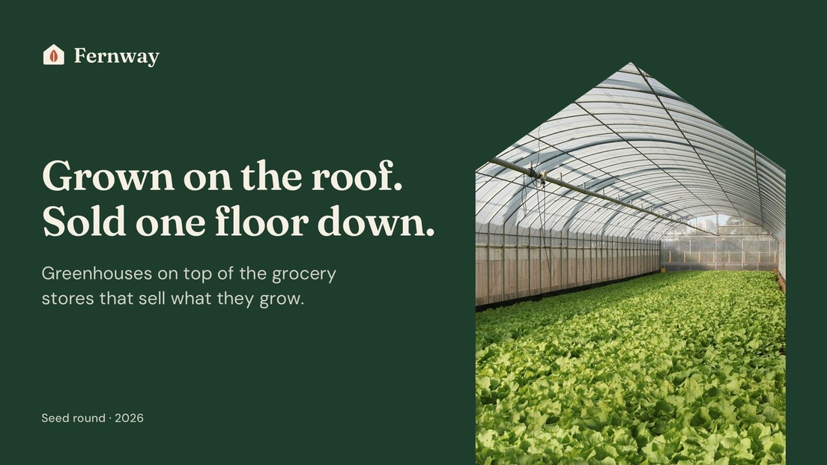
It builds from your kit: template, logos,
colours, fonts and rules
Fernway’s kit, and the title slide built from it
It reads .potx templates, logos, tokens, CSS and guideline PDFs.
Notes:
It reads templates, logos, tokens, CSS and guideline PDFs, and shows you a brand board to confirm before it builds anything.

Slide 6
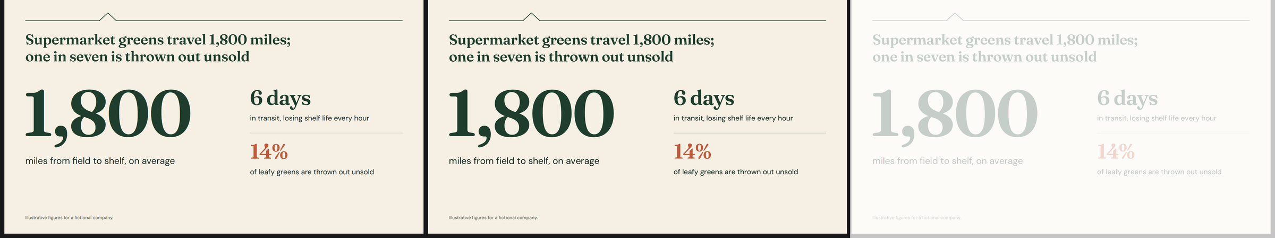
Every build is rendered in real PowerPoint
and checked against the design
The design
PowerPoint’s render
Pixels that differ: 0.0%
The check allows ±2 px for how renderers round glyphs.
A rewrapped line, a shifted block or a wrong colour fails the build.
Notes:
Left is the design, middle is what PowerPoint drew, right is the pixel difference. Fonts PowerPoint would swap, transitions and animations are checked too.

Slide 7
0 px
25
slide transitions, Morph included
Text lands exactly
where it was designed
14
Measured baseline error across 175 text styles, calibrated against PowerPoint itself.
entrance animations, each read back from PowerPoint
Notes:
Before calibration, text could sit up to 8 px off. Now it lands where it was designed. Every transition and animation is read back from PowerPoint to prove it took.

Slide 8
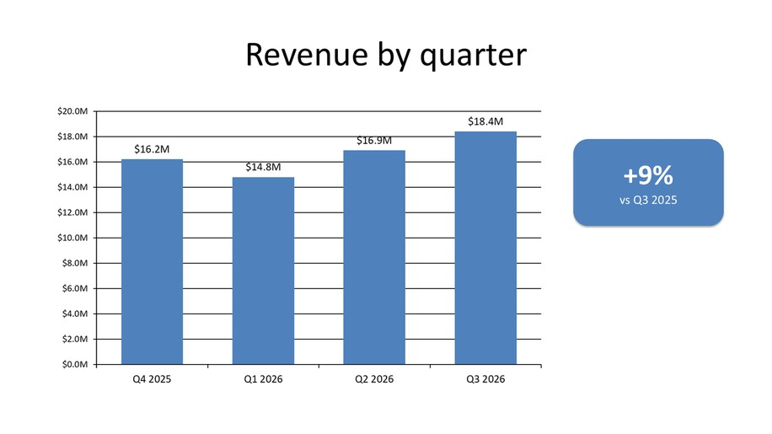
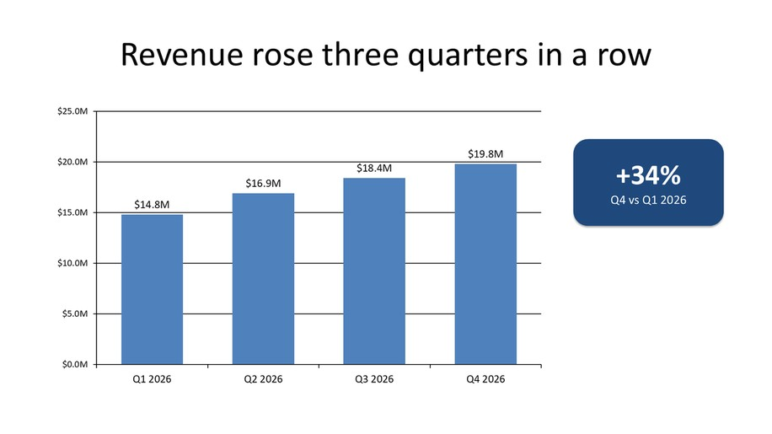
Create a deck, edit yours in place, or review one
Before: the Q3 review
Create
A new deck from a brief, documents, data or a website
After: Q4, from
one edits.json
Edit
Your deck, changed in place: words, numbers, charts, slides
Review
A scored critique of any deck, with exact fixes
Notes:
Edit mode keeps their template and formatting and changes only what you ask: here, new numbers, chart data and a takeaway headline.

Slide 9
A fresh-eyes reviewer scores the design
before anything ships
Round 1
Round 2, after the fixes
A real finding from round 1
“Terracotta lands on $0.9M software, the smallest use of the money. On the ask slide it tells investors that software is the point.”
Fix: put Terracotta on the $3.5M of roof builds. Fixed in round 2.
Nothing ships with a score below 4.
Scores out of 5 for the Fernway example, rounds 1 and 2 (examples/pitch-deck/qa/review.json).
Notes:
The author never signs off their own design. A separate reviewer scores eight dimensions against a studio bar and returns exact fixes.

Slide 10

Try it on your next deck
/plugin install slidekick@slidekick
github.com/aarshx05/slidekick
Notes:
Install it, point it at your brand kit, and ask for your next deck.

