Slide 1

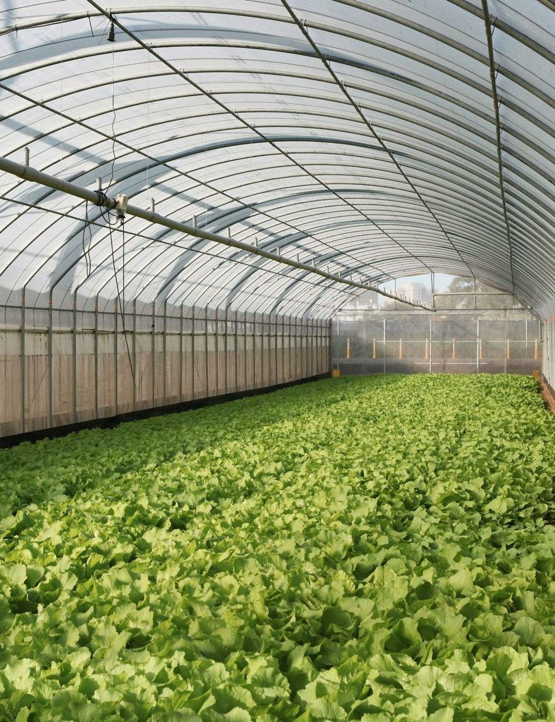

Grown on the roof.
Sold one floor down.
Greenhouses on top of the grocery stores that sell what they grow.
Seed round · 2026
Notes:
Fernway turns the roof of a grocery store into the farm that supplies it. Everything in this deck is about one roof, then twenty.

Slide 2
Supermarket greens travel 1,800 miles;
one in seven is thrown out unsold
1,800
6 days
in transit, losing shelf life every hour
14%
miles from field to shelf, on average
of leafy greens are thrown out unsold
Illustrative figures for a fictional company.
Notes:
Every lettuce in the store has been on the road for most of a week, and one in seven never sells.

Slide 3
The best farmland
in town is above
the produce aisle
40,000 sq ft
A typical supermarket roof is 40,000 sq ft: flat, sunny, built to carry load, and empty.
Notes:
Grocery stores sit on the flattest, sunniest, most structurally sound empty land in any city. Watch the roof.

Slide 4
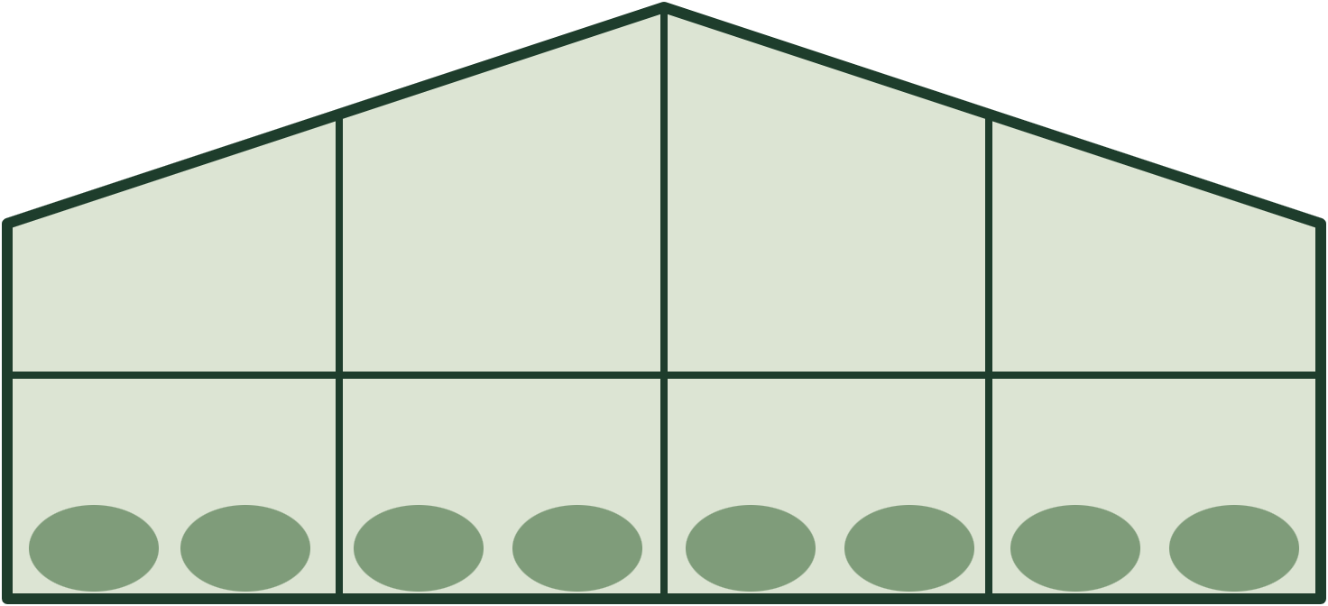
We farm the roof, and the harvest
rides the freight lift down
5:40 am
Harvest
Picked at dawn, roots on
6:05
Pack
Washed and boxed in the rooftop pack room
6:12
Lift
Down the store’s own freight lift
6:18
Shelf
On display, 38 minutes after picking
We lease the roof and fund the build. The grocer pays nothing.
Notes:
Walk the clock: picked at 5:40, on the shelf at 6:18. We lease the roof and pay for the build, so the grocer has no capex.

Slide 5
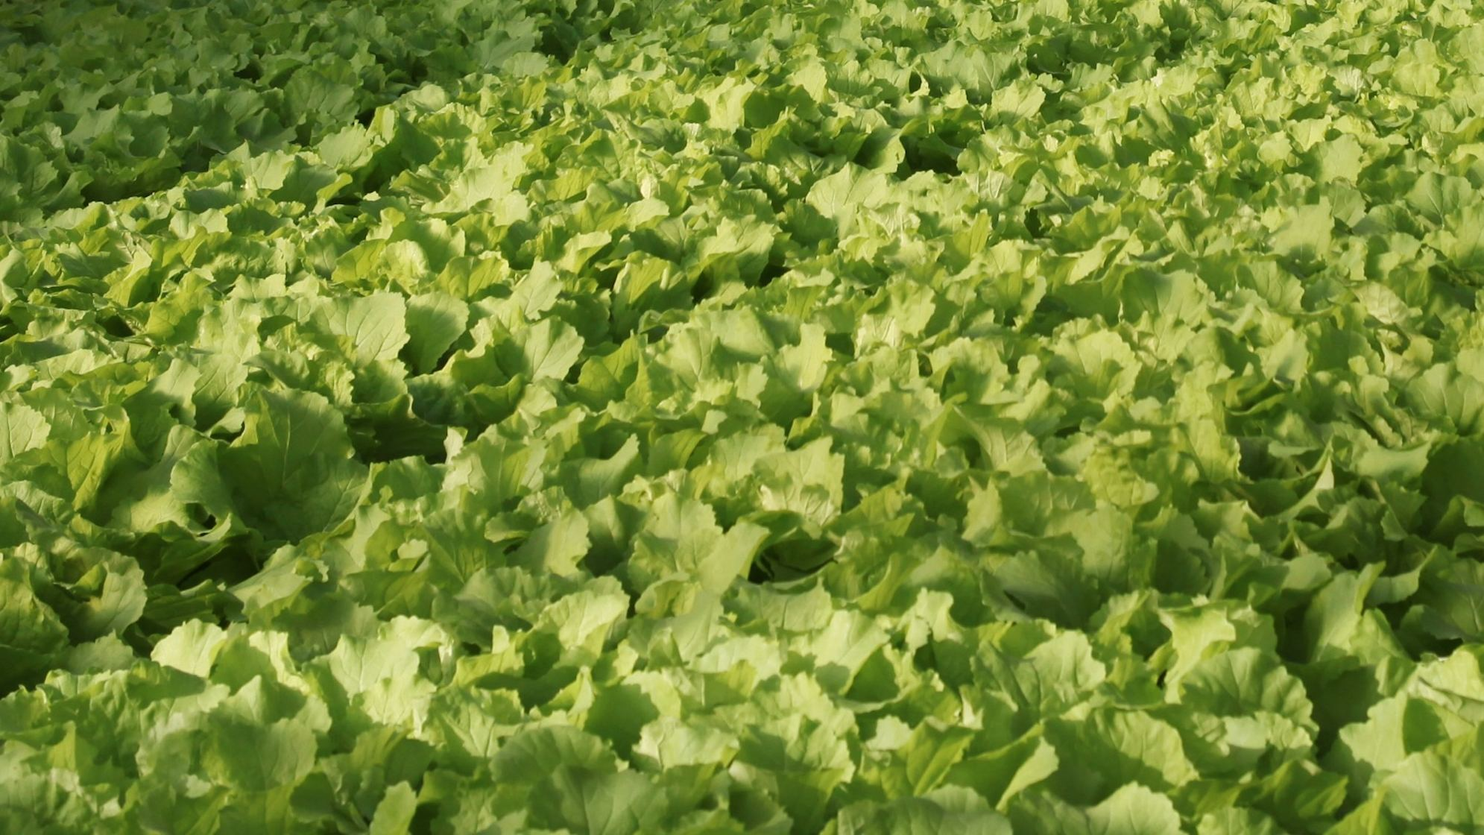
38
minutes from harvest
to the shelf
Shrink on our greens: 4%,
against 14% for trucked greens
Median across our three pilot stores. Photo: wei / Unsplash. Figures illustrative.
Notes:
Fresher greens last longer on the shelf and sell. Shrink on ours is 4%, against 14% for trucked greens.

Slide 6
Revenue grew 6.9× in a year
on three pilot roofs
6.9×
growth from Q3 2025
to Q3 2026
$1.05M
annual run rate. Roofs 2 and 3 went live in Q1 and Q2 2026.
Fernway finance, illustrative.
Notes:
Each new roof steps revenue up. Q3 2026 is the first full quarter with all three roofs: $262k, a $1.05M run rate.

Slide 7
Each roof earns $124k a year
and pays back in 26 months
26
months to pay back a $270k roof build
Per roof per year: a 30% contribution margin before overhead. Fernway per-roof model, illustrative.
Notes:
One roof sells 140,000 lb a year at $2.95, which is $413k. After labour, inputs and the roof lease, $124k is left: a 30% margin and a 26-month payback on a $270k build.

Slide 8
9,400 suitable roofs make a $3.9B
market in the top 50 metros
How we sized it
9,400 stores in the top 50 metros have a flat, load-rated roof over 25,000 sq ft. At $413k a roof, that is $3.9B.
4%
of those roofs are our 2030 goal:
400 roofs, $165M a year.
Fernway market analysis, illustrative. TAM: US grocery spend on leafy greens and herbs.
Notes:
We only count roofs we could build on today: flat, over 25,000 square feet, rated for the load. 400 of them is 4%.

Slide 9
Only rooftop growing skips the truck
and costs the grocer nothing
Model | Distance to shelf | Cost to grocer | Shelf life | Energy per lb
Fernway rooftop | 1 floor | $0 | 12–14 days | 2 kWh
Indoor vertical farm | 40–150 miles | $0 | 10–12 days | 11 kWh
Field farm and cold chain | ~1,800 miles | $0 | 5–7 days | 0.4 kWh + diesel
In-store growing cabinets | 0 miles | $25k+ each | 10 days | 14 kWh
Fernway competitive analysis, illustrative. Energy per lb of leafy greens, growing only.
Notes:
Vertical farms skip the field but still truck, and pay for every photon. Cabinets skip the truck but the grocer buys them. We are the only model with both at zero.

Slide 10
The seed round takes us from 3 roofs
to 20 by 2028
20
9
3
2026
2027
End of 2028
Three pilot roofs live
with one regional grocer
Nine roofs, and a second
grocery chain signs
Twenty roofs and
an $8.3M run rate
Notes:
Three roofs today, nine next year with a second chain, twenty by the end of 2028. Twenty roofs at $413k is an $8.3M run rate.

Slide 11
Raising $6M to put greens on 20 roofs
$3.5M
$1.6M
$0.9M
roof builds
team and ops
software
founders@fernway.example
Fernway is a fictional company. All figures are illustrative.
Notes:
We are raising $6M. $3.5M goes onto roofs, $1.6M into the growing team, $0.9M into the climate-control software that runs every roof.

