Slide 1
E - VOTING

Slide 2
DESCRIPTION
Voting is a fundamental right of every citizen. But the process of voting is controlled by central authority on which people have to blindly trust.
In this project we are developing an application which implements online voting system through blockchain technology which makes the process decentralized and trust worthy.

Slide 3
WHY BLOCKCHAIN?
Blockchain is a network of interconnected nodes where each node is called a block. Each block has its own unique hash value and also the hash of the previous block. Whenever data tampering is done on a block the hash of the block changes which in turn changes the hash of the block containing previous block hash value as of the changed one. So using a blockchain helps us to implement a system that is immutable, transparent and efficient.

Slide 4
Benefits Of Using E-Voting
→ Increasing the level of participation
The Internet voting system tends to maximize user participation, by allowing them to vote from anywhere and from any device that has an internet connection.
→ Security
E-voting system is implemented using “Blockchain” which ensure the security.

Slide 5
​
→ Efficiency​
The reduction in organizational and implementation costs significantly increases the​ efficiency of election management compared to traditional paper voting, for example.​
​
→ Precision​
The electronic vote eliminates errors in manual count, which brings with it​ an accurate and quick publication of results, with receipt of vote for each vote cast.

Slide 6
Technology used:
Software requirements:
→ Visual Studio code: Visual Studio Code, also commonly referred to as VS Code, is a source-code editor made by Microsoft with the Electron Framework, for Windows, Linux and macOS.
Hardware requirements:
→ Processor: Intel Core i5 and above
→ Memory: 8 GB

Slide 7
DEVELOPMENT
→ Frontend: Implemented using ReactJS.
→ Backend: Ethereum network is used via Metamask. Solidity is used for implementing smart contracts on the Ethereum platform.

Slide 8
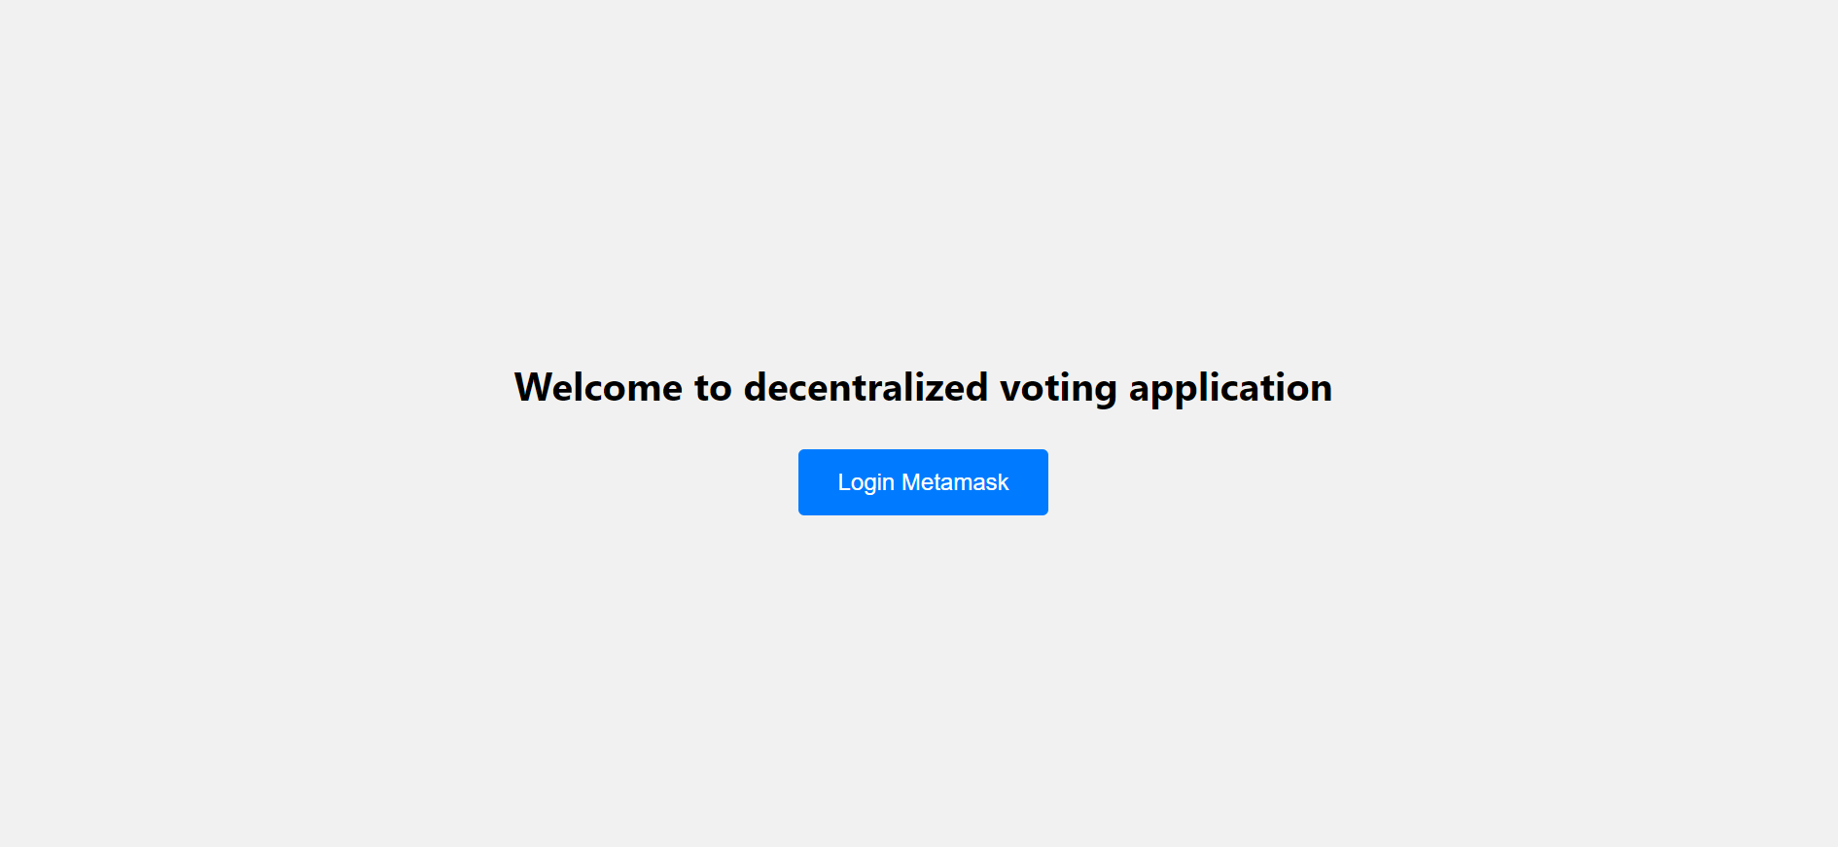
Through Metamask account we can login to the application

Slide 9
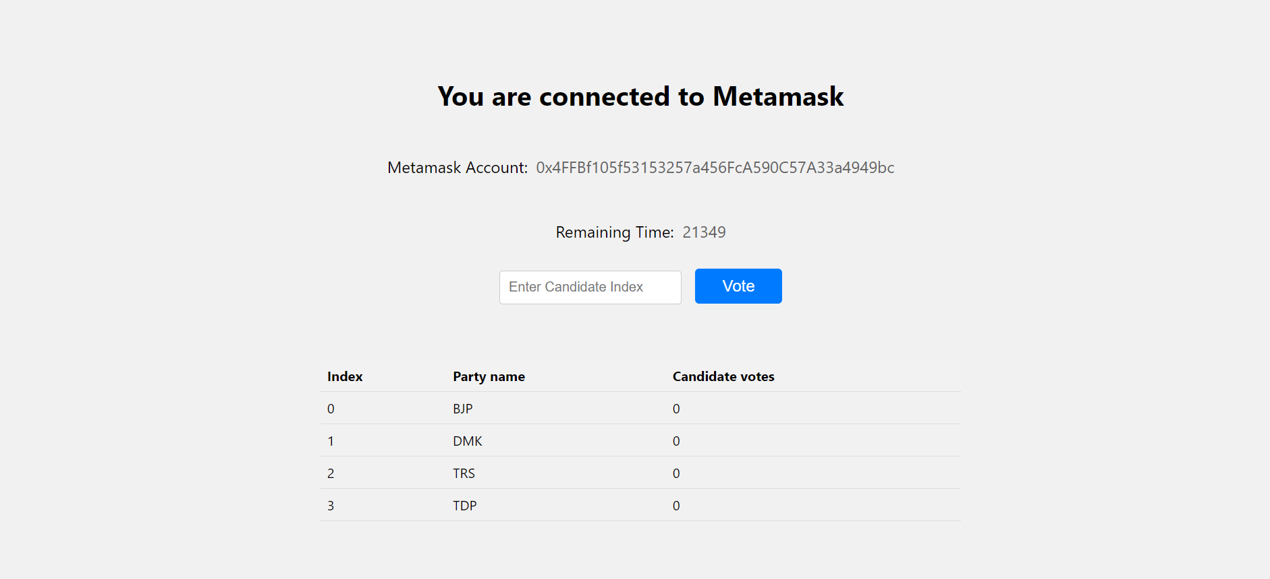
Voting Page

Slide 10
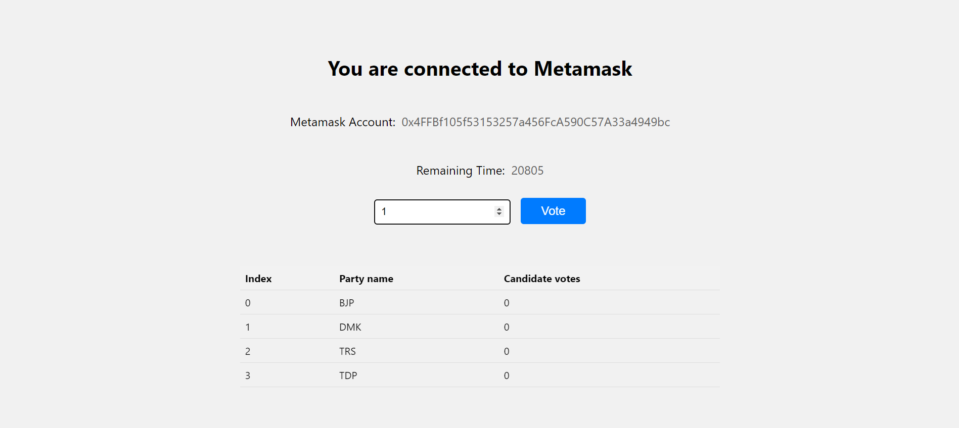
Then we can vote a candidate by entering the candidate index

Slide 11
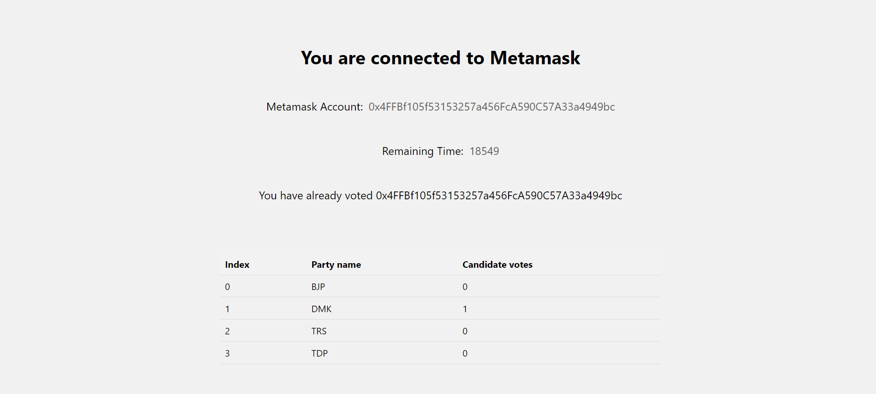
Confirmation page

Slide 12
With this project I was able to gain knowledge about the blockchain technology and got hands on experience of writing smart contracts and implementing Ethereum blockchain using Metamask. This project can further be extended by including features such as pre-analysis where result analysis can be done using the help of Artificial Intelligence.

