Slide 1
E - LEARNING

Slide 2
ABSTRACT
E-learning is an integral part of smart education. The challenge is to easily integrate the e-learning system into a smart educational environment. The e-learning services rely on a software system that allows access to all the materials for the educational process and makes them electronically available to all the students on the Internet whenever they need and wherever they are. In this work, we tried to develop a e-learning website where the tutors can upload the content to provide free educational access to all those who want to learn and the users can access the tutor content.

Slide 3
Technology used:
Software requirements:
→ Visual Studio code: Visual Studio Code, also commonly referred to as VS Code, is a source-code editor made by Microsoft with the Electron Framework, for Windows, Linux and macOS.
→ XAMPP: XAMPP is a free and open-source cross-platform web server solution stack package developed by Apache Friends, consisting mainly of the Apache HTTP Server, MariaDB database, and interpreters for scripts written in the PHP and Perl programming languages
Hardware requirements:
→ Processor: Intel Core i5 and above
→ Memory: 8 GB

Slide 4
FEATURES
→ Login: A proper login, register system is provided for both users and tutors so that every tutor can share his/her content independently and users can access it.
→ Playlists/Content: Tutor can easily create playlists, upload the content and the users will be able to access the active content.
→Update: In case the tutor wants to change his profile, playlists information or content information he/she can easily do it and same goes with the user profile.

Slide 5
→ Likes: Users can like the video about which the tutors will be updated.
→Comments: To make the website more responsive we included the feature of commenting where the users can comment about the tutor video.
​
→Portability: The display and working of website in taken care so that it can be accessible through any device like desktop, mobile etc.

Slide 6
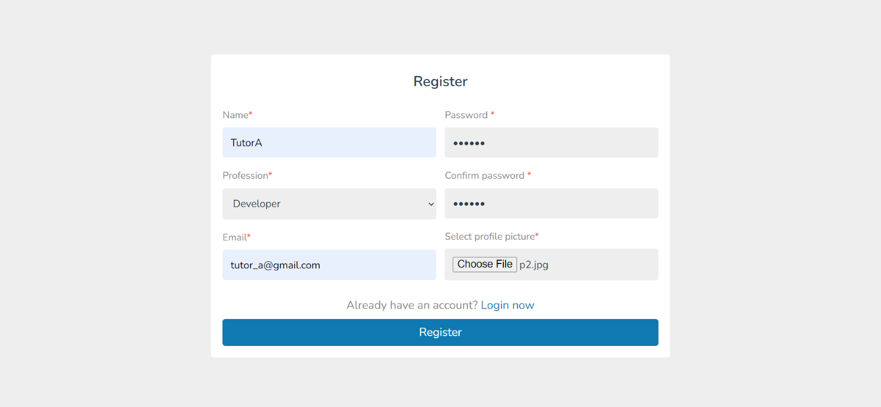
Register Page

Slide 7
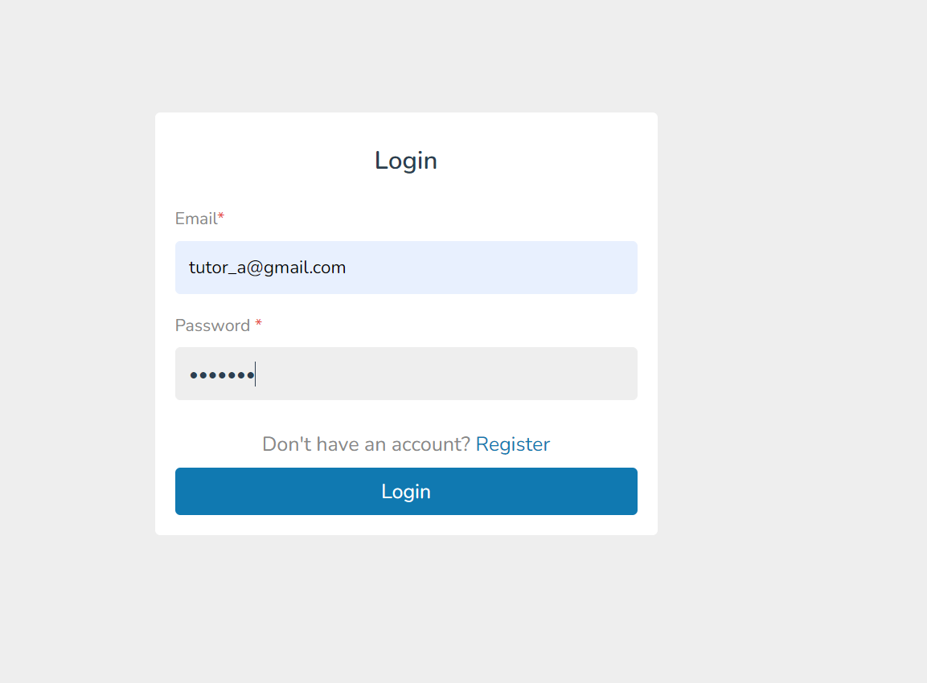
Login Page

Slide 8
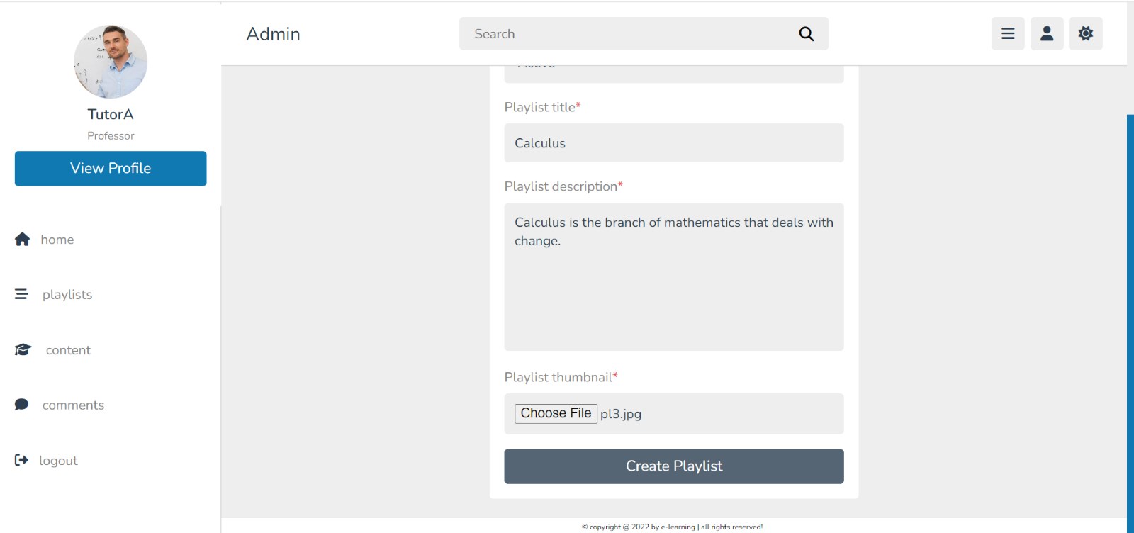
Add Playlists

Slide 9
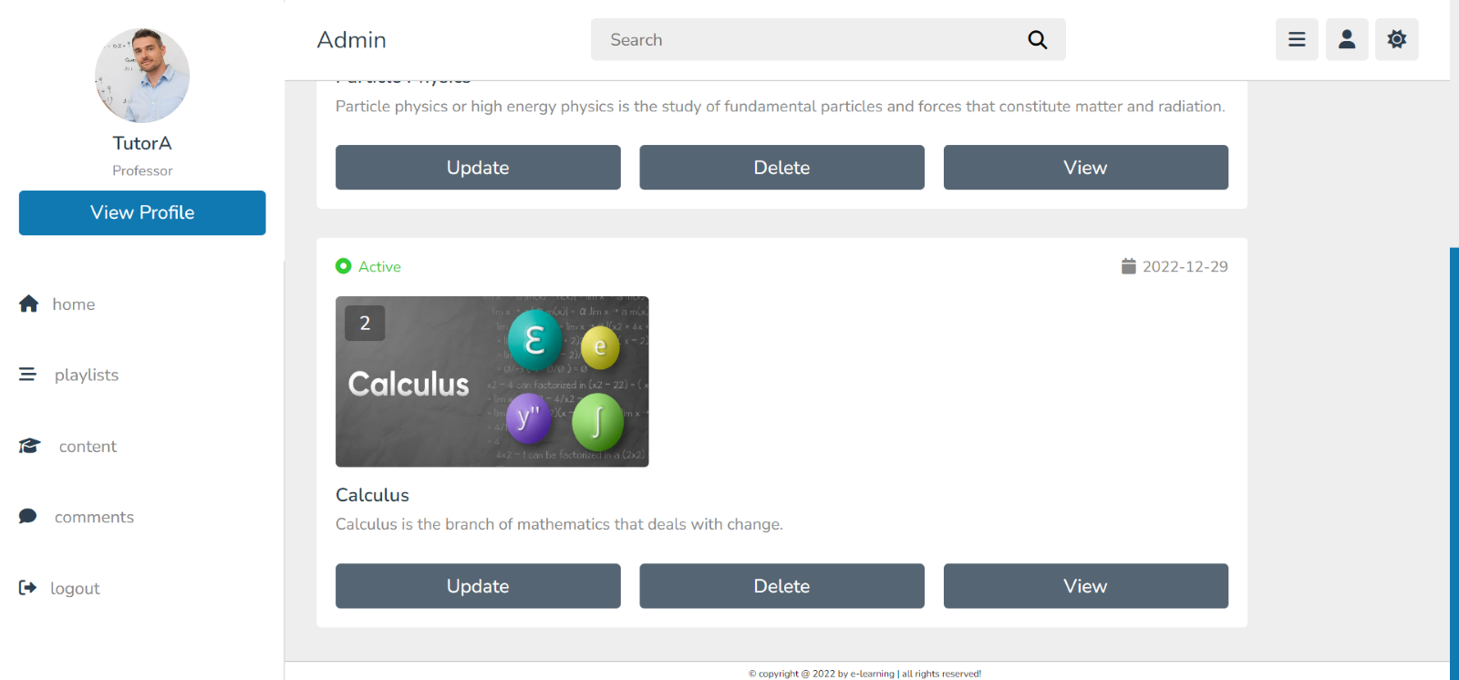
View Playlists

Slide 10
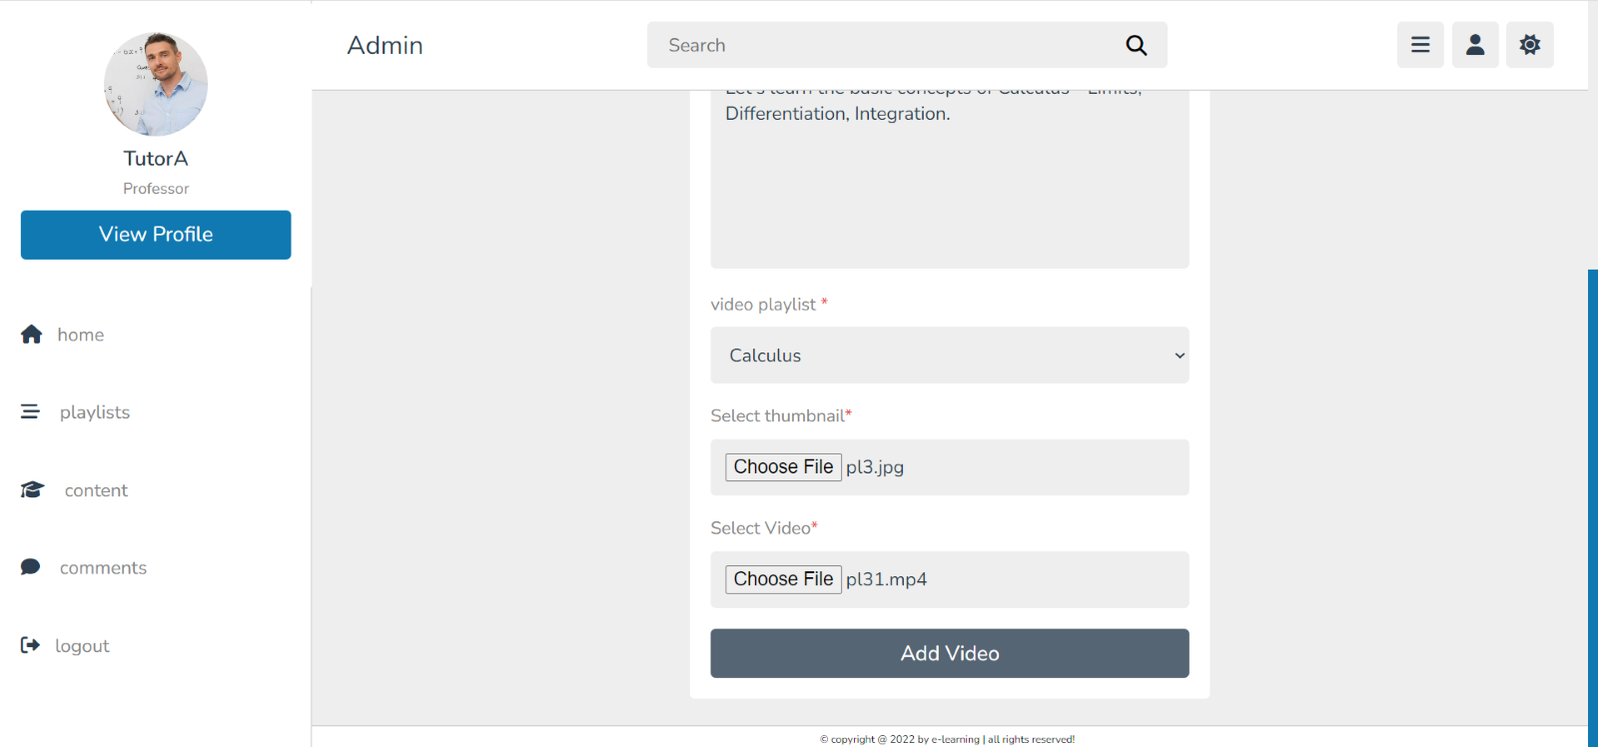
Upload Videos in corresponding playlists

Slide 11
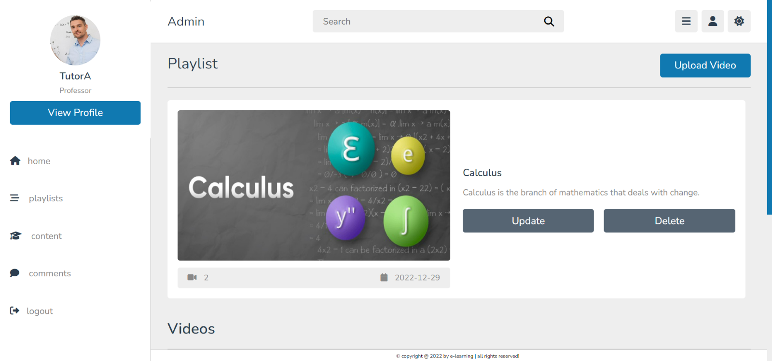
View content

Slide 12
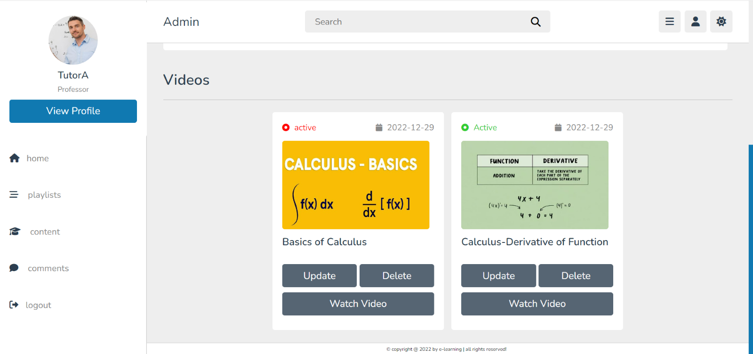

Slide 13
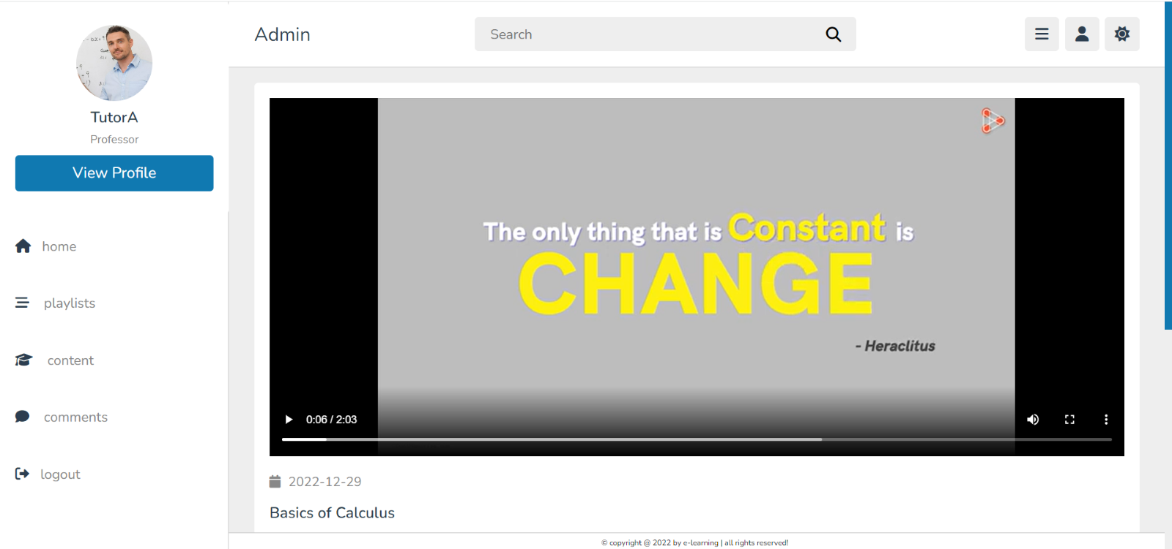
Watch Video

Slide 14
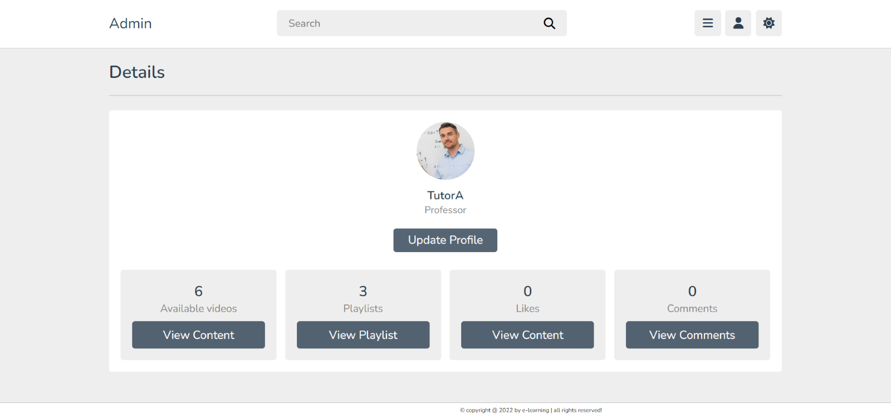
View Profile

Slide 15
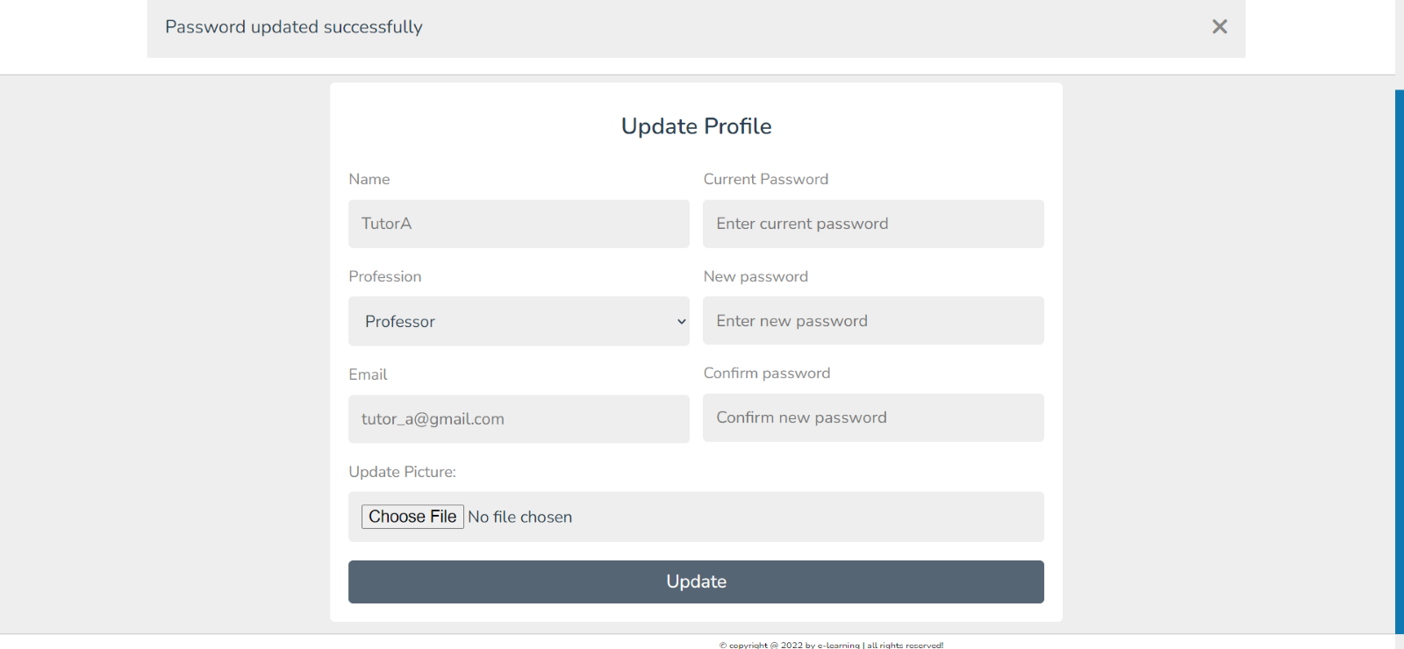
Update profile/playlist/content

Slide 16
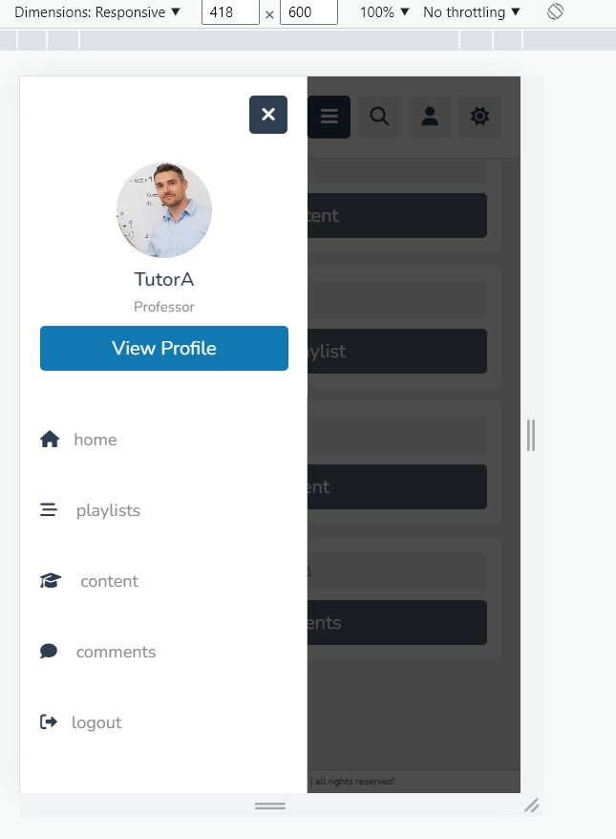
Portable in any device

Slide 17
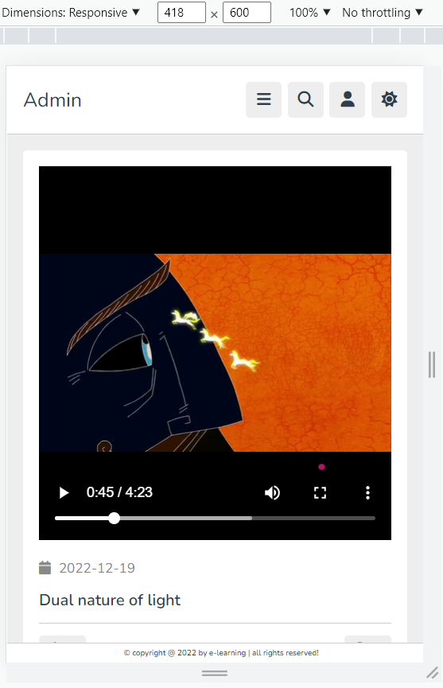

Slide 18
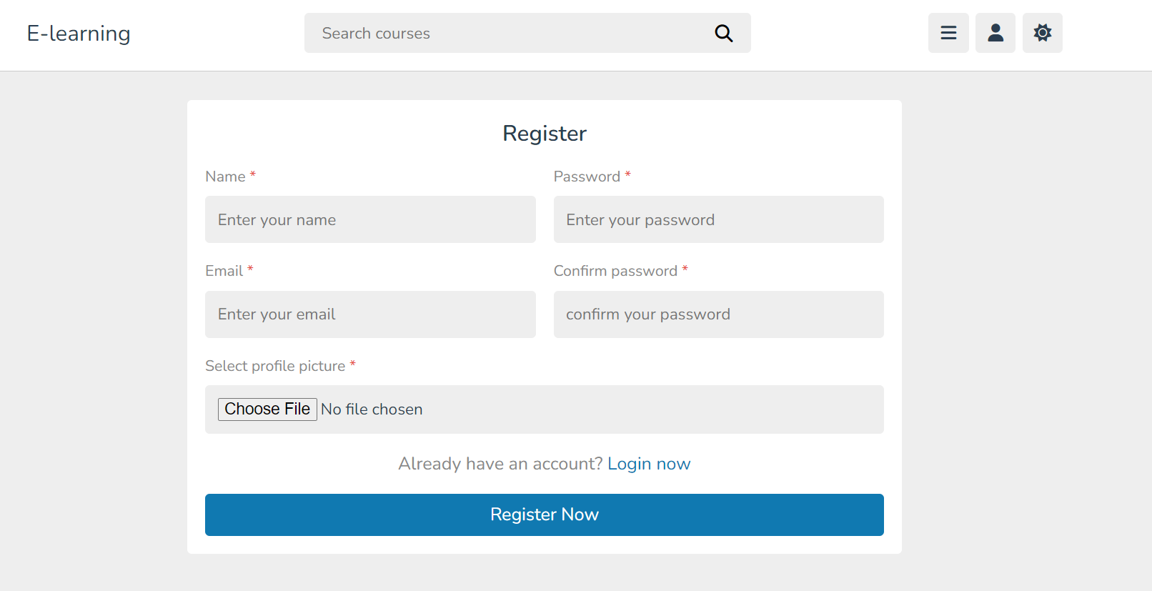
User Register Page

Slide 19
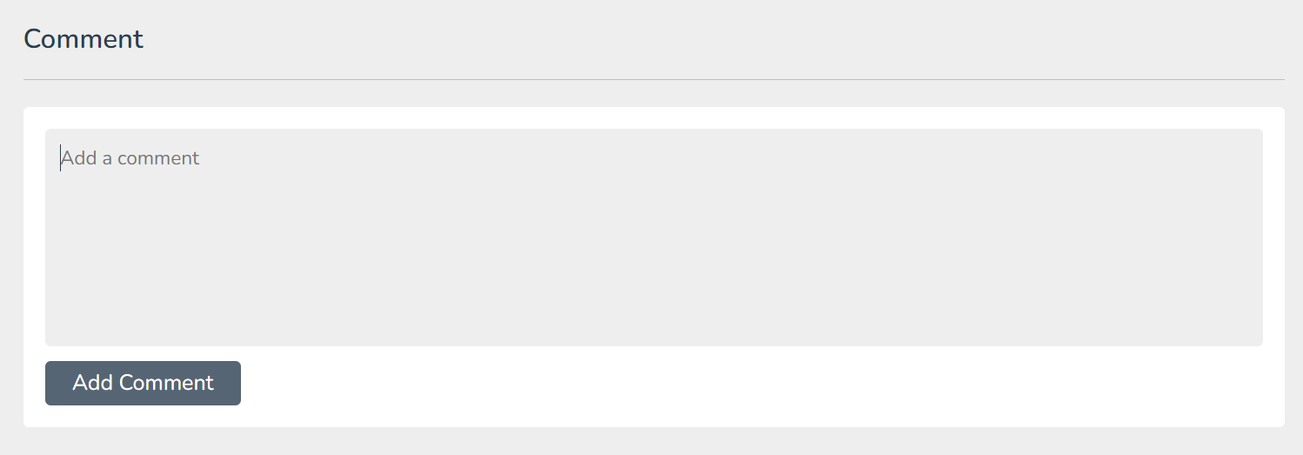
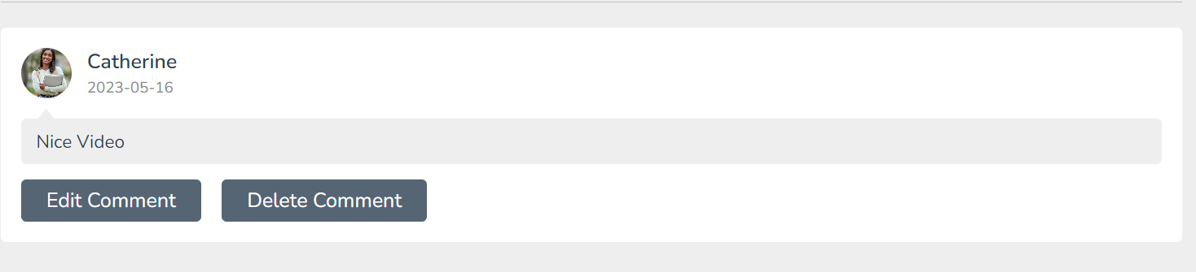
User Comment Section

Slide 20
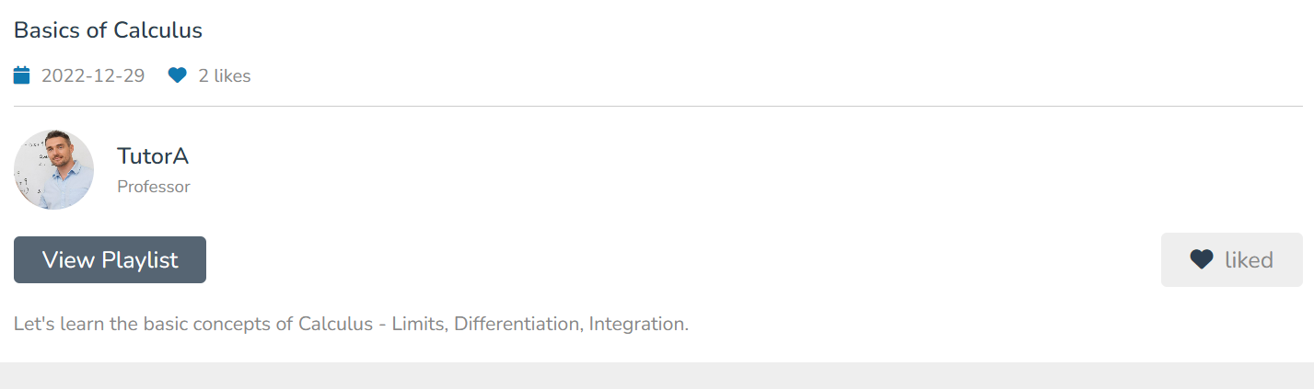
Like feature at the user end

Slide 21
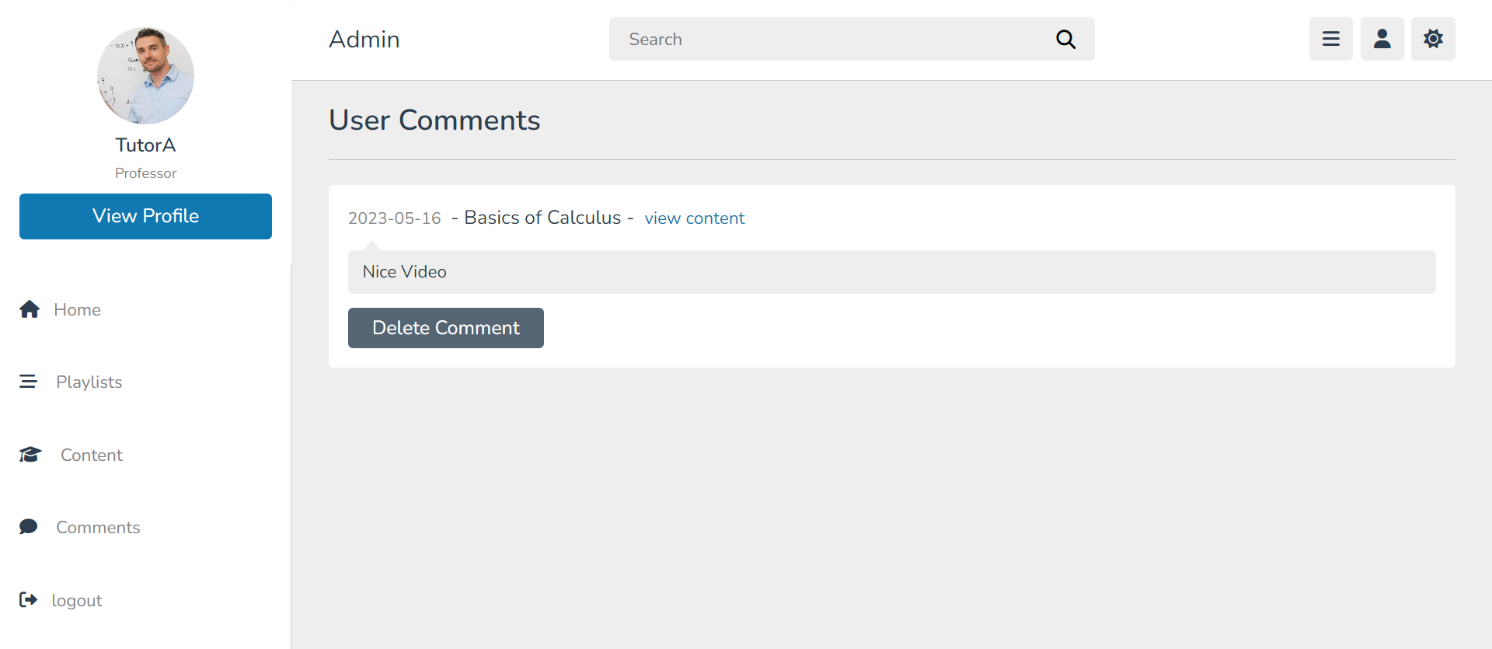
Tutor Comments Page

Slide 22
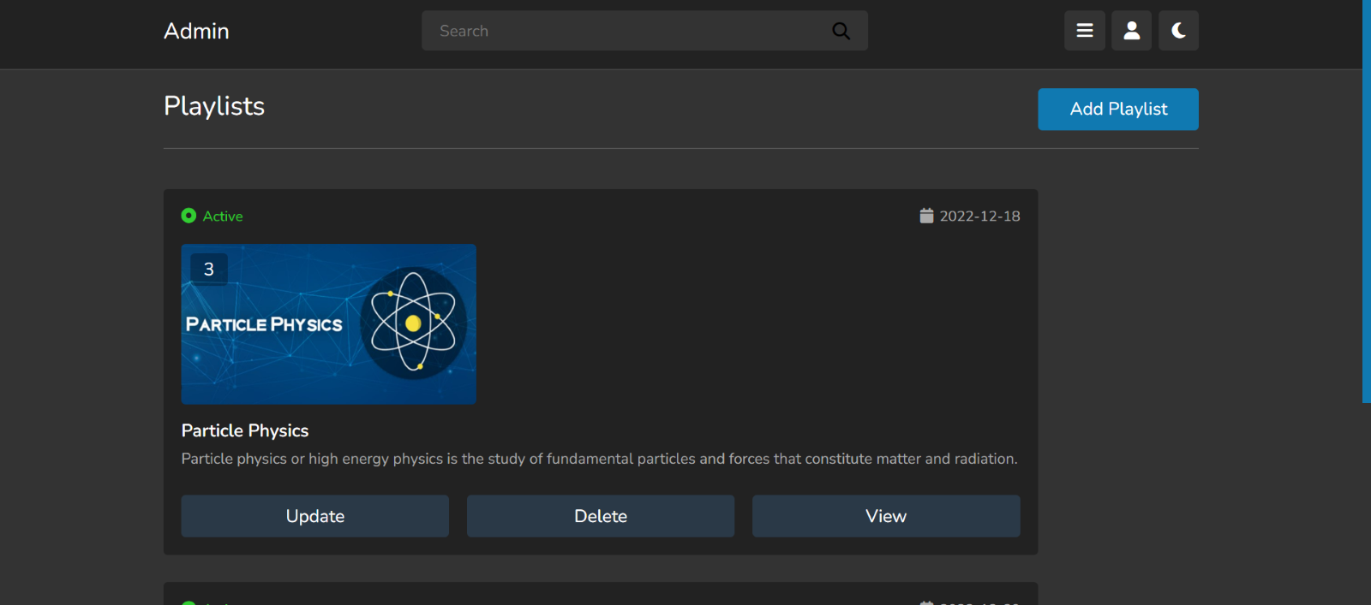
Theme change

Slide 23
This project helped me to learn web development from scratch. It gave me a great insight on working on projects related to web development. Connecting to the backend server and working simultaneously on both front-end and back-end was a great experience.

