Slide 1

Apache Kafka
Introduction

Slide 2
Agenda
What is Kafka?
Why do we need Kafka ?
Kafka Real time use cases

Slide 3


Messaging System

Slide 4
Messaging System
Day 1

Slide 5
Messaging System
Day 1

Slide 6
Messaging System
Day 1
Day 2

Slide 7
Messaging System
Day 1
Day 2
Day 3

Slide 8
Messaging System
Day 4

Slide 9

Messaging System

Slide 10

Messaging System

Slide 11

Messaging System
Application 1
Application 2

Slide 12
Messaging System
Application 1
Application 2

Slide 13
Messaging System
Application 1
Application 2

Slide 14
Messaging System
Application 1
Application 2
Messaging System

Slide 15


Messaging System
No loss of data
Application 1
Application 2
Messaging System
Notes:
Messaging system: RabbitMQ, Kafka

Slide 16
Agenda
What is Kafka?
Why do we need Kafka ?
Kafka Real time use cases

Slide 17

What is Kafka
Apache kafka is
an open source
Distributed
Event streaming platform

Slide 18
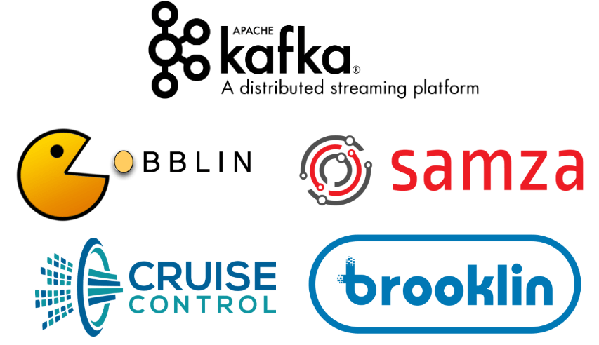
Open Source
Apache Kafka was originally developed by LinkedIn and was donated to Apache
Notes:
Brooklin -> collects data from various sources and distributing to different applications
Samza : Distributed stream processing system
Gobblin -> Data integration framework
Cruise Control -> managing the data flow on nodes

Slide 19
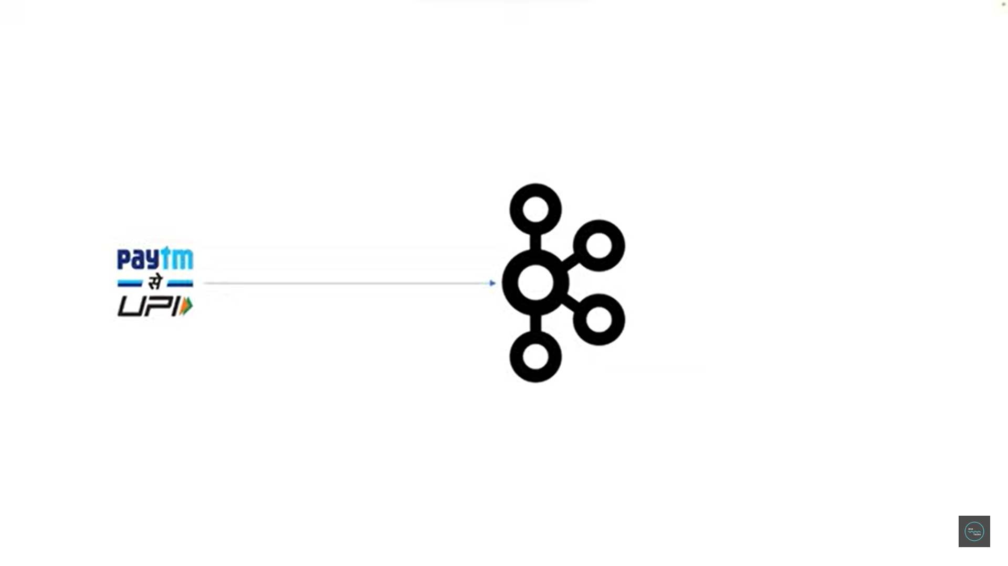
Events Streaming Platform
Each user action is captured as an event
Notes:
Event:
User sending money to friend, paying to vendor -> transaction

Slide 20
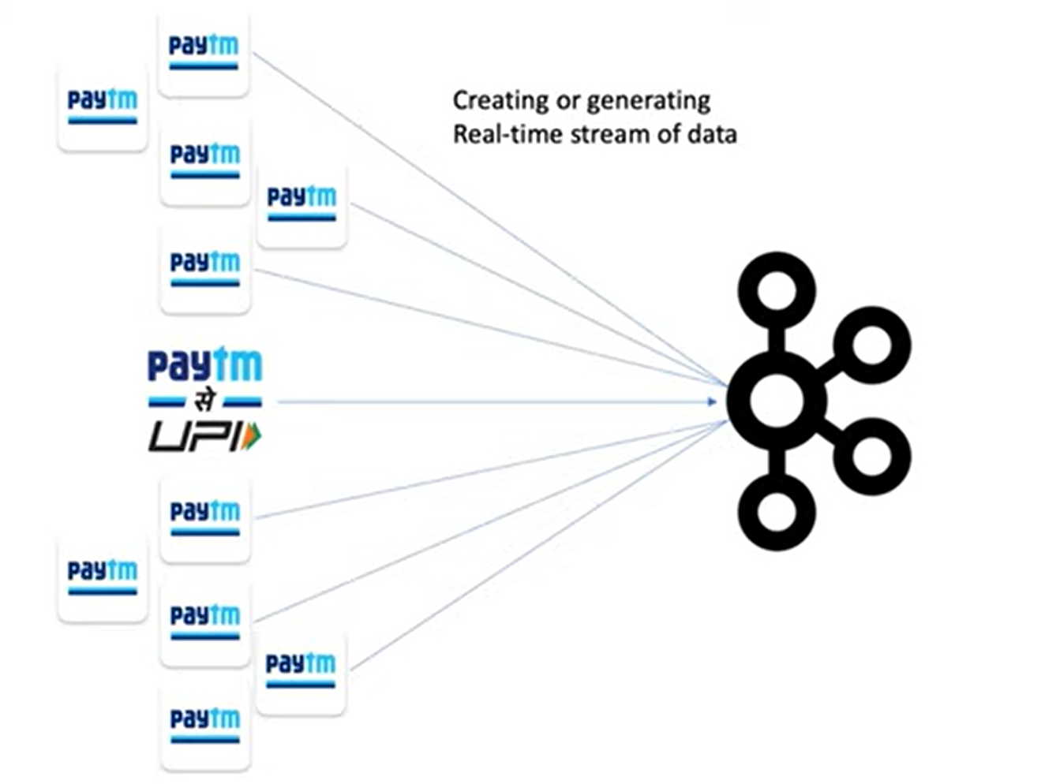
Events Streaming Platform
Millions of user events captured and send to server
Notes:
Millions of users transactions-> streaming to kafka server

Slide 21
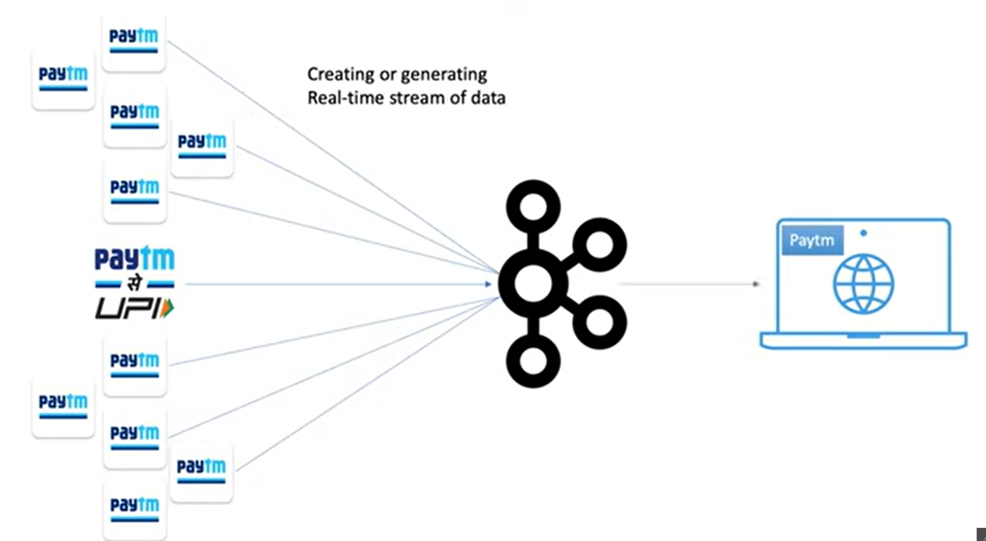

Slide 22
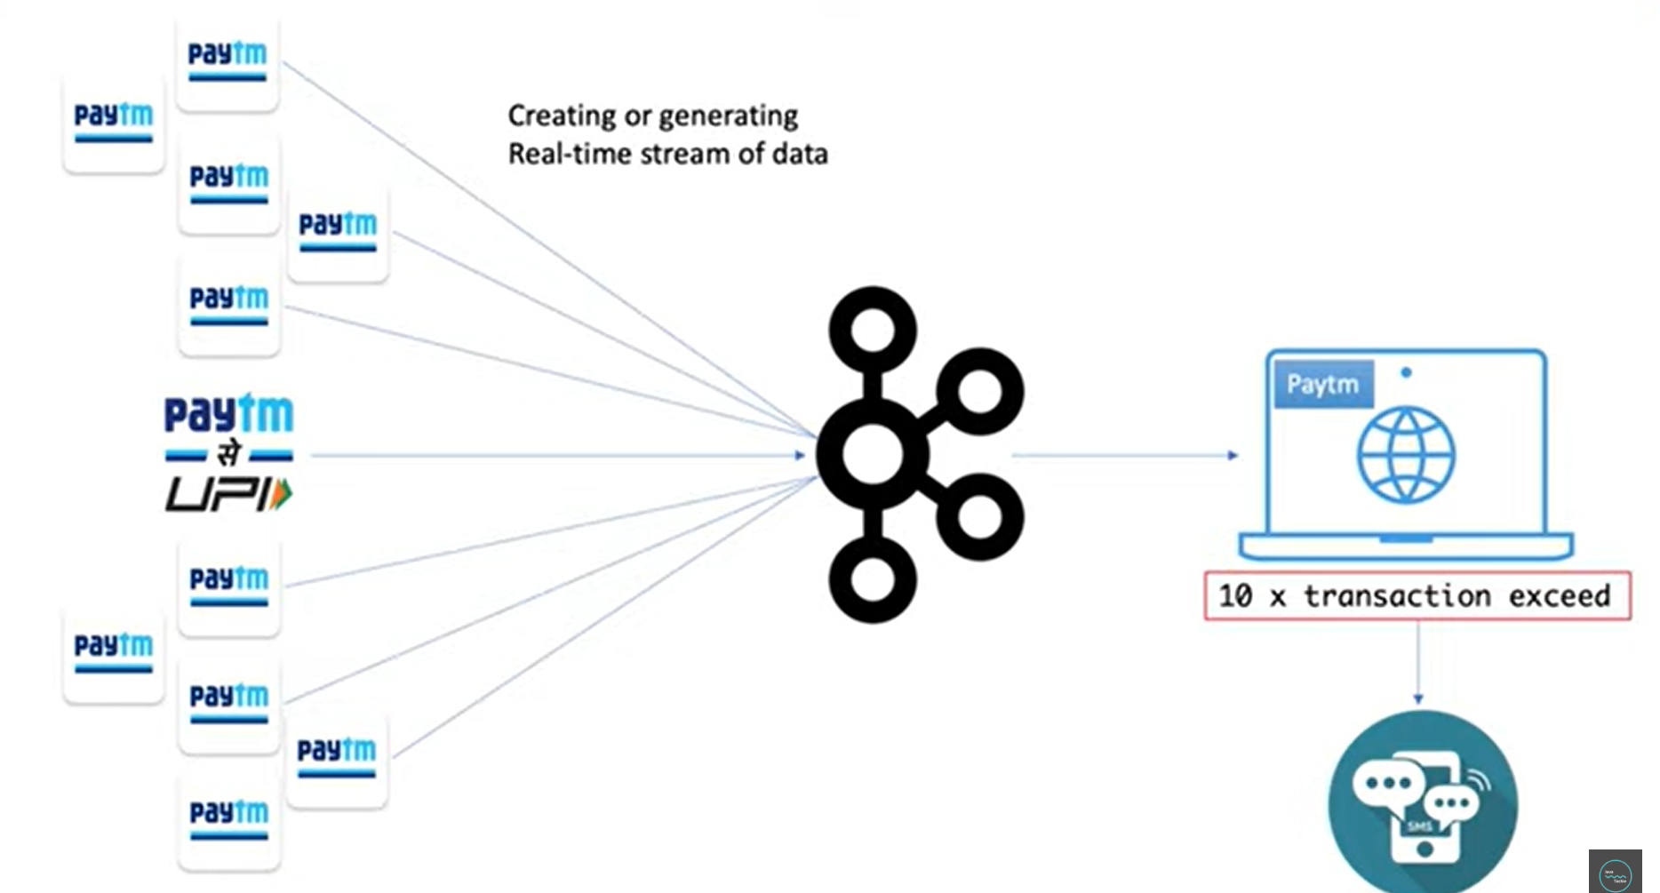

Slide 23
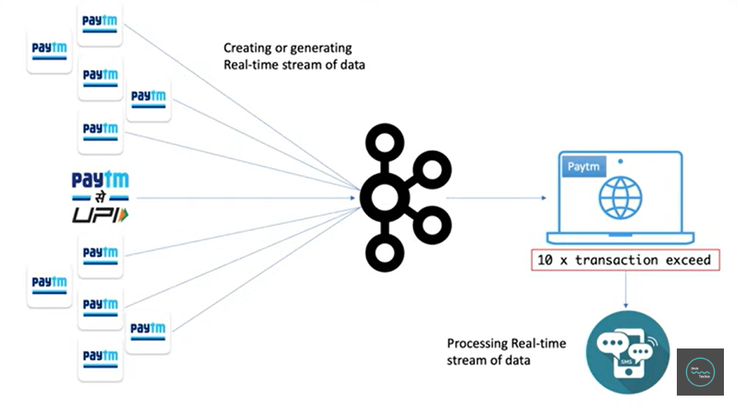
Real time events processing

Slide 24
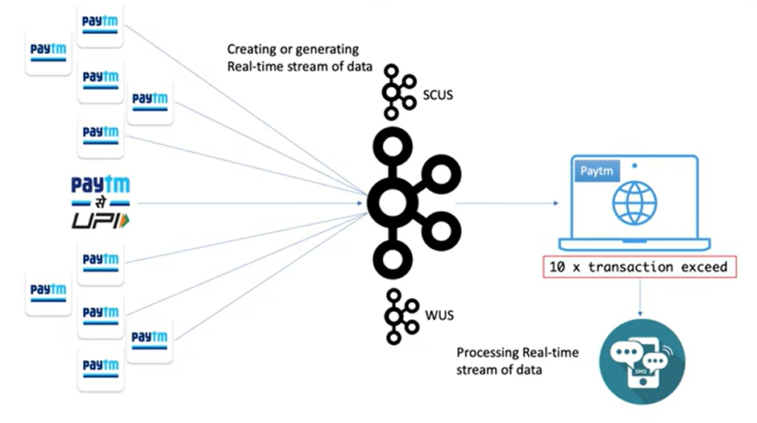
Distributed – Low latency

Slide 25
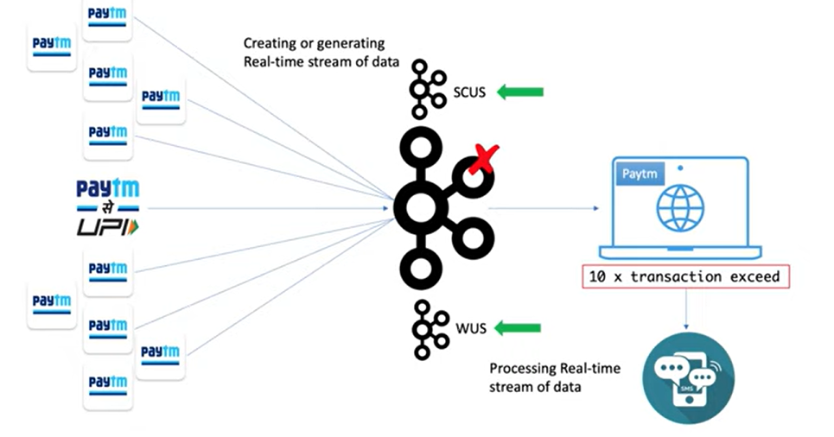
Fault tolerance

Slide 26
Agenda
What is Kafka?
Why do we need Kafka ?
Kafka Real time use cases

Slide 27

Frontend
Web services
Database slave
Chat server
Data Warehouse

Slide 28
Frontend
Database Server
Security Systems
Web services
Real time monitoring
Database slave
Logging
Chat server
Data Warehouse

Slide 29
Frontend
Database Server
Security Systems
Web services
Real time monitoring
Database slave
Logging
Chat server
Data Warehouse

Slide 30




Frontend
Database Server
Security Systems
Web services
Real time monitoring
Database slave
Logging
Chat server
Data Warehouse

Slide 31
Frontend
5
4
Database Server
4
Security Systems
Web services
5
4
Real time monitoring
Database slave
5
4
Logging
Chat server
5
4
Data Warehouse

Slide 32
Frontend
Database Server
Security Systems
Web services
Real time monitoring
Database slave
Kafka
Logging
Chat server
Data Warehouse

Slide 33
Agenda
What is Kafka?
Why do we need Kafka ?
Kafka Real time use cases

Slide 34
Agenda
What is Kafka?
Why do we need Kafka ?
Kafka Real time use cases

Slide 35

References
https://softwareengineeringdaily.com/2020/02/20/linkedin-kafka/#:~:text=LinkedIn%20as%20a%20developer%20of%20Kafka&text=Since%20the%20ecosystem%20around%20Kafka,been%20open%2Dsourced%20on%20Github.
https://www.fisdom.com/upi-lite-everything-you-need-to-know/

