Slide 1

Apache Kafka
Architecture & Components

Slide 2
Kafka Components
Producer
Consumer
Broker
Topic
Cluster
Topic
Partitions
Offset
Consumer Group
Zookeeper

Slide 3
Kafka Components
Producer
Consumer
Broker
Topic
Cluster
Topic
Partitions
Offset
Consumer Group
Zookeeper

Slide 4
Producer
Rider App
In any transaction producer is the source of data that is publishing the messages/events
Producer

Slide 5
Kafka Components
Producer
Consumer
Broker
Topic
Cluster
Topic
Partitions
Offset
Consumer Group
Zookeeper

Slide 6
Consumer
Rider App
Driver App
The application acting as a listener or receiver is called Consumer application.
Producer
Consumer

Slide 7
Kafka Components
Producer
Consumer
Broker
Topic
Cluster
Topic
Partitions
Offset
Consumer Group
Zookeeper

Slide 8
Broker/Kafka Server
Rider App
Driver App
Kafka Server
Producer
Producer and Consumer application do not communicate with each other directly
The Kafka server used as a messaging system for transferring the messages from the producer application to the consumer application
Consumer

Slide 9
Kafka Components
Producer
Consumer
Broker
Cluster
Topic
Partitions
Offset
Consumer Group
Zookeeper

Slide 10
Cluster
Broker 0
Driver App
Kafka Server
When the producers sending large volume of data, one kafka server may not be able to handle the data.
We add more kafka servers as additional brokers.
There can be one or more brokers in the Kafka cluster
Rider App
Payment App
Broker 1
Tracking app
Kafka Cluster
Broker 2

Slide 11
Kafka Components
Producer
Consumer
Broker
Cluster
Topic
Partitions
Offset
Consumer Group
Zookeeper

Slide 12
Topic
Kafka Server
Driver App
Booking topic
A topic is a category or feed name to which records are published.
Topics in Kafka are always multi-subscriber; that is, a topic can have zero, one, or many consumers that subscribe to the data written to it.
Rider App
Payment Topic
Payment App
Location
Tracking app

Slide 13
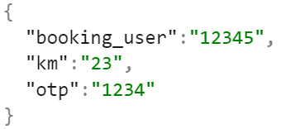
Kafka Server
Driver App
Booking topic
Rider App
Payment Topic
Payment App
Location
Tracking app

Slide 14
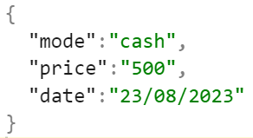
Kafka Server
Driver App
Booking topic
Rider App
Payment Topic
Payment App
Location
Tracking app

Slide 15
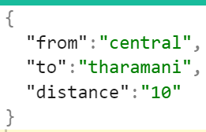
Kafka Server
Driver App
Booking topic
Rider App
Payment Topic
Payment App
Location
Tracking app

Slide 16
Partition
B0 P0
P0 P0
L0 P0
Broker 0
Driver App
Kafka Server
Copy of data into different partitions in different servers
The producer is responsible for choosing which record to assign to which partition within the topic.
This can be done in a round-robin fashion simply to balance load
B1 P1
P1 P1
L1 P1
Rider App
Payment App
Broker 1
Tracking app
B2 P2
P2 P2
L2 P2
Kafka Cluster
Broker 2

Slide 17
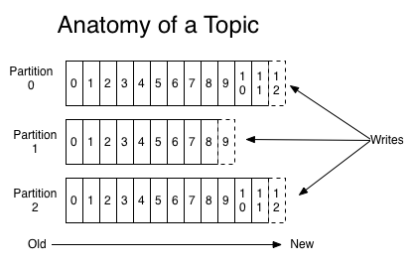
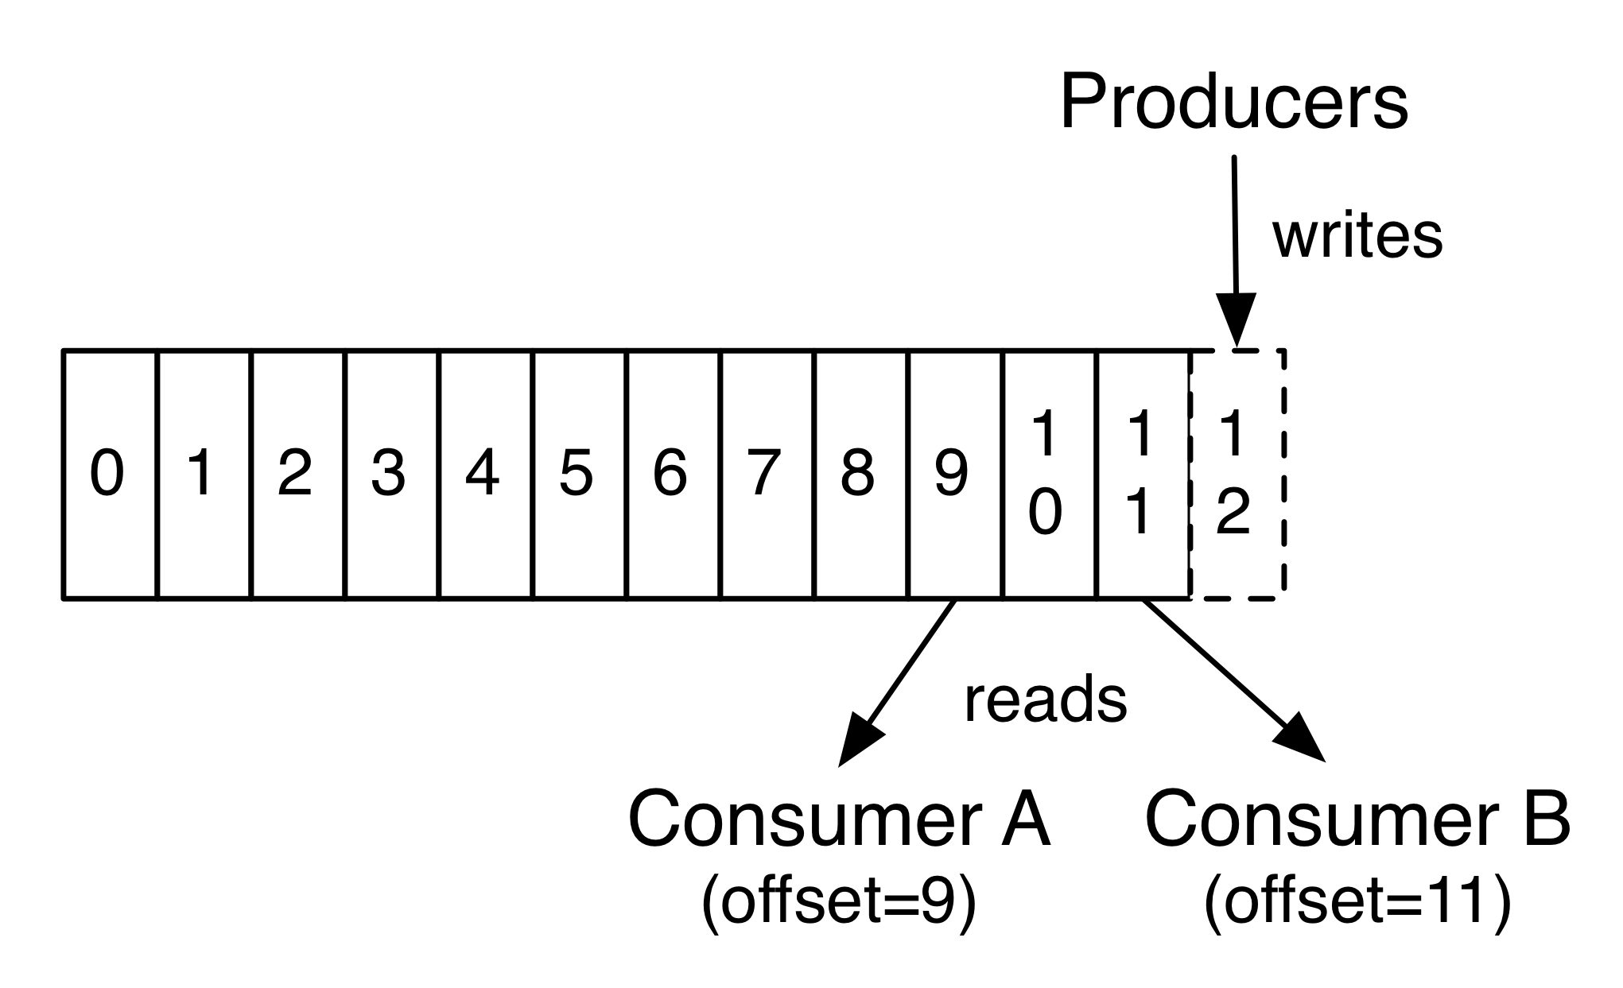

Slide 18
Kafka Components
Producer
Consumer
Broker
Topic
Cluster
Topic
Partitions
Offset
Consumer Group
Zookeeper

Slide 19
Segments and Offset
B1 P1
P1 P1
L1 P1
Broker 1
Kafka Server
Segments
Storing topic into different partitions
Offsets
0 1 2 3 4
Payment topic - > Partition 1

Slide 20
B1 P1
P1 P1
L1 P1
Broker 1
Kafka Server
Segments
Payment App
Offsets
0 1 2 3 4
Payment topic - > Partition 1

Slide 21
B1 P1
P1 P1
L1 P1
Broker 1
Kafka Server
Segments
Payment App
Offsets
0 1 2 3 4
Payment topic - > Partition 1

Slide 22
B1 P1
P1 P1
L1 P1
Broker 1
Kafka Server
Segments
Payment App
Offsets
0 1 2 3 4
Payment topic - > Partition 1

Slide 23
B1 P1
P1 P1
L1 P1
Broker 1
Kafka Server
Segments
Offsets 3
Payment App
0 1 2 3 4
Payment topic - > Partition 1

Slide 24

B1 P1
P1 P1
L1 P1
Broker 1
Kafka Server
Segments
Offsets 3
Payment App
0 1 2 3 4
Payment App
Payment topic - > Partition 1

Slide 25
Kafka Components
Producer
Consumer
Broker
Topic
Cluster
Topic
Partitions
Offset
Consumer Group
Zookeeper

Slide 26
Consumer Group
B1 P1
P1 P1
L1 P1
Broker 1/ Kafka Server
Driver App
Kafka Server
B2 P2
P2 P2
L2 P2
Rider App
Payment App
Broker 2
Tracking app
B3 P3
L2 P2
L3 P3
Kafka Cluster
Broker 3

Slide 27
Consumer Group
B1 P1
Rider App
Broker 1/ Kafka Server
Booking App
Kafka Server
Rider App
B2 P2
Rider App
Rider App
Broker 2
Rider App
B3 P3
Kafka Cluster
Broker 3

Slide 28
Consumer Group
B1 P1
Booking App
Rider App
Broker 1/ Kafka Server
Booking App
Kafka Server
Rider App
Booking App
B2 P2
Rider App
Consumer Group
Rider App
Broker 2
Rider App
B3 P3
Kafka Cluster
Broker 3

Slide 29
Consumer Group
B1 P1
Booking App
Rider App
Broker 1/ Kafka Server
Booking App
Kafka Server
Rider App
Booking App
B2 P2
Rider App
Rider App
Broker 2
Rider App
B3 P3
Kafka Cluster
Broker 3

Slide 30
Consumer Group
B1 P1
Booking App
Rider App
Broker 1/ Kafka Server
Booking App
Kafka Server
Rider App
Booking App
B2 P2
Rider App
Rider App
Broker 2
Rider App
B3 P3
Kafka Cluster
Broker 3

Slide 31
Consumer Group
B1 P1
Booking App
Rider App
Broker 1/ Kafka Server
Booking App
Kafka Server
Rider App
Booking App
B2 P2
Rider App
Rider App
Broker 2
Rider App
B3 P3
Kafka Cluster
Broker 3

Slide 32
Consumer Group
B1 P1
Booking App
Rider App
Broker 1/ Kafka Server
Booking App
Kafka Server
Rider App
Booking App
B2 P2
Rider App
Booking App
Rider App
Broker 2
Consumer Group
Rider App
B3 P3
Kafka Cluster
Broker 3

Slide 33
Consumer Group
B1 P1
Booking App
Rider App
Broker 1/ Kafka Server
Booking App
Kafka Server
Rider App
Booking App
B2 P2
Not active
Rider App
Booking App
Rider App
Broker 2
Consumer Group
Rider App
B3 P3
Kafka Cluster
Broker 3

Slide 34
Consumer Group
B1 P1
Booking App
Rider App
Broker 1/ Kafka Server
Booking App
Kafka Server
Rider App
Booking App
B2 P2
Rider App
Booking App
Not active
Rider App
Broker 2
Consumer Group
Rider App
B3 P3
Kafka Cluster
Broker 3

Slide 35
Consumer Group
B1 P1
Booking App
Rider App
Broker 1/ Kafka Server
Booking App
Kafka Server
Rider App
Booking App
B2 P2
Rider App
Booking App
active
Rider App
Broker 2
Consumer Group
Rider App
B3 P3
Kafka Cluster
Broker 3

Slide 36
Consumer Group
B1 P1
Booking App
Rider App
Broker 1/ Kafka Server
Booking App
Kafka Server
Rider App
Consumer rebalancing
Booking App
B2 P2
Rider App
Booking App
active
Rider App
Broker 2
Consumer Group
Rider App
B3 P3
Kafka Cluster
Broker 3

Slide 37

Zookeeper
Rider App
B1 P1
Rider App
Booking App
Broker 1/ Kafka Server
Rider App
B2 P2
Booking App
Rider App
A ZooKeeper is used to store information about the Kafka cluster and details of the consumer clients.
It manages brokers by maintaining a list of them.
If any changes like a broker die, new topics, etc., occurs, the ZooKeeper sends notifications to Apache Kafka
Broker 2
Booking App
Rider App
B3 P3
Consumer Group
Broker 3
Producers
Kafka Cluster
Zookeeper

Slide 38
Zookeeper
Rider App
B1 P1
Rider App
Booking App
Broker 1/ Kafka Server
Rider App
B2 P2
Booking App
Rider App
A ZooKeeper is used to store information about the Kafka cluster and details of the consumer clients.
It manages brokers by maintaining a list of them.
If any changes like a broker die, new topics, etc., occurs, the ZooKeeper sends notifications to Apache Kafka
Broker 2
Booking App
Rider App
B3 P3
Consumer Group
Broker 3
Update Offset value
Producers
Kafka Cluster
Get Kafka broker id
Zookeeper

Slide 39
To be continued…

