Slide 1
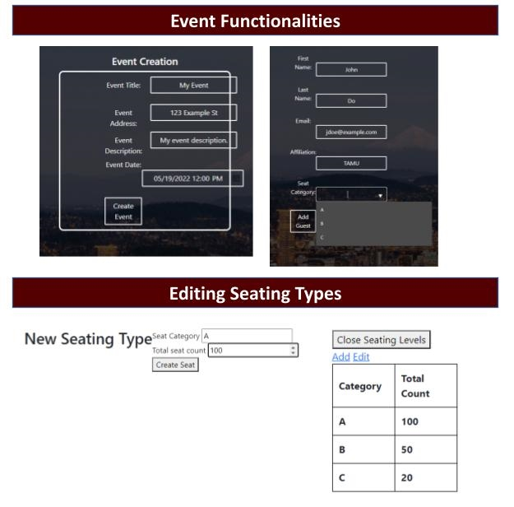
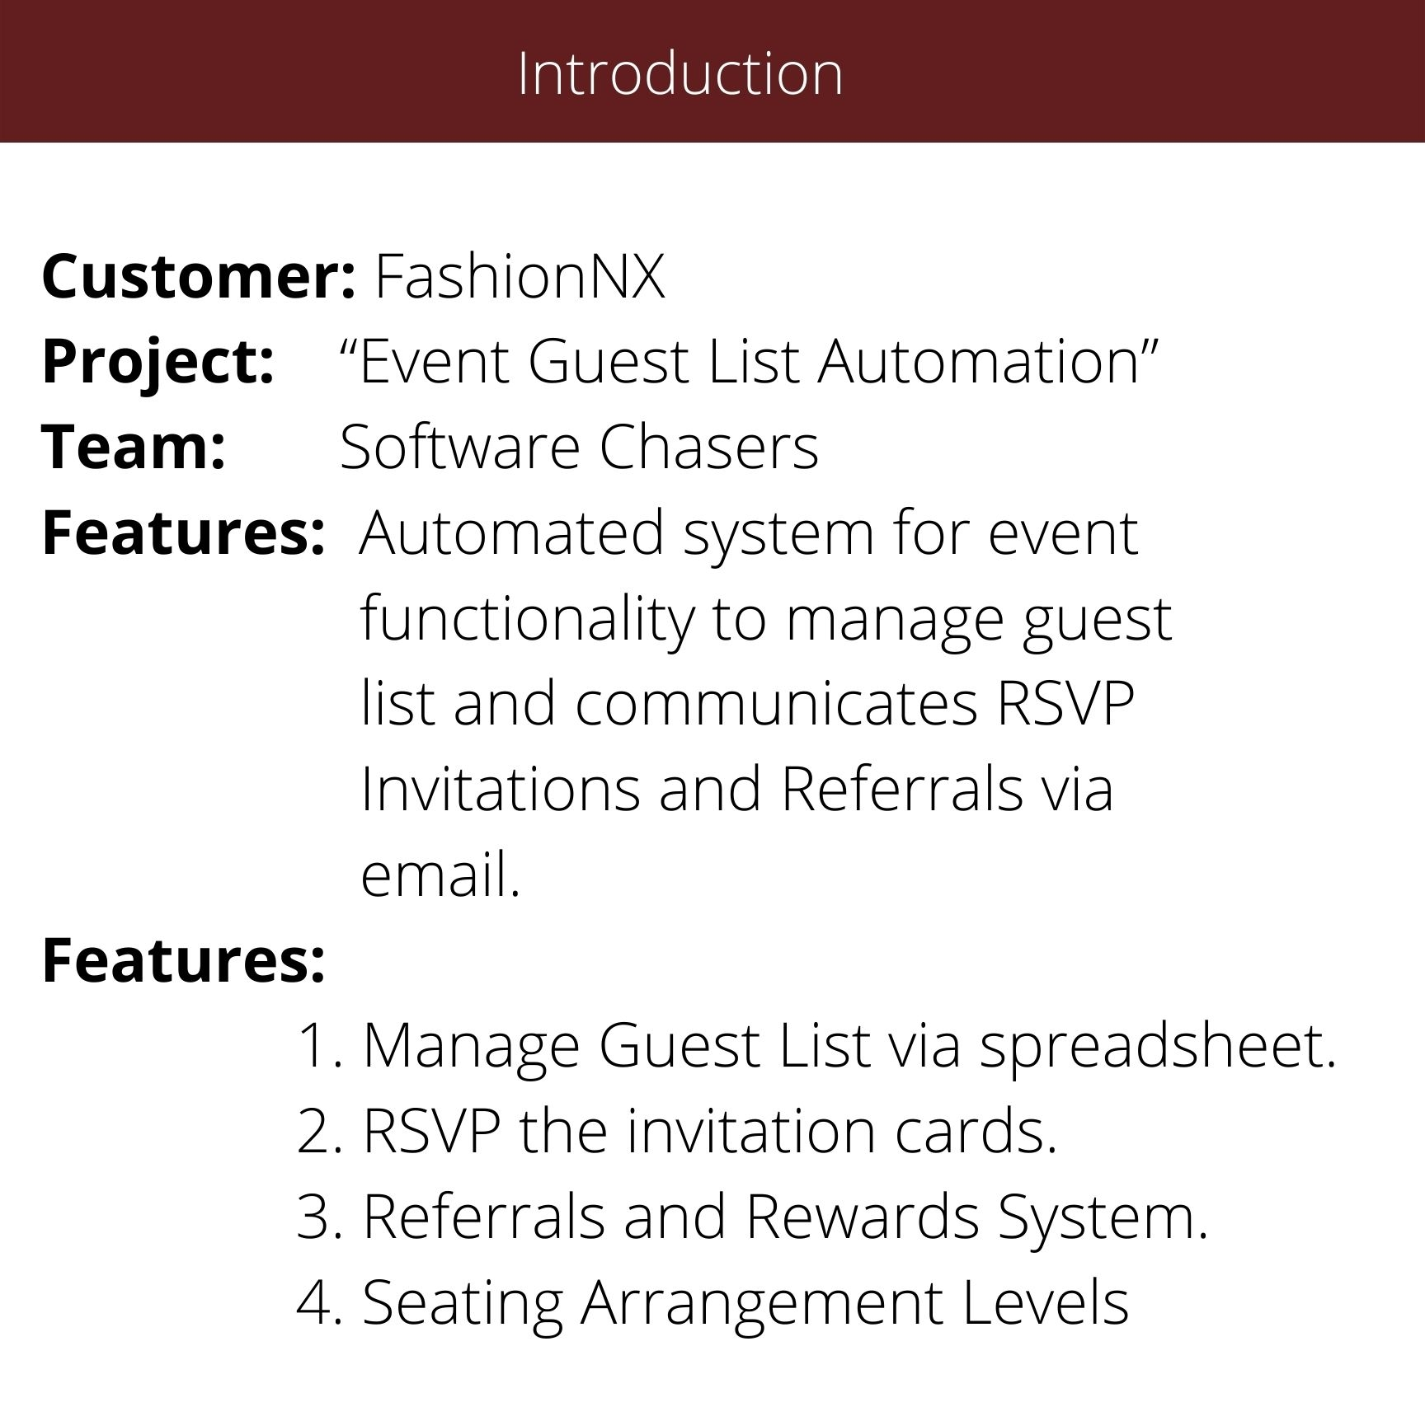
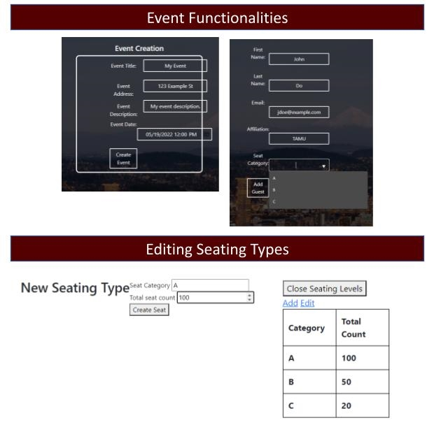
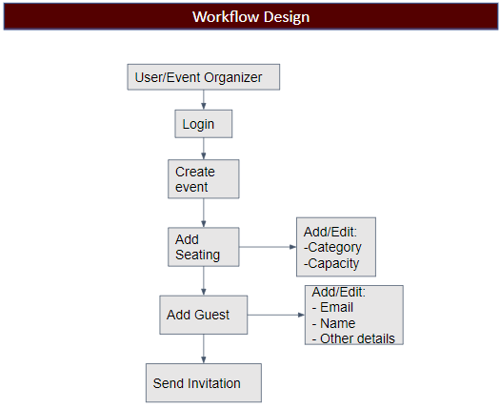
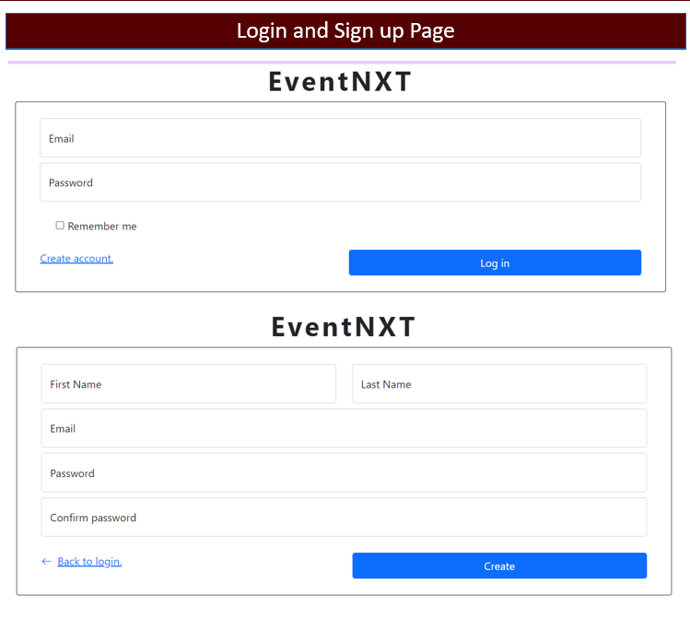
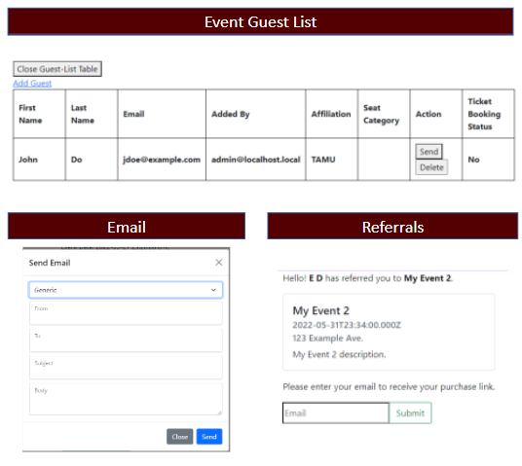
Dept. of Computer Science and Engineering, Texas A&M University
Conclusion
The user experience was improved for the automation system for creating and managing events by implementing additional functionalities in the backend along with redesigning existing modules. Our team had a meaningful experience implementing this project and interacting with the client.

Slide 2
Dept. of Computer Science and Engineering, Texas A&M University
Introduction
Workflow Design
Dashboard User Interface
User/Event Organizer
Login
Create event
Add Seating
Add/Edit:
-Category
-Capacity
Add Guest
Add/Edit:
- Email
- Name
- Other details
Send Invitation

Slide 3
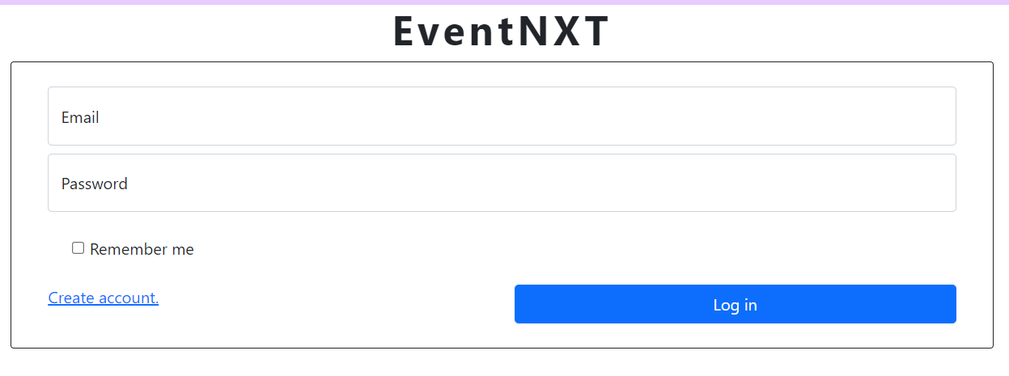
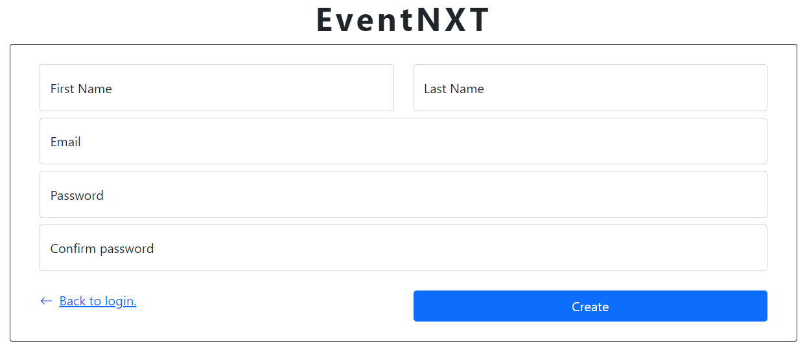
Introduction
Login and Sign up Page
Dashboard User Interface
Dept. of Computer Science and Engineering, Texas A&M University

Slide 4
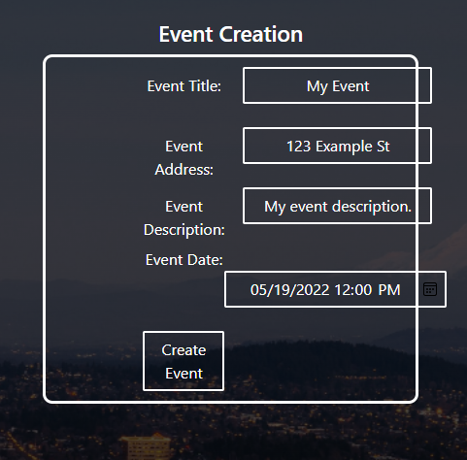
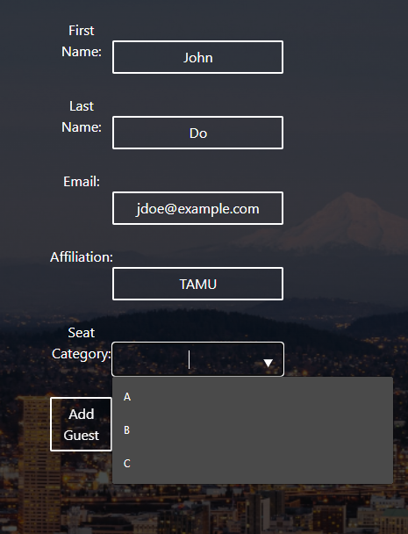
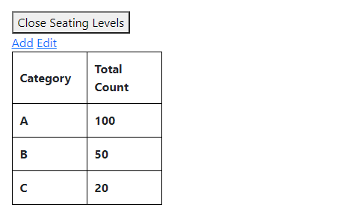
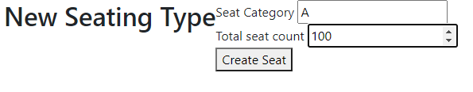
Dept. of Computer Science and Engineering, Texas A&M University
Introduction
Event Functionalities
Dashboard User Interface
Editing Seating Types

Slide 5
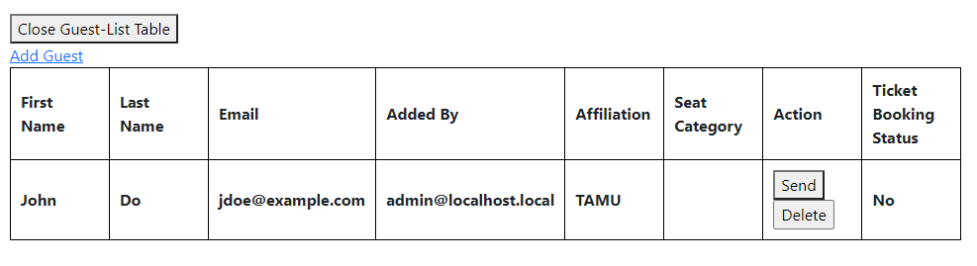
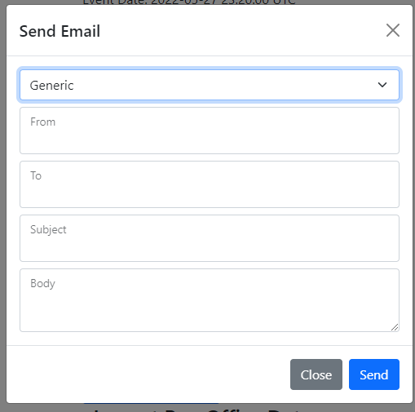
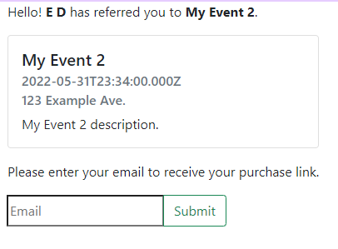
Dept. of Computer Science and Engineering, Texas A&M University
Introduction
Event Guest List
Dashboard User Interface
Email
Referrals

Slide 6
Dept. of Computer Science and Engineering, Texas A&M University
Introduction
Conclusion
Dashboard User Interface
The user experience was improved for the automation system for creating and managing events by implementing additional functionalities in the backend along with redesigning existing modules. Our team had a meaningful experience implementing this project and interacting with the client.

