Slide 1
Analysis on University Rankings
Haoran Xu, Yihan Wang, Aarthy Ramesh, Yeswanth Reddy, Anirudh Ramesh

Slide 2

Why is it important to analyze university rankings?

Slide 3
Are all the ranking systems consistent?
Would expenditure affect ranking?
Which countries have the top-ranked universities and how does it change over time?
Questions Addressed

Slide 4
Found from CWUR, Shanghai Ranking (ARWU) and Times Higher Education Rankings
Includes various parameters such as citations, research output, alumni employment, etc.
Expenditure data from UNESCO Institute for Statistics
Data
Global rankings from different sources!

Slide 5
Comparison of top 100 universities

Slide 6
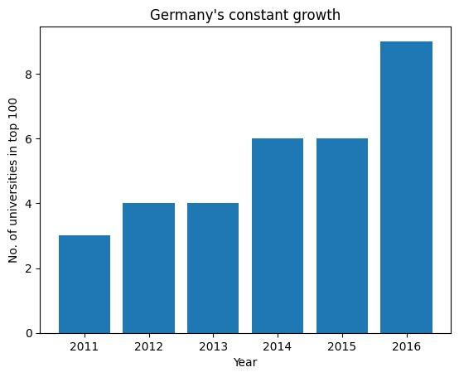
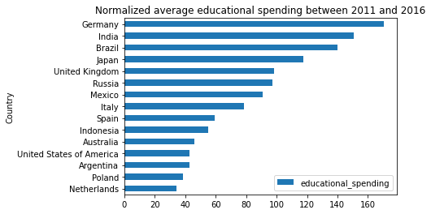
Germany - A Story of Growth

Slide 7
Expenditures and rankings of different countries

Slide 8
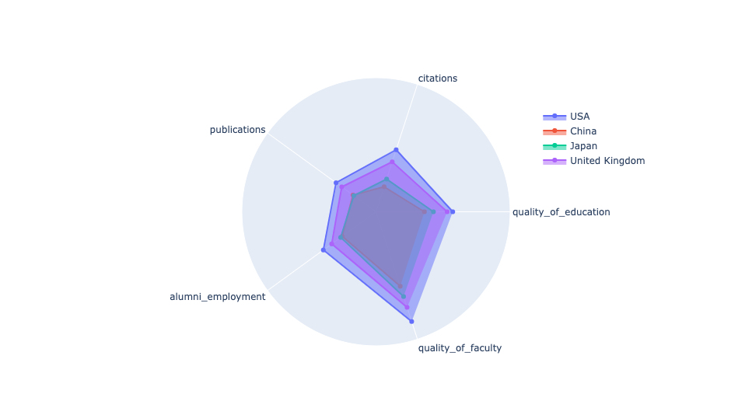
CWUR ranking parameters comparison
Overall, USA dominates the rankings.

Slide 9
ARWU ranking parameters comparison

Slide 10

What about UCSD?

Slide 11
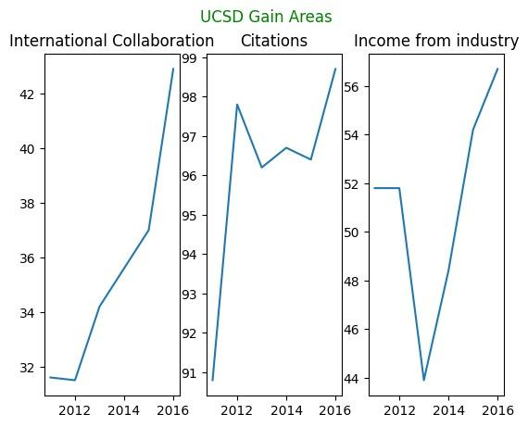

UCSD Analysis

Slide 12
UCSD Analysis

Slide 13
Conclusion
Rankings are not consistent across websites
Different websites give priorities to different factors.
Increase in expenditure resulted in better rankings for some countries but there is no clear correlation.
No clear trends in rankings across countries over time

