Slide 1
Digital Portfolio
STUDENT NAME : Madhumitha J
REGISTER NO : 212400140
NMID : 5848AC3548B8AD98F5A4C008BC1BD855
DEPARTMENT : BCA
COLLEGE : S.I.V.E.T COLLEGE
UNIVERSITY : University of Madras

Slide 2
PROJECT TITLE
DIGITAL PORTFOLIO

Slide 3


Agenda
Problem Statement
Project Overview
End Users
Tools and Technologies
Portfolio design and Layout
Features and Functionality
Results and Screenshots
Conclusion
Github Link
3/21/2024 Annual Review

Slide 4

PROBLEM STATEMENT
Traditional portfolios are often limited, inaccessible, and difficult to update, making it challenging for individuals to effectively showcase their skills and work
A digital portfolio solves this by providing a dynamic, accessible, and easily updatable platform for personal and professional presentation.

Slide 5

PROJECT OVERVIEW
Many individuals struggle to effectively present their skills, projects, and achievements using traditional paper-based or static formats.
These methods lack accessibility, interactivity, and ease of updating.
A digital portfolio addresses this issue by offering a dynamic, centralized, and professional platform to showcase work, improving visibility and engagement in academic or professional environments.

Slide 6

WHO ARE THE END USERS?
Teachers and Professors – They use the digital portfolio to assess students’ learning progress, project work, and overall academic performance in a more interactive and organized format.
Employers and Recruiters –They review digital portfolios to evaluate a candidate’s qualifications, practical skills, and suitability for internships, jobs, or freelance opportunities
Clients – In cases where students offer services like design, writing, or programming, clients use the portfolio to assess the student’s previous work before hiring
Students – They are the primary users who create and maintain the digital portfolio to showcase their academic achievements, skills, projects, and experiences.

Slide 7

TOOLS AND TECHNIQUES
Tools:
HTML – To structure the content of the portfolio.
CSS – Styles the content
JavaScript – Adds interactivity and dynamic features.
Techniques:
Use semantic HTML
Apply responsive CSS (e.g., Flexbox, Grid)
Use JavaScript for dynamic elements
Keep code clean and organized
Code editor –virtual studio code
Test across devices and browsers

Slide 8
POTFOLIO DESIGN AND LAYOUT
Portfolio Design:
Clean & Minimal: Avoid clutter; use whitespace effectively.
Consistent Style: Use a unified color scheme, fonts, and icon style.
Professional Look: Choose modern and readable typography; keep visuals high quality.
User-Friendly: Easy navigation with clear menus and call-to-action buttons.
Responsive: Must look good on all devices (mobile, tablet, desktop).
Portfolio Layout:
Header: Includes your name/logo and navigation menu.
Hero Section: A short intro or tagline that tells who you are.
About Section: Brief bio, skills, and background info.
Projects Section: Showcases your best work with images, descriptions, and links.
Skills Section: Lists technical and soft skills (can include icons or charts).
8

Slide 9
FEATURES AND FUNCTIONALITY
Features:
Project Gallery : Visual display of work
About Me Section : Brief bio and background
Skills Section : List of tools and technologies
Contact Form : For direct communication
Responsive Design : Mobile and tablet friendly
Downloadable Resume : Optional PDF CV
Functionality:
Navigation Menu : Easy movement between sections
Interactive Elements : Hover effects, sliders, filters
Embedded Media : Videos, images, or documents
SEO Optimization : Helps people find your portfolio online
Social Media Links : Connects to your LinkedIn, GitHub

Slide 10
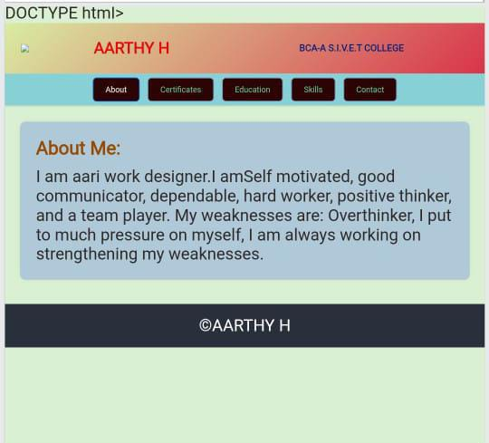

RESULTS AND SCREENSHOTS
3/21/2024 Annual Review
10

Slide 11
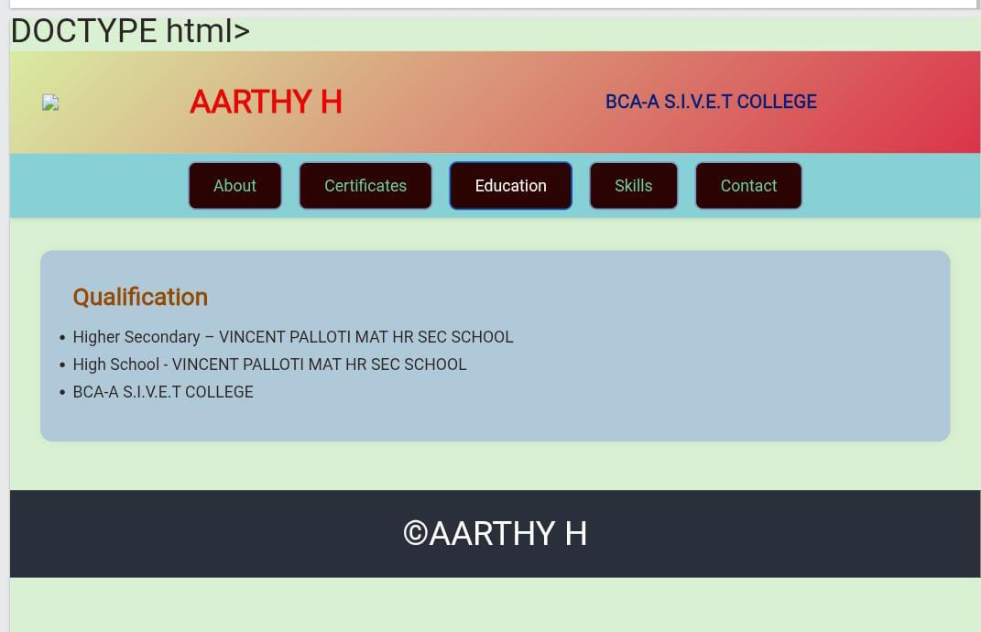
SCREENSHORTS

Slide 12
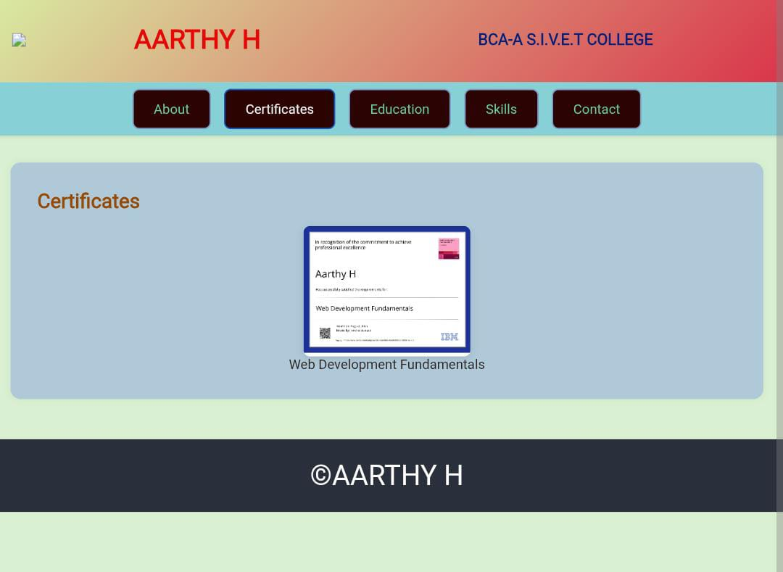
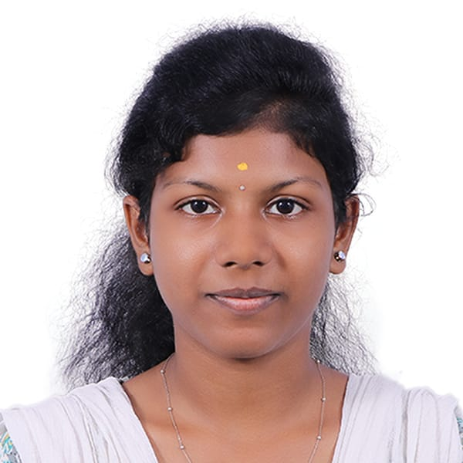
CERTIFICATES

Slide 13
CONCLUSION
THANK YOU For visiting My portfolio ! I am passionate about for learning, growing, and taking on new Challenges.
This portfolio, reflects my skills, Creativity, and dedication to
building a strong foundation in My career.
I look forward to exploring opportunities where I can contribute, collaborate, and Continue to improve.
If you’d like to connect or know more about me, feel free to reach out through the contact section.
13

Slide 14
Github Link
Link : https://aarthy0728.github.io/Aarthy/

