Slide 1

Orange supply
A Dining Hall Inventory Management System
Project by:
Aarti Mehra
Maitreyi Ahire
Sania Bhojwani

Slide 2
Project Objectives
Developing a comprehensive digital inventory management system
Providing access to the inventory management system for all five dining halls
Migrating existing inventory data to the new digital system
Automating the process of placing orders
Increasing operational efficiency of the Syracuse Dining Halls.
Creating a scalable and flexible inventory management system.
Reducing human error

Slide 3
Requirement Gathering
Analyze Existing Inventory, Bills and Documents
Requirement Meeting with Dining Hall Managers

Slide 4
Functional requirements
Develop a web-based inventory management system for real-time tracking
Create a scalable and adaptable inventory management system that can handle future growth and changes in inventory needs
Migrate existing inventory data from paper-based or other legacy systems to the new digital system while maintaining data integrity and accuracy

Slide 5
Non-functional requirements
System must be scalable and adaptive to changing business requirements
System must adhere to all applicable legislation and standards, assuring legal and ethical compliance
Safeguard inventory data from illegal access or data breaches

Slide 6
Actors/users
Dining hall Supervisors
Dining hall Employees
Food services administration

Slide 7
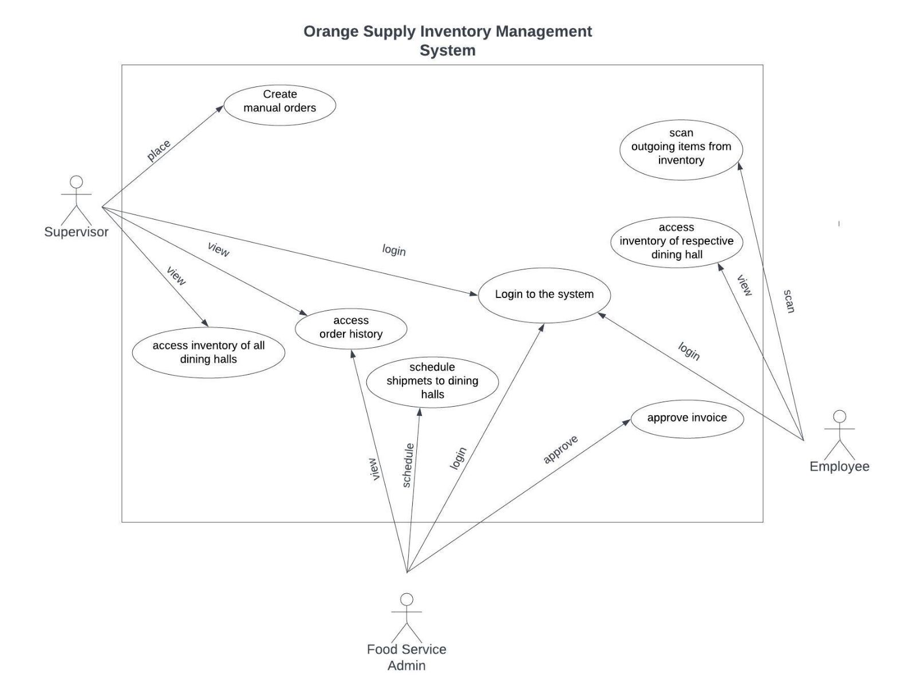
Use-case diagram

Slide 8
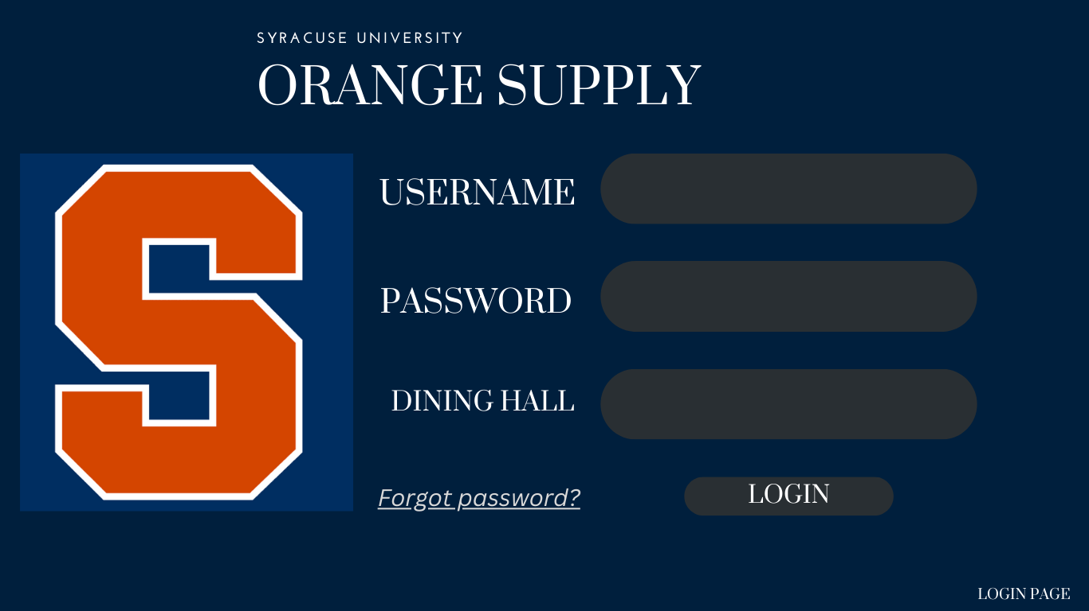
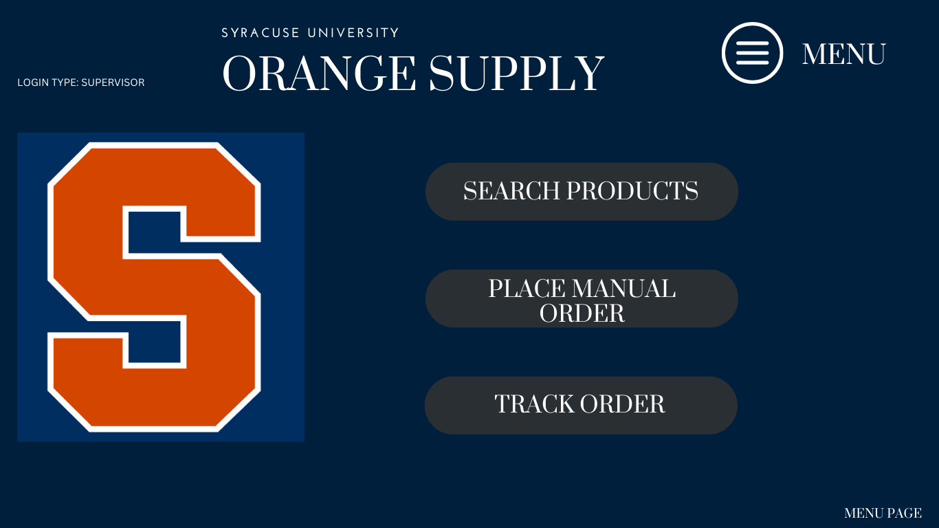
User interface

Slide 9
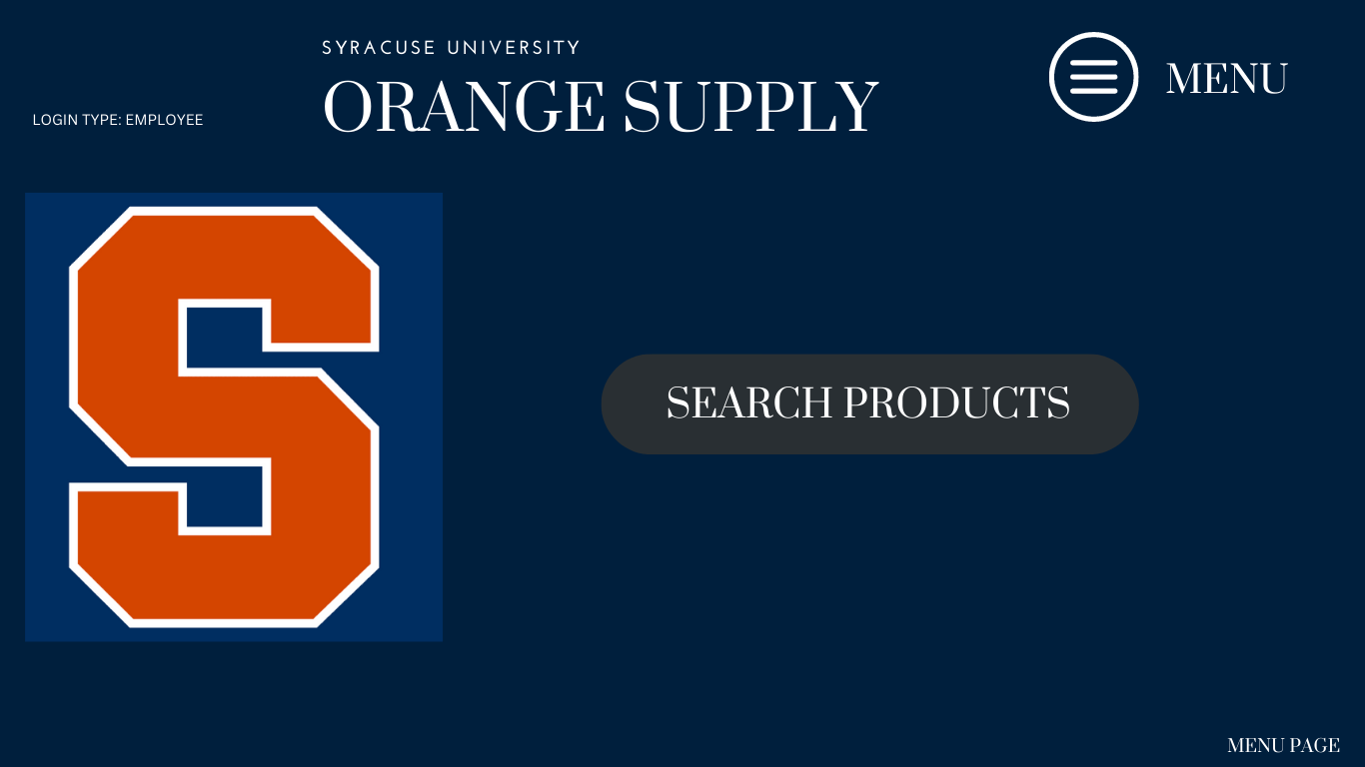
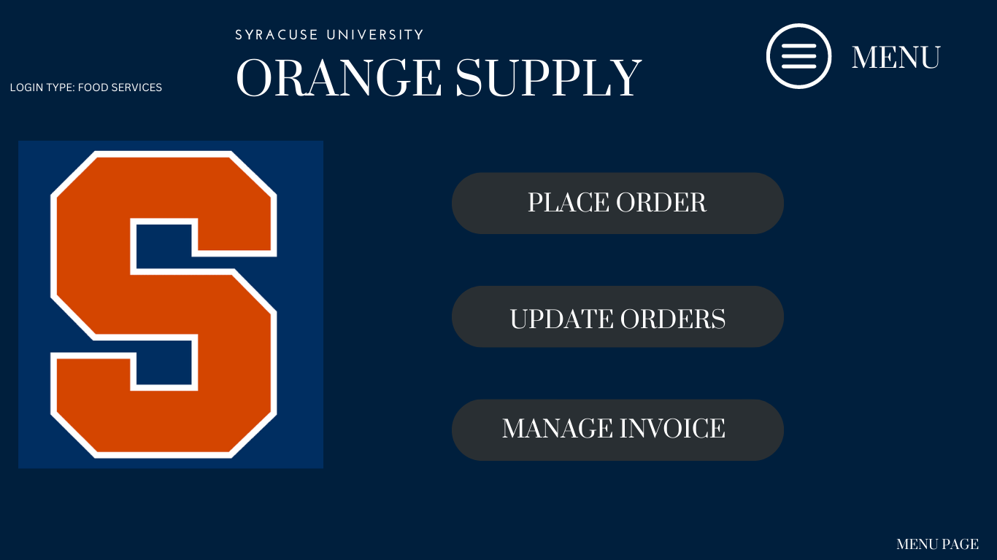
User interface

Slide 10
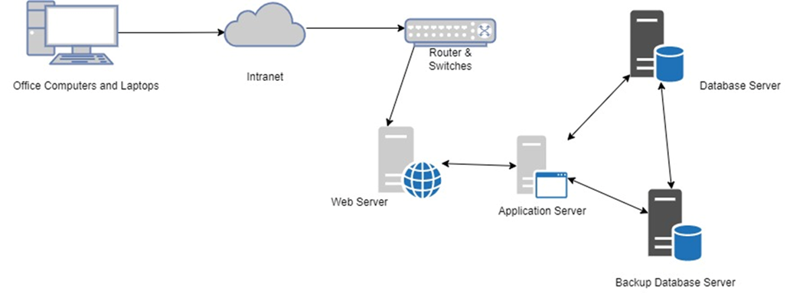
SYSTEM architecture

Slide 11
OPERATIONAL AND ECONOMIC feasibility
A digitized system to improve efficiency and reduce manual efforts
Small scale project with limited scope
Projected personnel costs - $ 50,375.00
Projected equipment costs - $ 31,080.00
Lifetime ROI - 60.49%
Involvement of users in the project planning
Backed by management and users
No workforce reduction, but training required to familiarize users
No effect on the current system during implementation

Slide 12
Technical and Schedule feasibility
Ease of acquiring new resources, softwares, hardwares, servers and licenses
Scalable for future needs, to handle organizational growth and user volume
Available in-house technical expertise
Scheduled considering importance and availability of resources
Accelerated timeline will increase personnel costs

Slide 13
How will the system benefit?
Automate the inventory management process, reducing the likelihood of stockouts and overstocking
Optimize the use of storage space and ensure that the right products are always available for customers
Overall, the system will help increase efficiency, reduce costs, and improve customer satisfaction

Slide 14
Thank you

