Slide 1


HEALTHCARE COST ANALYSIS FOR A SAMPLE U.S. POPULATION
Determining the factors on which the cost depends
and recommendations about how to lower the cost
Aarti Mehra
Nakul Rattan
Himanshu Mangal
Nandita Pathardikar

Slide 2

Project Goal
The dataset of this project contains healthcare cost information from Health Management Organization, with each row representing a single person.
Actionable insight based on the data available and also, accurately predict customers for which the cost will be expensive.
The project consists of using various analysis techniques and models to better recommend the changes to be made to lower the healthcare cost, based on the concepts of correlation.
High level focus points :
Determine the parameters to decide whether the healthcare cost is expensive or not - predict people who will spend a lot of money on health care next year.
Provide actionable insight to the HMO, in terms of how to lower their total health care costs, by providing a specific recommendation on how to lower health care costs.

Slide 3
Our Recommendation
Run anti-smoking campaigns targeting children and younger adults, while promoting a healthier lifestyle for everyone.

Slide 4
PROJECT : DATA ANALYSIS FLOW
STEP 1:
LOADING DATA INTO R WITH APPROPRIATE PACKAGES AND LIBRARIES
STEP 2:
EXPLORING THE DATA – VARIABLES AND PARAMETERS FOR ANALYSIS
STEP 3:
DATA CLEANING – ELIMINATING / REPLACING MISSING VALUES
STEP 4:
STUDY AND OVERVIEW OF IMPORTANT VARIABLES FOR DECISION MAKING
STEP 5:
DATA MODELING, VISUALIZATION AND DETERMINING TRENDS
STEP 6:
CONCLUSION AND RECOMMENDA-TIONS

Slide 5
PROJECT DATASET VARIABLES
Age
BMI
Children
Smoker
Location
Location Type
Education Level
Yearly Physical
Exercise
Married
Hypertension
Gender

Slide 6
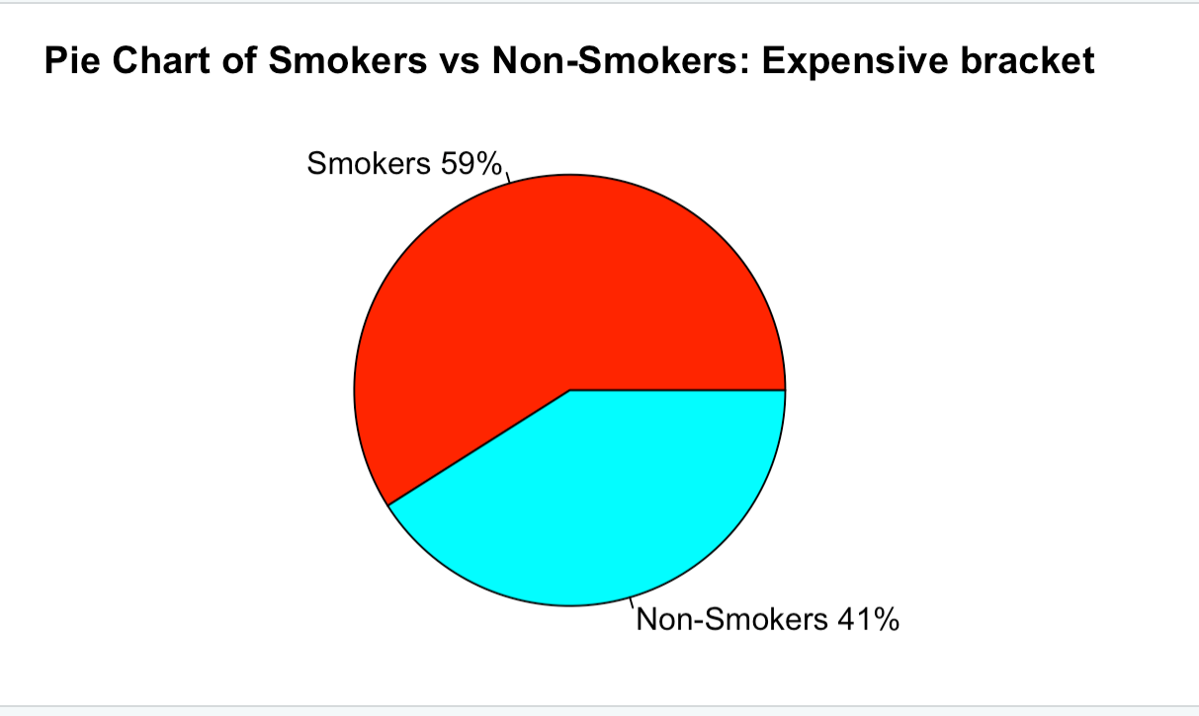
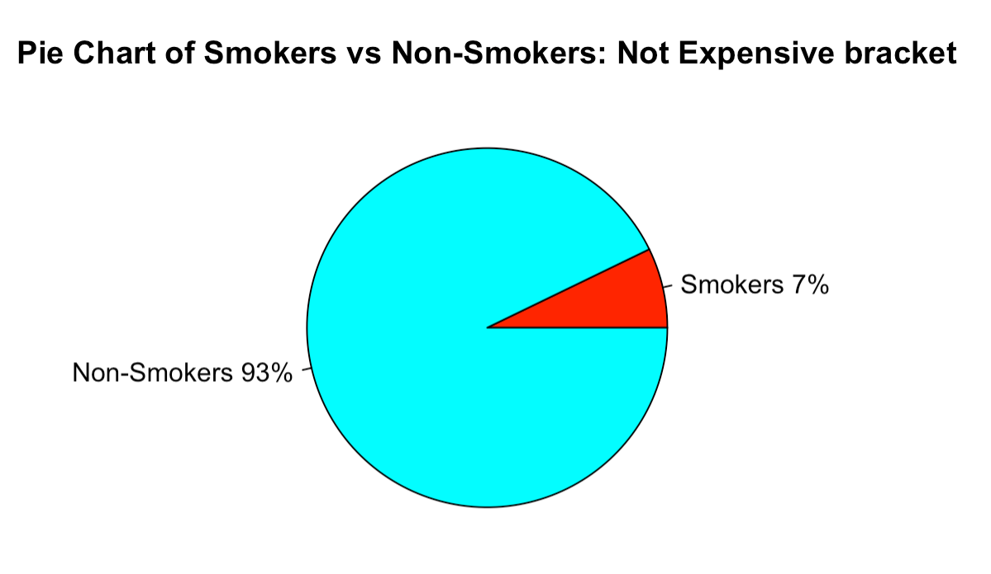
Data Exploratory Analysis : Findings
59% of people who have a high cost of healthcare are smokers, suggesting a possible outcome : smokers have a greater need of a healthcare treatment as compared to non-smokers
41% of all people who have a high cost of healthcare are non-smokers
93% of people who have a low cost of healthcare are non-smokers, suggesting a possible outcome : non-smokers do not fall ill, relatively to smokers
7% of people who have a low cost of healthcare are smokers

Slide 7
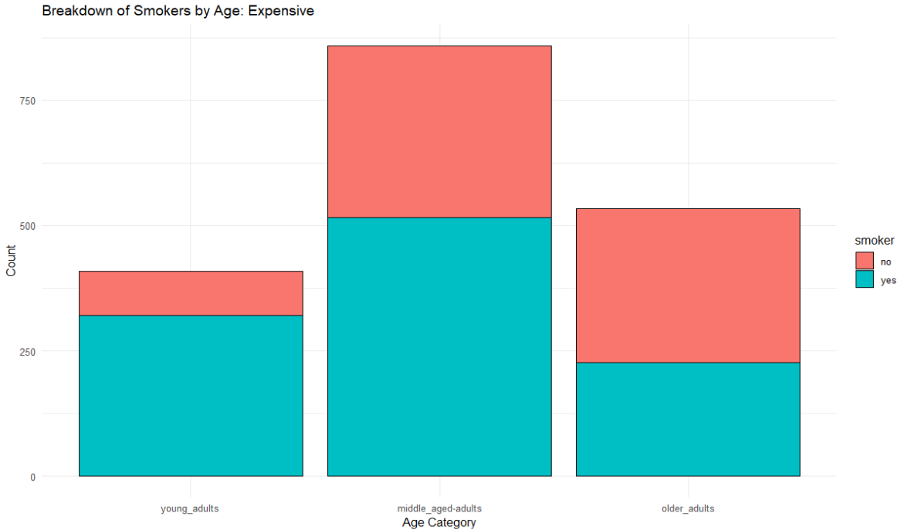
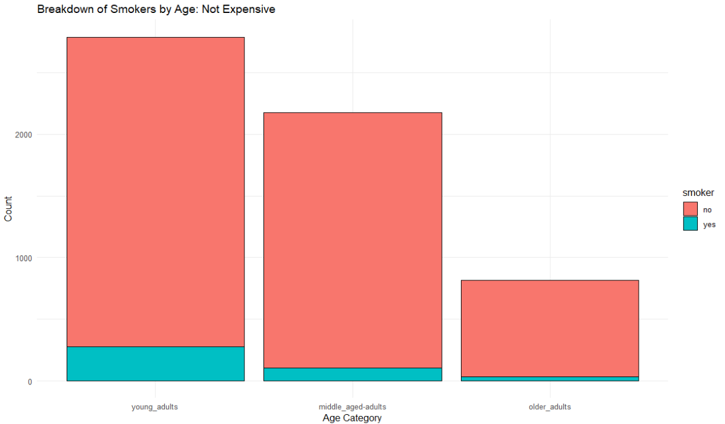
A Closer look at the Smokers
Key Findings:
Most young adults in the who were in the expensive bracket were smokers.
The majority of middle-aged adults in the expensive bracket were smokers.
Smoking was not a big factor in older adults, probably because age related health treatments played a big factor.

Slide 8
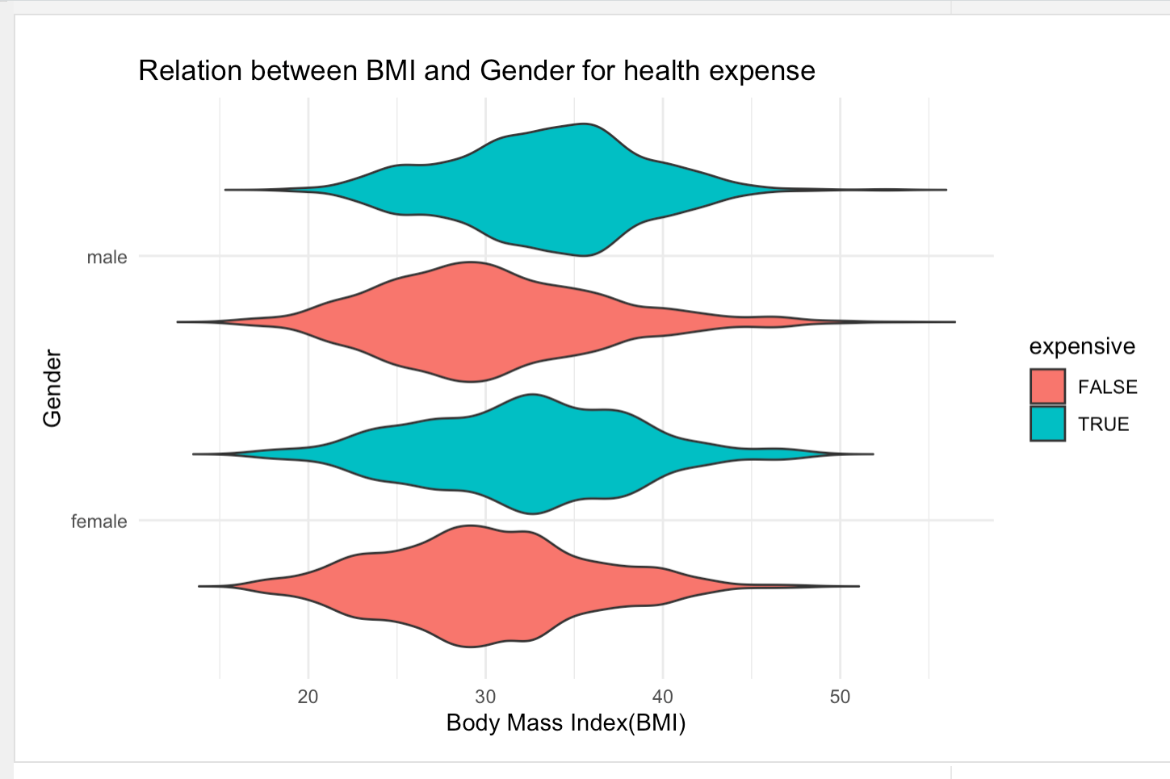
Data Exploratory Analysis : Findings
Visualization used : violin-plot, plotting BMI based on gender.
X-axis -> Body Mass Index
Y-axis -> Gender
Observation : Healthcare cost for people with higher BMI is far more than those with lower BMI.

Slide 9
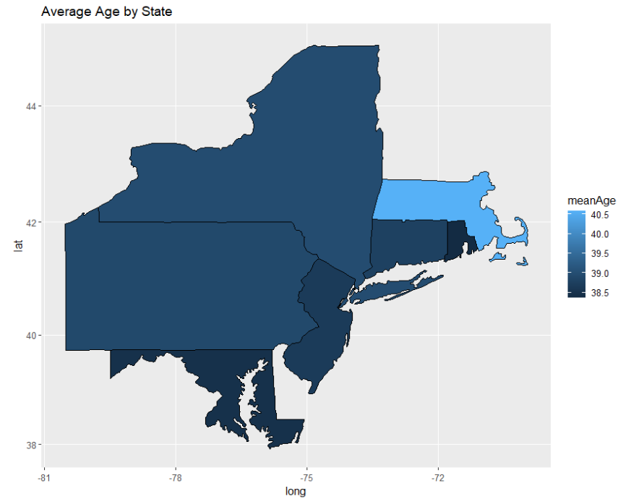
Data Exploratory Analysis : Findings
Visualization used : Map
Observation :
Highest Average Age: Massachusetts
Lowest Average Age: Rhode Island

Slide 10
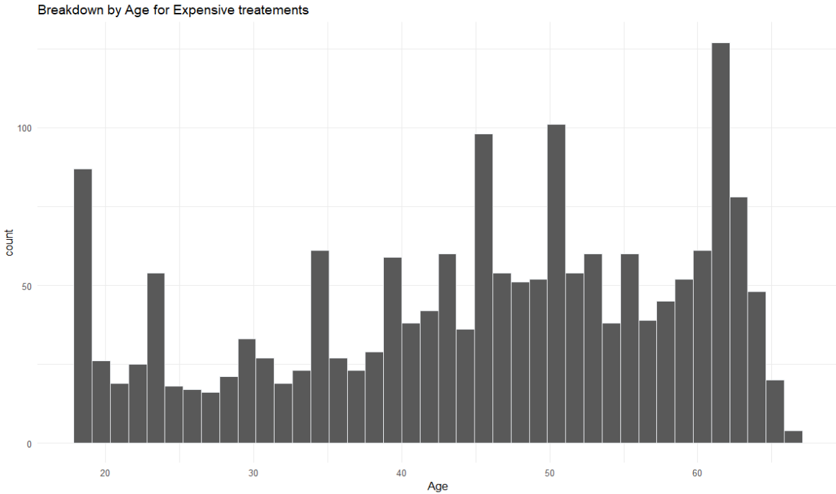
Data Exploratory Analysis : Findings
Visualization used : Histogram
X-axis -> Age
Y-Axis -> Count of people.
Observation : Majority of the people who have an expensive healthcare fall in one of the following three age groups –
Less than 20 years
More than 60 years
Between 45-50 years of age.

Slide 11
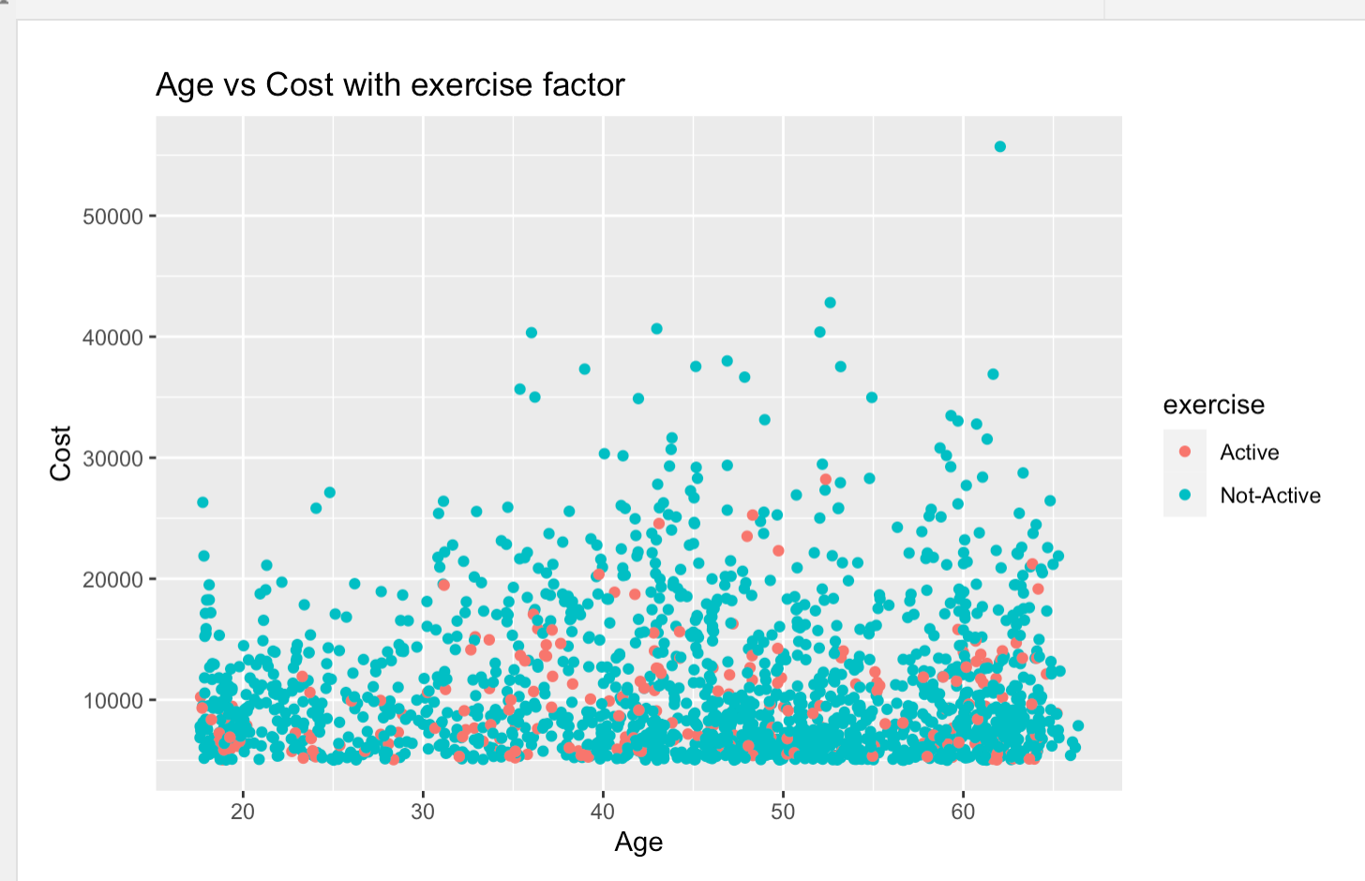
Data Exploratory Analysis : Findings
Visualization used : jitter plot based on exercise, X-axis -> Age, Y-axis -> cost of healthcare
Observation : the plot here suggests that most individuals pay between $10,000 and $15,000, irrespective of their age, with a very few of them exercising actively. There is no specific pattern to define a correlation between age, cost, and exercise.

Slide 12
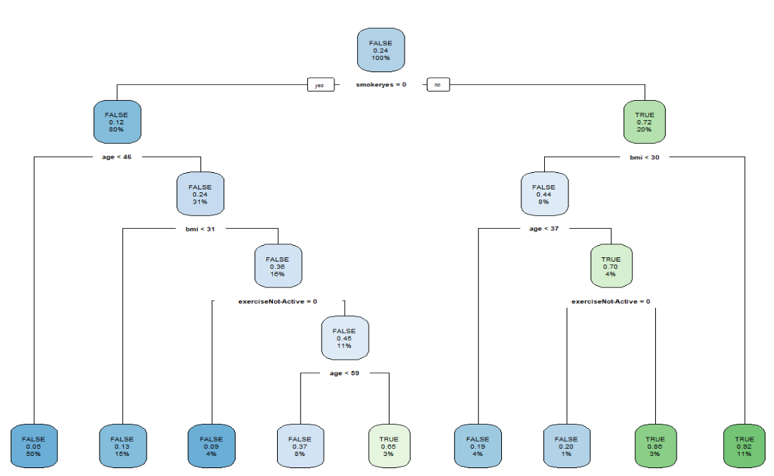
Findings from the Model
Key Findings:
High chance of cost being expensive if:
Person is a smoker
BMI > 30
High chance of cost not being expensive:
Not a smoker
Age < 46 OR
BMI < 31

Slide 13
Thank You

