Slide 1
IST 659 Restaurant Management System
Team Members: Aarti Mehra, Rajashekar Reddy Mora, Saikumarreddy pochireddygari

Slide 2

Overview of the project
To build an application from ordering food from a Restaurant to generating bill and payment. The application users will have access to manage orders from the app.
For this we are using various tools like Azure data studio, Microsoft power apps, and various SQL concepts.

Slide 3
ER Requirement Spreadsheet
Please find the attached ER Requirement Spreadsheet for the project.

Slide 4
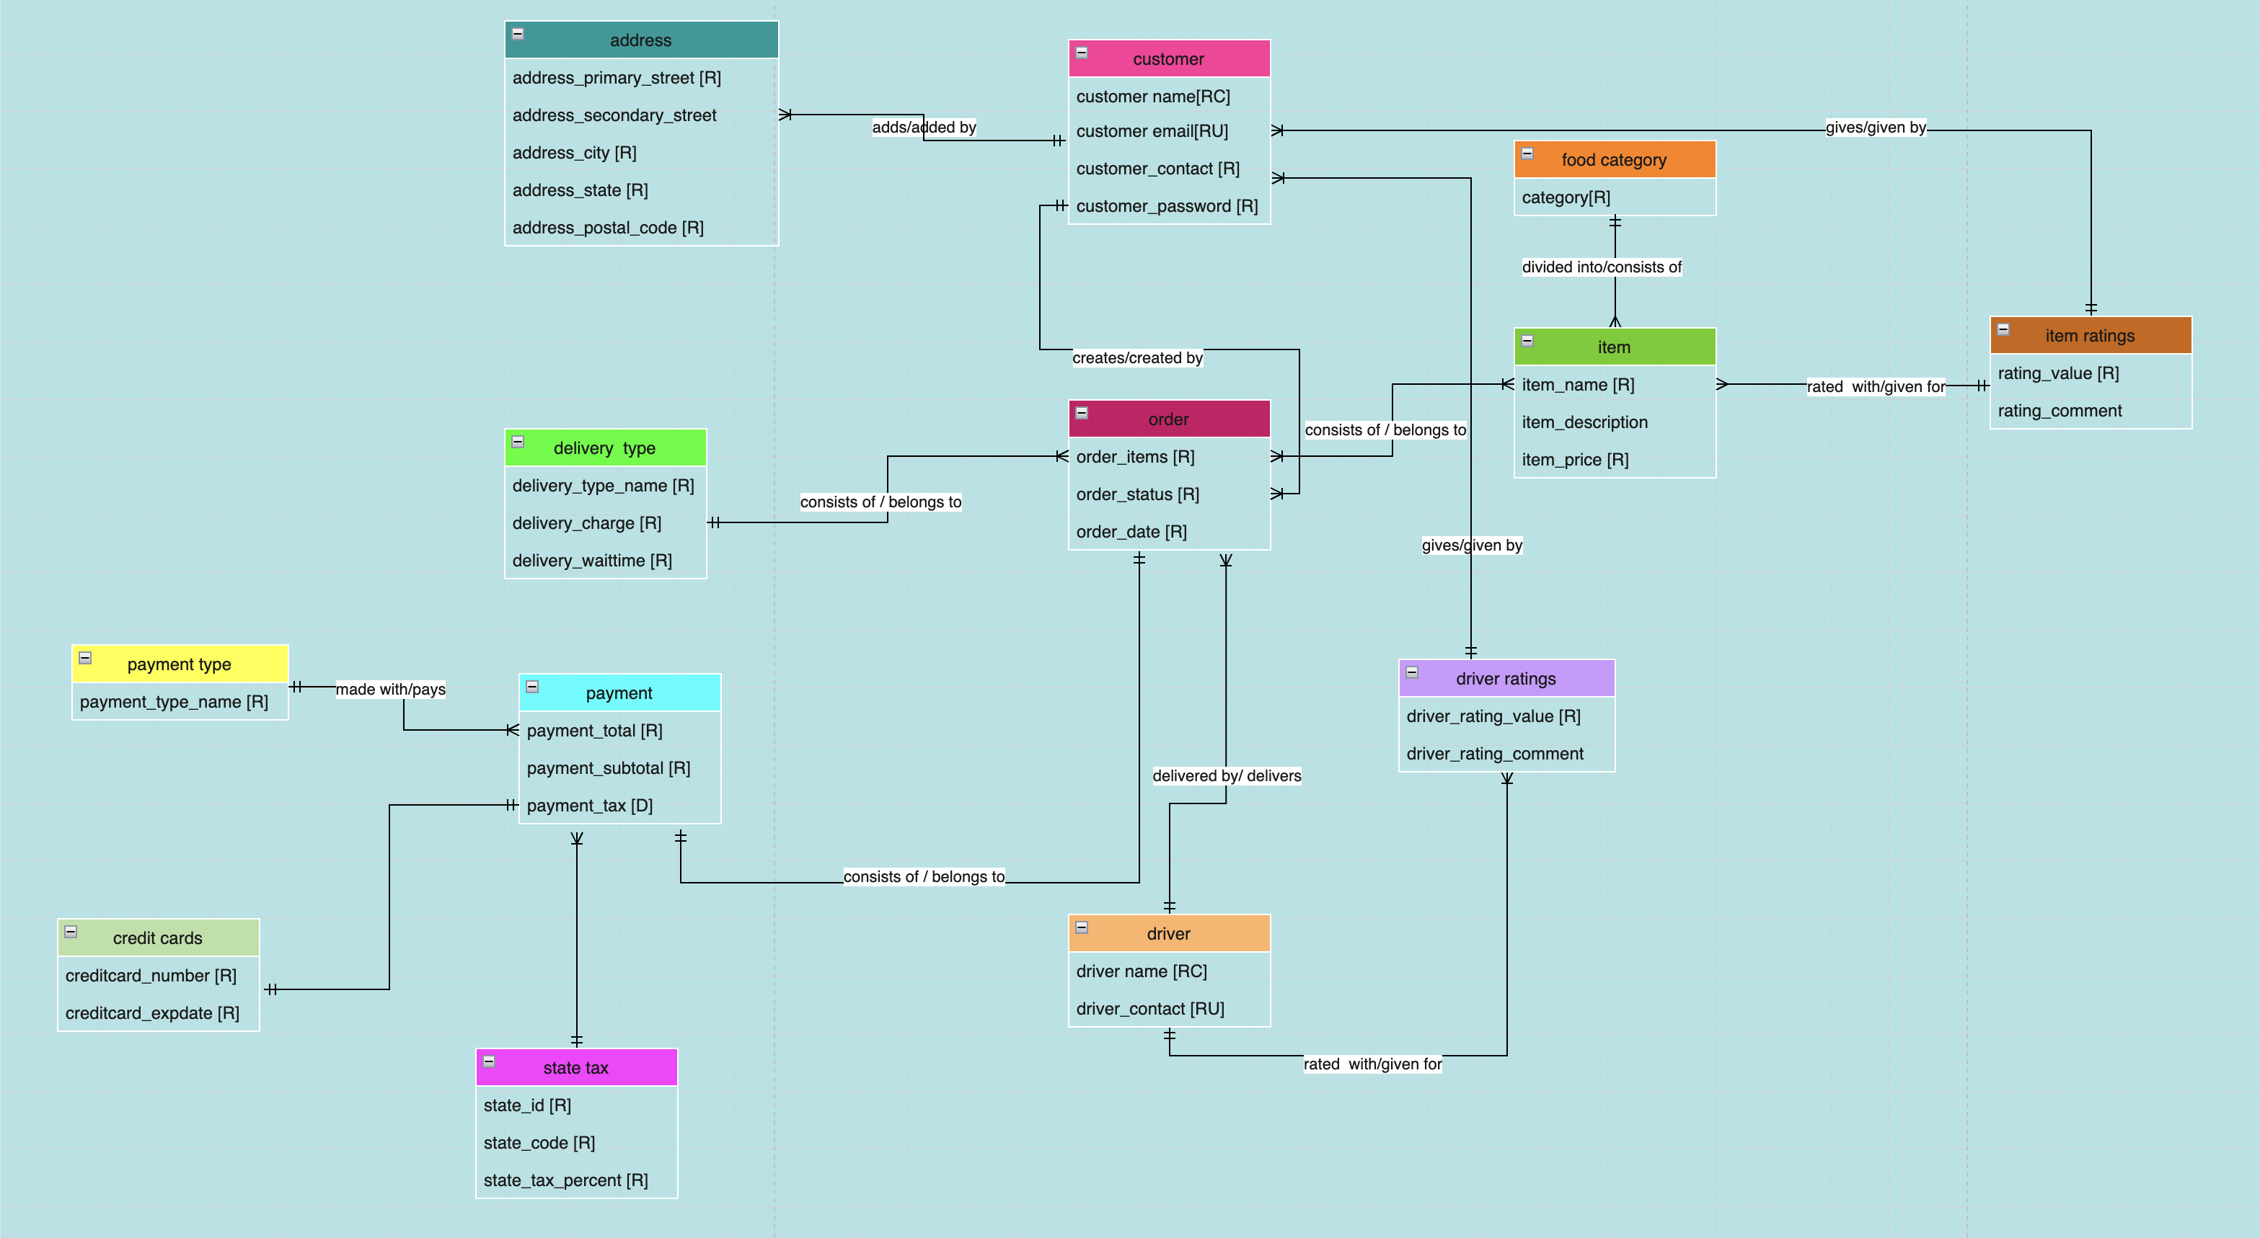
Conceptual Model

Slide 5
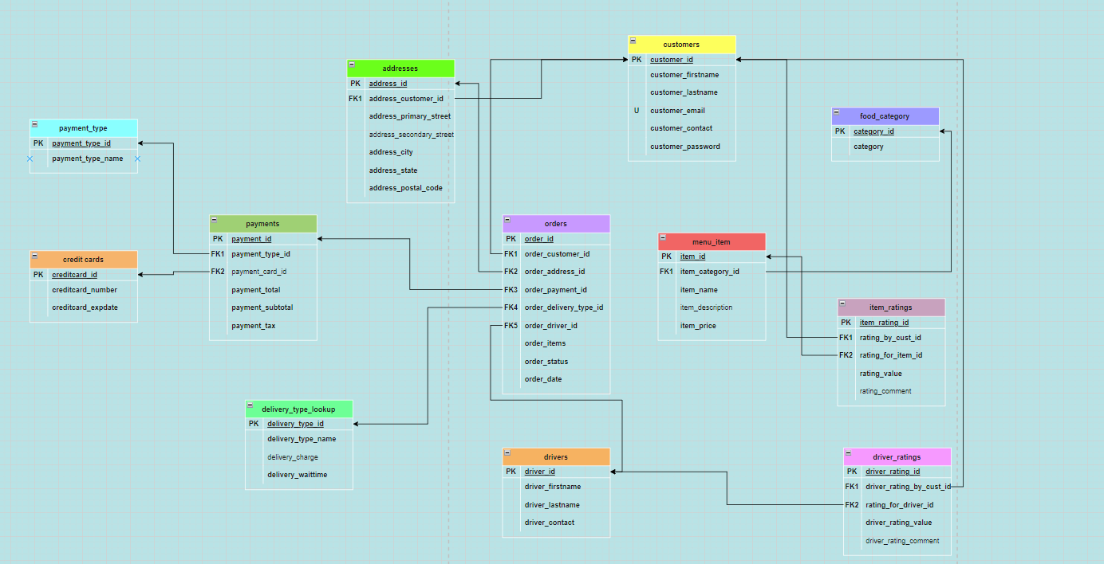
Logical Model

Slide 6
External Data Model
We created the following procedures and views as a part of the external data logic.
p_insert_details_on_signup – To insert customer details like name, email address, password, contact and addresses in the database
p_confirm_order – To insert credit card details, payment related details like total amount paid, the payment method, order details like the items order, the data of the order to the database
p_rate_food_items – To save the customer ratings of particular items in the database item_rating table
p_rate_drivers – To save customer ratings of drivers who delivered their orders in the database to driver_ratings table
v_item_rating – To get a report of the highest rated items and the customers who rated them.

Slide 7
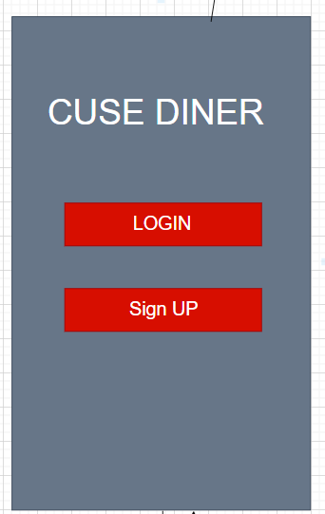
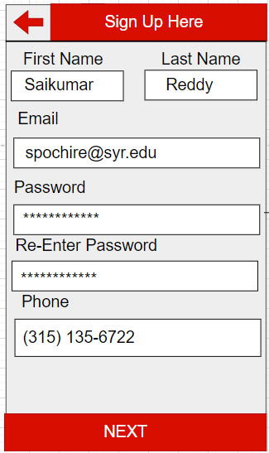
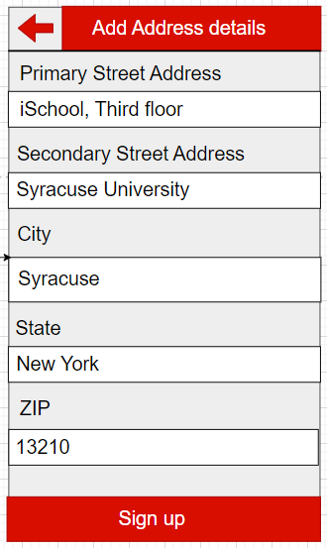
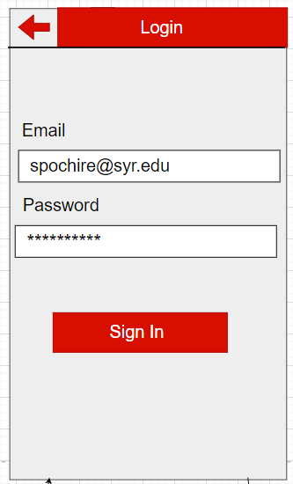
Application Layouts

Slide 8
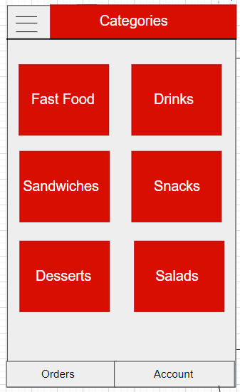
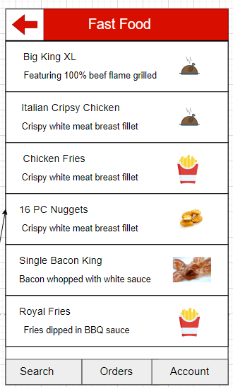
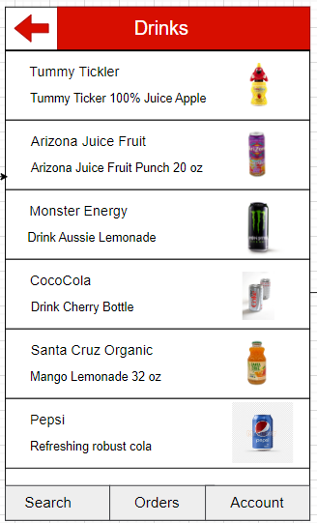
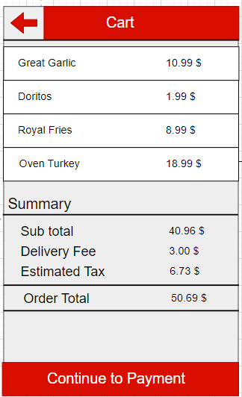
Application Layouts

Slide 9
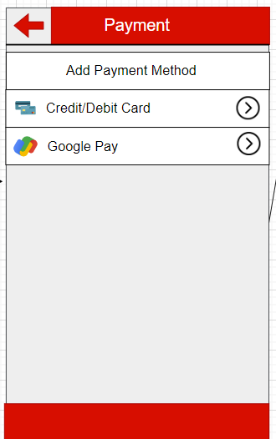
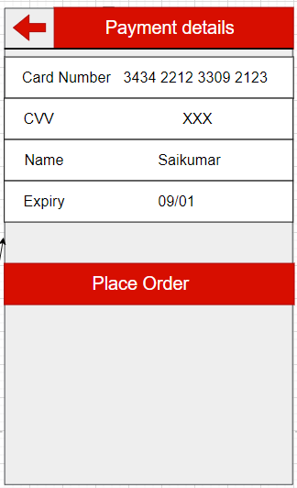
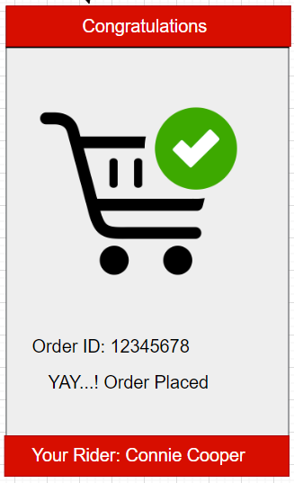
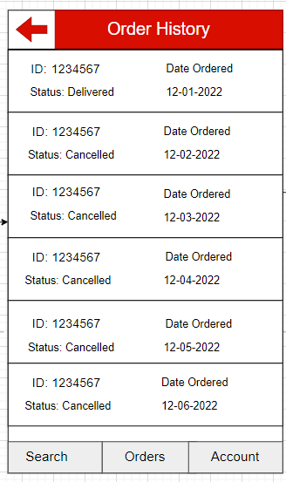
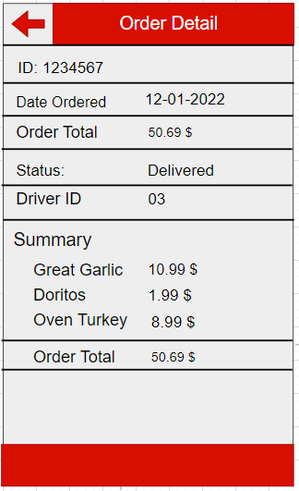
Application Layouts

Slide 10

Reflection on design and implementation
Firstly, we have understood the business problem and we have formulated the approach into three stages, conceptual stage, logical stage, implementation phase.
In the conceptual stage we have drafted the required functionalities and designed an ER diagram.
Next in the logical stage, we have established the structure between all the entities.
Lastly, we have implemented the data base model using SQL scripts and developed the UI using draw.io and power apps.

Slide 11
Demo UI and table data
Since the demo video was big in size we have uploaded it on Syracuse University Videos site.
URL:
https://video.syr.edu/media/t/1_g6nknme3

Slide 12
THANK YOU

