Slide 1
Bluestock Mutual Fund Analytics Capstone Project Submitted By: Aarti Kumari Bluestock Fintech June 2026

Slide 2
Problem Statement & Objectives
Problem Statement: Investors and analysts need a centralized platform to analyze mutual fund performance, risk, investor behaviour, and market trends. Objectives: • Build ETL Pipeline • Create SQLite Database • Perform EDA • Compute Performance Metrics • Develop Power BI Dashboard • Perform Advanced Analytics • Generate Insights and Recommendations

Slide 3
Data Sources
Data Sources:
• Fund Master Data
• NAV History Data
• AUM Data
• SIP Inflow Data
• Category Inflows
• Folio Count Data
• Scheme Performance Data
• Investor Transactions
• Portfolio Holdings
• Benchmark Indices

Slide 4
System Architecture
Raw Data ↓ Data Cleaning ↓ SQLite Database ↓ SQL Analysis ↓ EDA ↓ Performance Analytics ↓ Power BI Dashboard ↓ Advanced Analytics

Slide 5
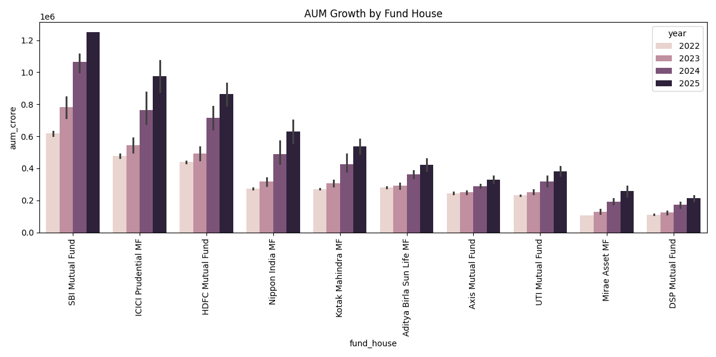
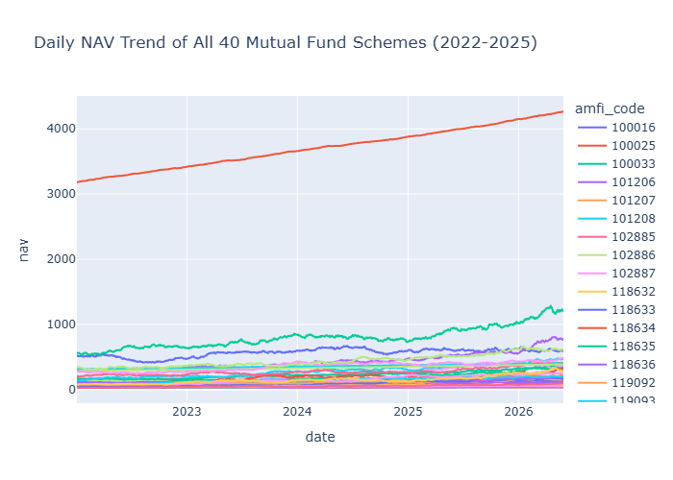
EDA Highlights (1):
Industry AUM showed continuous growth.
NAV trends indicate long-term wealth creation potential

Slide 6
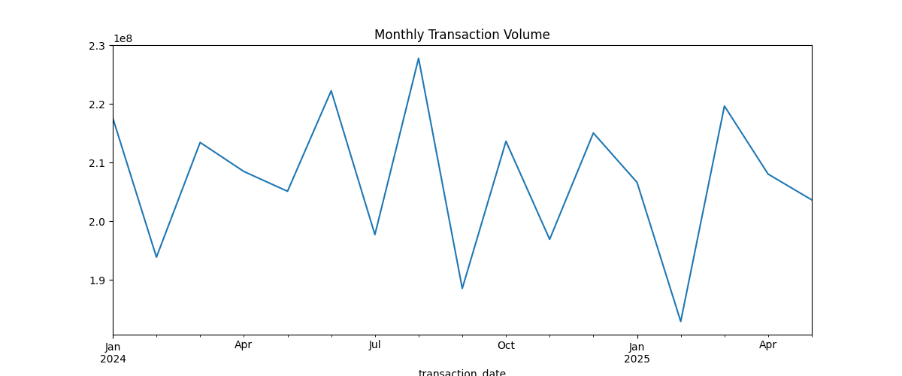
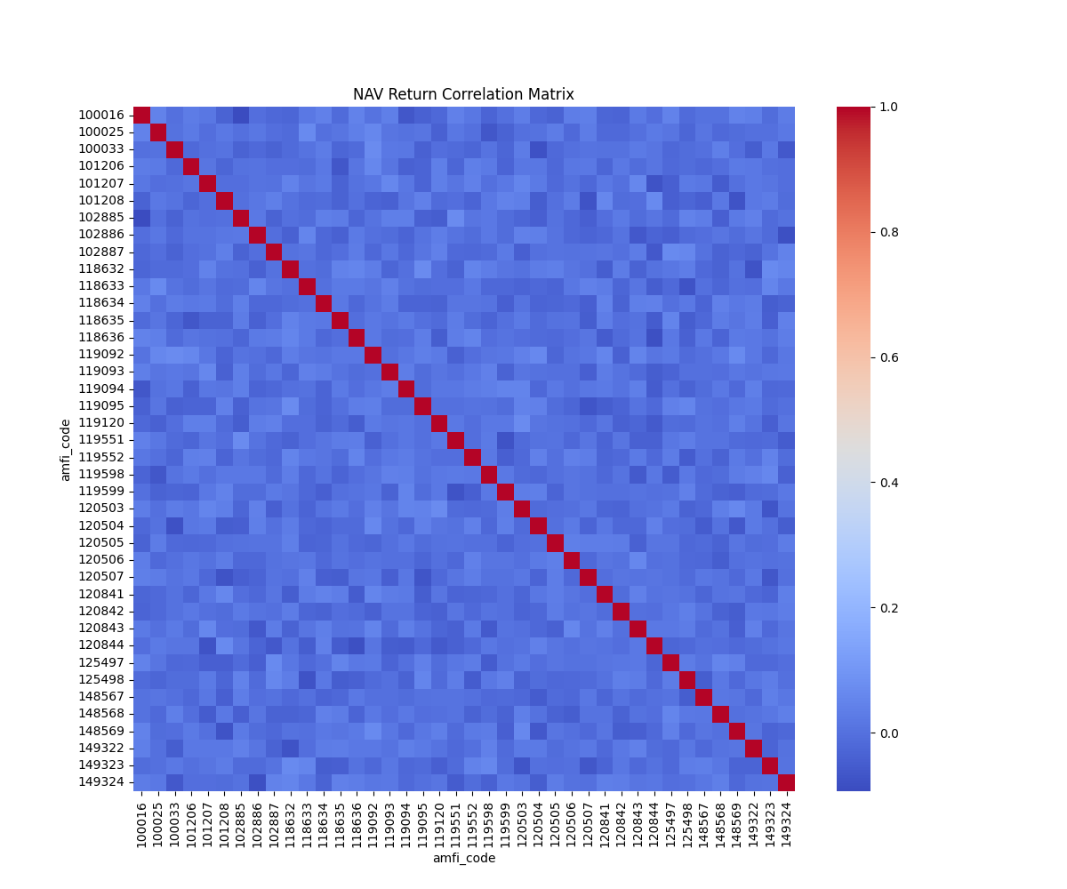
EDA Highlights (2):
SIP participation increased steadily
Strong relationships observed among financial variables

Slide 7
Performance Analytics:
Metrics Calculated ; • CAGR • Sharpe Ratio • Sortino Ratio • Alpha • Beta • Maximum Drawdown
Outcome: Risk-adjusted evaluation of mutual funds.

Slide 8
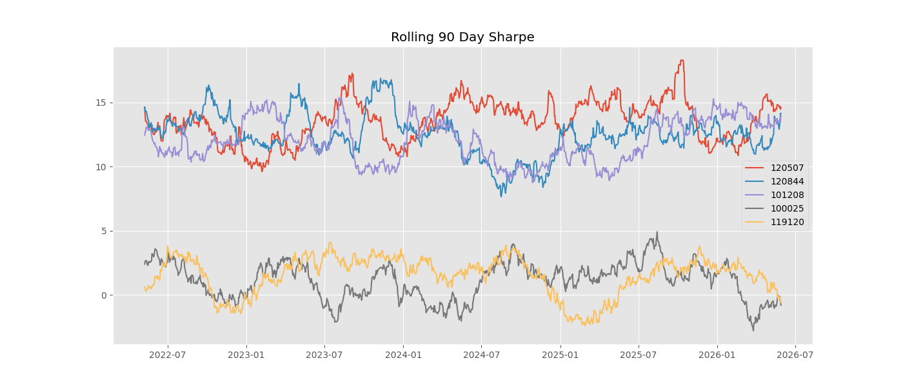
Advanced Analytics :
Advanced Analytics;
• VaR • CVaR • Rolling Sharpe • Cohort Analysis • SIP Continuity Analysis • HHI Analysis • Fund Recommender

Slide 9
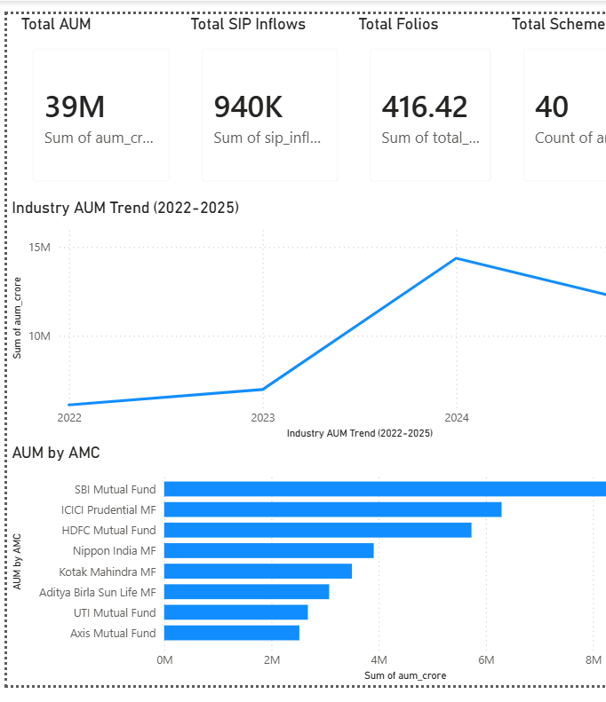
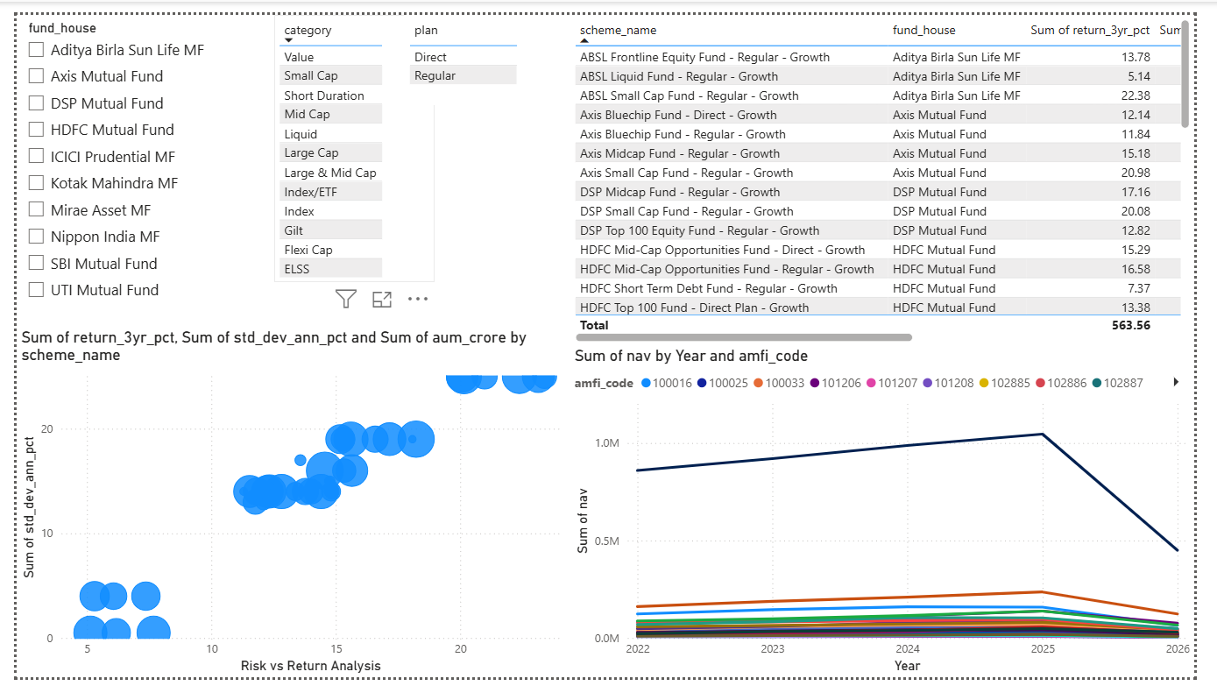
Dashboard :

Slide 10
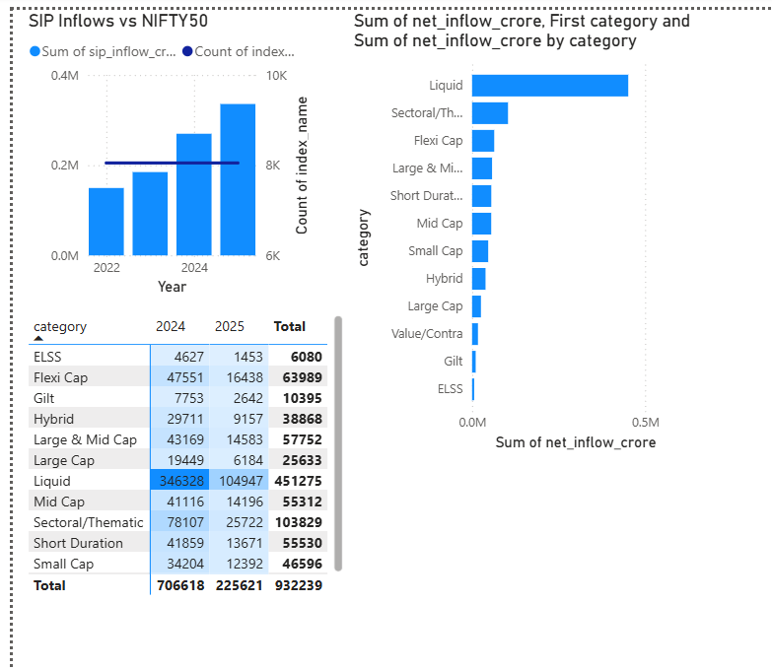
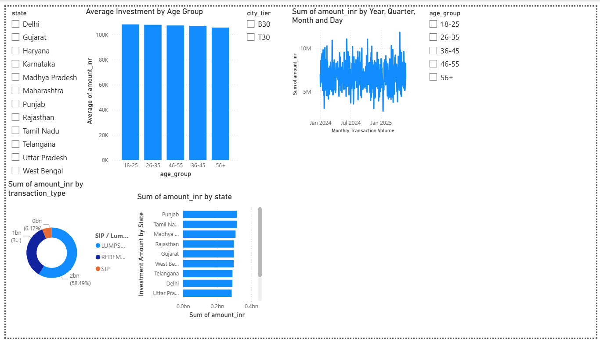
Dashboard :

Slide 11
Key Findings :
• AUM growth remained strong.
• SIP inflows increased consistently.
• Top Sharpe Ratio funds delivered better risk-adjusted returns.
• Investor participation continues to rise.
• Most SIP investors maintain continuity.
• Portfolio concentration varies significantly across funds.

Slide 12
thank you
Questions & Discussion Aarti Kumari
Bluestock Mutual Fund Analytics Capstone Project

