Slide 1
Household Daily Expense Analysis (Using SQL for Data Analysis)
Presented by:-Arti kejbhat

Slide 2
Purpose of this project
The purpose of this project is to analyse household expenses using SQL and convert raw expense data into meaningful financial insights.

Slide 3
Business Understanding
Problem Statement
A family has multiple daily expenses such as:
Grocery
Electricity and utilities
Medical expenses
Transportation
Education
Entertainment
Insurance
Loan & EMI

Slide 4
Project Objectives
Understand household spending patterns
Identify high-value expenses
Find small and unusual expenses
Analyze payment behaviour
Identify recurring expenses
Find pending/partial payments
Calculate total and average spending
Identify expenses requiring attention

Slide 5
Challenges
Write JOIN Queries
Understanding JOIN queries especially when we when we needed information
From the expenses and payment methods tables
Handling Empty Results
Sometimes a query returned zero rows. I learned that this does not always mean there is an error; it can simply mean that no record matches the given condition

Slide 6
Project Constraints
Limited Data I have a limited number of expense records.
Fixed Categories I use predefined expense categories.
Payment Data Some payment analysis depends on available data.
Past Data I analyze recorded expenses, not future spending.
Data Accuracy Results depend on correct data entry.

Slide 7
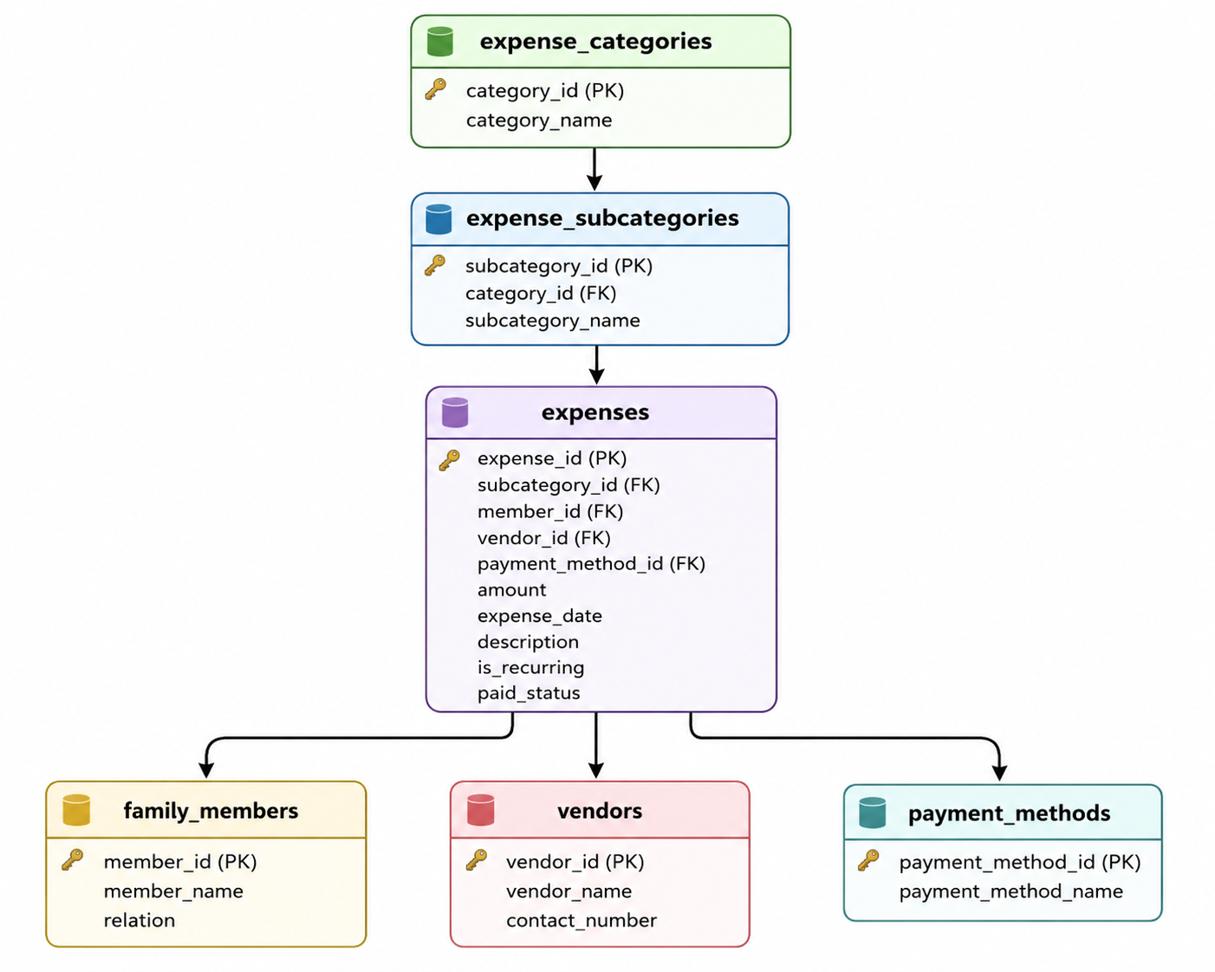
Database Structure

Slide 8
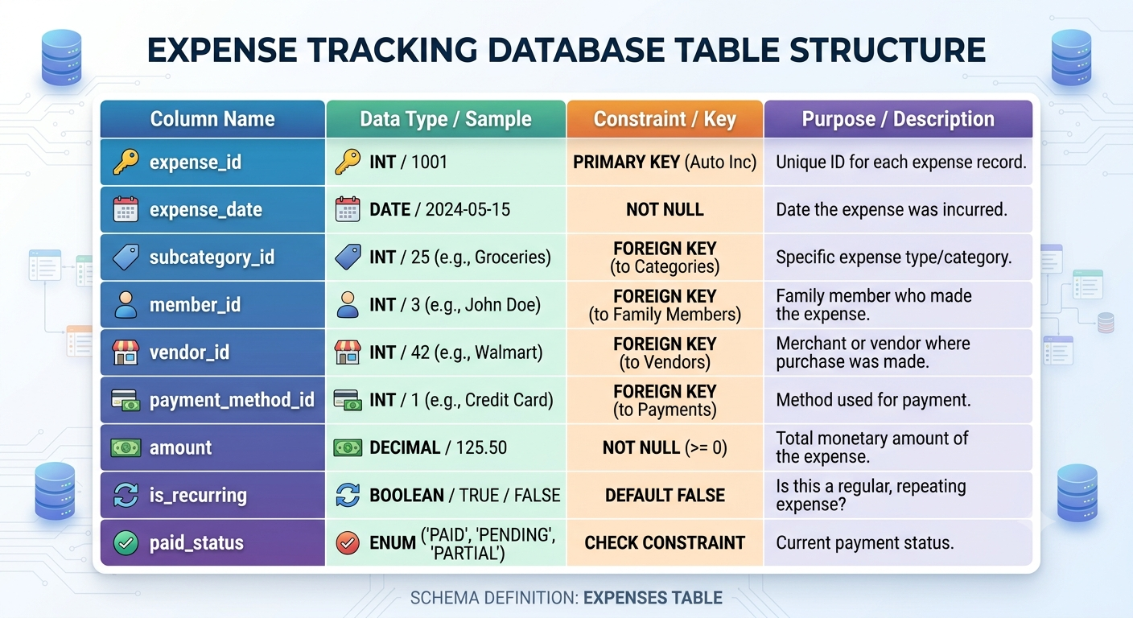
Data Understanding (important column in expenses)

Slide 9
SQL Analysis
SELECT
WHERE
Comparison operators
AND
OR
DISTINCT
COUNT()
SUM()
AVG()
MIN()
MAX()
LIKE
JOIN
Operator precedence

Slide 10
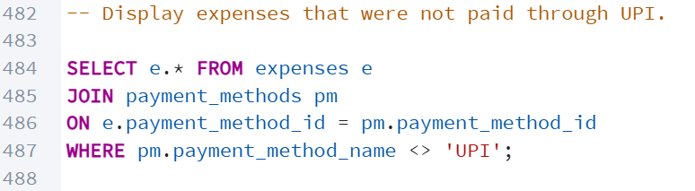
Payment Behaviour
Example: UPI Spending
Business Insight
This helps the family understand its digital payment behaviour and how much spending is done through UPI.

Slide 11
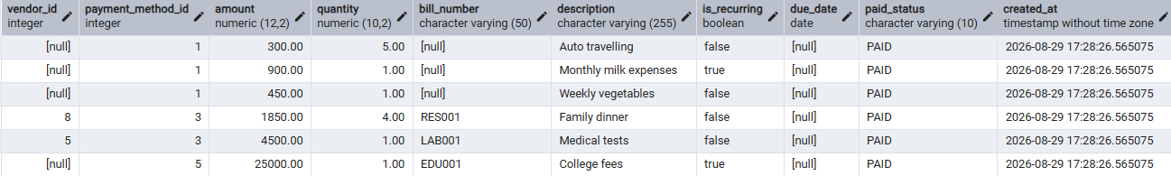
Output

Slide 12
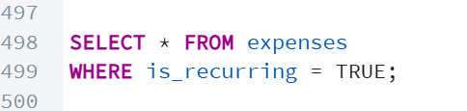
Recurring Expenses
What is Recurring?
Regular expenses that occur repeatedly, such as monthly or yearly expenses
Examples:
Electricity Bill
Building Maintenance
Mobile Recharge
Loan EMI
Insurance
Query:

Slide 13
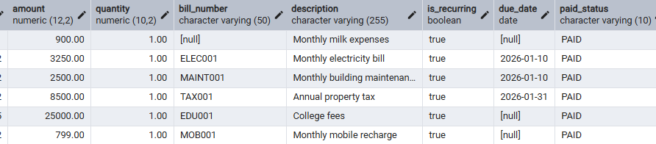
OUTPUT

Slide 14
High-Value Expense Analysis
From current data, the amount > ₹2,000 query identifies 7 high-value
Transactions
Important examples include:
College Fees = ₹25,000
Property Tax = ₹8,500
Medical Tests = ₹4,500
Electricity Bill = ₹3,250
Family Train Tickets = ₹3,200

Slide 15
Aggregation Analysis
SELECT SUM(amount)FROM expenses;(SUM → Total spending)
SELECT AVG(amount)FROM expenses;(AVG → Average expense)
SELECT MAX(amount), MIN(amount)FROM expenses;(MAX → Highest expense MIN → Lowest expense)
SELECT COUNT(*)FROM expenses;(COUNT → Number of transactions)

Slide 16
Key Findings
Based on SQL analysis:
High-value expenses need special attention.
Recurring expenses represent regular financial commitments.
UPI is one of the payment methods used by the family.
Education, taxation and medical expenses can create large transactions.
Small expenses should also be monitored because they can accumulate over time.
Pending/partial payments need follow-up.

Slide 17
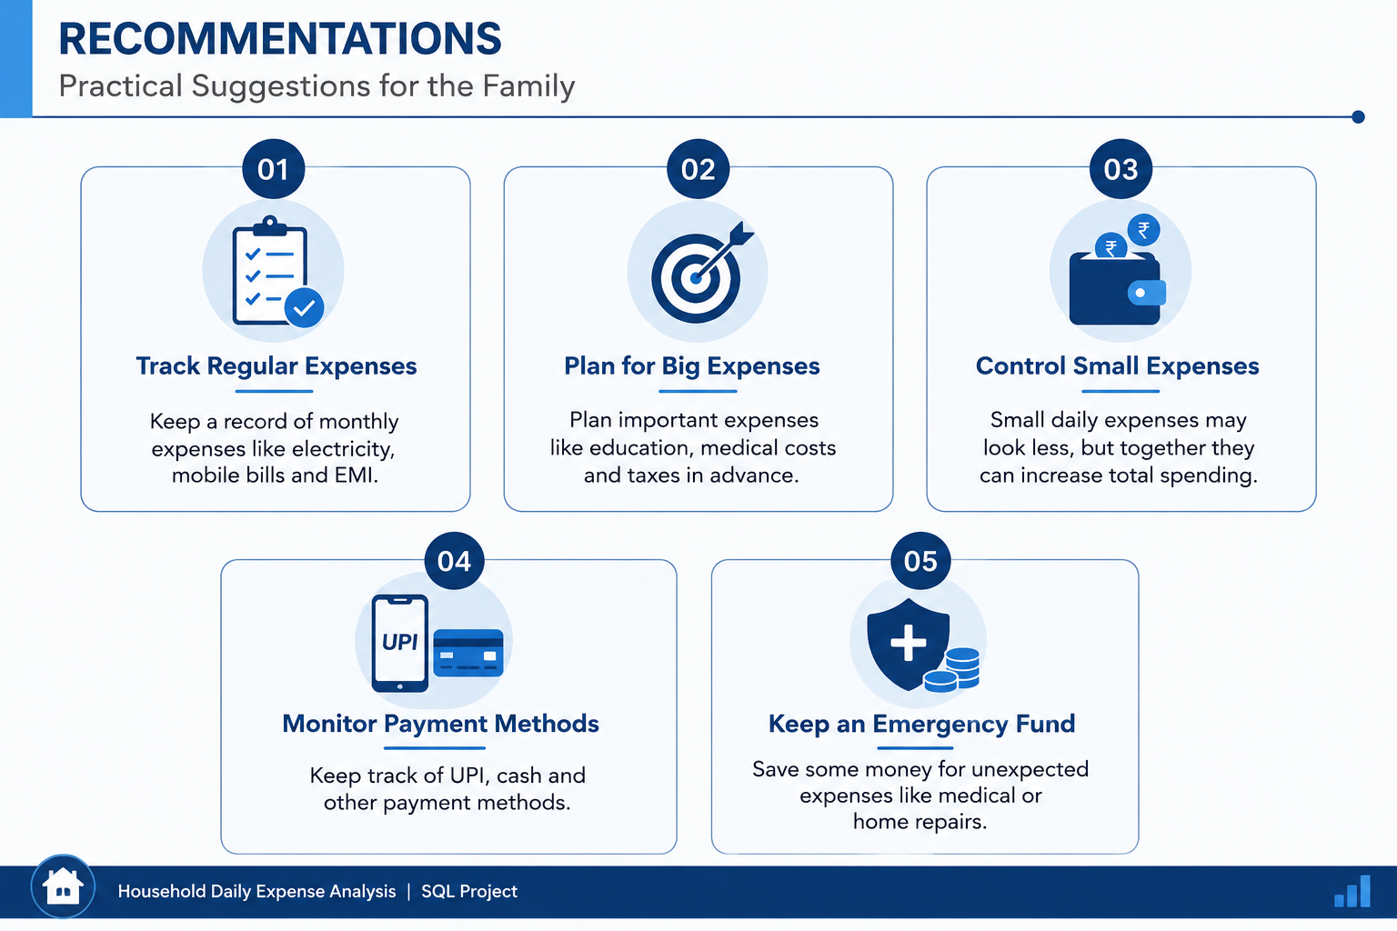

Slide 18
Conclusion
This project helped us understand how a real-life household problem can be
converted into a data analysis problem.
Using SQL, I Was able to:
Organize household expense data
Filter specific expenses
Analyze payment behavior
Identify recurring expenses
Calculate financial metrics
Find high-value transactions
Convert SQL results into meaningful business insights

Slide 19
THANK YOU….!

