Slide 1

Data Aware Transition Systems for Prediction in Business Processes
Prof. K. K. Shukla,
Professor,
Department of Computer Science and Engineering,
Indian Institute of Technology (BHU) Varanasi,
Varanasi, INDIA 221005.
Aartik (17075001)
Aditya Mittal (17075004)
Ankit Choudhary (17075011)

Slide 2
About the Project
This work presents methodologies for predicting the remaining time of a running business process and the future activity sequence of the process.
The dataset used here is the management of road-traffic fines by local police of an Italian municipality. The management of road-traffic fines have to comply with Italian laws. When a driver commits a violation, a policeman opens a new fine management and the amount of fine depends on the violation performed. If the offender does not pay within 60 days since the reception of the fine notification, the fine doubles.If the offender never pays, eventually the fine is sent to a specialized agency for credit collection. The offender can appeal to a judge, If the appeal is in favor of the offender, the fine is dismissed.
We extracted only that log from the dataset which ends with "sending for credit collection", i.e., the offenders have not paid the fine in full.

Slide 3
Process Mining
Process Mining is a process analysis method that aims to discover, monitor and improve real processes by extracting knowledge easily from available event logs in the systems of current information of an organization.
Discovery, which takes an event log and produces a process model without using any prior information, with the help of Process Mining algorithms.
Conformance, where the event records and the corresponding process models are compared, and the resulting coincidences or differences are identified, in order to diagnose the deviations or inefficiencies between the process model derivative business and ideal processes.
Enhancement, where the process models are adapted and improved according to the data of the real process.

Slide 4
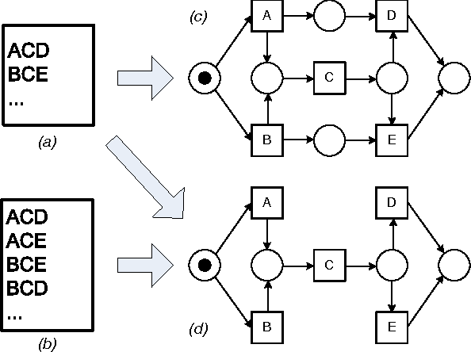
Transition System
A transition system consists of a set of configurations and a collection of transitions. Transition systems are used to describe dynamic processes with configurations representing states and transitions saying how to go from state to state
Transition System

Slide 5
Data Preprocessing
The data is in XES format. So, we have converted it into a python readable format that is in the .csv file
One Hot Encoding
one hot encoder takes the number of different types for a feature and assigns a value to each kind, now one hot coded vector for that type of feature consist of 0s with 1 at the position of its value

Slide 6
Algorithms Used
Support Vector Regressor
Naive Bayes
Dijkstra’s shortest path

Slide 7
Support Vector Regression
In SVR we try to fit the error within a certain threshold.
Terms used in SVR are
Kernel: The function used to map a lower dimensional data into a higher dimensional data.
Hyperplane: In SVM this is basically the separation line between the data classes. Although in SVR we define it as the line that will help us predict the continuous value or target value.
Boundary line: In SVR, there are two lines other than hyperplane which create a margin. The support vectors can be on the boundary lines or outside it. This boundary line separates the two classes.
Support vectors: These are the data points which are closest to the boundary. The distance of the points is minimum or least.

Slide 8
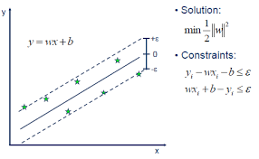
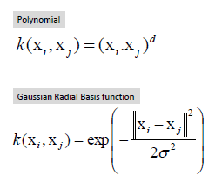
For non-linear SVR, the kernel functions transform the data into a higher dimensional feature space to make it possible to perform the linear separation.
Example of Hyper Plane
Kernel Functions

Slide 9
Naive Bayes
Naive Bayes classifiers are a collection of classification algorithms based on Bayes Theorem.
It is a family of algorithms where all of them share a common principle, i.e., every pair of features being classified is independent of each other.
The Bayes Rule is a way of going from P(X|Y), known from the training dataset, to find P(Y|X).
• Bayes Rule, P(Y |X) = P(X|Y ) ∗ P(Y ) /P(X)
In real world, we typically have multiple X variables. Since all the Xs are assumed to be independent of each other, we can just multiply the likelihood of all the X’s.

Slide 10
Dijkstra’s Algorithm
In Dijkstra’s algorithm, we generate a SPT (shortest path tree) with given source as root.We maintain two sets, one set contains vertices included in shortest path tree, other set includes vertices not yet included in shortest path tree.
At every step of the algorithm, we find a vertex which is in the other set (set of not yet included) and has a minimum distance from the source.
We initialize the distance values of all nodes to infinite and assign the distance value as 0 for the source node.
While SPT doesn’t include all vertices:
Pick a vertex u which is not there in sptSet and has minimum distance value.
Include u to SPT.
Update distance value of all adjacent vertices of u.

Slide 11
Techniques Used
VDA
Simple Regression
Regression with Contextual Information
Data Aware Transition System

Slide 12
VDA
we implement an annotated transition system which keeps information about the meantime remaining from the current state and returns that time.
To train our model, we iterate through all the traces in the event log. For each event in a trace, we store the remaining time, till the process is completed, in the corresponding state. Now for each state, we take the average of the remaining time measurements.

Slide 13
Simple Regression
we have used epsilon-SVR here.
To construct the training dataset for the model, we concatenate all the one hot encoded vectors for each and every trace and put this concatenated vector in our training set.
we use grid search for autotuning. For prediction, we first convert the partial trace into a vector, as above, suitable for input to our model and then our model predicts the remaining time.

Slide 14
Regression with Contextual Information
This approach makes use of control-flow-information to add contextual information.
We use a transition system for this purpose.
we define an event representation function and a state representation function to construct a TS.
We have used the process activity name to represent any event.
To define a state, we first take a starting state Sstart and then add the events as they occur to the current state to get a new state. We have used three different abstractions as state representation functions namely: 1. set 2. multiset 3. Sequence
For training, We calculate the state associated with each partial trace and we encode it into a one-hot vector. We apply SVR on the TS to train our model.

Slide 15
Data Aware Transition System
we use an annotated TS.
Each state of the TS is decorated with the set of measurements containing the remaining time starting from the state itself.
we enrich each state with a Naive Bayes classifier and each transition with a support vector regressor.
. In a state s Naive Bayes estimates the probability of transition from that state to any other state.
In a transition, SVR estimates the remaining time from that state if the corresponding transition occurs.
To predict the remaining time from any state, we take the weighted mean of remaining times for all possible continuations from the state s where the NB probability acts as the weight.

Slide 16
Future Activity Prediction
The DATS model is also used for predicting the most likely sequence of activities till the process ends.
Since we have the probabilities of transition between any two states therefore we tackle this as a shortest path problem.
The probabilities have to be multiplied to get the likelihood of a sequence. We use logarithm function to transform probabilities into distance like values (log(pq) = log(p) + log(q)).
We use as edge cost the opposite of the logarithm of the transition probability.
Using this transformation, we construct a graph corresponding to the TS where the shortest path problem is found using Dijkstra’s algorithm.

Slide 17
Techniques Used
To measure and compare the accuracy, we used two indicators: the Mean Absolute Percentage Error (MAPE) and the Root Mean Square Percentage Error (RMSPE).

Slide 18
Experimental Results
S. No. | Method | MAPE | RMSPE
1 | VDA | 6.524 | 10.059
2 | SVR | 2.478 | 3.153
3 | SVR + TS(seq.) | 3.777 | 8.268
4 | SVR + TS(set.) | 3.805 | 8.264
5 | DATS(seq.) | 2.524 | 3.091
6 | DATS(set.) | 1.724 | 2.338

Slide 19
MAPE Values
MAPE Values

Slide 20
RMSPE Values
RMSPE Values

Slide 21
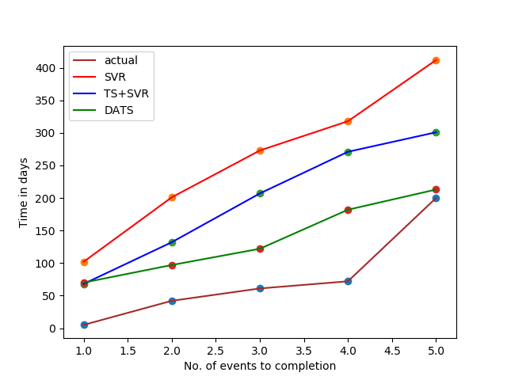
Comparison between various approaches

Slide 22
Conclusion
By looking at the results and observations made in this project, we conclude that DATS is the best method for time prediction among the 4 approaches implemented here followed by the method (TS + SVR), SVR, VDA respectively.
DATS outperforms all the other approaches because it makes use of both a classifier and a regressor, and it is able to utilize the control-flow information more efficiently.

Slide 23
References
[1]Article title:Process Mining plays an essential role in Digital Transformation
Website title:Medium
URL:https://medium.com/@pedrorobledobpm/process-mining-plays-anessential-role-in-digita -transformation384839236bbe
[2]Article title:Transition system
Website title:En.wikipedia.org
URL:https://en.wikipedia.org/wiki/Transition_system
[3]Website title:Andrea.burattin.net
URL:https://andrea.burattin.net/public-files/publications/2018-computing.pdf

Slide 24
[4]Article title:Support Vector Regression Or SVR
Website title:Medium
URL:https://medium.com/coinmonks/support-vector-regression-or-svr-8eb3acf6d0ff
[5]Article title:How Naive Bayes Algorithm Works? (with example and full code) | ML+
Website title:Machine Learning Plus
URL:https://www.machinelearningplus.com/predictive-modeling/how-naive-bayes-algorithm-works-with- example-and-full-code/
[6]Website title:Processmining.org
URL:http://www.processmining.org/_media/publications/time-prediction-is-p608.pdf
[7]Article title:Python Program for Dijkstra's shortest path algorithm | Greedy Algo-7 – GeeksforGeeks
Website title:GeeksforGeeks
URL:https://www.geeksforgeeks.org/python-program-for-dijkstras-shortest-path-algorithm-greedy-algo-7/

