Slide 1
BIRLA INSTITUTE OF TECHNOLOGY AND SCIENCE, PILANI
8th SEMESTER 2019-24 Batch
DISSERTATION
Topic : Exploratory Data Analysis (EDA) on Women’s health and fitness - A case study.
Submitted to :
Examiners:
Prof. Gururaj H S,
Prof. Mohammad Saleem Bagewadi
Supervisor:
Siva Prasad Geetha Nagarajan
Submitted by :
Aarti Pramod
2019AT15015
Date : 2024-02-04

Slide 2
Contents
Topic Introduction
Objectives
Methodology
Future Enhancements

Slide 3
Introduction
Exploratory Data Analysis (EDA) on Women’s health and fitness - A case study.
Unveiling Health and Fitness Insights through Exploratory Data Analysis based on gender and location using python.
Data Visualization in an interactive dashboard using streamlit

Slide 4
Objectives
To conduct an in-depth exploration of health and fitness data using Python programming
language.
To identify patterns, trends, and relationships within the data that can provide insights
into health and fitness behaviours.
To develop visualisations and data summaries that effectively communicate the findings
of the analysis using streamline library.

Slide 5
Methodology
Data Collection: Utilize various data sources, including wearable devices, fitness apps,
healthcare records, and publicly available datasets, to gather a comprehensive collection
of health and fitness data.
Data Preprocessing: Employ Python libraries like pandas and NumPy to clean and
prepare the data for analysis, handling data inconsistencies, and data transformations.
Exploratory Data Analysis (EDA): Conduct EDA using Python libraries like pandas.
Data Visualization: Create informative and engaging visualizations using Python
libraries like Matplotlib, Seaborn, plotly and streamlit to represent the data insights.
Data Summaries: Summarize the key findings and insights obtained from the EDA,
highlighting patterns, trends, and relationships within the data.

Slide 6
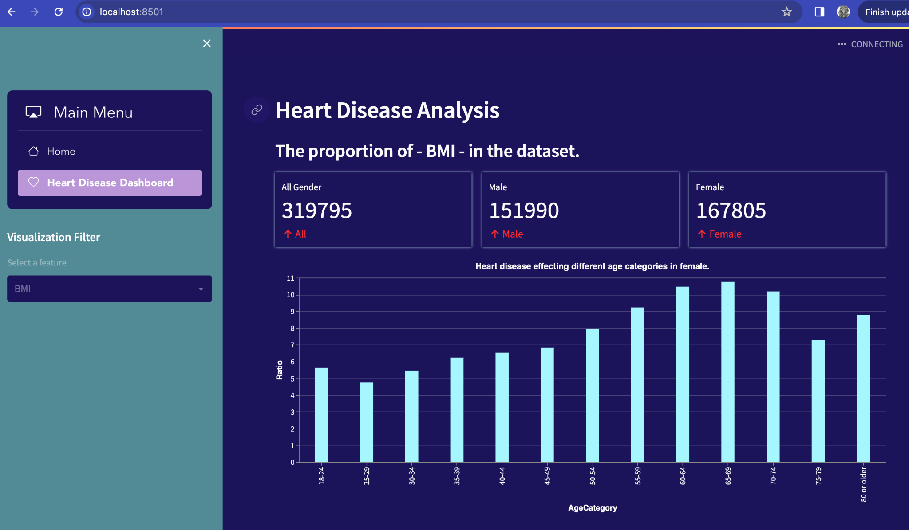
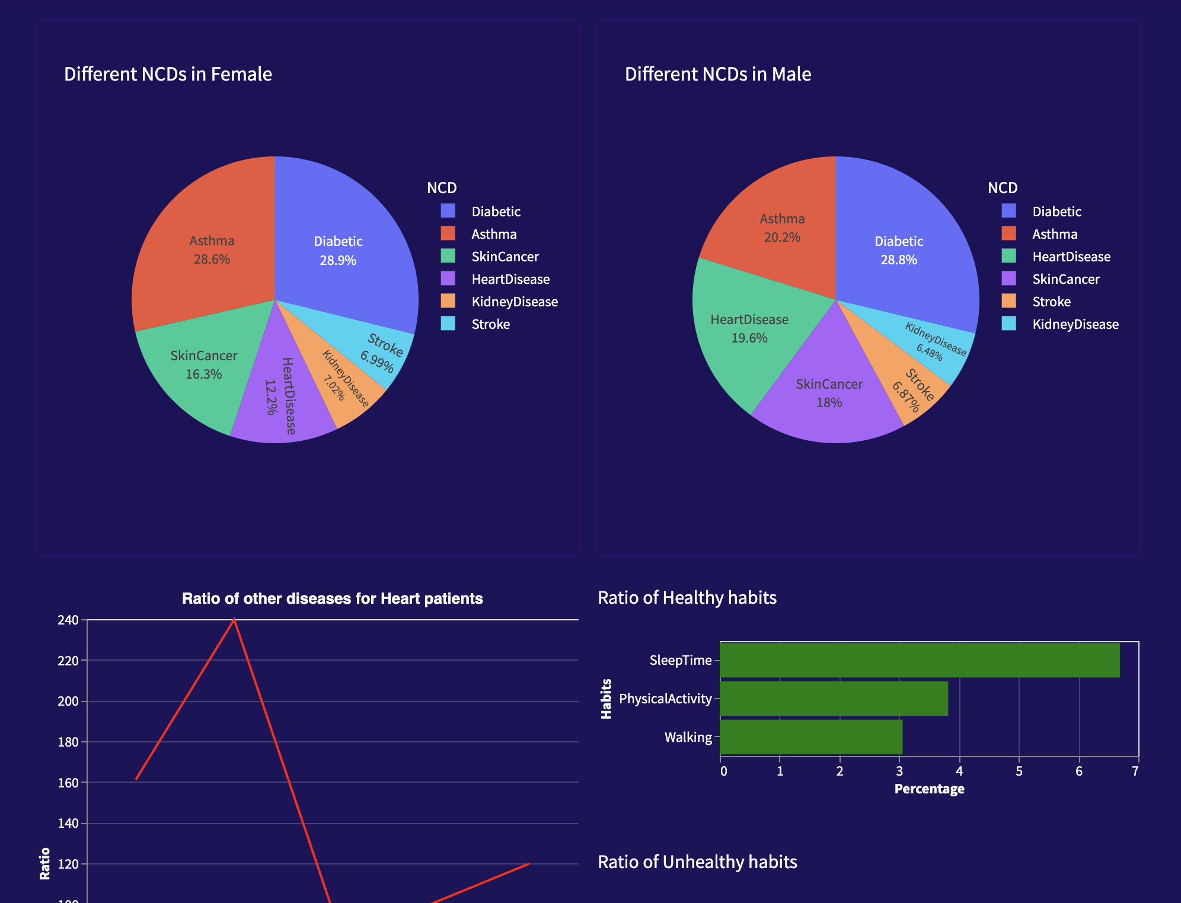
Visualization in Streamlit page
streamlit run app.py

Slide 7
Future Enhancements
User can upload the data in any of the (excel, csv , pnj , or jpg, pdf) format and do the data analysis on the data.
Use NLP and OCR technologies to read the data and produce result.
Build ML models to predict different scenarios and possible health issues for the corresponding authorities to take precautions or preventive actions and spread awareness.
Can be further developed to perform real time dashboard by streaming live data for quick decision making.

Slide 8
Thank You

