Slide 1
Java with the flow! Adaptive Navigation System Aarti Rao Manjeshwar Harini Ravichandran Jayaprakash Jayakumar Karthik Subramanian Pon Arasu Neranj Subramanian
Project 3 – 3/2/2015

Slide 2
Overview
Goal
Content Model
User Model
Adaptation
System Interactions
Prototype
Evaluation
Tech Stack & Development Plan

Slide 3
Goal – Enhancing usability
Drawbacks in StackOverflow –
Content displayed is not adaptive enough
Not social
Does not represent usefulness of links
Solution: Java with the Flow!
Track user behavior using browser events for capturing reading time, etc.
Content presentation based on group traffic and usefulness
Link adaptation – Visually distinguish between links based on expertise
Notes:
Especially for new user
Making the system more usable by addressing the drawbacks in Stackoverfow

Slide 4
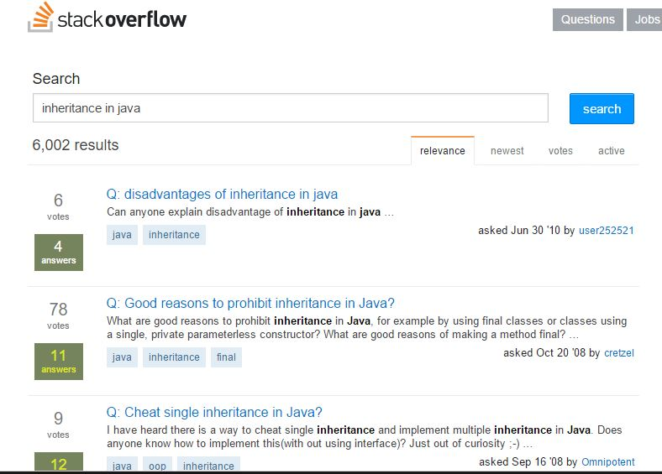

Slide 5
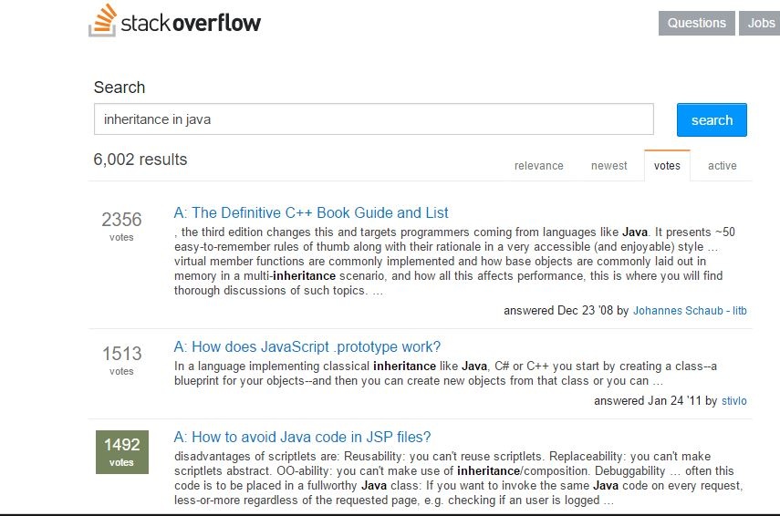

Slide 6
Goal – Enhancing usability
Drawbacks in StackOverflow –
Content displayed is not adaptive enough
Not social
Does not represent usefulness of links
Solution: Java with the Flow!
Track user behavior using browser events for capturing reading time, etc.
Content presentation based on group traffic and usefulness
Link adaptation – Visually distinguish between links based on expertise
Notes:
Especially for new user
Making the system more usable by addressing the drawbacks in Stackoverfow

Slide 7
Content Model
From StackOverflow: Questions, Answers, Comments, Votes
Score, based on votes, usefulness, answers, views
Identify Java topics and build concept map that represents the relationship between topics
Cluster posts into one or more topics
K-means clustering
Keyword extraction
Notes:
1. Score – represents degree of usefulness, calculated as a weighted average of public opinion by giving more weight to novice users
2. The posts are conversational – it wont make sense to have one topic associated with each posts – we need multiple

Slide 8
User Model
Interests
Voting behavior
User’s “Following List”
Expertise
For a new user, gather interests explicitly and assign threshold score
Update score based on user’s interaction with the system
Notes:
1. Interactions: voting behaviour, no. of useful answers..

Slide 9
Adaptation
Explicit
Group Traffic
Usefulness rating
Switch mode based on user’s intention
Reading spree mode
Answer like a pro mode
Implicit
User Interests
User Expertise
Followers’ answers
Usefulness
Sentiment analysis of comments
Browser events from the post
Notes:
Group traffic - View counts
Usefulness rating – individual rating overrides group traffic opinion

Slide 10
System Interactions
Ask questions, Answer questions, Comment
Update interests
Rate degree of usefulness for posts and answers – not just upvotes/downvotes
Bookmark posts
Search
Follow users

Slide 11
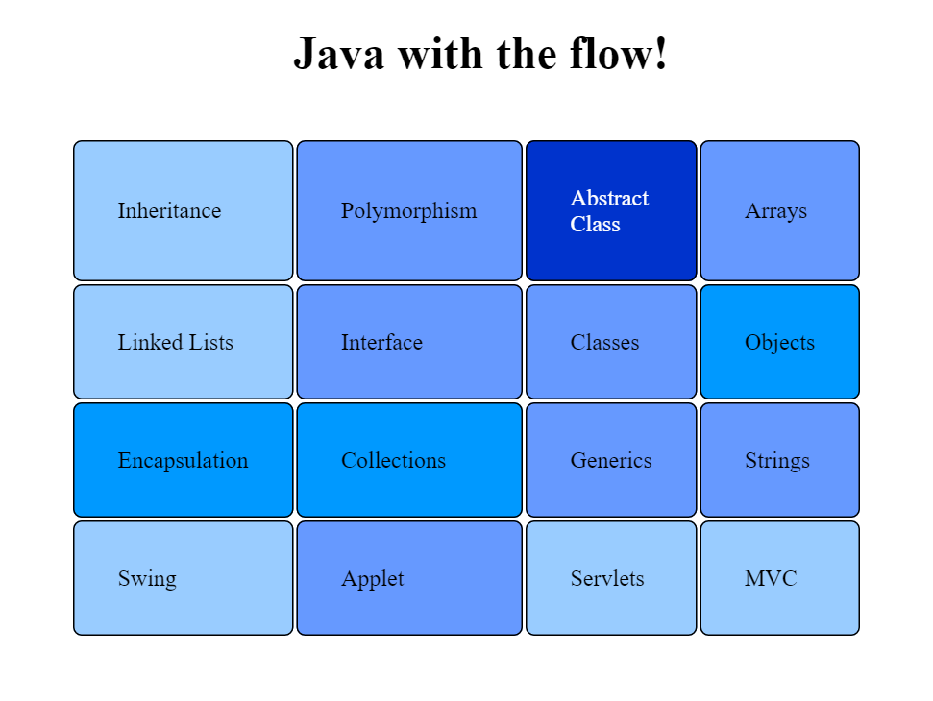
Prototype

Slide 12
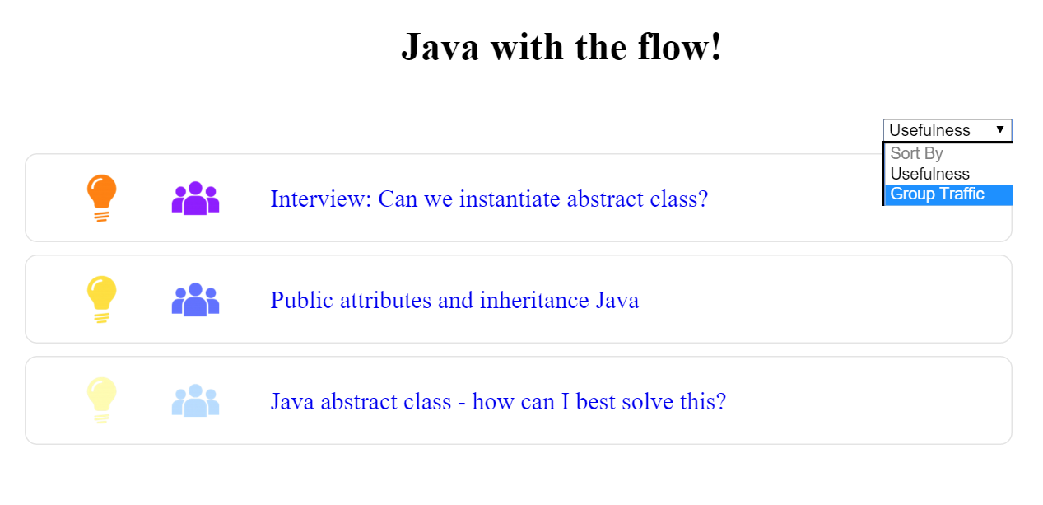
Prototype

Slide 13
Evaluation
Design two sets of similar tasks
Find volunteers to execute the tasks on both existing and new system, alternatively
Compare performance metrics
Collect user feedback on system usability

Slide 14
Technology Stack
Python/Flask
MySQL
JavaScript
Bootstrap
D3.js
Lucene/ Solr
NLTK

Slide 15
Development Plan
Current Status
Collected data from StackOverflow
Created database
Designed Mock UI
Phase 1 – March 11th
Clustering posts
User interface

Slide 16
Development Plan
Phase 2 – March 25th
Implementing user and content models
Adaptation system
Phase 3 – April 8th
System Integration
Final Phase
Evaluation

Slide 17
Global warming is real!
We cannot take this planet for granted!
We DO NOT take this project for granted !

