Slide 1

Computational Governance: A Judging Pitch for Optimizing Democracy
Leveraging technology to enhance democratic decision-making
Notes:
AI-generated content may be incorrect. ---

Slide 2
Opening and Context
Notes:
Computational Governance: Framing the Core Idea

Slide 3

Computational Governance: Framing the Core Idea
Reframing Governance
Governance is viewed as a computational optimization problem to improve democratic decision-making beyond ideology.
Challenges in Modern Democracy
Current democratic systems struggle due to inability to measure and reconcile complex societal opinions effectively.
Interdisciplinary Approach
Combining mathematics, economics, and AI to quantify public input and optimize policy outcomes transparently.
Strengthening Democracy
The framework augments democratic institutions with ethical and scalable tools improving decision quality and trust.
Notes:
This presentation introduces a new way to think about democratic decision-making by framing governance as a computational optimization problem rather than a purely political or ideological process. The core motivation is simple but powerful: modern democracies struggle not because people lack opinions, but because current systems cannot measure, aggregate, and reconcile those opinions effectively. Voting systems typically reduce complex societal preferences into binary outcomes, which leads to polarization, inefficiency, and gridlock. This project, developed by Aarti S. Ravikumar, proposes Computational Governance as an interdisciplinary framework that combines mathematics, economics, and artificial intelligence to address this structural limitation. The approach treats public input as quantifiable data, applies formal optimization methods to search for compromise solutions, and produces outcomes that maximize overall societal utility while respecting constraints. Rather than replacing democratic institutions, the system is designed to augment them with transparent, interpretable tools that improve decision quality. This opening sets the stage for why such a shift is necessary now, particularly in an era of increasing polarization, misinformation, and declining public trust. By the end of the presentation, the audience will see how the proposed system not only identifies better policy outcomes in simulations, but also provides a scalable, ethical framework that could be applied in real-world governance settings. The key takeaway is that democracy does not need to be abandoned or automated away; instead, it can be strengthened by borrowing rigor from engineering and economics to better align outcomes with collective well-being.

Slide 4
The Core Problem
Notes:
Why Traditional Voting Systems Fail

Slide 5
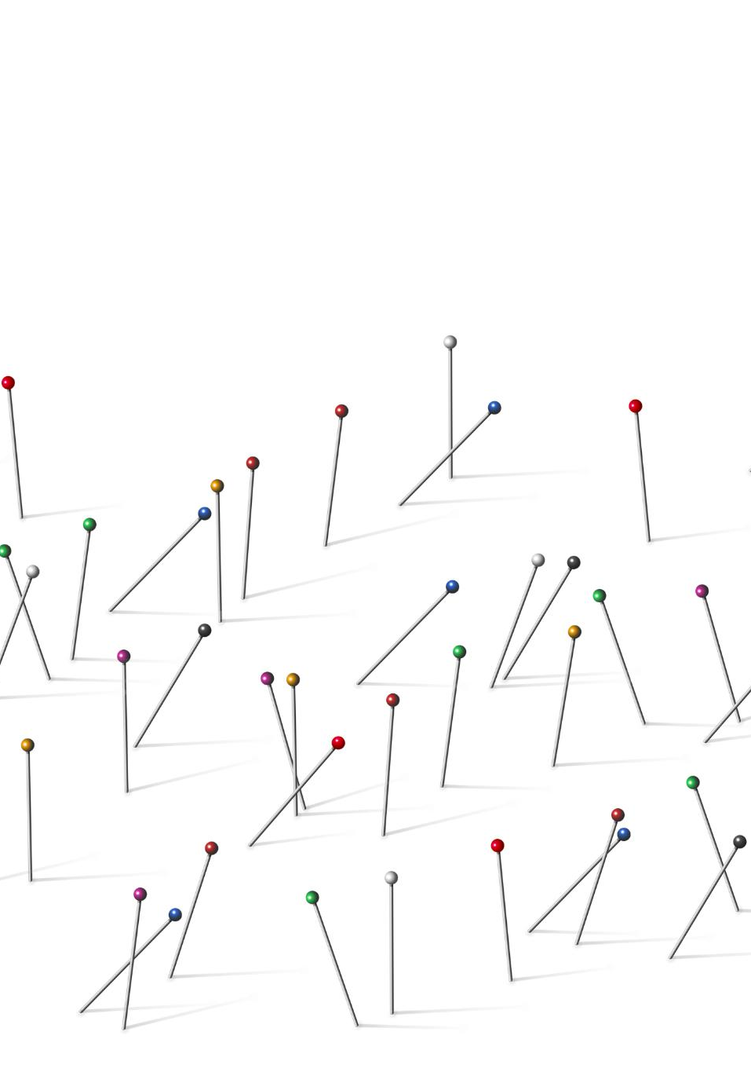
Why Traditional Voting Systems Fail
Majority Voting Limitations
Majority voting captures preference direction but ignores intensity, allowing weakly held views to override strongly held ones.
Political Polarization Effects
Current systems incentivize polarization by focusing on narrow majorities, hindering broad compromise and cooperative solutions.
Lack of Preference Nuance
Voting outcomes do not reveal trade-offs or priorities, leaving policymakers guessing about constituent concerns and preferences.
Need for New Approach
Addressing preference measurement is essential for reforms that capture intensity, support compromise, and reduce zero-sum dynamics.
Notes:
Traditional democratic systems rely heavily on majority voting, which captures the direction of preferences but ignores their intensity. This creates a fundamental problem: a large group that cares weakly about an issue can consistently override a smaller group that cares deeply, even when the latter faces serious consequences. As a result, policies that appear democratically legitimate may still be inefficient or harmful in practice. This structure also incentivizes political polarization, since winning requires mobilizing narrow majorities rather than finding solutions that work reasonably well for most people. Another major limitation is that voting outcomes provide no insight into trade-offs, priorities, or acceptable compromises. Policymakers are left guessing which parts of a policy matter most to constituents, and citizens often feel unheard when nuanced preferences are flattened into yes-or-no choices. These issues are not merely political; they are structural and mathematical in nature. From a systems perspective, current voting mechanisms discard valuable information that could be used to improve outcomes. This project identifies preference measurement as the root problem and argues that without addressing it, reforms at the surface level will continue to fail. By clearly articulating why existing systems struggle, this slide motivates the need for a fundamentally different approach—one that can capture intensity, support compromise, and reduce zero-sum dynamics without undermining democratic participation.

Slide 6
Conceptual Shift
Notes:
Reframing Governance as an Optimization Problem

Slide 7

Reframing Governance as an Optimization Problem
Governance as Optimization
Governance is reframed as an optimization problem focusing on maximizing societal utility within constraints.
Trade-offs and Efficiency
The approach allows explicit evaluation of trade-offs aiming for Pareto efficient outcomes without equal happiness assumption.
Transparency and Fairness
Optimization enables more transparent and effective democratic systems while keeping human values central.
Notes:
The central conceptual shift in this project is to treat governance as an optimization problem rather than a winner-takes-all contest. In engineering and economics, complex systems are routinely optimized under constraints to achieve the best overall performance. This project applies the same mindset to democratic decision-making. Instead of asking which option wins the most votes, the system asks which option maximizes total societal utility while respecting political, legal, and ethical boundaries. This reframing allows for trade-offs to be made explicit and evaluated quantitatively. Importantly, it does not assume that everyone must be made equally happy; rather, it seeks outcomes where gains to one group do not come at disproportionate losses to another. This aligns with the concept of Pareto efficiency, a foundational idea in economics. By formalizing preferences and constraints, governance becomes a problem that can be analyzed, simulated, and improved over time. This slide explains why optimization is a natural fit for democratic systems and how it opens the door to solutions that are both more transparent and more effective. It also emphasizes that human values remain central: algorithms do not decide what society should value, but they help process information more fairly once those values are expressed.

Slide 8
Solution Part I
Notes:
The Pareto Legislative Engine

Slide 9
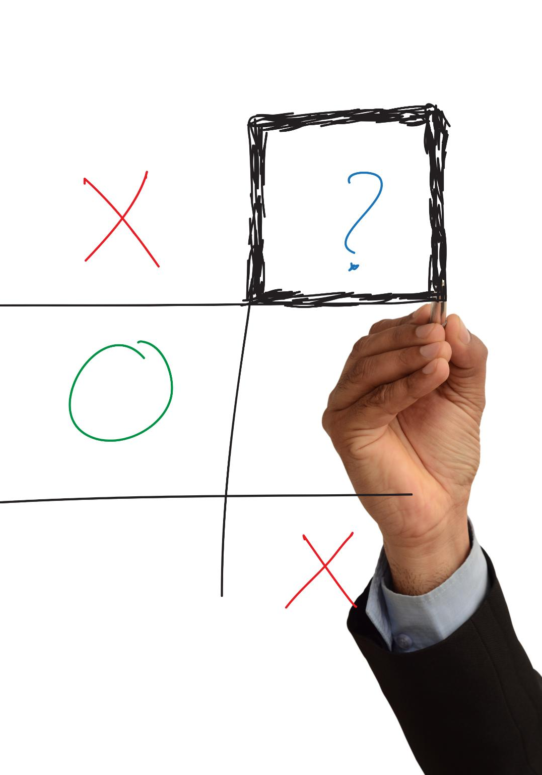
The Pareto Legislative Engine
Quadratic Voting Mechanism
Participants allocate votes with increasing cost to express true preference intensity, discouraging strategic exaggeration.
Preference Intensity Measurement
PLE captures richer public preference data than traditional polls by measuring how strongly issues matter to voters.
Pareto-Efficient Compromise
Optimization finds policy solutions where no group can be better off without worsening another beyond limits.
Legislative Application
PLE scales mechanism design principles into a practical, automated legislative process, advancing participatory tools.
Notes:
The first major component of the proposed system is the Pareto Legislative Engine (PLE). The PLE is designed to measure preference intensity using quadratic voting and then compute compromise solutions that are Pareto-efficient. In quadratic voting, participants are given a limited budget of voice credits and can allocate more votes to issues they care deeply about, but at an increasing cost. This discourages strategic exaggeration and forces individuals to prioritize what truly matters to them. The resulting data provides a much richer picture of public preferences than traditional polls or elections. The PLE then uses this information as input to an optimization process that searches for policy configurations where no group can be made better off without making another group worse off beyond acceptable limits. This approach is grounded in mechanism design, a field recognized by the Nobel Prize in Economic Sciences. The key innovation is scaling these ideas to a legislative context and integrating them into a practical, automated pipeline. This slide explains how the PLE works conceptually and why it represents a meaningful advancement over existing participatory tools.

Slide 10
Solution Part II
Notes:
Adaptive Trust Networks

Slide 11

Adaptive Trust Networks
Dynamic Credibility Scoring
ATNs assign trust scores based on expertise, accuracy, and consistency, updating scores over time with new outcomes.
Self-Correcting Trust System
The system rewards reliable inputs without silencing dissent, ensuring a balanced and adaptive governance model.
Transparency and Accountability
Making trust explicit reduces misinformation while welcoming new voices and evidence in decision-making.
Notes:
The second major innovation is the Adaptive Trust Network (ATN), which addresses the problem of credibility in large-scale decision-making. In real-world governance, not all information sources are equally reliable, yet most systems treat all input as if it were interchangeable. The ATN introduces a dynamic trust layer that assigns credibility scores to participants based on factors such as expertise, historical accuracy, and consistency. These trust scores are not fixed; they update over time as predictions and recommendations are validated or contradicted by outcomes. This creates a self-correcting system that rewards reliability without permanently silencing dissent. When combined with preference data, trust-weighted input helps ensure that decisions reflect both what people care about and how well-supported different claims are. This slide emphasizes that the ATN is not about elitism or technocracy, but about transparency and accountability. By making trust explicit and measurable, the system reduces the influence of misinformation while remaining open to new voices and evidence.

Slide 12
System Architecture
Notes:
End-to-End Computational Governance Pipeline

Slide 13

End-to-End Computational Governance Pipeline
Quadratic Voting Input
Citizens express preference direction and intensity using quadratic voting to influence decisions effectively.
Adaptive Trust Network
The trust network adapts influence based on user credibility and historical performance to weigh inputs fairly.
Optimization Engine Output
Optimizes trust-weighted preferences to produce ranked policy options maximizing utility under constraints.
Transparent and Modular Design
System transparency ensures inputs and results are explainable, facilitating modularity and continuous improvement.
Notes:
This slide brings together the previous components into a single, coherent pipeline. The system begins with quadratic voting, where citizens express both direction and intensity of preferences. These inputs then pass through the Adaptive Trust Network, which adjusts influence based on credibility and past performance. Finally, the optimization engine processes the trust-weighted preferences to identify policy outcomes that maximize total utility under defined constraints. The output is not a single forced decision, but a ranked set of compromise options that policymakers and the public can inspect and debate. This architecture emphasizes transparency at every stage: inputs, transformations, and outputs are all visible and explainable. By structuring governance as a pipeline, the system becomes modular, testable, and improvable over time. This slide helps judges understand that the project is not just a theoretical idea, but a systems-level design that could realistically be implemented and evaluated in stages.

Slide 14
Empirical Evidence
Notes:
Simulation Results: PLE vs. Majority Voting

Slide 15

Simulation Results: PLE vs. Majority Voting
Simulation Setup
The simulation compares majority voting with the Pareto Legislative Engine using two groups with distinct utility peaks.
Majority Voting Outcome
Majority voting chooses the option favored by the larger group but leaves potential utility unrealized.
PLE Compromise Advantage
PLE identifies a compromise maximizing combined utility, producing better societal outcomes than majority rule.
Significance of Results
Results show PLE outperforms traditional methods, offering insights into improving decision-making in politics.
Notes:
To demonstrate the value of the proposed approach, the project includes a simple but illustrative simulation comparing majority voting with the Pareto Legislative Engine. In the simulation, two groups have different preferred policy outcomes, each with a utility curve that peaks at a different point. Majority voting selects the option favored by the larger group, even though this choice leaves significant potential utility unrealized. In contrast, the PLE identifies a compromise point between the two peaks that maximizes total combined utility. This result highlights a key insight: majority rule does not necessarily produce the best outcome for society as a whole. While the simulation is intentionally simple, it captures a dynamic that appears frequently in real politics. This slide explains how the simulation was set up, what assumptions were made, and why the results matter. It also clarifies that the purpose is not to claim definitive empirical proof, but to provide evidence that the framework behaves as intended and outperforms traditional methods under controlled conditions.

Slide 16
Impact and Implications
Notes:
Reducing Polarization and Improving Decisions

Slide 17

Reducing Polarization and Improving Decisions
Reducing Political Polarization
The system shifts focus from winning to optimizing, discouraging extreme views and encouraging compromise.
Enhancing Trust in Institutions
Clearer constituent signals increase policymakers' responsiveness, boosting citizen confidence in governance.
Scalable Decision Framework
The adaptable system can be implemented from local councils to national legislatures and diverse political contexts.
Cross-Context Application
The framework benefits organizations, cooperatives, and international bodies facing conflicting interests.
Notes:
The broader impact of this work lies in its potential to reduce polarization and improve trust in democratic institutions. By changing the incentive structure from winning to optimizing, the system discourages extreme positioning and rewards constructive compromise. Policymakers gain access to clearer signals about constituent priorities, while citizens gain confidence that their input is being used meaningfully. The framework is also highly scalable: it can be applied at different levels of governance, from local councils to national legislatures, and adapted to different political contexts. Beyond politics, the ideas presented here could influence how large organizations, cooperatives, and international bodies make decisions under conflicting interests. This slide emphasizes why the project matters beyond its technical details and why it represents a meaningful contribution to both social science and applied computing.

Slide 18
Conclusion
Notes:
Closing: Making Democracy Measurable

Slide 19

Closing: Making Democracy Measurable
Enhancing Democracy
Making democracy measurable and transparent strengthens governance through data-driven decision-making tools.
Innovative Framework
The Pareto Legislative Engine and Adaptive Trust Networks address structural flaws in democratic processes.
Augmenting Human Judgment
This system supports human decision-making by clarifying trade-offs and revealing optimal policy options.
Future Research Invitation
The project invites further experimentation and dialogue, laying foundation for next-gen democratic systems.
Notes:
The presentation concludes by reinforcing the central message: democracy can be strengthened by making it more measurable, transparent, and optimization-driven. The Pareto Legislative Engine and Adaptive Trust Networks together form a coherent framework that addresses long-standing structural flaws in democratic decision-making. Rather than replacing human judgment, the system augments it with tools that clarify trade-offs and reveal better options. This closing slide summarizes the key contributions, reiterates the novelty of the approach, and leaves judges with a clear takeaway: this project reframes governance in a way that is both technically rigorous and socially meaningful. It invites further research, experimentation, and discussion, positioning the work not as a final answer, but as a foundation for a new class of democratic systems.

