Slide 1
Library management system (SRS Report)
Prepared By : Dhineshkumar D
Reg No : 613520104008
Members:
Sivasakthi V (613520104036)
Chandru K (613520104303)
Dhineshkumar D (613520104008)
College Name : GCE – DPI Department : CSE

Slide 2
Library management system
1. INTRODUCTION
With the increase in the number of readers, better management of libraries system is required. The Library management system focuses on improving the management of libraries in a city or town. “What If you can check whether a book is available in the library through your phone?”. The Integrated Library Management System provides you the ease of issuing, renewing, or reserving a book from an library within your town through your phone. The Integrated Library Management System is developed on the web platform which basically focuses on issuing, renewing and reserving a book.
1.1 PURPOSE
The Purpose of the Project is to maintain the details of books and library Members of different libraries. The main purpose of this project is to maintain a easy circulation system between clients and the libraries, to issue books using single library card, also to search and reserve any book from different available libraries and to maintain details about the user (fine, address, phone Number). Moreover, the user can check all these features from their home.

Slide 3
1.2 SCOPE
Manually updating the library system into an web based application so that the user can know the details of the books available and maximum limit on borrowing from their computer and also through their phones.
The ILM System Provides information’s like details of the books, insertion of new books, deletion of lost books, limitation of issuing books, fine on keeping a book more than one month from the issued date.
2. OVERALL DESCRIPTION
2.1 PRODUCT PRESPECTIVE
The Proposed Library Management System will take care of the current book detail at any point of time. The Book issue, book return will update the current book details automatically so that user will get the update current book details.
2.2 SOFTWARE REQUIREMENT
Front End
HTML
CSS

Slide 4
JAVASCRIPT
PYTHON
Back End
PYTHON
MYSQL
NODE JS
EXPRESS JS
2.3 PRODUCT PRESPECTIVE
Laptop
4 GB RAM
1.2 GHz Processor
Intel i3
Windows 7 / 8 / 8.1 / 10 / 11

Slide 5
2.4.1 FUNCTIONAL REQUIREMENT
R.1: REGISTER
LIBRARIAN : The Librarian have to provide details about himself like Name, Mobile No, Email etc…
STUDENT : The Student have to provide details about his/ her Name, Mobile No, Email , Register No, etc…
R.2: LOGIN
LIBRARIAN : Enter Username and Password then he will get the access to use the features of this software.
STUDENT : Enter Username and Password and he / she will get the access to use the features of this software.
R.3: MANAGING BOOKS
R.3.1 : LIBRARIAN
Librarian can ADD, DELETE, SEARCH, RESERVE, RENEW, ISSUE BOOKS AND FINE MANAGEMENT.
R.3.2 : STUDENT
User can SEARCH, RESERVE, REQUEST, RETURN BOOKS.

Slide 6
2.4.2 NON FUNCTIONAL REQUIREMENT
USABILITY REQUIREMENTS
The System shall allow the users to access the system from the phone using web application. The system uses a web application as a interface. Since all users are familiar with the general usage of website, no special training is required. The system is user friendly which makes the system easy.
AVAILABILITY REQUIREMENT
The System is available 100% for the user and is used 24 hours a day and 365 days a year. The System shall be operational 24 hours a day and 7 days at week.
PERFORMANCE REQUIREMENT
The information is refreshed depending upon whether some updates have occurred or not in the application. The System shall respond to the member in not less than two seconds from the time of the request submittal. The system shall be allowed to take more time when doing large processing jobs. Response to view information shall take no longer than 5 seconds to appear on the screen.

Slide 7
2.5 USER CHARACTERISTICS
USER MODULE:
SEARCH A BOOK
RESERVE A BOOK
REQUEST A BOOK
RETURN A BOOK
FINE DETAILS
LIBRARIAN MODULE
ADD A BOOK
DELETE A BOOK
SEARCH A BOOK
RESERVE A BOOK
REQUEST DETAILS
ISSUE BOOK
FINE MANAGEMENT

Slide 8
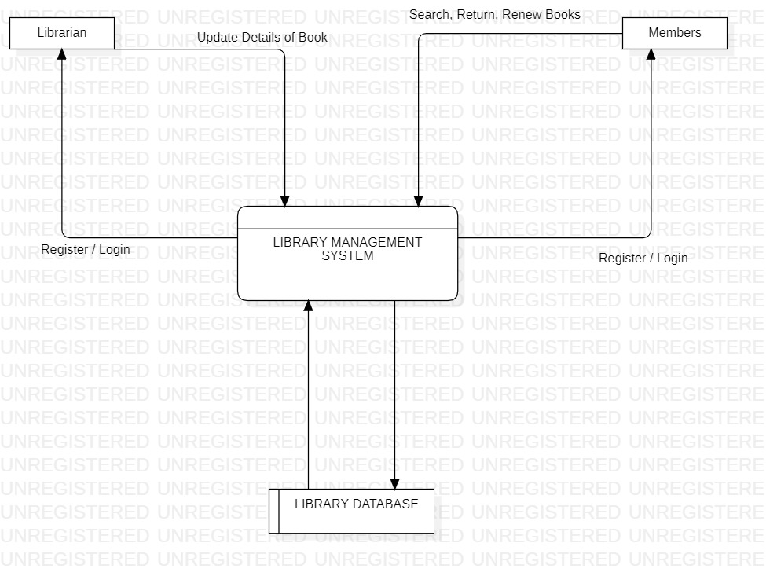
2.5 FLOW DIAGRAM

Slide 9
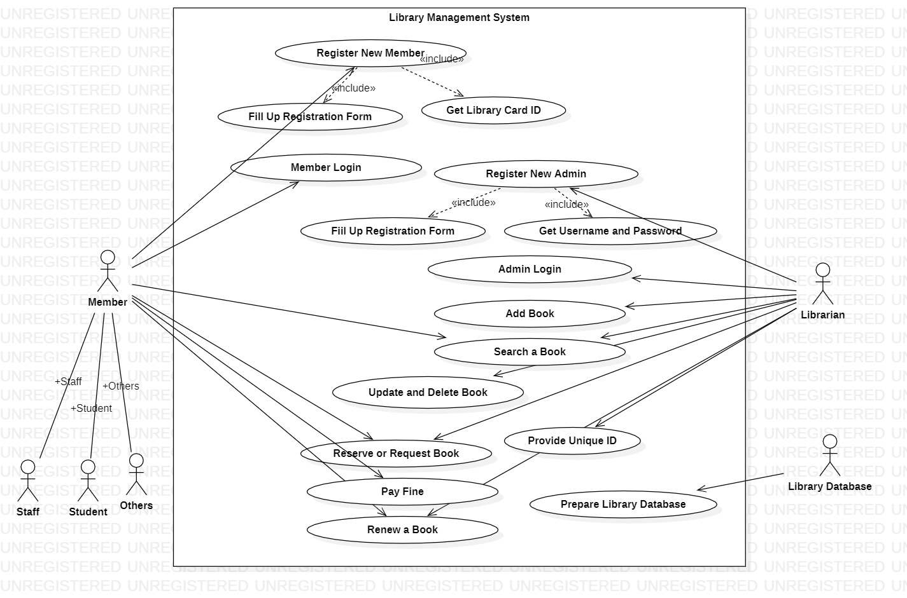
2.6 USE CASE DIAGRAM

Slide 10
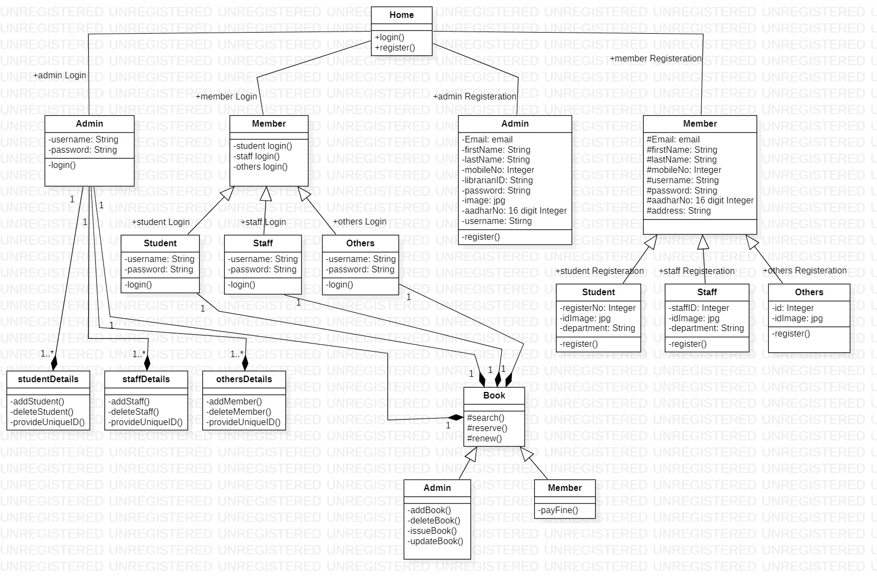
2.7 CLASS DIAGRAM

Slide 11
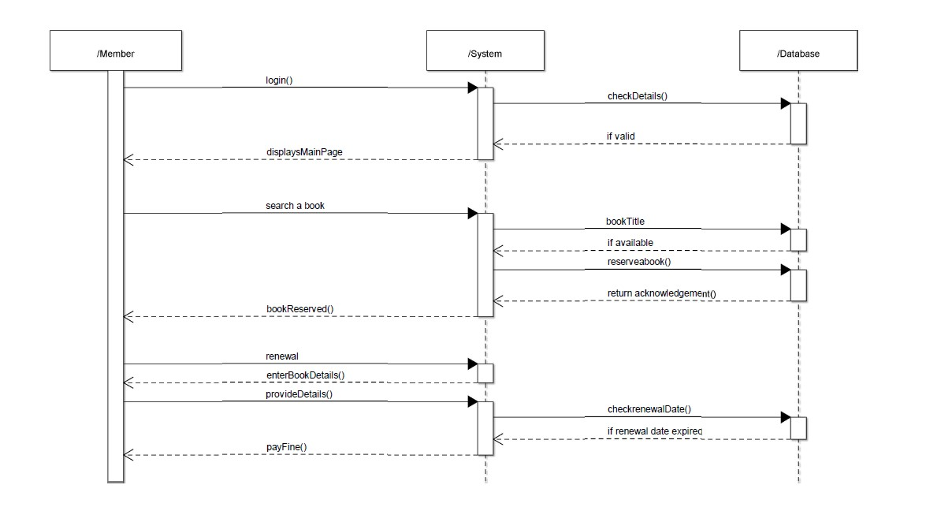
2.8 SEQUENCE DIAGRAM
Member Login System

Slide 12
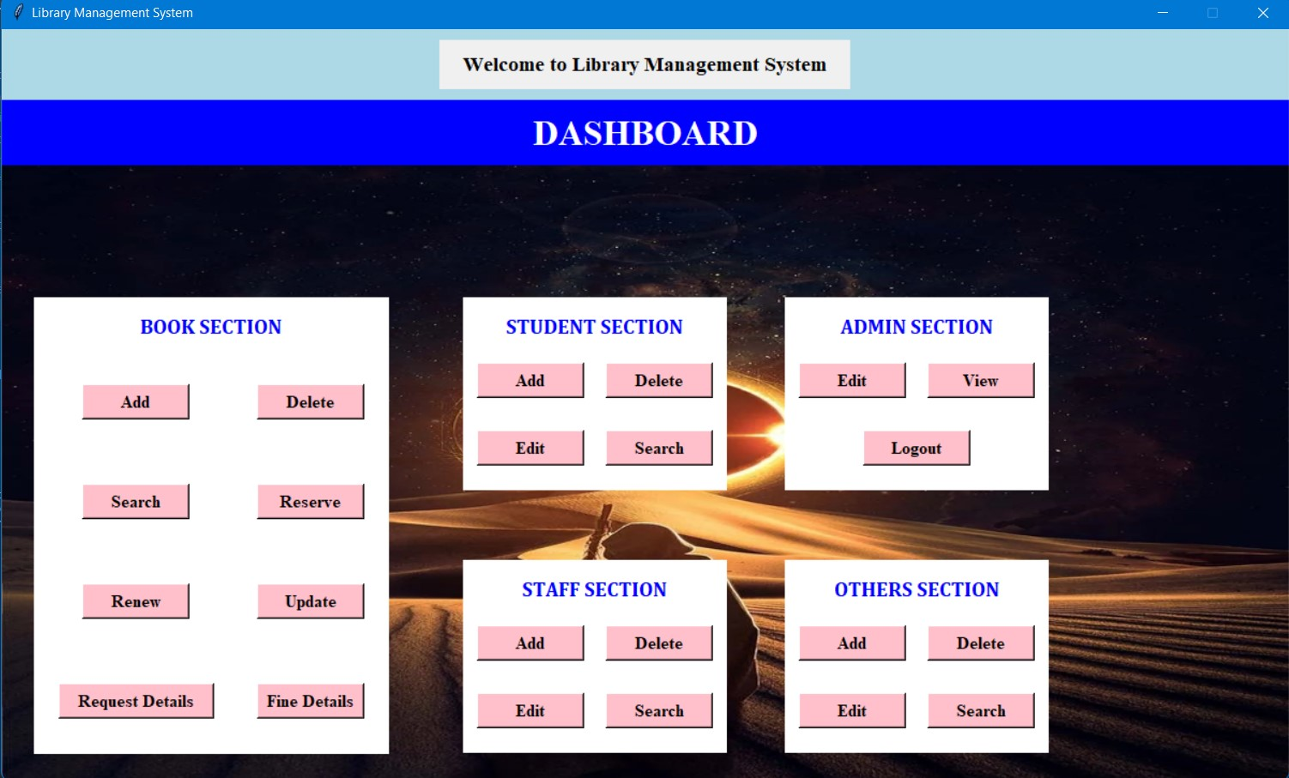
2.9 DASHBOARD PAGE

Slide 13
2.10 CONCLUSION
Finally this project takes minimum 2 month of time to complete and maximum 3 months of time to complete.
We are assuring which used Software are fully licensed software , Hardware and Open Source Software.
THANKS TO CHOOSE US…
Your’s Obediently,
Sivasakthi V (613520104036)
Chandru K (613520104303)
Dhineshkumar D (613520104008)

