Slide 1
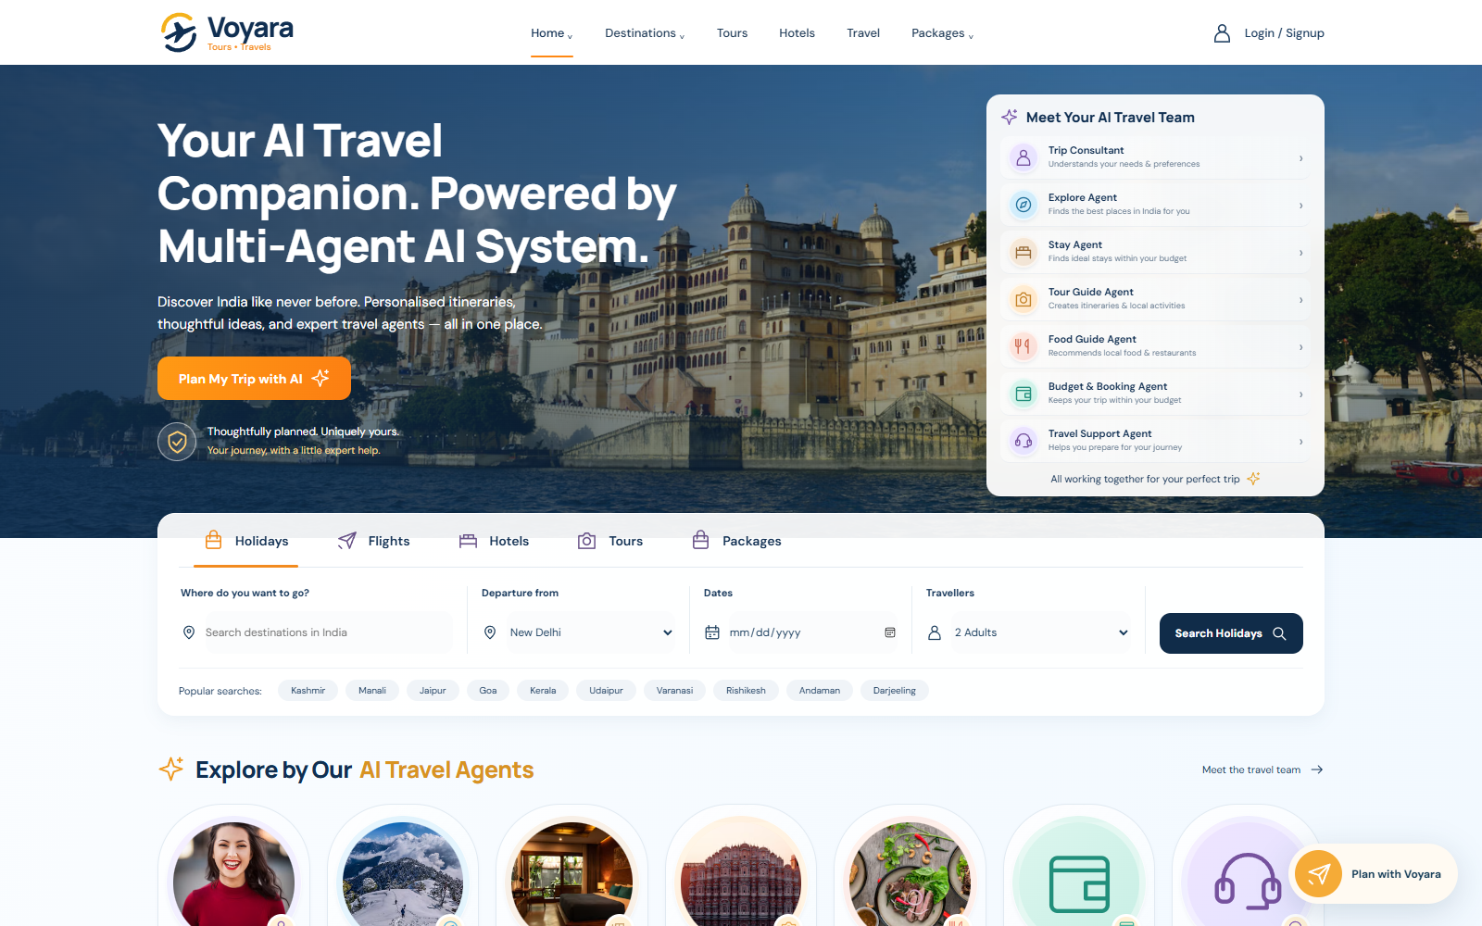
Iron Web + Voyara
AZINHACK ’26
Shared memory for
travel planning agents
Current trip requirements, source evidence
and visible agent execution
Team Unstoppable 4s
Leader Ishmeet Singh
Member Vansh Varshney
Member Aarush Srivastava
UNSTOPPABLE 4s
01 / 08
Notes:
Introduce Iron Web as the shared memory infrastructure and Voyara as the working travel application. Team details come directly from the user. This deck uses the eight-slide limit including this cover. The screenshot records a real local demonstration, not current supplier inventory. TinyFish is planned and is explicitly identified on slide 6.
Sources
https://github.com/aarush-srivastava7812/Iron-Web/blob/c11beccc73386aea38994a19feb79dbb04bca5df/README.md
https://github.com/aarush-srivastava7812/Iron-Web/blob/c11beccc73386aea38994a19feb79dbb04bca5df/docs/screenshots/demo-2026-10-18/voyara-home.png
https://docs.google.com/document/d/1L1N8HhK9QGGKPn2gja6v6GH8BVHnBuJQqDPcl2WpajM/edit?usp=sharing

Slide 2
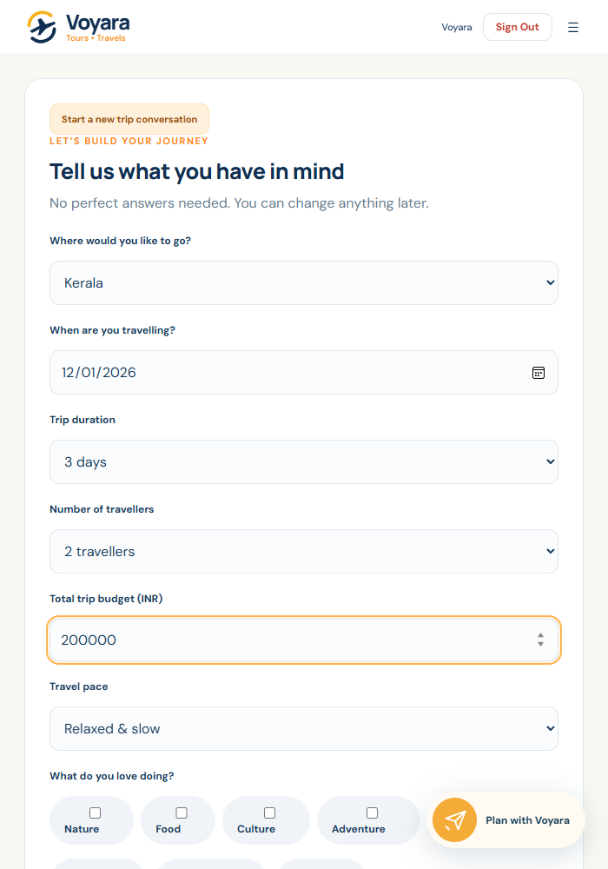
Travel plans change after the first prompt
The problem is keeping every specialist current
A traveler lowers the budget
WHO IT HELPS
A cached plan can keep the old allowance unless the system tracks accepted changes.
Travelers who
revise plans
Teams that need
traceable agent
recommendations
Different specialists need the same facts
Stays, food and itinerary choices must use the same trip, dates and dietary requirements.
Voyara keeps the plan in one workflow
Travelers edit their trip details, review plan versions and export a private Travel Book PDF.
Prototype impact: fewer repeated requirements and clearer plan revisions. User-outcome gains remain unmeasured.
UNSTOPPABLE 4s
02 / 08
Notes:
Demonstrate the actual problem: stale personalization when a requirement changes. The product supports structured trip details, saved drafts, Travel Book PDFs and booking requests. Benefits here are intended practical benefits, not measured adoption or customer-outcome statistics. Catalog inventory and estimates are synthetic and require supplier confirmation. Screenshot provenance is local recorded demo.
Sources
https://github.com/aarush-srivastava7812/Iron-Web/blob/c11beccc73386aea38994a19feb79dbb04bca5df/README.md
https://github.com/aarush-srivastava7812/Iron-Web/blob/c11beccc73386aea38994a19feb79dbb04bca5df/stitch_ai_travel_booking_platform/README.md
https://github.com/aarush-srivastava7812/Iron-Web/blob/c11beccc73386aea38994a19feb79dbb04bca5df/docs/screenshots/demo-2026-10-18/voyara-trip-request.png

Slide 3
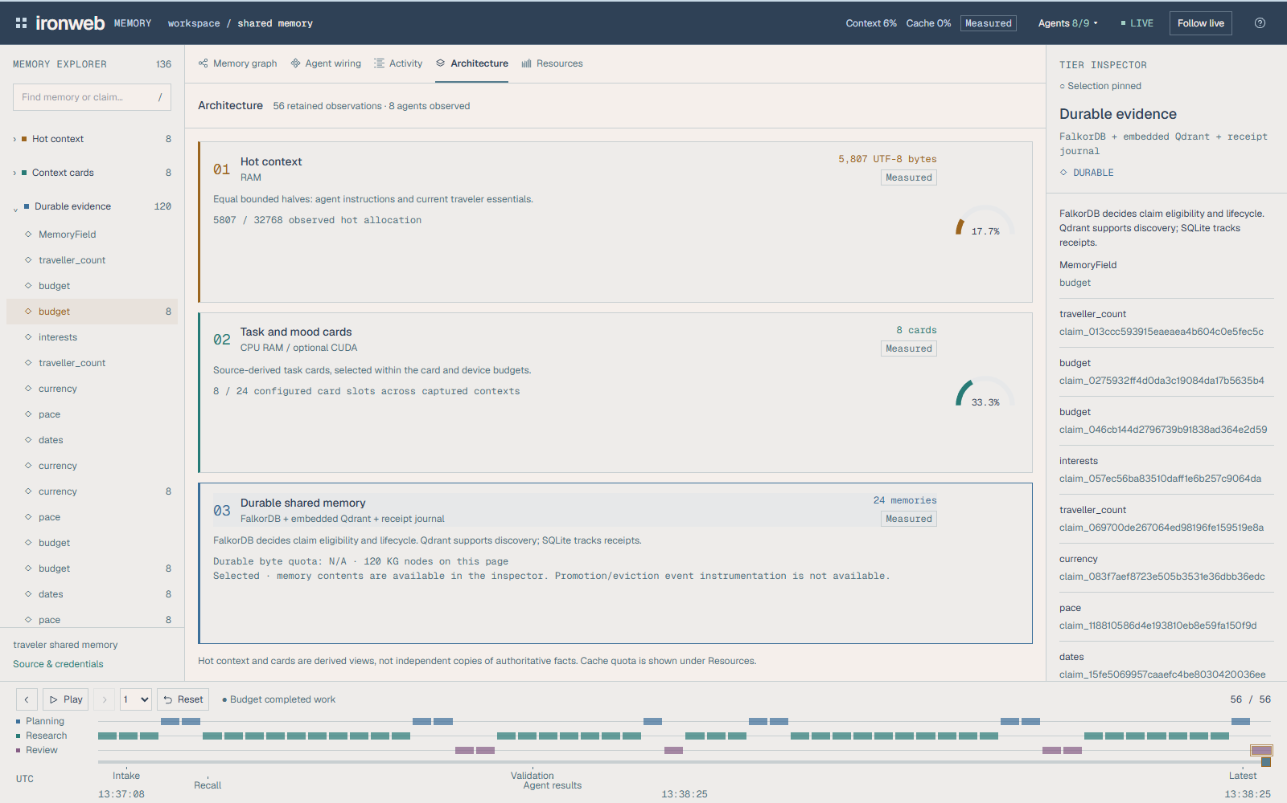
System architecture and three-tier memory
One backend owns the connected memory runtime
Vercel website
Voyara browser
Vite / JavaScript
FastAPI
Sessions + trip ownership
SQLite
Application data
The frontend proxies /api to Render for same-origin sessions.
Render API + dashboard
Dashboard relay
Read-only HTTP / SSE
Agent workflow
Shared memory gateway
NVIDIA NIM
gpt-oss-20b
FastAPI owns memory. A read-only relay powers the separate dashboard.
TIER 1
Hot agent + traveler context
TIER 2
Task cards + bounded cache
TIER 3
FalkorDB + Qdrant + journal
Recorded three-tier architecture view
UNSTOPPABLE 4s
03 / 08
Notes:
This is an editable conceptual architecture diagram paired with a real local dashboard architecture screenshot. The deployed Vercel project uses stitch_ai_travel_booking_platform/frontend and dist output. The API owner runs a single worker with embedded Qdrant and a private journal, plus FalkorDB. The three-tier gateway assembles current scoped context from hot text, evidence-derived cards and authoritative durable evidence. CUDA card-vector matching is optional, while CPU is the operational default. The dashboard stays separate and reads published snapshots through its relay. Current Render free-tier storage is ephemeral across restarts/redeploys, so durable retention needs an appropriate persistent deployment. The public website does not expose the separate local memory dashboard.
Sources
https://github.com/aarush-srivastava7812/Iron-Web/blob/c11beccc73386aea38994a19feb79dbb04bca5df/README.md
https://github.com/aarush-srivastava7812/Iron-Web/blob/c11beccc73386aea38994a19feb79dbb04bca5df/docs/architecture.md
https://github.com/aarush-srivastava7812/Iron-Web/blob/c11beccc73386aea38994a19feb79dbb04bca5df/docs/three_tier_memory.md
https://github.com/aarush-srivastava7812/Iron-Web/blob/c11beccc73386aea38994a19feb79dbb04bca5df/deploy/voyara/README.md
https://github.com/aarush-srivastava7812/Iron-Web/blob/c11beccc73386aea38994a19feb79dbb04bca5df/docs/screenshots/demo-2026-10-18/dashboard-architecture.png

Slide 4
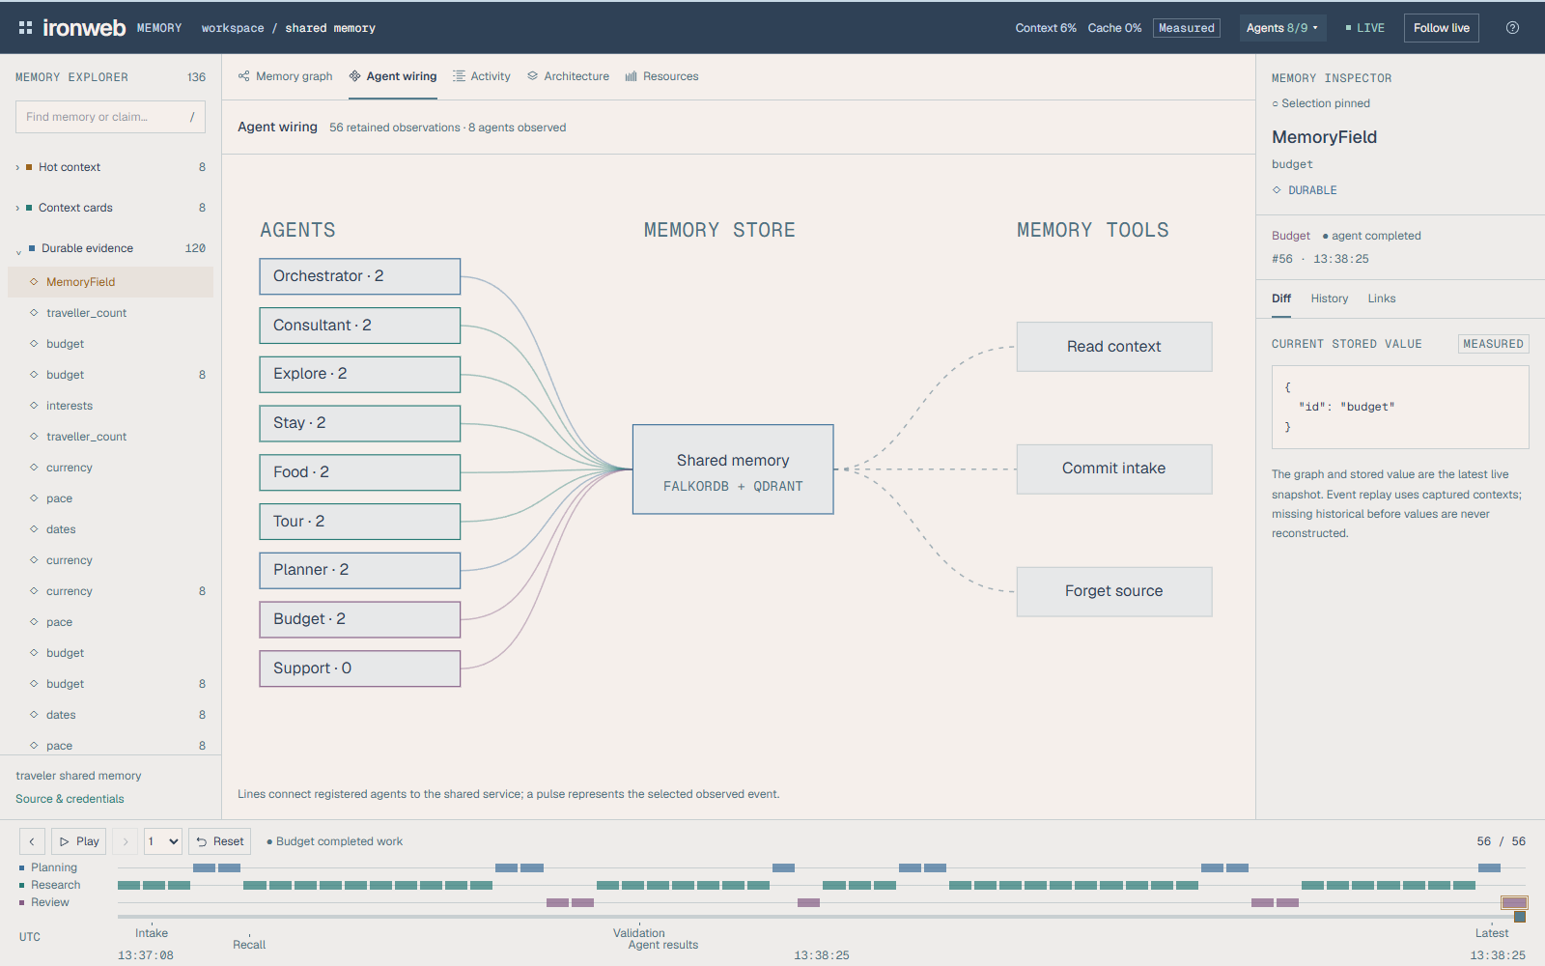
Seven specialists in the tested planning path
LangGraph routes independent research in parallel
Explore
Stays
Trip
consultant
Itinerary
planner
Budget
reviewer
Tour guide
Food guide
Actual registered memory actors
Validate
current plan
Typed tool actions
Schemas and allowlists constrain
each specialist’s execution.
The shared gateway supplies scoped evidence. Validation can
request a bounded revision before the current plan returns.
Only needed agents run
UNSTOPPABLE 4s
04 / 08
Notes:
The full tested Plan route uses seven hosted specialists: consultant, explore, stay, tour guide, food guide, itinerary and budget. The orchestrator coordinates execution. Travel support runs when the route needs it. Nine registered memory actors therefore do not imply nine simultaneous hosted calls. The actual local screenshot shows the registered actor graph and observed activity for that recorded run, rather than seven concurrent calls. Backend/tool contracts define bounded revision and typed outputs. Specialist tools include compare_stays, build_schedule and calculate_budget. Hosted agents do not execute payments or confirmed supplier bookings. A previous hosted smoke test completed all seven specialists with NVIDIA mode, but its one-run timing is not a general latency benchmark.
Sources
https://github.com/aarush-srivastava7812/Iron-Web/blob/c11beccc73386aea38994a19feb79dbb04bca5df/README.md
https://github.com/aarush-srivastava7812/Iron-Web/blob/c11beccc73386aea38994a19feb79dbb04bca5df/agents/README.md
https://github.com/aarush-srivastava7812/Iron-Web/blob/c11beccc73386aea38994a19feb79dbb04bca5df/agents/orchestration/graph.py
https://github.com/aarush-srivastava7812/Iron-Web/blob/c11beccc73386aea38994a19feb79dbb04bca5df/agents/schemas.py
https://github.com/aarush-srivastava7812/Iron-Web/blob/c11beccc73386aea38994a19feb79dbb04bca5df/docs/screenshots/demo-2026-10-18/dashboard-agent-wiring.png

Slide 5
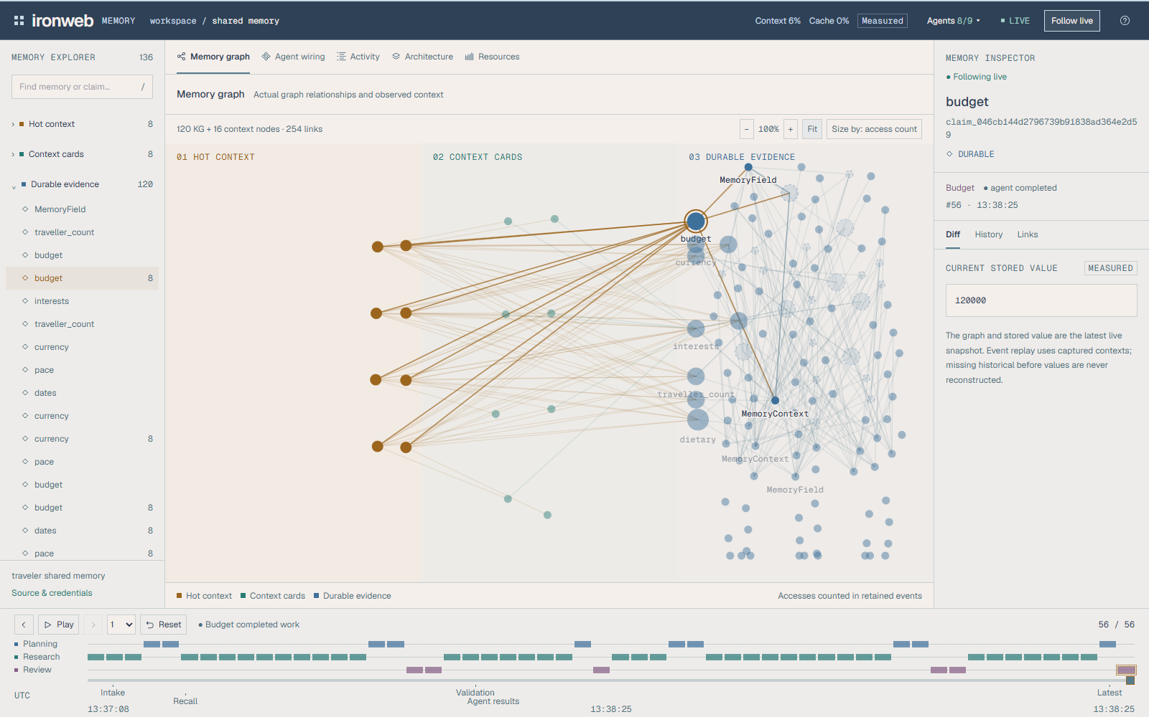
Accepted changes invalidate dependent work
A graph links each plan to the evidence it used
RECORDED BUDGET REVISION
INR 200,000
Original confirmed budget
INR 120,000
Traveler accepts a new budget
Review required
Old dependent work becomes stale
Current plan
Agents rebuild from eligible evidence
UNSTOPPABLE 4s
05 / 08
Notes:
The screenshot is the actual recorded local demonstration, where the selected graph-backed budget is 120000 after a change from 200000. The system retains source IDs, accepted versions, scopes and work dependencies. Current snapshots revalidate freshness after generation. Pending, missing or disputed mandatory requirements block readiness. Deletion invalidates derived context and does not silently revive earlier budgets. The image itself is a source screenshot; labels and the lifecycle explanation on the right remain editable. Replay uses captured event contexts, while graph and resource aggregates are latest snapshots rather than complete historical database reconstructions.
Sources
https://github.com/aarush-srivastava7812/Iron-Web/blob/c11beccc73386aea38994a19feb79dbb04bca5df/README.md
https://github.com/aarush-srivastava7812/Iron-Web/blob/c11beccc73386aea38994a19feb79dbb04bca5df/docs/memory_evolution.md
https://github.com/aarush-srivastava7812/Iron-Web/blob/c11beccc73386aea38994a19feb79dbb04bca5df/docs/screenshots/demo-2026-10-18/dashboard-memory-graph.png
https://github.com/aarush-srivastava7812/Iron-Web/blob/c11beccc73386aea38994a19feb79dbb04bca5df/docs/shared_memory_service.md

Slide 6
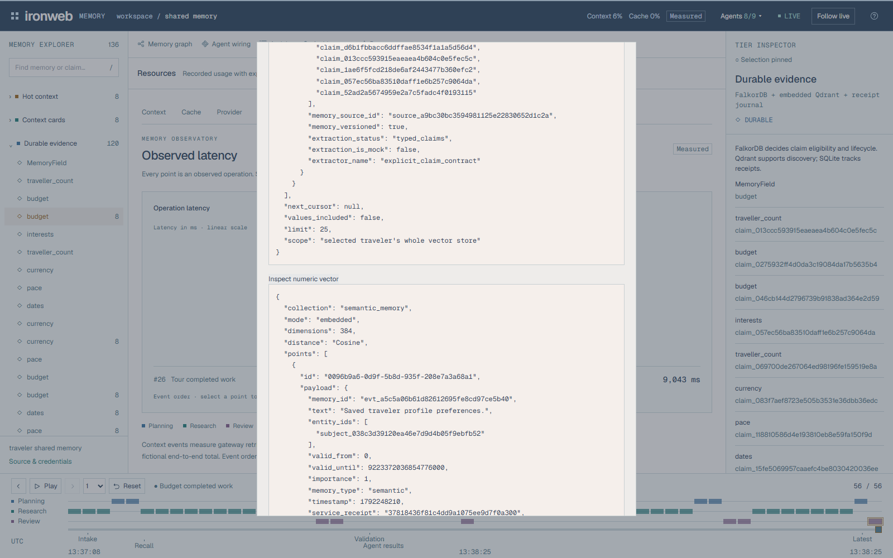
TinyFish integration for current web evidence
PLANNED INTEGRATION (NOT IMPLEMENTED)
Web facts with
retained sources
Official travel pages
Opening hours / stay details
TinyFish
Fetch or Web Agent
TinyFish would fetch official travel pages.
The adapter would retain URLs, fetch
times and evidence status.
Scoped memory gateway
Evidence review + freshness
Evidence adapter
URL + fetched time + status
Acceptance before claiming integration
A real provider run, retained source evidence, error handling
and a visible example in the README and demo video
Existing source inspector; TinyFish remains planned.
UNSTOPPABLE 4s
06 / 08
Notes:
The user explicitly confirmed that no working TinyFish integration exists and requested that it be labeled planned. The hackathon brief requires functional and meaningful TinyFish usage, worth 20 points. This slide is a proposed implementation path, not a claim that the integration already works. All connectors are dashed to reinforce its planned status. The screenshot shows the existing source/numeric-vector inspector, not TinyFish output. Suggested use: obtain current source evidence for travel details, record source URL/retrieval time/status, validate evidence and expose it through the existing gateway. Exact provider endpoints and credentials are not specified here. Current supplier inventory is synthetic. No live fares, stock or supplier guarantees are claimed. TinyFish must be implemented and demonstrated before presenting this slide as delivered.
Sources
https://docs.google.com/document/d/1L1N8HhK9QGGKPn2gja6v6GH8BVHnBuJQqDPcl2WpajM/edit?usp=sharing
https://github.com/aarush-srivastava7812/Iron-Web/blob/c11beccc73386aea38994a19feb79dbb04bca5df/README.md
https://github.com/aarush-srivastava7812/Iron-Web/blob/c11beccc73386aea38994a19feb79dbb04bca5df/docs/screenshots/demo-2026-10-18/dashboard-source-inspection.png
User confirmation in this conversation: No—label TinyFish as planned.

Slide 7
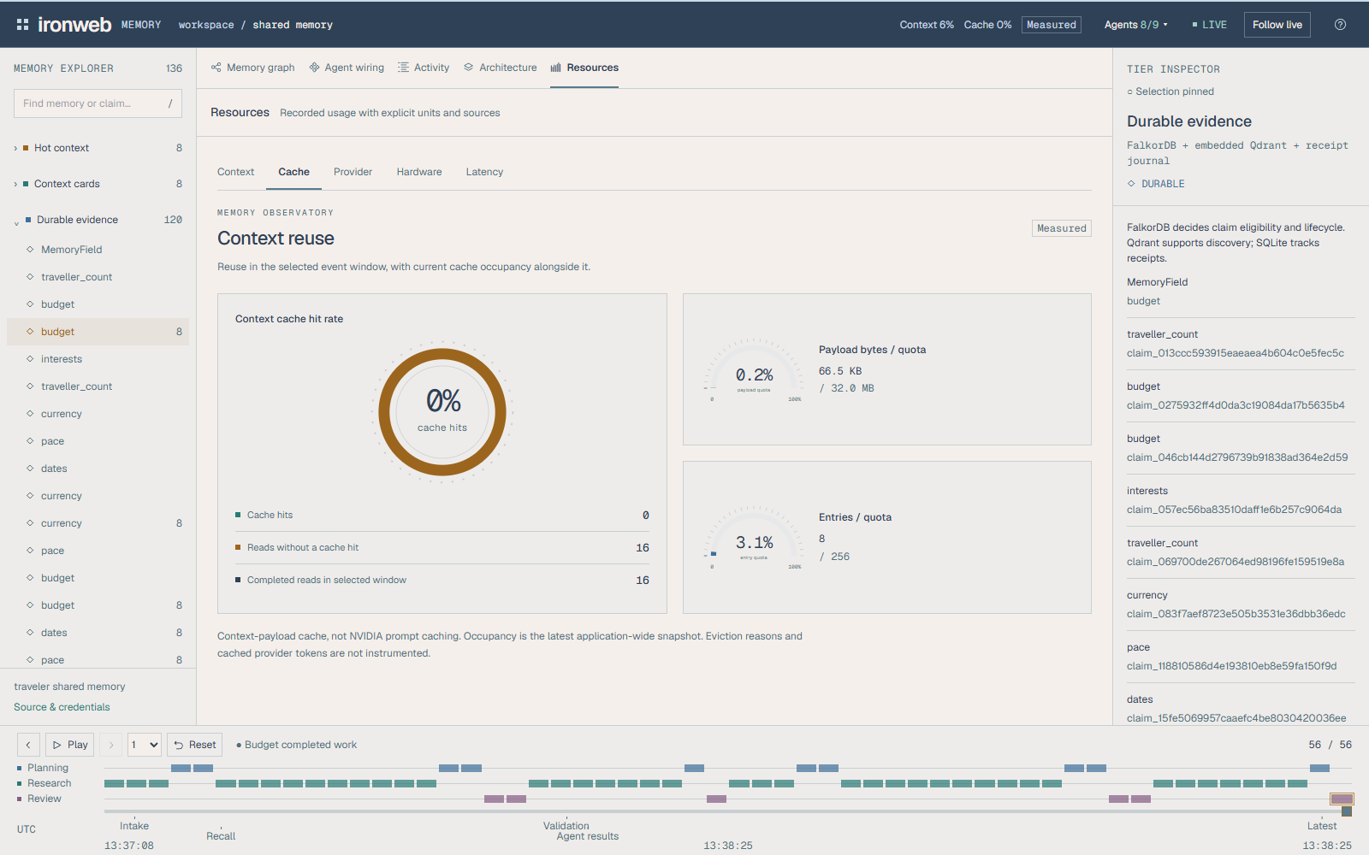
Measured context preparation and correctness
Warm caching reduced repeated context assembly
Median context preparation, milliseconds
15.2×
Lower median context assembly time
with RAM + CPU in this fixture
36/36 field checks correct
Supported, disputed and missing fields in a regression fixture
Recorded cache view, separate from timed fixture
Local fixture: 15 repeats, one active card, identical prompt/evidence. Context preparation only; no generation timing.
UNSTOPPABLE 4s
07 / 08
Notes:
Timings come from report/three_tier_20261015_verified/results.json. Uncached equivalent p50 232.86 ms, RAM+CPU p50 15.34 ms, RAM+GPU p50 15.82 ms. Calculated ratio = 15.1799. Each mode repeats the same request 15 times with identical final prompt/claim dependencies, real BAAI/bge-small-en-v1.5 embeddings, a retained Mistral plain-text tokenizer contract and one active 384-dimensional card. No generative model or hosted inference is measured. The cache screenshot records a separate local demonstration and is illustrative of observability, not the source of the chart values. Warm CPU/GPU are close; first GPU rebuild is about 1058.20 ms versus about 237.39 ms for CPU. CPU remains the operational default. Do not generalize the ratio to end-to-end AI speed or multi-user production workloads. Field correctness is 36/36 on a separate developer-designed regression fixture, not a blind external test. Neither result is an official upstream benchmark score.
Sources
https://github.com/aarush-srivastava7812/Iron-Web/blob/c11beccc73386aea38994a19feb79dbb04bca5df/report/three_tier_20261015_verified/README.md
https://github.com/aarush-srivastava7812/Iron-Web/blob/c11beccc73386aea38994a19feb79dbb04bca5df/report/three_tier_20261015_verified/results.json
https://github.com/aarush-srivastava7812/Iron-Web/blob/c11beccc73386aea38994a19feb79dbb04bca5df/report/memory_evaluation_20261014_final/results.json
https://github.com/aarush-srivastava7812/Iron-Web/blob/c11beccc73386aea38994a19feb79dbb04bca5df/docs/memory_research_protocol.md
https://github.com/aarush-srivastava7812/Iron-Web/blob/c11beccc73386aea38994a19feb79dbb04bca5df/docs/screenshots/demo-2026-10-18/dashboard-cache.png

Slide 8
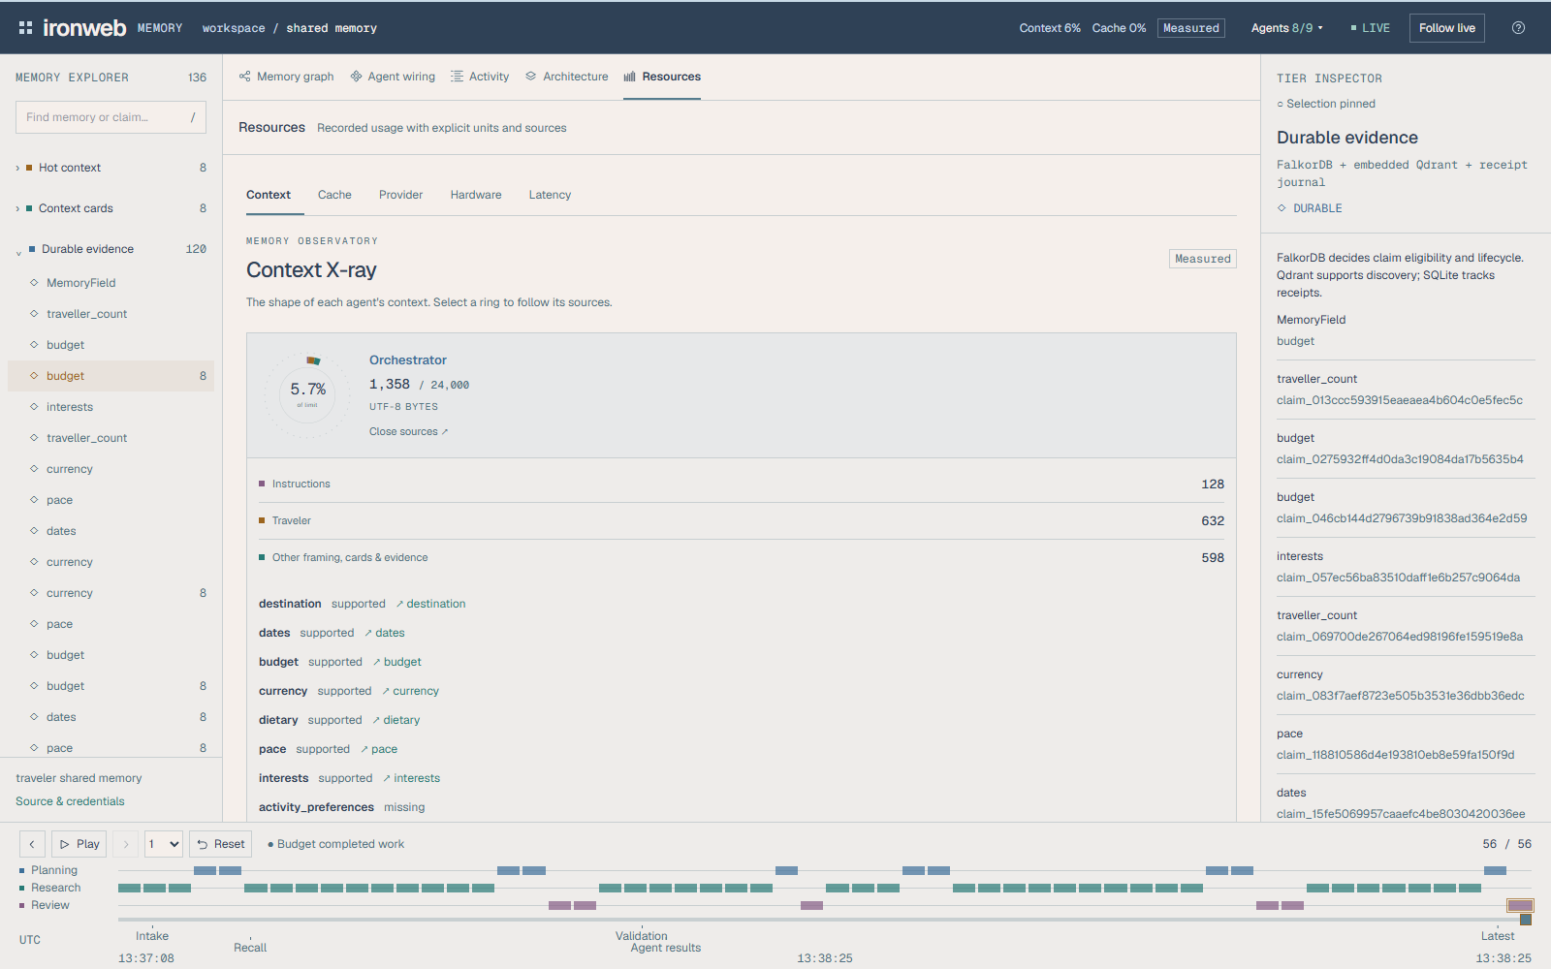
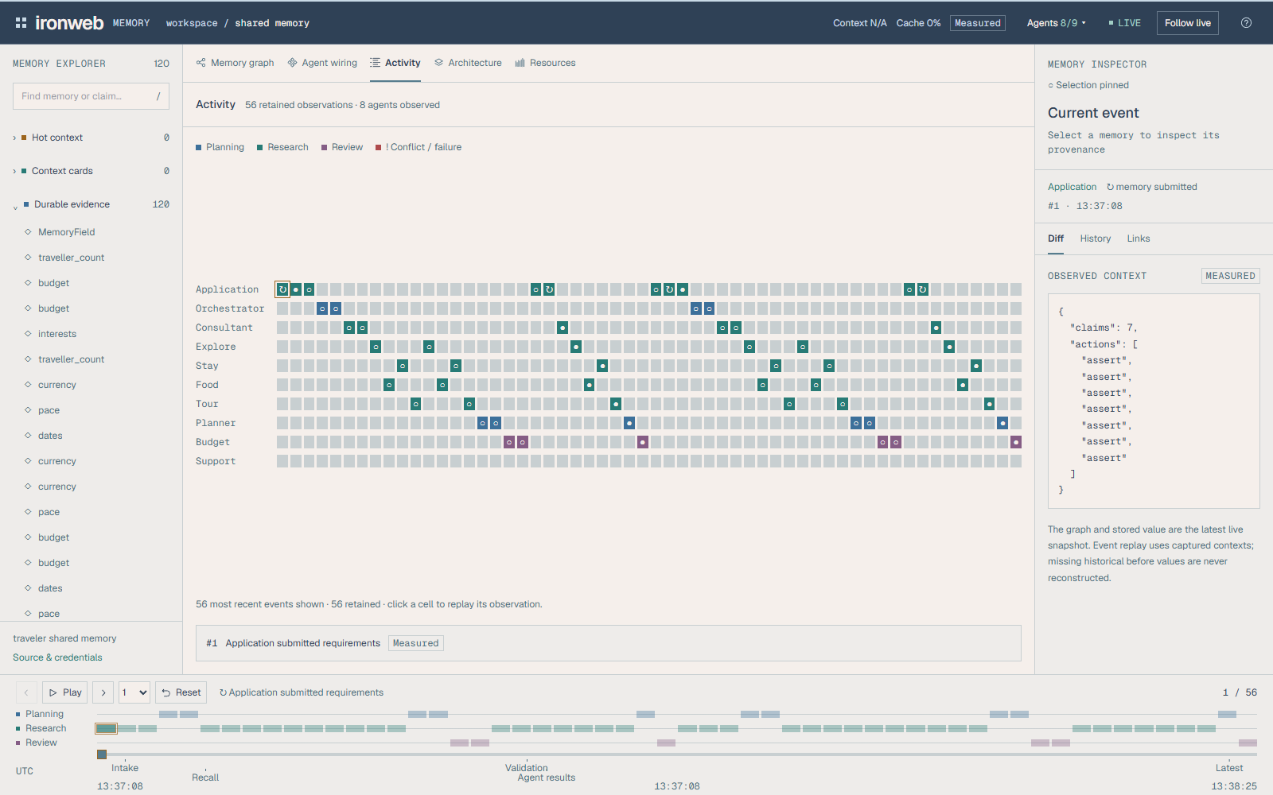
Memory observability during execution
A read-only dashboard connects contexts, sources and agent events
Trace the selected context
Inspect the fields and source claims
each agent used for its response.
Follow the actual work
Actor timelines link captured contexts
to the selected event.
Recorded agent activity
UNSTOPPABLE 4s
08 / 08
Notes:
The replacement closing slide focuses on technical observability rather than access instructions or submission scoring. Both screenshots are actual local demonstration captures from the retained October 18 demo. The main Context X-ray exposes captured context allocation, fields, supporting evidence and source links. The Activity view displays observed events by actor, supports selection and links the event to its captured context. The dashboard uses a separate read-only HTTP/SSE relay scoped to a selected account/trip. No diagram implies administrative access across users. Context history is event-specific, while graph/store/resource aggregates remain current snapshots. Screenshots use UTF-8-byte accounting for the declared consumer profile, not a model token-billing claim.
Sources
https://github.com/aarush-srivastava7812/Iron-Web/blob/c11beccc73386aea38994a19feb79dbb04bca5df/README.md
https://github.com/aarush-srivastava7812/Iron-Web/blob/c11beccc73386aea38994a19feb79dbb04bca5df/docs/capabilities.md
https://github.com/aarush-srivastava7812/Iron-Web/blob/c11beccc73386aea38994a19feb79dbb04bca5df/docs/screenshots/demo-2026-10-18/dashboard-context-xray.png
https://github.com/aarush-srivastava7812/Iron-Web/blob/c11beccc73386aea38994a19feb79dbb04bca5df/docs/screenshots/demo-2026-10-18/dashboard-activity.png

