Slide 1
Autonomous vehicles
(Part 2 of the hackathon)

Slide 2
Levels of Automation
One of the first concepts to be understood while understanding AVs is the levels of automation. The levels based on the mainly the human-vehicle interaction which is largely reflected in the technologies used and the architecture.
Very largely speaking, level 0 is when the driver has full control of the vehicle. Levels 1 and 2 are when the vehicle’s ADAS (advanced driver assistance system) has the ability to support the driver and levels 3 to 6 involve the Advanced Driving System (ADS) with increased dependency on the ADS.

Slide 3
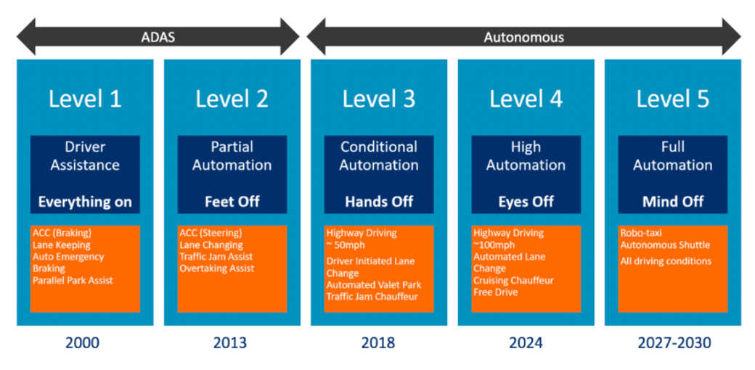
Image courtesy: IEEE

Slide 4
Evidently, full automation would be much bigger than just one vehicle and its architecture and sensors. It would involve incorporation of IoT, SLAM, Machine Learning, Path planning, sensor fusion, V2X, etc. Most of these concepts are inherently interlinked, anyway.
Full autonomy is said to be accessible only with the introduction of 5G technology because unsurprisingly, computational and connectivity abilities for all the above technologies have to be very high.
Some of the concepts have been briefly explained in the following slides.

Slide 5
Sensors
One of the fundamental building blocks of any autonomous vehicle is its sensing ability. Without the vehicles ability to sense its surroundings and changes in its surroundings, it is very handicapped.
Sensors can be grouped into two main categories- active sensors and passive sensors
Passive sensors are like receiving sensors which give outputs based on the energies absorbed (eg. heat, light), while active sensors send out electromagnetic signals (of varying wavelength and frequency) and use the response to decide the outputs.

Slide 6
Passive Sensors
Charge Couple Device (CCD) is one of the main passive sensor technologies. It is different from the traditional PN-junction diode photodiode in that it has a metal-oxide semiconductor (CMOS) structure
This is used in competition with Complementary Metal Oxide Semiconductor (CMOS) devices.
Both of these devices use the same basic concept- incoming photons generate photoelectrons in the depletion region. The varying intensity of the incoming light is used to generate different values of charge which is therefore converted to an electric signal which can then be used for computation, processing.
The difference between the two technologies is illustrated in the next slide.

Slide 7
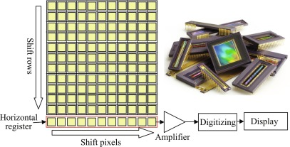
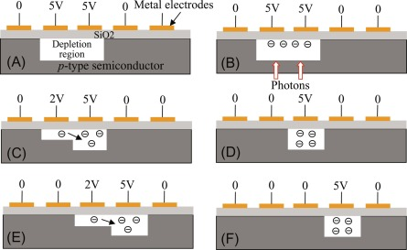
CCD vs. CMOS
CCD uses a method of shifting the intensity captured in each pixel to one side where the signal is the amplified and used for digitization, processing, etc.
Charge shifting can be accomplished by progressively shifting gate voltage along the (2D) array. (The 2D array is in the focal plane of the incoming radiation)
Image courtesy: Elsevier

Slide 8
In contrast to this, CMOS technology uses a transistor for each pixel, therefore converting the input to each pixel separately and then combining it.
While CMOS obviously has its benefits, its one major drawback is that the presence of transistors along with the sensor elements, reduces its light sensitivity
While passive CMOS sensors are generally used in the visual light spectrum, the same CMOS technology could be used in thermal imaging cameras as well.

Slide 9
Active sensors
As mentioned before, active sensors use the concept of Time of Flight (ToF). ToF measures the travel time of a signal from its source to a target, by waiting for the reflection of the signal to return.
The frequency of the signal used determines the energy used by the system, as well as its accuracy. Therefore, determining the correct wavelength plays a key role in choosing which system to use. Some systems are described in the next slide.

Slide 10
Ultrasonic sensors- Also known as SONAR, use ultrasound waves for ranging and are by far the oldest and lowest cost of these systems. As sound waves have the lowest frequency (longest wavelengths) among the sensors used, they are more easily disturbed. This means the sensor is easily affected by adverse environmental conditions like rain and dust.
RADAR (RAdio Detection And Ranging) uses radio waves for ranging. Radio waves travel at the speed of light and have the lowest frequency (longest wavelength) which makes them highly resilient to environmental changes like wind, rain, etc. It is also comparatively less costly.

Slide 11
LIDAR (LIght Detection And Ranging) uses light in the form of a pulsed laser. LIDAR sensors send out 50,000 - 200,000 pulses per second to cover an area and compile the returning signals into a 3D point cloud.
Some types of Lidars are- mechanical scanning LiDARs which use mirrors or mechanical components to rotate the LiDAR, microelectromechanical mirrors (MEMS) based LIDARS distribute the laser pulses via one or multiple tiny tilting mirrors, whose angle is controlled by the voltage applied to them, flash LiDARs, phased array LiDARs.
LIDAR has the benefits of having a relatively wide field of vision, with potentially full 360 degree 3D coverage (depending on the type of LIDAR chosen).

Slide 12
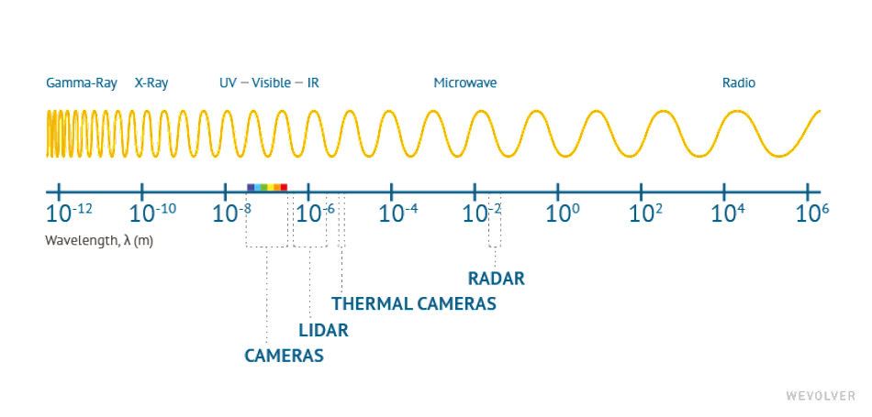
To summarise, obviously a combination of both active and passive sensors is to be used for different parts of the automobile based on the range of the incoming radiations. The following diagram illustrates the wavelength-sensor relation nicely.
Image courtesy: WeVolver

Slide 13
The following technical factors affect the choice of sensors:
The scanning range, determining the amount of time you have to react to an object that is being sensed.
Resolution, determining how much detail the sensor can give you.
Field of view or the angular resolution, determining how many sensors you would need to cover the area you want to perceive.
Ability to distinguish between multiple static and moving objects in 3D, determining the number of objects you can track.
Refresh rate, determining how frequently the information from the sensor is updated.
General reliability and accuracy in different environmental conditions.
Cost, size and software compatibility.
Amount of data generated.

Slide 14
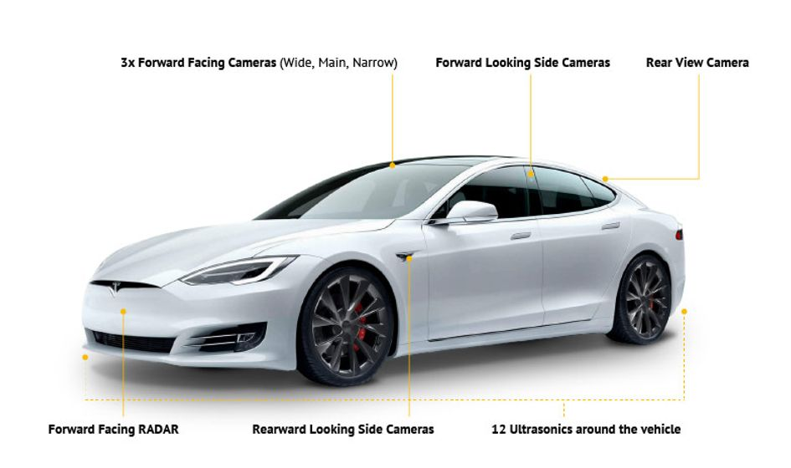
An example of different sensors being used in different places of a Tesla model.
Image courtesy: WeVolver

Slide 15
Maps
Another very important aspect of AVs are maps.
However, autonomous vehicles will likely need a new class of high definition (HD) maps that represent the world at up to two orders of magnitude more detail.
HD maps can represent lanes, geometry, traffic signs, the road surface, and the location of objects like trees. The information in such a map is represented in layers, with generally at least one of the layers containing 3D geometric information of the world in high detail to enable precise calculations.

Slide 16
Simultaneous Localization and Mapping (SLAM)
For AVs, it is very probable that the vehicle has to travel in unknown territory or respond to environment changes. The process of sensing its surrounding and mapping them simultaneously and maneuvering its way through the constructed map is termed as SLAM.
Sensor fusion is obviously an integral part of SLAM. It is a multi-level process that deals with the association, correlation, and combination of data, and enables to achieve less expensive, higher quality, or more relevant information than when using a single data source alone.

Slide 17
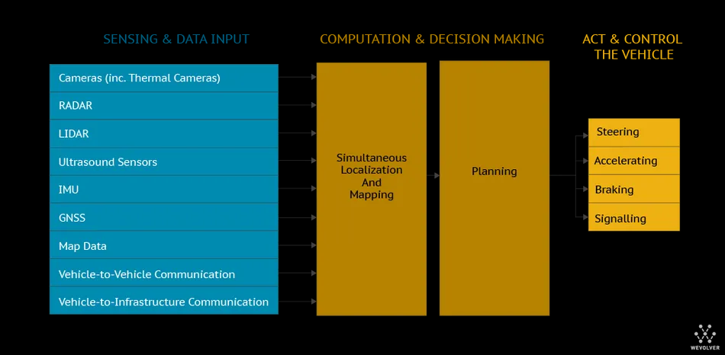
The illustration explains the key role of SLAM
Image courtesy: WeVolver

Slide 18
Machine Learning
Different types of machine learning algorithms are currently being used for different applications in autonomous vehicles.
Some of the types of ML are CNN, RNN, DRL and multiple hybrids of these methods.
CNN is used for image and spatial image learning, i.e. to extract the most significant features based on the dataset
Recurrent Neural Networks (RNNs) are used when working with videos.
DRL combines Deep Learning (DL) and Reinforcement Learning. DRL methods let software-defined ‘agents’ learn the best possible actions to achieve their goals in a virtual environment using a reward function.

Slide 19
Actuation
The shift in the method of actuation for braking, steering, etc. will be made possible by Electronic Control Units (ECUs).
Currently, cars use mechanical inputs given by the driver which are converted to hydraulic or pneumatic by ECUs.
In a (semi-)autonomous car, such functionality is replaced by drive control software directly communicating to an ECU

Slide 20
Communication and Connectivity
This would be a subpart of the huge world of the Internet of Things (IoT). Communication of autonomous objects with autonomous objects is what the future looks like.
Vehicle-to-vehicle (V2V) communications comprises a wireless network where automobiles send messages to each other with information about what they’re doing. This data would include speed, location, direction of travel, braking, and loss of stability. Vehicle-to-vehicle technology uses Dedicated Short-Range Communications (DSRC). It’s described as a WiFi like network because the frequency is in a similar range.

Slide 21
Vehicle-to-infrastructure (V2I) technology is a communication framework that enables several vehicles to share information with a variety of devices supporting the highway system of a particular country.
These devices consist of RFID readers, signage, cameras, lane makers, streetlights, and parking meters among others.
Currently, V2I technology is usually considered to be over Cellular Networks (CNs) but it also is used often with DSRCs.
Signal Phase and Timing (SPaT) is a very interesting technology which could be a subpart of V2I. The concept of SPaT is to for traffic management and to set speed limits to improve fuel economy and flow of traffic. This would use IoT and a lot of AI and ML.

Slide 22
Path Planning (Also part B of task 2)
Path planning is an important aspect of autonomous vehicles, the name suggests what it is.
It would be very significant for the concept of Robotic taxis, coordination of vehicles for traffic control and lane crossing.
Path planning is very interlinked with SLAM. The first question posed for path planning is the representation of the map. If the map is fully not known, the path would keep getting updated based on the data the robot (Autonomous Vehicle) is receiving.
The second very important aspect of path planning is the algorithm used.

Slide 23
Map representation- This is the first step, whether the complete environment is known or not. There are two approaches to this- discrete or continuous
Discrete maps require the entire area (including the unknown bits) to be divided into grids of equal or varying shapes and sizes. The continuous approach assumes nodes at a periodic interval such that the robot can travel from one node to another.
A common type of map representation is the Occupancy Grid Map (OGM). In this, the map is divided into grids of an arbitrary resolution and each grid is assigned a binary value which indicates obstacles to the path, i.e. the grids are either occupied or not occupied and the path planning must go around the occupied grids.

Slide 24
For my final year Btech project, I was required to do path planning of an autonomous drone as a subpart of using it for the search of search and rescue. While this did not use SLAM because obstacles were not considered, the path still had to be optimised so as to find the location of stranded victims in the least amount of time. So in an extremely primitive way, path planning was done.
After assuming a speed based on the UAV parameters, and the sensor capture speed, the Travelling Salesman Optimisation concept was used to find an optimal route. The main criteria in this case, of course was to minimize time and distance. In order to do this, the entire area was divided into a grid of 13*5 cells. The following formula was used on Microsoft Excel to get the time travelled by the UAV between any two grids (based on the speed of the UAV and the scaling done, the time taken by the UAV to traverse between any to adjacent nodes was 3 seconds):
Time (i,j) =SQRT(((MOD(j,13)-MOD(i,13))*3)^2 + ((QUOTIENT(j,13)-QUOTIENT(i,13))*3)^2)

Slide 25
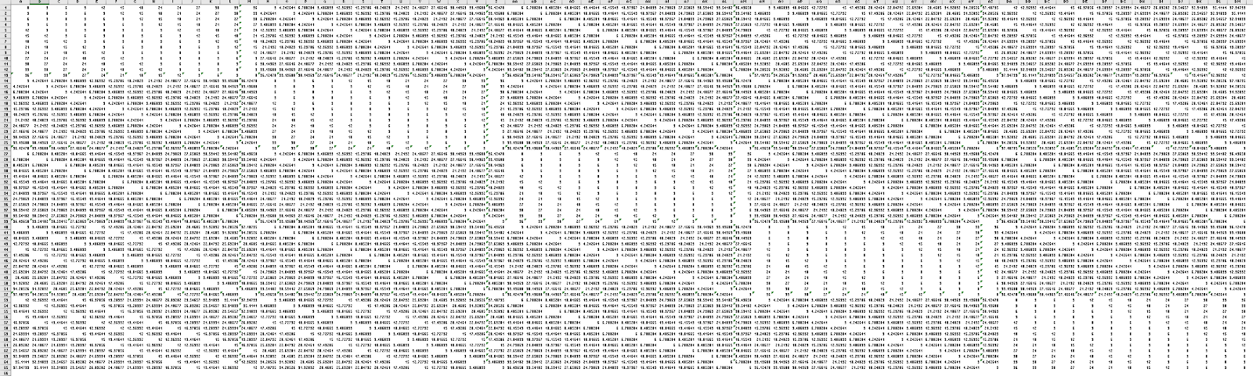
The following 65*65 matrix was obtained.
(A more legible version of it can obviously be sent, this is for representation purposes only)

Slide 26
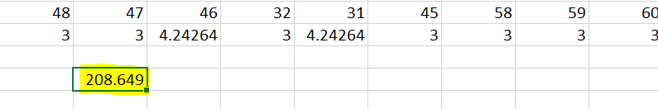
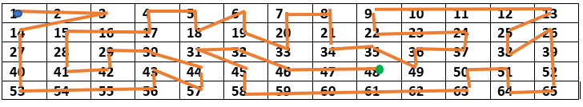
After applying the optimization tool, the following result was obtained:
i.e. the UAV would take 209 seconds to cover the area following the optimised path which was a lot less than a simple back and forth sweep path

Slide 27
This is just one very very small example with only a couple constraints. Many algorithms for path planning are present.
Most importantly, SLAM and path planning are very interlinked in the case of AVs as the path would be constantly updated.
Some examples of algorithms used in regard to self-driving cars are:
Voronoi Diagram algorithm
Cost cell algorithm
State Lattices algorithm

Slide 28
Lastly, an important aspect of path planning is how the robot (the car) is represented. This would affect the scaling of the grids and the occupancy of the cells if the OGM approach is used A very broad representation of the path planning process is given below
Map representation
Robot representation
Applying the algorithm and SLAM

Slide 29
Thank you!

