Slide 1
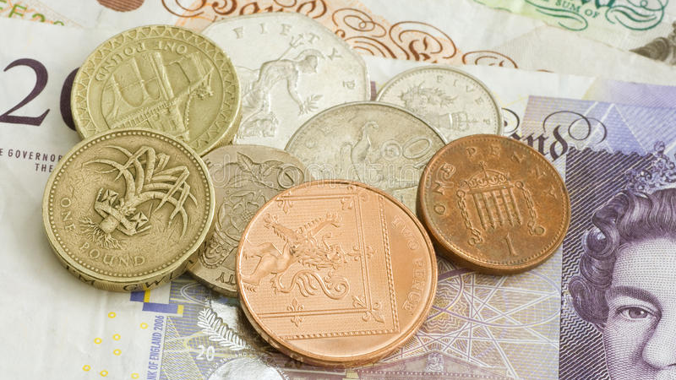
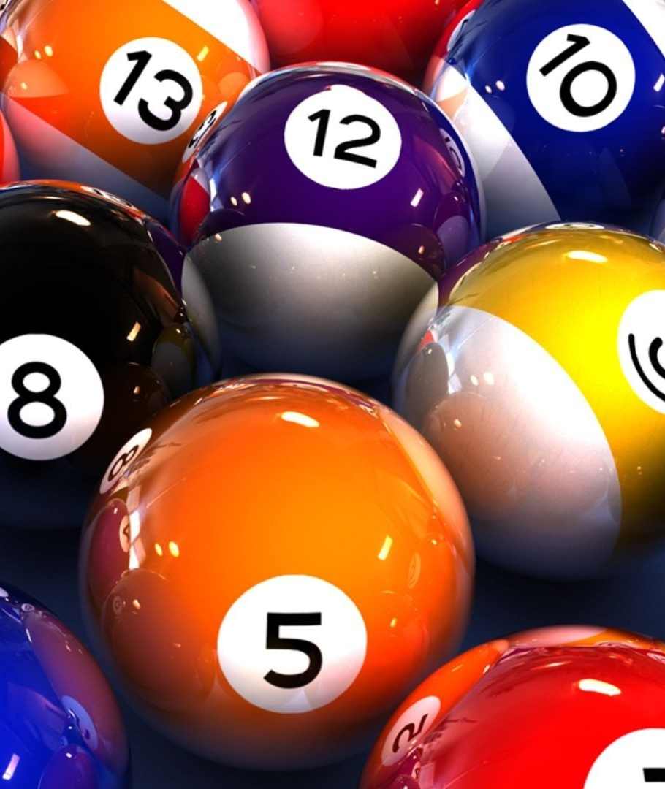
BINGO
An Application of Monte Carlo Simulation
- Aarushi Mishra

Slide 2
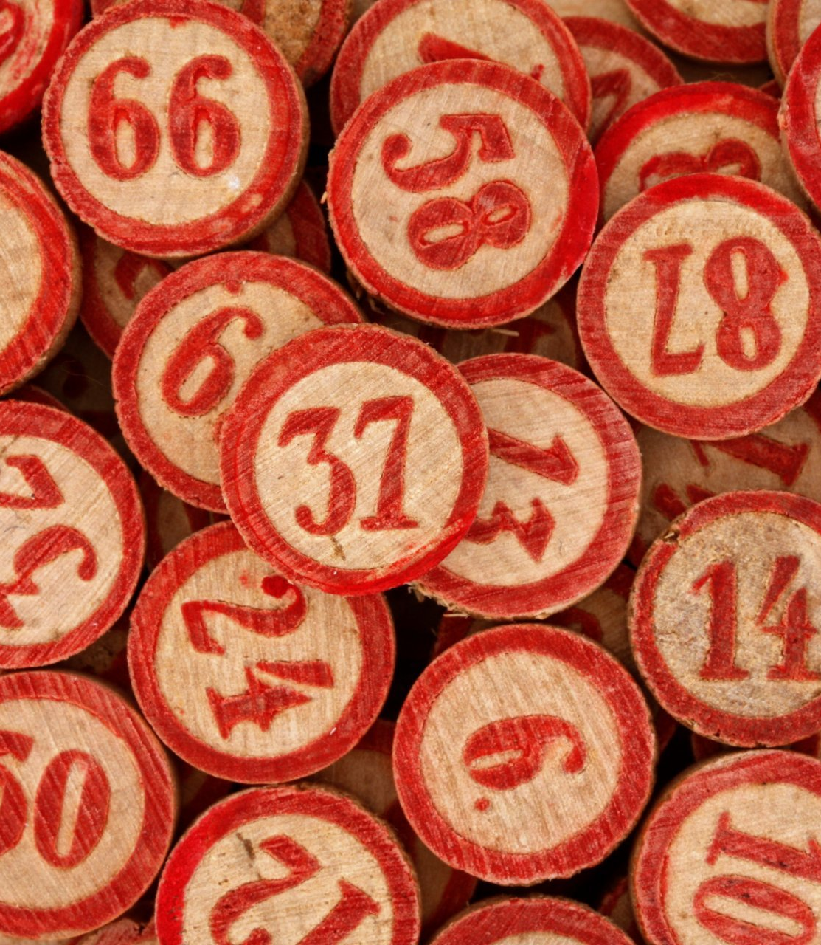
Objective
Simulate a particular scenario of the game to understand Monte Carlo simulation and its application in real world
Based on the results, take an informed decision

Slide 3
Let’s Talk About the Game
Bingo is a game of probability in which players mark off numbers on cards as the numbers are drawn randomly by a caller
The person, who strikes off all or some numbers first, wins
Two variations of the game:
- American Bingo
- British Bingo

Slide 4
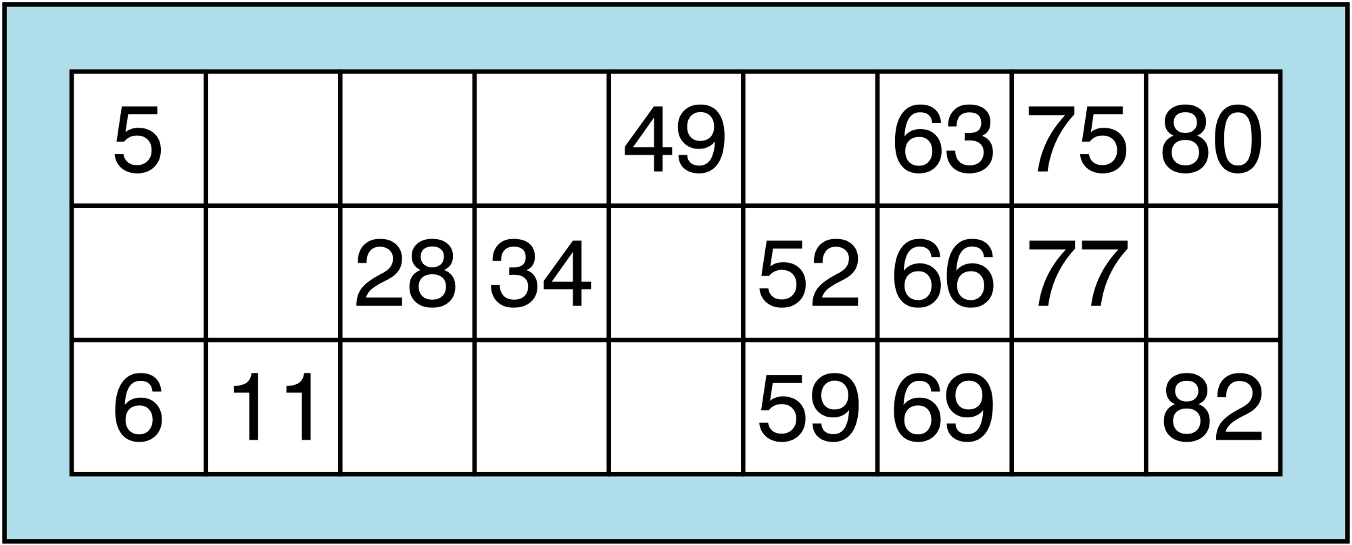
British Bingo
Each player first buys a ticket in order to participate in the game
4 blanks and 5 random numbers in each row ranging between 1 and 90
3 rows
9 columns

Slide 5
British Bingo
The usual winning combinations are:
1. Single line
2. Double line
3. Four Corners
4. Full house
Each winning combination is associated with a particular prize amount

Slide 6
Scenario
A Bingo Club is planning to make some changes to the game in order to attract more participants
The idea is to introduce 2 new Windfalls:
1. Bingo Bonus – requires buying a Special Ticket
2. Lucky Star – requires buying a Lucky Star Ticket

Slide 7
Scenario
These tickets are such that they cost more as compared to normal tickets but offer chances of winning big prize amounts
The profit perspective lies in the fact that it is highly uncertain whether a person, who bought these tickets, will win the jackpot amount

Slide 8
Scenario
Uncertainty is equally unfortunate / fortunate for either of the parties
The aim of the this simulation is to inform the decision of the club on what pay-out amount should be designated for winning each windfall

Slide 9
Hypothesis
“ The pay-out amount for each windfall must be double the price of the ticket. ”

Slide 10
Simulation’s Variables of Uncertainty
For ticket/card generation:
Numbers printed on the ticket ->Uniform
Position of numbers on the ticket->Uniform
Lucky number for lucky star ticket -> Uniform
2. For Game:
Number of players -> Discrete Random
The number called out by the caller -> Uniform

Slide 11
Code Execution
The code is expected to attain the following functionalities:
Generate a type of ticket per player
Replicate the playing environment
Produce useful results

Slide 12
Result
I expect that the simulation results will help the bingo club to decide what pay-out amount is safe such that the it never looses money even when the chances of profit are uncertain

Slide 13
Suggestions and/or Feedback ?

Slide 14


KEEP CALM AND PLAY

