Slide 1
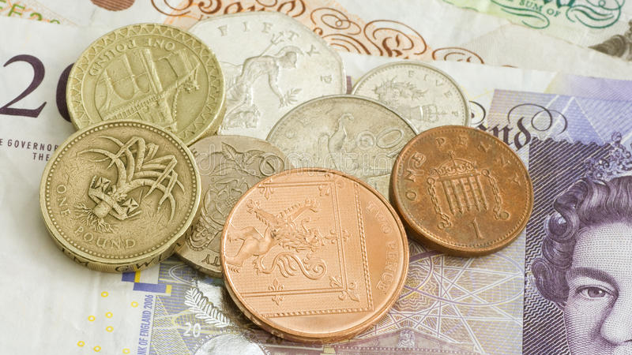
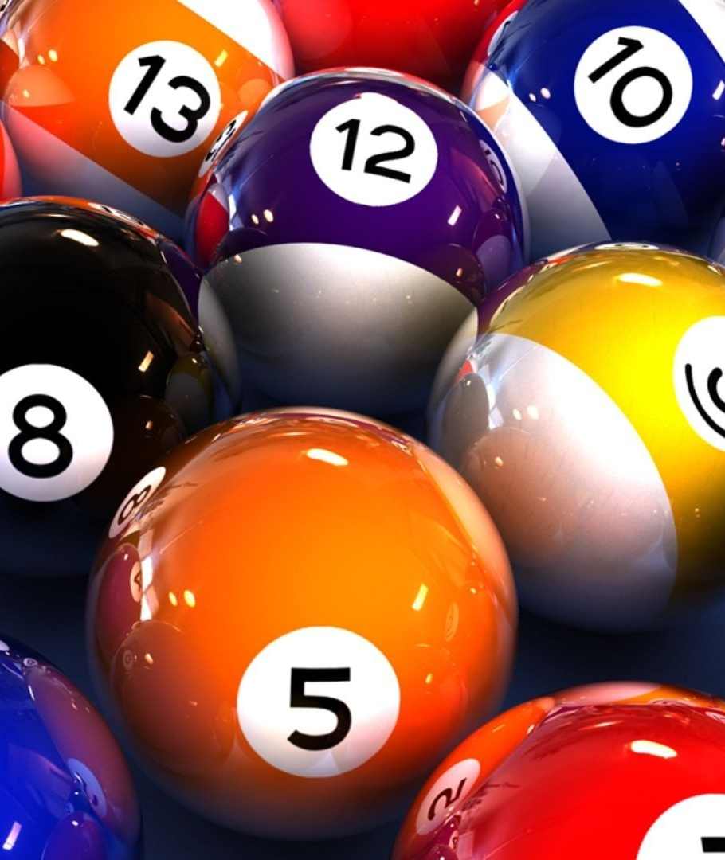
BINGO
An Application of Monte Carlo Simulation
- Aarushi Mishra

Slide 2
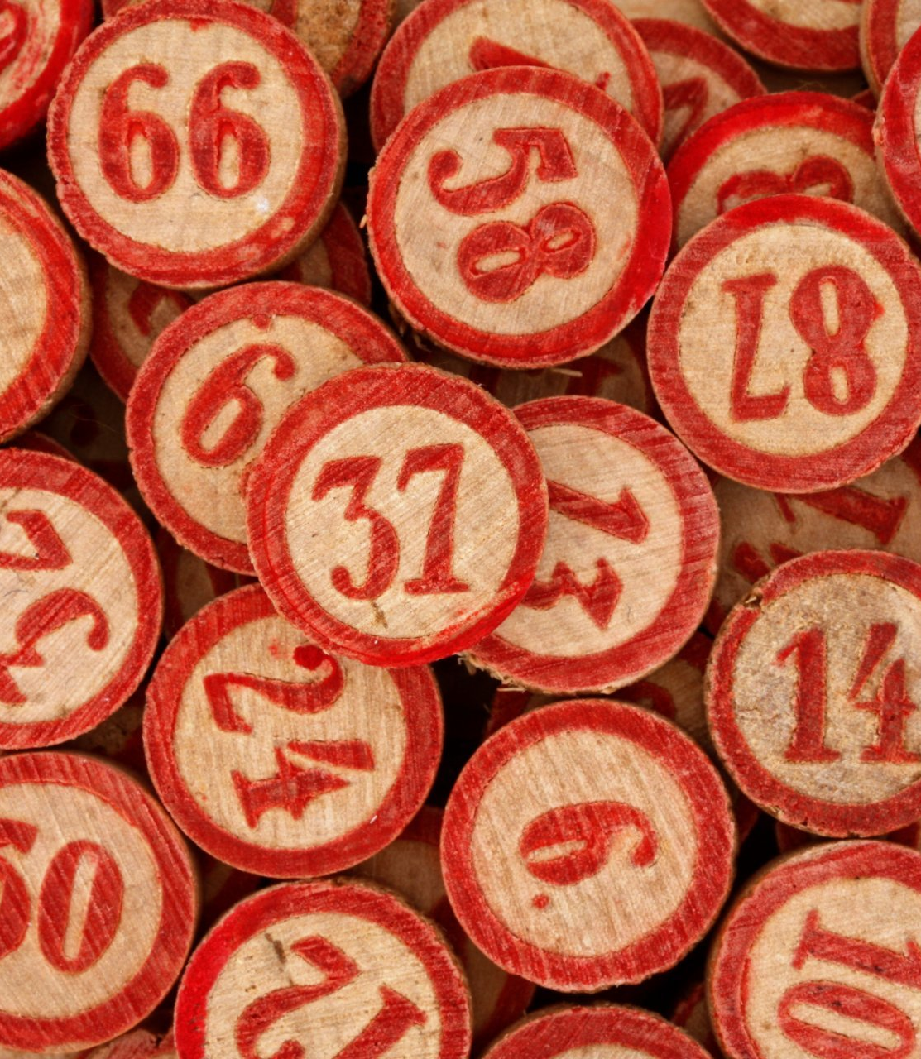
Objective
Simulate a particular scenario of the game to understand Monte Carlo simulation and its application in real world
Based on the results, take an informed decision

Slide 3
Let’s Talk About the Game
Bingo is a game of probability in which players mark off numbers on cards as the numbers are drawn randomly by a caller
The person, who strikes off all or some numbers first, wins
Two variations of the game:
- American Bingo
- British Bingo

Slide 4
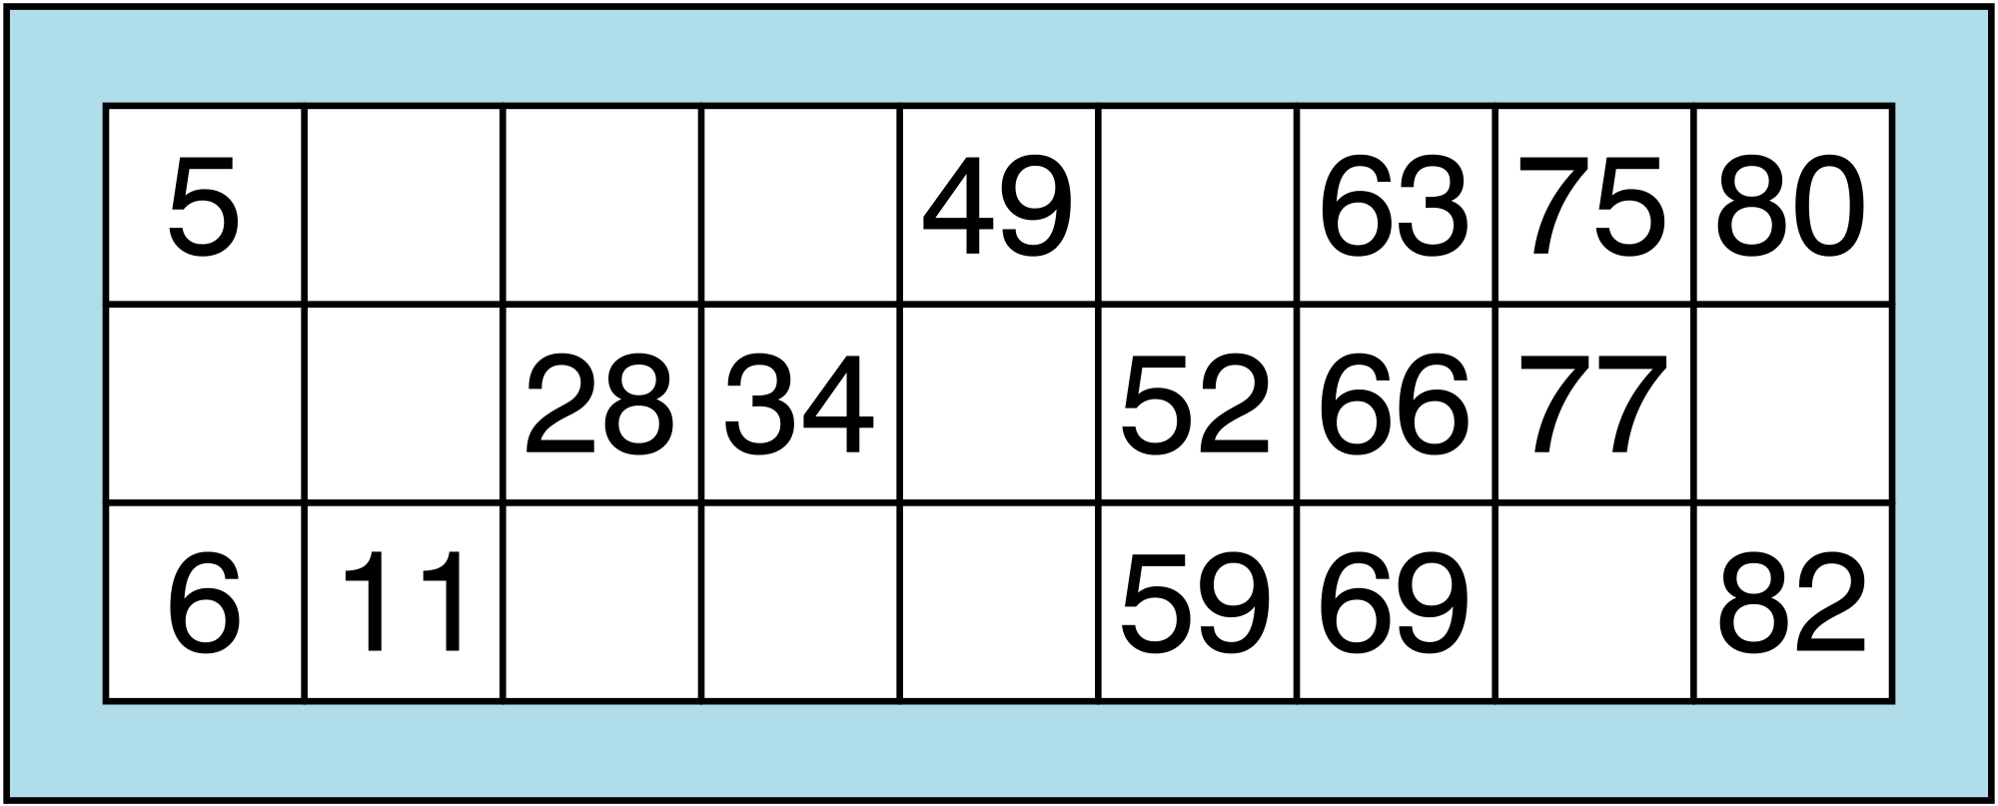
British Bingo
Each player first buys a ticket in order to participate in the game
4 blanks and 5 random numbers in each row ranging between 1 and 90
3 rows
9 columns

Slide 5
British Bingo
The usual winning combinations are:
1. Single line
2. Double line
3. Four Corners
4. Full house
Each winning combination is associated with a particular prize amount

Slide 6
Scenario
A Bingo Club is planning to make some changes to the game in order to attract more participants
The idea is to introduce 2 new Windfalls:
Bingo Bonus – requires buying a Lucky Star Ticket
Jackpot – requires buying a Special Ticket

Slide 7
Scenario
These tickets are such that they cost more as compared to normal tickets but offer chances of winning big prize amounts
The profit perspective lies in the fact that it is highly uncertain whether a person, who bought these tickets, will win the jackpot amount

Slide 8
Scenario
Uncertainty is equally unfortunate / fortunate for either of the parties
The aim of the this simulation is to inform the decision of the club on what pay-out amount should be designated for winning each windfall

Slide 9
Hypothesis
“ The pay-out amount for each windfall must be double the price of the ticket. ”

Slide 10
Types of Ticket
1. Normal Ticket
Cost - £ 10
Associated Windfalls - None

Slide 11
Types of Ticket
2. Lucky Star Ticket
It has a randomly selected lucky number
Lucky Number
Cost - £ 15
Associated Windfall – Bingo Bonus £ 1000
Bingo Bonus is won if last number makeed off for a full house is same as the lucky number

Slide 12
Types of Ticket
3. Special Ticket
Cost - £ 25
Associated Windfall – Jackpot £ 10,000
Jackpot is won if the number marked off for full house is the 100th called number

Slide 13
Pay-outs
1. Single line £ 40
2. Double line £ 60
3. Four Corners £ 50
4. Full house £ 70
Bingo Bonus £ 1000
Jackpot £ 10,000

Slide 14
Simulation’s Variables of Uncertainty
For ticket/card generation:
Numbers printed on the ticket ->Uniform
Position of numbers on the ticket->Uniform
Lucky number for lucky star ticket -> Uniform
2. For Game:
Number of players -> Discrete Random
The number called out by the caller -> Uniform

Slide 15
Code Execution
The code attains the following functionalities:
Generate a type of ticket per player
Replicate the playing environment
Produce useful results

Slide 16
Code Execution
Running simulation requires three python files
Bingo_Ticket.py
Bingo_Game.py
Bingo_Main.py

Slide 17
Results
Simulation results helped to adjust the pay-out amount such that club earns a fair amount of profit
A Bingo Bonus of £ 1000 and Jackpot of £ 10,000 is a safe pay-out amount
The initial hypothesis is thus, rejected based on results

Slide 18
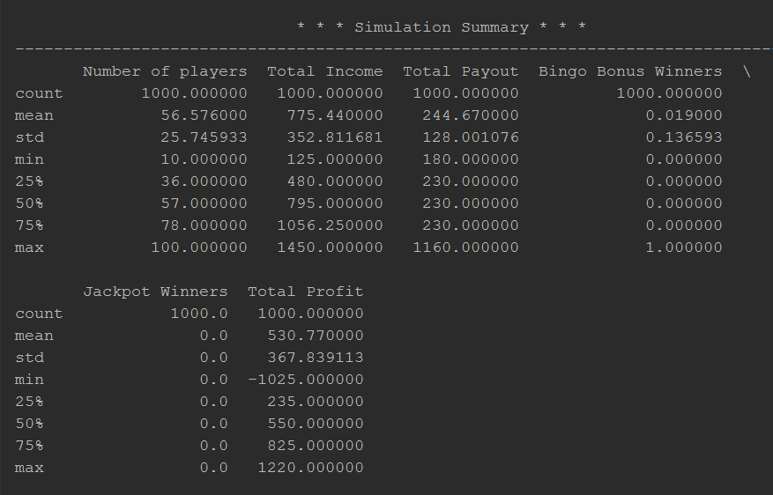
Result
Statistical Summary for 1000 games

Slide 19
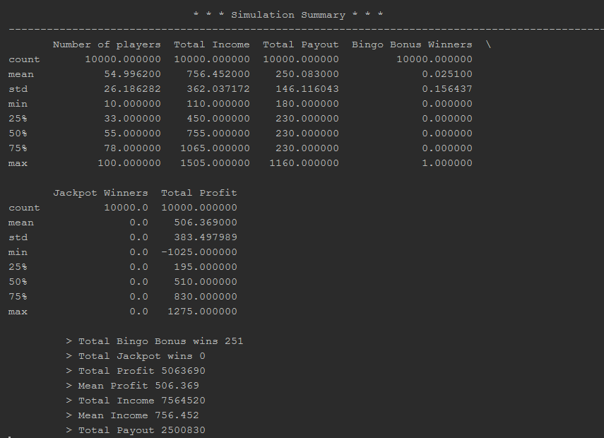
Result
Statistical Summary for 10,000 games

Slide 20
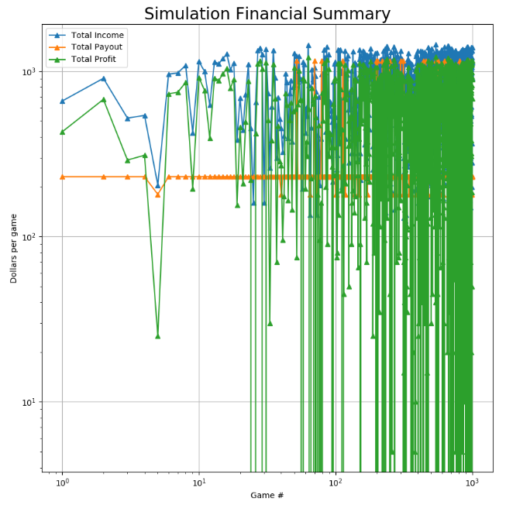
Result
Plot for 1000 games

Slide 21
Limitations
Each participant buys only one ticket for a game.
Minimum number of players in one game is 10.
Maximum number of players in one game is 100.
No coinciding winning occurs.
This simulation is applicable to British Bingo only.

Slide 22
Suggestions and/or Feedback ?

Slide 23


KEEP CALM AND PLAY

