Slide 1
Blue Bikes ML Predictions
By Vita Khan, Aarushi Attray, and Quinn Reilly
Notes:
Welcome to our final presentation about blue bikes machine learning predictions.

Slide 2
Introduction
Why Predict Blue Bike Trip Durations?
Urban traffic congestion is a growing challenge, necessitating sustainable alternatives like bike-sharing.
Understanding patterns in Blue Bike usage can help optimize availability and system efficiency.
Key Research Questions:
Are there peaks in bike usage during certain times?
Which stations have the most traffic, and how does usage vary geographically?
How do demographics (e.g., age, gender, membership type) affect trip duration?
Can we predict trip durations using time of day, user demographics, and station data?
Notes:
Urban traffic congestion is a major challenge. Bike-sharing systems like Blue Bike can offer sustainable alternatives, but their efficiency depends on understanding usage patterns. Our key research questions include:
Are there peaks in bike usage during certain times?
Which stations have the most traffic, and how does usage vary geographically?
How do demographics (e.g., age, gender, membership type) affect trip duration?
Can we predict trip durations using time of day, user demographics, and station data?

Slide 3
Data Description and Pipeline
Data Collection & Cleaning
Source: Blue Bike data obtained via web scraping.
Cleaning Steps:
Removed invalid values (e.g., NaN, 0, negative durations).
Converted timestamps to DateTime format.
Excluded unanalyzable records (e.g., trips with incomplete data).
Visualize using plotting libraries, such as Seaborn, Plotly, and Matplotlib
Implement Machine Learning models and perform regression analysis
Scope of Analysis:
Selected two datasets (January for winter, July for summer) to explore seasonal usage patterns.
Features used: time of day, user demographics (age, membership type), station locations, and ride type.
Notes:
We used Blue Bike data collected via web scraping.
To clean data we removed invalid values and negative durations, converted timestamps for accurate analysis, and excluded incomplete records.
We visualized the data using libraries like Seaborn, Plotly, and Matplotlib, then applied regression models for prediction.
To capture seasonal patterns, we analyzed January and July datasets. Features included time of day, user demographics, station locations, and ride type.

Slide 4
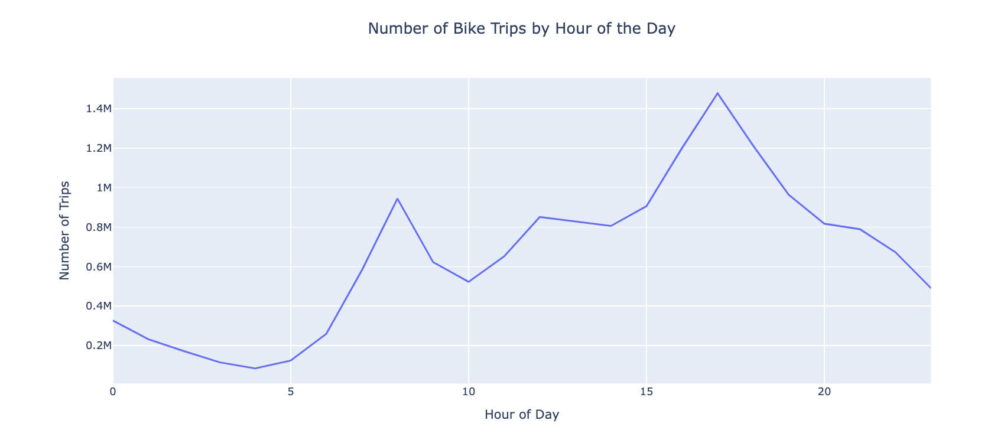
Exploratory Analysis and Plotting
Line Plot Insights:
Displays bike trips per hour based on start time.
Answers:
Are there peaks in bike usage during the day?
Key Findings:
Two clear peaks:
Morning: ~8 AM (commute to work/stations).
Evening: ~5 PM (commute back home/stations).
Evening usage exceeds morning usage, with the highest peak at 5 PM.
Notes:
Before implementing our Machine learning models, we conducted an exploratory analysis and visualized plots to answer some of our focus questions. First, we started with our line plot, where we analyzed bike trips per hour based on start time. We identified two peaks in bike usage during the day: in the morning around 8 am and in evening at 5 pm. Evening usage exceeds morning, with the highest peak at 5 PM. This reflects commuter behavior and highlights the need for more bikes during peak hours.

Slide 5
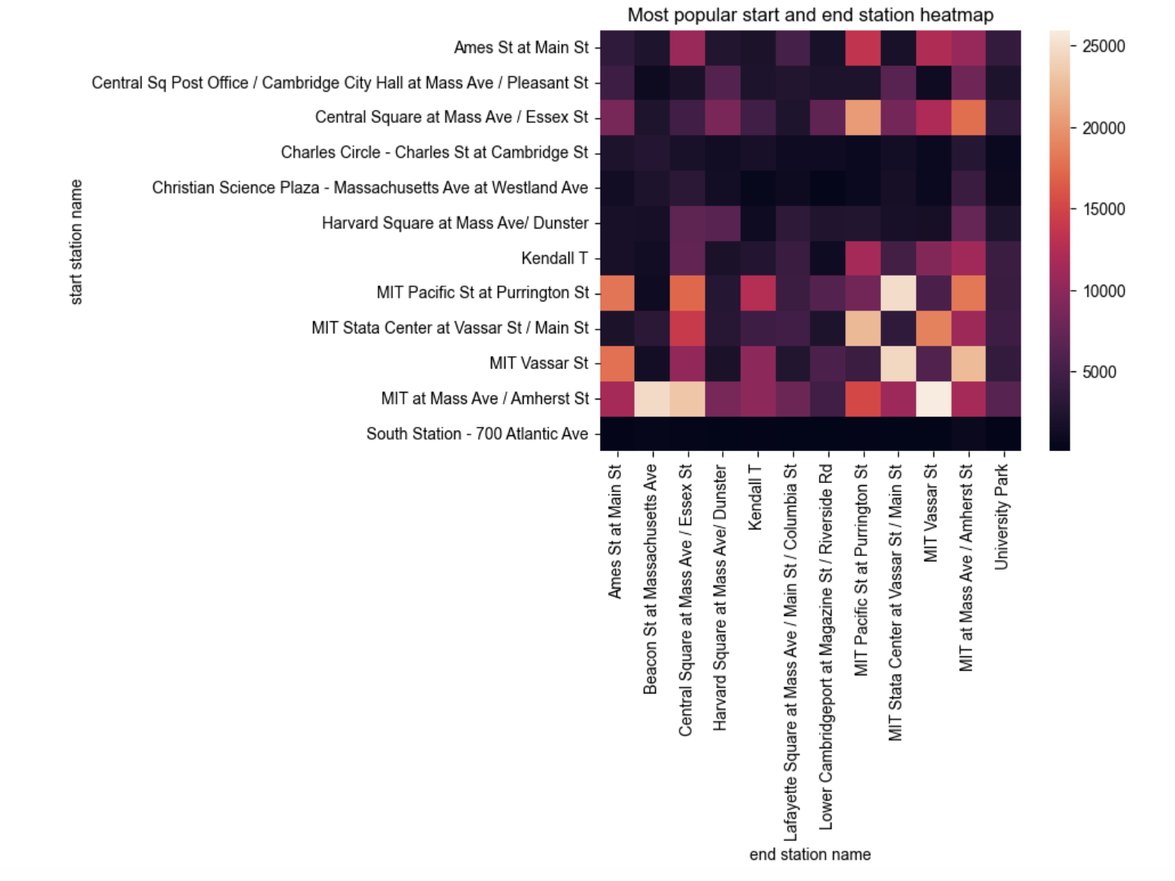
Heatmap Insights:
Identifies high and low-traffic stations geographically.
Answers:
Which stations have the highest traffic?
Where are high-demand areas for more bikes?
Key Findings:
High traffic: MIT area (e.g., Pacific St & Purrington St, Stata Center).
Low traffic: South Station.
Implication:
Guides bike placement and supply in high-demand areas.
Notes:
Next, we mapped traffic intensity by station using the Heatmap. We found the high traffic areas near MIT, such as Pacific and Purrington St. Then, the low traffic is at South Station. This implies that allocating more bikes to these high-demand areas will enhance system efficiency.

Slide 6
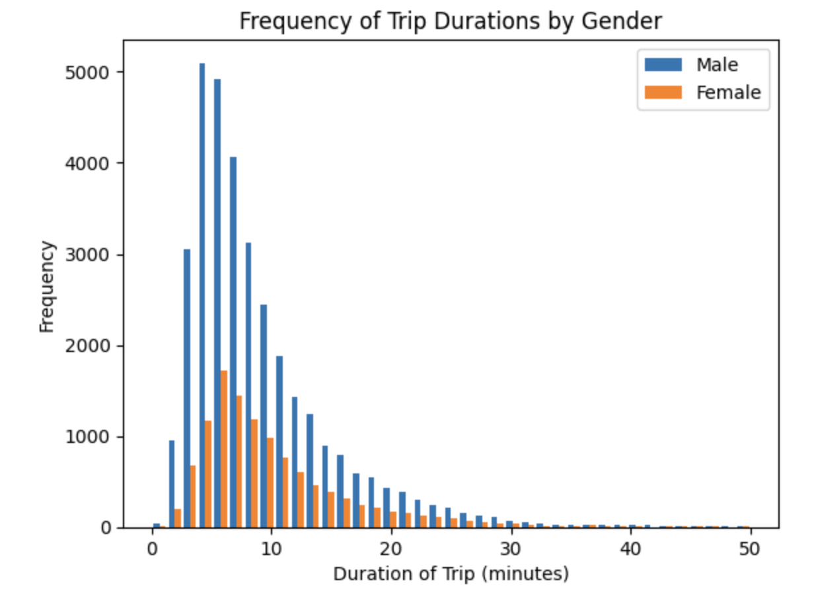
Histogram Insights:
Visualizes frequency distribution of trip durations by gender.
Answers:
How does trip duration vary by user type (e.g., gender)?
Key Findings:
Males take trips more frequently than females.
Most common trip durations: 5–8 minutes.
Both genders prefer short trips (<10 minutes).
Long trips (>30 minutes) are rare.

Slide 7
Methods
Linear Regression
Assumes linear relationships between predictors (time of day, demographics) and trip duration.
Significant violations of linearity, independence, and constant variance assumptions.
Polynomial Regression
Explored nonlinear relationships and included interaction terms (e.g., membership type × ride type).
Slightly improved metrics but underperformed Linear Regression.
PCA + Regression
Addressed multicollinearity by simplifying predictors while retaining maximum variance.
Simplified analysis but did not improve predictive performance

Slide 8
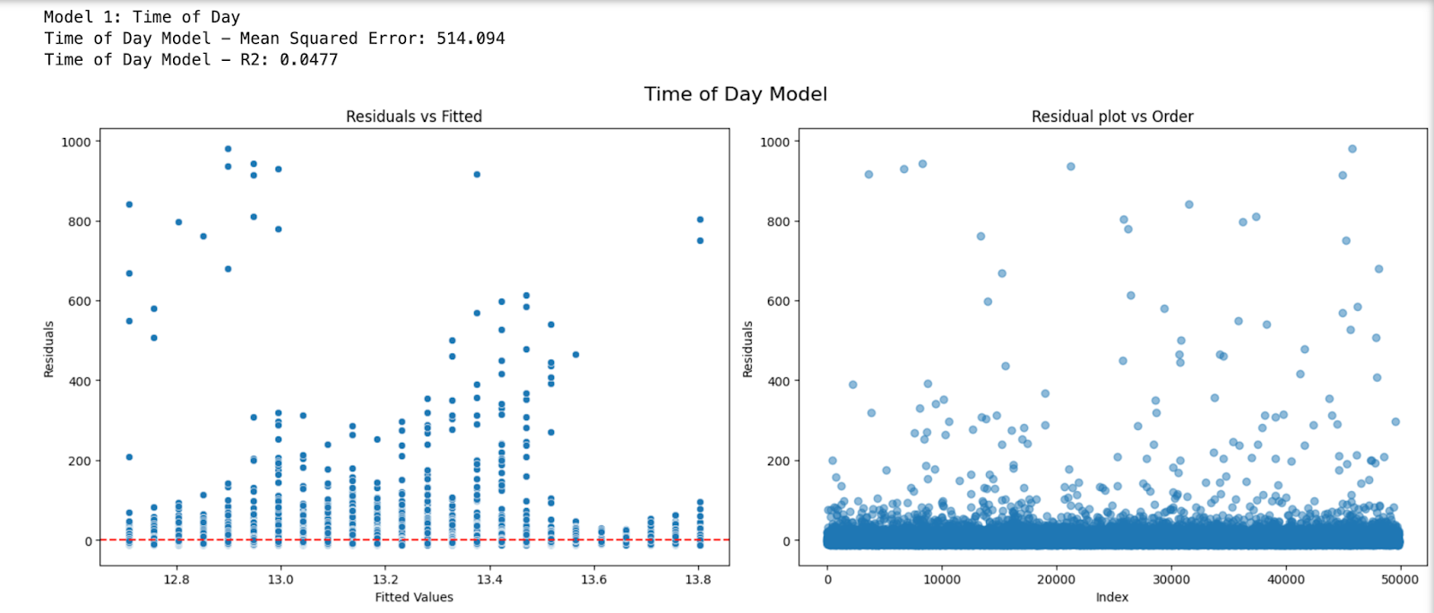
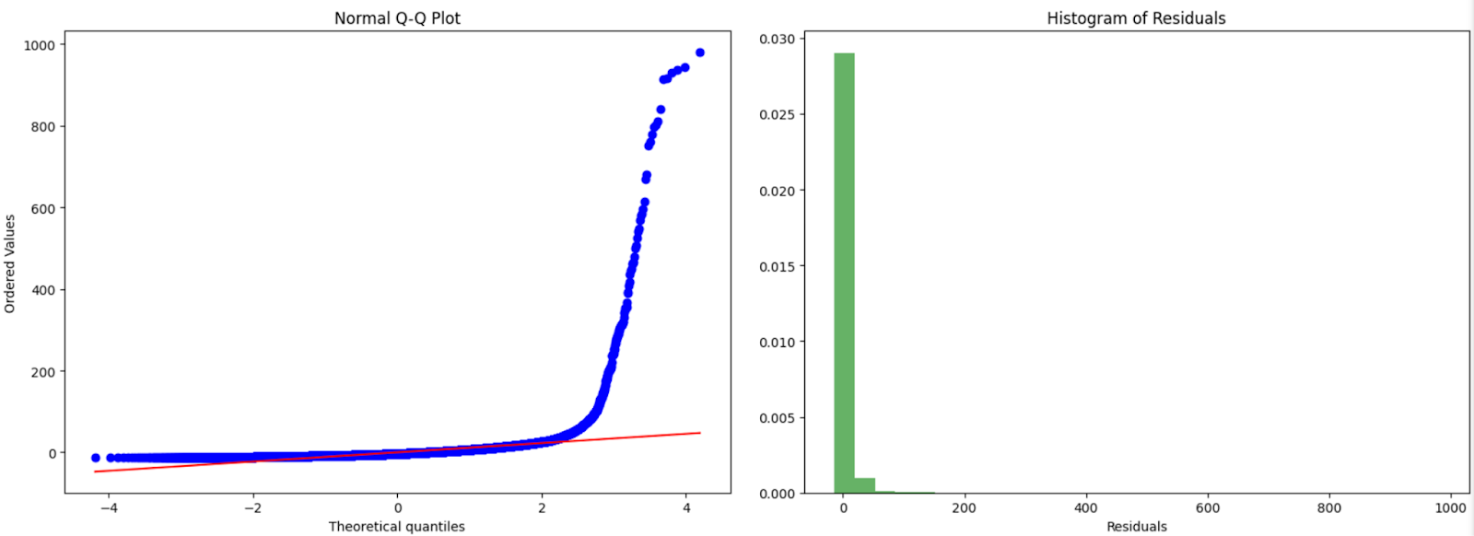
Model 1
Linear Regression:
Time of Day
MSE = 514
R² = 0.0477
Significant assumption violations observed (e.g., nonlinear patterns in residual plots).

Slide 9
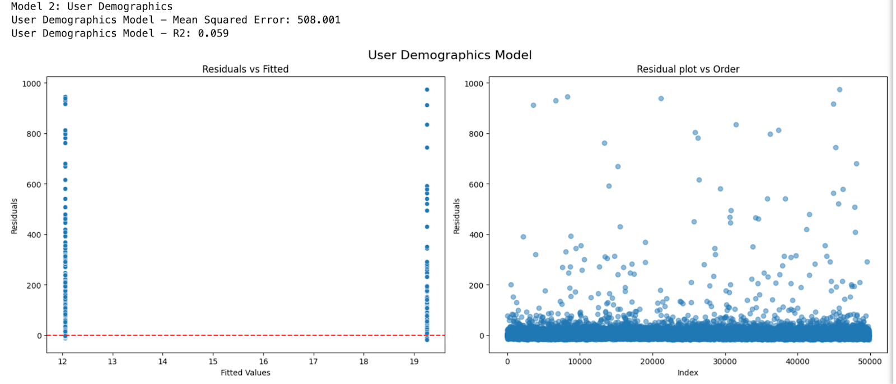
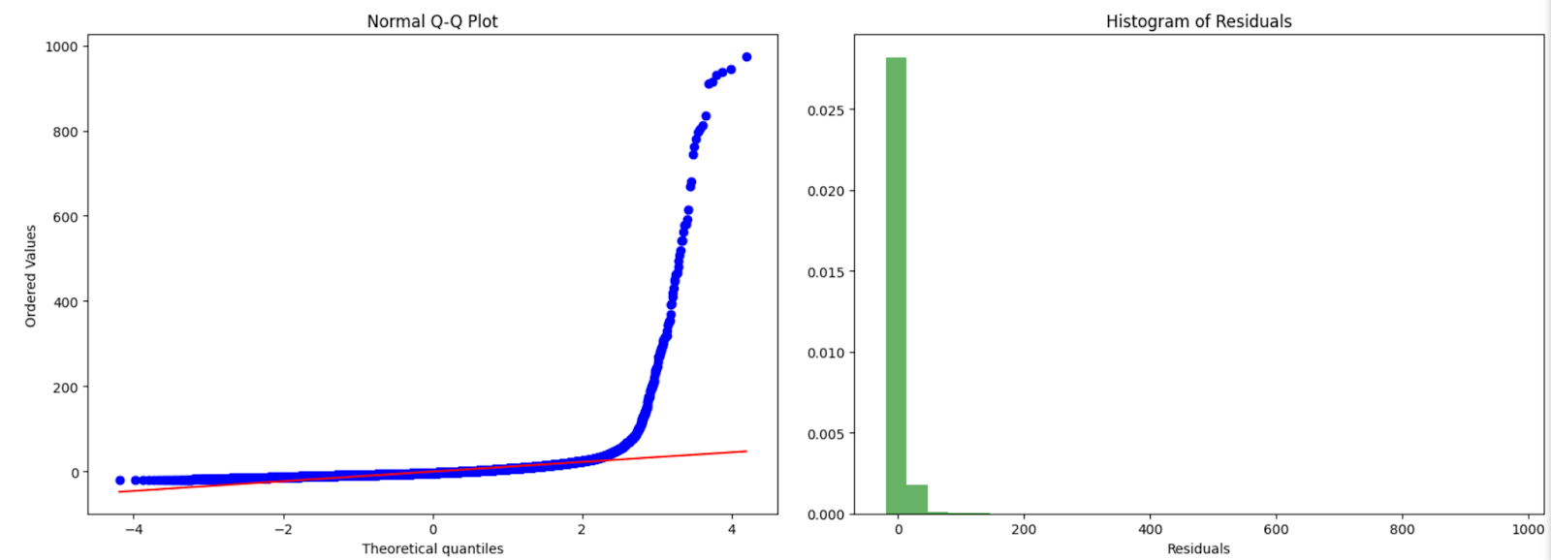
Model 2
Linear Regression:
User Demographics
MSE = 508.001
R² = 0.059
Highest R² among all models
Violations of linearity and constant variance, potential independence violation, non-normal distribution

Slide 10
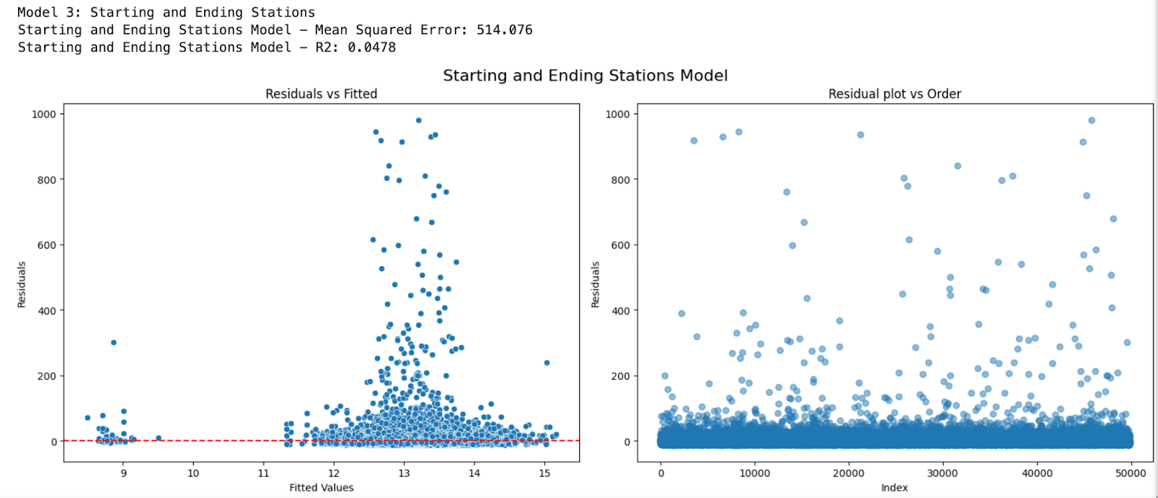
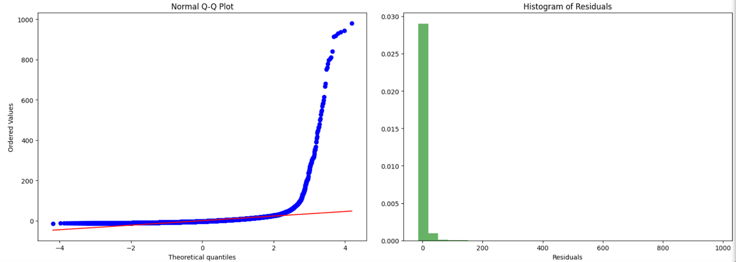
Model 3
Linear Regression:
Starting and Ending Stations
MSE = 514.076
R² = 0.0478
Violations of linearity and constant variance assumptions.
Notes:
The Residuals vs. Fitted -> violations of linearity and constant variance assumptions, as data points were not evenly distributed around the y=0 line and showed occasional gaps and outliers.
the Independence assumption might be violated-> density above the y = 0 line. Finally, we see that the
residuals are right skewed on the Q-Q plot and Histogram of residuals, indicating violations of the normality assumption.

Slide 11
Polynomial Regression and PCA
Polynomial Regression:
Initial model: R² = 0.0035, MSE = 627.869.
Improved model (interaction terms): R² = 0.0482, MSE = 599.699.
Still underperformed compared to Linear Regression (R² = 0.059, MSE = 508.001)
PCA + Regression:
Simplified predictor relationships but failed to improve R² or MSE.
All models exhibited significant limitations due to violations of fundamental assumptions
Notes:
We then applied Polynomial Regression models to explore potential nonlinear relationships. Initially, this approach yielded an MSE of 627.869 and an R² value of 0.0035, performing worse than the Linear Regression models. To improve the model, we incorporated interaction terms and dummy variables (e.g., member_casual and rideable_type) with binary values of 0 and 1. This adjustment slightly improved the results, reducing the MSE to 599.699 and increasing the R² value to 0.0482. However, these metrics remained worse than those of the Linear Regression models, indicating limited improvement.

Slide 12
Discussion
Limitations:
Critical assumption violations across all models:
Nonlinearity in predictor relationships.
Heteroscedasticity (non-constant variance of residuals).
Skewed residual distributions violating normality assumptions.
Low R² Values: Models explained <6% of trip duration variability, likely due to missing critical features (e.g., weather, traffic).
Future Research Directions:
Include richer datasets (e.g., weather, socioeconomic factors).
Explore non-parametric models (e.g., Random Forest, Gradient Boosting).
Use geospatial modeling to account for station-specific factors.
Consider mixed-effects models to address hierarchical structures in the data.

Slide 13
Conclusion
Summary
Linear Regression was the best model but revealed the complexity of predicting real-world trip durations.
All models suffered from assumption violations and low predictive accuracy.
Takeaway
Effective trip duration prediction requires richer datasets and advanced modeling techniques.
Broader Implications
Results provide insights for improving bike-sharing system optimization through data-driven strategies.

Slide 14
Thank You!

