Slide 1

Next Gen Retail Analytics Dashboard
Team:
Aarushi Kotwani
Vatsal Dalal
Tileshwar Narayan

Slide 2

Problem Statement
Retailers struggle with wide variety data insights and integration issues across key business areas like products, customers, and sales. This leads to inefficiencies in decision-making and adapting to industry changes. Some of the problems faced:
Fragmented Data Insights: In the retail sector, businesses encounter challenges with fragmented data insights across crucial areas like products, customers, and sales.
Integration Hurdles: Existing analytics tools often struggle with integration, impeding the seamless flow of data and hindering retailers' agility in responding to industry shifts effectively.
Impact on Decision-making: The fragmented nature of data and integration hurdles adversely affect decision-making processes, limiting retailers' ability to optimize operations and capitalize on emerging opportunities.

Slide 3
What We would Achieve
With our project, we aim to address these challenges by offering a comprehensive analytics solution that integrates key variables seamlessly, empowering retailers to make informed decisions and optimize operations. Some of the basic things that we want to achieve from this project are as:
Comprehensive Integration: Our project seeks to resolve retail challenges by offering a holistic analytics solution. Through seamless integration of essential variables like products, customers, and sales data, we aim to provide retailers with a unified platform for deriving actionable insights.
Enhanced Decision-Making: By harnessing the power of integrated data, our solution empowers retailers to make informed decisions with confidence. Access to comprehensive insights enables businesses to optimize operations effectively and capitalize on emerging opportunities.
Future-Proof Adaptability: With a focus on operational optimization and adaptability, our project aims to revolutionize the retail landscape. By staying ahead of industry shifts and facilitating sustainable growth in the data-driven era, we empower businesses to thrive in a dynamic marketplace.

Slide 4
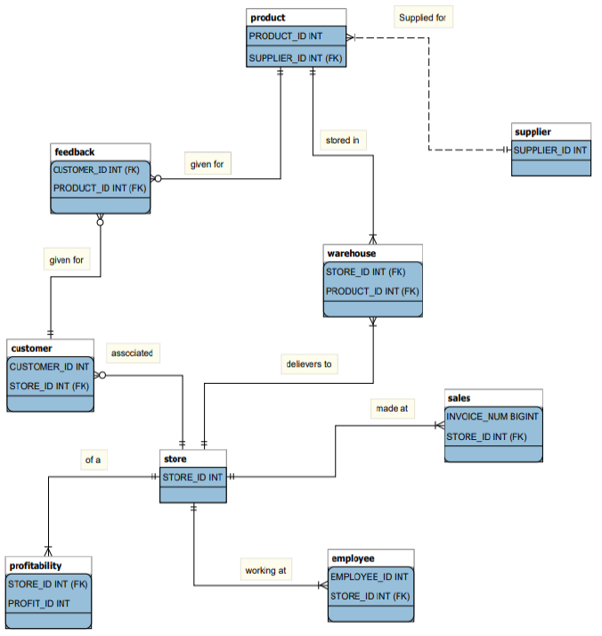
ER Diagram

Slide 5
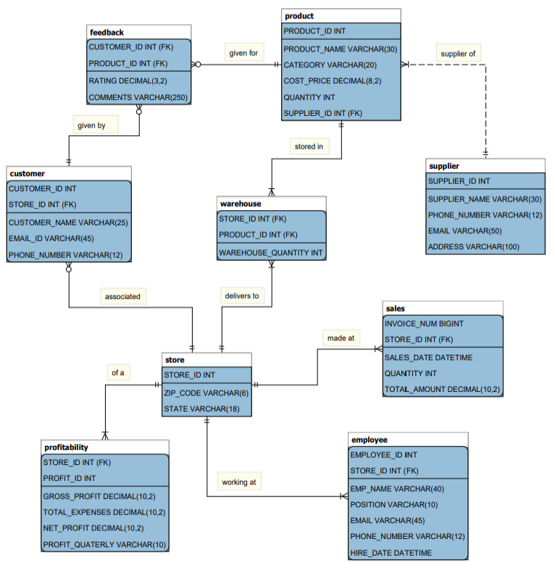
Logical Diagram

Slide 6
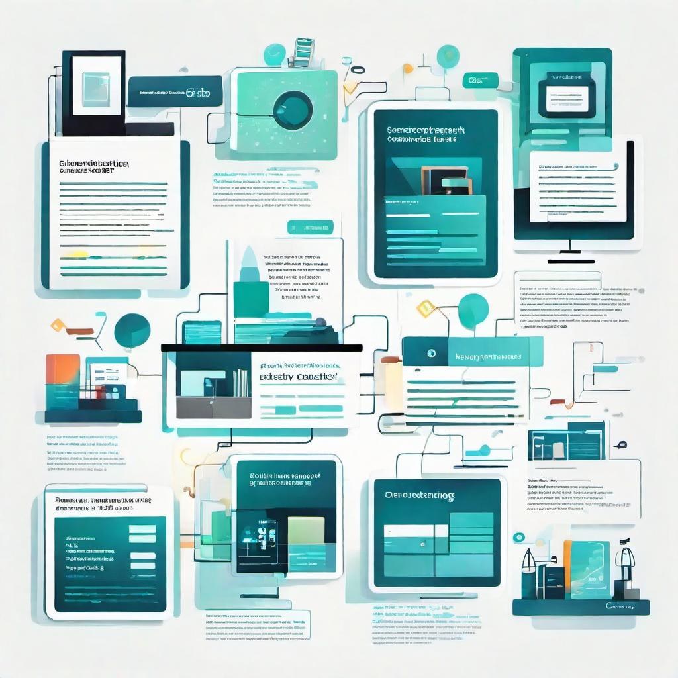
Data Structure and Data Population
Our database comprises nine primary tables: Store, Product, Warehouse, Sales, Profitability, Customer, Supplier, and Feedback.
Each table has been chosen, including various fields, and has been appropriately assigned primary keys and foreign keys as required.
The relationships between the tables have been established according to the specified requirements, incorporating one-to-many, many-to-many, weak, and optional relationships.
Data was generated by selecting specific variables from Mockaroo. Each field was meticulously chosen, and data was generated and subsequently populated in our database.

Slide 7
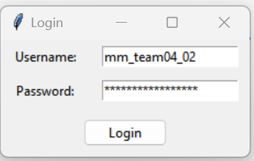
Working of Application
We will embark on an exploration of the intricately designed application, meticulously tailored for our database. Within this platform, users will have the opportunity to navigate through and engage with data in a manner that aligns with their individual preferences and requirements.
Step 1: Enter Username and Password and then click Login (For Server)

Slide 8
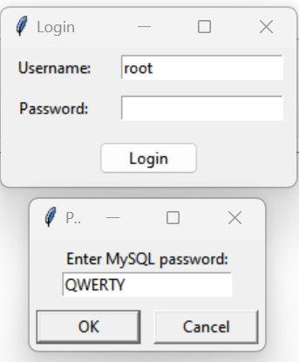
Working of Application
Step 2: Connecting to Local Host
Enter Username: root
If there is a Password, then Enter the same in the new Pop-Up window.
If there is no Password, then directly Click on OK.

Slide 9
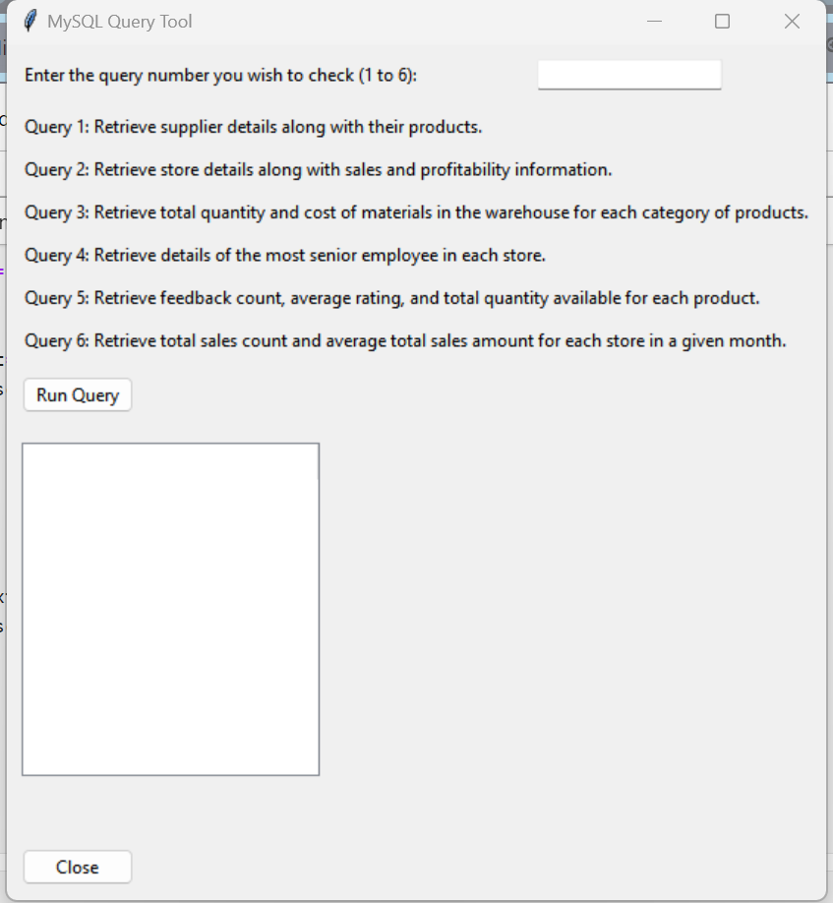
Working of Application
Step 3: Enter Query Number as per Your choice and Click on Run Query and you want to exit just click on Close.

Slide 10
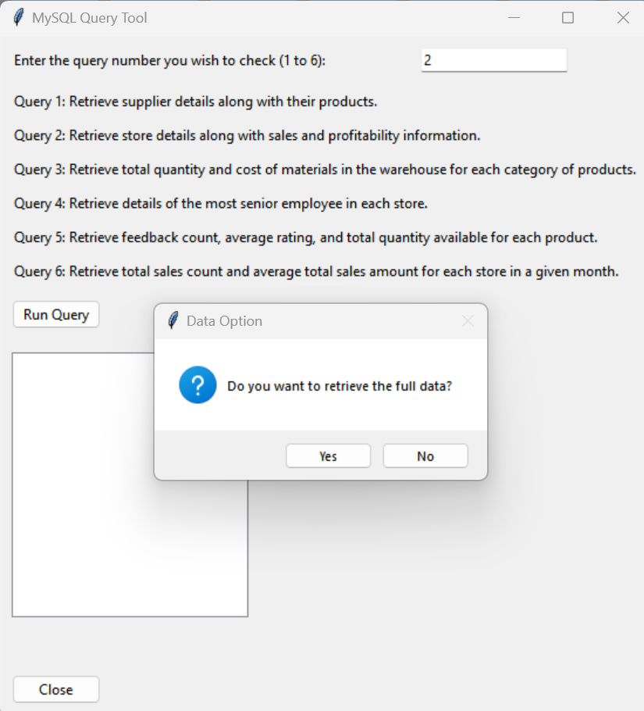
Working of Application
Step 4: If you want the whole query to run click on Yes and if you want specific data then click on No.

Slide 11
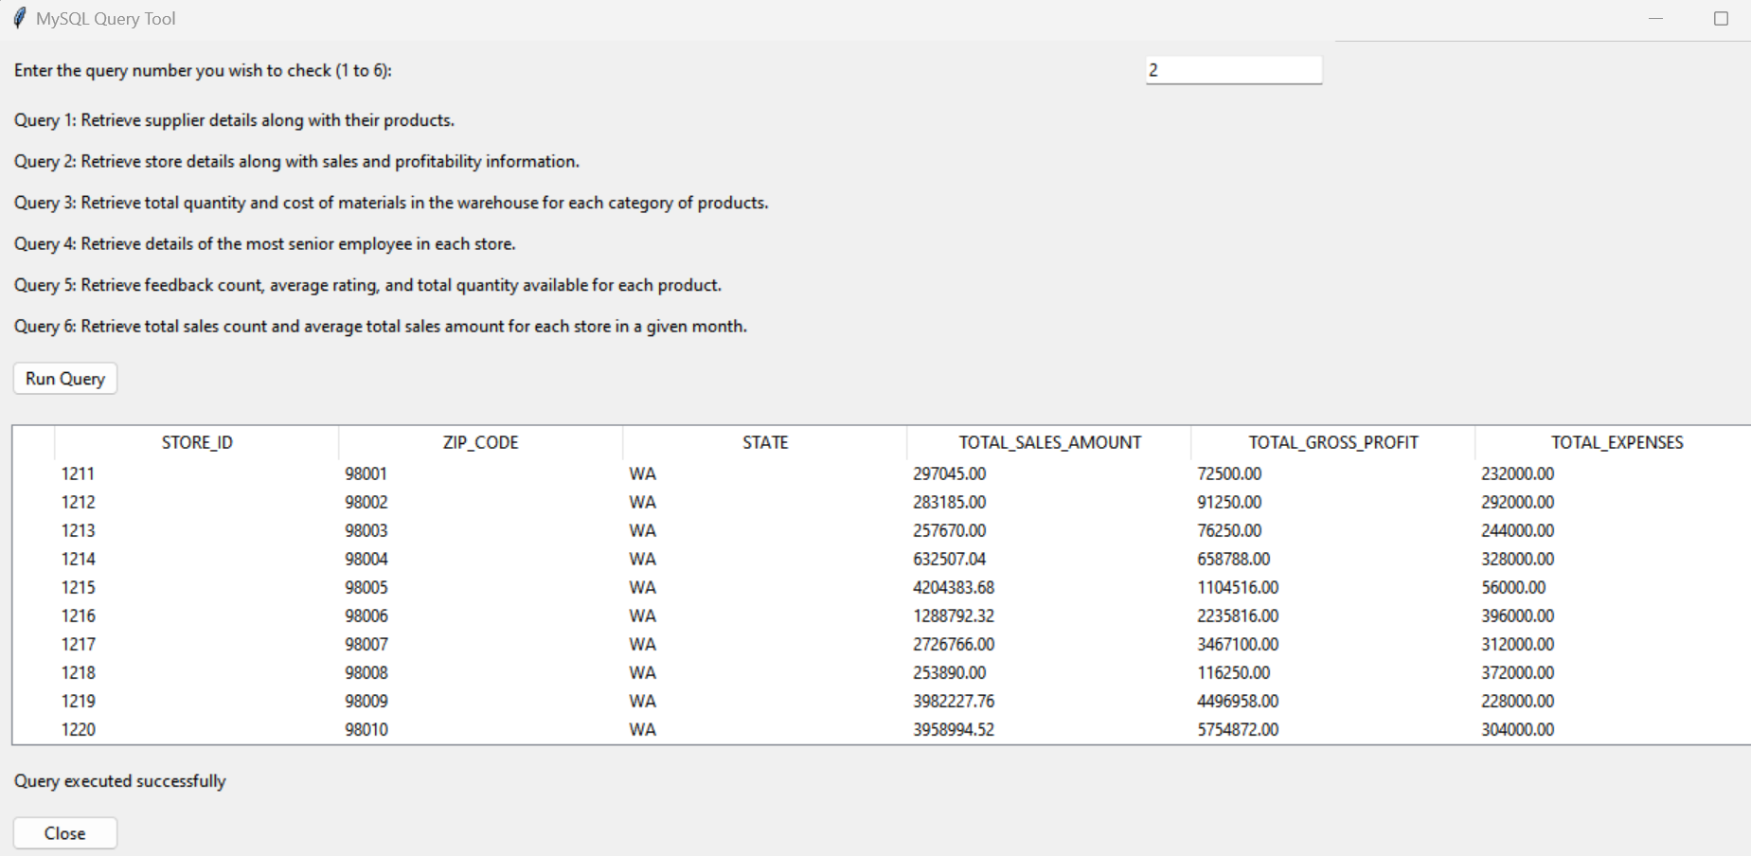
Working of Application
Step 5: If Yes then will we have the whole data displayed

Slide 12
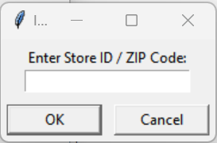
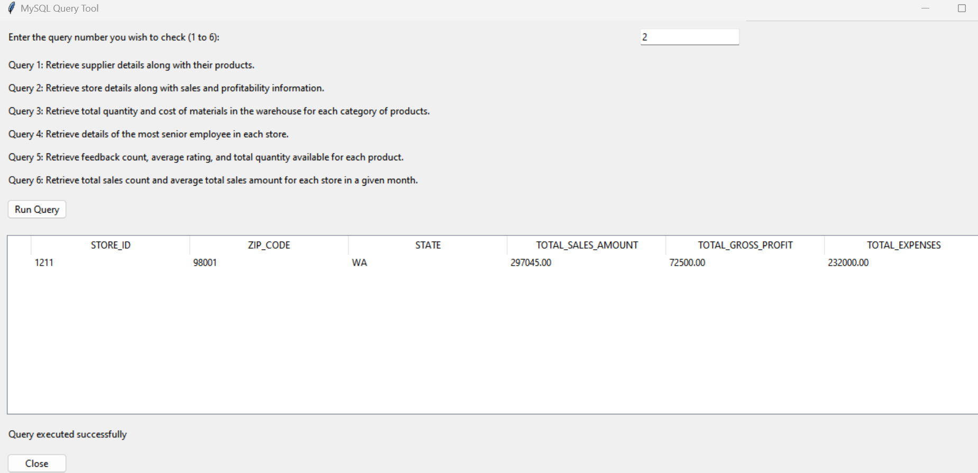
Working of Application
Step 6: If we want to check specific row, we can enter details as asked in the prompt. We can enter Store ID or ZIP code and the application search as per the data provided and the result of specific Store ID will be displayed.

Slide 13
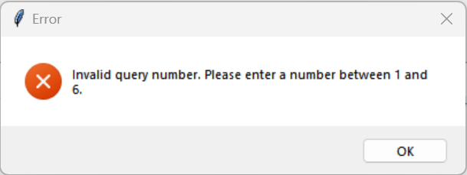
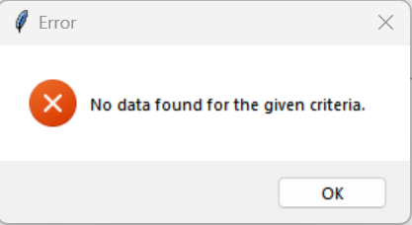
Working of Application
Additional Features: Whenever we enter any wrong detail, we will be prompted with an error message right from Query Selection or specific data drawing.

Slide 14
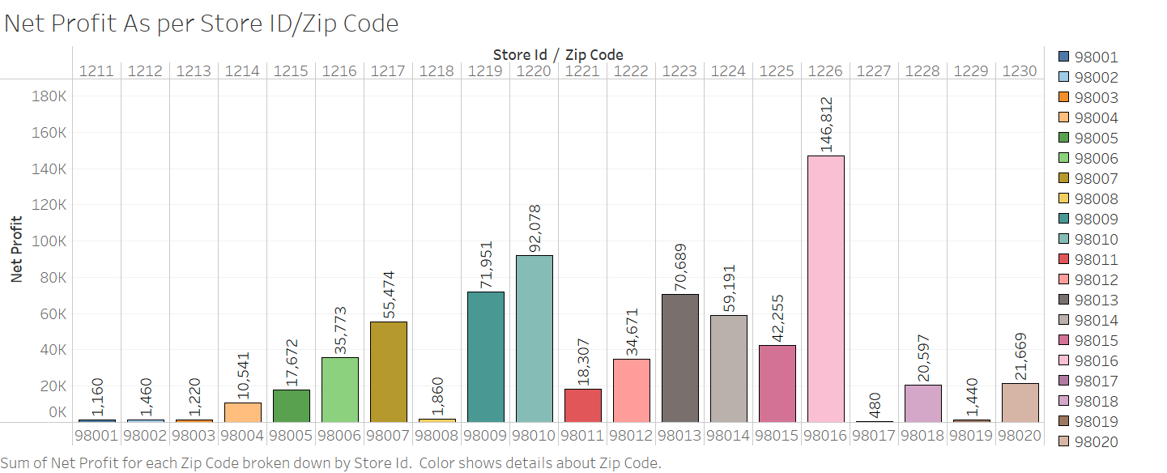
Data Analysis
Initiating data analysis for the project, we aim to unveil insights and patterns within the dataset to drive informed decision-making.
Sum of Net Profit for each Zip Code broken down by Store Id. Color shows details about Zip Code.

Slide 15
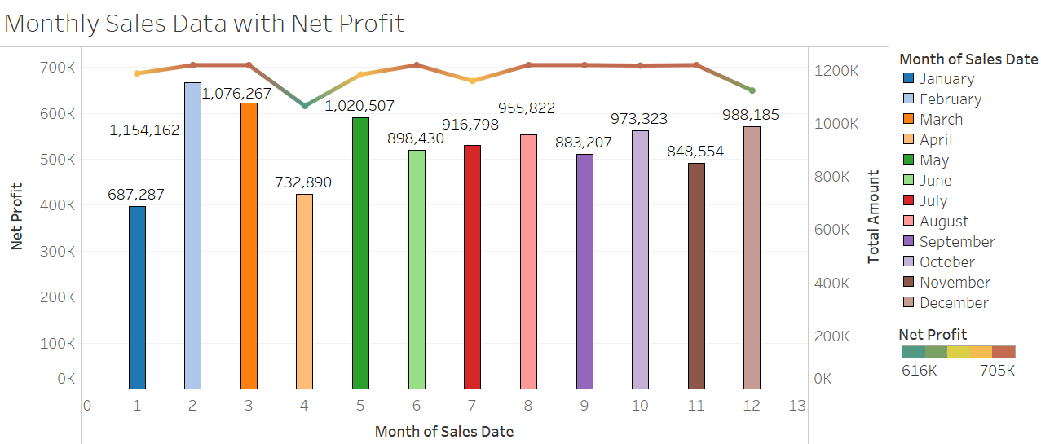
Data Analysis
The trends of Net Profit and sum of Total Amount for Sales Date Month. For pane Sum of Net Profit: Color shows Net Profit. Details are shown for Net Profit. For pane Sum of Total Amount: Color shows details about Sales Date Month

Slide 16
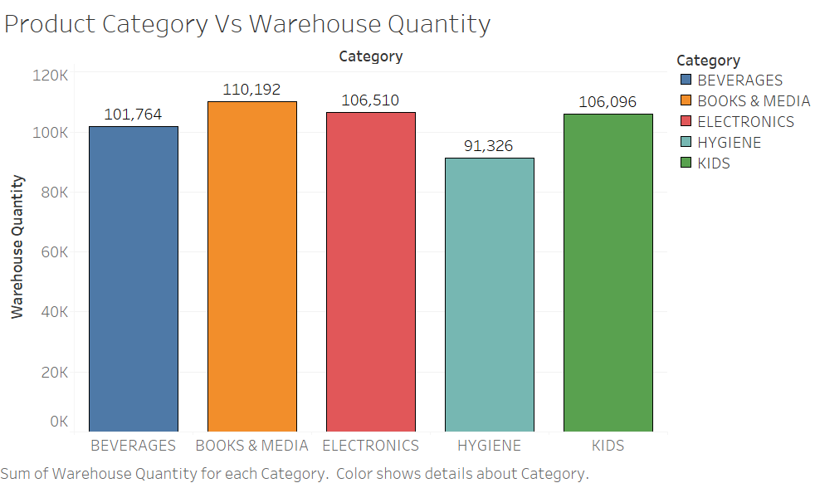
Data Analysis
Sum of Warehouse Quantity for each Category. Color shows details about Category.

Slide 17
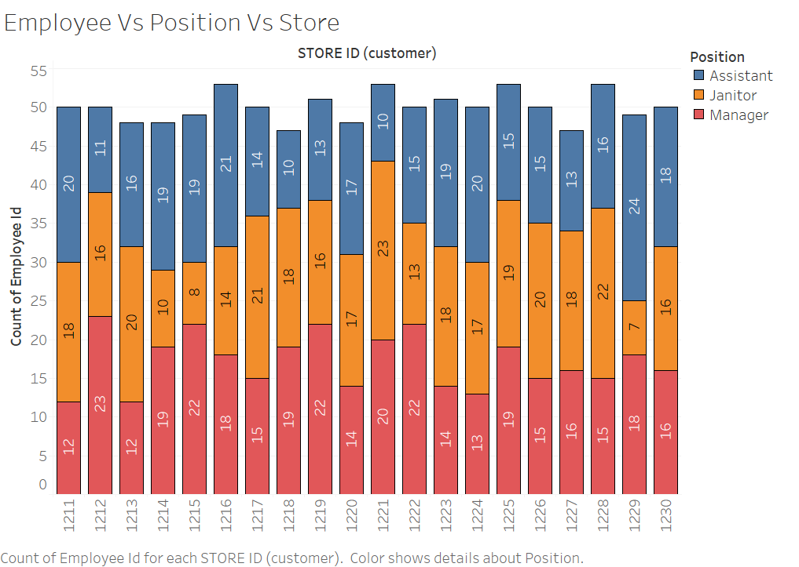
Data Analysis
Count of Employee Id for each STORE ID (customer). Color shows details about Position.

Slide 18
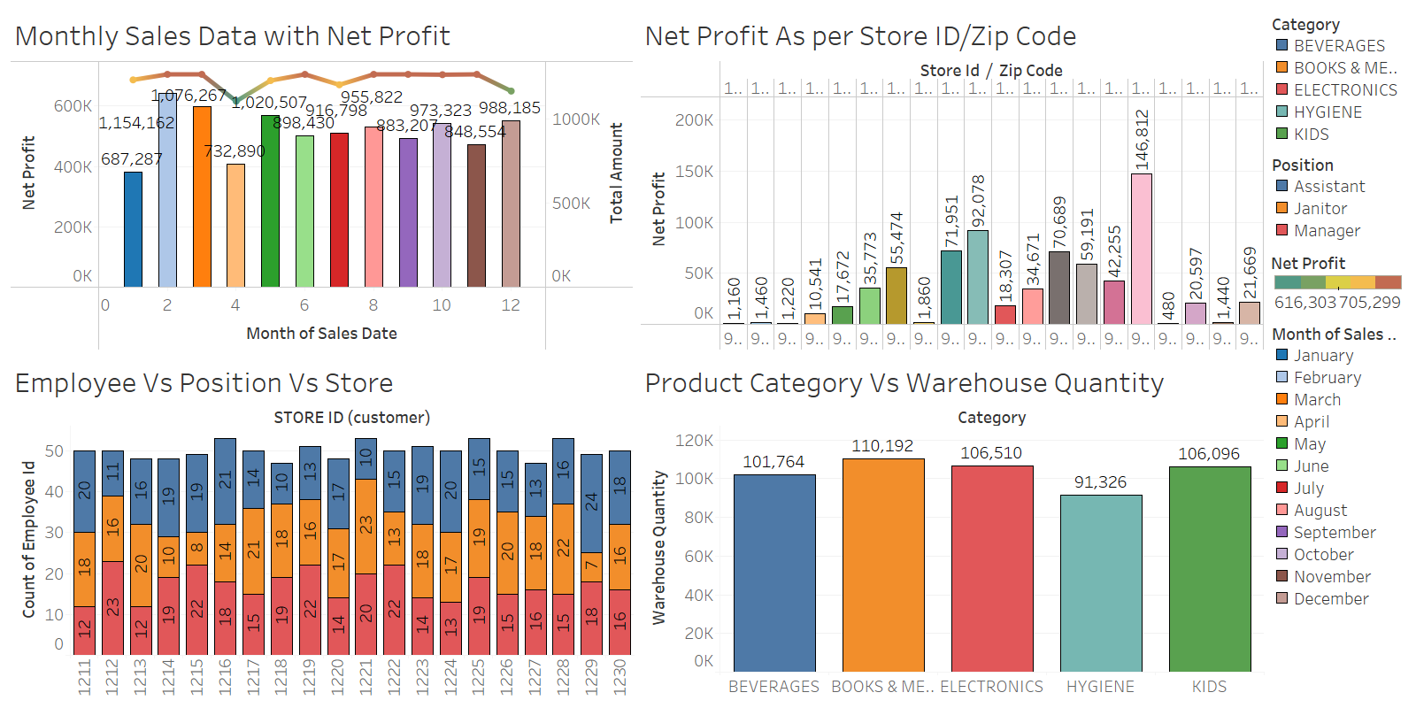
Conclusion
Our project represents a transformative step forward in addressing the challenges faced by the retail sector. By offering a comprehensive analytics solution that integrates crucial variables and enhances decision-making capabilities, we empower retailers to optimize operations and drive sustainable growth. With a commitment to adaptability and future-proofing, we envision our project as a catalyst for innovation, enabling businesses to thrive in an ever-evolving market landscape.

