Slide 1
Festivals
Aarushi
29th March

Slide 2
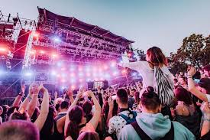
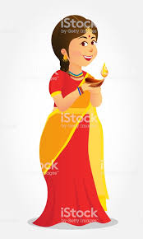
What is Festivals
Festivals is a Fugshun
Exsample Gurupurab,Ganesh chaturthi ext.

Slide 3
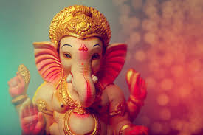
Ganesh Chaturthi
Ganesh Chaturthi is celebrated to Lord Ganesh
The wisdom, prosperity and good forune.

Slide 4
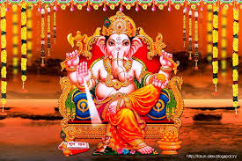
About Ganesha
Ganesh Chaturthi is celebrated
In the month of august.
Ganesha is born from mund…...

Slide 5
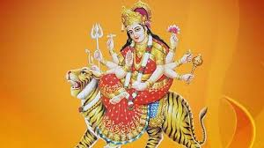
Navratri
Navratri is a Hindu festival of worship and dance.The word Navratri means nine nights in sanskrit,: Nava-Nine and Ratri-nights.The famous Indian form of dance- GARBA.

Slide 6
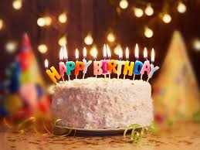
Birthdays
A Birthday is a day I or you Born day and you will haveA Birthday party.

Slide 7
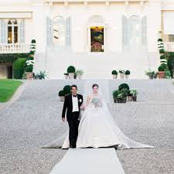
Weddings
A Wedding is a very happy
Occasion for the family.In India We celebrate Wedding over several days…..

Slide 8
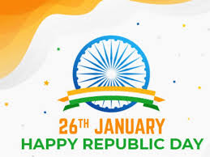
Republic Day
26th January, 1950 is one of the
Important day that is Republic
Day.

Slide 9
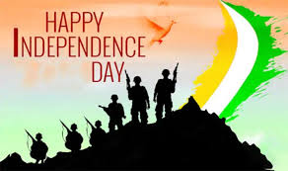
Independence Day
India gained its independence
From British rule on the 15th OF Augest 1947.So, this day is celebrated as
^{Independence Day.}

Slide 10
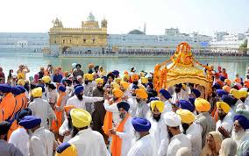
Gurupurab-The Festival of Sikhs
Sikhs celebrate the Birthdday of
Their ten gurus as ‘Gurupurab’
Three weeks before the festival
People start going for processions(called Prabhat pheris)

Slide 11
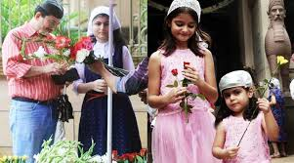
Parsi New Year
Parsi New Year’ is known as ‘navroz’ (nav – means new andRoz means day…..

Slide 12
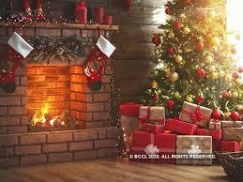
Christmas
Christians celebrate Christmas on
25th December every year to mark
The birth of Jesus Christ

Slide 13
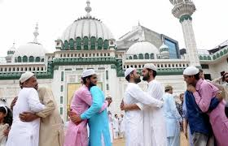
Id-ul-Fitr
Id-ul-fitr popularly known
of the breaking of Fast; …...

Slide 14
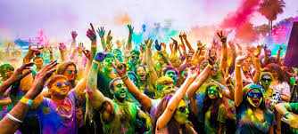
Holi
Holi is a colours Festival
Holi is celebrated on 8th march

Slide 15
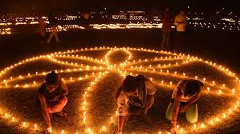
Diwali
Diwali,is also known as
Deepavali,and Diwali is a
Light festival.

