Slide 1
Sharks
Aarushi Pujeri
7th April 2020

Slide 2
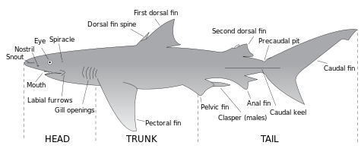
Intruduction
Until the 16th century,[6] sharks were known to mariners as "sea dogs"

Slide 3
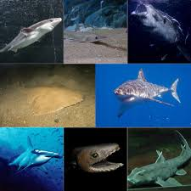
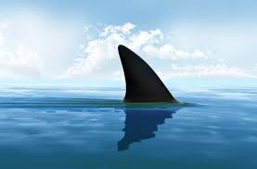
Intruduction to Sharks
There are 400 kinds of shark,all different and all part of a group that has dominated the oceans of Million of years.Often all you will see of a shark above fin.

Slide 4
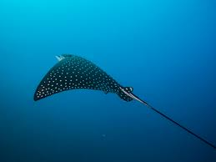
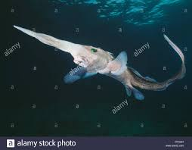
About shark
Sharks aren’t only fish that have
Skeletons made of cartilage-
Spookfish and rays do too….

Slide 5
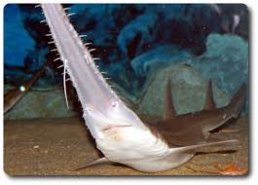
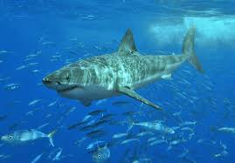
About sharks
This is a saw shark this shark
Ueses its saw to catch its prey
And sharks have powerful,teeth
Because to catch the prey. Many
Sharks,like this great white have
A eye that will roll because if a
Shark is attacks that.

Slide 6
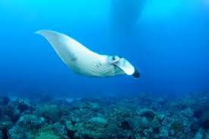
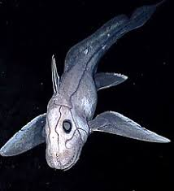
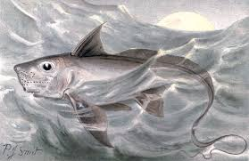
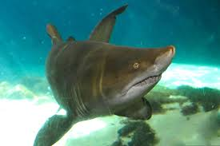
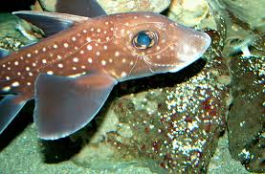
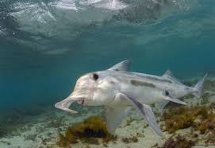
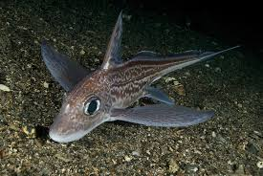
Different kinds of shark
manta ray
pacific spookfish
Dogfish sharks
ghost shark
spotted ratfish
elephant shark
rabbitfish
saw shark

Slide 7
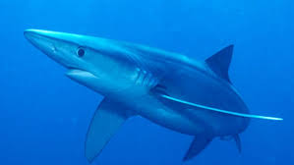
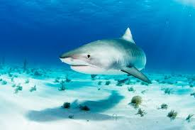
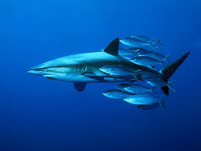
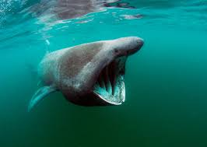
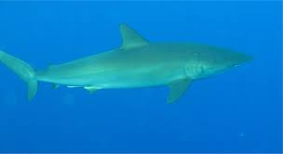
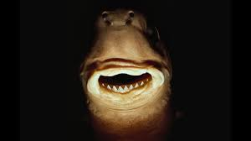
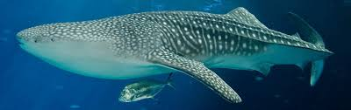
silky shark
tiger shark
dusky shark
basking shark
great white shark
cokie-cutter shark
blue shark
Whale shark

Slide 8
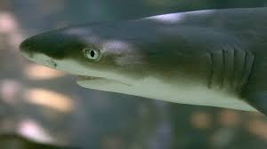
About lemon shark
A lemon shark swishes its
Powerful tail fin back and forth
to move forward. Its other fins
Keep it on a stable course.

Slide 9
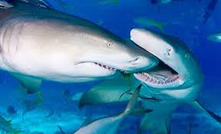
Lemon shark
There’s a reason why sharks,such as these lemon sharks, usually eat alone. If miltiple sharks try to attack the same prey,the sharks may go crazy, biting at anything in their way-even one another.

Slide 10
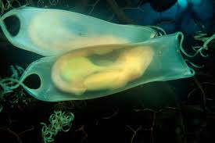
Sharks babies
Most shark babies are called
Pups grow inside their mother’s
but some hatch from eggs laid on
The ocean floor.

Slide 11
Born killers
Some sharks like spiny dogfish,hatch from egg
while still inside their mothers.For food, they eat
their weaker brothers and sisters. Then they
born.

Slide 12
Whale shark
Whale shark is the most biggest shark in the
world.

Slide 13
Thank You

Slide 14
backup
Cartilage is a resilient and smooth elastic tissue, a rubber-like padding that covers and protects the ends of long bones at the joints, and is a structural component of the rib cage, the ear, the nose, the bronchial tubes, the intervertebral discs, and many other body components.

