Slide 1






ASTROSAGE ANALYSIS
By Aarushi Shukla

Slide 2
introduction

Slide 3
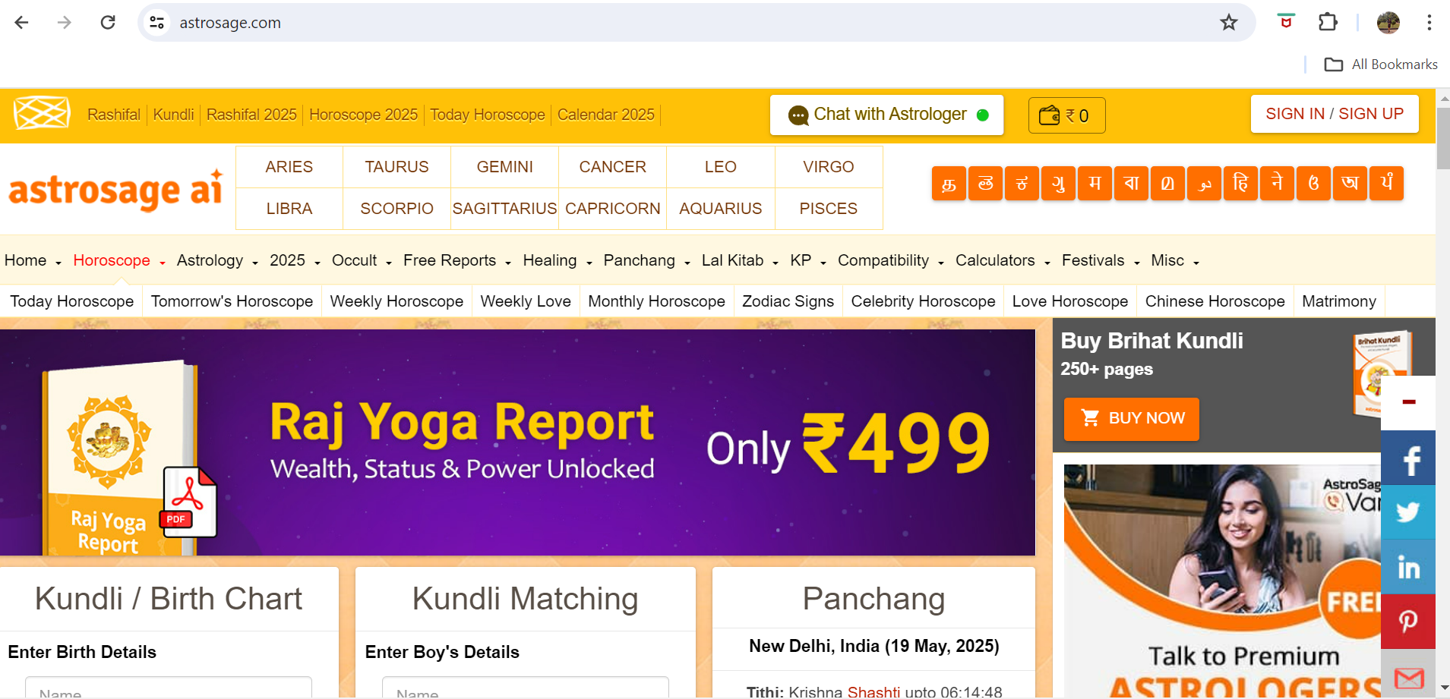
WHAT ARE WE AND HOW DO WE LOOK?

Slide 4
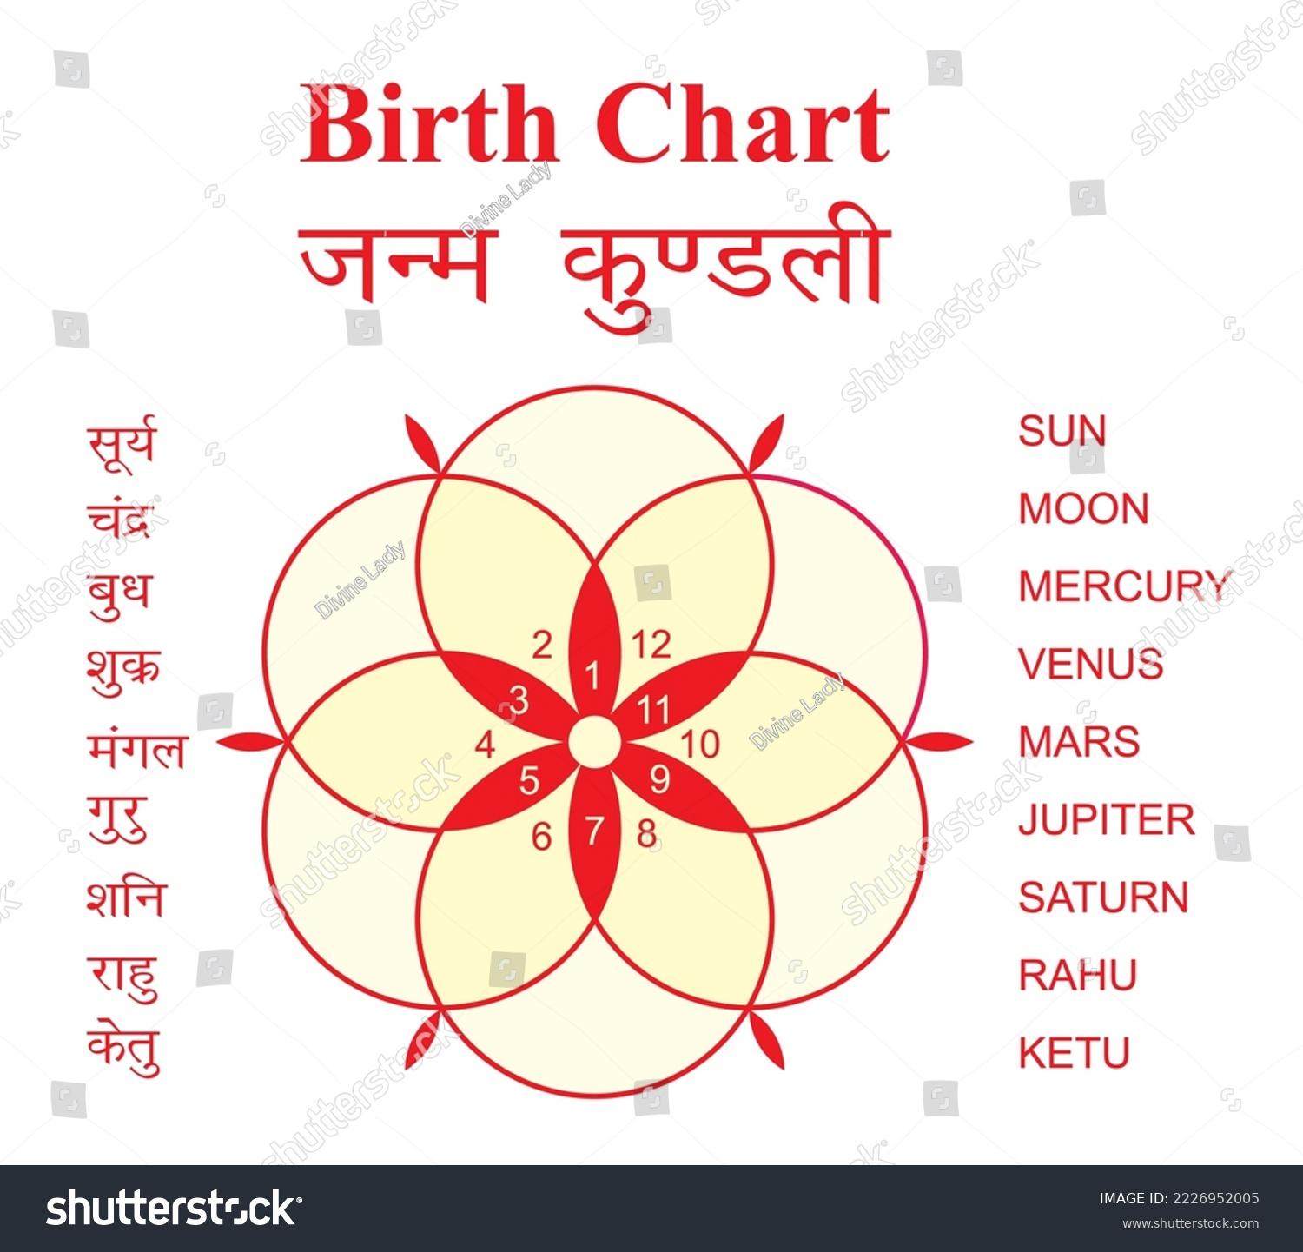
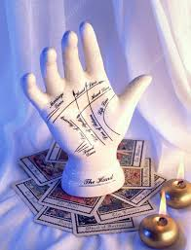


Astrosage Services
Your guide to a brighter future, one star at a time !
Horoscope
Daily, Weekly, Monthly, and Yearly Forecasts
Covers key areas
Multiple formats available:
Birth Chart
Janam Kundli Creation
In depth anaylsis like doshas, and planetary positions
Remedies based on your chart
Matchmaking
Gun milan
Marriage Muhrat
Compatibility check
Consultations
Live Chat and Call Consultations
Different pricing as per your convenience
Palmistry
Tarot Reading

Slide 5
Problem Statement

Slide 6
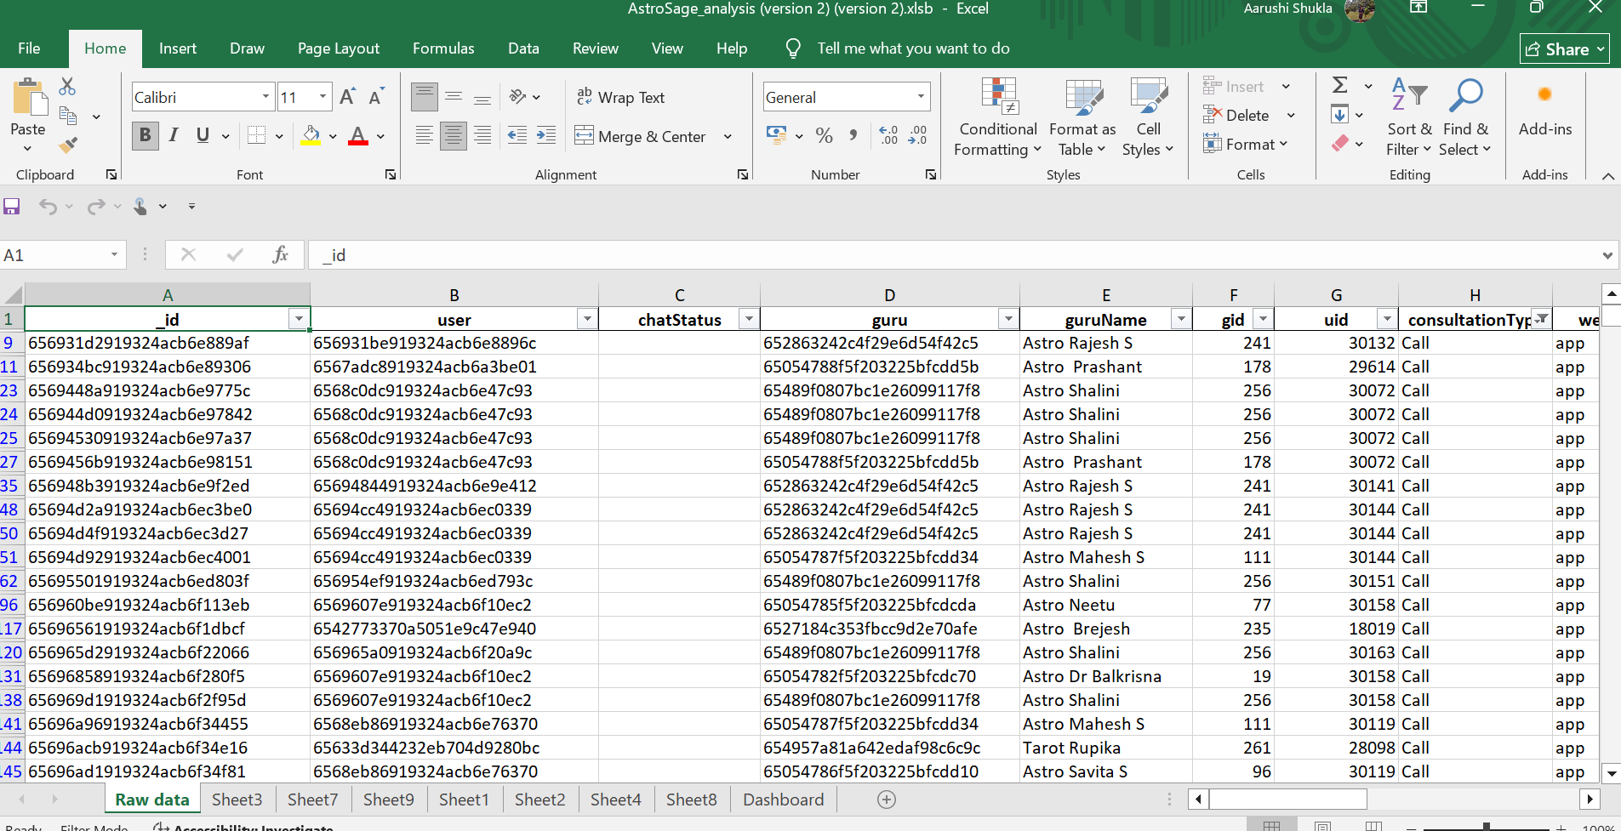
Problem Statement
AstroSage has received a 1 crore investment and aims to optimize its call center operations. The goal is to determine how to allocate this investment to maximize operational efficiency, customer satisfaction, and profitability. The analysis will consider historical call data, performance metrics, and market trends to make informed decisions.

Slide 7
DATA OVERVIEW

Slide 8
Data Loading in Excel
Spreadsheets Basics
Loaded the data in Excel, checked through all the columns for better insight
Used functions like IF, ISBLANK, SUBSTITUTE, PROPER, and TEXT.
01
02
03
04
Data Cleaning
Data Manipulation
Check for duplicates, null values, dates etc
Used IF function to fill blank spaces with NOT APPLICABLE, NOT AVAILABLE, NONE etc as per requirement.

Slide 9
Data Summarization
Answer Document
Summarized data through Pivot, Charts, Dashboard,
Word Document containing the asnwers of objective and subjective questions
.
05
06
07
08
Data Visualization
Presentation
Dashboards
Powerpoint Presentation

Slide 10
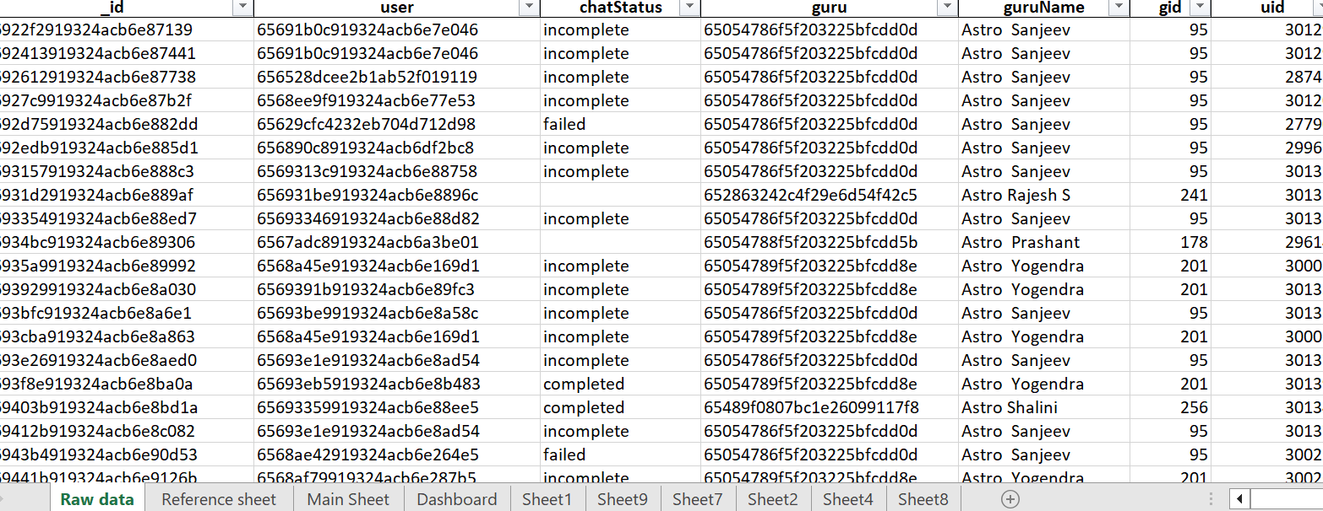

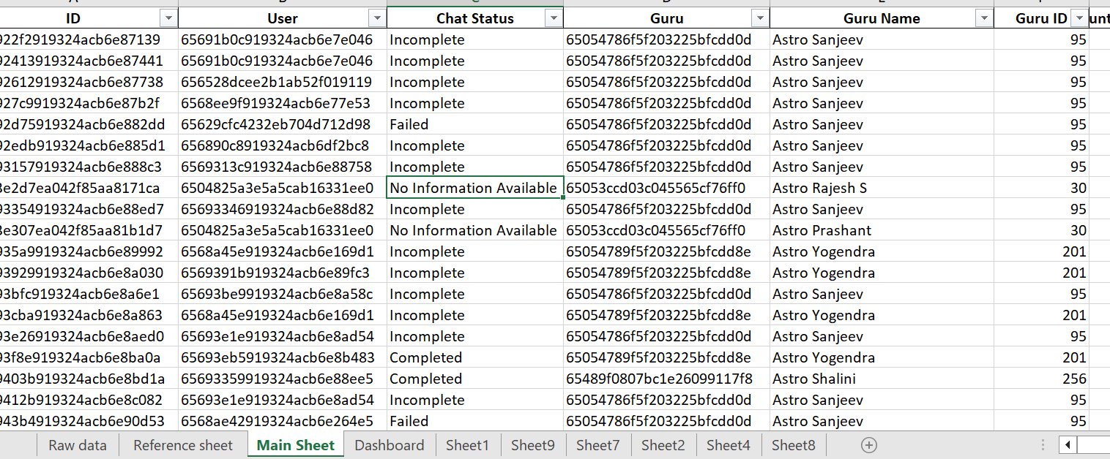
Data Cleaning
Data loaded in Excel
Thoroughly understood the data
Filled blank spaces with Not applicable/Not available as per the requirement
Used =PROPER for capitalising the first letter
Added conditional formatting
Filled blank spaces with respect to consultation type, for example, if the consultation type is call, chat second is 0
Used functions like SUBSTITUTE, TRIM for proper segregation of data
Used the TEXT function to obtain the date and time in the required format
Used IF, ISBLANK to fill out blank spaces.

Slide 11
methodology

Slide 12
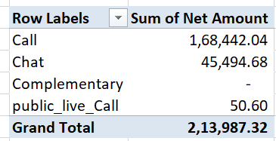
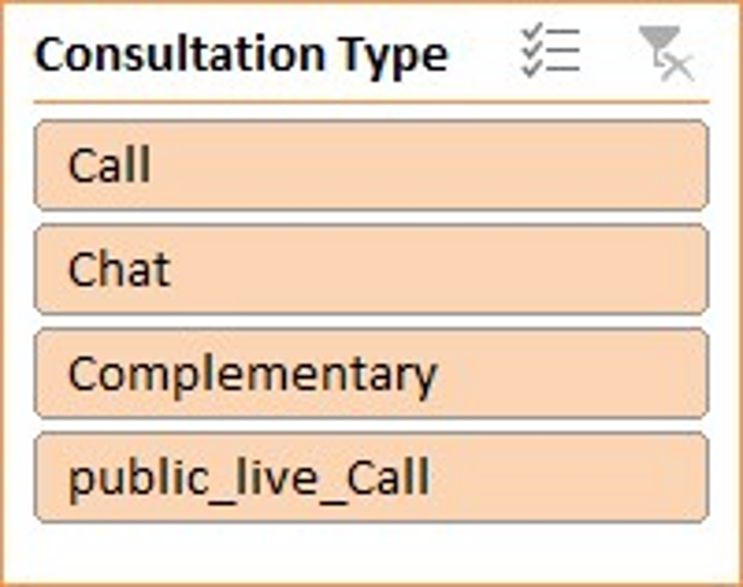
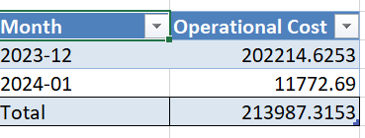
ANALYTICAL APPROACH AND TOOLS
PIVOT
CHART
SLICER
TABLE
Used SUM, AVERAGE,MAX, and MIN function to perform calculations
Used TRIM, LENGTH, PROPER functions to remove extra spaces, determine the length of data in a cell, and make data more appealing.
Most widely used function. Helped in creating timeline, proper summarization of data.
Used IF and ISBLANK to fill unwanted spaces.
CONDITIONAL AGGREGATES like SUMIFS and SUMIF.
AGGREGATE FUNCTIONS
STRING FUNCTIONS
LOGICAL FUNCTIONS

Slide 13
ANALYSIS OF OBJECTIVE QUESTION
5
GROWTH
It can be seen that the call type is growing and generating profit with a huge margin gap with other consultation types.
Net amount
1
4
Affordable
The total amount generated by all four consultation types was ₨ 2,13,987.32 . Call type being the largest contributor.
A total of 8508 calls were received in the 2 months timespan, with repeat call percentage going upto 98%, which shows that the platform is affordable.
Consultation type
2
Experience
There were a total of 4 consultation types- Calls, Chat, Complementary, Public Live call. Call sector being the most used and highly rated type.
3
Complementary was rated the highest, but if we considered weighted average, Call type with the average rating of 4 was highest.

Slide 14

Average no of calls handled per agent per day.
Average satisfaction score
Correlation between astrologer’s call duration and customer satisfaction
~2
3
0.058
56.60
35
Repeat call percentage
Total attributes in data

Slide 15
Key insights
The average daily call volume is ~250
December experienced the highest volume of calls, ie, 8090 calls, and January received the lowest volume of calls, 418 calls.
Correlation | Values
Correlation between astrologer call duration and customer satisfaction | 0.058403726
Correlation between User on call duration and customer satisfaction | 0.054758181

Slide 16
BENEFITS
ASSOCIATED RISKS
IMPROVE TRAINING PROGRAMS
RISKS MITIGATION
ALLOCATION OF BUDGET

Slide 17
After analyzing the data, I have concluded that more investment should be made in improving training programs for other consultancy types, i.e., chat, live call, and complementary.
Chat is the one with the most rows of data, but still, the amount generated is less.
Complementary, in general, should have the most rows of data and the least amount generated because it is a no-cost option the user gets in the beginning, but it still has only 2 rows of data.
This led to the conclusion that the agent(astrologer) needs more training.

Slide 18
IDEA
RESEARCH
POSSIBLE RISKS
Decided after analysing the data, and observing vast difference in the amount generated by all four consultation types
Lack of productivity, cost ineffectiveness, delay in response, long queue time, demand for more pay
Investment in Training
RISKS MITIGATION
BUSINESS
ALLOCATION OF BUDGET
In-house training, free resources, 50-50 ratio of training and production, proper breaks in middle, growth opportunities
Allocating 1 crore accordingly
Follow up at every step

Slide 19
Insights
Recommendations
Peak call periods are visible at 6 AM–7 PM or 3 PM–4 PM.
Low volume hours could be late night at 9 PM-11 PM or early morning at 3 AM-4 AM
Availability of more personnel during those hours
Reducing the number of breaks during that hour.
Automated call-backs
Reduction in queue time
AI-based chatbots.
Shift allowance to increase people in the morning shift during 6 AM-7AM

Slide 20
Agent Performance: AstroGuru shows better performance with longer average call duration (195s vs 110s)
Call Volume: AstroSage dominates with 7,797 calls vs AstroGuru's 711 calls
Customer Satisfaction: Approximately similar ratings (4 vs 4.5)

Slide 21
Strategic recommendations

Slide 22
ALLOCATE 1 CRORE RUPEE INVESTMENT
Step 2- 30 lacs
Technology update, investment in proper customer service, checking its efficiency during peak hours, advertising the website
Step 4- 15 lacs
Incentive programs, salary hike for skilled personnel, avoid employees from quitting, redressal for employee grievances
Step 1- 25 lacs
Talent acquisition, train the trainer, live training/shadowing of junior employee,strong HR system
Step 3- 30 lacs
Enhancing the infrastructure, transportation facility, high-speed internet, and digital library with recording of calls and messages

Slide 23
Focus during peak hours.
Focus on other consultation types.
Train the trainer.
New technologies like chatbots, proper addressing during queue hours should be used.
Verification checks to develop reliability and return calls.
Proper addressing of issues to satisfy the grievance.
Digital Library for training purpose.
Support to junior staff.

Slide 24
Dashboard and visualization

Slide 25
INSIGHTS
1. Consultation Type Usage
Call consultations dominate at 79%, followed by Chat (0%), Complementary (0%), and public_live_Call (21%).
Indicates a strong user preference for a call-based consultation type.

Slide 26
2. Monthly Net Income
Net income peaked in December 2023 and dropped significantly in January 2024.
This could reflect seasonal demand or reduced consultations post-festive period.

Slide 27
3. Call & Chat Status
Completed calls make up 41%, but there’s a high rate of incomplete (10%), no-answer (20%), and failed (14%) calls.
Chat statuses also show incomplete and pending chats (0%), indicating potential technical or user experience issues.

Slide 28
4. Top 10 Gurus
Guru ID 287 had the highest consultations (1580), followed by IDs 281, 221, and 256.
Some gurus have significantly higher traction, which could be leveraged for promotions or mentoring.

Slide 29
5. Website Usage
Dashboard users dominate at 72%, compared to App (28%) and Gurucool (0%).
Indicates a higher user engagement through web-based access, suggesting the mobile app needs improvement or promotion.

Slide 30
6. Hourly Call Distribution
Peak hours: 10 AM to 6 PM, with highest traffic between 6 AM to 9 AM.
Lowest activity post 11 PM, suggesting optimal staffing should be focused on peak hours.

Slide 31
7. Average Rating
Public Live Call and Call services have the highest ratings, followed by others.
This supports the observed user preference for direct voice interaction.

Slide 32
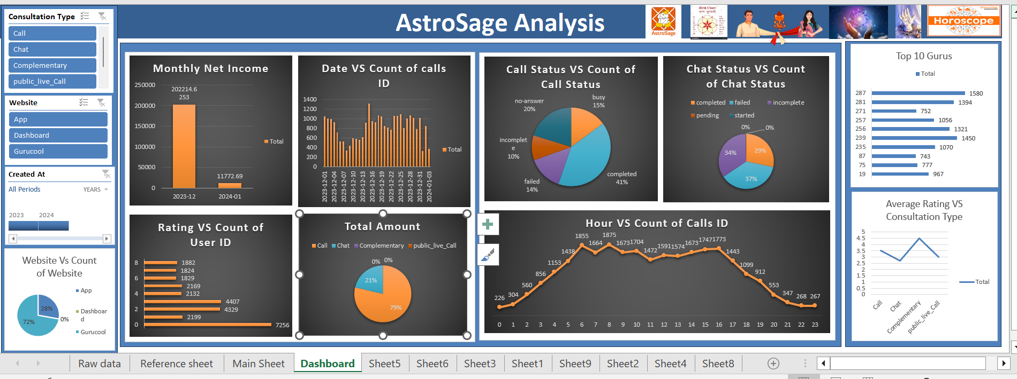

Slide 33

Recommendations
Improve Call Completion Rate
As per the data, a high number of calls were marked as no-answer, failed, or incomplete. Adding features like reminders, scheduled callbacks, etc, could make a big difference in improving call success rates.
Promote Underused Services
As of now, most users stick to voice calls. To get more attraction on Chat, Complementary, and public_live_Call services, we should run targeted campaigns. Maybe introduce those features through quick app pop-ups or offer free trials to show users what they’re missing. Also, we can use a hybrid consultation type, for example, using chat in the beginning and ultimately switching to a call.
Boost App Adoption
With most people using the dashboard, it’s clear the app isn't getting the attention it deserves. We could look into making the app smoother and more user-friendly. Things like app-exclusive deals, better notifications, or even a refreshed look might help drive more installs and engagement.

Slide 34
Adjust Staffing
The peak consultation hours are between 11 AM and 3 PM. To make the most of this, we should consider shifting more staff to those hours while scaling down during quieter times. This can help improve response rates and also manage costs more effectively.
Recognize Top Gurus
Some gurus are doing an amazing job. Let’s celebrate them—whether that’s through internal recognition or giving them the spotlight in user communications. Plus, their strategies and work habits could be shared as best practices for the rest of the team.
Keep an Eye on Seasonal Trends
It looks like income dropped after December. To keep engagement steady, we could plan ahead for slower months like January with promotional offers, seasonal content, or discounts. A little boost in off-peak periods can go a long way.

Slide 35
Thankyou
🌱 Let’s protect our planet – avoid printing ppts whenever possible.

