Slide 1
HOTEL BOOKINGS Exploratory Data Analysis (eda) CAPSTONE PROJECT-I
Submitted By
Aarushi Srivastava

Slide 2
ABSTRACT
The Hotel industry is an ever-growing industry and various kinds of trends demand to be noticed and exercised regularly in order to minimize retention rates and expand businesses. The average hotel occupancy rate is around 66% in India and the revenue generated is over $3.95 trillion worldwide , so we can assuredly say that the industry is here to stay and proliferate for higher returns. In this project, I will try to highlight the significant business impacting trends observed over the period of time like when the best time of year to book a hotel room is and which amenities or practices result in higher booking rates and make some useful analysis to facilitate the interest of stake holders and business owners in terms of reducing retentions rates, identifying the indicators as to why the guests are leaving or not re-booking and measures to amplify the bookings.

Slide 3
DATA- DESCRIPTION
Hotel : there are two types of hotels, city hotel and resort hotel.
is_cancelled : this indicates whether booking was cancelled(1) or not(0)
lead-time : Time lapse between reservation and arrival date.
arrival_date_year : Year of arrival date.
arrival_date_month : Month of arrival date.
arrival_date_week_number : Week number of arrival date.
arrival_date_day_of_month : Day of arrival date.
stays_in_weekend_nights : No of weekend night the guest stayed or booked the stay.
stays_in_week_nights : No of week nights the guest stayed or booked the stay.
adults : No of adults.
children : No of children.
babies : No of babies.
meal : Kind of meal opted for.
country : Country code.

Slide 4
market_segment : Which segment of market the customer belong to.
distribution_channel : How the customer accessed the stay-corporate booking/direct/TA.TO.
is_repeated_guest : Guest coming for first time(0) or not (1).
previous_cancellations : Was there a cancellation before.
previous_bookings_not_canceled : Number of previous bookings not cancelled.
reserved_room_type : Type of room reserved.
assigned_room_type : Type of room assigned.
booking_changes : Count of changes made to the booking.
deposit_type : Deposit Type.
agent : Booked through agent.
company : ID of the company that made the booking.
days_in_waiting_list : Number of days in waiting list.
customer_type : Type of customer- Contract, Group , Transient , Transient Party.

Slide 5
adr : Average Daily Rate
required_car_parking_spaces : If car parking is required.
total_of_special_requests : Number of additional special requirements.
reservation_status : Last status of reservation like checked out, cancelled or no show.
reservation_status_date : Date of specified status.

Slide 6
UNDERSTANDING THE DATASET
The given dataset describes various aspects of Hotel Bookings like meal, country, weekly v/s weekend stays,agent etc.
Our objective is to analyze various factors that govern bookings and highlight the causes that result in poor business profitability.
The dataset consist of 119390 rows and 32 columns.
There are 31994 duplicate values in the dataset.
There are 4 columns having missing values:children,country,agent and company.
The dataset consist of 2 columns having Binary data(0 and 1): is_cancelled, is_repeated_guest.

Slide 7
SUBJECT OF ANALYSIS
Which type of hotel(City or Resort) has maximum number of bookings and maximum stay.
What is the Average Daily Rate(ADR) for both types of hotels.
Booking cancellation trends hotel-wise.
Maximum and minimum bookings made by type of customers.
Meal Preference by customers.
Which countries contribute to hotel industry business.
Nature of bookings and cancellations among different market segments.
Repeated booking patterns in type of customers and market segment.
Maximum booking changes done by which type of customers.
Booking Cancellation Rates Hotel-Wise.

Slide 8
Which months observes maximum traffic in terms of hotel bookings.
Which years have generated maximum business in the hotel industry.
Weekday v/s Weekend Stay Patterns observed among customers.
Customer Distribution Hotel-Wise.
Room-Preference Hotel-Wise.
Parking Space Preference Hotel-Wise.
Repeated Booking trends Hotel-Wise.
Agent Booking Analysis. Which agent has made maximum and minimum bookings.
Market Segment Analysis Hotel-Wise.
Cancellation Rate trends based on Deposit type.
No of special request/ no of children or babies.
Correlation between different variables.
Pair plot Analysis.

Slide 9
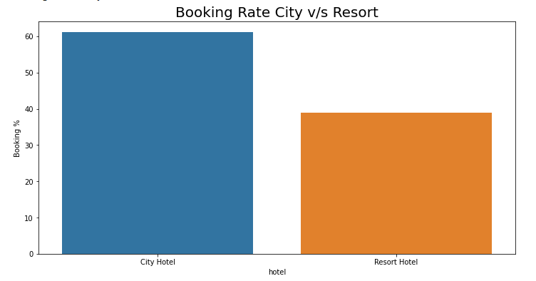

Booking Rate City V/S Resort
Approximately 60% bookings come from City Hotel and 40% from Resort Hotel . Hence booking rate is higher for City Hotels.

Slide 10
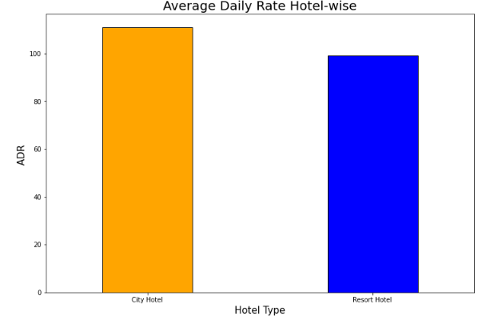
Average Daily Rates City V/S Resort
ADR for City Hotels is 110.98 whereas for Resort Hotels it is 99.02% . Daily Rates are high for City hotels in comparison to Resort Hotels.

Slide 11
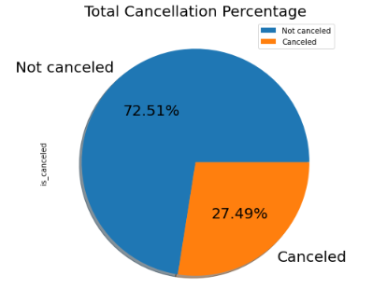
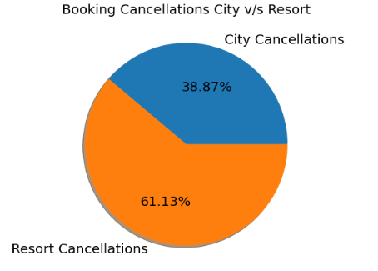
Cancellation Trends
Approximately 27.5% bookings are cancelled out of which there are more cancellations observed in Resort Hotels (~60%) as compared to City Hotels(~40%).

Slide 12
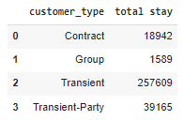
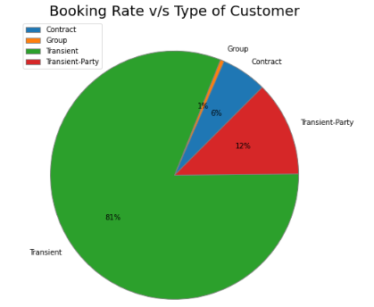
Booking Rate V/S Type Of Customers
Transient : 81 %
Transient-Party : 12%
Contract : 6%
Group : 1%
Maximum bookings made by transient customers.

Slide 13
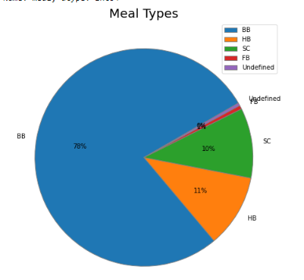
Meal Preferences
BB : 78%
HB : 11%
SC : 10%
FB : 0.4%
Undefined : 0.6%
BB ( Bed & Breakfast )
HB ( Half Board Breakfast & Dinner )
FB ( Full Board Breakfast , Lunch & Dinner )
SC (Self-catering)
Most customers prefer BB Meal . FB meals can be promoted by providing complimentary dessert.

Slide 14
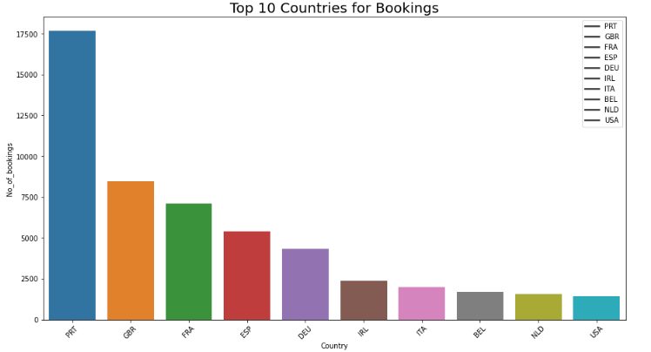
Bookings made Country-Wise
Top countries contributing in the hotel business are {PRT,GBR,FRA,ESP,DEU,IRL,ITA,BEL,NLD,USA} in the same order.

Slide 15
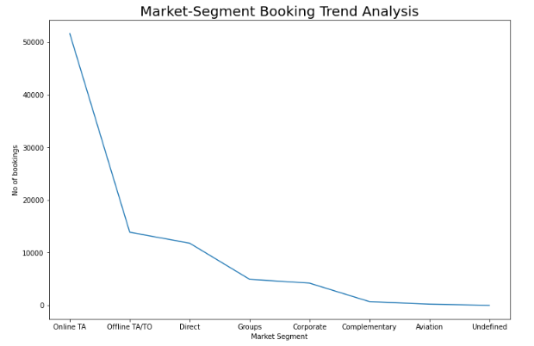
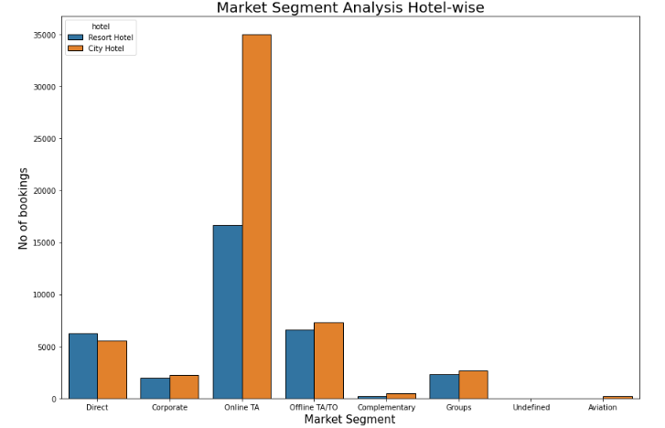
Market Segment Analysis
Maximum bookings are generated by Online TA and minimum through Aviation sector. Marketing strategies to promote business in declining segments is suggested.

Slide 16
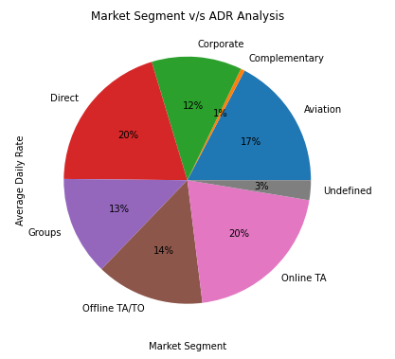
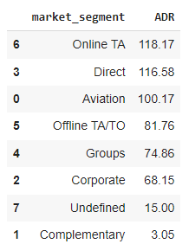
Market Segment V/S ADR
Online TA, Direct and Aviation market segments contribute to the highest ADR and Groups,Corporate and complementary has minimum daily rates

Slide 17
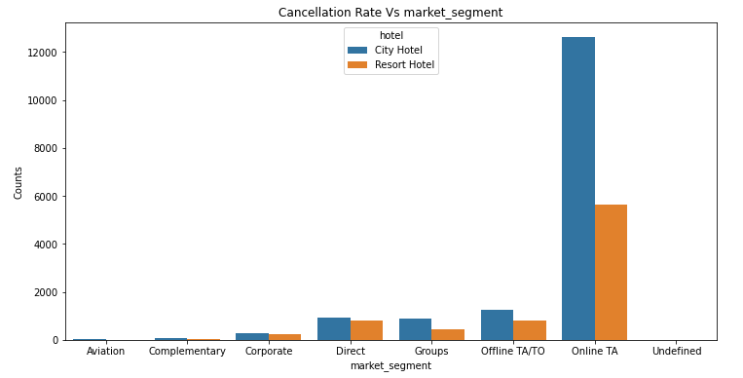
Market Segment V/S Cancellations
Maximum cancellations are made through Online TA /TO ( Travelling Allowance)market segment followed by Direct . Hotels can provide coupons and vouchers to these customers to minimize cancellations.

Slide 18
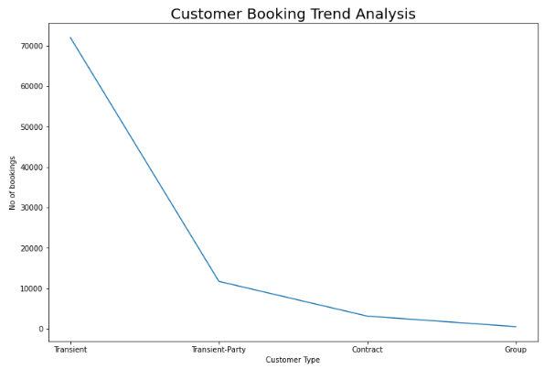
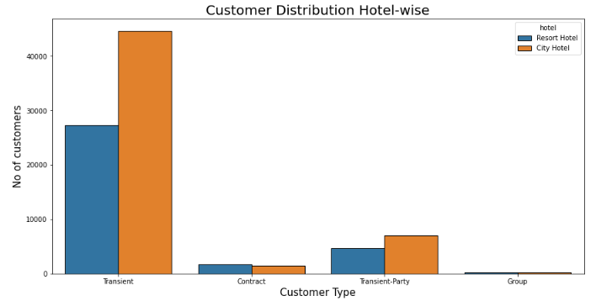
Customer-Booking Analysis
Maximum bookings are made by Transient customers in both types of hotels . Minimum bookings are made by Group customers. Hence, to attract group customers as they will result in better daily rates , hotels can provide redeemable points/ discounts to families or group bookings

Slide 19
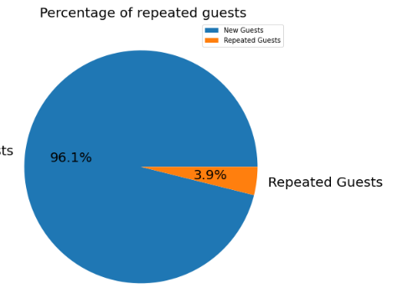
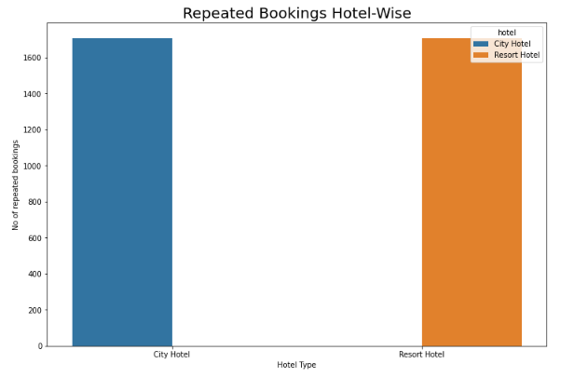
Repeated Customers
Approximately 4% of customers have re booked the hotel ,96% are new guests which is an indicative of unsatisfactory stay experience. Hotels should prioritize stay experience of the guests. No of repeated guest are almost same in both types of hotels.

Slide 20
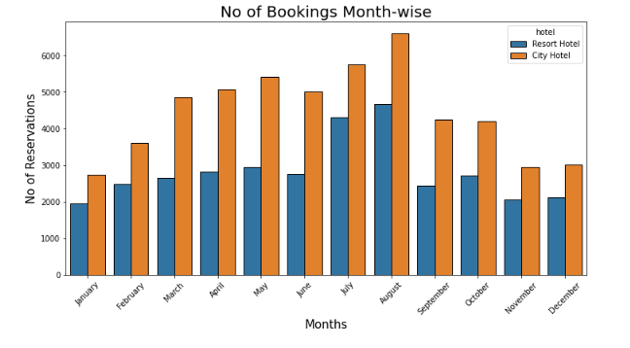
Month-wise Booking Trends
Maximum bookings are made in the months of May , July and August.
Minimum bookings are made in January , February , November and December .
Marketing strategies can be improved to increase booking rates in these months

Slide 21
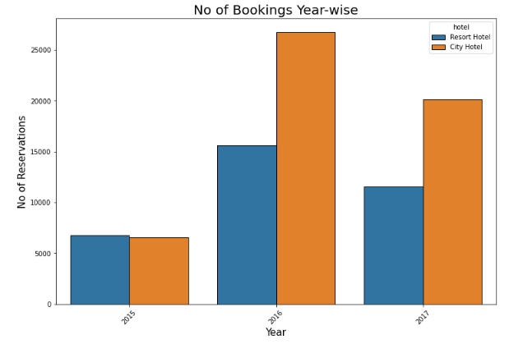
Year-wise Booking Trends
Maximum bookings were made in the year 2016 in both types of hotels.

Slide 22
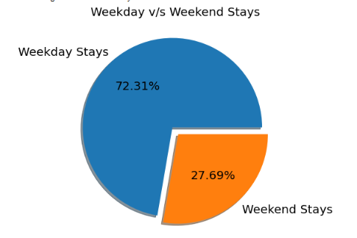
Weekday V/S Weekend Stay Trends
Customers prefer weekday stay to weekend stay. Almost 72% customers book during weekdays which may be due to corporate bookings ,other 28% prefer weekend stays.

Slide 23
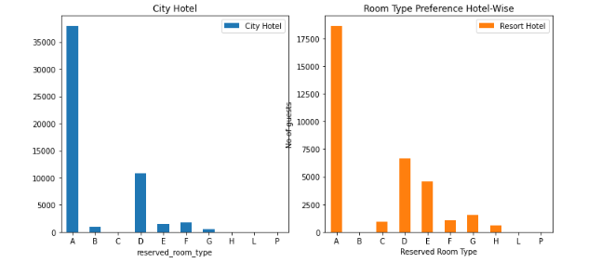
Room-type Preference Hotel-wise
City Hotel :{ Most Preferred : A,D, Least Preferred : G, Negligible Bookings : C,H ,L,P}
Resort Hotel : { Most Preferred : A,D,E, Least Preferred : H, Negligible Bookings : B,L,P}
The Hotels should inspect why customers are not preferring some room types.

Slide 24
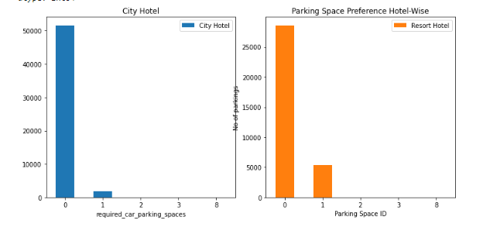
Parking Space Preference Hotel-wise
Parking spaces are not usually required by customers in both hotels.
More customers prefer parking spaces in Resort Hotels as compared to City Hotels.
Mostly customers want 1 or 2 parking spaces.

Slide 25
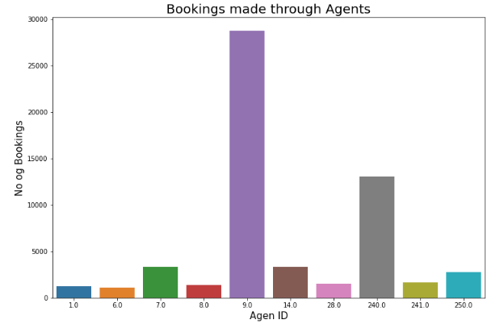
Agent Booking Analysis
Booking rates are improved when bookings are made through agents.
Agent 9 has made maximum number of bookings. Agent 6 has made minimum bookings.

Slide 26
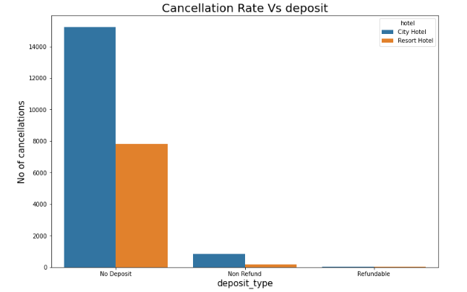
Cancellation Rates V/S Deposit Type
No of cancellations are more where no deposit is made. Non-refundable deposits show more cancellations as compared to Refundable deposits.
Hotels may impose refundable deposits to decrease cancellation rates.

Slide 27
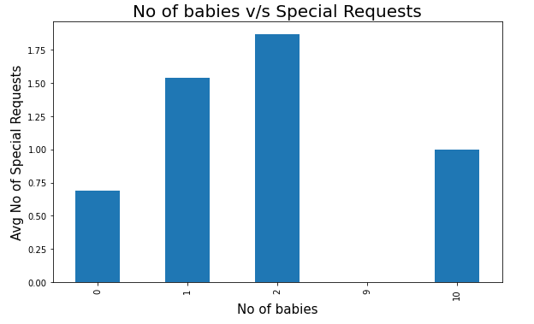
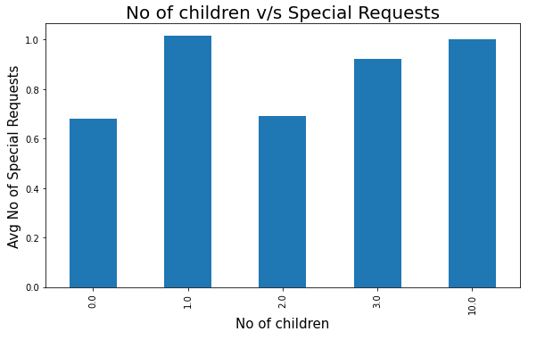
Special Requests V/S Children Or Babies Accompanied
No of special requests are more when children or babies are accompanied.

Slide 28
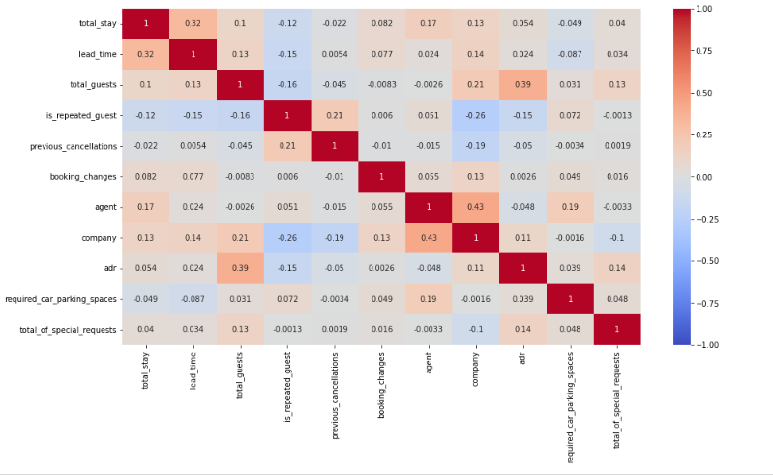
Correlation Heatmap
Positive Correlation :totalstay-leadtime, totalguest-adr , agent-company
Negative Correlation : is_repeated_guest-company, total_stay-is_repeated_guest.

Slide 29
Conclusion
City Hotels have more bookings in comparison to Resort Hotels.
Maximum booking trends are observed in the months of July and August .January,February,November and December observes least booking.
Maximum bookings were made in the year 2016 in both City and Resort Hotels.
Almost 27.5% bookings are cancelled. Out of these, 39% are from City Hotels and 61% cancellations are made in Resort Hotels.
Most preferred meal type is BB which accounts for almost 78% of meal bookings. Other meals types have bookings - HB : 11%, SC : 10%, FB-1%
Top countries contributing in the hotel business are {PRT,GBR,FRA,ESP,DEU,IRL,ITA,BEL,NLD,USA} in the same order.
Total stay patterns are observed as more no of days for stay in Resort Hotels than City Hotels.
Weekday bookings are more in comparison to weekend bookings. Almost 72.31% of stays are made during the week and only 27.69% of stays are during weekends.

Slide 30
Agent ID 9 has made maximum number of bookings and Agent ID 6 has made minimum number of bookings.
Booking rate is higher when bookings are made through agents.
Both types of Hotels have almost same no of repeated bookings.
Room Preference Hotel-Wise
City Hotel : { Most Preferred : A,D, Least Preferred : G,Negligible Bookings : C,H ,L,P}
Resort Hotel : { Most Preferred : A,D,E,Least Preferred : H,Negligible Bookings : B,L,P}
Resort Hotel guests require more parking spaces as compared to City Hotel Guests.
Transient Customer Type make most no of bookings in both hotels whereas customer type Group and Contract make least bookings.
Maximum bookings are made through Online TA market segment and minimum bookings are made through Aviation Segment.
Cancellations are more in Non-refundable deposit type.
No of special requests are more when children or babies are accompanied.
ADR is higher for City Hotel than Resort Hotel.

Slide 31
Thank you !

