Slide 1

ADVANCE FULL-STACK
PROJECT
Project Name - LearnWithUs

Slide 2

CONTENTS
INTRODUCTION
WHY LearnWithUs
GOALS
TARGET AUDIENCE
TECHNOLOGIES USED
FUTURE SCOPE

Slide 3


1
INTRODUCTION
The project is based on a website which is a one stop solution for finding the best Software Development Courses available online. The title for the website is ”Learn with us”.
LEARN WITH US

Slide 4
2
Why LearnWithUs
The website is made with the idea that many people who are aspiring to learn development online get a one stop solution for finding the best courses. Our website allows the users to choose from variety of courses on different topics. This website is beneficial for people in rural areas which do not have any coaching centers nearby as it allows the users to access the courses anytime anywhere.
LEARN WITH US

Slide 5
3
GOALS AND OBJECTIVES
User Satisfaction
Accessible Education
Skill Development
Affordability and Accessibility
LEARN WITH US

Slide 6
4
TARGET AUDIENCE
Students of all Ages
Adult Learners
Job Seekers
IT and Software Professionals
Teachers and Educators
LEARN WITH US

Slide 7
5
TECHNOLOGIES USED
HTML
CSS
JAVASCRIPT
REACTJS
MongoDB
LEARN WITH US

Slide 8
6
FUTURE SCOPE
Android and iOS App
Personal Teaching Assistant
Teachers and professor can add their own courses
LEARN WITH US

Slide 9
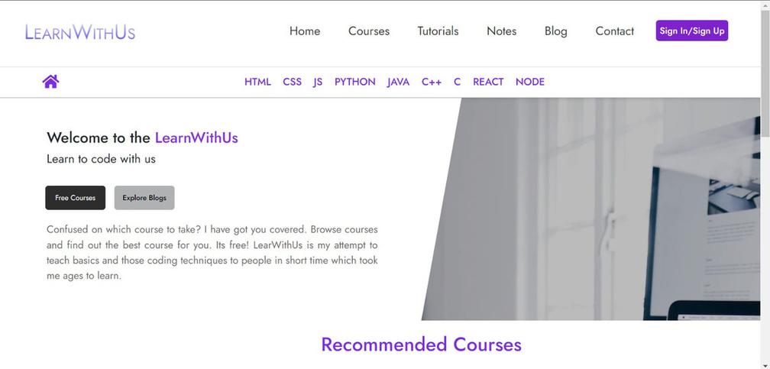
7
The page shown beside is the HOME PAGE of the website, you can see the Logo of the website which says “LEARN WITH US” i.e also the title of the website. The website has been given a purple and white theme. On the top the user can see the NAVIGATION PANEL i.e the header, which is helpful in browsing throughout different pages in the website.
LEARN WIH US

Slide 10
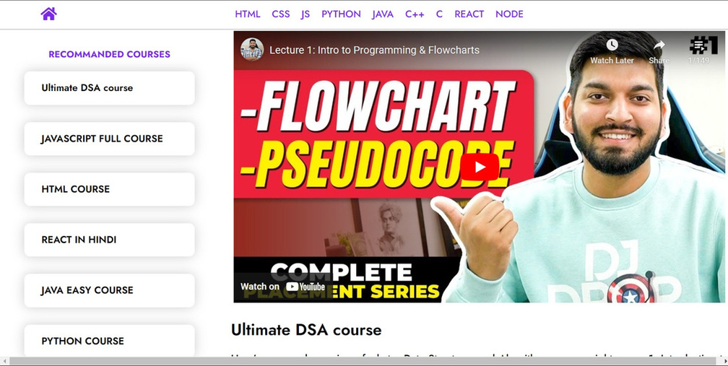
8
This is the recommended courses section of the website where the courses have been hand picked by various experts on the basis of customer reviews and ratings
LEARN WIH US

Slide 11
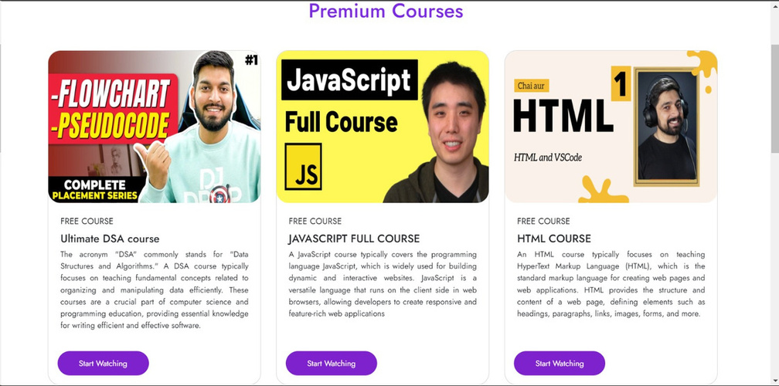
9
Then comes the Premium Courses section of the Home page. The courses available in this section are little expensive but provide best quality content
LEARN WITH US

Slide 12
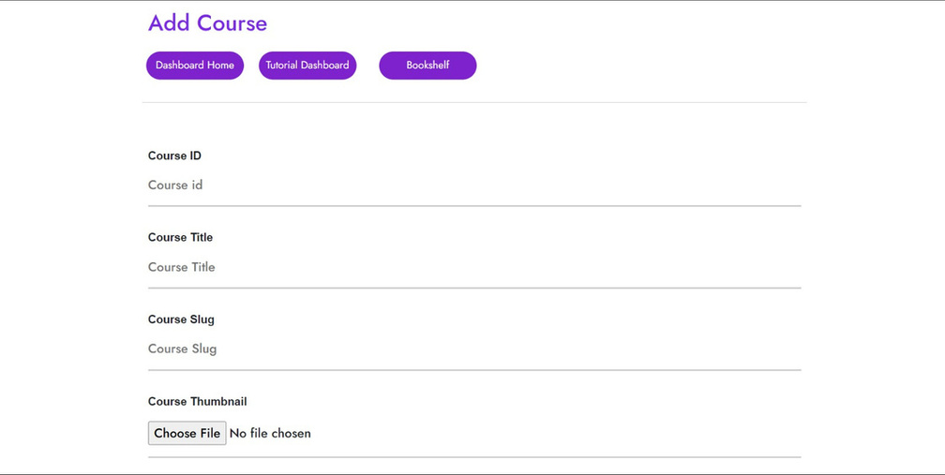
10
This is the page where the admin can add courses and the user can access them all from one place. This will reduce the user’s hassle of searching every course again and again
LEARN WIH US

Slide 13
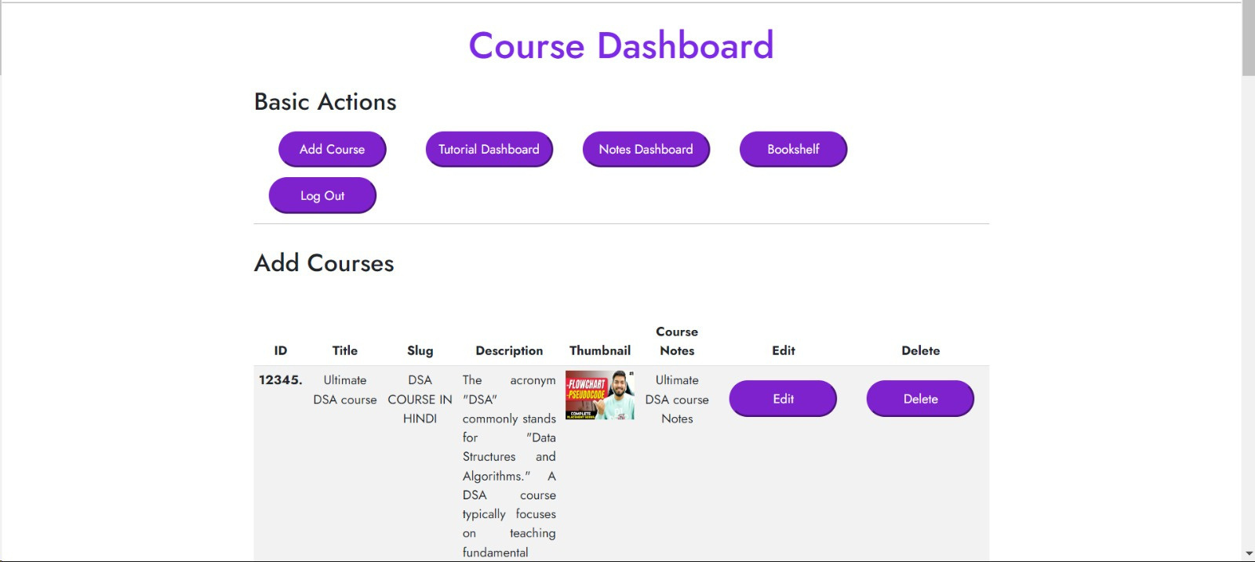
11

Slide 14
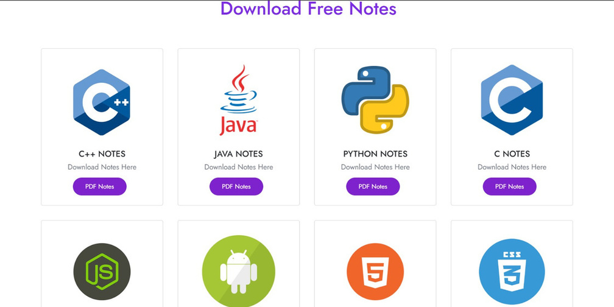
12
Along with the courses the user also gets access to free notes which can be added into their account or downloaded at any time
LEARN WIH US

Slide 15
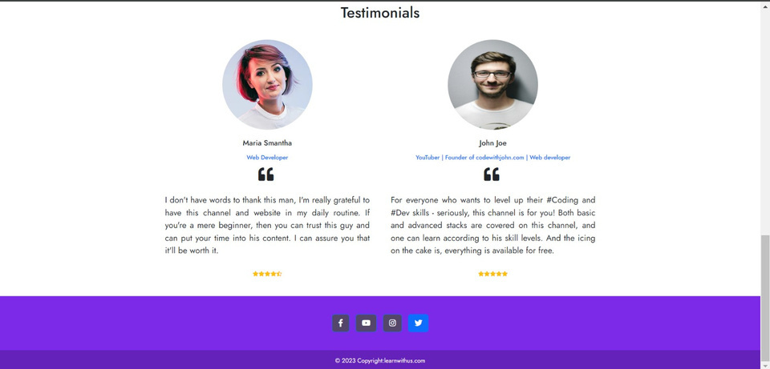
13
In the last we have the FOOTER of the website which consist of copyright notice, social media icons, etc.
LEARN WIH US

Slide 16
THANK YOU
Presented By :-
Anuj Mukhija(2110990231)
Aditi Rattan Bhardwaj(2110990081)
Aarush Khanna(2110990014)
Amritjot (2110990167)
Akash Uniyal(2110990116)

