Slide 1
Amazon Inventory Reconciliation Using AI
Counting the items in a fulfilment-centre bin from one photo - and flagging bins whose recorded inventory disagrees
Aarush Patil & Aryan Arora | PES1UG24AM005 / PES1UG24AM055
UE24CS352A Machine Learning - Mini-Project | PES University
Notes:
Intro: one-line pitch. Problem = count items in a bin from a photo, use it to catch inventory mismatches.

Slide 2
The problem: recorded inventory vs. what is really in the bin
Setting: robots carry fabric bins in Amazon fulfilment centres; items get misplaced while handled.
Consequence: recorded count != actual count, so customers get late or wrong deliveries.
Our task: predict the number of items (0-5) from a bin photo; compare with the recorded count.
Why hard: occlusion by tape/bags, mixed shapes, 450K+ different products.
Bin photo
CNN
counts items
Predicted
vs recorded
MATCH /
VARIANCE
Reconciliation = flag bins where the camera disagrees with the system, then recount only those.
Aarush Patil & Aryan Arora | PES1UG24AM005 / PES1UG24AM055 | UE24CS352A
2
Notes:
Explain business value: recount only flagged bins instead of auditing everything.

Slide 3
Dataset: Amazon Bin Image Dataset (ABID)
Source: public AWS Open Data bucket aft-vbi-pds, 535,234 bin photos with JSON metadata.
Label: EXPECTED_QUANTITY = number of items in the bin.
Our subset: random sample (seed 42), bins with 0-5 items, resized to 224x224.
Split: 30,000 images: 21,000 train / 6,000 val / 3,000 test (stratified 70/20/10).
Caveat: some photos are unreadable even for humans.
Aarush Patil & Aryan Arora | PES1UG24AM005 / PES1UG24AM055 | UE24CS352A
3

Slide 4
Approach: one reproducible pipeline
Download
+ resize
Stratified
split
Baselines
PCA / HOG
ResNet
transfer
Evaluate
+ reconcile
download_data.py, build_splits.py - data over HTTPS, no AWS account
baselines.py - scikit-learn models on PCA / HOG features
train_cnn.py - PyTorch ResNet with SGDR, LR finder, AMP, TTA
make_results.py, demo.py - metrics, figures, variance detection, Gradio app
Aarush Patil & Aryan Arora | PES1UG24AM005 / PES1UG24AM055 | UE24CS352A
4

Slide 5
Classical baselines
Features: 64x64 raw pixels -> standardise -> randomized PCA (256 comps); HOG on grayscale.
Models: logistic regression, linear SVM, decision tree, RBF-SVM (8K train subsample).
Tuning: on the validation split; test touched once.
Model | Test acc. | RMSE
Random guess | 16.7% | -
LogReg (PCA) | 28.5% | 1.37
Linear SVM (PCA) | 27.7% | 1.37
Decision tree (PCA) | 25.5% | 1.57
RBF-SVM (PCA) | 29.8% | 1.32
RBF-SVM (HOG) | 31.9% | 1.32
Hand-crafted / linear features struggle with occluded, cluttered bins.
Aarush Patil & Aryan Arora | PES1UG24AM005 / PES1UG24AM055 | UE24CS352A
5

Slide 6
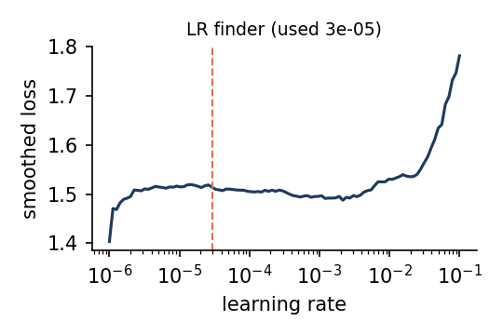
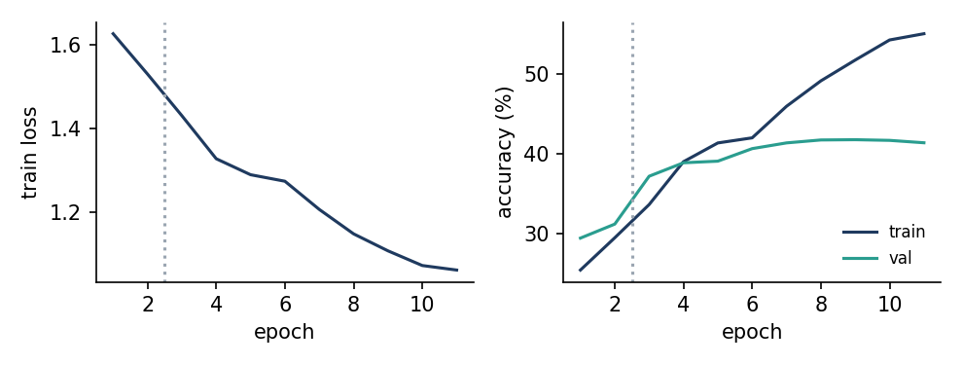
CNN: ImageNet-pretrained ResNet, two-stage fine-tuning
Stage 1: freeze backbone, train the new head.
Stage 2: unfreeze all; discriminative LRs (lr/9, lr/3, lr).
Schedule: AdamW + cosine annealing with warm restarts (SGDR).
LR finder: range test picks the head LR.
Data aug: h-flip + colour jitter; h-flip TTA at test time.
Speed: mixed precision on a free Colab T4.
resnet34 | 21.29 M params | 2+9 epochs | head lr 2.9e-05
Best run: loss and accuracy per epoch
Aarush Patil & Aryan Arora | PES1UG24AM005 / PES1UG24AM055 | UE24CS352A
6

Slide 7
Ablation: counting is ordinal, not just categorical
Softmax head (standard)
Ordinal head (ours)
6 outputs, cross-entropy
count = argmax
missing by 1 or by 4 costs the same
5 outputs P(count > k), k = 0..4, BCE
count = number of outputs above 0.5
e.g. 3 items -> [1, 1, 1, 0, 0]
Test result: softmax 41.2% acc, RMSE 1.11 vs ordinal 39.4% acc, RMSE 1.04
Aarush Patil & Aryan Arora | PES1UG24AM005 / PES1UG24AM055 | UE24CS352A
7

Slide 8
Results: CNN vs. classical models
41.2%
best CNN test accuracy
1.11
RMSE (items)
2.5x
vs random guessing (16.7%)
Aarush Patil & Aryan Arora | PES1UG24AM005 / PES1UG24AM055 | UE24CS352A
8

Slide 9
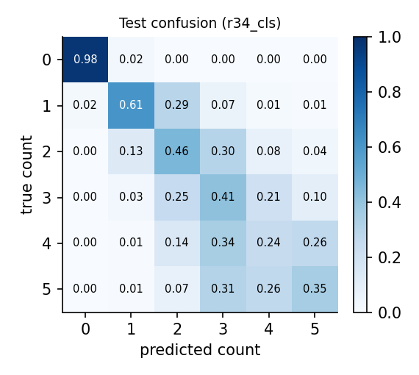
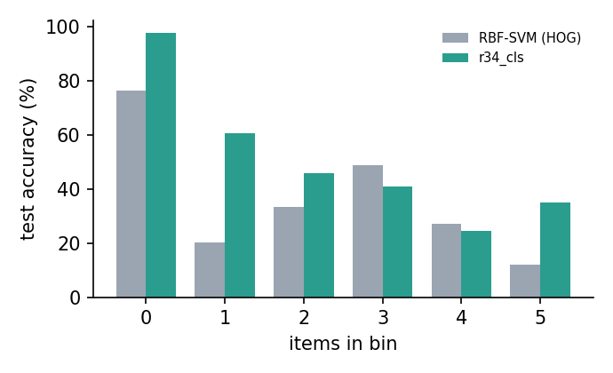
Where does it fail?
83.4% of bins are counted within +-1 item
MAE 0.78 items
Best on bins with 0 items (98%), weakest on 4 items (24%)
Aarush Patil & Aryan Arora | PES1UG24AM005 / PES1UG24AM055 | UE24CS352A
9

Slide 10
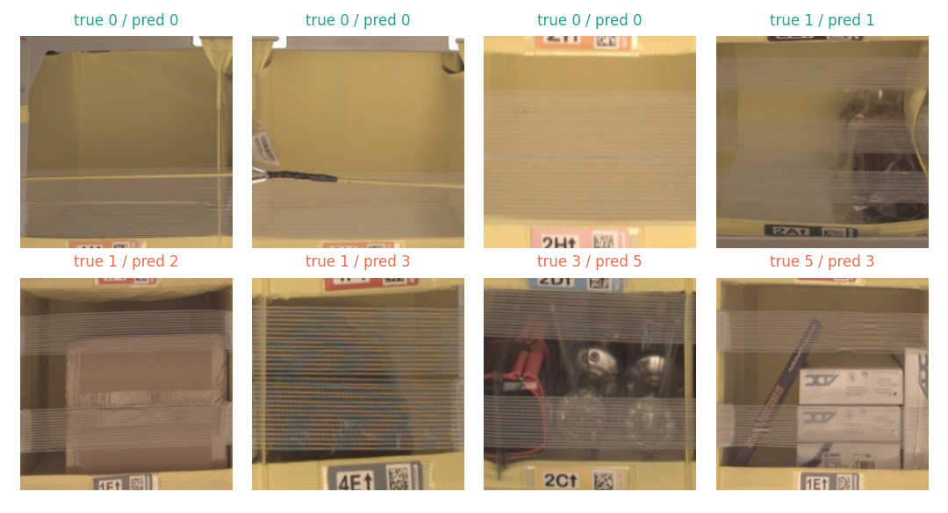
Qualitative examples (test set)
Top row: correct counts
Bottom row: mistakes - look for occlusion, tape or overlapping items
Some bins are hard to count even for a human
Aarush Patil & Aryan Arora | PES1UG24AM005 / PES1UG24AM055 | UE24CS352A
10

Slide 11
From counts to inventory reconciliation
Simulation: recorded count wrong by +-1/2 items in 15% of test bins (public data has only true counts).
Rule: flag a bin when predicted != recorded.
Score: 1 - P(recorded count) as threshold-free detector (AUROC).
19.4%
81.4%
precision
recall
0.31
0.73
F1
AUROC
mean over 20 random draws of the simulated errors
Aarush Patil & Aryan Arora | PES1UG24AM005 / PES1UG24AM055 | UE24CS352A
11

Slide 12
Live demo
Upload
bin photo
Type recorded
count
Model counts
(+ TTA)
MATCH or
VARIANCE
Run: python demo.py --run runs/<best> --gradio (public link in Colab)
CLI: python demo.py --run runs/<best> --image bin.jpg --recorded 3
Batch: --csv recorded.csv --images data/images -> reconciliation_report.csv
Output: predicted count, class probabilities, P(recorded count), recount flag
Aarush Patil & Aryan Arora | PES1UG24AM005 / PES1UG24AM055 | UE24CS352A
12

Slide 13
Conclusions and future work
CNN beats classical: 41.2% test accuracy, RMSE 1.11 - 2.5x random, +29% vs best classical (31.9%).
Context: Stanford ResNet34 paper reports 56.2% / RMSE 0.90 on a different, larger subset - only indicative.
Practical: predicted counts can flag mismatching bins for targeted recounts.
Limits: occlusion caps accuracy; single split/seed; recording errors simulated.
Next: clean occluded labels, ensembles, higher resolution, multi-angle photos, real variance logs.
Aarush Patil & Aryan Arora | PES1UG24AM005 / PES1UG24AM055 | UE24CS352A
13

Slide 14
Backup: setup details and repository
Item | Value
Subset | 30,000 images, bins with 0-5 items
Input | 224x224 RGB, ImageNet normalisation
Best CNN | resnet34, cls head, 2+9 epochs, lr 2.9e-05
Optimiser | AdamW (wd 0.01), SGDR cosine restarts, AMP
Hardware | Tesla T4
Latency | 6.2 ms / image (batch 1)
Repo | download_data, build_splits, baselines, train_cnn, make_results, demo
Aarush Patil & Aryan Arora | PES1UG24AM005 / PES1UG24AM055 | UE24CS352A
14

